Slide 1

18 May 2022
Seda 2021-22 Annual Report
Presentation to Portfolio Committee on Small Business Development
N Mbatha: CEO (Acting)

Slide 2


OUTLINE
Organisational Overview
​Seda Performance 2021 -22 FY
Financial Information​
Governance & Compliance
Human Resources Report
Success Stories

Slide 3

1.Organisational Overview

Slide 4




Organisational overview
MISSION: To promote entrepreneurship and facilitate the development of small enterprises by providing customized business support services that result in business growth and sustainability in collaboration with other role players in the ecosystem.
VISION:
To make a difference in SMMEs lives everyday.
VALUES:
Nurture, Innovation, Customer Centricity & Responsible Conduct

Slide 5
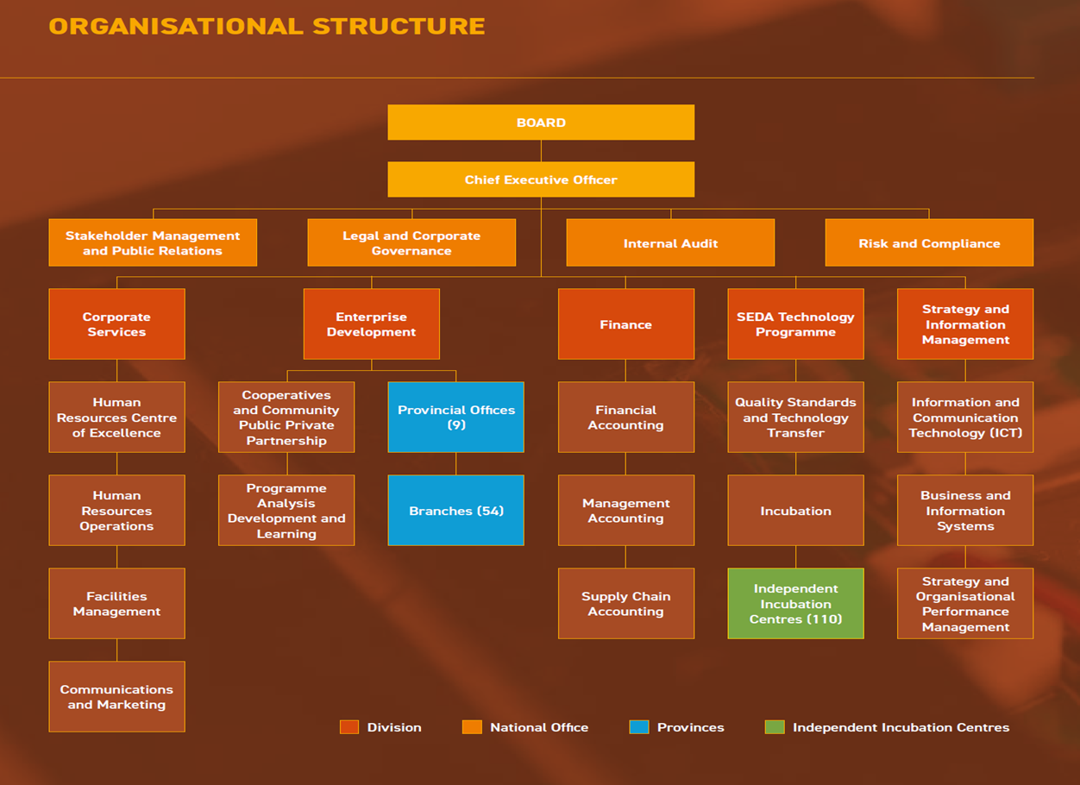

ORGANISAIONAL STRUCTURE
Organisational overview

Slide 6

2. Seda Performance vs Targets: 2021 -22 FY

Slide 7
Summary performance
Seda’s performance information is presented in accordance to the approved Annual Performance Plan 2021-22
In the year under review Seda measured its performance on 30 indicators at output level
The organisation achieved and exceeded the set targets on 24 indicators
This performance reflect an achievement of 80% on set indicators.
Total clients supported – 181 984
Clients supported under Township Rural Entrepreneurship Programme (TREP) – 31 457

Slide 8
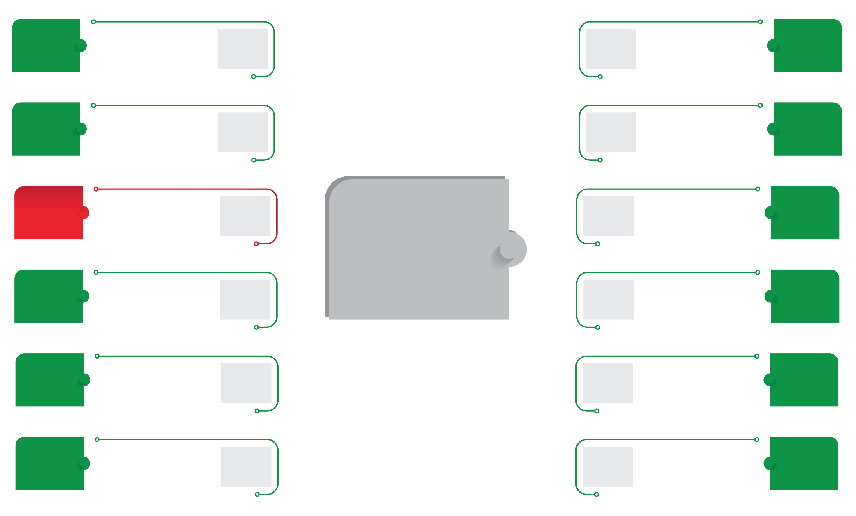

Performance dashboard
67 029
Entrepreneurship
Awareness
37 104
3 247
Incubation
Programme
3 269
31 457
Township & Rural
based clients
28 052
2 783
Productivity
Improvement
2 901
623
Wholesalers
& Retailers
1 000
Total SMMEs &
Cooperatives
Supported
181 984
2 783
Quality
Improvement
3 820
3 807
Access to
Local
Markets
2 500
2 783
Manufacturing
9 839
1 933
Access to
International
Markets
1 000
2 783
Sector specific
training
4 692
1 170
Export platforms
1 000
2 783
Enterprise Coaching
2 794

Slide 9






Performance dashboard
Seda Access Points
Seda Branches - 54
Incubation centers - 110
5176
Jobs Created & Sustained
Number of SMMEs that had Turnover Growth – 2 990
Seda Client Profile:
98% SMMEs
2% Cooperatives
Clients Accessed via Ecosystem Partners
52 830
Clients by Gender
Male 45%
Female 55%

Slide 10

2.1 Programme 1 :Township, Rural and Informal Business

Slide 11
2.1 Programme 1 :Township, Rural and Informal Business
No. | Performance Measure | Target | Achievement
1. | Number of SMMEs and Cooperatives reached through entrepreneurship awareness sessions | 37 104 | 67 029
2. | Number of Spaza shops and general dealers supported | 9 276 | 7731
3. | Number of Personal Care businesses supported | 2 000 | 2993
4. | Number of Informal and Micro Restaurants and Tshisanyama supported | 1 500 | 4523
5. | Number of Fruit and vegetable vendors supported | 4 638 | 4832

Slide 12
2.1 Programme 1 :Township, Rural and Informal Business
No. | Performance Measure | Target | Achievement
6. | Number of Panel beaters, motor mechanics, auto spares and auto-fitment businesses supported | 4 638 | 2 806
7. | Number of Small scale bakeries and confectionaries supported | 2 000 | 2843
8. | Number of Clothing, leather and textile businesses supported | 2 000 | 3840
9. | Number of Butcheries supported | 2 000 | 1889
10. | Number of jobs created | 4 683 | 5176

Slide 13
2.2 Programme 2 : Business Competitiveness and Viability

Slide 14

2.2 Programme 2 :Business Competitiveness and Viability
No. | Performance Measure | Target | Achievement
1. | Number of SMMEs & Cooperatives supported to be competitive in local markets | 2 500 | 3807
2. | Number of SMMEs and Cooperatives listed to supply wholesalers and retailers | 1 000 | 623
3. | Number of SMMEs & Cooperatives exposed to international markets | 1 000 | 1 933
4. | Number of SMMEs & Cooperatives registered on export platforms | 1 000 | 1 170
5. | Number of SMMEs and Cooperatives assisted with incubation programme | 3 247 | 3 269
6. | Number of SMMEs and Cooperatives assisted with productivity improvement | 2 783 | 2901
7. | Number of SMMEs and Cooperatives assisted with quality improvement | 2 783 | 3820

Slide 15
2.2 Programme 2 :Business Competitiveness and Viability
No. | Performance Measure | Target | Achievement
8. | Number of SMMEs & Cooperatives assisted through the ecosystem | 70 000 | 52 830
9. | Percentage of Identified Stakeholders Participating in the Ecosystem | 75% | 100%
10. | Number of SMMEs and Cooperatives whose turnover has increased | 2 783 | 2 990
11. | Number of SMMEs and Cooperatives supported in the manufacturing Sector | 2 783 | 9 839
12. | Number of SMMEs and Cooperatives supported through Sector specific training | 2 783 | 4 692
13. | Number of SMMEs and Cooperatives supported enterprise Coaching | 2 783 | 2 794

Slide 16
2.3 Programme 3 : Administration

Slide 17
2.3 Programme 3 : Administration
No. | Performance Measure | Target | Achievement
1. | Percentage of innovative ideas implemented | 25% | 33%
2. | Percentage of staff recognised for excellence | 25% | 67%
3. | Percentage of staff satisfaction | 75% | 43%
4. | Percentage of customer satisfaction | 80% | 95%
5. | Percentage of stakeholder satisfaction | 80% | 86%
6. | Percentage of vacancy rate | 10% | 7%
7. | Percentage of funds allocated to core delivery | 75% | 88,2%

Slide 18

3. Financial
Information

Slide 19
Financial Information
In the year under review, Seda received an Unqualified Audit opinion, however, AGSA identified limitations in the management of the performance information, which requires management attention; key weaknesses emanate from various levels of data collection aggregation and validation. Seda is currently implementing a reporting system which is in final stages of development
Seda spent R1.185 billion, representing 99.6% of the available budget. Seda does not have any surplus funds to roll over for the first time in more than 5 years.

Slide 20
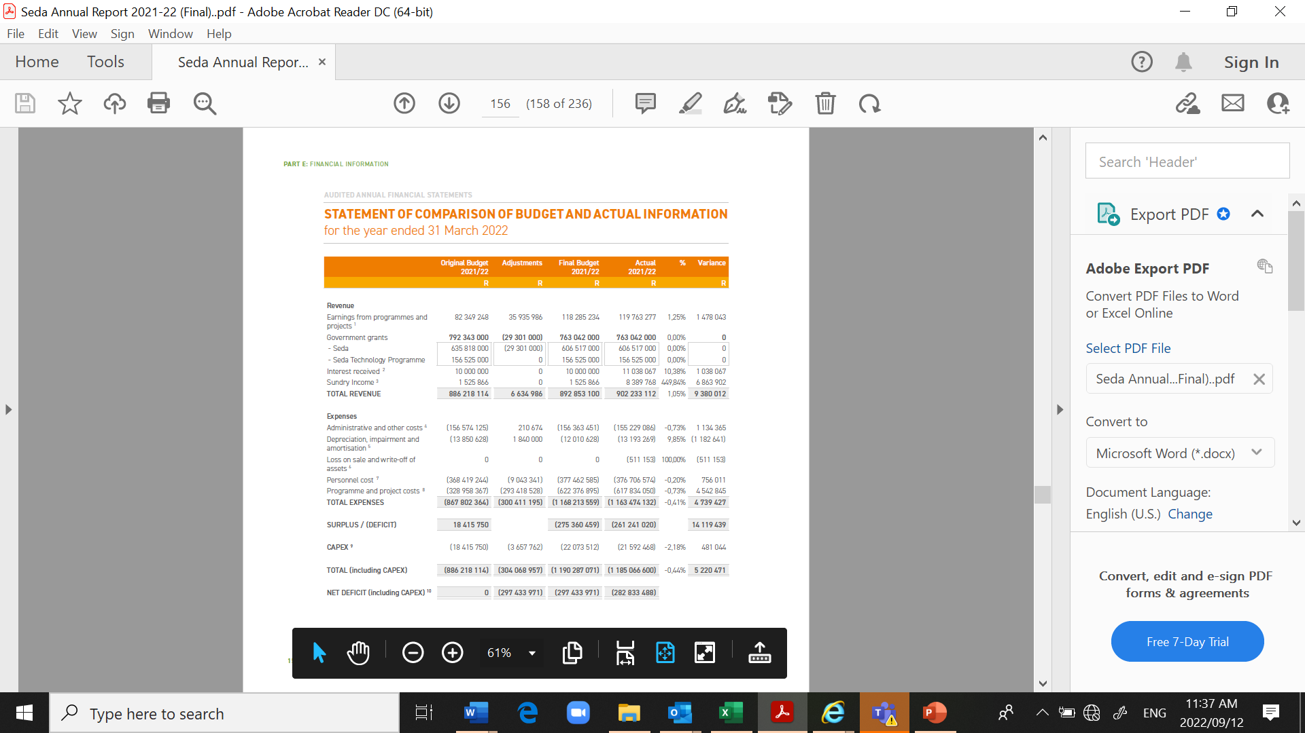

Slide 21
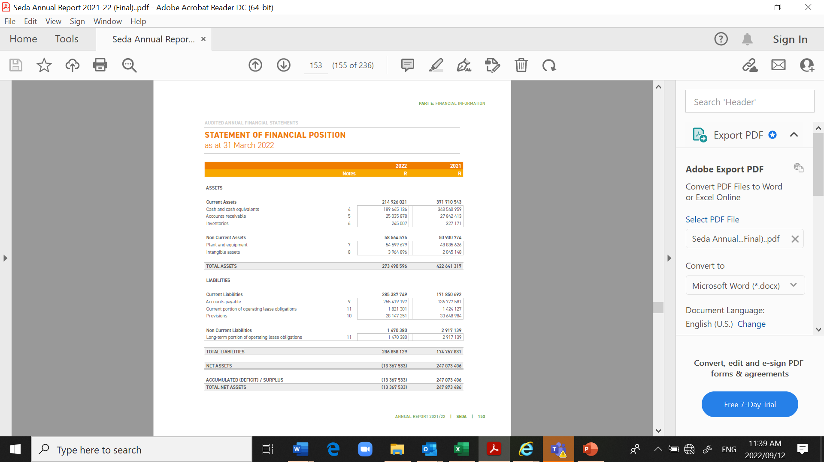

Slide 22
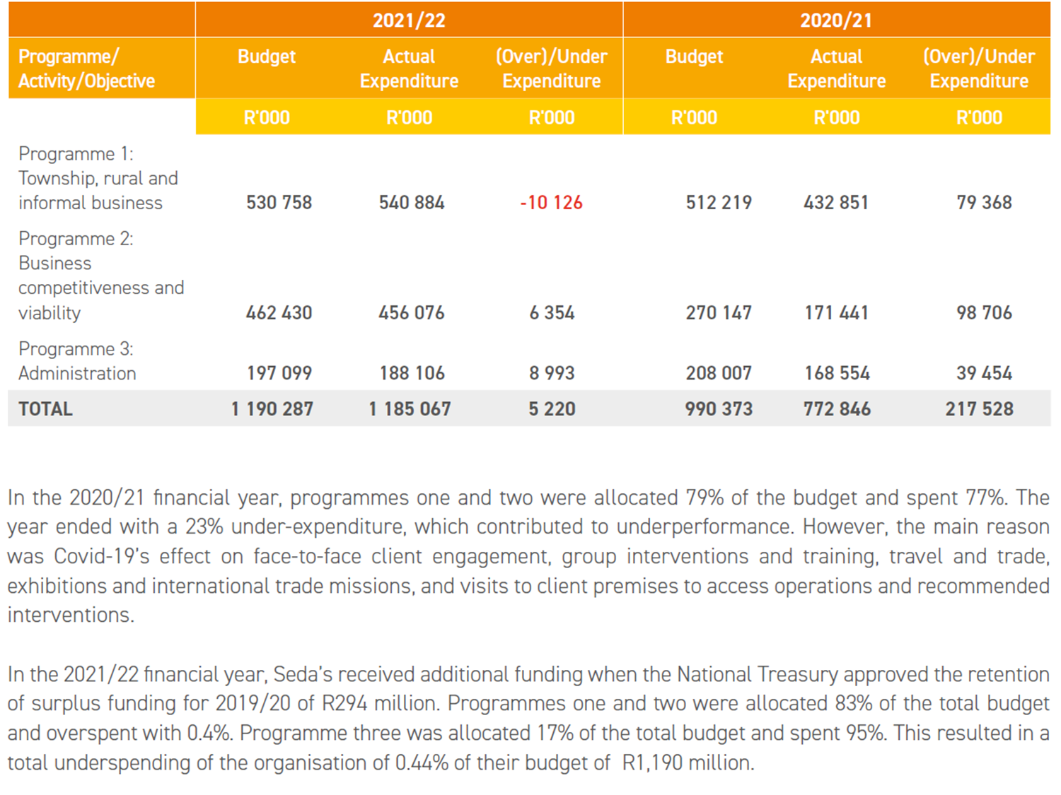
Linking Performance with Budget
LINKING PERFORMANCE WITH BUDGET PERFORMANCE

Slide 23
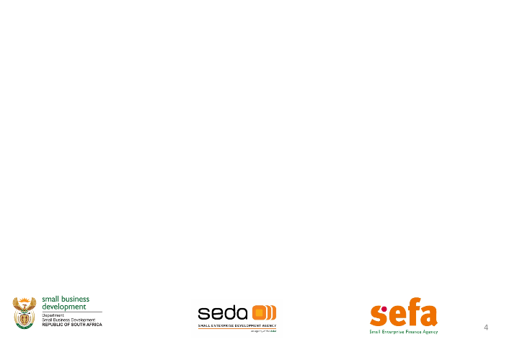
Financial Information Analysis
The entity had a total income of R902.2 million, which represented only a 4% increase from the 2020-21 financial year. The percentage growth was mainly due to the increase in allocation from the Dsbd grant and other specific projects.
Seda made an application to Treasury to approve the previous year’s surplus and National treasury approved R294 million. This increased the expenditure budget increase to R1.190 billion, of which R1.185 billion was spent, resulting in an underspending of R5.2 million (0.44%) vs (2020/21: R217.5 million) (21.96%).
Included in the expenditure of R1.185 billion is an overall spending of R773.1 million on goods and services during the 2021-22 financial year compared to R400.8 million in the previous year. The 93% increase in spending as compared to the previous year was due to the approved surplus by the National Treasury.
The financial resource constraints due to budget cut over the MTEF period and lack of surplus had adverse impact on the implementation of some projects. Seda budget has not been reviewed or increased post COVID-19, yet the mandate to support the SMMEs has increased.

Slide 24
Annual Expenditure split per Province

Slide 25

4. Human
Resource
Report

Slide 26
HR Plans and Goals
HR PLANS AND GOALS
Seda values lay the foundation for the understanding of clients' needs and employees' attitudes as they influence perceptions, to enhance the core business value proposition and impact in collaboration with all role-players in the ecosystem; hence a performance-driven culture is deep-rooted at all levels in the organisation;
The performance-driven culture is vital as we strive towards the achievement of the set objectives and to keep the SEDA brand visible, accessible and solid within this competitive space;
Develop employee's expertise and ensure that Line Managers are trained and skilled;
Continue to prioritize Employees' Mental Health and Well-being; and
Improve Employee Satisfaction level by enhancing employee engagement sessions.

Slide 27
Staff Compliment
Programme | 2020/2021 No. of Employees | 2021/2022 Approved Posts | 2021/2022 No. of Employees | 2021/2022 Vacancies | % of vacancies
Programme 1: EDD | 504 | 548 | 522 | 26 | 5%
Programme 2: STP | 23 | 28 | 26 | 2 | 7%
Programme 3: Administration | 119 | 137 | 116 | 21 | 15%
Total | 646 | 713 | 664 | 49 | 7%

Slide 28
Labour Relations
Reason | Number | % of total no. of staff leaving
Resignation | 37 | 5%
Dismissal | 2 | 0%
Retirement | 3 | 0%
Ill health | 0 | 0%
Expiry of contract | 8 | 1%
Other | 1 | 0%
Total | 34 | 5%

Slide 29

5. Governance & Compliance

Slide 30
Audit & Risk Committee
Committee | No of meetings held | Number of members | Names of members
Audit & Risk | 8 | 7 | Ms M Phiri (Chairperson) Ms BT Nkambule Mr J Matsho Adv D Block Mr C de Kock Ms S Nyakale Adv M Xulu

Slide 31
Human Resource & Remuneration Committee
Committee | No of meetings held | Number of members | Names of members
Human Resource & Remunerations Committee | 9 | 5 | Mr J Matsho (Chairperson) Mr M Sibeko Adv D Block Ms N Kana Dr M Ndlovu Mr N Mbatha (ACEO)

Slide 32
Social Ethics Committee
Committee | No of meetings held | Number of members | Names of members
Social Ethics Committee | 4 | 6 | Dr S Bvuma (Chairperson) Mr J Matsho Adv. D Block Ms N Kana Mr M Sibeko Mr N Mbatha (ACEO)

Slide 33
Strategy and Organisational Performance Committee
Committee | No of meetings held | Number of members | Names of members
Strategy And Organisational Performance Committee | 9 | 9 | Ms Nkambule(Chairperson) Mr C de Kock Dr S Bvuma Adv. M Xulu Ms S Nyakale Ms N Kana Mr M Maki Mr M Sibeko Mr N Mbatha (ACEO)

Slide 34

6. Success Stories

Slide 35
AFRICAN HORIZON (Eastern Cape)
Impact | The business has signed a five-year contract with AL-ASR Collection Retailers, the value of the contract is R119 340 000. Turnover increasing by 200% and the number of employees by 22.
Business Challenges | Mr Ntwasa wanted to grow the business and faced the following challenges: A need to acquire equipment and machinery to support large-scale production Lack of corporate identity, promotional material and website.
Seda Intervention | An application to the Small Enterprise Finance Agency (sefa) for bridging finance. A total of R8 973 373.93 was granted by sefa and as a result, African Horizon acquired industrial machinery to support large-scale production. The business was also assisted with the development of a website and marketing collateral.

Slide 36
Legratron Electronics (Pty) Ltd (Free State)
Impact | Increase employees from 8 to 10, Improve turnover from R825 370 pa to R1 149 288 pa, Receive VESA accreditation, Secured a contract in Swaziland for 36 Trucks which increased their units in that country to 57.
Business Challenges | Lacked market access
Seda Intervention | The business was taken through a journey of interventions, among others: New offices in Parys, Referred to Innovation Hub for further support, Linked with a service provider to penetrate international market, Mentored through SECP

Slide 37
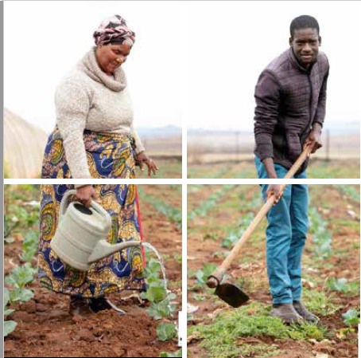
INTANDEKHO AGRICULTURAL PRIMARY COOPERATIVE LTD (Mpumalanga
Impact | Turnover increased by 203% The cooperative sustained five jobs and created five part-time job opportunities.
Business Challenges | The cooperative aimed to plant 10 000 seedlings consisting of 3 000 cabbages, and the rest spinach, mixed beetroot and some onions. The plan was to have at least five contract employees as the business gains momentum and to improve the fresh produce available locally.
Seda Intervention | The business received basic business skills training and entrepreneurship programme. The cooperative was invited to a boot camp session with the CfERI, business coaching, access to market, marketing The business was assisted with access to finance and managed to approach other big clients such as Izimbali and MST Boarding school, which led to an increase in clientele, and business growth.

Slide 38


Slide 39
