Slide 1


Portfolio Committee on Employment and Labour
PRODUCTIVITY SA ANNUAL REPORT 2021/22
Mr Mothunye Mothiba, Chief Executive Officer
Wednesday, 12 October 2022

Slide 2
TABLE OF CONTENTS
The Legislative Mandate
Productivity SA Operating Environment
Annual Performance Information 2021/22
Key Achievements for the 2021/22 FY
Challenges and areas of non-performance for 2021/22 FY
Financial Information for the year 2021/22 FY
Audit outcomes 2021/22 FY
Strategic Plan 2019/20-2023/24 and Priorities over the MTSF
Annual Performance Plan 2022/23 FY
Budget 2022/23 - 2025/26
Conclusion and Recommendations

Slide 3
PRODUCTIVITY SA MANDATE
Productivity SA fulfils an economic or social mandate of government, which is to promote employment growth and productivity.
Delivers on the mandate of the DEL, with a focusing on: improved economic efficiency and productivity, creation of decent employment, and promoting social dialogue and workplace democratisation.

Slide 4
PRODUCTIVITY SA OPERATING ENVIRONMENT
Productivity South Africa operates in a dynamic and challenging environment characterised by:
Nine (9) Critical Socio-economic and Labour Market Indicators (GDP Growth, Employment Growth, Productivity Growth, Global Competitiveness, Business Efficiency, Income Growth, Inequality and Exclusion, Informality, and Poverty) are showing A RED FLAG AND NATIONAL CRISIS.
The rapid technological advancements, as well as the COVID-19 crisis had a devastating effect on our economic and labour market systems and reshaping business models, and we should respond with agility. We should leverage the emerging opportunities flowing from the collective global response to these, including how we deal with the Future of Work, using instruments provided by the ILO (Centenary Declaration for the FoW, R204 and the Abidjan Declaration among others)
Low productivity growth (labour productivity and total factor productivity) particularly of the SMMEs in the productive/industry sectors. It is an undisputed fact that productivity improvement is the most effective way of ensuring long-term competitiveness, long-term business success, economic growth and, should be addressed holistically if we are to tackle the challenges of unemployment, poverty, inequality, and exclusion.
A decline in the contribution of the manufacturing sector to the GDP Growth over the last two decades. The sector accounts for around 13% of GDP and is an important source of employment and productivity growth and of demand for the service sector. It is without saying that this sector be a national priority if we are to begin pushing back the tide of joblessness that fundamentally threatens our social stability.

Slide 5
PRODUCTIVITY SA OPERATING ENVIRONMENT (cont.)
Low Competitiveness - SA’s global competitiveness ranking was at 62 out of 64 countries in 2021 and 60 out of 63 countries in 2022, with the Competitiveness Score at 40 in 2022. Infrastructure (including education and innovation systems) and Business Efficiency (including productivity and efficiency and management practices) ranking the lowest at 60 and 56 respectively.
The Competitiveness Score at 40, which is way below the norm is reflective of a country unable to manage its competencies to achieve long-term value creation. Governments therefore need to provide an environment characterized by efficient infrastructures, institutions and policies that encourage sustainable value creation by the enterprises.
SMMEs constitute close to 90% of businesses and are acknowledged as productive drivers of the economy, however, no National Integrated Enterprise Development and Support Strategy and programme interventions in place.
A dual economy characterised by high levels of informality, inequality and exclusion, with over 65% of SMMEs operating in the informal sector. ILO Recommendation 204, 2015 which is the first international labour standard to focus on the informal economy in its entirety and diversity and to point clearly in the direction of transition to the formal economy as the means for realising decent work for all and for achieving inclusive development is of strategic significance for the world of work and for the future of work.

Slide 6
ANNUAL PERFORMANCE INFORMATION 2021/22

Slide 7
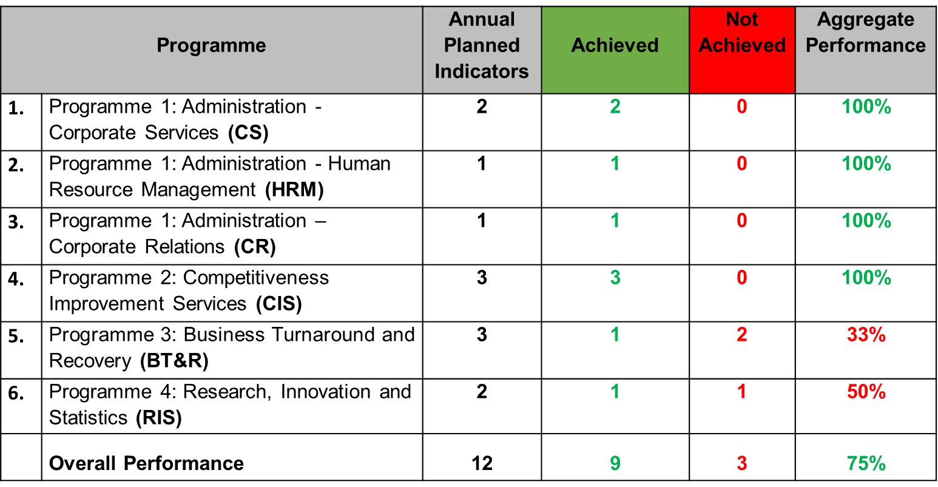
2021/22 PERFORMANCE PER PROGRAMME

Slide 8
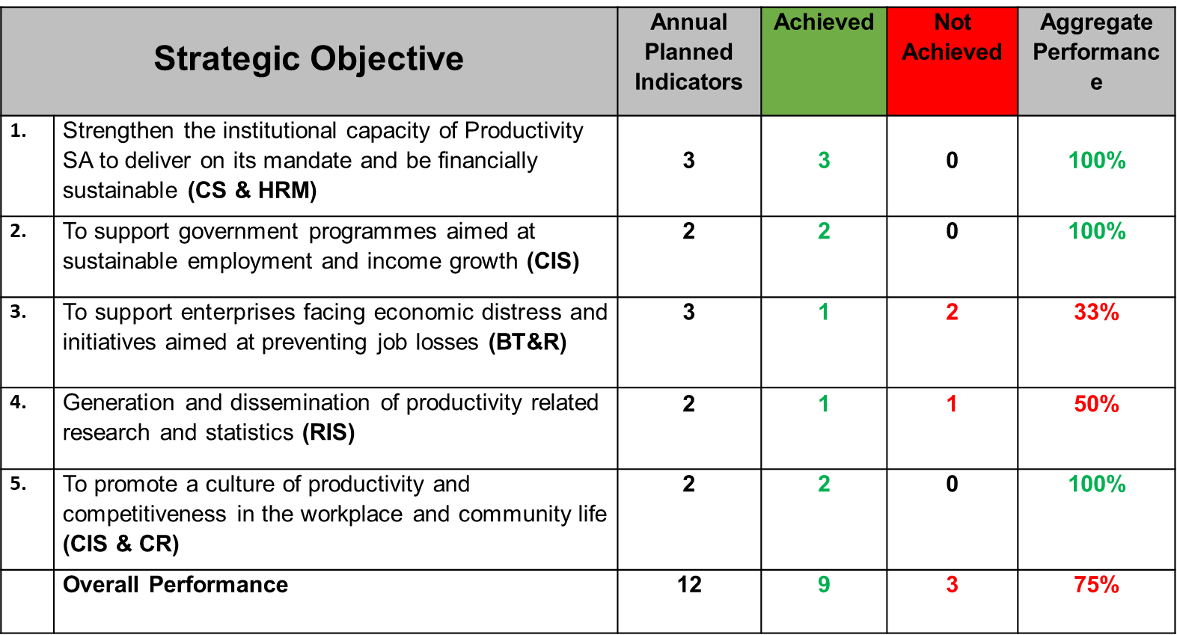
2021/22 PERFORMANCE PER STRATEGIC OBJECTIVE

Slide 9
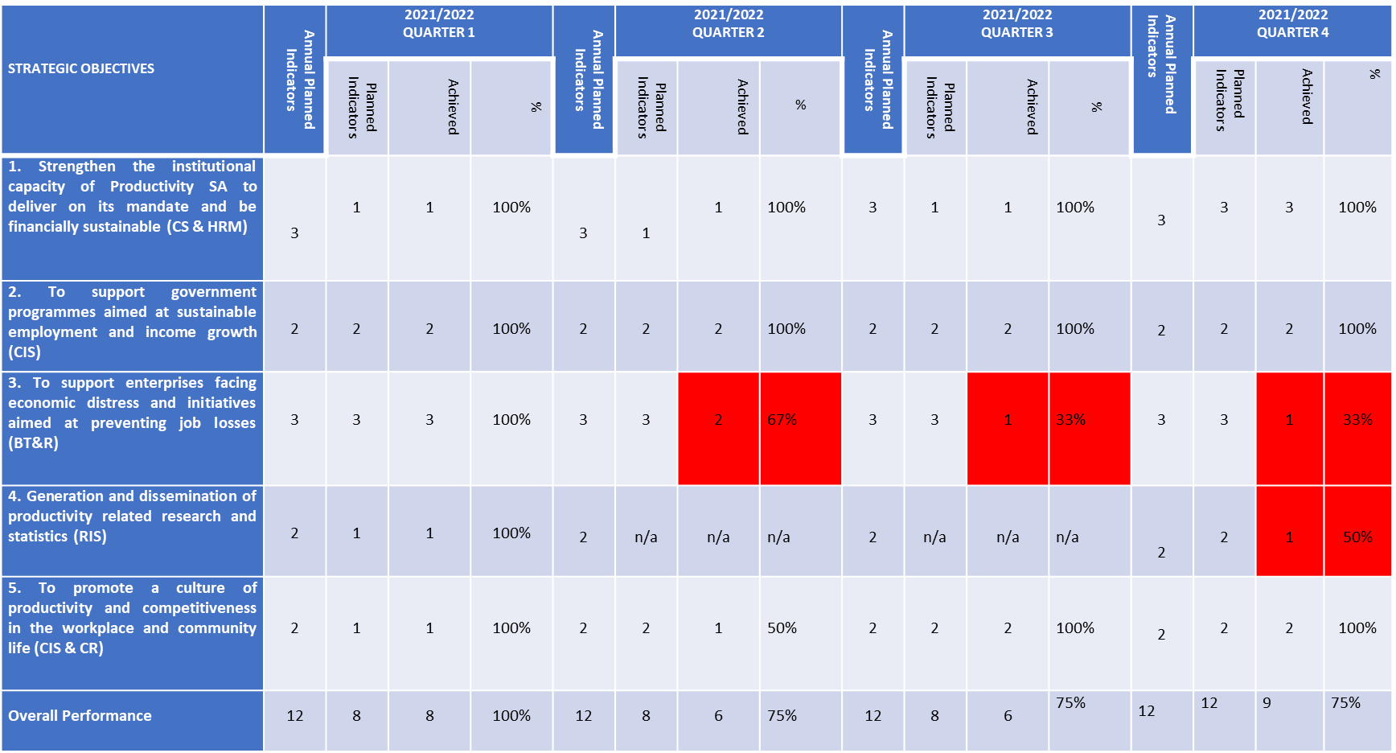
ORGANISATIONAL PERFORMANCE PER STRATEGIC OBJECTIVE– 2021/22 FY

Slide 10
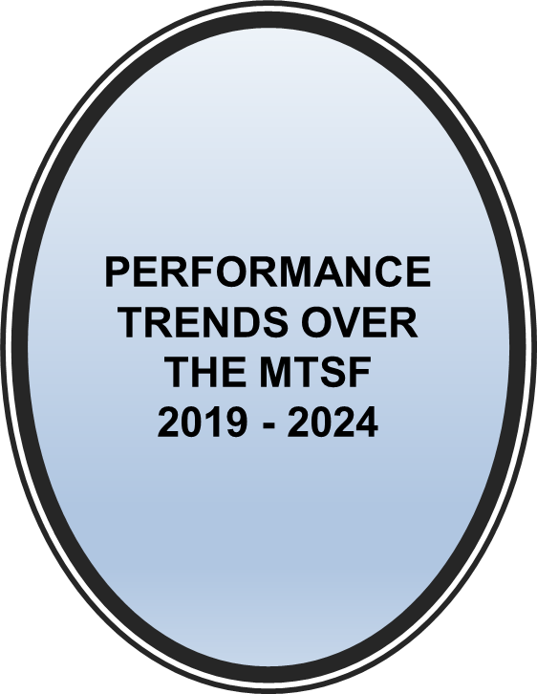

Slide 11
KEY ACHIEVEMENTS FOR THE 2021/22 FY
During the year under review, we achieved 75% of our APP targets, with nine (9) of the twelve (12) planned Key Performance Indicators achieved. This included scaling up our support for SMMEs, which according to recent data by StatsSA constitute over 90% of businesses in the country.
Over 4300 SMMEs, entrepreneurs and workers (including establishing Workplace Collaboration teams and training their members) were supported through the Competitiveness Improvement Services.
Through the Workplace Challenge Programme (WPC), which is our flagship programme funded by the dtic, we supported 101 enterprises., most of which are in the SEZs/ IDZ and Industrial Parks. 80% of the businesses supported are owned by Black people, 51% of these are owned by women, with 25% owned by young people.
Despite the challenges experienced during the implementation of the Turnaround Strategies, we supported 83 companies facing economic distress, established Future Forums and trained 777 of the members. The interventions resulted in 7697 jobs being saved against a target of 9550.

Slide 12
KEY ACHIEVEMENTS FOR THE 2021/22 FY
In collaboration with the dtic (which provided funding), we implemented the Itukise Internship Programme (targeting mostly industrial engineering graduates).
Most of the 1200 interns placed were in the companies participating in our CIS Programmes, including the WPC Programme. About R15 799 859 was paid in stipends to the interns. Over 100 interns who graduated from the Itukise Internship Programme were placed in permanent employment.
We are participating in the NEDLAC structures and workstreams on areas for collaboration and through this involvement, Productivity SA has supported the creation of an enabling ecosystem for SMMEs, start-ups and co-operatives in the formal and informal economy through its BT&R and CIS programmatic initiatives.

Slide 13
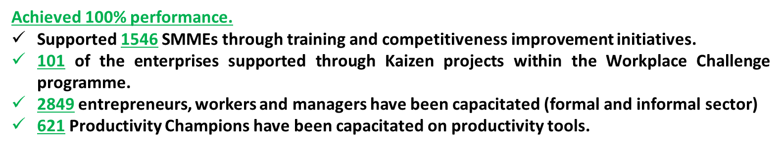
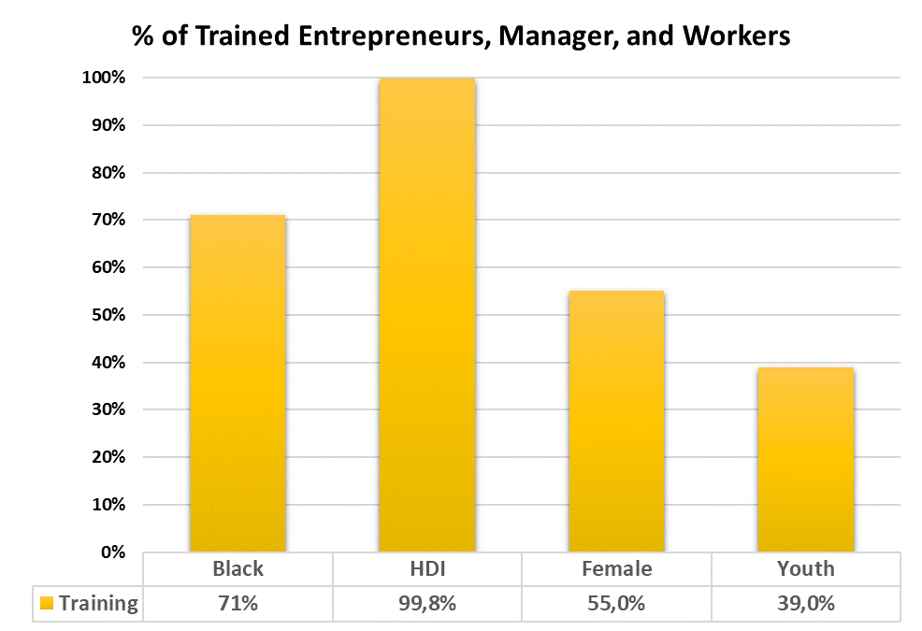
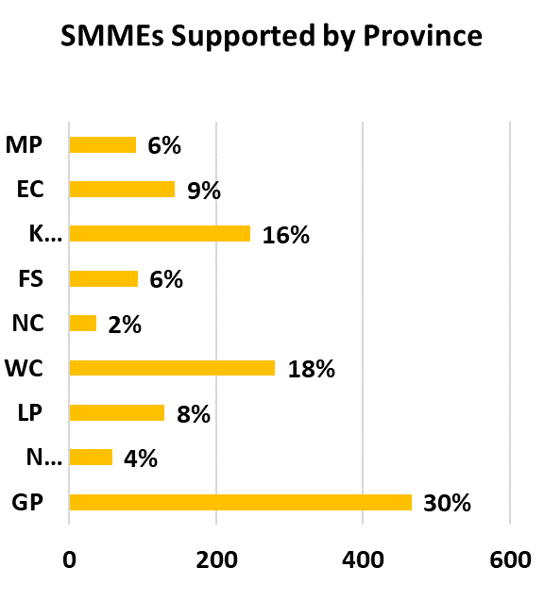
KEY ACHIEVEMENTS FOR THE 2021/22 FY - Competitiveness Improvement Services (CIS)

Slide 14
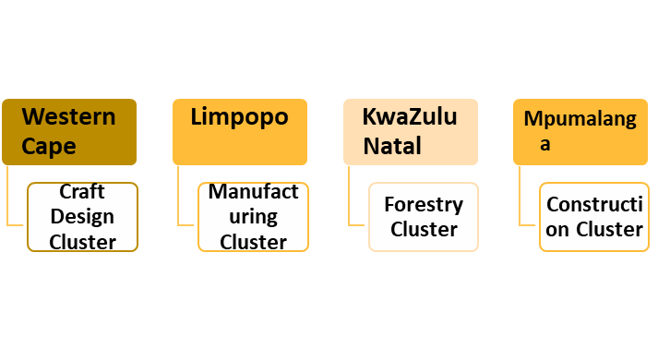
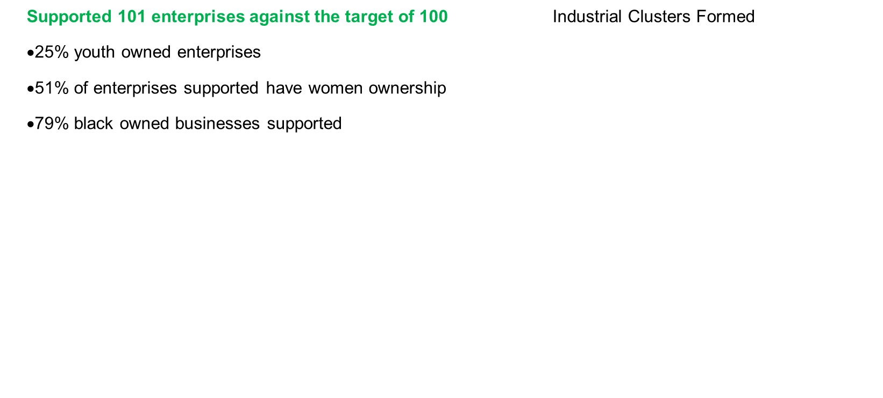
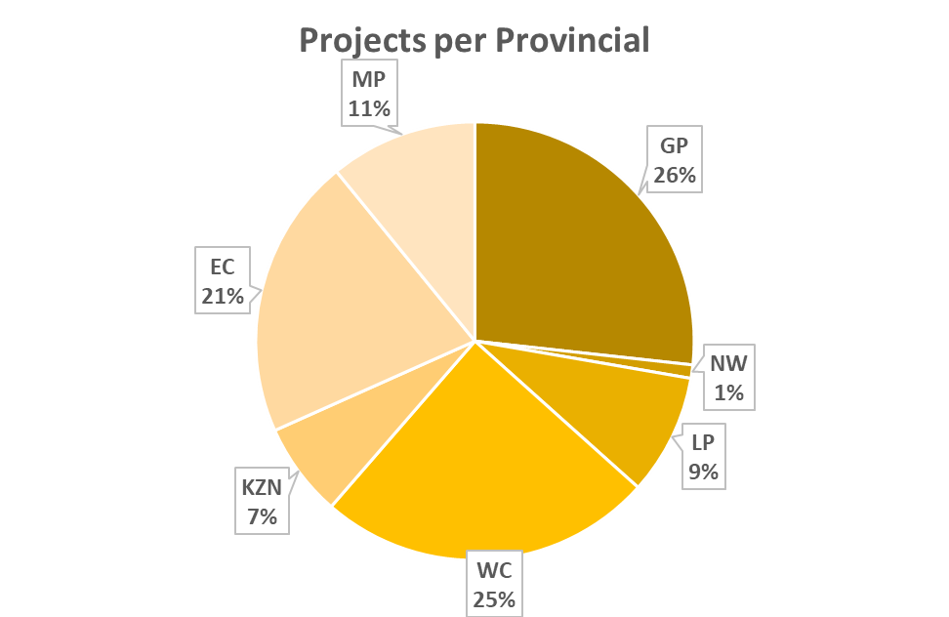
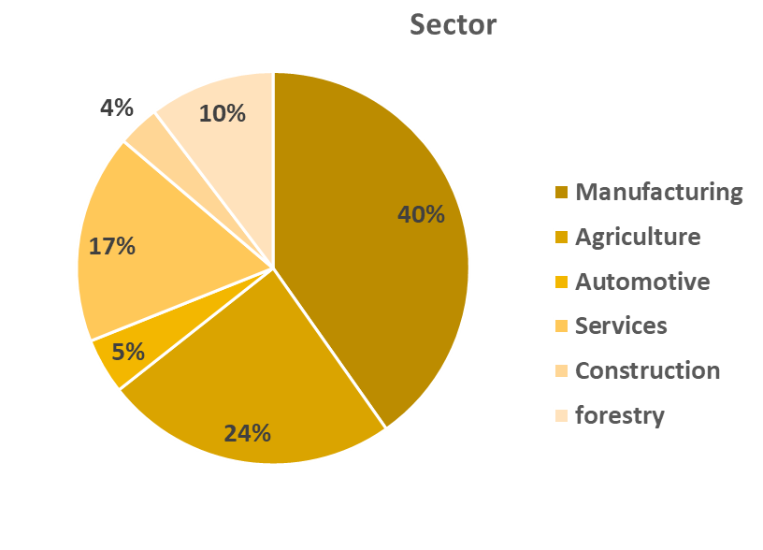
KEY ACHIEVEMENTS FOR THE 2021/22 FY
Workplace Challenge (WPC) Programme

Slide 15
Business Turnaround and Recovery (BT&R)
Programme Performance

Slide 16
BT&R PROJECTS: NURTURED AND JOBS RETAINED PER PROVINCE

Slide 17
BT&R PROJECTS: OPERATIONAL SECTORS 2021/2022

Slide 18
BT&R PROJECTS: JOBS RETAINED BY GENDER AND RACE 2021/2022

Slide 19
CHALLENGES AND AREAS OF NON-PERFORMANCE
FOR 2021/22 FY
Out of 2,3million SMMEs, Productivity SA can only service a fraction of the total number due to lack of funding. The CIS programme is reliant on other Regional and National Partners to achieve the APP targets with the use of additional funding.
Investment into technology would further assist the CIS unit improve on access to clients and service offerings to support the SMMEs in both the inform and formal economy to become sustainable entities that create decent work.
The BT&R Programme was the least performing programme with overall achievement of 33%, only achieving one of the three (3) KPIs. .
Given the importance of the BT&R Programme, in the face of the numbers of companies scaling down operations to stay afloat and some shutting down and retrenching millions of workers, a lot must be done to address the administrative and regulatory requirements as well as funding of the programme to support more companies and save jobs.
In the current economic climate with more businesses facing economic distress and expecting them to meet the legislative and compliance obligations relating to UIF and SARS becomes a barrier and excludes most businesses (with 20 companies prevented from accessing the BT&R interventions.
The BT&R programme was suspended in the fourth (4th) quarter of 2021/2022 FY, due to a lack of funding and uncertainty about future funding. This negatively affected 108 nurtured companies, employing 10727 and 927 Future Forum members could not function as planned during this period.

Slide 20
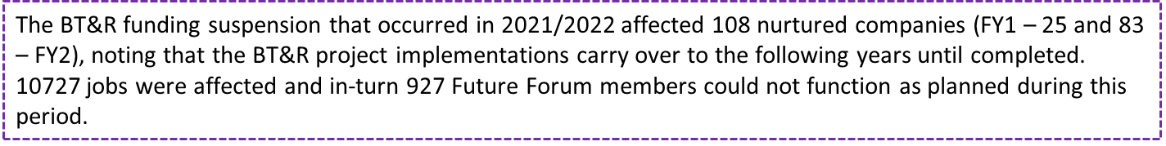
BT&R COMPANIES AFFECTED BY THE SUSPENSION 2021/2022

Slide 21
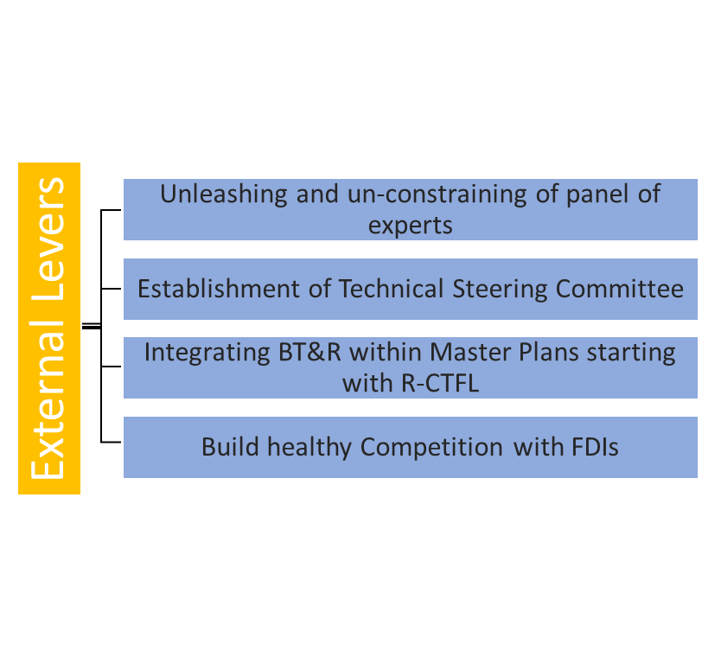
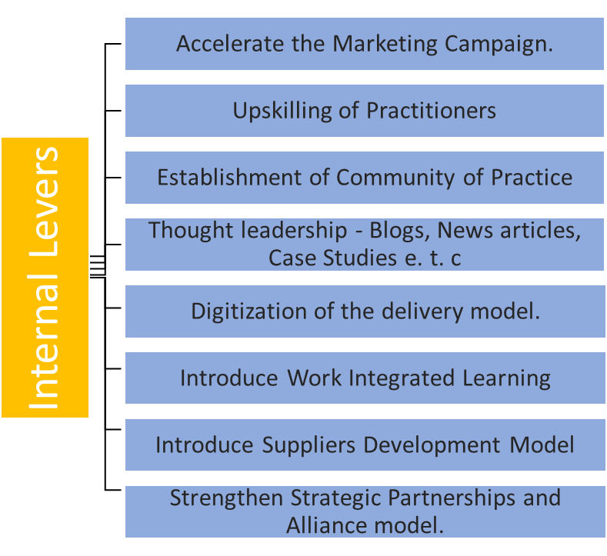
BT&R PROGRAMME ACCELERATION PLAN

Slide 23
KEY ACHIEVEMENTS FOR THE 2021/22 FY
The entity obtained an Unqualified Audit Opinion for the financial year 2021/22.
Grant funding increased by 20% year-on-year.
The entity had a Surplus for the year amounting to R3,751,061
Current assets exceeded current liabilities as at year-end.
The financial statements were prepared on a going concern basis and that was ratified by the Auditors.
As at 31 March 2021, the entity recorded an Accumulated Surplus of R15,135,591.
Irregular expenditure of R1,894,374 and Fruitless and Wasteful expenditure of R47,760 incurred.

Slide 24
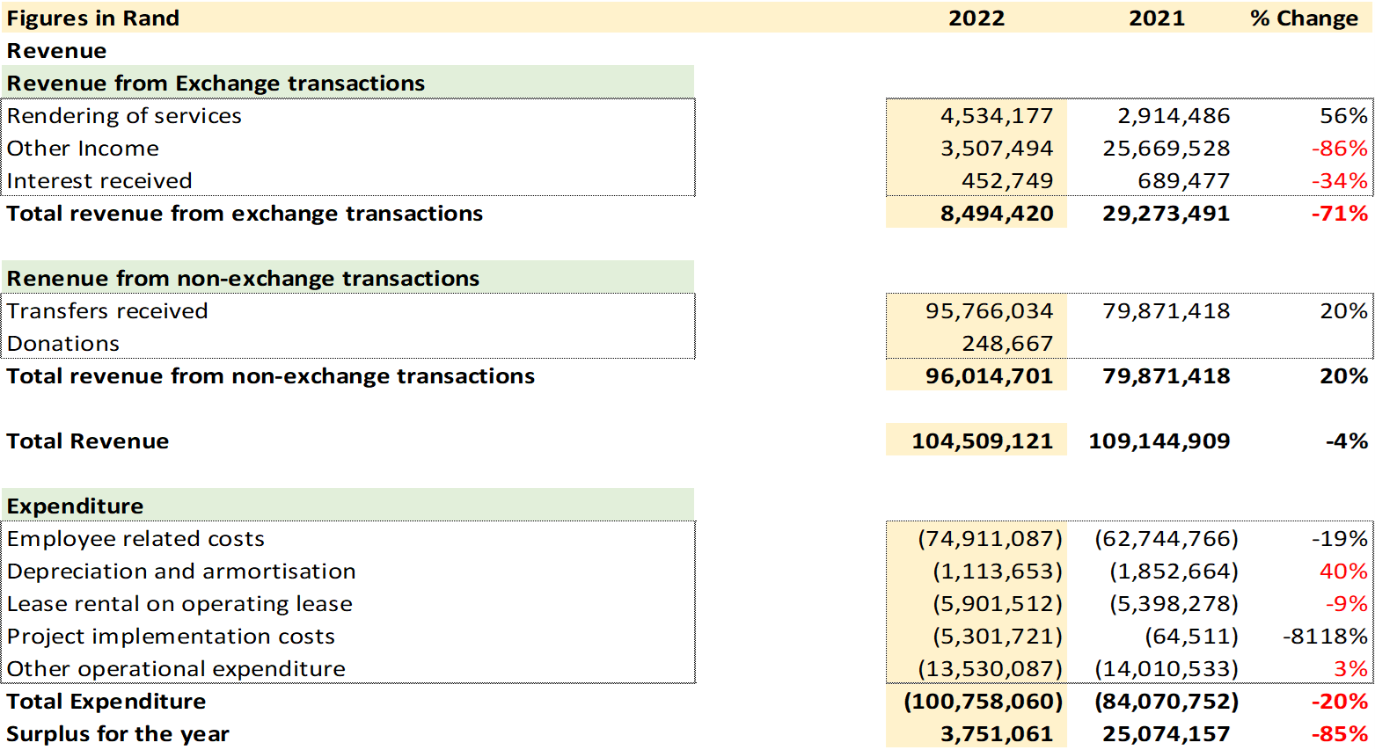
FINANCIAL PERFORMANCE FOR THE YEAR
ENDED 2021/22

Slide 25
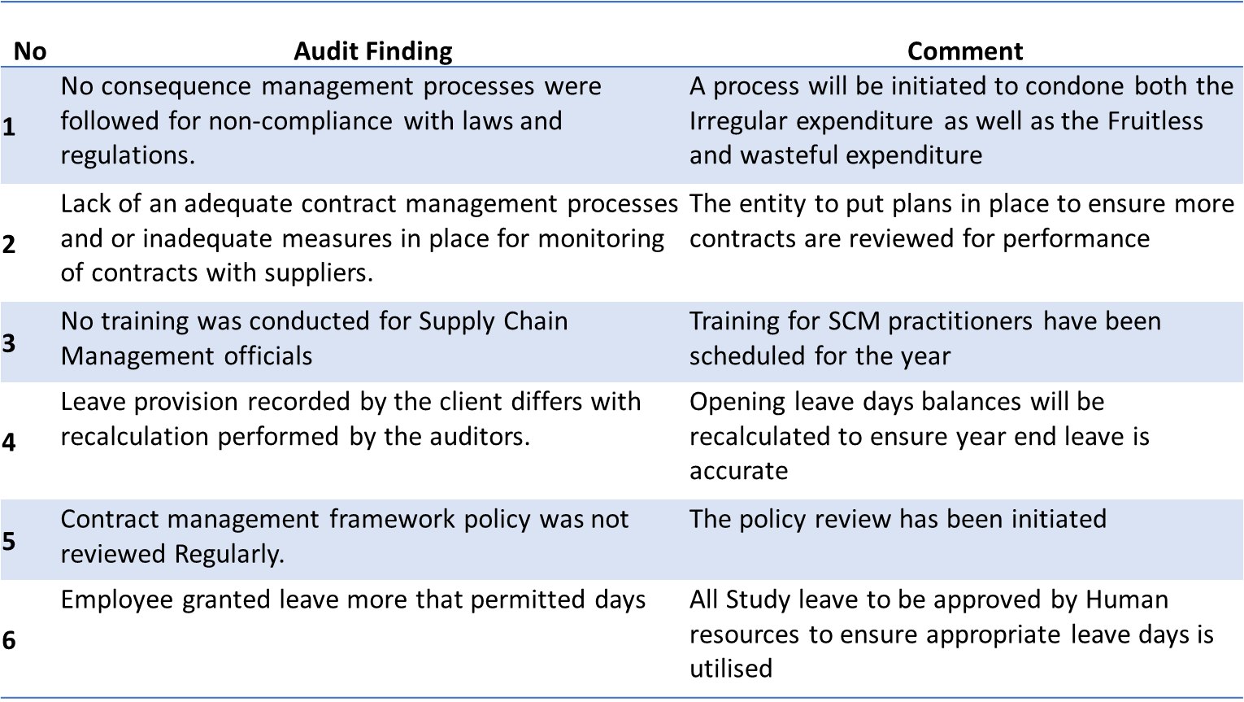
AUDIT OUTCOMES

Slide 26
STRATEGIC PLAN 2019/20 - 2023/24 AND
PRIORITIES OVER THE MTSF ANNUAL PERFORMANCE PLAN 2022/23

Slide 27
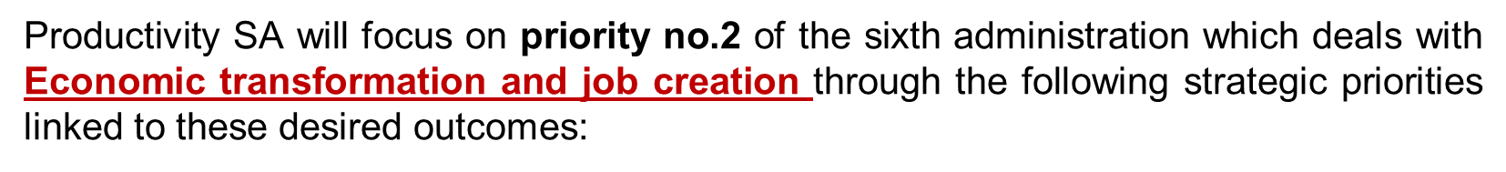
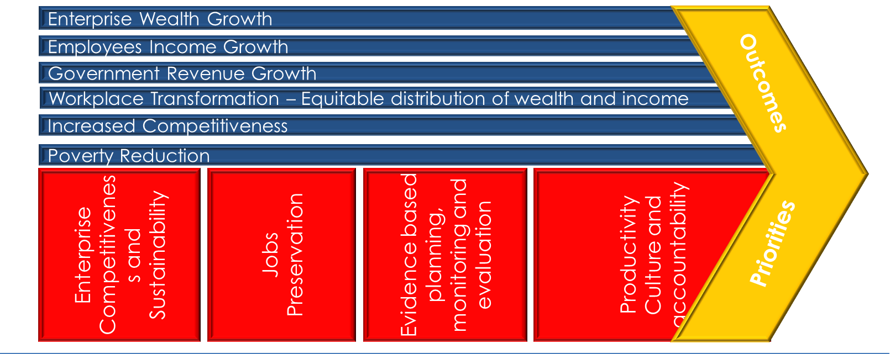
PRIORITIES OVER THE MTSF 2019 – 2024

Slide 28
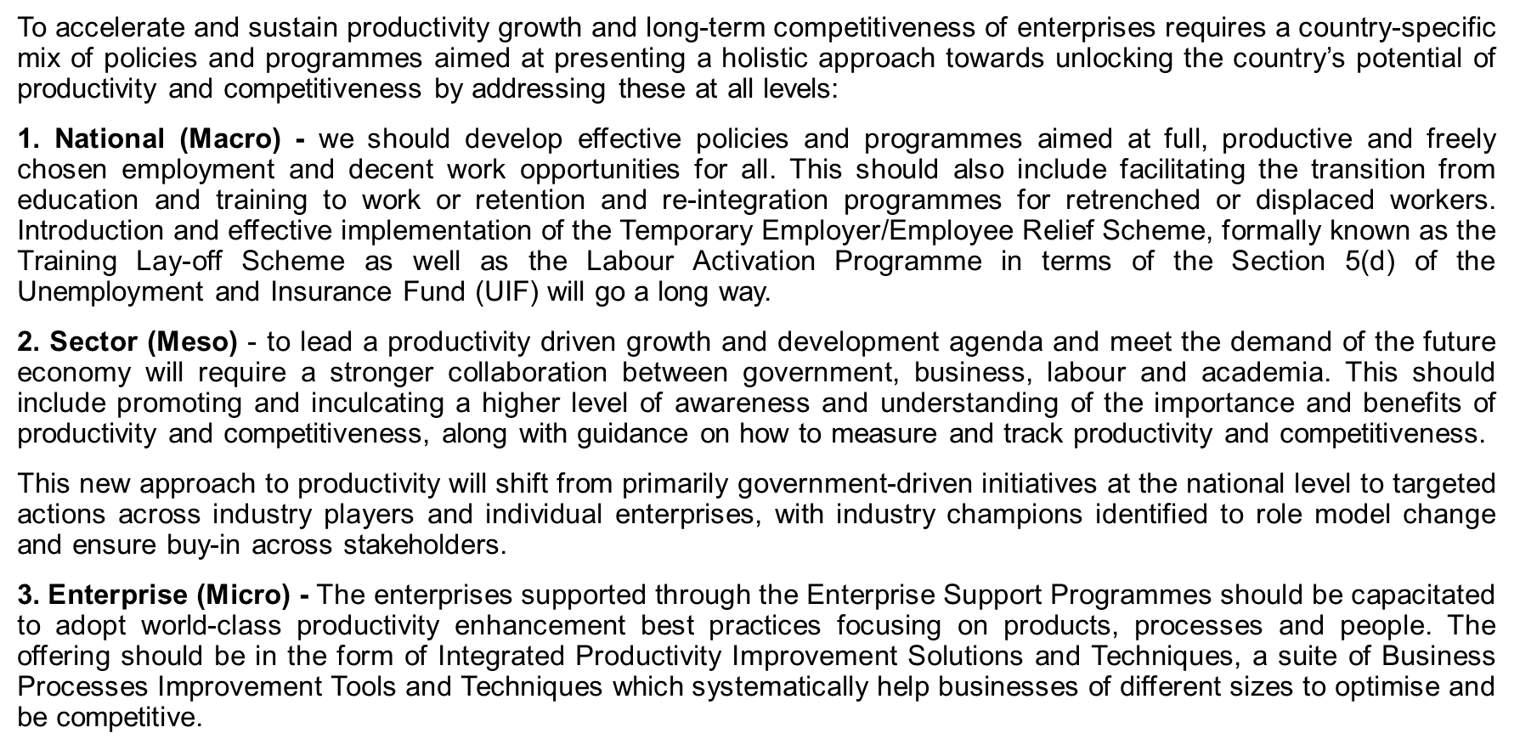
THE CHANGE AGENDA – A Productivity Driven long-term Competitiveness and Sustained Inclusive Growth for South Africa towards 2030

Slide 29
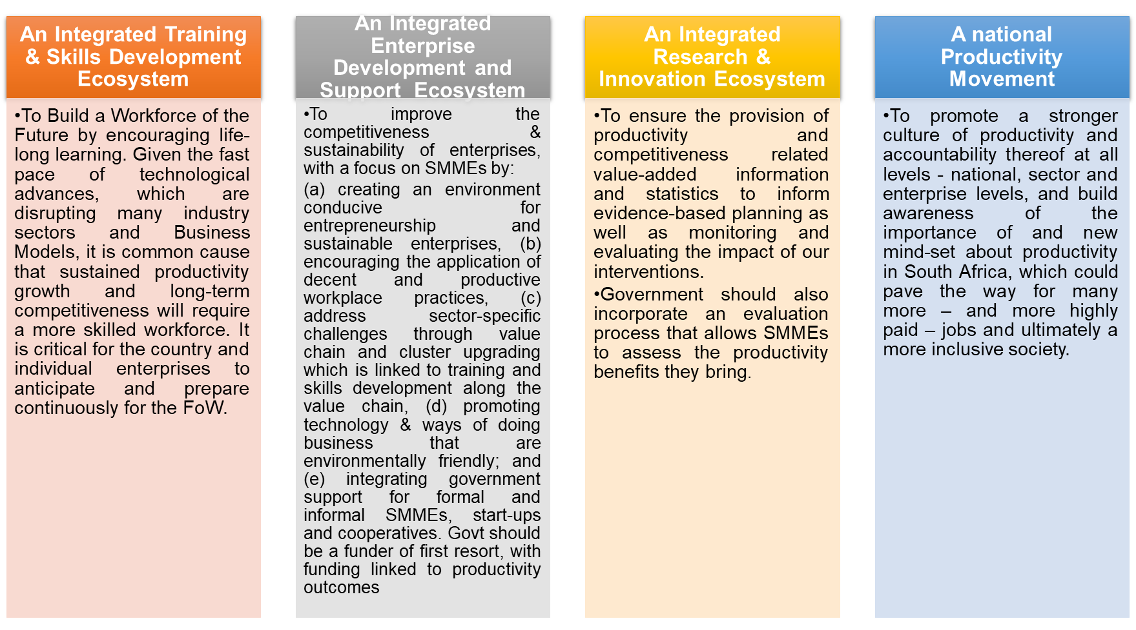
THE CHANGE AGENDA- AN INTEGRATED ENTERPRISE DEVELOPMENT AND SUPPORT ECOSYTEM DURING AND POST COVID-19 AND TOWARDS 2030

Slide 30
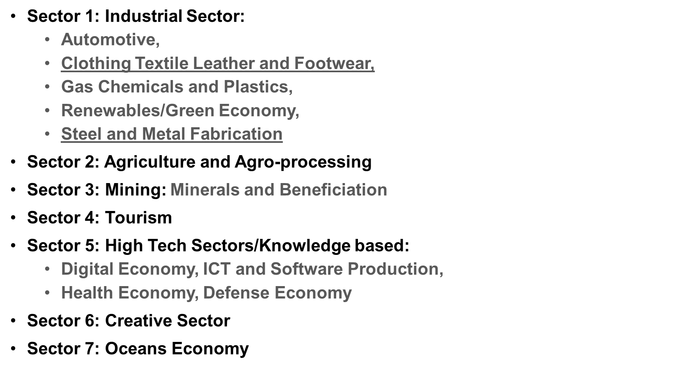
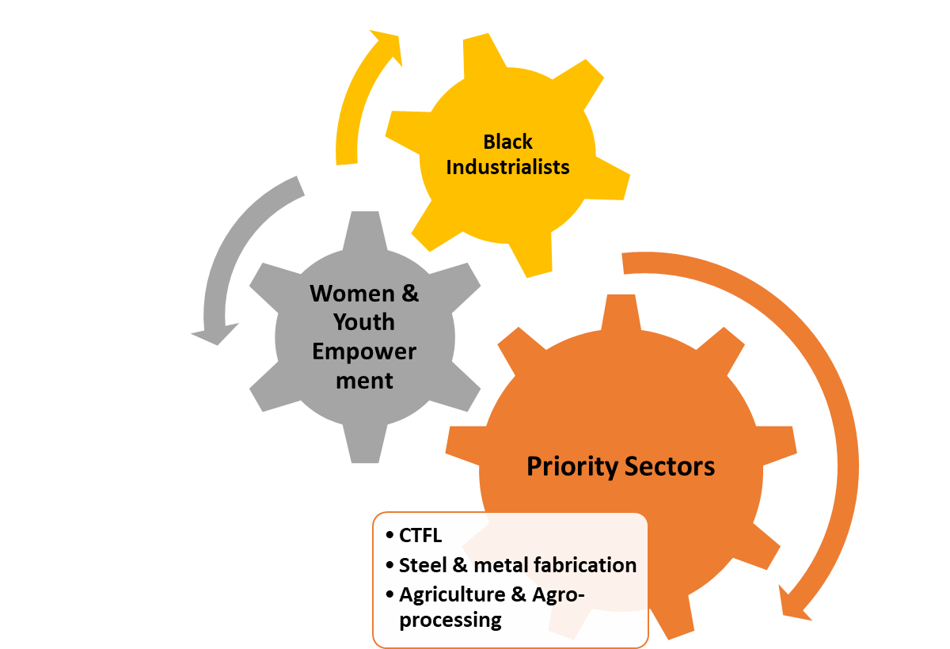
NATIONAL PRIORITY SECTORS
*RE-IMAGINING OUR INDUSTRIAL STRATEGY TO BOOST INCLUSION & PRIVATE INVESTMENT

Slide 31
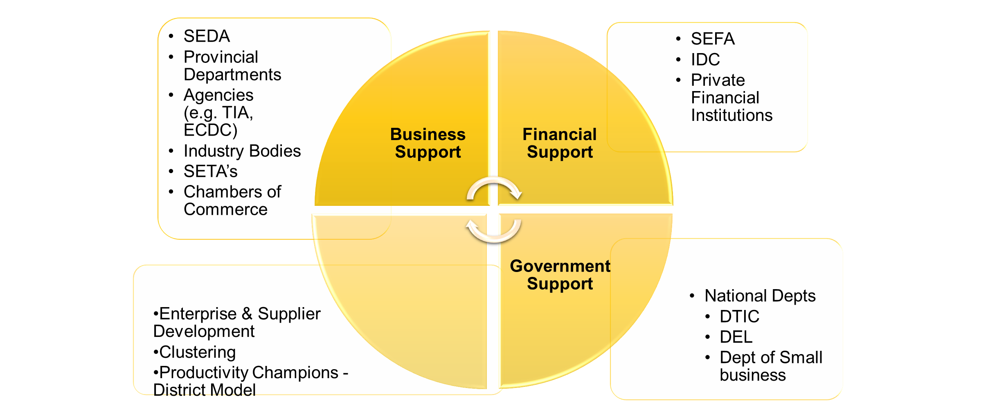
INTEGRATED Enterprise Development AND SUPPORT EcoSystem

Slide 32
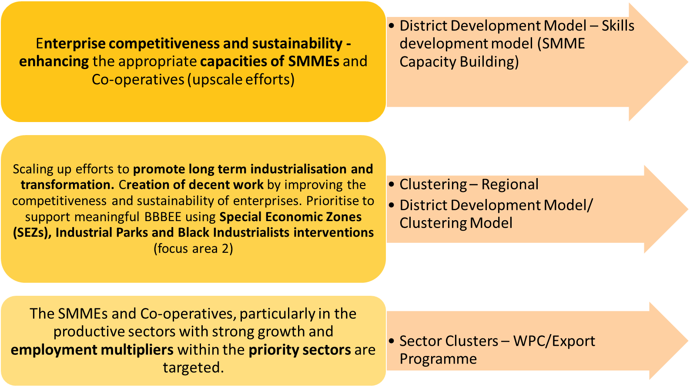
INTEGRATED ENTERPRISE DEVELOPMENT AND SUPPORT ECOSYSTEM

Slide 33
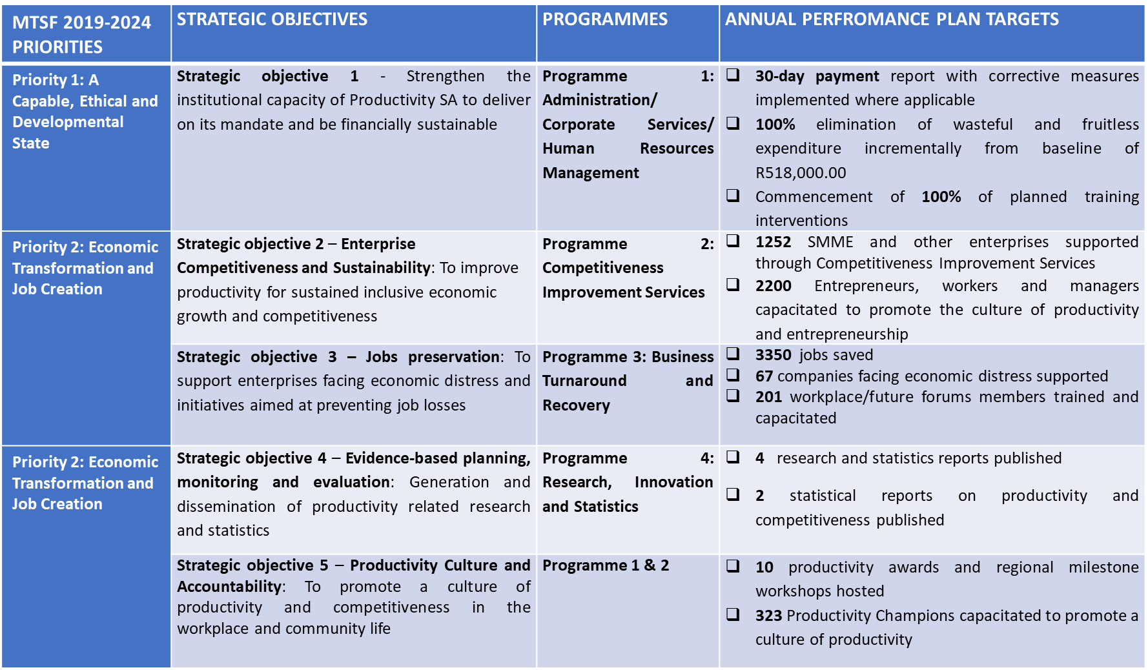
ANNUAL PERFORMANCE PLAN FOR THE 2022/23 FY

Slide 34
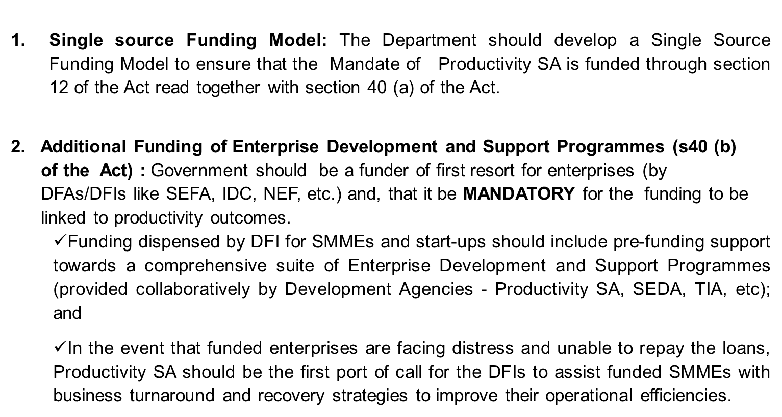
CONCLUSIONS AND RECOMMENDATIONS

Slide 35
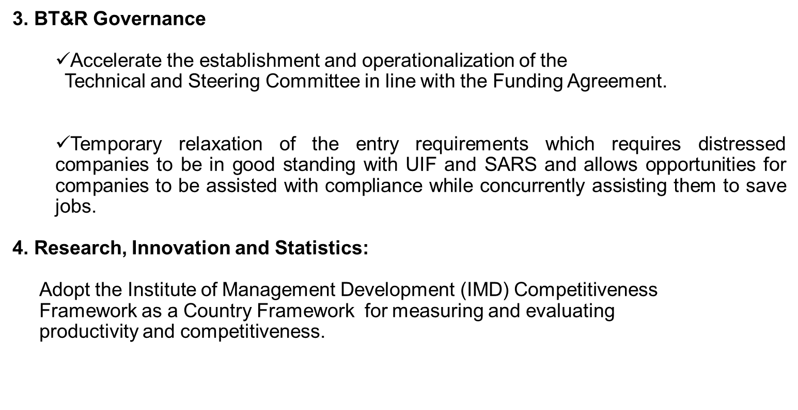
CONCLUSIONS AND RECOMMENDATIONS

Slide 36


Slide 37
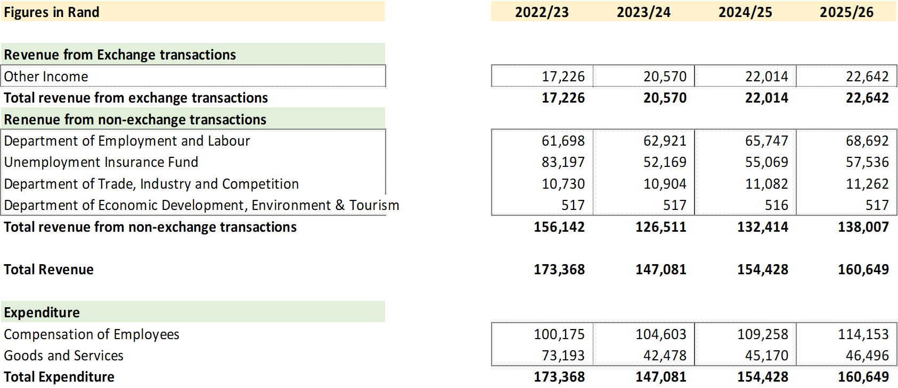
BUDGET – 2022/23 to 2025/26

Slide 38
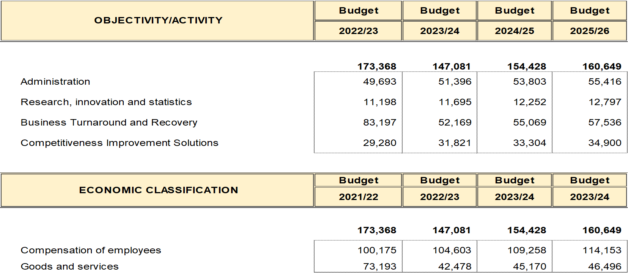
BUDGET PER PROGRAMME

Slide 39

Thank You…

