Slide 1
ANNUAL REPORT FOR THE 2021/22 FINANCIAL YEAR
BRIEFING TO THE PORTFOLIO COMMITTEE ON PUBLIC SERVICE AND ADMINISTRATION,PLANNING, MONITORING & EVALUATION
12 OCTOBER 2022

Slide 2
PRESENTATION OVERVIEW
2021/22 at a glance
AR 21/22
Summary of Performance Information
AR
21/22
Audit outcome
Reflections on the key achievements
Financial Performance
Overview of draft Performance Information per Program
AR 21/22
2

Slide 3
PSC AT A GLANCE
Total Budget
R286 mil
Footprint
1 National
9 Provincial Offices
Establishment
14 Commissioners
279
employees
Audit Outcome
Clean Audit Opinion: 3 Years in a row
FY2021/22
Achieved 22 out of 23 targets (96%) (audited)

Slide 4
REFLECTIONS ON KEY ACHIEVEMENTS
The implementation of Priority 1 through the NDP 5-year Implementation Plan and the MTSF has enabled the PSC to identify 4 Outcomes that would contribute towards building “A capable, ethical and development state”.
The expected results from these outcomes are behavioural change in the Public Service at an institutional and individual level that sets the foundation for a capable and ethical state.
An improved service delivery culture
Sound leadership practices in the Public Service
A well coordinated and functioning M&E System (Data Warehouse for the PSC
A strong & well-functioning PSC

Slide 5
REFLECTIONS ON KEY ACHIEVEMENTS
Issued a circular on the implementation of unlawful instructions to Executive Authorities and Heads of Departments as a reminder of their duty to act within the confines of the law and to report any unlawful instruction.
Played a substantive role towards the development of the National Implementation Framework on the Professionalisation of the Public Service.
Facilitated selected Heads of Department (HoDs) Evaluations in line with the Performance Management and Development (PMDS) Framework for HoDs.
Issued articles on topical issues focusing on the impact of the COVID-19 in education, human resource management as well as Labour Relations prescripts and practices.
Intervened and engaged the suppliers and relevant institutions to unlock the payment of suppliers within 30 days.
Conducted a Webinar on the effectiveness, efficiency and value for money of the procurement system.
5

Slide 6
REFLECTIONS ON KEY ACHIEVEMENTS
Intervened on behalf of citizens to facilitate access to services during the lockdown such as the fast-tracking of COVID-19 grants (R350), water tanks being delivered in KwaZulu-Natal Province and the processing of travel documents by SAPS.
Participation at various events with strategic partners, such as the South Africa - European Union Strategic Partnership Dialogue Facility, the University of South Africa, the United Nations Office on Drugs and Crime and the NSG.
Published its Quarterly Bulletin, the Pulse of the Public Service, through virtual media briefings which covered topics such as the non-payment of suppliers by departments and the management of employee productivity and responsiveness to the public in hybrid working arrangements.
Qualitative evaluations of departmental compliance with the constitutional values and principles which culminated in the State of the Public Service Report (SOPS).
Conducted inspections at selected education facilities in 8 provinces to assess compliance with minimum health, safety and social distancing requirements to mitigate the risk of COVID-19 during the phased re-opening of schools for grade 7s and 12s.
6

Slide 7
SUMMARY OF PERFORMANCE FOR 2021/22
The PSC attained all its Annual Performance Plan (APP) targets in the 2021/22 financial year.
PROGRAMME | TOTAL NO OF APP TARGETS | TOTAL ACHIEVED
Administration | 5 | 4
Leadership and Management Practices (LMP) | 5 | 5
Monitoring and Evaluation (M&E) | 6 | 6
Integrity and Anti-Corruption (IAC) | 7 | 7
Total | 23 | 22
One target in the APP was not met, namely the 100% payment of valid invoices paid within 7-14 days of receipt.
7

Slide 8
OVERVIEW OF PERFORMANCE INFORMATION

Slide 9
PROGRAMME 1: ADMINISTRATION
Output indicator | Actual achievement | Deviation from the planned target | Reasons for deviation
Unqualified audit outcome opinion obtained | Unqualified audit outcome opinion | None | None
Percentage of valid invoices paid within 7-14 working days of receipt by March 2022 | 88% A cumulative total of (4567 of 5192) of valid invoices were paid within 14 days of receipt. | (12%) | The entire SCM Directorate was either infected or exposed to Covid-19. This necessitated office closure for about two weeks. Unfortunately, the payment process chain was impacted negatively. The OCFO had set a very high standard, a reduction of payment days from 30 to 14 days was a challenge to meet.
Promotion of Access to Information Act, Section 15 Notice submitted to DoJCD by March 2022 | Section 15 Notice of PAIA submitted to DoJCD in March 2022 | Achieved | None
Number of quarterly bulletins produced | 4 | Achieved | None
Percentage of B-B-BBEE suppliers appointed by March 2022 | 62% B-BBEE suppliers were appointed for the period under review | Target exceeded by 22%: due to the majority of service providers selected were 100% B-BBEE compliant | None

Slide 10
PROGRAMME 1: ADMINISTRATION
22 out of 23 targets met which translates to 96% overall performance
One target outlined in the APP was not met, the 100% payment of valid invoices paid within 7-14 working days of receipt.
The target has been rectified in Annual Performance Plan for the 2022/23 financial year and aligned with the 30 day prescribed timeframe.

Slide 11
PROGRAMME 2: LEADERSHIP AND MANAGEMENT PRACTICISES
Output indicator | Actual achievement | Deviation from the planned target | Reasons for deviation
Percentage of grievances finalised within 30 days (for levels 2-12) of receipt of all relevant information | 83% | The target was exceeded by 18%, although in absolute terms, the PSC concluded fewer cases than in 2020/2021 and previous two financial years | Revised targets due to continued impact of covid-19 and fewer grievance being referred to the PSC
Percentage of grievances finalised within 45 days (for SMS) of receipt of all relevant information | 74% | Target exceeded by 9%, although in absolute terms, the PSC concluded fewer cases than in 2020/2021 and previous two financial years | Revised targets due to continued impact of covid-19 and fewer grievance being referred to the PSC
Number of reports on leadership and human resource management practices. | 2 | None | None
Number of reports on the management of grievances in the Public Service produced. | 3 | None | None
Number of grievance communique produced. | 2 | None | None

Slide 12
PROGRAMME 3: MONITORING & EVALUATION
Output indicator | Actual achievement | Deviation from the planned target | Reasons for deviation
Number of approved State of the Public Service reports produced. | 1 | None | None
Number of evaluation reports on the impact of changed practices. | 2 | None | None
Number of inspection reports on the implementation of service standards at selected facilities. | 9 | None | None
Number of reports on selected service delivery processes/areas produced. | 1 | None | None
Number of approved Section 196 (4) (e) reports. | 1 | None | None

Slide 13
PROGRAMME 3: MONITORING & EVALUATOIN
Output indicator | Actual achievement | Deviation from the planned target | Reasons for deviation
Number of CVP promotional engagements held. | 21 | Target exceeded by 16 | Due to the continued need to foster a culture of professionalism, ethical conduct, responsiveness and accountability.

Slide 14
PROGRAMME 4: INTEGRITY AND ANTI-CORRUPTION
Output indicator | Actual achievement | Deviation from the planned target | Reasons for deviation
Percentage of public administration investigations finalised within 90 working days upon receipt of all relevant information. Cases concluded include cases carried forward from the previous financial year and those received in the year under review. | 93% | Target exceeded by 33% | Emanating from an audit conducted in 2021/22, only those complaints investigated by the PSC is reported on and considered when calculating the percentage investigations finalised within 90 working days upon receipt of all relevant information. The implementation of strict monitoring and control measures, including a Case Closure Checklist.
Number of overview reports on financial misconduct produced. | 1 | 1 | None
Percentage of NACH cases referred within 7 days of receipt of case report. | 100% 1563 out of 1563 (100%) cases were referred within 7 working days | Target exceed by 20% | The target was exceeded due to the following interventions: Provision of adequate training for staff Close monitoring of compliance with timeframes
Number of reports on closure of NACH cases produced. | 1 | 1 | None
Number of reports on Financial Disclosure Framework produced. | 1 | 1 | None

Slide 15
PERFORMANCE COMPARISON: THREE YEAR PERFORMANCE TRENDS

Slide 16
2021/22 AUDITED FINANCIAL PERFORMANCE

Slide 17
ACTUAL EXPENDITURE PER ECONOMIC CLASSIFFICATION
17

Slide 18
2021/22 AUDITED BUDGET vs EXPENDITURE
Programme | Final Budget | Actual Expenditure | Actual % of Budget | Variance | Actual Amount
 | (R’000) | (R’000) | (%) | (%) | (R’000)
Administration | 134,559 | 121,947 | 90.6% | 9.4% | 12,612
Leadership & Management Practices | 49,773 | 49,728 | 99.9% | 0.1% | 45
Monitoring & Evaluation | 44,267 | 41,668 | 94.1% | 5.9% | 2,599
Integrity & Anti-Corruption | 57,672 | 52,428 | 90.9% | 9.1% | 5,244
TOTAL | 286,271 | 265,771 | 92.8% | 7.2% | 20,500
18

Slide 19
2021/22 AUDITED BUDGET VS EXPENDITURE
 | Final Budget | Actual Expenditure | Actual % of Budget | Variance | Actual Amount
Economic Classification | (R’000) | (R’000) | (%) | (%) | (R’000)
Compensation of Employees | 216,505 | 204,753 | 94.6% | 5.4% | 11,752
Goods and Services | 64,444 | 55,691 | 86.4% | 13.6% | 8,753
Transfers and subsidies | 1,933 | 1,933 | 100% | 0.0% | -
Payment for capital assets | 3,389 | 3,383 | 99.8% | 0.2% | 6
Payments for Financial Assets | – | 11 | 0.0% | 0.0% | (11)
TOTAL | 286,271 | 265,771 | 92.8% | 7.2% | 20,500
19

Slide 20
PSC 2021/22 AUDIT OUTCOME
Types of Audit Outcomes
Clean audit
Unqualified audit with findings
Qualified with findings
Adverse with findings
Disclaimer with findings
Outstanding audits
20

Slide 21
2020/21 AUDIT OUTCOME
21

Slide 22
2021/22 AUDIT OUTCOME
Creditors payment days
22

Slide 23
2021/22 AUDIT OUTCOME
There were no Audit Report findings 2021/22 FY.
No material errors on AFS and PR.
No irregular, fruitless, wasteful and unauthorised expenditure incurred.
Only a historical SITA R2.4 million of 2018/19 FY which ended in 2021/22 FY. Was condoned by National Treasury’s OCPO.
Overall financial viability assessment has improved.
No cases for employees doing business with state.
No deficiencies found in internal control on procurement and contract management.
Improvements on days PSC’s to pay creditors
23

Slide 24
PROGRAMME 4: INTEGRITY AND ANTI-CORRUPTION
Output indicator | Actual achievement | Deviation from the planned target | Reasons for deviation
Number of research reports on professional ethics | 1 | None | None
Number of articles on the promotion of professional ethics produced | 4 | None | None

Slide 25
BRIEFING TO THE PORTFOLIO COMMITTEE ON PUBLIC SERVICE AND ADMINISTRATION:
PROGRESS REPORT WITH REGARD TO THE IMPLEMENTATION OF THE
RECOMMENDATIONS CONTAINED IN THE BUDGET REPORT 2022/23 FINANCIAL YEAR
12 OCTOBER 2022

Slide 26
BACKGROUND
The Portfolio Committee on Public Service and Administration (PC) requested feedback on the progress made towards the implementation of the following recommendations contained in the 2022/23 budget report:
The PSC should speed up the finalisation of the legislative reform project, which seeks to allow the institution to be supported by the Secretariat independent of the Executive in order to strengthen the Commission.
The PSC should consult with the Speakers of the Provincial Legislatures on a continuous basis to discuss the work of the PSC, which includes fast tracking of appointments of the Commissioners.
The PSC should review its organisational structure with the intention of strengthening capacity in the provincial offices in order to cover a wide spectrum of provincial departments as well as making an impact to the citizens in the provinces.
The PSC should through its Service Delivery Inspections expand its reach of monitoring government facilities in all sectors in the semi-rural and rural provinces.
26

Slide 27
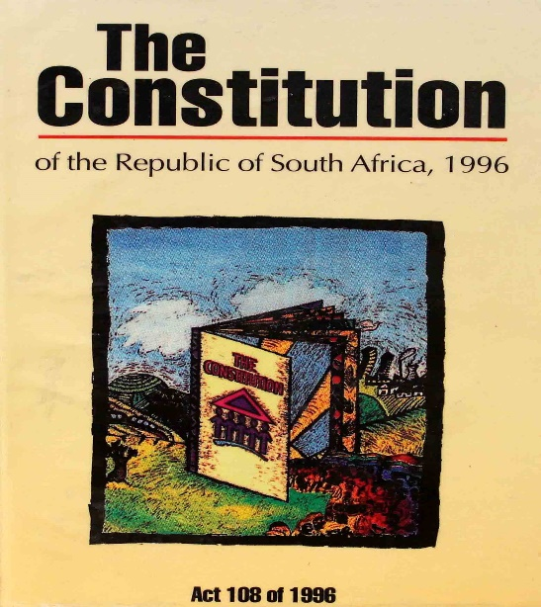
SPEEDING UP OF THE LEGISLATIVE REFORM PROJECT
.
Extent of the legislative reform
The Public Service Commission Act, 1997 is to be repealed and replaced by a new Act with the following amendments:
The PSC is to establish a secretariat to replace the OPSC. This is to ensure that the PSC executes its mandate fully as an independent and impartial constitutional entity.
The OPSC should be removed as a government department in terms of the Public Service Act of 1994 and be moved through a function shift to the PSC as a PSC Secretariat established in terms of the Public Service Commission Act.
Extension of the PSC mandate to Municipalities and Public Entities.
8

Slide 28
SPEEDING UP OF THE LEGISLATIVE REFORM PROJECT
The PSC need to fast track the establishment of the PSC Secretariat. The PSC staff are employees of the PSC. A request be made through the Office MPSA that a proclamation be issued by the President to establish the Office of the PSC as the Secretariat to the Public Service Commission.
PSC Bill sixth draft was finalised and the process of gazetting the Bill should be fast tracked once Cabinet has made a decision.
The PSC Bill will be immediately presented and discussed with other stakeholders such as the Minister of Local Government and Traditional Affairs and SALGA
As a parallel process, the function shift of the OPSC to the PSC as its secretariat may be
implemented once a proclamation is signed by the President and published.
28

Slide 29
Milestones Achieved to Date
Business Case to the PSC Bill was finalised in 2020. PSC Bill draft one to draft six were consulted with various stakeholders and internal staff. Inputs received from stakeholders were built into the sixth draft of the PSC Bill, 2022
PSC Bill sixth draft was finalised and supported by the Chief State Law Advisor in March 2022
Socio Economic Impact assessment of the PSC Bill stage 2 drafted and supported by DPME in May 2022
Cabinet Memorandum and Explanatory Memorandum, Bill and SEIAS submitted to MPSA for support and submission to Cabinet and Cabinet Cluster in August 2022 .
29

Slide 30
WAY FORWARD
The PSC Bill is submitted to the Portfolio Committee for support.
The PSC Bill 2022 will be presented to FOSAD.
The PSC Bill will be submitted to Cabinet for approval of the publication of the PSC Bill in the Government Gazette, for public consultation.
In Parliament, the PSC Bill will be treated as a section 79 of the Constitution Bill, which means the Bill will have to be discussed at the National Assembly and the NCOP as it is a national legislation that affects the functions & competencies of the provinces.
The PSC Bill will assist the PSC with the full implementation of its mandate and the establishment of the PSC Secretariat.
The PSC Bill also has to be referred to the National House of Traditional and Khoi-san Leaders.
The guidance and support of the Portfolio Committee in moving this Bill forward will be appreciated.
30

Slide 31
INTERACTION WITH PROVINCIAL LEGISLATURES TO FAST TRACK APPOINTMENT OF PSC COMMISSIONERS

Slide 32
INTERACTION WITH PROVINCIAL LEGISLATURES TO FAST TRACK APPOINTMENT OF PSC COMMISSIONERS
The Public Service Commission, through the Chairperson, has engaged with the following legislatures regarding the appointment of Commissioners or the renewal of terms of Commissioners:
North-West Provincial Legislature (Renewal of term)
Western Cape Provincial Legislature (Renewal of term)
Mpumalanga Provincial Legislature (Advertising of post)
There are currently three vacant posts for Commissioners:
Gauteng (Process has started and interviews have been conducted).
Mpumalanga (Post has to be advertised)
National (Post has to be advertised).
32

Slide 33
REVIEW OF THE PSC ORGANISATIONAL STRUCTURE TO STRENGTHEN PROVINCIAL CAPACITY
The process to review the PSC organisational structure
is in an advanced stage and the target date to present
a revised structure to the Executive Authority is 3
1 December 2022.
In the meantime the capacity of the provincial offices
has been increased by means of the appointment
of two Interns per provincial office (Except Mpumalanga
where one Intern was appointed).
Additional capacity will also be created by means of the creation of four Assistant Director posts per provincial office additional to the establishment to increase capacity as and interim measure
33

Slide 34
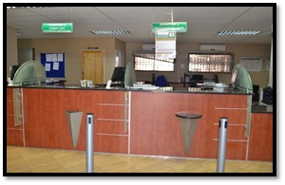
INCREASING PSC REACH THROUGH SERVICE DELIVERY INSPECTIONS
The PSC conducted unannounced inspections at facilities of the Department of Home Affairs (DHA) following numerous reports of long queues (2021/22).
The inspections were conducted at 57 DHA facilities across the nine provinces with specific attention focused on rural, semi-rural and urban as well as the prevalence of similar challenges. This approach was useful as it provided the most representative picture of the daily operations and practices at the service delivery site on that day.
The inspections entailed making observations of the operations and obtaining evidence on the extent to which services were accessible and modernised towards being responsive to the needs of the citizens. This method enabled the PSC to have a first-hand account of the nature of service delivery and customer experience at each site.
34

Slide 35
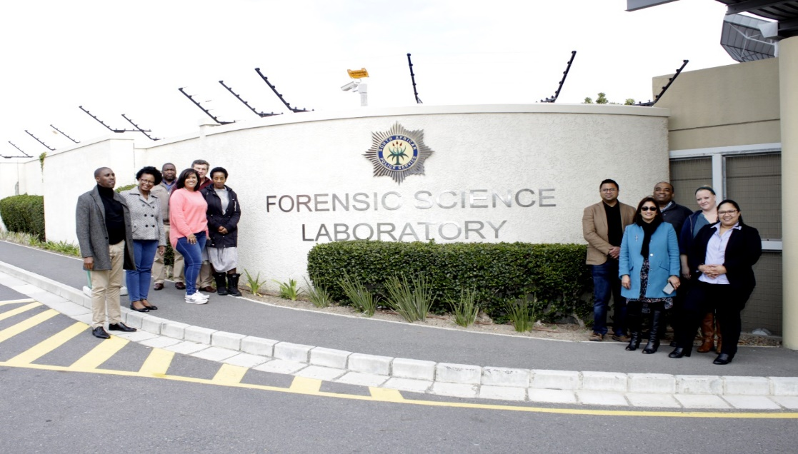
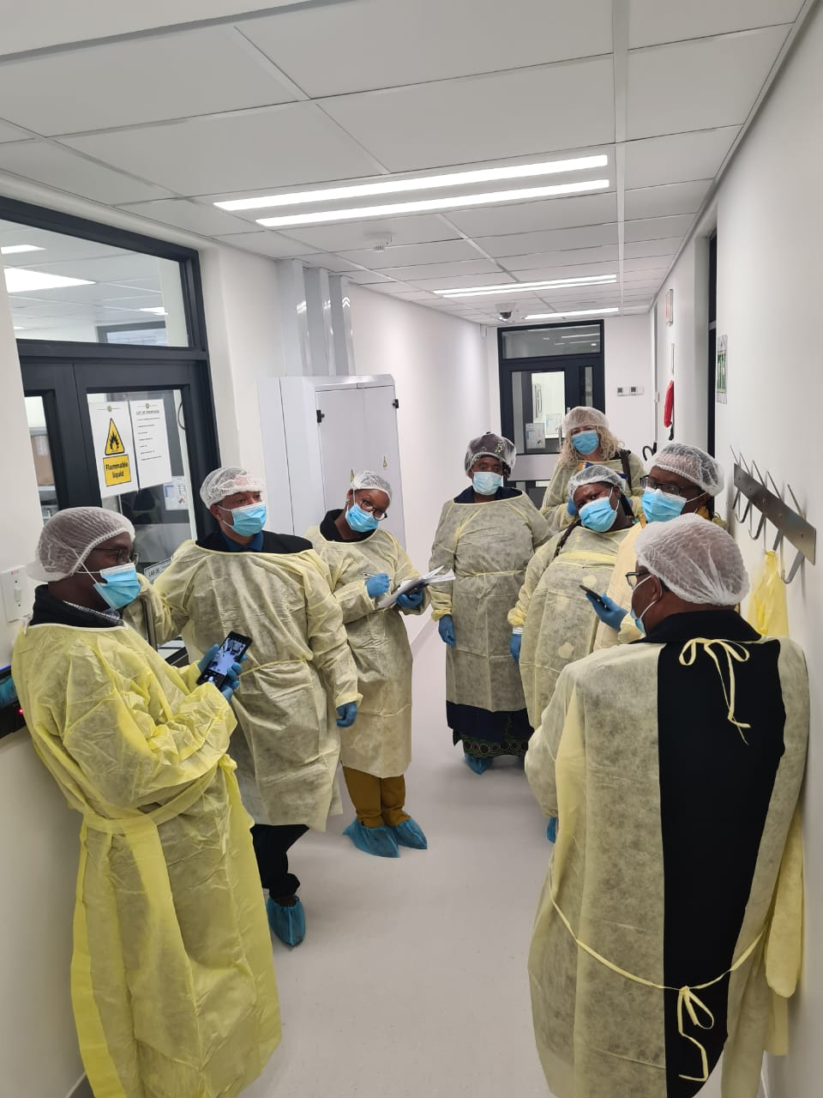
INCREASING PSC REACH THROUGH SERVICE DELIVERY INSPECTIONS
The PSC recently completed inspections in the SAPS Forensic Science Laboratories (FSLs) focused on the effectiveness and efficiency of the FSLs in dealing with the backlogs to improve service delivery to the Criminal Justice System and the public.
35

Slide 36
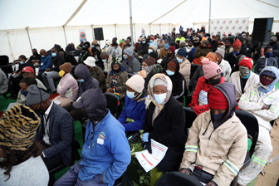
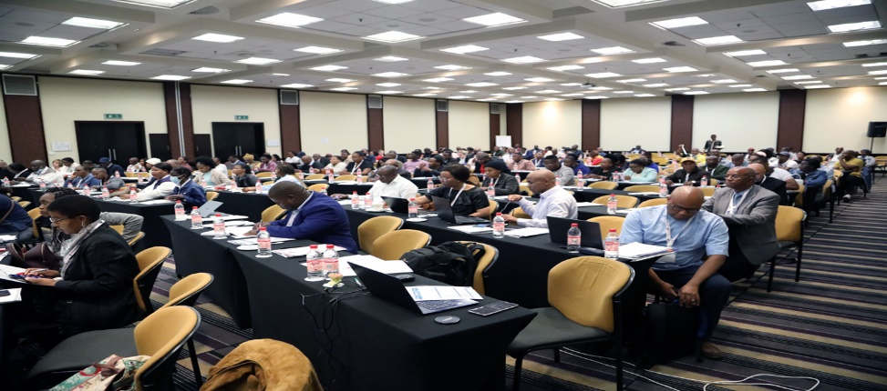
INCREASING PSC REACH THROUGH SERVICE DELIVERY INSPECTIONS
Citizens Forums (CFs) is a process that involves government at all levels working with citizens to identify service delivery challenges and propose practical measures to unlock blockages toward improved service delivery. The PSC commenced with its community engagements in October 2021 at the Link Location in Mthatha.
PSC is conducing Citizens Forums in all nine provinces currently (2022/23). During Q1&Q2 Citizens Forums were conducted in
Setlagole Village (North West) on 22 June,
Pretoria (Gauteng) on 13 Sept and at
Klein Mier in the Dawid Kruiper Municipality (Northern Cape) on 22 Sept.
36

Slide 37
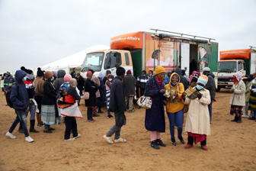
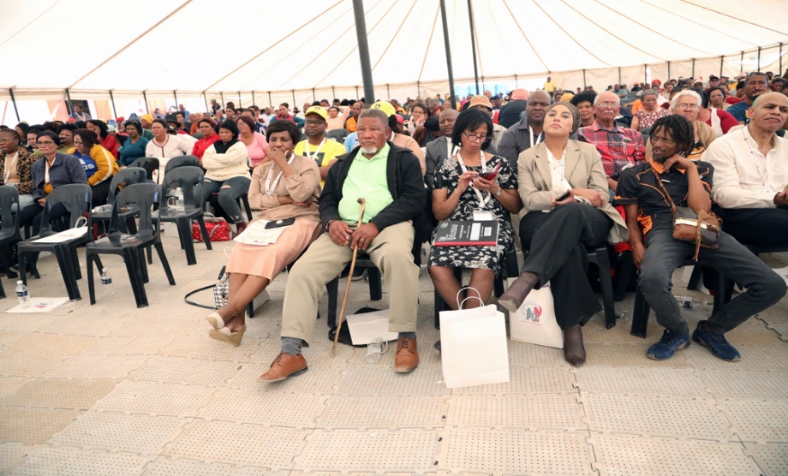
INCREASING PSC REACH THROUGH SERVICE DELIVERY INSPECTIONS
PSC will be conducting 6 more CFs during the last 2 quarters, these will be held in
Ilembe District Municipality in KZN and Bloemfontein in the Free State, in Nov (Q3)
Eastern Cape, Limpopo, Mpumalanga and Western Cape.
37

