Slide 1
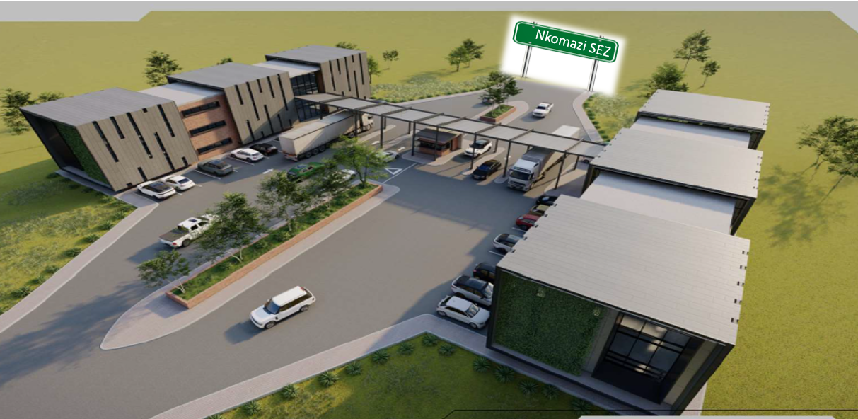


Slide 2


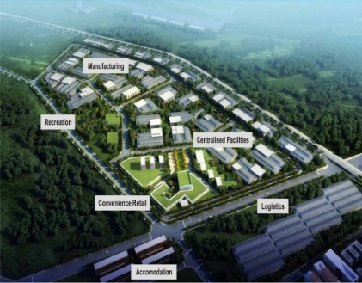
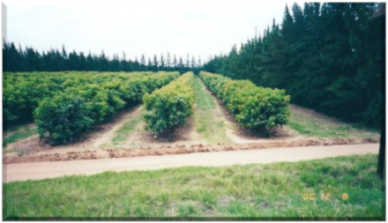
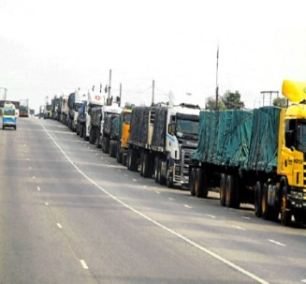

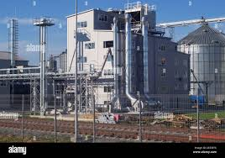
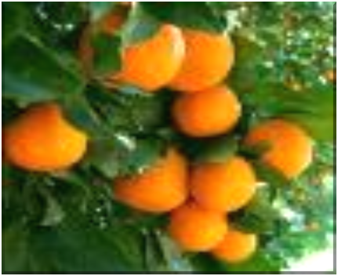

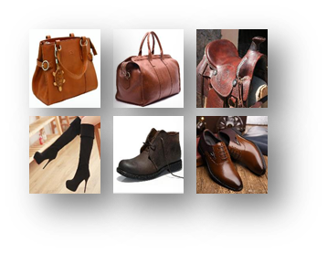

NKOMAZI SPECIAL ECONOMIC ZONE
PROGRESS REPORT
10 October 2022

Slide 3

CONTENT
Nkomazi Special Economic Zone (SEZ)
SEZ implementation process: progress achieved to date
SEZ Interim Phase : Key Activities on Critical Path
Investment Pipeline
Risk & Mitigation
2022/23 Priorities
Recommendations
1

Slide 4

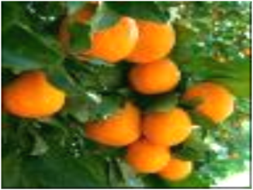


Introduction to Nkomazi Special Economic Zone

Slide 5
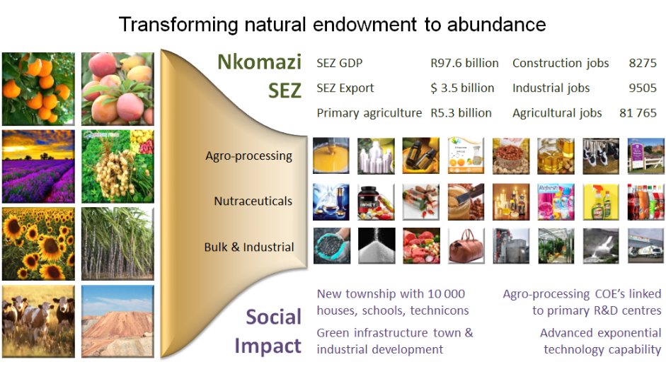
SEZ strategic intent
3

Slide 6
Nkomazi SEZ Establishment Phases
Phase | Description | Key Activities
Phase 1 | Designation Phase | Pre-feasibility Feasibility Designation
Phase 2 | Interim Phase | Setup of SEZ Entity (& operationalization of the entity) Satisfy all statutory requirements Finalise all civil engineering detailed designs
Phase 3 | Development Phase | Physical development of the Nkomazi SEZ
4

Slide 7
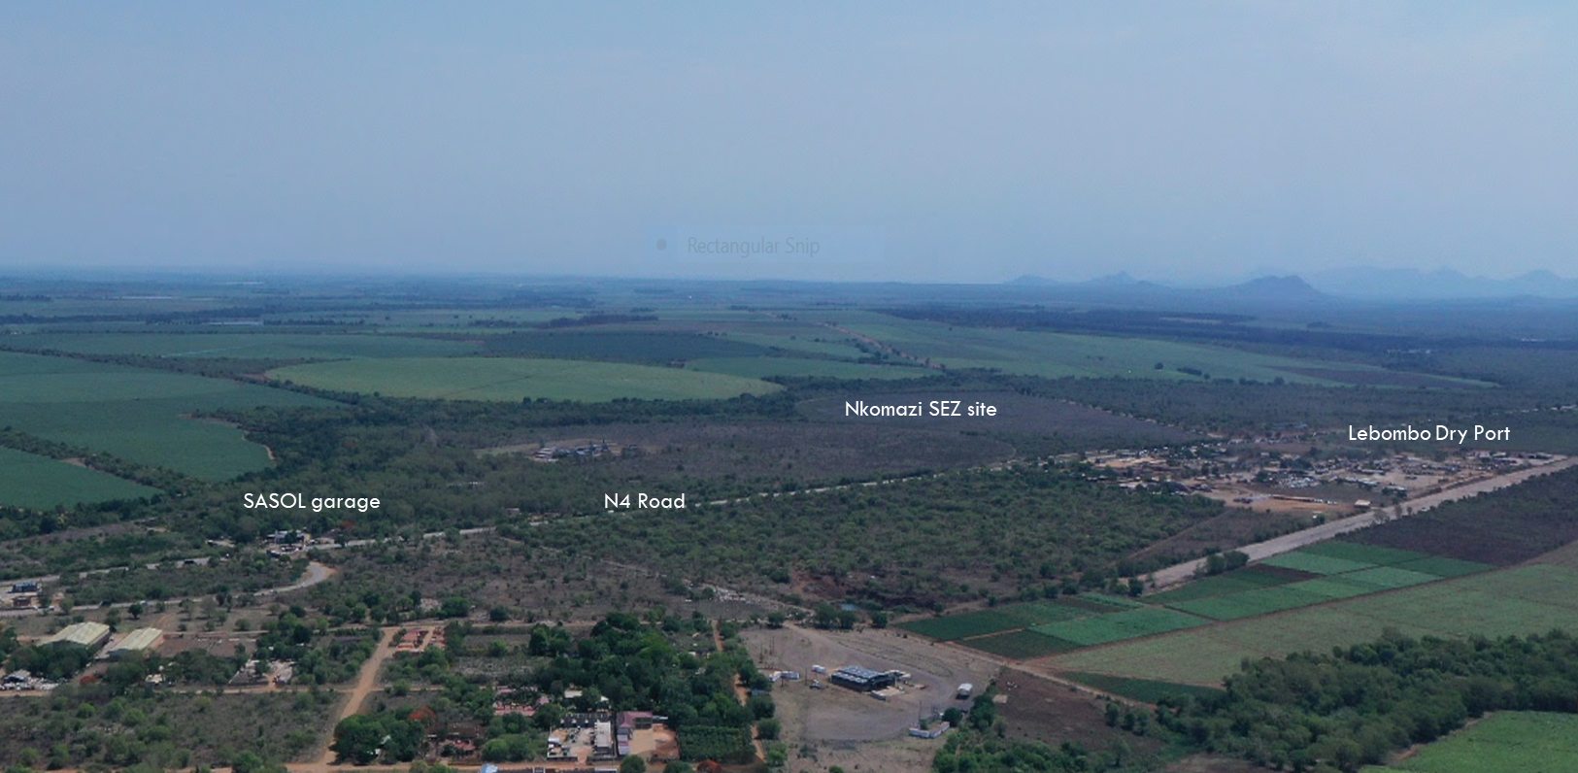
Nkomazi SEZ site
5

Slide 8
SEZ Implementation Process:
Progress Achieved to date

Slide 9
SEZ ENTITY AND GOVERNANCE
Nkomazi Special Economic Zone designation gazetted on the 22nd of March 2019;
Nkomazi SEZ Entity registered as State Owned Company in Jan 2021and a stand-alone Entity;
MEC appointed a six member Interim SEZ Board in March 2021, (3x Dtic; DEDT; Nkomazi and Ehlanzeni municipalities with One (1) member each);
PMU of three members appointed immediately after designation and Acting CEO and CFO seconded to the Entity in July 2021 to strengthen the PMU;
Institutional Arrangements have been put in place to assist in the implementation of the SEZ programme (i.e. Political Oversight; Steering Committee and Rapid Intervention Task Team);
Nkomazi SEZ Five-Year Strategy already in place.
7

Slide 10

TOWNSHIP ESTABLISHMENT AND LAND PREPARATION
A fifty-year (50) Land Lease Agreement between SEZ Entity & Nkomazi municipality already in place;
Change of Land Use in support of the SEZ approved by DAFF;
Environmental Authorisation for the identified site already in place(i.e. 673 ha, Portion 58, Komatipoort Townlands 182 JU), however with Conditions of Establishment;
Site Layout Plan for Township Establishment approved by municipality and at final stage of registration with the office of the Surveyor General;
Preliminary designs of internal infrastructure already done and commencement of detailed designs underway;
Nkomazi SEZ part of municipal Spatial Development Framework and Komatipoort Precinct Plan.
8

Slide 11
SEZ INTERIM PHASE:
Key Activities on Critical Path

Slide 12
Corporate Governance issues
Key Focus Area | Current Status | Recommendation
SEZ Entity registration | SEZ Entity registered with CIPC as SOC (as contemplated in section 1of the PFMA) and a stand-alone Entity in Jan 2021 | SEZ Entity to be registered with CIPC as SOC (as contemplated in section 1of the PFMA) and subsidiary of MEGA
SEZ Entity ownership | DEDT MEC is the licensee/shareholder (as per the SEZ Act) | DEDT MEC remains the licensee/shareholder of the SEZ Entity
Appointment of Board members | DEDT MEC appoints the SEZ Board (as per the SEZ Act) | DEDT MEC, as the licensee, to proceed to appoint the SEZ Board as per SEZ Act, however, ensures all Parties are represented in the Board
SEZ Corporate Governance Model | SEZ Interim Board in place. Acting CEO and Acting CFO seconded to SEZ to strengthen the existing PMU | Quadripartite Governance Model to be pursued – new approach to drive the implementation of the national SEZ Strategic Framework
SEZ Entity listing with national Treasury | Not listed as schedule 3-D company with National Treasury as yet due to National Treasury not supporting addition of more new schedule 3-D SEZs | Nkomazi SEZ to be registered as a subsidiary of MEGA since MEGA is already a schedule 3-D Entity. This will shorten the listing process with National Treasury
10

Slide 13
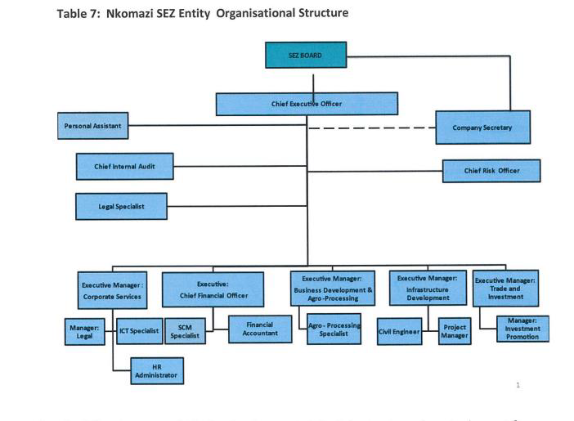
The approved Organisational Structure
Organisational Structure for the SEZ Entity completed and ready for implementation;
Job profiles and Job grading for 20 posts completed;
Recruitment Plan activated
11

Slide 14
Township Establishment
CONDITION | PROGRESS TO DATE
To have Township establishment registered prior commencement of development | Township Establishment at final stage of approval, however, opening of Township Register and proclaiming Nkomazi Township could only happen once the Right of Way Servitude has been obtained from the new private owner
12

Slide 15
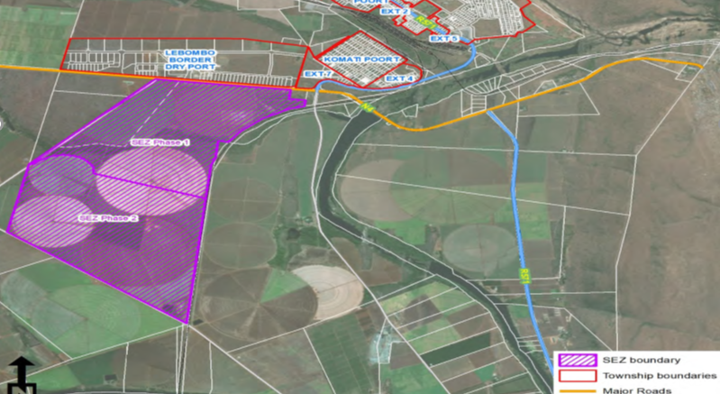
Nkomazi SEZ site
300 ha
SEZ Phase 1
373 ha
SEZ Phase 2
13

Slide 16
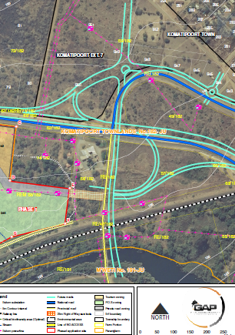
Right of Way Servitude
CONDITION:
Secure Right of Way Servitude from SASOL to access the SEZ site
PROGRESS TO DATE
  SASOL has alienated the land to private owner. Engagement with the new owner and Sasol on the Servitude matter underway.
Servitude
14

Slide 17

Water Use Licence Application
CONDITION:
A Water Use License must be obtained prior to any development taking place. (WULA Application)
PROGRESS TO DATE
Service Provider already appointed to conduct detailed engineering designs - a requirement for the application of the Water Use Licence. Work expected to be completed within 3 months (December 2022) and thereafter the application will be lodged with the Department of Water and Sanitation for approval. The Komati Water Basin Authority is also participating in this to ensure compliance with requirements
15

Slide 18
Detailed Engineering Designs
CONDITION:
The township owner shall, at its costs and to the satisfaction of the Municipality, design, provide and construct all engineering services.
PROGRESS TO DATE
Preliminary designs of internal infrastructure done and procurement of professionals to conduct detailed civil engineering designs already underway (i.e. detailed designs of water infrastructure; storm water drainage; sewer infrastructure; sewer treatment facility and access roads to the site)
16

Slide 19
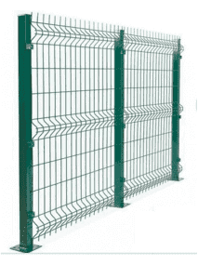
Physical Barrier fence/wall
CONDITION:
Physical barrier made out of CLEARVU fence or similar must be erected to the satisfaction of SANRAL and TRAC
PROGRESS TO DATE:
The National PMU assisted to rework the required Specifications and procurement process of a service provider already underway (Currently at Evaluation Stage of Bid) and erection of fence to commence in Q3 of the current financial year
17

Slide 20
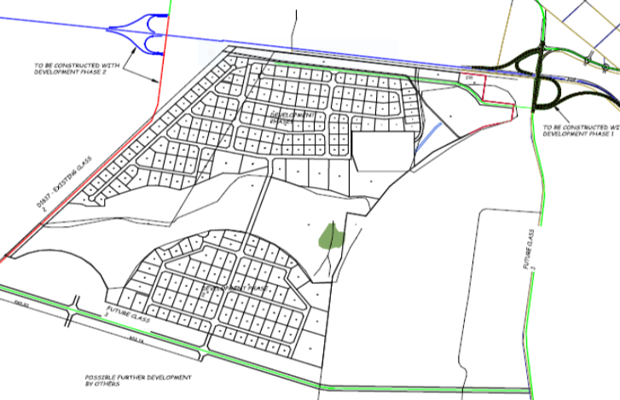
Upgrading N4 Interchange
CONDITION:
Any access regarding the ingress and egress to the proposed township is only permitted from the link of the upgraded N4 interchange
PROGRESS TO DATE
An additional Detailed Traffic Impact study has already been completed and;
The report of the study will be used to engage SANRAL and TRAC, requesting both parties to grant permission to the SEZ Entity to access its site and proceed with site establishment activities.
18

Slide 21
Action Plan
No. | Delivery milestones | Jul 2022 | Aug 2022 | Sept 2022 | Oct 2022 | Nov 2022 | Dec 2022 | Jan 2023 | Feb 2023 | Mar 2023 | Progress to date
 | Corporate Governance
 | Approval of Nkomazi SEZ as subsidiary of MEGA (MEC, EXCO, MEGA and SEZ Board) |  |  |  |  |  |  |  |  |  | Honourable MEC approved amendment, however discussions to be finalized on with Dtic on specific roles of the shareholder, MEGA and SEZ Entity
2. | Registration of Nkomazi SEZ with CIPC as subsidiary of MEGA
3. | Listing of SEZ Entity with National Treasury (as schedule 3D company)
4. | Appointment of SEZ Board in terms of the SEZ Act (from advertisement to appointment)
 | Township Establishment
5. | Right of Way Servitude on SASOL land resolved |  |  |  |  |  |  |  |  |  | SASOL has already alienated the land to a private owner and engagement have already commenced with the new owner.
6. | Opening of Township Register and proclaiming Nkomazi SEZ as Township
 | Water Use Licence Application
7. | Appointment of Service Provider for detailed engineering designs of Water Use infrastructure |  |  |  |  |  |  |  |  |  | ECA Consulting appointed and work has commenced.
8. | Conduct detailed engineering designs on water and Water Treatment Plant
9. | Lodging of Water Use Licence Application with the Department of Water Affairs and the processing thereof (i.e. processing and issuing of the Water Use Licence)
19

Slide 22
Action Plan
 |  | Jul 2022 | Aug 2022 | Sept 2022 | Oct 2022 | Nov 2022 | Dec 2022 | Jan 2023 | Feb 2023 | Mar 2023 | Progress to date
 | Barrier Fence/wall
10. | Appointment of Service Provider for the construction of the barrier fence |  |  |  |  |  |  |  |  |  | Procurement process on course and appointment will be effected by October 2022
11. | Construction of the barrier fence
 | Land Preparation for development
12. | Transfer Land Lease Agreement between MEGA and Nkomazi Municipality to Nkomazi SEZ Entity as per clause 27 (1) of the Agreement |  |  |  |  |  |  |  |  |  | Required transfer documentation already submitted for approval by MEGA Board.
13. | Appointment of Service Provider for detailed engineering designs of internal infrastructure services (water, storm water drainage; sewer; sewer treatment facility and access roads to the site) |  |  |  |  |  |  |  |  |  | Agreement reached with DBSA to utilize their Panel for implementation of contract. Required documentation being exchanged for effecting appointment by October 2022
14. | Conduct detailed engineering designs on internal infrastructure services
 | Access road to SEZ site
15. | Conduct additional Traffic Impact Assessment study |  |  |  |  |  |  |  |  |  | Additional Traffic Impact Assessment study has been completed
16. | Engaging SANRAL and TRAC on permission to access the SEZ site in the short-term to medium term |  |  |  |  |  |  |  |  |  | Negotiations with SANRAL has already commenced to allow site establishment.
17. | Development of a programme for the construction of the N4 interchange road
20

Slide 23
Investment Pipeline

Slide 24
Investment Pipeline: Eight (8) stages
No. of investors to date:
12 x Investors attracted in areas of Energy, Logistics, Agro-Processing sectors
8
7
Appeal /Investment Facilitation & Aftercare
SEZ Board
Approval / Rejection
6
5
SEZ EXCO
Recommendation
1
4
SEZ Legal unit due diligence
DP World
3
Multi -Stakeholder Evaluation
Investor Pre-Screening
Meeting
1
2
Vutomi Energy
1
Initiation Meeting
3
Biodegradable Sa
Kase Group
InovaSure
Referral or approached investor
5
Agrowex Industries
Nkomazi Energy
Sangari South Africa
African Eden Projects
Sanaha
2
22
AgriMarine Industries
Feggy Essential Oils

Slide 25
List of Potential Investors
No: | Investor | Area of Investment | Est. Value of Investment (R) | Estimated No. of Jobs | Stages
1 | DP World | Logistics | R363 m | 1000 | stage 7
2 | Biodegradable SA | Agro-processing | R650 m | 10 000 | stage 5
3 | Kase Group | Agro-processing | R130 m | 60 | stage 5
4 | Vutomi Energy | Green Energy | R8 b | 500 | stage 6
5 | InovaSure | Green Energy | R29 b | 5000 | stage 5
6 | Agrowex Industries | Agro-processing | R100 m | 180 | stage 4
7 | Nkomazi Energy | Green Energy | R220 m | 50 | stage 4
8 | Sangari South Africa | Green Energy | R280 m | 600 | stage 4
9 | African Eden Projects | Agro-processing | R1 b | 15 000 | stage 4
10 | Sanaha | Agro-processing | R8 b | 10 000 | stage 4
11 | AgriMarine Industries | Agro-processing | R250 m | 1500 | stage 3
12 | Feggy Essential Oils | Agro-processing | R100 m | 120 | stage 3
TOTAL |  |  | R 48, 533 b | 43 410
23

Slide 26
  Projects approved by SEZ Board

Slide 27

DP World Dry Port Project
SUPPORT REQUIRED | PROGRESS TO DATE
Objective: Establishment of inland port to handle cargo containers and bulk materials transport through transshipment of road cargo to rail (intermodal logistical Hub to handle export and import of commodities from Komatipoort to Maputo Harbour): Required assistance: Facilitation of Land Availability Agreement between DP World and Nkomazi SEZ Entity; Rezoning of selected site for the project; Obtaining of Environmental Authorisation; Facilitation of negotiation between DP World and Transnet regarding the construction of the Rail Siding | Land Availability Agreement being finalised with the assistance of the National PMU; Required Environmental Authorization processes already commenced Procurement process of Town Planner completed. Work to commence in October 2022 Negotiations between Transnet and DP World about the proposed rail siding already facilitated by national PMU
25

Slide 28
Project Layout Plan: Phase 1 Operations
26

Slide 29
  Risks and Mitigation

Slide 30
Risk and Mitigation
DEVELOPMENT PHASE | KEY RISK | MITIGATION ACTIVITIES
Physical Development of the Nkomazi SEZ | SEZ Entity not fully capacitated and affecting SEZ implementation plan. | Appointment of full time Board and functional SEZ structure in place (vacant positions filled)
 | Slow pace of implementing the bulk infrastructure development programme to accommodate potential investors | Access to adequate funding and securing the requisite engineering capacity.
 | Ability to support SMME’s to participate in SEZ agro processing value chain on a commercial basis | Develop a well resourced and integrated support plan for SMME’s and small holder farmers.
 | Lack of water for irrigation expansion to support mass agricultural production. | Construction of Mountain View Dam and roll out of efficient irrigation systems.
 | Non alignment of trade policies with neighbouring countries (e.g. Eswatini and Mozambique) hampers free flow of agricultural produce across borders. | Engage Dtic and DALRRD to review and align existing trade policies.
28

Slide 31
Stakeholder Engagements
Economic Cluster | Stakeholder | Roles and responsibility
Agro-processing | Organized Agriculture | Participate in and liaise with the SEZ Entity around agro-processing opportunities within the zone
 | Commodity groups and associations | Participate in and liaise with the SEZ Entity around socio- economic development matters within the zone
 | Dept of Agric, DRDLR, Rural Develop, DFI, Dept of Education, Research Institutions, SARS, Customs | Policy direction, implementation of programmes and attraction of foreign investments Support and provide an enabling economic environment
 | Tribal Authorities | Access and allocation of available land
 | Nkomazi Community/Nkomazi Local Municipality and District Municipality | Participate in and liaise with the SEZ Entity around socio- economic development matters
Infrastructure | Public and private Funding Institutions, SANRAL, Transnet, TRAC, Dept of Public works, Eskom, Dept of Water and Sanitation | Co-fund the infrastructure requirements of the Nkomazi SEZ Assist in the planning, design, and construction of specific infrastructure elements (e.g., N4 interchange, railway siding inside the SEZ)
Logistics | TRAC, Transnet, Dry Port, KMIA, Dept of Transport, Dept Home Affairs, | Assist the SEZ Entity in realising its infrastructure and operational aspirations
29

Slide 32
  2022/23 Priorities

Slide 33
2022/23 Annual Targets
Nkomazi SEZ Entity with sound organisational governance; positive organisational culture and institutionalised business processes established;
Value of R 6 billion from the indicative investment pipeline converted into successful investment;
SEZ Marketing Plan and compelling agro-brand developed and adopted;
Agricultural produce supply chains to the SEZ of established businesses developed and intensified;
Comprehensive support of the SMME’s and Black Industrialists in the agro-processing value chain provided;
SEZ Infrastructure Development Programme developed
31

Slide 34
FUNDING REQUIREMENTS:
 | Phase 0 | Phase 0 | Phase 1 | Phase 2 | Phase 3 | Sum Total
Perimeter Fencing and Entrance Gate |  | 40 000 000 | 6 480 000 |  | 4 720 000 | 11 200 000
6Ml Water Treatment Works | 2Ml WTW | 20 000 000 | 53 275 850 | 31 585 850 |  | 84 861 700
Raw Water Pump station |  |  | 2 500 000 |  |  | 2 500 000
20Ml Bulk Storage reservoir | 5Ml Storage | 10 000 000 | 32 501 011 |  |  | 32 501 011
5Ml Wastewater Treatment Works | 1.5Ml WWTW | 18 000 000 | 59 604 380 | 39 428 550 |  | 99 032 930
Water Reticulation Network |  | 3 543 163 | 5 905 271 | 669 340 | 890 796 | 7 465 407
Sewer Reticulation Network |  | 3 271 494 | 5 452 490 | 3 162 195 | 3 496 445 | 12 111 130
Sewer Pump stations |  | 0 | 0 | 5 116 000 | 5 116 000 | 10 232 000
Stormwater Infrastructure |  | 7 100 741 | 11 834 569 | 5 161 875 | 12 229 891 | 29 226 335
Access Roads |  | 32 416 330 | 54 027 216 | 22 435 544 | 40 879 896 | 117 342 656
New N4 Fly-over Interchange |  | 45 215 460 | 45 215 460 |  |  | 45 215 460
Ngweti River Bridge Crossing |  |  |  |  | 22 500 000 | 22 500 000
Electricity Infrastructure |  | 18 000 000 | 30 000 000 | 70 000 000 |  | 100 000 000
SUB-TOTAL |  | 197 547 188 | 306 796 247 | 177 559 354 | 89 833 028 | 574 188 629
Allow for 10% Contingencies |  | 19 754 719
SUB-TOTAL |  | R217 301 906
Professional & Specialist Fees @ 14% |  | R30 422 267
SUB-TOTAL |  | R247 724 173
VAT @ 15% |  | R37 158 626
TOTAL INCLUDING VAT |  | R284 882 799
TOTAL COST OF PHASES |  | R 1 433 260 057
2022/23 Budget
Goods and Services |  | 23 000 000
Transfers |  | 12 000 000
Capital Payments |  | 29 949 000
TOTAL |  | R 64 449 000
19
32

Slide 35
Recommendations
It is recommended that the Portfolio Committee note the progress report on the Nkomazi SEZ
33

Slide 36

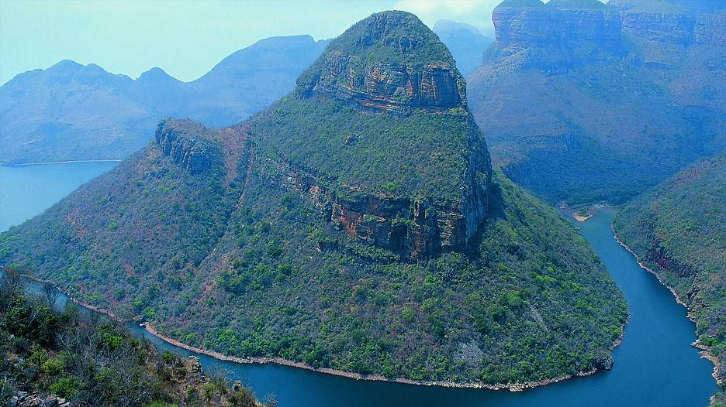
THANK YOU

