Slide 1
Nedlac
Annual Report
2021/22

Slide 2
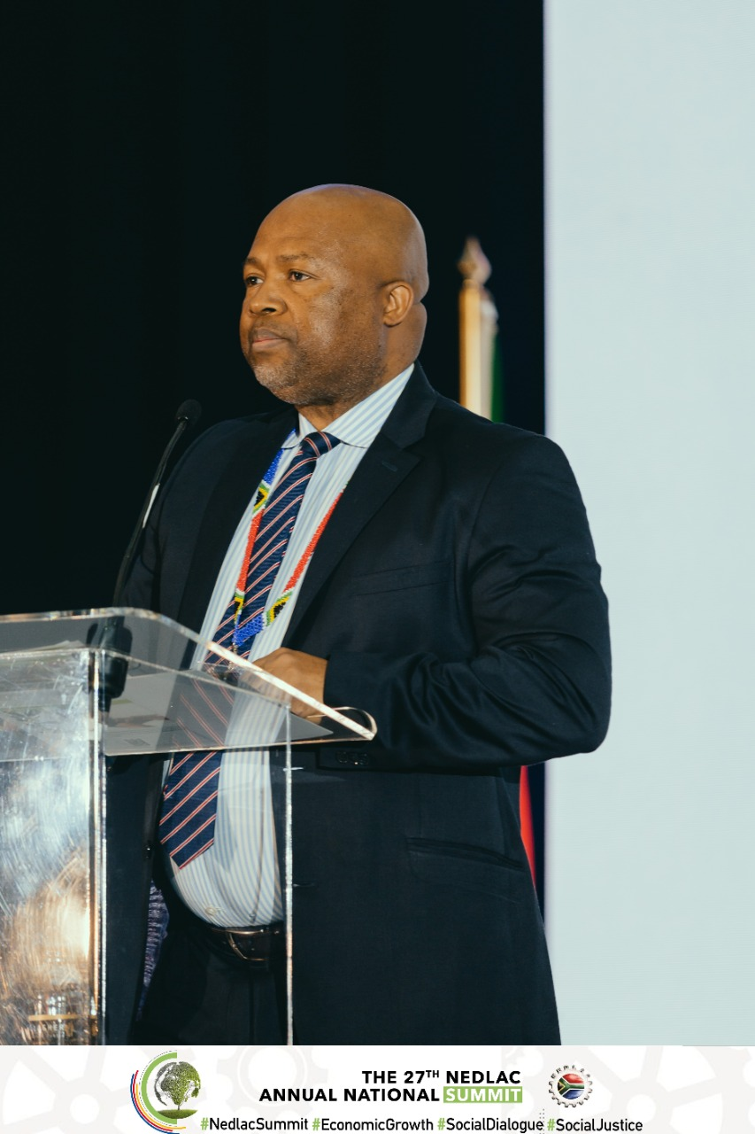
Agenda
Performance
Economic recovery
Covid-19 pandemic
Social dialogues
Inputting into legislation and policy
Progress on making Nedlac fit for purpose
Financial performance
Audit outcomes

Slide 3
year
Performance 2021/22 Financial Year

Slide 4
Performance indicators
Programme | No of indicators | No achieved | Not achieved | % achieved
Administration | 8 | 5 | 3 | 60%
Programmes | 4 | 3 | 1 | 75%
Capacity building | 3 | 2 | 1 | 60%
TOTAL | 15 | 10 | 5 | 66%

Slide 5
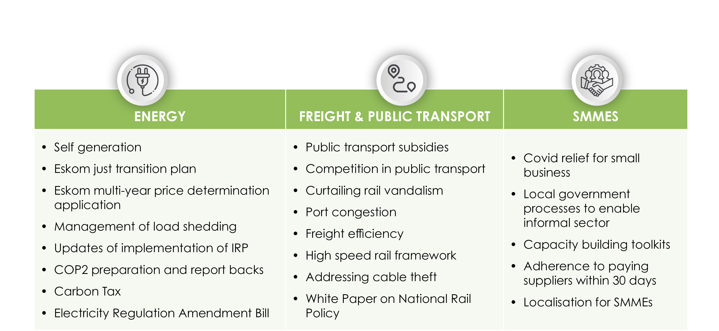
Implementation of the ERRP
The focus was on information sharing and engagement in the following areas:

Slide 6
Responding to the Covid-19 Pandemic
Prevention of Covid-19 transmission | Vaccination programme | Mitigating impact on economy and relief
Active monitoring, information sharing to respond to the changing science and circumstances Promotion and/or review of non-pharmaceutical interventions including masks, gatherings, social distancing, curfews, restrictions on travel, alcohol, etc Directions, Regulations and Code on the management of Covid in the workplace | Delivery of vaccine partnership by B4SA Mobilisation for vaccines including All of Society Commitment Communication and behavioural change interventions Consideration of incentives and (vaccine certificates, attending of larger events) Promotion of vaccine mandates in workplaces | Oversight over Covid-19 social relief of distress grant Motivating for and oversight over Social Relief of Distress Grant, school feeding Motivating for appropriate opening up of tourism, hospitality, events

Slide 7
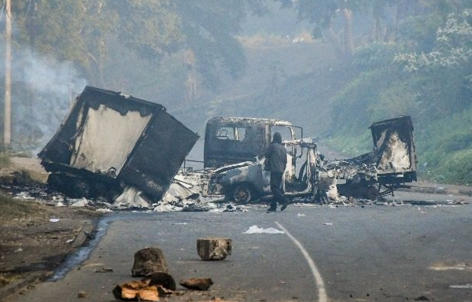
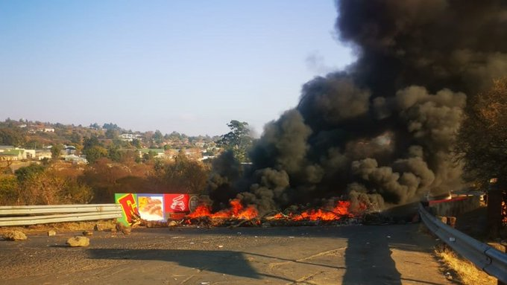
Response to July 2021 Public Violence
Nedlac social partners called for, and worked with, government on:
Stabilisation through increased presence of law enforcement
Securing essential infrastructure and supplies especially between Gauteng and KZN
Relief and support including:
Extending the SRD grant
Food parcel distribution (Solidarity Fund)
Introducing WABU grant by UI for workers who could not work due to companies not working
Relief for uninsured and inadequately insured businesses
Building an active citizenry to defend lives and livelihoods

Slide 8
Social Dialogues
Date | Topic | Highlight
2/7/21 | Government Budget Planning | National Treasury
3/09/21 | Critical Skills List | Dept. of Higher Education and Dept. of Home Affairs
17/09/21 | National Infrastructure Plan 2050 | Infrastructure SA
30/09/21 | Anti-corruption | Dept. Public Service and Administration
29/10/21 | Green Economy Interventions | Dept. Forestry, Fisheries and Environment Dept. of Public Works and Infrastructure
30/11/2 | National Labour Migration Policy and Employment Services Amendment Bill | Dept. Employment and Labour
2/12/21 | Gender Based Violence and Femicide and ILO Convention 190 | Dept. of Women, Youth and Persons with Disability
8/12/21 | Financial Sector Inclusion Policy | National Treasury
4/02/22 | Briefing on forthcoming national census | Statistics SA

Slide 9
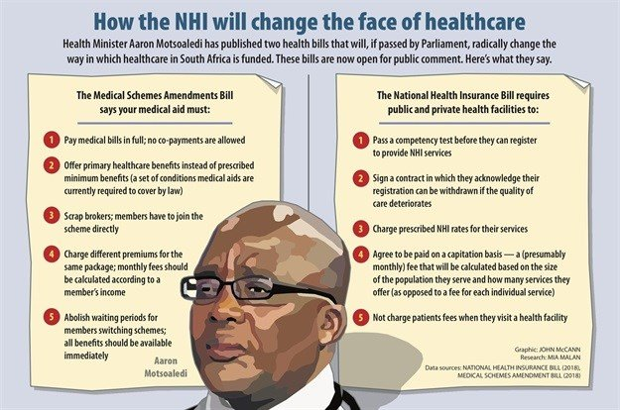
Inputting on Policy and Legislation
Completed reports on legislation
Policy | Department | Date
National Youth Development Amendment Bill | Dept. of Women, Youth and Persons with Disabilities | 18/05/21
National Health Insurance Bill | Dept. of Health | 29/07/21
Central Application Bill | Dept. of Basic Education | 8/10/21
Companies Amendment Bill | Dept. of Trade, Industry and Competition | 15/10/21

Slide 10
Inputting on Policy and Legislation
Completed reports on policy and regulation
Policy | Department | Date concluded
Official Identity Management Policy | Dept. of Home Affairs | 7/7/21
Green Paper on Comprehensive Social Security and Retirement Reforms | Dept. of Social Development | 5/8/21
AARTO Regulations | Dept of Transport | 26/11/21
Critical Skills List | Depts of Home Affairs & Higher Education | 21/12/21
Code of Good Practice on Prevention and Elimination of Harassment in the Workplace | Dept. of Employment and Labour | 11/2/22
Skills Strategy to support the successful implementation of the ERRP | Dept. of Higher Education and Training | 18/2/22
One Stop Border Post Policy | Dept. of Home Affairs | 18/2/22

Slide 11
Inputting on Policy and Legislation
Policy and legislation not completed by the end of financial year
Policy or legislation | Department
Social Development White Paper | Dept. of Social Development
Electronic Deeds Registration Amendment Bill | Dept. of Rural Development and Land Reforms
National Council on Gender-Based Violence and Femicide Bill | Dept. of Women, Youth and Persons with Disabilities
Labour Law Reforms Task Team (amendments to BCEA, LRA and other labour laws) | Dept. of Employment and Labour
Conduct of Financial Institutions Bill | National Treasury

Slide 12
Activities of Section 77 Standing Committee
Two notices were concluded:
A new draft Code of Good Practice on Protest Action to Promote or Defend the Socio-economic Interests of Workers
Key changes include:
Clarifying the roles and responsibilities of the Standing Committee, facilitators and other forums
Clarifying the timelines applicable to different processes once an application is made
Alignment with recent case law and ILO guidelines.
Matter | Applicant | Time period to consider
Violent Crimes in the Western Cape | COSATU in Western Cape | 11/9/18 – 3/6/21
Defence and Promotion of the Socio-Economic Interests of Workers and Working Class in General | SAFTU | 28/09/21– 13/4/21

Slide 13
Other Activities
What | Details
Research reports on Comprehensive Social Security and Retirement Reforms | The following research reports were summarised and consolidated into a single report for public dissemination: Feasibility of a basic income grant Impact on the investment environment of a national social security fund Economies of scale and costs within the occupational retirement system Actuarial assessment of a national social security fund
Expanded Public Works Programme study tours | The Development Chamber undertook study tours as part of their oversight work to Western Cape, North West and Limpopo in March 2022
Decent Work Country Programme | Steering Committee, co-ordinated by Nedlac engaged on a number of matters including informal work, skills, forced labour in the fishing sector and future of work
Demarcation disputes | Demarcations Standing Committee considered 16 awards from the CCMA
National Student Financial Aid Scheme (NSFAS) | A task team was established to engage on the progress made on new funding mechanisms for students. DHET is still to revert
Anti corruption working group | Developed a roadmap to support the implementation of the National Anti-Corruption Strategy including commitments from social partners.

Slide 14
Organisational Improvements
Financial Performance
Unqualified audit
Improved SCM Turnaround Times
Condonation of previous year’s irregular expenditure
Internal policy and strategy
Finance, risk and ICT policies revised
Communication strategy developed and implemented
Human Resources
New Organogram
Emerging issues unit
Employment of new staff
Revised renumeration structure
Capacity building and training
Study support and coaching for staff
Increased budget allocated to social partners for capacity building – however not utilised

Slide 15
Governance Task Team progress
Arising out of research and deliberations of the Governance Task Team, Exco agreed that the Task Team should proceed to consider amendments to the Nedlac Act, Constitution and protocols which will address:
Proper incorporation of the new work of Nedlac such as the ERRP and rapid response task teams into the Constitution and an increased focus on capacity building
Improved process to manage representivity
Streamlined governance processes of Manco and Exco
Updated processes of considering legislation and policy.
This work is ongoing.

Slide 16
Financial performance & Audit outcomes

Slide 17
Summary of statement of financial performance
Financial Performance data | Actual amount for 2020/21 | Actual amount for 2021/22 | Variance
Revenue from exchange and non- exchange transactions
Other operating revenue | R 94 295 | R 30 866 | (R 63 429)
Interest received - investment | R 1 146 839 | R 1 385 075 | R 238 236
Government grants | R 58 303 497 | R 59 093 000 | R 789 503
Total Revenue from exchange and non- exchange transactions | R 59 544 631 | R 60 508 941 | R 964 310
Personnel costs | R 28 272 595 | R 28 587 708 | (R 315 113)
Goods and services | R 17 328 371 | R 27 347 377 | (R 10 019006
Total expenses | R 45 600 966 | R 55 935 085 | (R10 334 119)
Surplus | R 13 943 665 | R 4 573 856 | (R 9 369 809)

Slide 18
Breakdown per programme
Programme | Annual budget 2021/22 | Actual expenditure 2021/22 | Variance
Programme 1: Administration | R 37 504 000 | R 42 059 000 | R 4 555 000
Programme 2: Core operations | R 17 529 000 | R 10 716 000 | R 6 813 000
Programme 3: Capacity building | R 4 937 000 | R 3 160 000 | R 1 777 000
Total | R 59 970 000 | R 55 935 000 | R 4 035 000

Slide 19
Audit outcomes
Nedlac received an unqualified audit outcome for the 2021/22 financial year from the Auditor General of South Africa.
Findings were noted on:
Misstatements on the annual financial statements that were corrected
Expenditure Management. Fruitless and wasteful expenditure amounting to R31 716.
To address the findings, we will:
Update ourselves on compliance with laws and regulations to avoid repeat findings
Ensure financial statements are prepared in accordance with the requirements of the Generally Recognised Accounting Practice (GRAP).

