Slide 1
annual performance REPORT (2021/22) Presented to the PORTFOLIO Committee ON Social Development 12 OCTOBER 2022

Slide 2
PURPOSE
To present the Annual Report for the NDA 2021-22 financial year Annual Report to the Portfolio Committee on Social Development, comprising of the following parts:
Programme Performance Information (Part B); and
Annual Financial Statements (AFS) for year ended March 31, 2022 (Part E).
Audit outcomes for the 2021-22 financial year.

Slide 3
NDA CONTEXTUAL ANALYSIS OF THE YEAR UNDER REVIEW
The year under review had both challenges and successes indicating the resilience of the NDA, these can be summarised in the following points:
The NDA Board’s term came to an end on 30 June 2022;
The Audit and Risk Committee had to be properly re-constituted to ensure it performs its functions in the absence of the Board;
The former CEO’s term of office came to end on the 31 October 2021;
The gaps created by the absence of these accountability functions created governance challenges;
To respond to these governance challenges, the Executive Authority appointed the Acting CEO from 01 November to date; and the Acting CEO was thereafter appointed to be the Interim Accounting Authority and was approved by the National Treasury in December 2021
The year under review also marked the start of the NDA turnaround strategy which is towards approval processes by the Board and the Executive Authority to open the way for its full implementation
The NDA for the first time, successfully submitted a request for condonation of R98 752 994.96 irregular expenditure by National Treasury and was granted and successfully removed from the books
Despite of the challenges faced by our economy we managed to mobilise funding for CSOs from stakeholders of R54 551 638 far exceeding the annual target of R20million
Programme 2 is a primary mandate area that accounts for 4 KPIs and by the end of the year all the 4 KPIs had been achieved.
Programme 3 is a secondary mandate area that accounts for 3 KPIs and by the end of the year also all the 3 KPIs had been achieved.

Slide 4
NDA PERFORMANCE OVERVIEW SUMMARY
The annual performance achieved in the year under review is one of the highest achievement over the past three (3) financial years.
Out of the 12 targets of the programmes performance areas in the APP, 10 targets (83%) were fully met, while others were even over achieved.
The two (2) targets not met were related to 80% reduction in irregular, fruitless and wasteful expenditure which only 56.3% achievement. The other KPI related to development of integrated portal for CSOs, this activity again had to delayed due to the expected impact of the turnaround strategy on NDA CSOs development programme and IT systems designs.
The NDA retained its unqualified audit opinion on its annual financial report, even under the prevailing governance challenges experienced during the financial year. Most of the AGSA indicators were classified as good except for findings that were picked up in our supply chain management.
For the second year running, the AGSA declared the reported Performance Information to be useful and reliable and free of any material findings.
The financial health of the NDA was found by the AGSA as good, with the start of the implementation of turnaround on resource mobilisation and response of the private sector in investing in poor communities, the NDA has a sustainable future.

Slide 5
PROGRAMME PERFORMANCE INFORMATION

Slide 6
SUMMARY OF ORGANISATIONAL PERFORMANCE

Slide 7
PROGRAMME 1: PERFORMANCE INFORMATION

Slide 8
Program 1: GOVERNANCE AND ADMINISTRATION
KPI 01 | Percentage (%) reduction of cumulative balance of IFW expenditure reported in the prior year Annual Financial Statements
Annual Target | 80% reduction of cumulative IFW expenditure
Annual Achievement | 56.3% (R98 752 994.96) of IFW expenditure reduced from the 2020/21 cumulative balance of R175 409 910.00
Deviation | 23.70%
Reasons for variance | The process of investigation of the Irregular Expenditure amounting to R23,2 million only got underway in the 2022/23 financial year, where an independent forensic investigator was appointed to investigate this Irregular Expenditure. Further, an amount of R26,9m on the Volunteer Programme was referred towards the end of the financial year to Internal Audit for determination. Once all the processes as prescribed in the Irregular Expenditure Framework have been completed in respect of these transactions, they will be submitted to the relevant approval authority for condonation.

Slide 9
Program 1: GOVERNANCE AND ADMINISTRATION
KPI 02 | Integrated Information Management system developed
Annual Target | Integrated Portal developed
Annual Achievement | Integrated Portal was not developed as anticipated due to a change in strategic direction
Deviation | Integrated Portal was not developed
Reasons for variance | During the development of the NDA Turnaround Strategy, it became apparent that the development of the Integrated Portal as was initially conceptualized would have to change drastically to align it to the proposed business model and business processes. A strategic and prudent decision was taken to delay the development of Integrated Portal which would have resulted in wasteful investment made in an IT project that would still require alignment to the new business model. The KPI will be pursued in the 2022/23 financial year in alignment to the IT requirements of the new business model.

Slide 10
Program 1: GOVERNANCE AND ADMINISTRATION
KPI 03 | Percentage (%) of Skills Audit Recommendations implemented
Annual Target | 30% of Skills Audit Recommendations Implemented
Annual Achievement | 38% (11 out 29) skills audit recommendations were implemented
Deviation | 8%
Reasons for variance | The availability of budgetary allocation for skills development and the extra effort by the HR component to avail more capacity building and training interventions to staff resulted in the over-achievement against the set annual target of 30%.

Slide 11
Program 1: GOVERNANCE AND ADMINISTRATION
KPI 04 | Approved NDA Turnaround Strategy
Annual Target | Revised NDA strategy approved
Annual Achievement | The NDA revised strategy was approved by the Interim Accounting Authority in line with the Turnaround Strategy
Deviation | None
Reasons for variance | None
KPI 05 | State and CSO Partnership model developed
Annual Target | Approved Partnership Model
Annual Achievement | State and CSO Partnership Model was developed and approved by the Interim Accounting Authority.
Deviation | None
Reasons for variance | None

Slide 12
PROGRAMME 2: PERFORMANCE INFORMATION

Slide 13
Program 2: CSO DEVELOPMENT
KPI 06 | Rand value of resources raised to fund CSOs development interventions
Annual Target | R20m
Annual Achievement | R54 551 638 (Kolomela Mine, Harmony Gold, Eskom Foundation, National Treasury, Chinese Embassy)
Deviation | R34 551 638
Reasons for variance | Engagements with National Treasury resulted in the award of R30 million from the Presidential Employment Stimulus programme which greatly contributed to the reported variance. This source of funding was not anticipated during planning for the financial year 2021/22. Its availability had a huge impact on the efforts towards resource mobilisation.

Slide 14
Program 2: CSO DEVELOPMENT
KPI 07 | Number of Work opportunities created as a result of CSOs development interventions
Annual Target | 500 Work opportunities created
Annual Achievement | 750 Work opportunities created
Deviation | 250 Work opportunities created
Reasons for variance | The deviation was due to the early disbursement of funds to the CSOs implementing the CARA programme. The timeous disbursement of funds allowed for a swift recruitment process by CSOs which resulted in the subsequent filling of the created work opportunities by community based volunteers who implemented the various aspects of the CARA programme.

Slide 15
Program 2: CSO DEVELOPMENT
KPI 08 | Number of CSOs capacitated to strengthen their institutional capacity
Annual Target | 1800 CSOs capacitated
Annual Achievement | 2558 CSOs received capacity support in Financial Management, Project Management, Conflict Resolution, Governance, etc.
Deviation | 758
Reasons for variance | The adjustment to level 2 and later to level 1 lockdown during the financial year allowed the hosting of face to face trainings. The physical method of delivering training allowed more attendees to participate in the sessions that resulted in the over-achievement of the target.

Slide 16
Program 2: CSO DEVELOPMENT
KPI 09 | Percentage (%) disbursement of funds for grant funding
Annual Target | 95% (R12 825 000.00) out of a total budget of R13 500 000.00
Annual Achievement | 98% (R13 296 794.00)
Deviation | 3%
Reasons for variance | The quality of the proposals submitted for consideration and approval were of high standard, deemed viable and aligned to the objectives and mandate of NDA. By meeting this criteria most of the proposals assessed qualified for funding.

Slide 17
PROGRAMME 3: PERFORMANCE INFORMATION

Slide 18
Program 3: RESEARCH
KPI 10 | Number of research publications undertaken to provide a basis for development policy
Annual Target | 3 Research Publications
Annual Achievement | 3 Research Publications: Regulatory Frameworks Requirements for the South African Civil Society Sector to promote their active participation in a developmental state The role and contribution towards the South African Economic Reconstruction and Recovery Plan The COVID-19 Responses to Food and Nutrition Security on Vulnerable Population Groups in South Africa
Deviation | None
Reasons for variance | None

Slide 19
Program 3: RESEARCH
KPI 11 | Number of evaluations conducted to inform programme implementation
Annual Target | 3 Evaluation Reports
Annual Achievement | 3 Evaluation Reports: Evaluation of food security project funded by the NDA during the period of 2018-2020 Outcome Evaluation of the NDA funded Income Generation projects, focusing on women owned co-operatives involved in sewing projects Outcomes Evaluation of Upgraded NDA ECD Infrastructure in Mpumalanga Province to provide conducive learning environment
Deviation | None
Reasons for variance | None

Slide 20
Program 3: RESEARCH
KPI 12 | Number of dialogues held with external stakeholders to inform development policy
Annual Target | 5 Dialogues
Annual Achievement | 5 Dialogues sessions held: Impact of COVID-19 on ECD centres; Parental Involvement and Challenges in ECD Centres and the impact of COVID-19; CSO Regulatory Frameworks; CSO Funding Mechanisms in South Africa; and Requirements for transforming the Civil Society Sector in South Africa.
Deviation | None
Reasons for variance | None

Slide 21
ANNUAL FINANCIAL STATEMENTS

Slide 22
2021-22 FINANCIAL POSITION - ASSETS
Cash holdings of R148,7 increased by R23,1m on prior year, mainly due to the underspend on the 2021-22 budget, and committed expenditure of R52,7m that is expected to be disbursed in the 2022-23 FY. Cash comprises the funds in the current account (17,8m), investment accounts (94m), and third party funds mainly for CARA (26,7m), and UIF (8,2m);
Receivables from exchange of R1,5m comprise mainly rental deposits held by lessors, with the Head Office lease in Parktown making up largest portion at R1,3m;
Property, plant & equipment comprises Computer Equip (3,9m), Furniture (742k), Office equip (420k);
Intangible assets comprise Ndzalama system (CSO database & IMS - R3,1m) and ERP system R13k

Slide 23
2021-22 FINANCIAL POSITION - LIABILITIES
Payables from exchange of R6,3 m decreased by R3,5m on prior year, and comprises trade payables/ accruals (4,5m), and the Operating lease liability (1,7m).
Payables from non-exchange of R3,2m comprise the remaining UIF covid-19 stipend accrual (2,7m), SARS & provident fund creditors (240k), and staff creditors for travel claims (R230k).
Provisions of R13,6m comprise the 2020-21 FY Bonus provision (5,9m), and R7,7m for 2021-22 FY;
S/T employee benefits of R10,2m comprise the Leave provision (9,3m), 13th cheque accrual (837k);
Accrual for committed projects of R9,9m is made up of Grant funding accruals (9,6m);
Un-utilised third party funds of R35,7m decreased by R28,9m on PY mainly due to the CARA disbursements of R24,5m as well as the return of Gauteng DSD funds of R3,8m.

Slide 24
2021-22 FINANCIAL PERFORMANCE
Total revenue recognized amounted to R275,5 million.
Total expenditure was recorded at R229,7, and decreased by R32,6m year-on-year.
Mandate expenditure decreased by R48,5m, mainly due to a decrease in CARA disbursements of R21,4m, in 3rd party funded capacity building costs of R8,7m (UIF stipends R5,8m), as well as a decrease in Volunteer Programme expenditure of R32,2m, offset by increases in disbursements to NDA funded projects of R8,3m, NDA funded capacity building of R1,7m, as well as mandate staff costs of R2,6m;
Admin expenditure increased by R15,9m mainly due to an increase in admin staff costs of R11,5m, Audit fees (R1,5m), and Consulting fees of R1,7m.
The NDA reflected an increase in its net Surplus position of R30,7m on PY, mainly due to lower than expected spending against the budget, and a higher value of commitments c/f than prior year, made up mainly of the volunteer programme budget of R30m, carried forward for implementation in the 2022-23 FY.

Slide 25
2021-22 FY – MANDATE EXPENDITURE
Grant funding increased by R8,3m mainly due to an increased number of projects approved for funding at the end of the FY;
CARA programme disbursements decreased by R21,4m on PY, mainly due to the programme running in its second year of implementation, with second tranche disbursements dependent on the progress of implementation by funded CSOs. At the end of the FY, R70,5m has been disbursed to 296 CSO’s involved in GBV support;
Volunteer programme – no expenditure was recorded in the 2021-22 FY, as the programme will be implemented in the 22-23 FY;
Mandate staff costs increased by R2,6m due to the 2021-22 cost of living increase, offset by the postponement in the filling of vacant positions to later in the FY, or early in the new year.

Slide 26
2021-22 FY – ADMIN EXPENDITURE
Audit fees increased by R1,5m due to an annual increase applied by the AG, as well as a prolonged 2020-21 final audit which concluded on 31 August 2021 instead of 31 July 2021;
Consulting fees increased by R1,7m mainly due to an increase in legal fees of R1,5m spent on labour relations matters, and payments on the turnaround strategy project of R1,4m;
Travel increased by R997k, due to increased travel spend on CARA project monitoring;
The increase in losses recognized relates to a write-off of irrecoverable lease deposits on leases exited in the 2016-17 and prior FY’s where lease deposits were not collected by the NDA, and the debt prescribed.
General expenses increased by R876k mainly due to an increase in advertising costs of R296k, head office refurbishment costs of R412k, and records and storage management costs of R246k.

Slide 27
2021-22 FY – STAFF COSTS
Mandate staff costs increased by R2,6m mainly due to the 2021-22 cost of living increase;
Admin staff costs increased by R6,6m due to the cost of living increase, as well as the filling of vacant posts such as the Senior Manager-Stakeholder Relations, the Corp Services Executive, and the Senior Manager-HR;
The increase in the performance bonus provision raised of R3,6m is due to a higher provision for the 2021-22 FY as provisioned by HR dept., at an average rate of 5.5% of TCC per employee;
The increase of R832k in long service recognition is due to the higher number of staff that have reached the 10 and 15 year employment milestone with the NDA, as compared to PY, and who cashed out long service leave benefits.

Slide 28
2021-22 FY – EXPENDITURE PER PROGRAMME
Employee compensation accounts for 63% of total expenditure for the 2021-22 FY, increasing by R14m (11%) year-on-year;
Programme 2 – CSO development costs were reported at R44m and comprises 19% of total expenditure, whilst Programme 1 – Admin (R40,2m) comprises 18%, and Research – Programme 3 (R1,7m) comprises 1% of expenditure.
CSO Development costs decreased by R51,6 million year-on-year, mainly due to a decrease in CARA fund disbursements of R21,4m, as well as a decrease in Volunteer Programme expenditure of R32,2m.

Slide 29
2021-22 FY – COMMITMENTS Disclosed in Note 24 of the AFS

Slide 30
2021-22 – IRREGULAR EXPENDITURE

Slide 31
2021-22 – FRUITLESS & WASTEFUL EXPENDITURE

Slide 32
2021-22 AUDIT OUTCOMES

Slide 33
2021-22 AUDIT OUTCOME

Slide 34
2021-22 AUDIT OUTCOME

Slide 35
ASSESSMENT OF ASSURANCE PROVIDERS

Slide 36
ROOT CAUSES & RISK AREAS

Slide 37
STATUS OF DRIVERS OF INTERNAL CONTROL

Slide 38
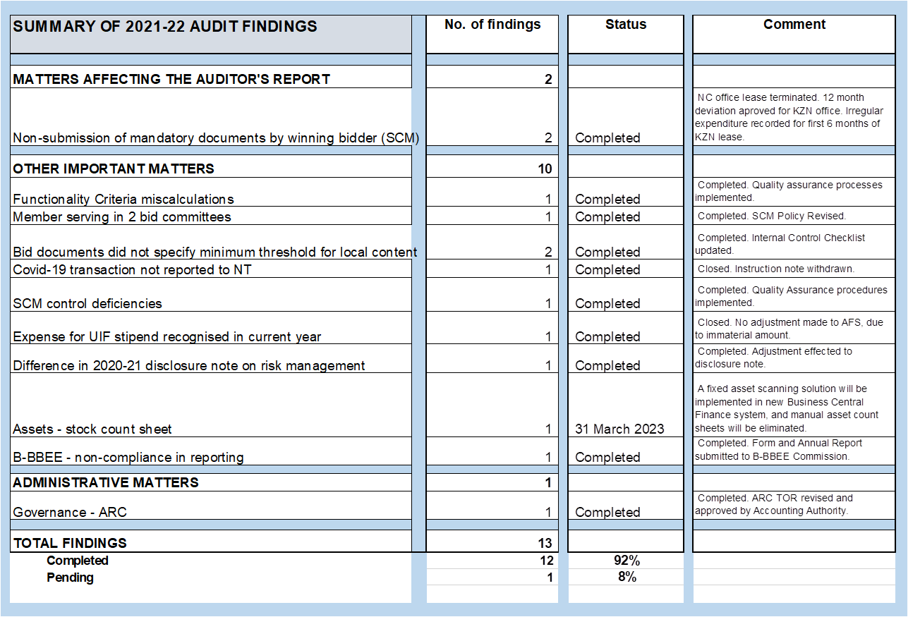
2021-22 SUMMARY OF AUDIT FINDINGS

Slide 39
CONCLUSION
It is proposed that the Portfolio Committee notes the Annual Report for the 2021/22 financial year, comprising mainly of the:
Programme Performance Information;
Annual Financial Statements (AFS) for year ended March 31, 2022; and
Audit outcomes for the 2021-22 financial year.

Slide 40
Thank you
THANK YOU

