Slide 1




2021/22 Annual Performance Report
Presented to the Portfolio Committee on Public Works and Infrastructure: 12 October 2022
Your Partner In Development

Slide 2


Contents
Purpose
Organisational and Operational Context
2021/22 Performance Report
2021/22 Financial Report
Governance Matters
2021/22 Audit Outcome
Conclusion and recommendations
2021/22 Annual Performance Report

Slide 3
Purpose
To present to the Portfolio Committee the Independent Development Trust (IDT)’s Annual Report and Unaudited Annual Financial Statements for the year ended 31 March 2022.
Architectural and engineering design
Presentations are communication tools.
Construction project management
Presentations are communication tools.
2021/22 Annual Performance Report
Consultation
Presentations are communication tools.

Slide 4

Organisational and Operational Context
2021/22 Annual Performance Report

Slide 5

Background / Introduction
The Independent Development Trust (IDT) is listed as a Schedule 2 entity in terms of the Public Finance Management Act (PFMA)
It supports the delivery of public social infrastructure as a contribution to the achievement of national development goals
The entity generates its revenue mainly from management fees derived from managing the implementation of social infrastructure projects on behalf of the government.
The 2021/22 reporting period represents the first complete reporting period in four years that the IDT had a fully functional and complete Accounting Authority since the appointment of a new Board of Trustees, which took office during the course of the second quarter of the 2021/22 financial year.

Slide 6

2021/22 Operating Environment
The IDT service delivery environment during the 2021/22 financial year was characterised by amongst others, the following socio-economic factors: -
  A subdued economic growth rate
  Construction sector was under significant pressure as spending on infrastructure declined.
  The industry was experiencing shrinking profit margins, cost overruns, labour disruptions and poor productivity,
  Rising cost of inputs.

Slide 7
2021/22 Operating Environment (cont.)
The IDT service delivery environment during the 2021/22 financial year was characterised by amongst others, the following socio-economic factors:-
  Demand for localisation of development benefits emphasising local procurement supplies for programmes, e.g. using local suppliers, creation and extension of job opportunities to local community members first;
  The proliferation of construction sector 'transformation forums' demanding participation in project implementation through subcontracting, leading to disruption of construction project work schedules;

Slide 8

2021/22 Operating Environment (cont.)
The IDT service delivery environment during the 2021/22 financial year was characterised by amongst others, the following socio-economic factors: -
  Demand for inclusive development approaches, for example, design of programmes that enhance the role and participation of small contractors
  Service delivery protests presents risks of construction projects disruption
  The challenge of ensuring that old and new social infrastructure meet the norms and standards to create a conducive service delivery environment for all

Slide 9

Organisational Context
New Board of Trustees: The appointment of the new board in July 2021 resolved a governance crisis that had set in following the departure of the previous board. Since coming into office, the board has been working hard to reconfigure the IDT into a fit-for-purpose and financially viable entity that can meet client expectations. Initiatives include:
  Governance: the board established various committees to provide effective oversight of the entity. The committees have been working on issues such as reconfiguration, financial sustainability, audit, risk, and human resources.
  Reconfiguration process seeks to find the most suitable form and shape for the IDT. A business case has since been completed, and its recommendations will be presented to Cabinet by the Executive Authority.
  Appointment of new staff: A number of critical positions have been filled, and this has created an opportunity for the entity to discharge its mandate effectively

Slide 10
Organisational Context
Business Generation: The board and management have been working hard to generate business from national and provincial clients, and notable progress has been made in this regard. Some of the new national clients include the Departments of Higher Education, Health, as well as provincial Departments of Transport in KZN and Rural Development in North West.
Policy review: Most IDT policies have been or are in the process of being reviewed to bring them up to date with current trends in legislative and related prescripts.
Reducing Litigation Cases: Management has been working on reducing litigation cases against the IDT. A litigation strategy has also been approved by the board ( this includes the implementation of a new contracting model)
Audit Matters: The entity received a Qualified Audit outcome for the 2021/22 financial year. This comes after five years of Audit Disclaimers.

Slide 11
2021/22 Performance
Report
2021/22 Annual Performance Report

Slide 12
Corporate Performance Overview
15%
Achieved
39%

Slide 13

Programme 1 Performance
OUTPUT INDICATORS | ANNUAL TARGETS & RELATED PERFORMANCE |  |  |  | REASON FOR VARIANCE CORRECTIVE ACTION
 | TARGET | ACTUAL | VARIANCE | PERFORMANCE LEVEL
Outcomes #1: Increased access to quality social infrastructure
Number of new or replacement facilities that comply with infrastructure norms completed | 15 | 17 | 2 | 113% | Target achieved
Number of non-greenfield social infrastructure facilities that comply with infrastructure norms completed | 25 | 19 | (6) | 76% | Delays in the transfer of funds affected the completion of projects as planned. Several contractors are still being affected by the aftermath of COVID, resulting in cash flow challenges
Percentage of projects completed on time | 70% | 56% | (14%) | 80%
Percentage of projects completed within budget | 70% | 100% | 30% | 143% | Target overachieved

Slide 14
Programme 1 Performance
OUTPUT INDICATORS | ANNUAL TARGETS & RELATED PERFORMANCE |  |  |  | REASON FOR VARIANCE CORRECTIVE ACTION
 | TARGET | ACTUAL | VARIANCE | PERFORMANCE LEVEL
Outcomes #2: A transformed built environment
% of weighted B-BBEE Spend (Based on total programme spend) | 70% | 44% | (26%) | 63% | Expired BBBEE certificates of suppliers that qualify for expenditure under the target not counted.
Percentage of programme contracts awarded to women contractors (participating in the CDP) | 30% | 0% | (30%) | 0% | No CDP panel contracts were awarded during the year. However, R 400 471 395 (17 percent) of programme expenditure was on women contractors, while R227 191 209 (10%) of programme expenditure was on youth contractors.
Percentage of programme contracts awarded to youth contractors (participating in the CDP) | 15% | 0% | (15%) | 0%

Slide 15
Programme 1 Performance
OUTPUT INDICATORS | ANNUAL TARGETS & RELATED PERFORMANCE |  |  |  | REASON FOR VARIANCE CORRECTIVE ACTION
 | TARGET | ACTUAL | VARIANCE | PERFORMANCE LEVEL
Outcomes #3: Decent employment (through public employment programmes)
Number of construction work opportunities created (IDT Portfolio) | 4 572 | 3 950 | (622) | 86% | .
Number of work opportunity created through EPWP (EPWP-NSS excluding IDT programme portfolio) | 42 868 | 100 212 | 57 344 | 234% | Target overachieved even though implementation commenced in October 2021 (3rd Quarter).

Slide 16
Expenditure Trends

Slide 17
Portfolio spend per programme

Slide 18
Programme 2 Performance
OUTPUT INDICATORS | ANNUAL TARGETS & RELATED PERFORMANCE |  |  |  | REASON FOR VARIANCE CORRECTIVE ACTION
 | TARGET | ACTUAL | VARIANCE | PERFORMANCE LEVEL
Outcomes #4: A financially sustainable entity
Value of programme spend | R 2 634bn | R 2 282 923 000 | (R351 077 m) | 87%
Management fee collection ratio | 80 % annual management fee collection ratio | 81% | (4%) | 95%
% of compliant programme invoices paid within 30 days of receipt | 100% compliant programme invoices paid within 30 days | 65% | (35%) | 65% | Delays in transfer of funds from clients. The need for complaint invoices to be processed by clients (transfer of programme funds to IDT based on received invoices)
% of compliant overheads invoices paid within 30 days of receipt | 100% compliant overheads invoices paid within 30 days | 83% | (17%) | 83% | The organisation experienced liquidity challenges which affected the payment of service providers. Insufficient funds available due to timing of grant transfers as well as low level of debtor collection affecting the liquidity position

Slide 19
Strategies to address Underperformance
Target | Strategy
Number of non-greenfield social infrastructure facilities that comply with infrastructure norms completed | Enforce the implementation of Service Delivery Agreements (SDAs) fund transfer clauses and speed up payment of contractors.
Percentage of projects completed on time | Continuous engagement with clients to transfer funds; fast-track approval of variation orders and replacement of non-performing contractors; and monitoring of contractors on-site
Percentage of projects completed within budget
Percentage of weighted B-BBEE Spend (Based on total programme spend) | Follow up and verification of suppliers’ BBBEE certificates
Percentage of programme contracts awarded to women contractors | Develop the framework for engaging clients to allocate projects to the Contractor Development Programme and assist regions in implementing the plan to set aside projects whilst complying with prescribed regulations.
Percentage of programme contracts awarded to youth contractors
Management fee collection ratio | Implement the debtor management policy and debt collection strategy.
Percentage of compliant programme invoices paid within 30 days of receipt | The entity continues to engage client departments on funding and replacement of contractors where contracts were terminated. Review and closely monitoring project register to ensure speedy resolution of problem issues affecting projects progress
Percentage of compliant overheads invoices paid within 30 days of receipt

Slide 20
2021/22 Financial
Report
2021/22 Annual Performance Report

Slide 21
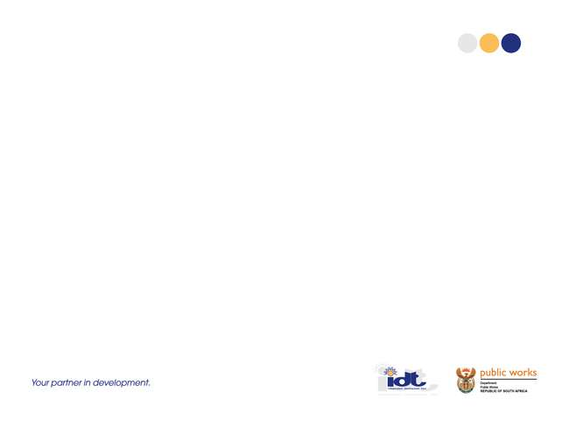
Financial Performance Review
Programme Spend by 31 March 2022: R 2, 2829 billion against an annual target of R 2.634 billion.
Management fees billed amounted to R 122, 112 million against total operating expenditure of R 205, 020 million representing a 60,0% self-funding rate.
The operating cost deficit of 40,0% was funded through Government grant (R93 million)

Slide 22
Financial Position Review
Cash and Cash equivalent:
  The entity had cash and cash equivalent of R 56, 586 million as at 31 March 2022. This is a 28. 13% decrease compared to cash and cash equivalent of R78, 736 million as at 31 March 2021.
Trade and other receivables:
  As of March 31, 2021, trade and other receivables of R40,041 million (2021: R40,392 million) were impaired and provided for. The amount of the provision was R72,538 million as of March 31, 2022 (2021: R88. 377 million) with the balance mainly composed of Management fees receivable from client Departments. The ageing of these trade receivables was as follows:
Current | 31- 60 days | 61 - 90 days | > 90 days | Total
R 21, 947m | R 2, 241m | R1, 297m | R13, 125m | R38, 610m

Slide 23
Financial Position Review (Cont.)
Programme assets and liabilities:
  The IDT has entered into binding arrangements with various client departments wherein it acts on behalf and for the benefit of the client departments in delivering programmes committed in their various votes. Such arrangements require the IDT to undertake transactions with third parties. As at 31 March 2022, the IDT had obligations to service providers to the value of R 1, 558 billion and consequently had receivables of the same amount from client Departments to honour the liability. This represents a 10, 62% decrease compared to the 2020/21 programme assets and liability of R 1, 743 billion.

Slide 24
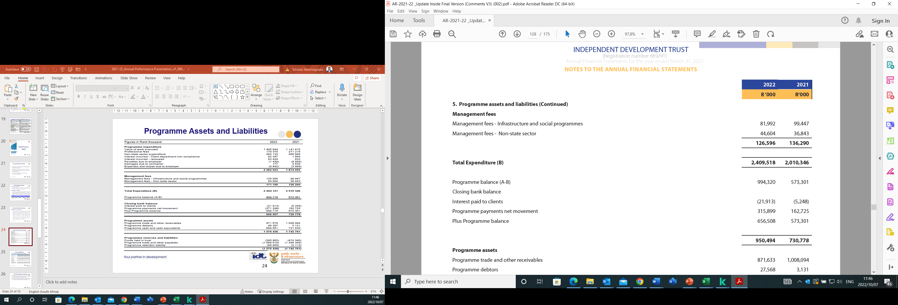
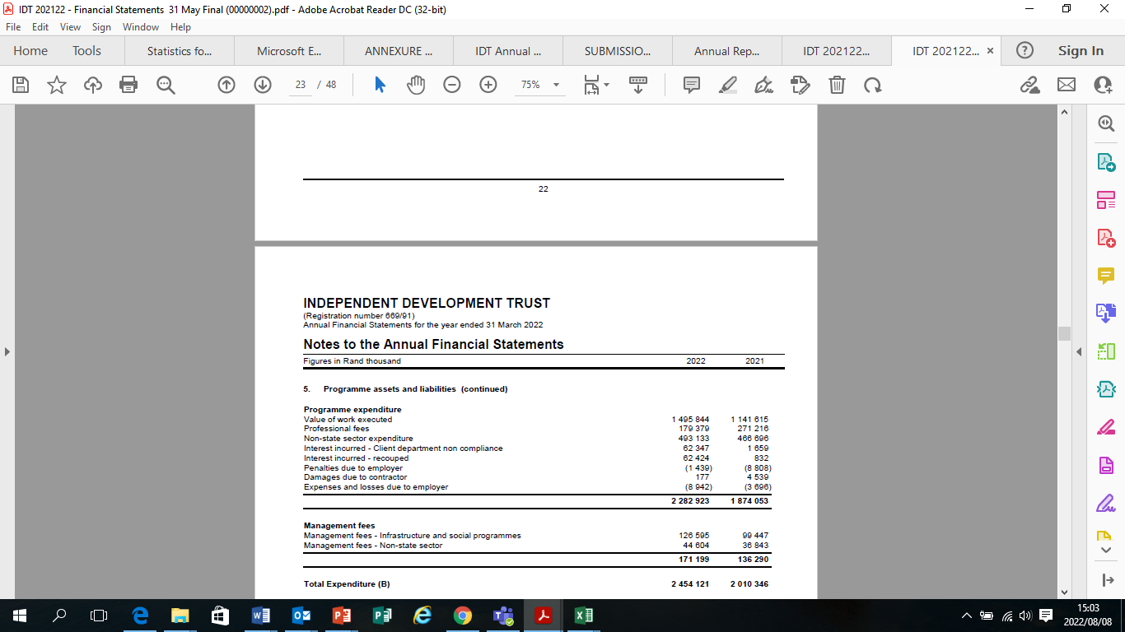
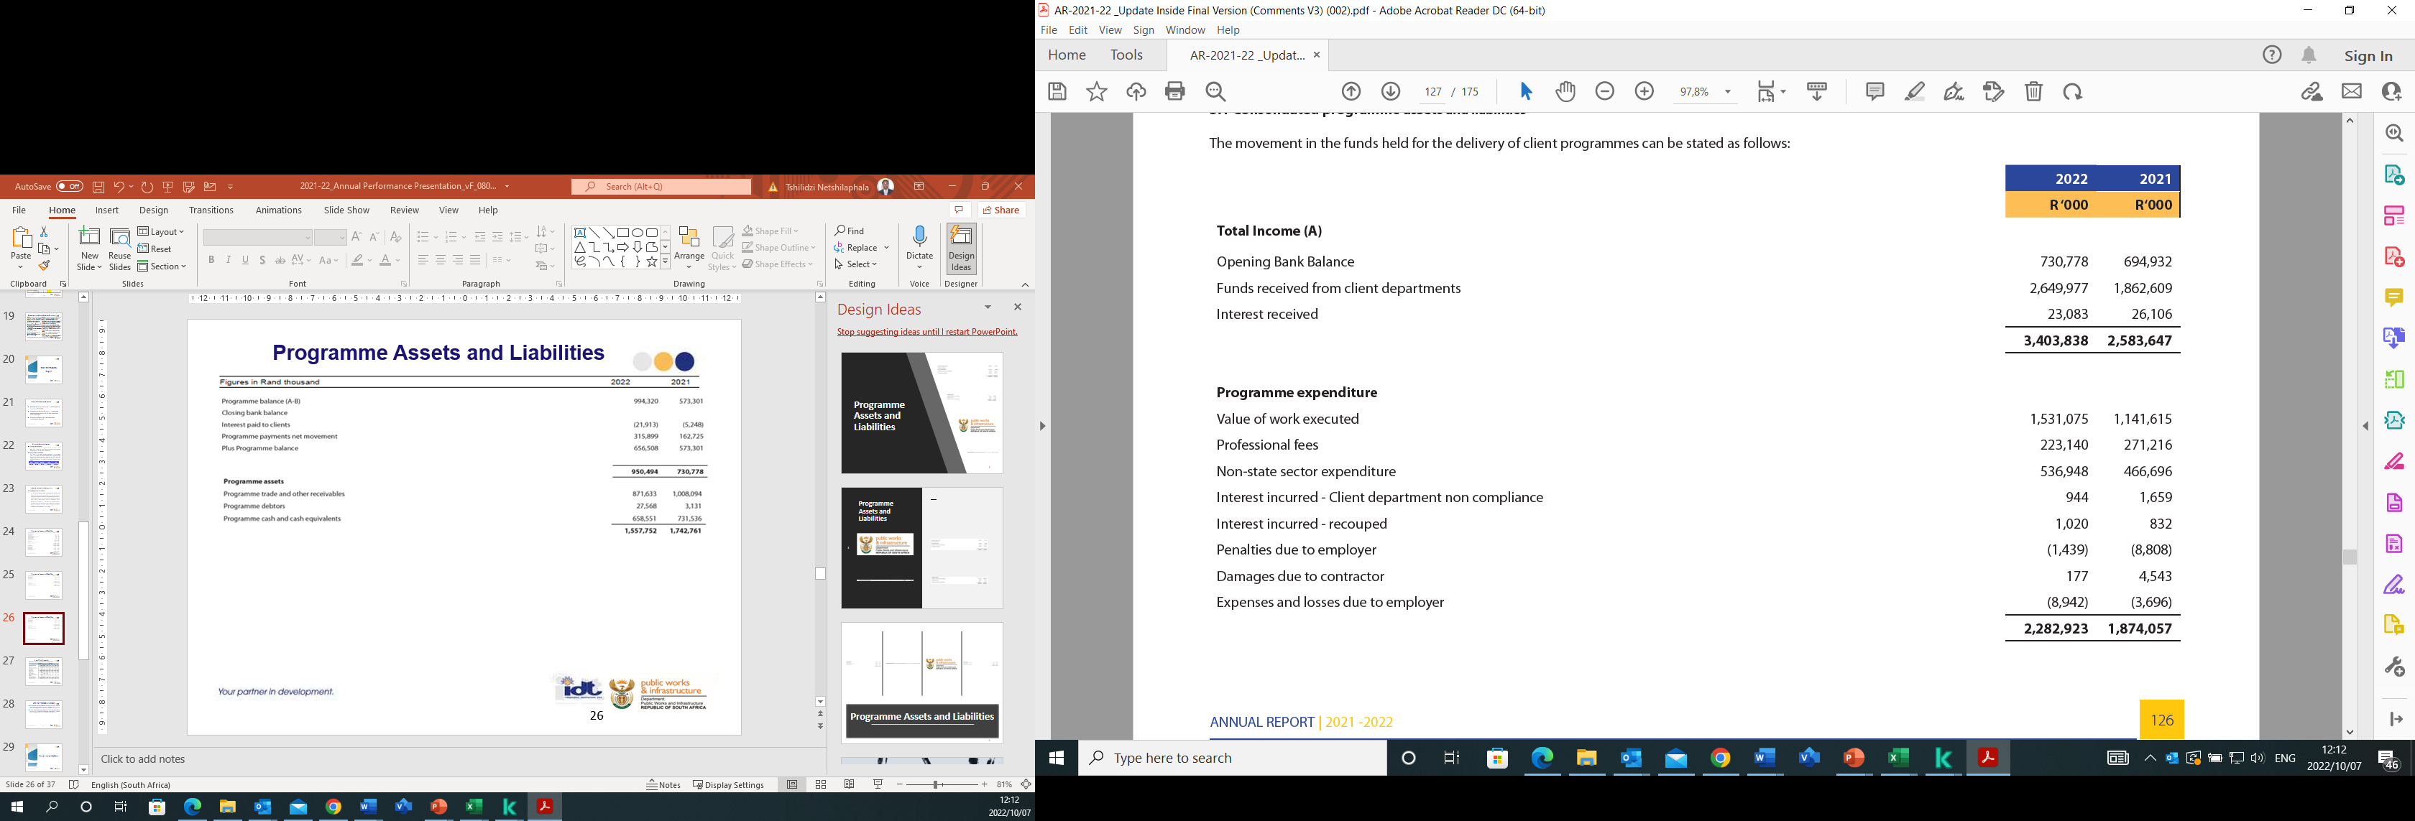
Programme Assets and Liabilities

Slide 25
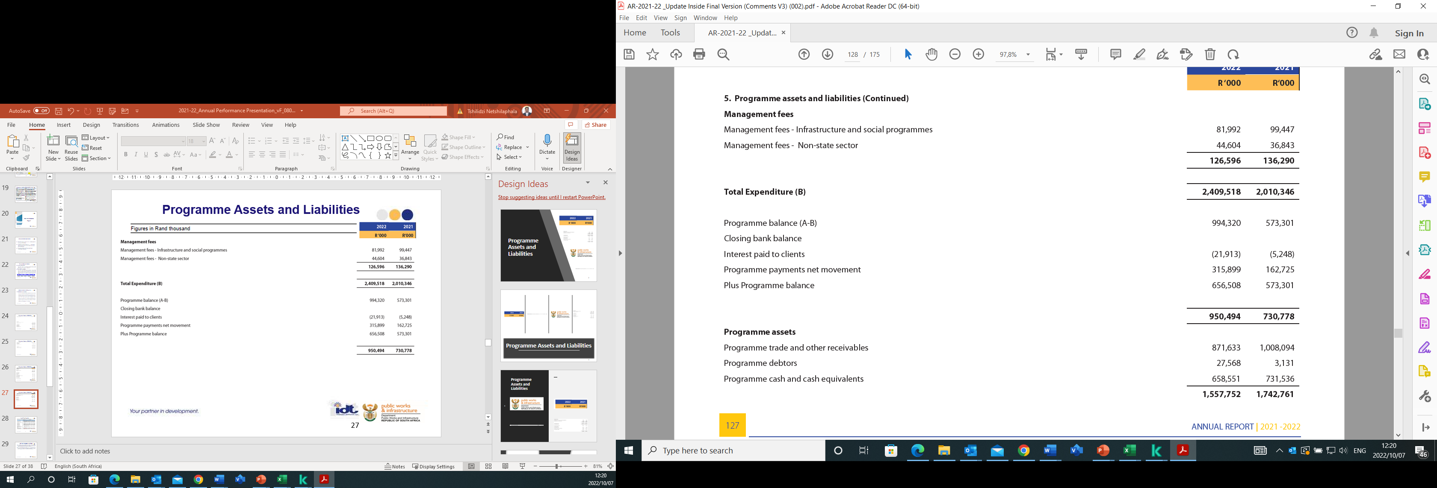
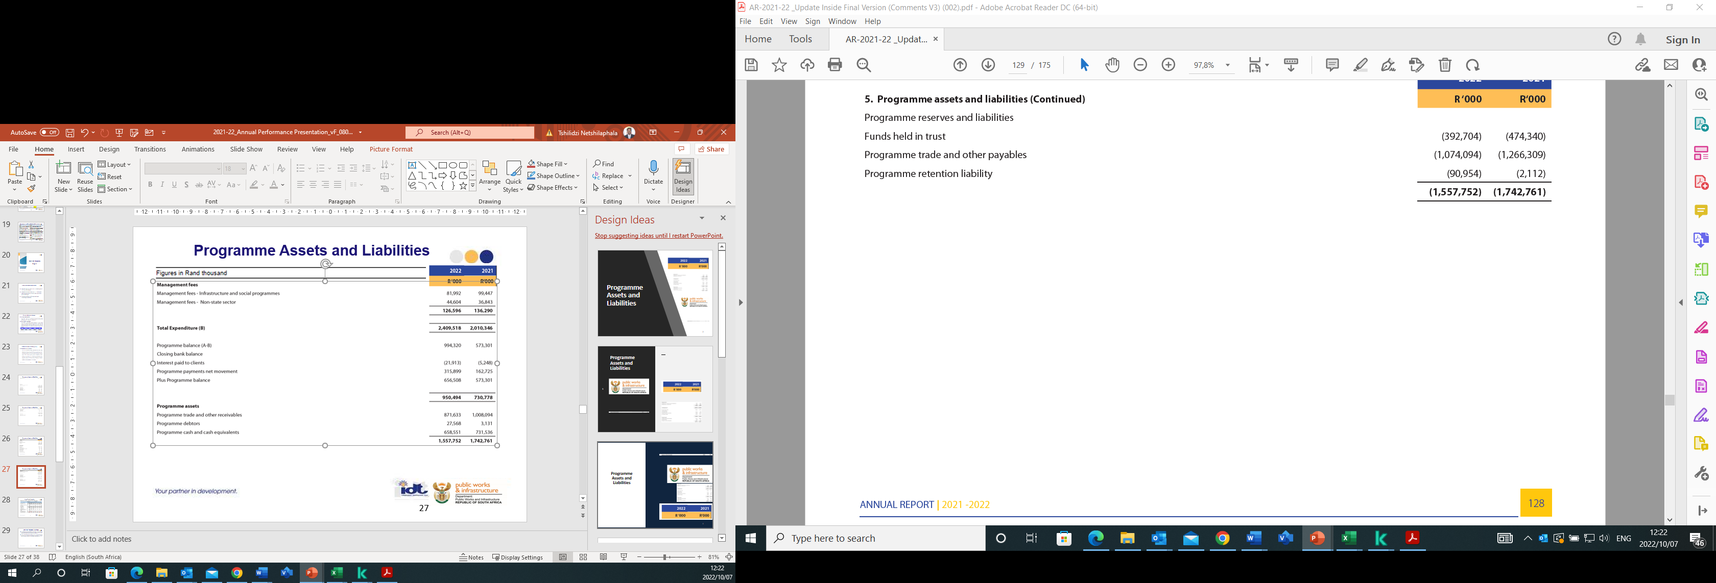
Programme Assets and Liabilities

Slide 26
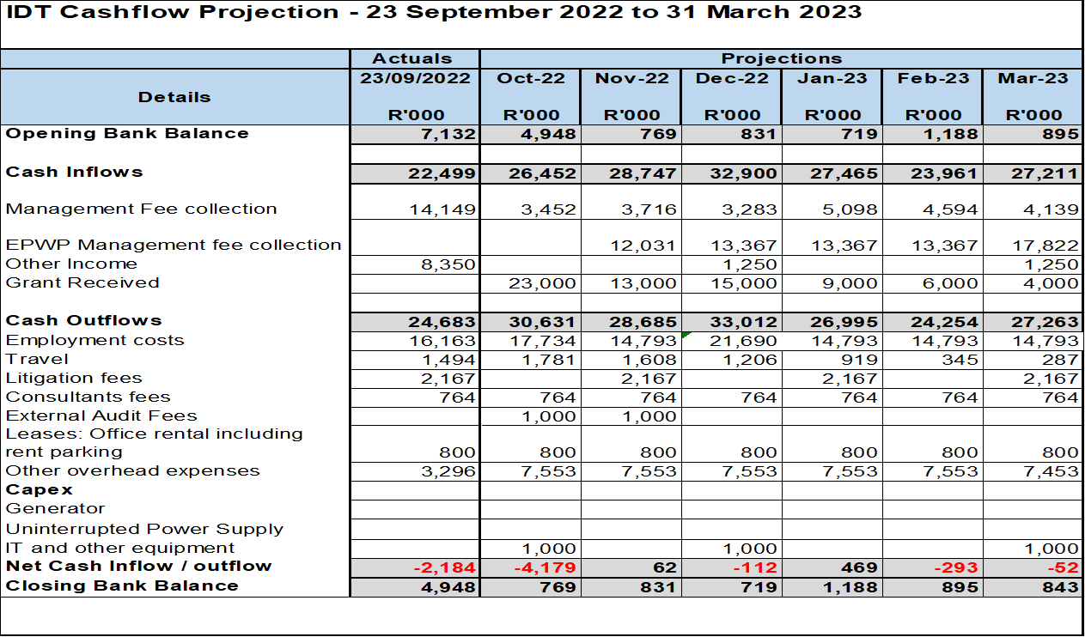
Cash Flow Projection

Slide 27
Cash Flow Projection Challenges
The organization requires an additional revenue stream to fund the shortfall in revenue and operational expenses. Currently, the organization is not able to fund its operations from the generation of management fee revenue alone.
A request for grant funding has been submitted to DPWI. The grant funding approval was received on 22 September 2022 from National Treasury and DPWI. A grant of R70.3m was approved to fund the IDT deficit for the 2022/23 financial year.

Slide 28
Governance Matters
2021/22 Annual Performance Report

Slide 29
Corporate Governance and Oversight
Functioning of the Board: the IDT operated under the leadership and oversight of a Board of Trustees comprised of eight (8) members whose term ended in April 2021. On 6 July 2021, the Minister of Public Works and Infrastructure appointed a new, full, 12-member Board of Trustees.
Meetings of the Board of Trustees: The Board held 8 meetings during the reporting period and a strategy workshop.
Audit & Risk Committee: The Board of Trustees established an Audit, Risk, and Compliance Committee to assist in fulfilling its oversight responsibilities for internal control and risk management, the audit process, and monitoring compliance with all applicable legal requirements and accounting standards. This Committee met 2 times during the reporting period.

Slide 30
Compliance Record
ITEM | DATE
Submitted 2020/21 Fourth Quarter Performance Report to the Executive Authority and the National Treasury | 30 April 2021
Submit 2021/22 First Quarterly Performance Report to the Executive Authority and the National Treasury | 30 July 2021
Submit signed AFS Template to Treasury (unaudited) | 15 September 2021
Submitted 2021/22 Second Quarter Performance Report to the Executive Authority and the National Treasury | 31 October 2021
Entities’ Quarterly performance Review with the Executive Authority | 5 October 2021
The tabling of IDT 2019/20 Annual Report | 3 November 2021
Submit Revised 2020/21Annual Performance Plan to the Executive Authority | 30 November 2021
Meeting to present the IDT’s input to the Economic Reconstruction and Recovery Plan | 08 December 2021
2021/22 Second and Third Quarterly Performance Reviews meeting with the Executive Authority (DPWI Entities Quarterly Performance Review) | 25 Feb 2022

Slide 31
2021/22 Audit Outcome
and Corrective
Measures
2021/22 Annual Performance Report

Slide 32
2021/22 Audit Outcome
After more than five years of audit disclaimers, the IDT received a qualified Audit Outcome for the 2021/22 financial year.
An Audit Action Plan has been prepared in line with the AGSA’s management report in order to address the findings contained therein.
The AGSA will be conducting a debriefing session with all relevant staff members on the root causes and the appropriate remedial actions, and this will aid in ensuring that the targeted actions are adequate to resolve the audit queries and prevent a recurrence.

Slide 33
Conclusion and Recommendation(s)
2021/22 Annual Performance Report

Slide 34
Recommendation
It is recommended that the Portfolio Committee:
  Notes the IDT’s Performance Report for the 2021/22 financial year

Slide 35
Thank You
2021/22 Annual Performance Report

