Slide 1
2021/22 ANNUAL REPORT PRESENTATION OCTOBER 2022

Slide 2
CONTENTS
Executive Summary
Strategic Outcomes and Outputs
Overview of Organisational Performance
2021/22 Highlights
Overview of Human Resources
Annual Financial Statements
Progress report on Audit findings implementation

Slide 3
EXECUTIVE SUMMARY
1.1. Organisational Environment
The new organisational structure was approved by the MPSA subject to funding being made available. A funding request was submitted to National Treasury as part of the MTEF processes.
The National Treasury approved a new budget structure for the CPSI with effect from 2022/23.
This new budget structure positions the CPSI to respond to current and anticipated demands.
In addition, the CPSI conducted an independent comprehensive, objective assessment of the CPSI to better position it for the future.
This study, completed in October 2021, together in the broader assessment of public sector innovation currently underway, will assist the CPSI to strategically position itself to support the achievement of its mandate.

Slide 4
2. ACHIEVEMENT OF INSTITUTIONAL IMPACTS AND OUTCOMES
Impact Statement: Improved effectiveness and efficiency of the public service and its service delivery to the public through innovation
OUTCOMES
Effective Corporate Governance: The achievement of this outcome will ensure, amongst others, accountability for the efficient, effective, and economic use of allocated resources towards fulfilling the mandate of the organisation.
Innovative Culture and Practice in the Public Sector entrenched: This outcome contributes directly to the achievement of the mandate of the CPSI and the implementation of the NDP. It is also a cross-cutting outcome that impacts on the seven priorities of government as identified by the Sixth Administration
Outcome | Outcome Indicator | MTSF Priority 6 | Baseline | Five-year target | Progress made towards the achievement of the five-year targets in relation to the outcome indicators
Effective Corporate Governance | Number of unqualified audit opinions | A Capable, Ethical and Developmental State | 1 p/a | 5 | 2
Innovative culture and practice in the Public Sector entrenched | Number of innovation initiatives enabled |  | 15 p/a | 75 | 33

Slide 5
ACHIEVEMENT OF INSTITUTIONAL IMPACTS AND OUTCOMES Conti...
The planned performance targets over the medium-term period contribute directly to the achievement of the mandate of the CPSI and the implementation of the NDP. It is also a cross-cutting outcome that affects the seven priorities of the government as identified by the Sixth Administration.
Solution development is a critical step in infusing innovation in the public sector; these solutions are mostly brought forth by innovators, within and outside of government. The CPSI supports initiatives and collaborates with partner institutions such as The Innovation Hub to jointly develop, test and pilot solutions. Furthermore, the CPSI affords youth an opportunity to build capacity in digital skills, through hackathons and related programmes as sources of potential service delivery solutions.
The creation of a culture and practice of innovation in the public sector is critical in ensuring that the public sector remains innovative. Public sector innovation thrives on vibrant knowledge platforms and products to encourage sharing and learning. These platforms are used to avoid reinventing the wheel. The platforms also serve as a source of innovative solutions for the replication programme. Furthermore, international knowledge platforms provide the global context to ensure that South Africa is kept abreast of new developments in the innovation space.
Many solutions that are unearthed through the Public Sector Innovation Awards Programme or through collaboration with the broader National System of Innovation have the potential for broader impact. As such, there is a demand for the replication and scaling of these solutions.

Slide 6
STRATEGIC OUTCOMES AND OUTPUTS Conti………
Outputs | Output Indicators
 |  | MTEF Period
 |  | 2021/22 | 2022/23 | 2023/24
Unqualified audit opinion on financial and non-financial information | Type of audit opinion on financial and non-financial information | Unqualified audit opinion on financial and non-financial information for 2020/21 financial year | Unqualified audit opinion on financial and non-financial information for 2021/22 financial year | Unqualified audit opinion on financial and non-financial information for 2022/23 financial year
Innovation research and development initiatives undertaken | Number of innovation research and development initiatives undertaken | 4 | 4 | 4
Knowledge platforms sustained to nurture an enabling environment for innovation in the public sector | Number of knowledge platforms sustained to nurture an enabling environment for innovation in the public sector | 9 | 9 | 9
Innovative solutions replicated in the public sector | Number of innovative solutions replicated in the public sector | 2 | 2 | 2

Slide 7
3.OVERVIEW OF ORGANISATIONAL PERFORMANCE FOR 2020/21
No of targets | Annual targets achieved | Annual target not achieved
4 | 4 | 0

Slide 8
3.OVERVIEW OF ORGANISATIONAL PERFORMANCE FOR 2020/21
PROGRAMME 1
Outcome | Output | Output Indicator | Planned Annual Target 2021/2022 | **Actual Achievement 2021/2022 | Deviation from planned target to Actual Achievement 2021/2022 | Reasons for deviations
Effective corporate governance | Unqualified audit opinion on financial and non-financial information | Type of audit opinion on financial and non-financial information | Unqualified audit opinion on financial and non-financial information for 2020/21 financial year | Achieved Unqualified audit opinion on financial and non-financial information for 2020/21 financial year | None | None

Slide 9
3.OVERVIEW OF ORGANISATIONAL PERFORMANCE FOR 2020/21
PROGRAMME 2
Outcome | Output | Output Indicator | Planned Annual Target 2021/22 | **Actual Achievement 2021/22 | Deviation from planned target to Actual Achievement 2021/22 | Reasons for deviations
Innovative culture and practice in the public sector entrenched | Innovation research and development initiatives undertaken | Number of innovation research and development initiatives undertaken | 4 | Achieved 5 innovation solutions (3 research initiatives and 2 development initiatives) | 1 Innovation solution (1 research initiative) | 1 additional research initiative was completed as part of the SA-EU Dialogue series initiative

Slide 10
3.OVERVIEW OF ORGANISATIONAL PERFORMANCE FOR 2020/21
Outcome | Output | Output Indicator | Planned Annual Target 2020/21 | **Actual Achievement 2020/21 | Deviation from planned target to Actual Achievement 2020/21 | Reasons for deviations
Innovative culture and practice in the public sector entrenched | Knowledge platforms sustained to nurture an enabling environment for innovation in the public sector | Number of knowledge platforms sustained to nurture an enabling environment for innovation in the public sector | 9 | Achieved 10 | 1 additional Innovation Workshop was held | The additional workshop was specifically targeted at capacitating the 2021 Public Sector Innovation Awards Finalists.

Slide 11
3.OVERVIEW OF ORGANISATIONAL PERFORMANCE FOR 2020/21
Outcome | Output | Output Indicator | Planned Annual Target 2020/21 | **Actual Achievement 2020/21 | Deviation from planned target to Actual Achievement 2020/21 | Reasons for deviations
Innovative culture and practice in the public sector entrenched | Innovative solutions replicated in the public sector | Number of innovative solutions replicated in the public sector | 2 | Achieved 2 innovative solutions replicated | None | N/A

Slide 12
5. 2021/22 HIGHLIGHTS
4.1 Administration
The CPSI has achieved a Clean Audit Outcome for the 2021/2022 Financial Year from the Auditor General, the 5th year in a row (Sixth in total).
4.2. Innovation Research and Development Initiatives Undertaken
The Research and Development Component initiated a new development project with the Northern Cape Office of the Premier, to develop a Virtual Thusong Centre and a Service Monitoring System. The project is currently in its design stage. Two additional development initiatives, namely the testing and piloting of a Forensics Mobile Application and a Patient Transport Management Mobile Application for Gauteng Emergency Medical Services (EMS), were also initiated. Research, including benchmarking against international practice, to position the CPSI for the next ten years and specifically within the contexts of the Fourth Industrial Revolution was concluded in October 2021.
Following a rapid assessment of the state of public sector innovation conducted in the previous year, the CPSI has, in partnership with the National Advisory Council on Innovation (NACI), completed the planning for a comprehensive qualitative and quantitative assessment to inform policy and strategy. This included the hosting of a validation workshop with key stakeholders in August 2021 to conduct a scoping exercise for the in-depth study. The initial phases of the project have commenced, with the literature review and conceptual framework (Phase 1) having been completed in October 2021. The development of the case study (qualitative study – Phase 2) was initiated in Q3, and it is anticipated that this phase will be completed during Q1 of the new financial year, after which the final phase, the quantitative survey will commence.

Slide 13
2021/22 HIGHLIGHTS Conti……
4.2. Innovation Research and Development Initiatives Undertaken (cont.)
Engagements with youth developers
Our support to the youth digital innovation eco-system continued through our support to the UK/SA Digital Literacy for Development Project (DL4D). We further provided mentorship during the following initiatives:
The Department of Communications and Digital Technologies, AlgoAtWork Robotics and the National ICT Youth Council hosted a two-day makerthon at the RBIDZ Techno Hub in Richards Bay
The Aquatech hackathon was hosted in collaboration with the Eastern Cape Office of the Premier. CPSI further served on the judging panel.
The MTN App of the Year App Academy and the Geekulcha Student Society Challenge.
The TadHack South Africa In addition to mentoring, CPSI also served as one of the judges.
The Youth ICT and Business VacWork Programme in Siyabuswa and Mthatha
The CPSI also hosted a #PSIHack22 on 24 and 25 February 2022. The hackathon focussed on public sector service delivery challenges.

Slide 14
2021/22 HIGHLIGHTS Conti……
Knowledge to nurture an enabling environment for innovation in the public sector
Public Sector Innovation Conference
The 15th Annual Public Sector Innovation Conference online webinar was held on the 24th and 25th August 2021. The conference focused on how public sector innovation can strengthen the implementation of the District Development Model to improve service delivery.
Speakers including international experts were secured in this regard. The webinars provided a platform to share innovative approaches and solutions that improve service delivery. Bangladesh shared its public sector innovation journey as part of the conference. Following this conference, the CPSI held discussions with Bangladesh under the banner of the South-South Network for Public Sector Innovation (SSN4PSI). A meeting was held in May 2022 to outline how the CPSI can participate in this South-South Network.

Slide 15
2021/22 HIGHLIGHTS Conti……
Public Sector Innovation Awards Programme
The 19th Public Sector Innovation Awards Programme was officially launched virtually in July 2021.
The Public Sector Innovation Awards event was held in February 2022. Public sector individuals and teams were formally awarded by the Deputy Minister for the Public service and Administration for their service delivery innovations.
In addition, public servants who are system developers, were also recognised and awarded through the Public Sector Innovation Trailblazer Awards. This is a special award for innovative solutions that are developed internally within government institutions.
The Deputy Minister further conferred Special Ministerial Awards to individuals and institutions that are contributing to improving delivery of services to citizens.

Slide 16
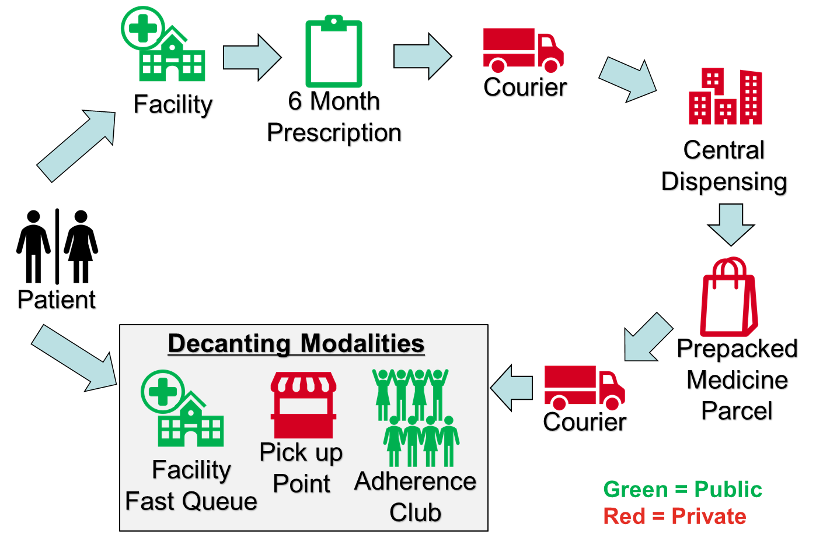
2021/22 HIGHLIGHTS Conti……
2021 PUBLIC SECTOR INNOVATOR OF THE YEAR
Central Chronic Medication Dispensary and Distribution (CCMDD)
THE CHALLENGE
South Africa has experienced an unpredicted growth in patients requiring access to long term therapies, driven in part by universal access to Antiretroviral Therapy (ART) and steady increases in patients with non-communicable diseases (NCD) requiring chronic therapy. The over extension of public sector health care facilities is creating strain on available resources and has contributed towards medicine shortages and challenges in the quality of care provided. Some of the challenges experienced by patients include protracted waiting times and often congested facilities.
THE INNOVATION
The innovation digitises a patient’s public health prescription at the public health facility. The platform is a web-based solution that allows for duplicate prescriptions, or contra-indicated medicines to be identified. The digital prescriptions and any necessary clinical notes are transferred to private courier pharmacies to dispense and distribute the patient’s prescription to the patient’s chosen pickup points (PuPs).

Slide 17
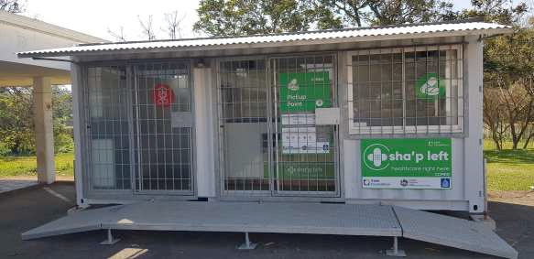
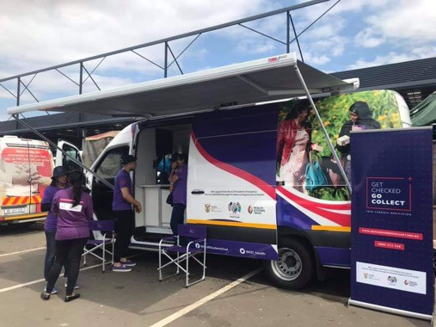
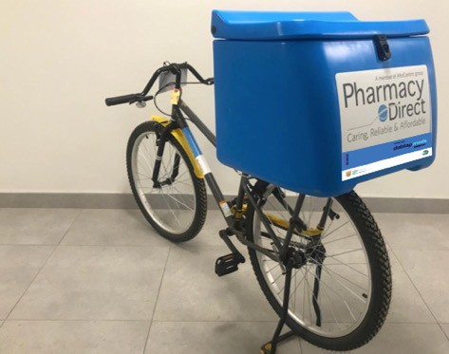
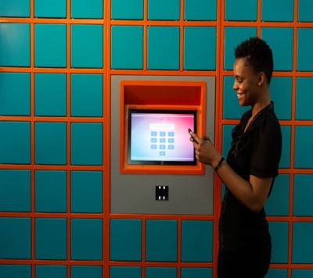
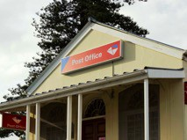
Examples of CCMDD pick-up points pick-up points
80 000 pat on home delivery
60% patients collecting from external PUPs

Slide 18
2021/22 HIGHLIGHTS Conti……
Ideas That Work Journal
The CPSI continues to use this online innovation knowledge platform to encourage learning and sharing of innovative solutions, approaches, and insights.
Design Thinking and Innovation Workshops
In 2021, four virtual innovation workshops focussing on Design Thinking and Public Sector Innovation were held to continue to build capacity in the public service. An additional workshop for the 2021 Public Sector Innovation Awards Finalists was also held.
International Public Sector Innovation Programme
The CPSI continues to participate as the National Contact Point (NCP) for the OECD’s OPSI and the OECD National Foresight Practitioners’ Network. The NCP meeting was held on 14-15 April 2021 and 7 December 2021, whilst the Practitioners’ Network met online on 11-13 October 2021.
The CPSI further participated in the SAIIA Building Anticipatory Governance in SADC post COVID-19 Webinar held on 12 May 2021. These partnerships enabled the CPSI to incorporate learning from global innovative practices into our webinars.

Slide 19
2021/22 HIGHLIGHTS Conti……
Innovative Solutions replicated in the Public Sector
E-Learning Solution
The CPSI facilitated the replication of an E- Learning solution in the Eastern Cape, and this solution will also be replicated in the North West and the Free State provinces during the 2022/23 financial year.
The SchoolLMS solution introduces cost-saving to ICT in education through innovative integration of tools, content, and users by making learning and teaching materials available for learners electronically and
online.
The solution is an integration platform that has a functionality for the distribution of eBooks and interactive content, as well as a functionality that facilitates the submission of digital handwritten lessons and assessments – homework, classwork, assignments, tests, and exams.

Slide 20
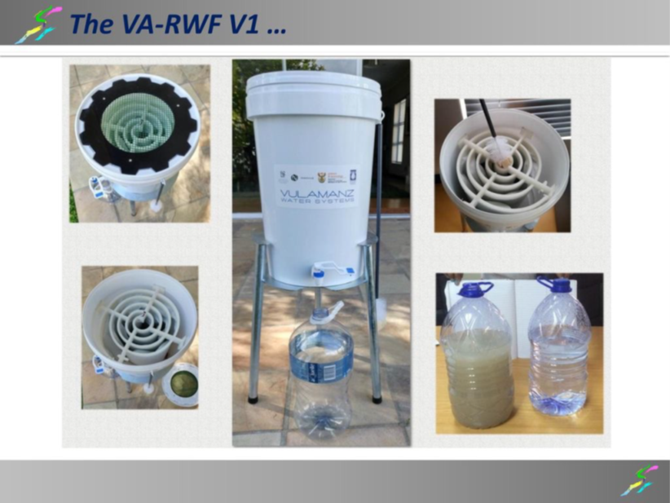
2021/22 HIGHLIGHTS Conti……
Innovative Solutions replicated in the Public Sector
Vulamanzi Water Filtering System
The Vulamazi Water Purification System is a point of-use membrane technology that provides safe drinking water to under serviced or rural communities. The technology used by the Vulamanzi Water Purification System is a Woven Fabric Microfilter (WFMF) that is produced in South Africa. It is a point-of use (POU) household water treatment unit consisting of a microfilter and a post-disinfection step. It removes suspended material, colloids, and water-borne pathogens to give safe drinking water from raw water that is contaminated with biological pathogens.
Hammanskraal has well-documented water challenges, most of the time the water is brown and not fit for consumption.
The Vulamanzi Water Filtering solutions was replicated in Hammanskraal at Odirile Residential Care Centre.
This centre caters for persons with profound intellectual disabilities from age 2 to 55, providing a comprehensive service and care. Water challenges had a negative impact on the facility as it depends on the municipal trucks for water, a service that is inconsistent. As a result, the centre regularly buys bottled water which is very costly. The project has greatly assisted the centre to have constant supply of portable water and reduce their expenditure on water.

Slide 21
5. OVERVIEW OF HUMAN RESOURCES
Status of human resources in the department
The number of posts on the establishment of the CPSI increased during the 2021/22 reporting year from 30 to 32 posts. 30 of these posts were filled as of 31 March 2022, compared to the 27 posts of the 2020/21 report. Additional to the fixed establishment, two interns were employed.
The organisation had two vacant posts at the end of the reporting year. (Executive Director and Human Resource Officer).
Vacancy rate
The vacancy rate decreased from 16.67 per cent at the end of the 2020/21 reporting year to 9.6 per cent at the end of the 2021/22 reporting year.
Employment Equity
6.7% of persons with disabilities
60% of women at SMS level
20% of youth, mainly due to the internship programme.
Workforce planning and key strategies to attract and recruit a skilled and capable workforce
The CPSI has prioritised the appointment of staff with digital skills, in particular system developers, pending allocation of additional budget by NT through the MTEF processes.

Slide 22
6. ANNUAL FINANCIAL STATEMENTS FOR THE PERIOD ENDING 31 MARCH 2022 FOR THE CPSI

Slide 23
Appropriation statement (continued)
Appropriation per programme
 | 2021/22 |  |  |  |  |  |  | 2020/21
Programme | Adjusted Appropriation | Shifting of Funds | Virement | Final Appropriation | Actual Expenditure | Variance | Expenditure as % of final appropriation | Final Appropriation | Actual Expenditure
 | R'000 | R'000 | R'000 | R'000 | R'000 | R'000 | % | R'000 | R'000
1. Administration | 20 149 | - | - | 20 149 | 16 963 | 3 186 | 84.2% | 18 944 | 13 821
2. Public Sector Innovation | 21 304 | - | - | 21 304 | 16 817 | 4 487 | 78.9% | 15 890 | 13 710
Total | 41 453 | - | - | 41 453 | 33 780 | 7 673 | 81.5% | 34 834 | 27 531
Departmental receipts |  |  |  | 6 |  |  |  | 8
Aid assistance |  |  |  | - |  |  |  | -
Actual amounts per Statement of Financial Performance (Total Revenue) |  |  |  | 41 459 |  |  |  | 34 842
Actual amounts per Statement of Financial Performance Expenditure |  |  |  |  | 33 780 |  |  |  | 27 531

Slide 24
Appropriation statement (continued)
Appropriation per economic classification
 | 2021/22 |  |  |  |  |  |  | 2020/21
Programme | Adjusted Appropriation | Shifting of Funds | Virement | Final Appropriation | Actual Expenditure | Variance | Expenditure as % of final appropriation | Final Appropriation | Actual Expenditure
 | R'000 | R'000 | R'000 | R'000 | R'000 | R'000 | % | R'000 | R'000
Current payments | 40 683 | (2 287) | - | 38 396 | 31 883 | 6 513 | 83.0% | 34 596 | 27 297
Compensation of employees | 22 188 | - | - | 22 188 | 19 119 | 3 069 | 86.2% | 22 335 | 18 158
Goods and services | 18 495 | (2 287) | - | 16 208 | 12 764 | 3 444 | 78.8% | 12 261 | 9 139
Transfers and subsidies | 1 | - | - | 1 | - | 1 | 0.0% | 1 | -
Departmental agencies and accounts | 1 | - | - | 1 | - | 1 | 0.0% | 1 | -
Payments for capital assets | 763 | 2 287 | - | 3 050 | 1 892 | 1 158 | 62.0% | 237 | 234
Machinery and equipment | 424 | 1 904 | - | 2 328 | 1 170 | 1 158 | 50.3% | 237 | 234
Software and other intangible assets | 339 | 383 | - | 722 | 722 | - | 100.0% | - | -
Payment for financial assets | 6 | - | - | 6 | 5 | 1 | 83.3% | - | -
Total | 41 453 | - | - | 41 453 | 33 780 | 7 673 | 81.5% | 34 834 | 27 531

Slide 25
Appropriation statement (continued)
PROGRAMME 1: ADMINISTRATION
 | 2021/22 |  |  |  |  |  |  | 2020/21
Sub programme | Adjusted Appropriation | Shifting of Funds | Virement | Final Appropriation | Actual Expenditure | Variance | Expenditure as % of final appropriation | Final Appropriation | Actual Expenditure
 | R'000 | R'000 | R'000 | R'000 | R'000 | R'000 | % | R'000 | R'000
1. STRATEGIC MANAGEMENT | 3 243 | (29) | - | 3 214 | 1 631 | 1 583 | 50.7% | 3 970 | 2 262
2. CORPORATE RESOURCE MANAGEMENT | 10 895 | - | - | 10 895 | 10 089 | 806 | 92.6% | 8 750 | 6 263
3. OFFICE OF THE CHIEF FINANCIAL OFFICER | 6 011 | 29 | - | 6 040 | 5 243 | 797 | 86.8% | 6 224 | 5 296
Total | 20 149 | - | - | 20 149 | 16 963 | 3 186 | 84.2% | 18 944 | 13 821
PROGRAMME 2: PUBLIC SECTOR INNOVATION
 | 2021/22 |  |  |  |  |  |  | 2020/21
Sub programme | Adjusted Appropriation | Shifting of Funds | Virement | Final Appropriation | Actual Expenditure | Variance | Expenditure as % of final appropriation | Final Appropriation | Actual Expenditure
 | R'000 | R'000 | R'000 | R'000 | R'000 | R'000 | % | R'000 | R'000
1. RESEARCH AND DEVELOPMENT | 6 607 | - | - | 6 607 | 4 602 | 2 005 | 69.7% | 5 425 | 4 613
2. SOLUTION SUPPORT AND INCUBATION | 5 132 | - | - | 5 132 | 4 955 | 177 | 96.6% | 4 136 | 3 558
3. ENABLING ENVIRONMENT | 9 565 | - | - | 9 565 | 7 260 | 2 305 | 75.9% | 6 329 | 5 539
Total | 21 304 | - | - | 21 304 | 16 817 | 4 487 | 78.9% | 15 890 | 13 710
CSPI total | 41 453 | - | - | 41 453 | 33 780 | 7 673 | 81.5% | 34 834 | 27 531

Slide 26
Appropriation statement (continued)
The actual expenditure as at 31 March 2022 amounted to R33.780 million or 81.5 percent against the final appropriation of R41.453 million, resulting in underspending of R7.673 million as detailed below: Compensation of Employees - An amount of R19.119 million (86.2 percent) was spent on Compensation of Employees against the final appropriation of R22.188 million. The underspending of R3.069 million was mainly due to vacant posts in the department. The Executive Director and Human Resource Management Officer posts were in the process of being filled for the period under review.
Goods and Services - An amount of R12.764 million (78.8 percent) was spent on Goods and Services against the final appropriation of R16.208 million. The underspending of R3.444 million was mainly due to the following:
Project stakeholder engagements and design thinking workshops were held online in the first two quarters due COVID-19 lockdown restrictions, which resulted in underspending on travel and subsistence in those quarters;
The lower than anticipated expenditure for consumables, telephone cost, stationery, and printing cost due to the COVID-19 lockdown restrictions and most of the activities being conducted online;
Consultancy Services mainly due to the delayed implementation relating to innovative real-time monitoring of service delivery solution for the Department of Home Affairs as well as Risk Management Services; and
The Call for Entries for the Annual Public Sector Innovation Awards was hosted online, which resulted in an underspending.

Slide 27
Appropriation statement (continued)
Transfers and Subsidies
No expenditure was incurred for transfers and subsidies during the period under review.
Purchases for Capital Assets
An amount of R 1.892 million (62.0 percent) was spent on the Payment for Capital Assets against the final appropriation of R3.050 million. The underspending of R1.158 million was mainly due to the delayed delivery of servers and computers due to global shortage.
Payment for Financial Assets
An amount of R 5 000 was spent on the Payment for Financial Assets relating to theft and losses recoveries within the department.
The unspent funds were surrendered to the National Treasury

Slide 28
Irregular and Fruitless expenditure
2021/22
2020/21
R’000
R’000
Unauthorised expenditure |  | - |  | -
Irregular expenditure |  | 63 |  | 750
Fruitless and wasteful expenditure |  | 6 |  | 14
Total |  | 69 |  | 764
Details of irregular expenditure condoned
Details of irregular expenditure not condoned
Incident | Condoned by (relevant authority) | R’000
The procurement of furniture without adhering to local production and content requirements (KEVCON). |  | 63
Details of fruitless expenditure written-off
Incident | Condoned by (Accounting Officer) | R’000
Expenditure for the service that could not be rendered by the supplier. |  | 8

Slide 29
30 Days payment
Month | Number of payments processed on BAS per month | Average Payment days for the month | Overall Average payment days for the financial year to date
Apr-21 | 27 | 5.69 | 5.69
May-21 | 46 | 5.13 | 5.34
Jun-21 | 40 | 10.14 | 7.27
Jul-21 | 37 | 5.68 | 6.86
Aug-21 | 45 | 7.96 | 7.35
Sep-21 | 48 | 6.04 | 6.92
Oct-21 | 36 | 2.20 | 6.35
Nov-21 | 42 | 7.47 | 6.47
Dec-21 | 42 | 6.47 | 6.49
Jan-22 | 39 | 19.00 | 7.58
Feb-22 | 47 | 6.29 | 7.46
Mar-22 | 112 | 5.70 | 7.14
Total | 561 | 7.31 | 6.74
During the period April 2021 to 31 March 2022 the CPSI processed 561 payments with no payment exceeding 30 days recorded.
Overall Average payment days for the financial year was 7.31 days.

Slide 30
Progress Report on Audit findings implementation
Finding No. | Component | Description | Root cause | Agreed management comments/action plan(s) | Implementation date | Responsible person | Status of the implementation/ progress
202122/01 | FMA | The 2021/22 annual financial statements did not have the disclosure of the receivables accounting policy. | Policy issue | Incorporated changes to the 2021/22 AFS | 31 July 2022 | M. Makhananisa | Done
 |  |  |  | 2. Specimen checklist will be developed to prevent the re-occurrence | 31 August 2022 | M. Makhananisa | Done
202122/02 | CS | Executive Director, has not been filled within 12 months. | Process issue | The post was advertised, and the process of filling the post is currently underway | 30 September 2022 | MPSA M Sebone | Shortlisting stage
202122/03 | FMA SCM | Capital commitments order was subsequently cancelled after year end on 07 May 2022. | Policy issue | 1. Disclosure of the narrative added to the disclosure line item to the 2021/22 AFS. | 13 July 2022 | A Snyman | Done
 |  |  |  | 2. Process to review subsequent events that impact the Annual Financial Statements will be reviewed. | 30 September 2022 | A Snyman | Done
202122/03 | SM | CPSI did not submit the compliance report to the B-BBEE Commission as required by the B-BBEE Act and Regulation after 2020/21 | Process issue | 1. Submission to the B- BBEE Commission of 2020/21 certificated | 31 August 2022 | D Mavikane | Done
 |  |  |  | 2. Development of annual report submission certificate | 31 August 2022 | D Mavikane | Done

Slide 31
THANK YOU!

