Slide 1
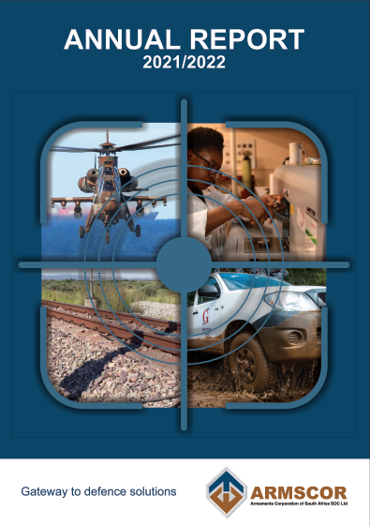
Presentation to the
PCDMV
on the
Annual Report
Presented by:
Adv. Solomzi Mbada
CEO
November 2022

Slide 2
SCOPE
General Information
  Introduction
  Strategic Overview
  Organisational Structure
Corporate Performance Information
  Performance against predetermined outputs
  Operational Review
Human Capital Management
Annual Financial Report
Challenges
Responses
Questions & Answers
AG’s Audit Report

Slide 3
INTRODUCTION
The aim of this presentation is to highlight the performance of Armscor during the 2021/22 financial year as contained in the Armscor Annual Report.
The presentation outlines achievements and challenges faced by the Corporation in carrying out its mandate.
The presentation also provides an update on current projects.

Slide 4
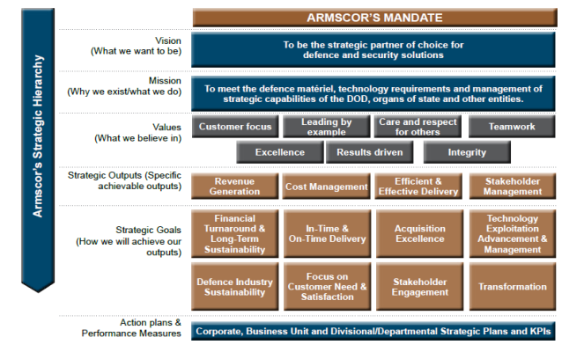
STRATEGIC OVERVIEW

Slide 5
ABOUT ARMSCOR
Armaments Corporation of South Africa SOC Limited (Armscor) was established in terms of Armaments Corporation of South Africa, Limited Act (Act No. 51 of 2003).
State-owned entity as contemplated in the Companies Act, 2008.
Listed as a Schedule 2, Public Entity in terms of the PFMA.
Further regulated by the regulations issued in terms of the PFMA and the Companies Act.
The Minister of Defence and Military Veterans is responsible for Armscor.
The Board of Directors is the Accounting Authority of Armscor.
  Armscor’s mandate is to meet the following requirements of the Department of Defence (DOD) effectively, efficiently and economically:
  Acquire Defence matériel on behalf of the DOD
  Provide defence operational research
  Provide marketing support to defence related industries
  Manage the strategic facilities on behalf of the DOD
  Provide Defence technology, research and development, analysis and test and evaluation requirements of the DOD
Adhere to accepted principles of corporate governance.
Armscor may also provide such service to other Departments or Governments on a regulated basis.
Armscor may enter into commercial activity, subject to approval of the Minister of Defence and Military Veterans.

Slide 6
FUNDING OF ARMSCOR
Financing of Armscor is mainly through income appropriated by Parliament and received via the Defence budget which consist of an allocation and payment for services rendered to the Department of Defence (2020: 80%; 2021: 76%). The funding is not sufficient to sustain the capability required and is supplemented by income from commercial services rendered (2020: 10%; 2021: 13%), investment income (2020: 5%; 2021: 6%) and other income (2020: 5%; 2021: 5%).

Slide 7
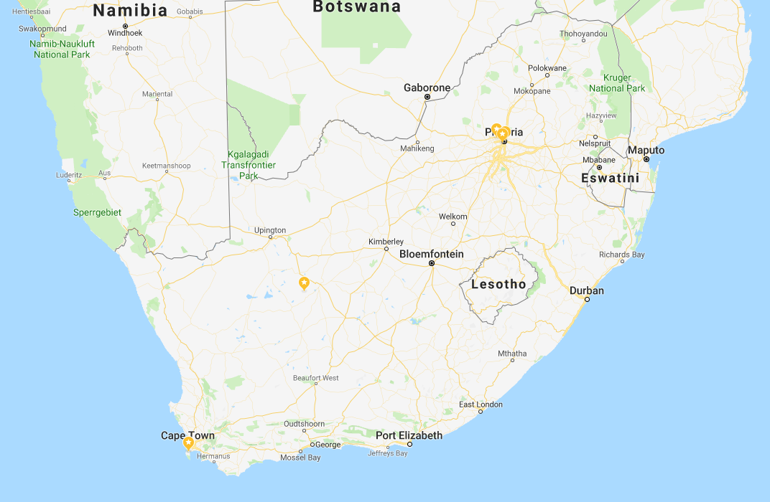
ABOUT ARMSCOR: ARMSCOR AND FACILITIES
Gerotek (36)
Armscor Head Office (731)
Protechnik (28)
Ergotech (14)
Hazmat (17)
Alkantpan (91)
IMT (58) & Dockyard (400)
NOTE: The figures in brackets is the number of permanent & Fixed Term Contract employees at each office as on 31 March 2022.

Slide 8


STRATEGIC OVERVIEW
Strategic Overview
Armscor aims to deliver a sustainable organisation that generates additional revenue, strengthening its partnerships, containing costs and delivering ground breaking technologies
Revenue Generation
Cost Management
Efficient and Effective
Delivery
Stakeholder
Management
Vision, Mission and Mandate
NDP, Vision 2030 6th Administration Priorities 2019-2024
MTSF 2019-2024 MOD&MV Priorities 2019-2024
In an attempt to improve operational efficiency and sustainability, Armscor introduced the Strategy - On Time, In Time – Towards a Sustainable Future.

Slide 9
FUNDING OF ARMSCOR
ARMSCOR’S ORGANISATIONAL AND
REPORTING STRUCTURE
MINISTER OF DEFENCE AND MILITARY VETERANS
ARMSCOR BOARD OF DIRECTORS
AUDIT & RISK COMMITTEE
HUMAN RESOURCES, SOCIAL & ETHICS COMMITTEE
TECHNOLOGY, INDUSTRY SUPPORT & SUSTAINABILITY COMMITTEE
ACQUISITION COMMITTEE
MILITARY VETERANS COMMITTEE
COMPANY SECRETARY
CEO
CORPORATE FINANCE
INTERNAL AUDIT
ACQUISITION
& SCM
RESEARCH & DEVELOPMENT
ARMSCOR DOCKYARD
EXECUTING FUNCTIONS OF THE EXECUTIVE COMMITTEE
CORPORATE SUPPORT
BUSINESS ASSURANCE
BUSINESS ENABLEMENT
SUPPORT FUNCTIONS OF THE EXECUTIVE COMMITTEE

Slide 10
ARMSCOR CORPORATE PERFORMANCE: SLA
Goal 1: Category 1 capital defence matériel acquisition excluding strategic defence acquisition but including technology acquisition
Output description (Projects) | Annual target 2021/22 | Achievement against target | Performance against output
1.1 Percentage of DOD capital requirements converted into orders placed. | 95% | 100% | DOD requirements to the value of R90,03m were received. Armscor committed R90,03m of the above mentioned funds resulting in an achievement of 100%. Target exceeded.
1.2 Execution of contracts as measured through actual cash flow on DOD orders placed. | 95% | 107,42% | The planned cash flow in terms of the first revision was R1,74872bn. Armscor managed to realise cash flow to the value of R1,79575bn resulting in an achievement of 102.69%. Adjustments for factors beyond Armscor’s control amounted to R77,07m. This resulted in a final achievement of 107,42%. Target exceeded.
CONFIDENTIAL
10

Slide 11
ARMSCOR CORPORATE PERFORMANCE: SLA
Goal 2: System support: Acquisition and procurement
Output description (Operational funds) | Annual target 2021/22 | Achievement against target | Performance against output
2.1 Percentage of DOD system support and procurement requirements converted into orders placed | 95% | 96% | DOD requirements to the value of R985,34m were received. Armscor committed R945,95m of the above mentioned funds resulting in an achievement of 96%. Target exceeded.
2.2 Execution of contracts as measured through actual cash flow on DOD orders placed. | 95% | 103,20% | The planned cash flow in terms of the first revision was R3,16872bn. Armscor managed to realise cash flow to the value of R2,28111bn resulting in an achievement of 71.99%. Adjustments for factors beyond Armscor’s control amounted to R958,41m. This result in a final achievement of 103,20%. Target exceeded.
CONFIDENTIAL
11

Slide 12
ARMSCOR CORPORATE PERFORMANCE: SLA
Goal 3: Schedule placement
Output description (Projects) | Annual target 2021/22 | Achievement against target | Performance against output
3.1 Average time taken to convert DOD requirements into orders including: | 95 days for shortened process COTS items. 120 days for non-COTS and Product Support GDA procurement. 145 days for SDA acquisition programs. | 78 74 128 | An average of 78 days taken from receipt of requirement to placement of contract Target exceeded. An average of 74 days taken from receipt of requirement to placement of contract Target exceeded. An average of 128 days taken from receipt of requirement to placement of contract. Target exceeded.
CONFIDENTIAL
12

Slide 13
ARMSCOR CORPORATE PERFORMANCE: SLA
Goal 4: Management of Defence Industrial Participation (DIP)
Output description (Projects) | Annual target 2021/22 | Achievement against target | Performance against output
4.1 Value of DIP credits to be granted to overseas suppliers. Active Portfolio: | R129,95m | R260,04m | DIP credits to the total value of R260 039 603 have been awarded during the 2021/22 financial year. Target exceeded.
Goal 5: Management and execution of Defence Technology, Research,
Test and Evaluation requirements of the Department of Defence
5.1 Percentage of execution of technology requirements. | 95% | 97,86% | DOD orders to the value of R129 410 178 have been awarded during the 2021/22 financial year. Amount invoiced: R126 641 655 and executed during the year. Target exceeded.
CONFIDENTIAL
13

Slide 14
ARMSCOR CORPORATE PERFORMANCE: SLA
6: Management and performance against Dockyard Mandate
Output description (Projects) | Annual target 2021/22 | Achievement against target | Performance against output
6.1 Percentage of contractual milestones executed. 6.2 Percentage of compliance to project finance. 6.3 Percentage of Ancillary Services executed. 6.4 Percentage of training requests executed. 6.5 Percentage compliance with quarterly report timelines. | 90% 90% 95% 90% 90% | 82% 50% 100% 100% 100% | Measurement is for projects taken (average) on by the Dockyard in accordance with available resources and under full Dockyard management control. Major contributing factors were, acceptance and/or approval delay, awaiting other repair organisation, FMEA or failure to investigate, insufficient spares and poor and/or limited failure description. Target not achieved. An invoice amounting to R3,9m could not be claimed from the FA due to the closure of the payment system from the DOD. The actual performance percentage for cost incurred is 71% considering the unclaimed expenditure. The balance on the FA was deferred to the 2022/23 financial year. Target not achieved. All quarterly reports submitted to Flag Officer Fleet on or prior to delivery date and signed off by the SA Navy. Target exceeded. Training requirements requested were provided and signed off by the SA Navy. Target exceeded. All quarterly reports submitted to Flag Officer Fleet on or prior to delivery date and signed off by the SA Navy. Target exceeded.
CONFIDENTIAL
14

Slide 15
ARMSCOR PERFORMANCE AGAINST STRATEGIC OUTPUTS
Strategic Output 1: Revenue Generation
No. | Output description | Annual target 2021/22 | Achievement against target | Performance against output
1.1 | Generate additional realisable revenue
1.1.1 | Group Revenue (transfer payment, other income, and finance income). | R1 324,3m | R1 429,4m | Goal achieved as total group revenue of R1 429,4m was received. Target exceeded.
1.1.2 | Revenue from existing facilities of Armscor R&D. | R310m | R238,3m | Total income generated (excluding Transfer Payment): R238,3m. Target not achieved.
1.1.3 | Revenue generated from the Business Enablement Business Unit. | R33,3m | R17,6m | A total of R17,6m was realised. Target not achieved.
Strategic Output 2: Cost Management
No. | Output description | Annual target 2021/22 | Achievement against target | Performance against output
2.1 | Strategic maintenance and reduction of capital and Operating costs
2.1.1 | Improve net financial position. | R3,1m surplus | R12,5m surplus | Surplus of R12,5m was realised. Target exceeded.
CONFIDENTIAL
15

Slide 16
ARMSCOR PERFORMANCE AGAINST STRATEGIC OUTPUTS
Strategic Output 3: Efficient and Effective Delivery
Output description | Annual target 2021/22 | Achievement against target | Performance against output
3.1 Effective Technology and IP Management
3.1.1 Development and Test Services: Percentage compliance with Technology Development Master Plan, in accordance with SLA between Armscor and DOD. | 90% | 99,72% | Orders placed: Budgeted target: R488,06m Orders placed: R486,71m Achievement 99,72% Target exceeded.
3.1.2 Completion of IP requests in terms of Armscor process. | 80% | 100% | 1 request for IP exploitation was received and was processed. Target achieved.
3.1.3 Maintain a complete and comprehensive IP Register which ensures the maintenance of an unqualified audit opinion, in respect of Armscor and DOD Intangible Capital Assets under Armscor’s management. | 31 March 2022 | 31 March 2022 | Complete and comprehensive IP register maintained. Target achieved.
3.1.4 Commercialize one IP Technology | 31 March 2022 | 21 April 2021 | The approval to commercialize one IP Technology was obtained on 21 April 2021. Target exceeded.
3.2 Infrastructure Renewal
3.2.1 Renew application systems to improve effectiveness and efficiency: Appoint an ERP Service Provider. | 31 May 2021 | - | The RFB process was completed. The Board approved the submission for order placement on 1 December 2021 subject to clarifying the issue regarding the 30% subcontracting with National Treasury. The response from National Treasury was received and Armscor was considering seeking legal opinion on how to proceed with the process. Target not achieved.
CONFIDENTIAL
16

Slide 17
ARMSCOR PERFORMANCE AGAINST STRATEGIC OUTPUTS
Strategic Output 3: Efficient and Effective Delivery
Output description | Annual target 2021/22 | Achievement against target | Performance against output
3.2 Infrastructure Renewal
3.2.1 Renew application systems to improve effectiveness and efficiency: Implementation of the approved application system renewal plan. | 80% | 0% | Only the payroll solution was implemented. The delays relating to ERP means delayed replacement of some legacy application systems (e.g. KBA, Finbis, Cyborg, etc.). Target not achieved.
3.2.1 Implement IT infrastructure Renewal in line with Business Continuity Plan in times of crises. | 31 March 2022 | 17 March 2022 | 3 infrastructure projects were identified to support the Business Continuity Plan: The procurement configuration and commissioning of 4 backup servers has been completed. Implementation of Storage at the head office has been completed. The submission for order placement for the Unified Computing System (UCS) was approved by the Board on 17 March 2022. Partially achieved.
3.2.2 Improve Information Security: 80% Implementation of the approved security architecture plan. | 30 June 2021 | - | 80% of the Audit Finding relating to the approved Cybersecurity Capability Implementation Plan were closed. Namely the divisional structure, Cybersecurity Assessment, Senior Management positions have been filled, Cybersecurity Governance documents have been improved. Target achieved later than planned.
CONFIDENTIAL
17

Slide 18
ARMSCOR PERFORMANCE AGAINST STRATEGIC OUTPUTS
Strategic Output 4: Stakeholder Management
Output description | Annual target 2021/222 | Achievement against target | Performance against output
4.1 Stakeholder Engagement Strategy
4.1.1 Conduct integrated employee engagement survey and determine new baseline (2020). | % Improvement based on 2020/21 baseline | % Improvement based on 2020/21 remained unchanged | The new Baseline was established in 2020/21. The % improvement remained unchanged. An Employee Engagement Survey implementation Plan 2021 – 2023 was promulgated to address focused areas to improve employee engagement levels. Thereafter, the survey will be conducted. EXCO approved that the survey be conducted every three years. No opportunity to perform
4.2 Transformation of Corporation
4.2.1 Achievement of approved Equity Plan that is directed towards: • increasing black representation, and | 83% | 87,05% | Overall, black representation totals 87,05%. Target exceeded.
• improving female representation. | 40% | 40% | Overall, female representation totals 40%. Target achieve
4.2.2 Controllable staff turnover in technical positions, excluding retirements (less than or equal to 4%). | <4% | 2,03% | There were 11 (out of 542 technical positions) resignations for the year. Target exceeded.
4.2.3 Skills Development Programme: • Provision of bursaries for full-time studies. | 23 | 29 | 29 students were enrolled on the Armscor Bursary Scheme as at 31 March 2022. Target exceeded.
• Contracting and development of graduate as interns | 30 | 31 | 31 candidates were appointed into the Talent Development Programme. Target exceeded.
4.2.4 Succession Planning Development: Percentage compliance with succession Planning Development | 80% | 83,01% | 83,01% compliance with the development plans as contracted with successors. Target exceeded.
4.2.5 Total number of people with disabilities. | 28 | 23 | The total number of people with disability appointed amounts to 23. Target not achieved.
CONFIDENTIAL
18

Slide 19

OPERATIONAL OVERVIEW
The core function of Armscor is to acquire defence matériel and related services, primarily for the South African National Defence Force (SANDF) but also for other Government departments and services with permission from the Minister of Defence and Military Veterans.
During the financial year under review, Armscor managed and executed contracts to a total order value of R12.424 Billion for the DOD.
Note : Contract values include unspent funds carried over from previous years
The continued decreasing funding allocation for projects in the Special Defence Account (Capital Budget) resulted in only 6 Capital projects with a funding allocation for the year as opposed to 15 during the previous year. A total of 24 Capital projects were being executed due to funds being carried over from the 2020/21 financial year.
Portfolio Component | Contract Value | Percentage
Technology and Capital Acquisition Projects | R8.464 Billion | 68.13%
Procurement and Maintenance & Support | R3.960 Billion | 31.87%
CONFIDENTIAL
19

Slide 20
OPERATIONAL OVERVIEW
Financial Performance
In terms of the Service Level Agreement between Armscor and the DOD, Armscor’s cash flow performance is measured against the joint Armscor/DOD cash flow planning that occurs during May/June of every year, adjusted with mutually-agreed deductions due to factors beyond Armscor’s control.
A total amount of R1 035.48 Million planned during the first revision as cash flow for the 2021/22 financial year is regarded as not being achievable due to factors beyond Armscor’s control and is supported by agreements from the DOD.
Taking agreed deductions into consideration, Armscor managed to achieve and exceed its targets for the year of 95% cash flow against the planned cash flow for both capital and operating funds.
20
CONFIDENTIAL

Slide 21
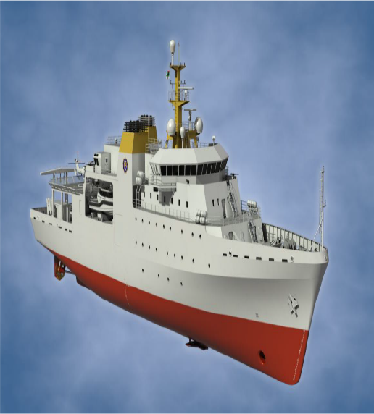
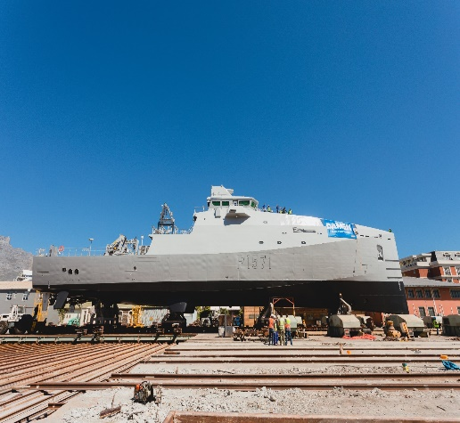
OPERATIONAL OVERVIEW
Acquisition - Maritime Systems
Hydrographic Survey Capability
  Entails the acquisition of the Hydrographic Survey Vessel, (HSV) including two fully integrated inshore survey motor boats (SMB’s) and one sea boat to replace the SAS Protea as well as upgrading of current shore-based hydrographic office (SANHO) infrastructure.
  Construction of the hull and superstructure of the HSV was completed and installation of equipment on board had commenced.
  All SMBs have been completed and the first SMB was handed over to the SA Navy on 31 March 2022.
  Upgrade of the SANHO and Sea Acceptance Trials of the Sea boat was completed.
Multi-Mission Patrol Capability
  Project comprises the construction of three Multi-Mission Inshore Patrol Vessels.
  The first vessel’s commissioning and acceptance trials were completed and the vessel is being prepared for delivery.
  Second vessel was approximately 70% complete .
  The keel of the third vessel had been laid and the construction and fitment thereof was approximately 20% complete
  Project is on schedule, with all major ship’s equipment already delivered to the shipyard.
CONFIDENTIAL
21

Slide 22
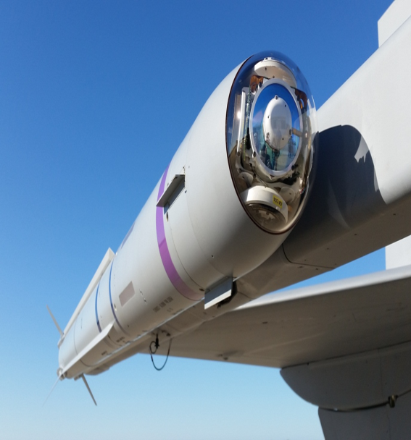
OPERATIONAL OVERVIEW
Acquisition - Airborne Systems
New Generation Short Range Air-to-Air Missile
  The programme entails the development and subsequent production of the A-Darter short-range air-to-air missile (SRAAM) system for the South African Air Force (SAAF).
  Development phase was formally completed during August 2019 and missile was qualified.
  Activities relating to the industrialisation of and preparation for the manufacturing of the missiles slowed down, the previous financial year and came to a complete halt during the financial year under review.
  Due to a total loss of all critical development and production personnel at Denel Dynamics, no progress was made with the production and delivery of the operational missiles.
  Armscor has initiated the evaluation of alternative methods of completing the required missiles for the SAAF to replace the current missiles on the Gripen fighter aircraft which are nearing the end of their operational life.
CONFIDENTIAL
22

Slide 23
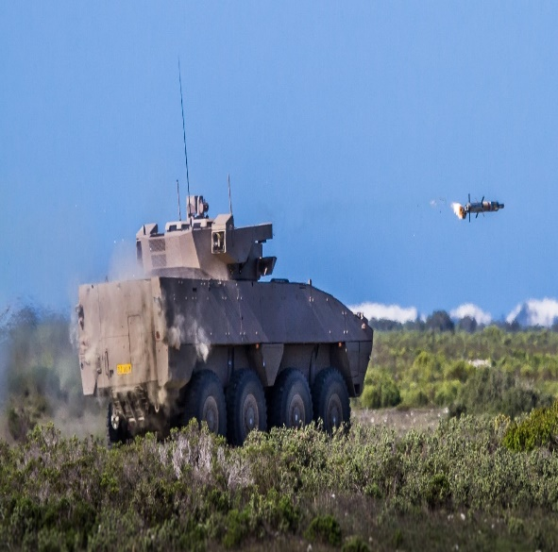
OPERATIONAL OVERVIEW
Acquisition – Landwards Systems
New-Generation Infantry Combat Vehicle
  The project provides for a complete New Generation Infantry Combat Vehicle Products System to replace the Ratel Infantry Combat Vehicle that has been in service since 1976.
  The Project has not shown any significant progress during the year under review. The development phase of the program was contractually scheduled to be completed by May 2012, but has still not been completed.
  The delays are mainly attributed to both technical and financial challenges within Denel as well as to their suppliers and sub-contractors not supplying the required subsystems due to non-payment by Denel.
  During the year under review, Denel is suffering from a debilitating lack of capacity and capability, and this has exacerbated the delays on the programme.
  Armscor is engaging with both Denel and the DOD with the aim of finding an acceptable solution to meet the User’s requirement for this capability.
Ground Based Air Defence System for the SA Army
  Project comprises three phases, being Local Warning Segment (LWS), upgrade of the Gun Fire Control System (GFCS) of the 35mm Anti-Aircraft guns, and Battle Management, Command & Control integration.
  Phases 1 and 2 have been successfully completed.
  Phase 3 - development of most of the system elements were completed, and prototypes of all of physical elements were completed. The systems integration process is planned to commence during the next financial year.
CONFIDENTIAL
23

Slide 24
OPERATIONAL OVERVIEW
Acquisition – Common Weapons Systems
New Generation Tactical Communication System
  The project comprises the acquisition of a complete new generation tactical communication system for the SANDF. This system will make provision for all tactical communication requirements for all arms of service and will ensure interoperability between all users.
  Development and Industrialization of the four major sub-systems, HF (High Frequency) Radio system, the V/UHF (Very/Ultra High Frequency) radio system, IPCS (Intra Platform Communication System) and the SRCS (Short Range Communication System) have been completed.
  Design Test and Evaluation (DT&E) commenced and all the field testing was completed during October 2021.
  The Operational Test and Evaluation (OT&E) of the complete system is expected to commence during June 2022 with completion scheduled for July 2022.
CONFIDENTIAL
24

Slide 25
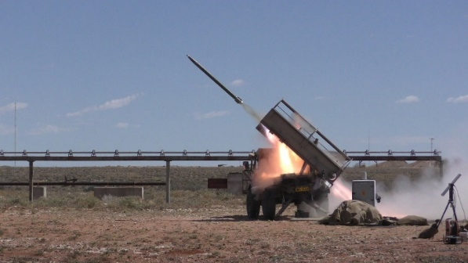
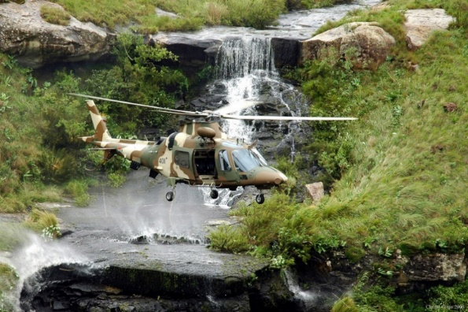
OPERATIONAL REVIEW
RESEARCH AND DEVELOPMENT (R&D) BUSINESS UNIT: ensures that strategic capabilities and facilities under its control continue to grow in accordance with the mandate and corporate goals of Armscor. This includes defence operational and scientiﬁc research, test and evaluation services and technology management, analysis and innovation management services
R&D total revenue for FY2021/22 amounted to R333.4m. The breakdown of the revenue is as follows:
  DOD Contracted Work: R129.4m
  Orders invoiced R126.6m (98% performance)
  Commercial contracted work: R84.9m (foreign & local)

Slide 26
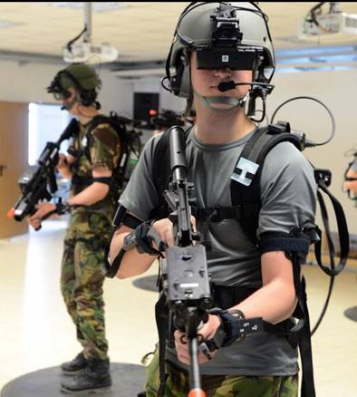

OPERATIONAL REVIEW
ERGOTECH: continues to lead in the South African ergonomics industry through providing a comprehensive array of ergonomics and occupational hygiene services to the SANDF and commercial clients.
The work on Virtual Reality continued in the previous year, where the usability study on the Virtual Reality equipment and software was conducted.
The objective was to identify possible Virtual Reality uses/applications that ERGOTECH can investigate to fulfil the SANDF requirements.
Applications for virtual reality have numerous beneficial prospects for various arms of service, such as decreasing the costs of training and improving the efficiency and safety of operations.
This work will be presented at the United Nations 6th International Partnership for Technology in Peacekeeping Symposium to be held in South Africa on 21 – 24 June 2022.

Slide 27
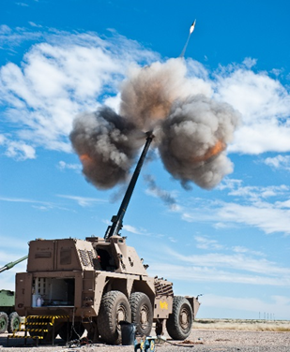
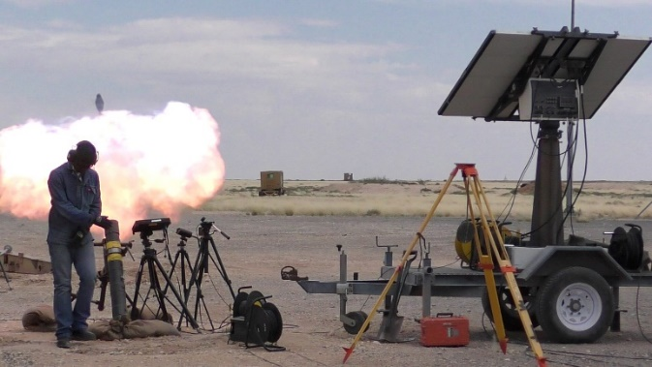
OPERATIONAL REVIEW
ALKANTPAN TEST RANGE: is an all purpose ballistic testing facility.
The procurement of a Flight Follower to increase the capability of the test range and attract more clients is at an advanced stage.
The Flight Follower will allow Alkantpan to track ammunition in flight for over 200m in Ultra-High speed.
The video images are used to establish or confirm projectile integrity, velocity and spin rate during flight and critically important in the development phase of
ammunition aerodynamics, as well as for the
qualification process.
Likely clients include RDM, Singapore, Rheinmetall Waffe Munitions and Diehl Germany.

Slide 28
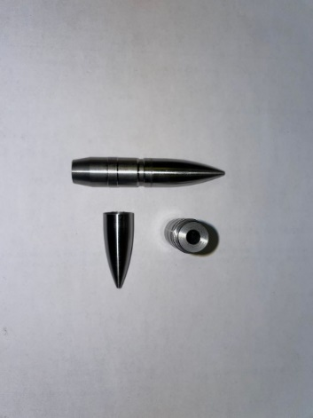
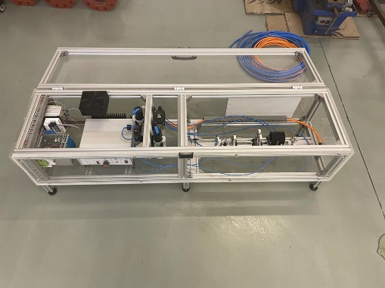
OPERATIONAL REVIEW
FLAMENGRO: offers an additive manufacturing, computational mechanics, test measurements and software development capabilities to the DOD as well as to the commercial clients in the defence industry.
A design and commissioning of a spin-jig (a test platform for ammunition spin rate) for a pre-fragmented 30mm projectile fuze testing has been achieved.
The spin-jig is a continuation of the pre-fragmented 30 mm projectile project in partnership with local manufacturers (Denel Rheinmetall – RDM, Denel PMP and Reutech Solutions).
To improve this projectile, Flamengro developed two versions that have improve lethality and performance (range and speed).
This 30 mm projectile is used by many defence forces through out the world and should be integrated in many weapon systems. This development has now surpassed technology readiness level 4.

Slide 29
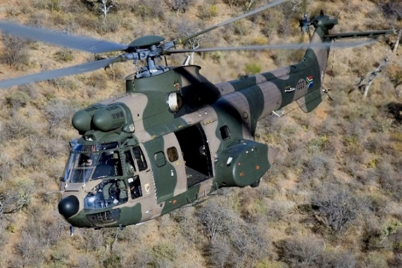
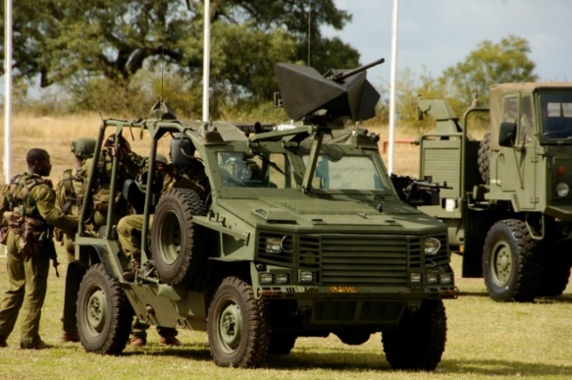
OPERATIONAL REVIEW
DDSI: renders defence capability analysis, environmental scanning, configuration and data management, Logistics and Systems Engineering support and Product System Management.
Specialist defence decision support services were offered to the Defence Secretariat on specialised topics that include:
Global, continental and regional analysis with emphasis on main security stressors.
The Defence Dilemma in terms of the fiscus perspective and the national defence capabilities including interventions for stability.
The analysis on the evolving dimensions of sovereignty and national security and the development of a national security construct.
The development of a national security campaign concept and the development of national defence priorities and broad capabilities.
Analysis of the July 2021 KZN uprising and the implications for defence planning.

Slide 30
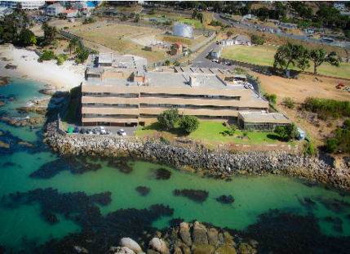
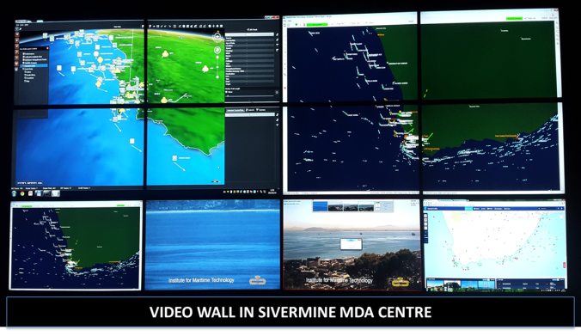
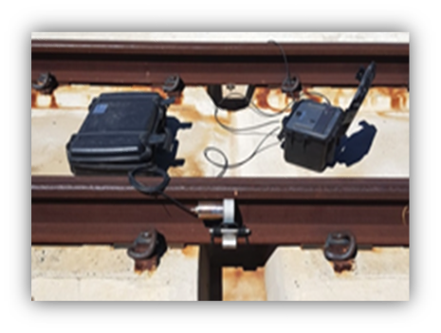
OPERATIONAL REVIEW
INSTITUTE OF MARITIME TECHNOLOGY (IMT) – provides services to the SANDF (primarily to the SA Navy), government departments, defence industry, the broader maritime community and other clients as part of its commercial initiatives.
Maritime Domain Awareness (MDA) System
  MDA is a system that fuses data from multiple surveillance sensors e.g. radar, cameras, etc. to provide a consolidated surveillance picture of the SA coastline.
  The MDA system provides a maritime picture to the SA Navy for situational awareness in order to effectively monitor the ship traffic around the SA coastline.
  IMT handed over the MDA Centre West to the SA Navy; will be handing over the MDA Centre East in FY2022/23.
  Ultrasonic Broken Rail Detector (UBRD) System
  UBRD system is a railway safety system that detects broken rail and sends alarms to the railway operator.
  The system is critical to the safe and efficient operation of any modern railway.
  System is constantly developed and refined into the leading broken rail detector technology in the world; IMT successfully developed UBRD Version 5.

Slide 31
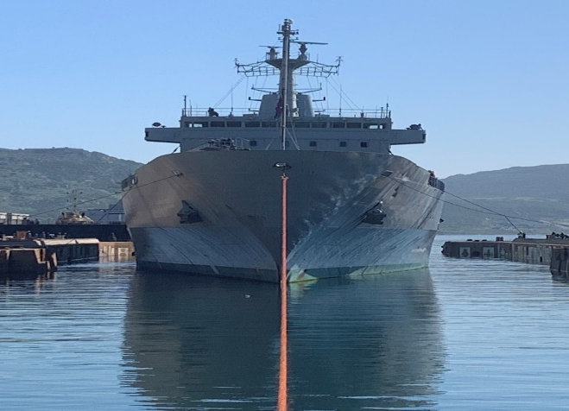
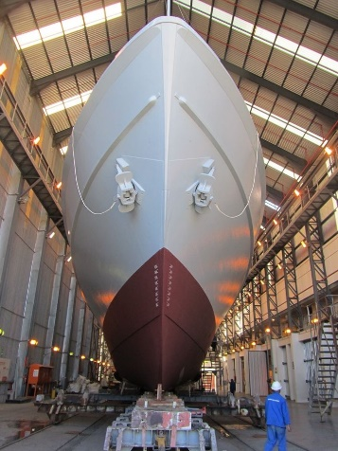
OPERATIONAL REVIEW
ARMSCOR DOCKYARD
The Dockyard is on a continuous drive to renew it’s capabilities and continuous improvement opportunities are being identified and implemented on an ongoing basis in order to deliver the required support to the SA Navy. Considerable progress was made during the past few years and the results are visible in the Dockyard in terms of renewal of people, equipment, processes, facilities and technologies, amongst others.

Slide 32
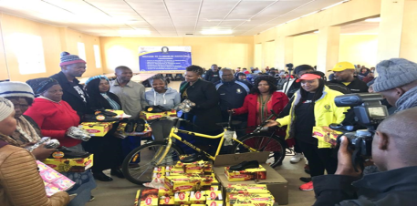
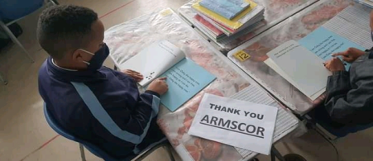
OPERATIONAL REVIEW
Corporate Social Investment
Armscor as a socially responsible organisation supports communities in which it operates. The focus is on education to assist learners from previously disadvantaged communities to improve their performance and results in Science, Technology, Engineering and Mathematics (STEM) subjects.
Initiatives highlighted in the Human Capital Programme include the following:
Back to School Campaign (North West, Free State, Limpopo Gauteng, Northern Cape)
    School shoes, uniforms and dignity packs were donated to learners in the Ganyesa, Taung, Mangaung, and Vhembe disadvantaged Communities.
    Donated school tables, chairs and reading materials for after school reading programme in Rosettenville.
    Support towards the renovation (doors and windows) and painting of class rooms in Priska.
  Workplace readiness (KwaZulu Natal)
    Supported a technical training initiative for learners with disabilities to prepare them for life after school.
STEM programme (North West, Gauteng)
    Supported the Maths and science intervention programmes for Grade 12 learners.

Slide 33
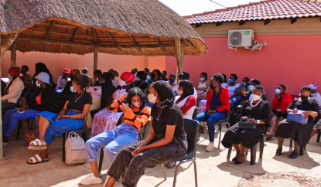
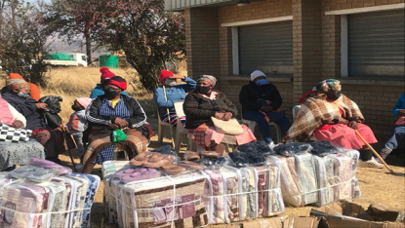
OPERATIONAL REVIEW
Corporate Social Investment (cont.)
Socio-Economic Upliftment Programme
These programmes are focused on improving the lives of communities and creating an inclusive economy. Initiatives highlighted under the Socio-Economic Upliftment programme include the following:
Assistance to old age homes (Free State, Northern Cape)
  Donated food parcels and blankets to old age home in Mangaung and Thabo Mofutsanyana District.
  Donated industrial washing machines, Dryer and gardening equipment in Priska.
Food parcels, water and blankets (Gauteng, Mpumalanga, Western Cape)
  Donated food parcels and gardening equipment to a centre housing children cancer patients in Diepkloof.
  Donated food parcels to disserving communities in Bushbuckridge and Khayelistsha.
Community workshop
  Workshop on Aids education, COVID-19 education and vaccine drive and awareness against GBV in Dennelton.
Military Veterans farming project (Eastern Cape)
  Provided support to military veterans with their farming project.
Disaster Relief Initiatives (Gauteng and Eastern Cape)
  Donated food parcels, water and blankets to a number of communities in KZN during the recent flood disaster.

Slide 34
HUMAN CAPITAL MANAGEMENT
STRATEGIC OBJECTIVE – STAKEHOLDER MANAGEMENT
Employment Equity Targets
Measuring our workforce demographics is vital to achieve a diverse workforce at all levels. Armscor continues to drive transformation through Employment Equity (EE) Plan. The target for increasing black representation for the financial year 2021/2022 was set at 83%. However, Armscor exceeded the target by achieving 87.05%.
The latest data show that female representation increased to 40% during the review period 2021/2022.

Slide 35

FINANCIAL PERFORMANCE
MAIN UNDERLYING PERFORMANCE FACTORS:
Net Surplus Detractors
Voluntary severance packages paid in the current year contributed to a 6% increase in personnel costs. Savings are expected to be realized over the next three years.
Expenses remain well managed and increased by 16% due to return of economic activity post COVID-19 and cost of the severance packages.
Lower revenue, excluding the main allocation, decreased by 9% due to reduced funding for technology projects and the lingering effect of COVID-19 on operations.
The fair value adjustment reflecting the lower value of fixed properties, resulted in a R46m cost to the Group in the current year.
Net Surplus Contributors
7% relative increase in the main allocation compared to prior year, which included cuts effected to fund unplanned government COVID-19 expenditure.
Allocation (government grant) covers 73,3% of expenditure.

Slide 36

SUSTAINABILITY REMEDIES
FINANCIAL POSITION
Financial Position:
Total group value (shareholder value) declined by R392,8m (13%) as the value of fixed properties reduced following a market valuation indicating the current low demand in the property market following the impact of COVID-19.
Non-current liabilities increased by 12% due to higher long term employee benefits.
The Group maintained a healthy liquidity and solvency position.

Slide 37
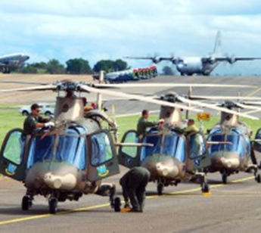
CHALLENGES
Funding challenges:
  Insufficient funding for maintenance of Strategic Capabilities – Gerotek, Alkantpan.
Insufficient funding to service maintenance and procurement requirements of DOD – resulting in inability to maintain DOD systems to the required availability levels.
Supply risk – Decline of Denel is impacting on the continued production and maintenance of strategic Defence Systems.
Industry Performance and decline – Decline of Denel has negative impact on sustainability of strategic second tier suppliers. Industry is scaling down and will be unable to ensure continued supply to critical systems and services to DOD.
Legacy Systems - Disparate and outdated information systems.

Slide 38
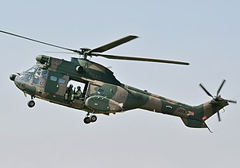
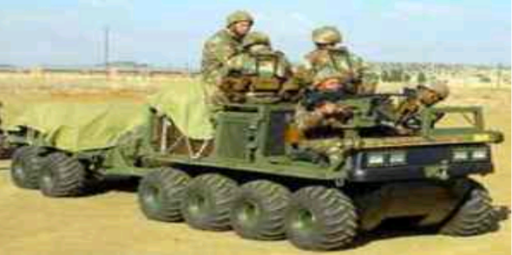
RESPONSES
Insufficient funding to service maintenance and procurement requirements of DOD – Armscor is developing optimised maintenance strategies for DOD – to maximise availability of systems at lower cost.
Supply risk – Alternative options are being explored to ensure continued supply of strategic capabilities – i.e. forming partnerships with other entities to supplement Denel capabilities and migrating strategic defence capabilities to Armscor.
Expand the model of paying suppliers directly and Denel ring fencing the project related funds.
Legacy Systems - Implement an ERP for the Corporation.
        - Process at an advanced stage.

Slide 39
AG’s AUDIT REPORT 2021/22
AG’S AUDIT REPORT 2021/22
Opinion - Received an unqualified audit report
Report on the annual performance report
Did not identify any material findings on the usefulness and reliability of the reported performance information
Report on the compliance with legislation:
Annual Financial statements
Finding: Material misstatement of contractual commitments note (note 45) in financial statements due to:
Inconsistent disclosure of contractual commitments
(Contractual commitments note disclosure included the capital commitments in 2021/22 – reflected separately in 2020/21)
Incomplete recognition of capital and contractual commitments in the prior year (2020/21)
(Prior year figure restated with amount not reflected in 2020/21 – R 46,5m)
Due to system imposed limitations due to legacy systems (not single ERP system but consolidation from different financial systems implementation of ERP system will assist
  Not detected during reviews by senior management implemented new report during 2021/22 to correct prior year understatement. However, the 2020/21 audited figure was not again reviewed in detail for completeness

Slide 40
AG’s AUDIT REPORT 2021/22
AG’S AUDIT REPORT 2021/22
Expenditure management
Finding : Effective an appropriate steps were not taken to prevent irregular expenditure (R 11.5 million) due to:
Contract extended above the 15% limit allowed
(Telkom WAN links tender renewal not completed before expiry of existing contract – continued on month to month basis in excess of 15% allowable limit)
Single source procurement without obtaining prior approval from National Treasury
(Payspace payroll system implemented due to previous payroll system phased out by supplier - applied for deviation to National Treasury .However, single source approval only received after implementation due to information requested. Irregular expenditure was condoned by National Treasury)
(Trueconf system used by Armscor for video conferencing - licenses renewed without obtaining single source approval)
Corrective actions :
Standardisation and review of contract registers to ensure completeness
Pro-active initiation of renewal of contracts before expiry
Training of SCM personnel regarding requirements for single/sole source procurement

Slide 41

CONTACT DETAILS
THANK YOU

