Slide 1
ACSA ANNUAL FINANCIAL RESULTS
FOR THE YEAR ENDED 31 MARCH 2022
FY 2021/2022

Slide 2

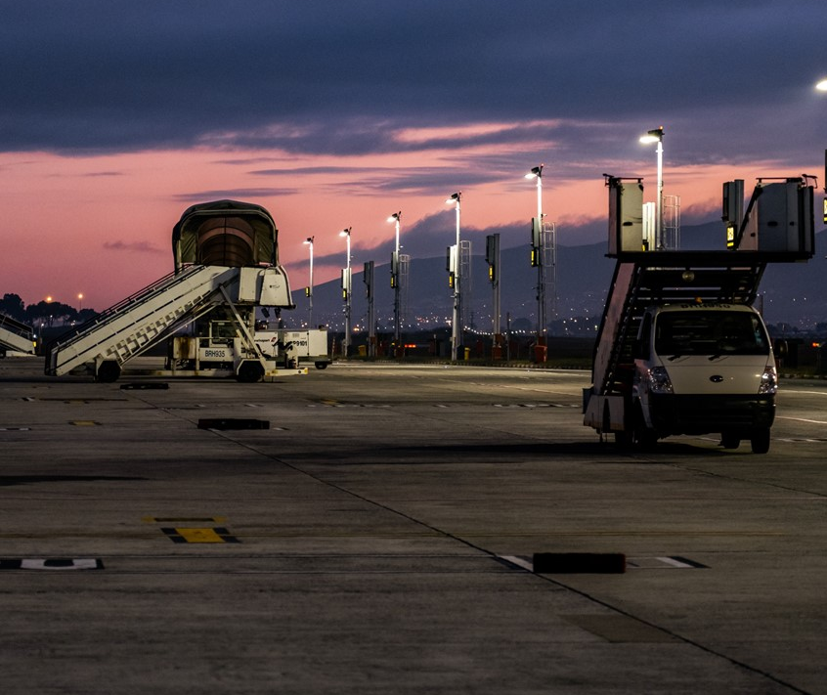
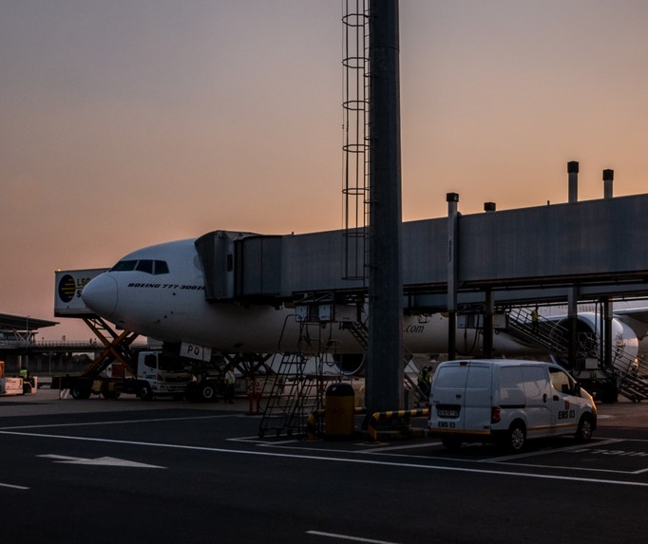

TABLE OF CONTENTS
01 INTRODUCTION
02 KEY HIGHLIGHTS
03 EXTERNAL ENVIRONMENT
04 RECOVER AND SUSTAIN STRATEGY
05 OPERATING ENVIRONMENT
06 FINANCIAL PERFORMANCE
07 FORWARD
LOOKING
08 QUESTIONS
& ANSWERS

Slide 3
01
INTRODUCTION

Slide 4
INTRODUCTION
ACSA has continued to demonstrate remarkable resilience and adaptability in the face of a slow recovery
  The Covid-19 pandemic continued to be the most significant challenge faced by ACSA
  Strategic, financial and operational responses that were put into place enabled us to sustain the business through this protracted period:
  The road to recovery will be long however global traffic trends are on upward trajectory and showing promising signs of recovery.
STRATEGY
FINANCIAL
OPERATING MODEL
Continued to implement the Recover & Sustain Strategy
Finalised the Growth Strategy with focus on Passenger Mobilisation, Aerotropolis Cargo, Global, Ground Handling
and Fuel Strategies
Continued implementation of the revised financial plan
Focused on our liquidity
Offered rental reprieves and support to our commercial partners
Implemented the new Governance Framework and Operating Model (GFOM)
Operational efficiency continues to be our primary focus

Slide 5
02
KEY HIGHLIGHTS

Slide 6

KEY HIGHLIGHTS
AIRPORT HEALTH ACCREDITATION MANAGEMENT
WORLD’S TOP 100 AIRPORTS
PEOPLE’S FAVOURITE
ACI Airport Health Accreditation programme provides airports with an assessment of how aligned their health measures are with the stipulated ACI protocols
  ACHIEVEMENT
    All nine ACSA airports are ACI accredited
Skytrax World Airports Awards based on a customer satisfaction survey conducted in global 500 airports
  ACHIEVEMENT
    Four of our airports were placed first in their categories in 2021
      Best Airport in Africa:
      CTIA (1) KSIA (2) ORTIA (3)
      Best Regional Airport in Africa:
      KSIA (1)
      Best Airport Staff in Africa:
      CTIA (1)
      Cleanest Airport in Africa (New Category):
      CTIA (1)
  ACHIEVEMENT
      2 to 5 mil PAX a year Category
    Two of our airports were placed in
    the Top 10 for this category
      CTIA (3), KSIA (6)
City Press Reader’s Choice Awards are made based on an online reader survey conducted by City Press
  ACHIEVEMENT
    Three of our airports were selected as their favourite airports
    by City Press readers
      O.R. Tambo International (Johannesburg)
      King Shaka International (Durban)
      Cape Town International
EXCELLENCE IN HUMAN RESOURCES MANAGEMENT
ACI Africa HR Excellence Awards recognize excellence in diversity, equality, competency building and sustainability in human resources management
  ACHIEVEMENT
    ACSA was placed first in the awards programme for 2021

Slide 7
03
EXTERNAL ENVIRONMENT

Slide 8
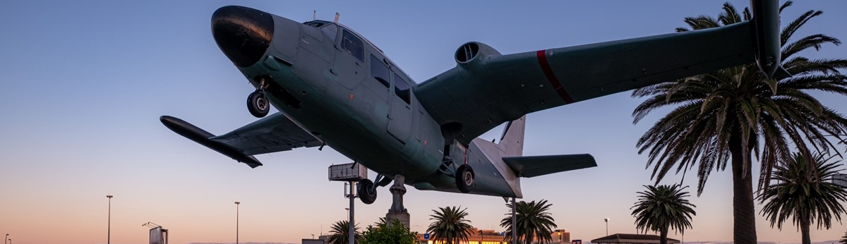
Macro-economic conditions
The industry is not immune to inflationary pressures
Global economy
Domestic economy
Tensions between Russia and Ukraine continue to place pressure on markets as energy prices continue to soar, surpassing 2014 levels
Jet fuel/oil is the largest cost item for airlines. Most airlines will be confronted by a cost blowout in the magnitude of 10% - 20%
Impact could delay the rate at which airlines restore pre-Covid-19 capacity
Increased cost of living could also undermine consumer demand for air travel
Intensity and duration of the ongoing loadshedding are expected to slow down economic growth
South African Reserve Bank (“SARB”) estimates South Africa’s GDP at 2.0% for 2022
Worsening of domestic inflation is expected to slow South African households’ real disposable income
All will have a negative impact on travelling and tourism expenditure
Results presentation for the year ended 31 march 2022
8

Slide 9
GLOBAL Aviation Industry Overview
Global air traffic recovery is still non-linear but showing positive trends with demand expected to continue into 2022
  Optimistic outlook for recovery with signs indicating that 2024/25 recovery to pre-pandemic levels is well underway
  Global uptake of Covid-19 vaccinations enhancing travel confidence
  Africa is anticipated to reach close to 72% of pre-pandemic passenger traffic levels by end of 2022
  Locally, recovery is expected to be led by domestic travel
Expected timing of full-year recovery to 2019 levels by region
uncertainty

Slide 10
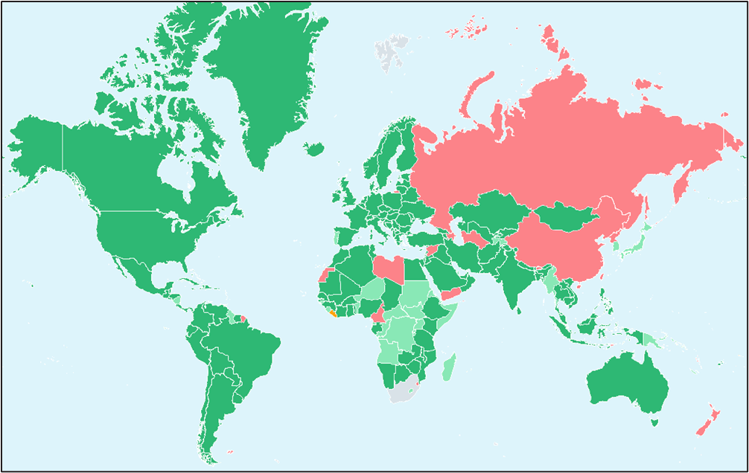
Easing of travel restrictions
Border restrictions remained one of the leading challenges for international travel in FY2021/22
OPEN
151 countries
Open for travel. Covid-19 testing / quarantine not required
TEST & TRAVEL
41 countries
Open for travel with required Covid-19 testing
TEST & QUARANTINE
5 countries
Open for travel with required Covid-19 testing and quarantine upon arrival
CLOSED
30 countries
Only returning citizens or people in special circumstances may enter
  Many countries have re-opened their borders for international travel and have moved from “closed”
  to international travel to “open with restrictions” under pre-travel requirements for testing and vaccination
  Asia-Pacific region however remains closed to international travel
  Markets like China, Japan, which make up a significant share of global traffic under “normal’ circumstances, remain restrictive – this is due to (1) the geo-political tensions (Russia/Ukraine conflict) and (2), the ongoing spread of the Covid-19 virus in Asia

Slide 11
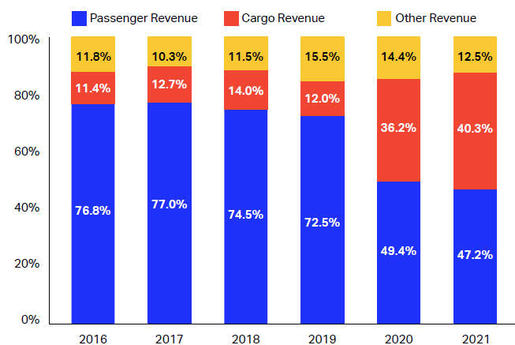
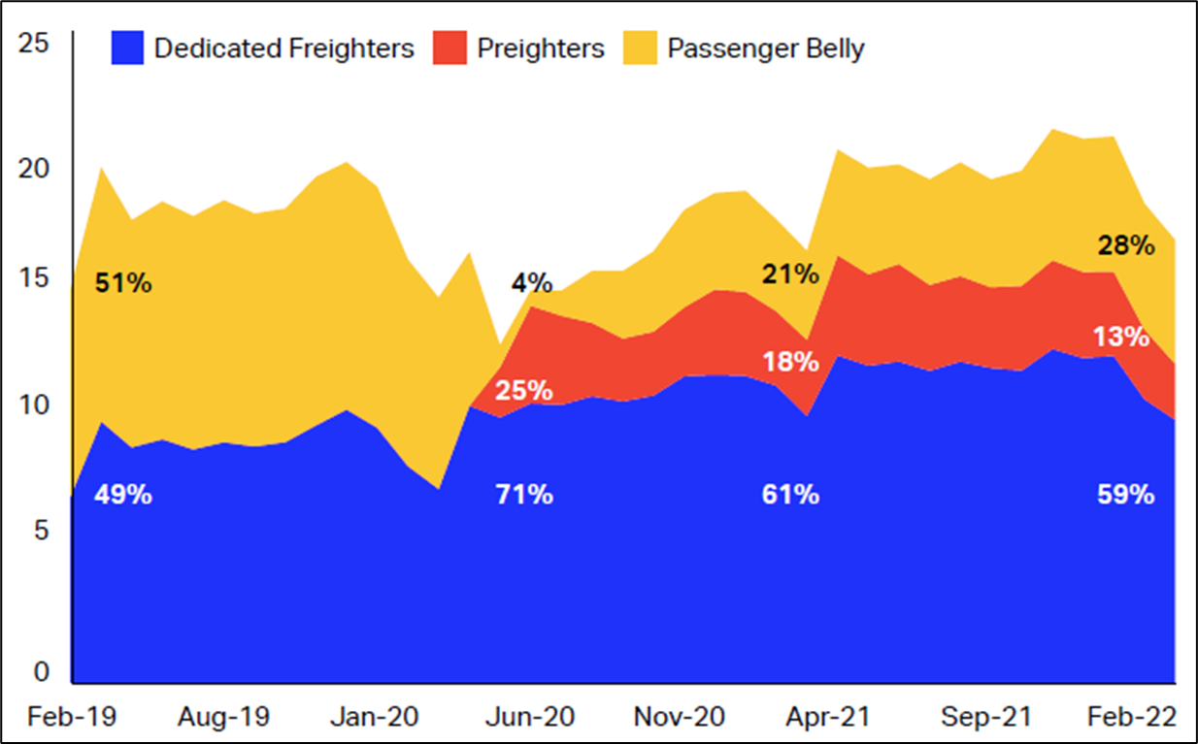
importance of cargo to sustainability
The Covid-19 pandemic has highlighted the importance of Cargo to the aviation industry
  Historically, cargo was evenly divided between aircraft belly and dedicated freighters. Post Covid-19, a higher percentage of cargo is transported via dedicated freighters.
  Airline revenue mix has also been affected – airlines generate higher revenues from cargo than pre-2019
Percentage Source of Airline Revenue
Carriage of International Air Cargo (million CTK)
Source: IATA Economics, Global Outlook for Air Transport Times of Turbulence & IATA Monthly statistics

Slide 12
04
RECOVER & SUSTAIN STRATEGY

Slide 13
RECOVER AND SUSTAIN STRATEGY
Our strategy will be implemented over three timeframes, now – 2025, 2026 – 2030 and beyond 2030 and is centred around three business pillars,
run airports, develop airports and grow footprint and to create value over the short-, medium- and long- term and is outlined as follows:
TIMEFRAME #1 - NOW – 2025
Extend and defend core businesses
Explore emerging businesses that could transform the company
Minimal Capex (Replace and Refurbish)
TIMEFRAME #2 - 2026 – 2030
Build emerging businesses, to drive revenue growth and contribute to economic growth, to ensure company’s longer-term future
More Investment Partnerships (Capacity Focus)
TIMEFRAME #3 - Beyond 2030
Operate the new ACSA with a redirected focus and growth trajectory
Pronounced Growth
RUN AIRPORTS
Run our airports efficiently, optimally and innovatively
  Restructuring, productivity enhancement and cost reduction initiatives will help maintain healthy performance
RUN AIRPORTS
Run our airports efficiently, optimally and innovatively
DEVELOP AIRPORTS
Optimise assets and plan for
new capacity and growth opportunities
  Implement growth initiatives to build new revenue streams
  Add additional capacity to support growth initiatives and/or traffic growth
DEVELOP AIRPORTS
Optimise assets and plan for
new capacity and growth opportunities
DEVELOP AIRPORTS
Planning and building partnerships
GROW FOOTPRINT
Seek growth opportunities in the continent and world
Implement growth opportunities to ensure the company’s long-term growth
GROW FOOTPRINT
Seek growth opportunities in the continent and world
GROW FOOTPRINT
Groundwork, research and planning

Slide 14
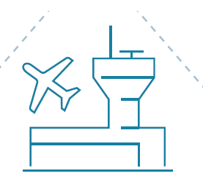
AIRPORT OPERATING MODEL
CLUSTER 1
O.R. Tambo International Airport Bram Fischer International Airport
CLUSTER 2
Cape Town International Airport
George Airport
Kimberley Airport
Upington Airport
CLUSTER 3
King Shaka International Airport
Chief Dawid Stuurman (Port Elizabeth) Airport
King Phalo (East London) Airport
  Cluster Outcomes:
  Regional Economic Integration
  Cross subsidization
  Skills rationalisation
  Feeder optimisation - Hub and spoke

Slide 15
05
OPERATING ENVIRONMENT

Slide 16
Traffic recovery
  ACSA network recovered to 49% of its pre-COVID passenger throughput by year-end
  Recovery in aircraft movements was 71%
  Domestic travel accounted for 81% of passenger traffic (70% pre-COVID)
  Recovery of international segment has been slower due to travel restrictions during the reporting period
  Recent liquidation of Comair will have negative impact on recovery
  Reduction in fleet capacity continues to be a challenge
PASSENGER RECOVERY BY AIRPORT
AIR TRAFFIC MOVEMENTS (‘000)
DEPARTING PASSENGERS (‘000)

Slide 17
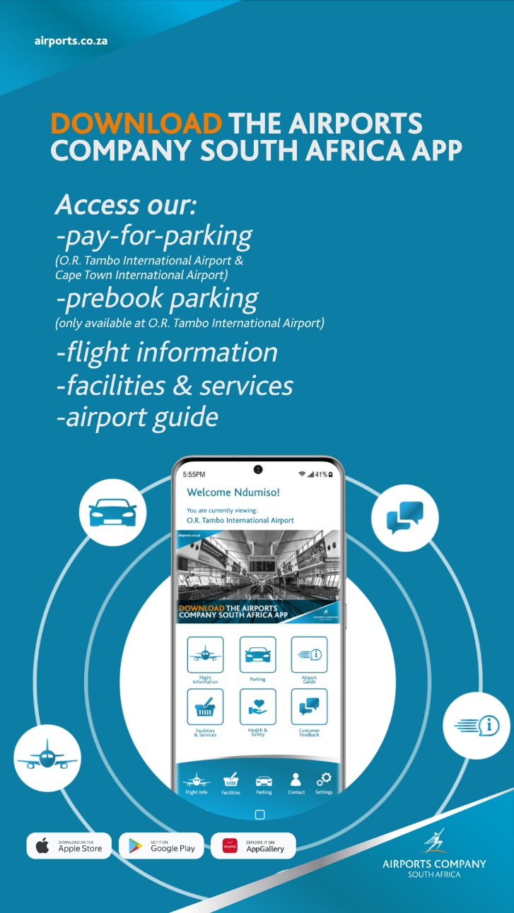
Business enablement
Information Technology
  Key objective of our IT strategy is to adopt and leverage appropriate technology to enhance the customer experience and operational efficiency while protecting our systems and information.
  Some of the projects introduced during the past two periods include:
    A biometrics-driven automated border control system at CTIA
    ACSA mobile application
    An upgraded Enterprise Resource Planning and Queue Management System
  Training Academy
  ACSA Training Academy designated and accredited ACI and ICAO Academy for South of Equator Africa. Process of transforming academy into an industry-wide African Regional aviation training centre of excellence.
  Academy will be a stand-alone entity in the next year - leverage our human capital, institutional knowledge and experience to offer tailored programmes for both internal and external clients.
  Monetisation of ACSA strategies, programmes and operational systems through other Domestic and Continental Airports, ACI Africa and ACI World

Slide 18


PERFORMANCE OVERVIEW
* OUR BUSINESS: Strategic objectives and KPIs |  | Metric | FY2022 Actual | FY2022 Target | Target achieved
Financial sustainability | OPEX allocation | R million | R3 173 million | R3 807 million | ●
 | CAPEX allocation | R million | R546 million | R1 000 million | ●
Diversify the business portfolio | Non-aeronautical revenue | R million | R2 180 million | R1 987 million | ●
Increase reputation | Stakeholder Management Plan | % | 93% | 80% | ●
 | Passenger satisfaction | Rating from 1 (poor) to 5 (excellent) | 3.94 | 3.6 | ●
 | ACI Airport Health Accreditation | Accreditation as per ACI criteria | ACI Airport Health Accreditation obtained for all 9 airports | Obtain ACI Airport Health Accreditation for all 9 airports | ●
OUR PEOPLE AND SOCIETY: Strategic objectives and KPIs |  | Metric | FY2022 Actual | FY2022 Target | Target achieved
Ensure successful transformation of ACSA operations | B-BBEE Level | B-BBEE as per the code | Level 2 | Level 2 | ●
 | % Black business share of commercial revenue generated | % | 42% | 40% | ●
 | # of job opportunities created | Number of job opportunities | 17 130 | 18 405 | ●
OUR ENVIRONMENTY: Strategic objectives and KPIs |  | Metric | FY2022 Actual | FY2022 Target | Target achieved
Reduce environment impact | ACI Carbon Accreditation Level | ACI level as per mapping certification criteria | Attained AC I Level 2 Reduction Certification for four airports (ORTIA, CTIA, KSIA, PEIA) | Maintain Level 2 Reduction Certification for at least three airports (ORTIA, CTIA, KSIA) | ●

Slide 19
06
FINANCIAL PERFORMANCE

Slide 20

Financial Performance Overview
The financial performance for the year reflects the impact of the COVID-19 pandemic, which severely curtailed both aeronautical and non-aeronautical revenues.
  There has been significant improvement in financial performance and the outlook. The performance was, however, affected by the two waves of Covid-19 and civil unrests in July 2021.
  The recovery was, however, uneven with domestic and regional traffic recovering to 58% and 36% of pre-pandemic levels respectively. In contrast, international traffic, hampered by the impact of travel restrictions and Omicron variant in the third quarter of the financial year, only recovered to 29% pre-pandemic levels.
  The financial position of the company remains solid with a strong asset base and low levels of debt.
  Capital expenditure program is limited to maintenance and refurbishment as part of the Recover and Sustain Strategy.
  The cost-reduction initiatives introduced in the previous financial year continued to minimise operating costs. These included headcount rationalisation through VSP and ER program.
  Rental reprieves for commercial partners who were also negatively affected by Covid-19.
Results for the year ended 31 March 2022
20

Slide 21
OVERALL EXTERNAL AUDIT OUTCOME
Report on the audit of the consolidated and separate financial statements
The consolidated and separate financial statements present fairly, in all material respects, the financial position of the group as at 31 march 2022, and its financial performance and cash flows for the year then ended in accordance with international financial reporting standards (IFRS) and the requirements of the Public Finance Management Act of South Africa Act 1 of 1999 (PFMA) and the Companies Act 71 of 2008.
Report on the audit of the annual performance report
The Auditor-General did not identify any material findings on the usefulness and reliability of the reported performance information for objective 1 – financial sustainability.
Report on the audit of compliance with legislation
Effective and appropriate steps were not taken to prevent irregular expenditure amounting to R44 million, as disclosed in note G.13 to the annual financial statements, as required by section 51(1)(b)(ii) of the PFMA. The majority of the irregular expenditure disclosed in the financial statements was caused by non-compliance with supply chain management prescripts or legislation that led to irregular expenditure.

Slide 22







FINANCIAL PERFORMANCE
REVENUE
 81%
R3.9 billion
(FY 2020/2021: R2.2 billion)
EBITDA
 119%
R342 million
(FY 2020/2021: -(R1.8 million))
PROFIT / (LOSS) FOR PERIOD
 61%
(R1.0 billion)
(FY 2020/2021: (R2.6 billion loss))
Revenue
R3.9 billion
EBITDA
R342 million
FY 2020/21:
R2,2 billion
FY 2020/21:
-R1,8 billion
Profit / (Loss) for period
-R1 billion
Operational Expenditure
R3.3 billion
FY 2020/21:
-R2,6 billion loss
FY2021/22
R3,8 billion
CAPITAL EXPENDITURE
 44%
R546 million
(FY 2020/2021: R973 million)
TOTAL ASSETS
 4%
R30.4 billion
(FY 2020/2021: R31.6 billion)
GEARING RATIO
26%
(FY 2020/2021: 23%)
Capital
Expenditure
R546 million
Total
Assets
R30.4 billion
OPERATIONAL EXPENDITURE
 13%
R3.3 billion
(FY 2020/2021: R3.8 billion)
FY2021/22 target:
R973 million
FY2020/21:
R31,6 billion
Gearing Ratio
26%
FY2020/21:
23%

Slide 23
FINANCIAL PERFORMANCE – TRAFFIC VOLUMES
DEPARTING PASSENGERS (Thousands)
AIRCRAFT MOVEMENT (Thousands)
  Traffic volumes more than doubled in comparison to 2020/21 but remained at about 50% of pre pandemic levels of 2019.
  Travel bans, national lockdown and civil unrests contributed to the slow recovery.

Slide 24
FINANCIAL PERFORMANCE - PERIOD ENDED 31 MARCH 2022
FINANCIAL PERFORMANCE AND INCOME & EXPENDITURE (Rmn)
PROFIT AND LOSS (Rmn)
  The performance reflects the impact of Covid-19 on the aviation sector in the last two financial years and consequent travel restrictions which continued during the year under review and had the effect of curtailing both aeronautical and non-aeronautical revenues.

Slide 25
FINANCIAL PERFORMANCE - PERIOD ENDED 31 MARCH 2022
AERONAUTICAL REVENUE (Rmn)
  Aeronautical revenue improved significantly by 121.7% to R1,8 billion (2021: R810 million). The improvement is due to increase in aircraft landings and departing passenger numbers.
  Non-aeronautical revenue performed better than last financial year by 57.1% to R2,1 billion (FY2020/21 R1,3 billion). The improvement takes into account rental revenue reprieves of R591 million (FY2020/21 R1.4 billion) granted to tenants to offset the negative impact of the COVID-19 pandemic.
NON-AERONAUTICAL REVENUE (Rmn)

Slide 26
FINANCIAL PERFORMANCE - PERIOD ENDED 31 MARCH 2022
TOP FIVE OPERATIONAL EXPENDITURE (Rmn)
  Operating costs increased by 3.9% to R2,02 billion (FY2020/21: R1,95 billion). The cost reduction initiatives introduced in the two previous financial years have assisted to minimise operating cost for the group.

Slide 27
FINANCIAL POSITION - PERIOD ENDED 31 MARCH 2022
ASSETS & LIABILITIES (Rmn)
  ASSETS
  Total assets for the period ended 31 March 2022 decreased to R30.4 billion compared to the balance of R31,6 billion at the beginning of the year:
  Capital Assets additions of R546 million offset by depreciation and amortisation charge of R1,2 billion
  Investment Property Fair Value loss of R91 million
  Cash and cash equivalents decreased by R1,3 billion, and
  Offset by increase is trade and other receivables of R747 million
  LIABILITIES
  Total liabilities decreased by R182 million to R10,7 billion compared to the balance of R10,8 billion at the beginning of the financial year:
  Decrease in deferred tax liability of R302 million,
  Decrease in interest bearing borrowing of R67 million
  Offset by increase in trade and other payables of R188 million, and
  Increase in provisions of R15 million.

Slide 28
CAPITAL EXPENDITURE - PERIOD ENDED 31 MARCH 2022
CAPITAL EXPENDITURE (Rmn)
  The Group had a Capital Allocation Target (“CAT”) of R973 million and a funding limit of R1 billion.
  The R546 million capital expenditure for the year is below the CAT by R427 million. This was due to various internal challenges with the capital execution program which are currently being addressed.

Slide 29
CASHFLOW - PERIOD ENDED 31 MARCH 2022
CASH AND CASH EQUIVALENTS (Rmn)
  The cash and cash equivalents (excluding short-term investments) decreased by R1,3 billion for the period ended 31 March 2022. These include the following movements:
  R47 million cash generated from operations. Total receipts for the year are R3,6 billion (R2,2 billion in FY 2021), compared to pre-COVID receipts of R7,5 billion in FY 2020.
  Additions of R525 million to fixed assets,
  Repayment of interest-bearing borrowings of R296 million, and
  Interest of R548 million paid on interest bearing borrowings.

Slide 30
GEARING RATIO
GEARING (%)
  GEARING RATIO:
  The gearing increase is driven by decrease of R1,3 billion in Total Assets to R30.3 billion (FY 20/21 R31,6 billion) whilst borrowings only decreased R67 million to R9,25 billion (FY 20/21 R9,32 billion)
  Major debt redemptions to be noted are as follows:
    R1,7 billion AIR02 fixed rate bond redeemable in April 2023;
    R2,9 billion AIR01 inflation bond redeemable in the financial year ending March 2029; and
    R2,5 billion consisting largely of preference shares redeemable in the financial year ending 31 March 2031.

Slide 31
IRREGULAR EXPENDITURE
IRREGULAR EXPENDITURE | Mar-22 | Mar-21
Opening Balance | 392 492 | 1 186 073
Add: Irregular Expenditure - current year | 36 714 | 274 120
Less: Amount condoned in the current year | - | -4 335
Less/Add: Irregular expenditure adjustment | - | -126 537
Add: prior year irregular expenditure identified in the current year | 13 034 | 6 075
Less: Irregular expenditure removed | - | -828 218
Less: Prior year error | - | -114 686
Closing Balance | 442 240 | 392 492
    Opening balance Irregular Expenditure (“IE”)
    The FY 2021 closing balance R634 million reported in the prior year AFS was adjusted to R393 million due to the following:
  R126 million of the opening balance adjustment pertains to two IE removals that were approved in FY 2019/20 .
  R114 million of previously reported IE was removed in the current financial year.
    Current Year Irregular Expenditure
    IE incurred in the current year amounts to R37 million (2021: R 274 million) due to non-compliance with regulations that govern Supply Chain Management. An amount of R13 million of the previous year’s IE has been identified in the current year.

Slide 32
Fruitless and wasteful EXPENDITURE
FRUITLESS AND WASTEFUL EXPENDITURE | Mar-22 | Mar-21
Opening Balance | 77 081 | 113 129
Add: Fruitless and wasteful Expenditure - current year | 3 797 | 72 351
Less: Amount written-off in the current year | -71 823 | -108 400
Less/Add: Fruitless and wasteful expenditure adjustment | - | -
Add: prior year Fruitless and wasteful expenditure identified in the current year | - | -
Less: Fruitless and wasteful expenditure removed | - | -
Less: Prior Year error | - | -
Closing Balance | 9 055 | 77 081
  Current year Fruitless and Wasteful Expenditure
  The fruitless and wasteful expenditure identified in the year relates to the following reported incidents:
  (a) Interest on SARS re-assessments (R53 thousand) and late VAT payment (R242 thousand).
  (b) Interest and penalties on late payments to suppliers R2.6 million
  (c) R989 thousand paid for goods not received.

Slide 33
AUDIT FINDINGS: FINANCIAL CONTROL
Findings | Root cause | Response
Financial reporting: various immaterial findings on accuracy and completeness of disclosure notes. Financial Accounting: Immaterial adjustments made to AFS after draft submission. Fixed Assets Accounting and Tax: findings on completeness and existence of assets Fixed Assets Accounting and Tax: Inaccurate allowance rates in Fixed Assets Tax Register | Insufficient detail, omissions and misstatement in disclosure notes Inefficient technological and human capacity to automate certain reporting processes and improve AFS preparation and review efficiencies. Inaccurate Fixed Asset Registers, due to incomplete assets verification data. | Initiative in progress: Re-build capacity (Reporting professionals and technology) and skills lost in the 2020, 2021 and 2022 financial years due to resignations and Covid-19 staff reduction initiative. Complete fixed assets physical verification and reassessment of useful lives and residual values in line with expected use. Complete assessment of fixed assets useful lives and residual values. Update both the Accounting and Tax Fixed Assets Registers with accurate data regarding existence, useful lives and tax allowance rates.

Slide 34
AUDIT FINDINGS: SUPPLY CHAIN MANAGEMENT
Findings | Root cause | Response
Non-compliance with PPPFA Non-compliance with NT Instructions Oracle payables business process control weaknesses Contract management – inadequate contract management and monitoring: | Non-compliance with SCM legislations (PFMA, PPPFA & PPR) - ineffective oversight and monitoring by management. Insufficient and ineffective ERP control environment. Poor contract management and unjustifiable deviation from competitive process. | Refresher and continuous training on all legislative requirements to TPEC and Bid Adjudication Committee members. Investigate the reasons for this non-compliance as per irregular expenditure framework and implement corrective measures. Enhancements of Oracle ERP System configurations.

Slide 35
AUDIT FINDINGS: INFORMATION TECHNOLOGY
Findings | Root cause | Management Action Plan
Unresolved adequacy issues in legacy systems by upgrading to the latest versions to address inefficiencies. (ZEAG and AMS) Information Technology Security Management weaknesses | Outdated Technology Critical Vacancies / Inadequate Structure/ Resource constraints | Upgrade of revenue management systems (ZEAG and AMS) Appoint cyber security expertise and resources to implement cyber security controls and enforce compliance to policy on oracle, firewalls, network and 249 hosts.

Slide 36
KEY CREDIT METRICS
NET DEBT TO CAPITALISATION (below 65%)
NET DEBT TO EBITDA RATIO (below 4x)
DSCR RATIO BY AVAILABLE CASH (above 1.5x)
EBITDA INTEREST COVER RATIO (above 3x)*

Slide 37
ROLLING 12 MONTHS CASH FORECAST – JUL 2022
TO JUN 2023
PROJECTED CASH FLOW (Rmn)
KEY CONSIDERATIONS
  CAPEX allocation limit of R1 billion maintained
  OPEX allocation maintained
  New debt borrowing of R1 billion
  Redemption of AIR02 fixed rate bond (R1.7 billion)

Slide 38
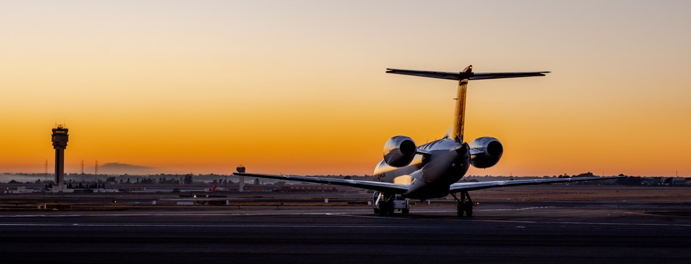
FINANCIAL PERFORMANCE OUTLOOK
- PERIOD ENDED 31 MARCH 2023
The company will continue to maintain minimal operating ad capital expenditures to preserve capital
Preserve capital
Reallocate capital
Tariff assistance
Operating expense reduction
of R1,8 billion by 2022/23
  OPEX: R1,3 billion
  Staff reduction: R500 million
Annual capital expenditure allocation limit of R1 billion
for 5-6 years
  Investment property monetisation
  International concession realisation
Limited tariff assistance given the decision to run the 2019 -2023 Permission to the end
Results presentation for the year ended 31 march 2022
38

Slide 39
Financial summary
  The group improved performance as compared to prior year due to easing of travel restrictions. This is reflected by improvement in both aeronautical and non aeronautical revenues, positive EBITDA and significant reduction in net loss i.e. R1 billion compared to R2,6 billion in prior year.
  The results demonstrate the group’s resilience in the face of unprecedented crisis precipitated by ongoing lockdowns, travel restrictions and the need to drastically scale back operations. These results indicate that the business in now in the recovery phase.
  The group’s economic regulation strategy continues to be implemented with the intention to improve predictability, transparency and balance the risk and reward in regulatory decisions. A permission application process is currently underway and the tariff decision will be implemented from the 2023/24 financial year.
  These matters relating to the funding of the group must be noted:
    The company has maintained short-term banking facilities amounting to R1,8 billion;
    The company is planning to refinance R1,7 billion of AIR02 fixed rate bond maturing in April 2023;
    AFD granted the waiver period relating on financial covenants until March 2024; and
    The company is still engaging PIC on possible shareholder financial support.
  The group continues to pursue further efficiencies throughout the business in order to ensure long-term financial sustainability as well as sustainable capital expenditure limits and disciplined capital allocation.

Slide 40
07
FORWARD LOOKING

Slide 41

FUTURE OUTLOOK
  Easing of global travel restrictions since late December 2021
  is supporting the recovery of the aviation sector.
  Foresee that both economic and COVID-related factors will continue to influence the recovery of passenger travel during the current period and beyond.
  Expect passenger traffic to continue to recover steadily throughout FY2023.
  Remain focused on our core business of running airports efficiently and strive to continuously improve the passenger experience.
  Growth Strategy Implementation, grow our footprint domestically and on the African Continent and diversification of Revenue Streams
  Execute innovative IT and digitisation initiatives through collaboration with our stakeholders.
  Redefine the airport’s space in city life and make airport hubs more attractive leisure destinations for both passengers and the public.
  Entrench the Revised Governance Framework and Operating Model, Capability Model and Organisational Structure to support sustained recovery and compliance.
  Permission application for FY2023/24 - FY2027/28 underway.
Results for the year ended 31 March 2022

