Slide 1
ELECTORAL COMMISSION ANNUAL REPORT 2022

Slide 2
Contents Page
Chief Electoral Officer’s overview
Summary of year 2021/22
Year 2021/22 by Numbers
Performance Information
Chief Financial Officer report
AGSA Audit
Statement of Financial Position Highlights
Statement of Financial Performance Highlights
Compliance with laws and regulations

Slide 3
CHIEF ELECTORAL OFFICER’S OVERVIEW

Slide 4
Introduction
It is my singular honour, as Chief Electoral Officer, to present the annual report for the financial year 2021/22, which covers activities undertaken by the Electoral Commission during the period 1 April 2021 to 31 March 2022.
The conduct of South Africa’s sixth democratic municipal elections, LGE 2021, dominated the financial year. This election project was perhaps our biggest challenge yet, given that free, fair and credible elections were delivered during an uncertain period of the coronavirus pandemic and following a Constitutional Court ruling.
The election was delivered in spite of a compressed 42-day election timetable and the introduction of innovative voter management technology.
These challenging conditions makes the achievement of a clean audit for the second consecutive year that much more remarkable.

Slide 5
Introduction
It speaks volumes about the dedication shown by the Commission, management and staff.
The achievements relates not only to the Commission’s electoral mandate, but also to a commitment to financial probity.

Slide 6
SUMMARY OF THE YEAR 2021/22
DELIVERED FREE & FAIR ELECTIONS FOR LGE 2021
2nd CLEAN AUDIT REPORT ISSUED BY AGSA

Slide 7
YEAR 2021/22 BY NUMBERS

Slide 8
YEAR 2021/22 BY NUMBERS

Slide 9
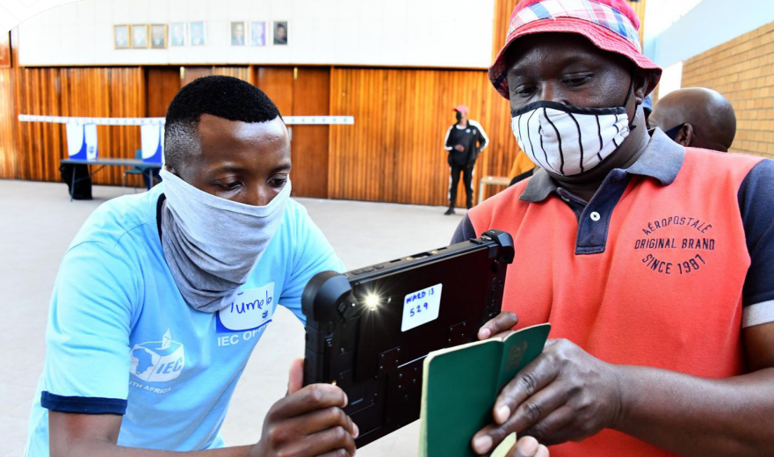
Performance Information

Slide 10
Strategic Outcome-oriented Goals
Division | Strategic Outcome oriented Goal | Number of targets | Number achieved/ exceeded | Number not achieved | % achievement
Programme 1: Administration | Goal 1: Strengthening governance, institutional excellence, professionalism and enabling business processes at all levels of the organisation | 4 | 3 | 1 | 75%
Programme 2: Electoral Operations | Goal 2: Achieving pre-eminence in the area of managing elections and referenda, including the strengthening of a cooperative relationship with political parties | 2 | 0 | 2 | 0%
Programme 3: Outreach | Goal 3: Strengthening electoral democracy | 5 | 5 | 0 | 100%
Programme 4: Party Funding | Goal 4: Contributed to the enhancement of transparency in elections and party funding | 2 | 2 | 0 | 100%
Total |  | 13 | 10 | 3 | 77%

Slide 11
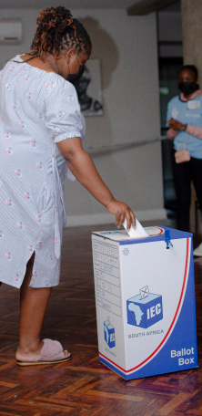
Programme 1: Administration
The purpose of Programme 1 is to achieve the strategic outcome of strengthening institutional effectiveness at all levels of the organisation. It also provides the overall strategic management of the Electoral Commission, as well as centralised support and financial management services.
OUTCOME :
Strengthened institutional effectiveness
Total targets: 4
Targets achieved: 3
% of achievement: 75%

Slide 12
Programme 1: Highlights
1. ICT ENVIROMENT
98,3% of 2 214 hrs target was achieved for network and application systems availability
2. STAFF
81,4% of 1113 posts were filled resulting in the target not achieved by 8,6%
01
ICT Environment
02
Staff
03
3. RISK
All the quarterly strategic risk assessment were performed. Target was achieved
4. Clean Audit
AGSA has issued a clean audit outcome. Target was achieved for the financial year ending 31 March 2022.
Risk
04
Clean Audit
Notes:
© Copyright Showeet.com – Creative & Free PowerPoint Templates

Slide 13
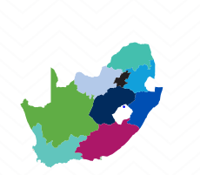
Programme 2: Electoral Operations
Programme 2 focuses on the strategic outcome of managing and delivering free and fair elections by striving for excellence at voting station level; ensuring accessibility and suitability of voting facilities and processes; managing results; maximising electoral justice for all stakeholders in the electoral process; enhancing the credibility of the voters’ roll; ensuring compliance with legal prescripts; and continuously improving the legislative framework.
OUTCOME :
Free and fair elections of representatives delivered
Total targets: 2
Target achieved: 0
% of achievement: 0%

Slide 14
Programme 2: Highlights
Manage Free and Fair Elections
1 election was set aside resulting in the target not being achieved. The Electoral Court set aside the Ward 33 election in Enoch Mgijima Municipality, principally because of the environmental circumstances surrounding the elections in the ward. While counsel had advised that there were reasonable prospects of success on appeal, the Commission opted not to appeal in order to contribute to the stability of governance in the municipality
2. Maintain Voter’s Roll
A target of 26 096 884 was not achieved resulting in an under achievement by 443 116. Traditionally, two general voter registration weekends are held ahead of a general election. Owing to Covid-19 and the regulations promulgated to curb the spread of the virus, it was not possible for the Electoral Commission to schedule two registration events.
01
Manage Free & Fair Elections
02
Maintain Voter’s Roll
Notes:
© Copyright Showeet.com – Creative & Free PowerPoint Templates

Slide 15
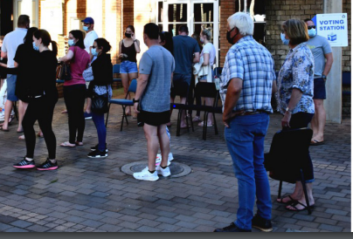
Programme 3: Outreach
This programme focuses on the strategic outcome of informing and engaging citizens
and stakeholders in electoral democracy. The programme fosters participation in electoral democracy by providing civic and democracy education on a continuous basis; voter and balloting education as may be required by each election; strategic and thought leadership on matters pertaining to electoral democracy; broadening our research agenda and issuing publications; increasing visibility through proactive consultation, effective communication, and presence among our stakeholders and communities; facilitating platforms for political dialogue; cultivating an environment conducive for the holding of free and fair elections; and constantly engaging the media.
OUTCOME :
Informed and engaged citizens and stakeholders in electoral democracy
Total targets: 5
Targets achieved: 5
% of achievement: 100%

Slide 16
Programme 3 : Highlights
Research Initativies
3 research initatives were achieved and exceeded.
Leadership Interactions
10 thought leadership
interactions were achieved as planned.
05
Research Initiatives
04
Leadership Interactions
Educational Events
42 619 is the total number
of civic and democracy education which were held resulting in the target being achieved and exceeded.
03
Stakeholder Meetings
55 meetings with stakeholders held resulting in the target being achieved and exceeded.
Educational Events
02
Stakeholder Meeting
01
Multimedia Communication
Target for multimedia communication on various platforms was achieved and exceeded
Multimedia
Communications
Notes:
© Copyright Showeet.com – Creative & Free PowerPoint Templates

Slide 17
Programme 4: Party Funding
This programme focuses on the strategic outcome of contributing to the enhancement of transparency in elections and party funding.
The programme manages party funding and donations in
compliance with legislation, and
strengthens cooperative relationships by providing consultative and liaison platforms between the Electoral Commission and political parties and candidates, using systems, people and processes that are sustainable.
It also provides effective management of the registration of political parties and processing of the nomination of candidates for various electoral events.
OUTCOME:
Contributes to the enhancement of transparency in elections and party funding
TOTAL TARGETS: 3
Target achieved: 3
% of Achievement: 100%

Slide 18
Programme 4: Party Funding
Disbursements
4 disbursements to
represented parties were made resulting in the target being achieved.
01
Liaison Sessions
19 liasion sessions held with stakeholders and potential contributors to the Multiparty Democracy Fund.
The target was achieved and exceeded by 9 meetings.
Disbursements
02
Liaisons Sessions
Notes:
© Copyright Showeet.com – Creative & Free PowerPoint Templates

Slide 19
Chief Financial Officer Report Presented by Ms Andile Dawn Mbatha CA (SA)
Notes:
© Copyright Showeet.com – Creative & Free PowerPoint Templates

Slide 20
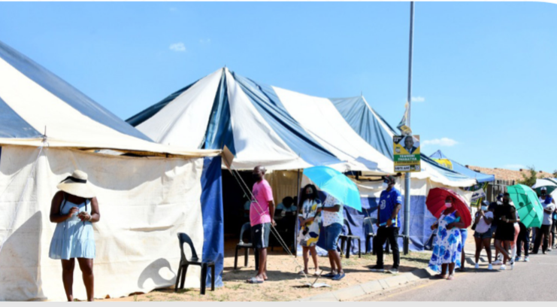
Contents
AGSA Audit
Statement of Financial Position Highlights
Statement of Financial Performance Highlights
Compliance with Laws and Regulations

Slide 21
AGSA AUDIT

Slide 22
No material matters identified by AGSA!

Slide 23
R3,5 billion awards selected for testing Testing including the procurement of the VMD devices

Slide 24
0% of irregular expenditure identified by AGSA

Slide 25
FINANCIAL STATEMENTS

Slide 26
Statement of Financial Position Highlights
01
Non-Current Assets
Capitalized the VMD at R545 million
Current assets
Receivables as a result of related party transactions and prepayments
02
Non-Current Liabilities
Operating lease and lump sum provision accounted
03
Current Liabilities
Normal Trade payable and year-end accruals
04
Net assets
Accumulated surplus as result of the net effect between total assets and liabilities
05
Notes:
© Copyright Showeet.com – Creative & Free PowerPoint Templates

Slide 27
Statement of Financial Performance Highlights
3.Revenue from exchange transctions
1.Revenue from NON-Exchange transactions
Revenue of R91 million was mainly generated from sponsorship for the ROCs and investment income
01
Government allocation increased by 7% to R2,250 billion. Lease revenue (free voting station) increased by 2 840% to R6,2 million
4.Goods & SERVICES
As result of election activies expenditure increased by 374% to R1,463 billion
02
2. Employee cost
5.Audit fee
03
Audit fees totalled R10,1 million
In relation to the election activities the expenditure increased by 27% to R962 million.
04
05
Notes:
© Copyright Showeet.com – Creative & Free PowerPoint Templates

Slide 28
Cost DRIVERS FOR LGE2021
5. Proffessional services
6.Communications & CONNECTIvity
4. SUBSISTENCE & TRAVEL
05
3.CONSUMABLES
7. Advertising
06
04
07
03
2.PRINTING & STATIONERY
02
01
1.CONFERENCES & WORKSHOPS
Notes:
© Copyright Showeet.com – Creative & Free PowerPoint Templates

Slide 29
COMPLIANCE WITH LAWS AND REGULATIONS

Slide 30
Irregular Expenditure
Ballot paper deviation
R16 million
Leases with Municipalities
R5.2 million
Internal Audit Panel
R41 million
Other matters
R12 million
Condonment in progress .R2,2 million has been condoned
Identified by management
R16 million condoned by National Treasury
Prior years non-compliance
Condoment process in progress
Secondary procument non-compliant
Prior year non-compliance
Current year non-compliance
There was a shortage of ballot papers
Identified by management
Identified by management
Prior year non-compliance
Administrative and political challenges
Identified by management
Non-compliance with National Treasury regulations
Condonment process in progress.R1,5 million has been condoned
Notes:
© Copyright Showeet.com

Slide 31
Fruitless and wasteful expenditure
Fruitless and wasteful expenditure of R1.7 million of this 98% relates to fraud which has been referred to South African Police Services the balance is interest due to late payment.

