Slide 1
Financing Standing Committee Presentation
October 2022

Slide 2
Anti-Money Laundering and Combating Terrorism
Financing Bill [B18-2022]

Slide 3
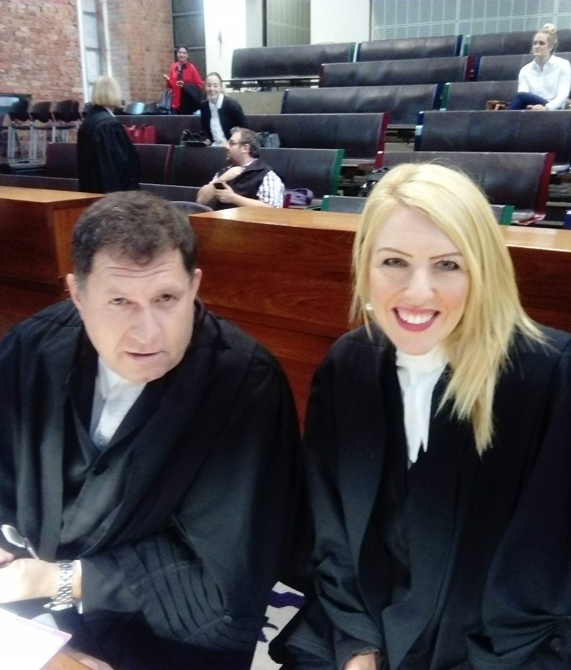
Introducing FOR SA
FOR SA is a faith and doctrinally neutral legal advocacy organisation, working to protect and promote the right to religious freedom.
Established in January 2014, religious leaders, organisations and individuals representing millions of people have joined FOR SA to contest multiple areas where rights are in danger of erosion.

Slide 4
Ambit of Religious Freedom

Slide 5
Religious Freedom & related rights
Ambit of the s15 right as per the Constitutional Court:
To believe AND to live out that belief by words and actions
Includes beliefs that are “bizarre, illogical or irrational to others, or are incapable of scientific proof”
Association:
S18 – implies institutional autonomy. (“Protecting the autonomy of religious associations is considered a central aspect of protecting religious rights.”)
Religious Communities:
S31 - Right to collectively practise their religion and form religious associations.
A defining characteristic of a religious organisation is that they restrict membership to those who adhere to their beliefs.

Slide 6
Synopsis of Concerns

Slide 7
Synopsis of Concerns – NPO Act
Mandatory registration as NPO:
  Gives broad and intrusive powers to the State to prescribe changes to a religious organisation’s founding documents.
  Will affect the organisation’s autonomy and meddle in its doctrine – Breaches doctrine of entanglement.
  Limits section 15, 18 and 31 rights without State offering section 36 justification analysis.
Duplication of process / burdens:
  Impose administrative and financial burdens on religious organisations in addition to SARS / CIPC / Master’s Office.
Criminal sanctions:
  Threat of imprisonment and/or a limitless fine
  Lack of DSD manpower to help religious organisations who want to comply.

Slide 8
Recommendations
Keep NPO registration with the DSD voluntary - especially given the duplication of registration / reporting / compliance duties with other state institutions and already having to comply with various tax reporting requirements imposed by SARS.
Alternatively:
S12(3) of the NPO Act be amended to specify that DSD cannot require changes to religious organisations’ founding document that would interfere with the religious organisations’ doctrines / tenets / beliefs; and that
S30 of the NPO Act be amended to remove the threat of imprisonment and/or a limitless fine.

Slide 9
QUESTIONS & ANSWERS

Slide 10
Contact us
Protecting and promoting
freedom of religion in South Africa!
+27 (21) 556 5502
info@forsa.org.za
FreedomOfReligionSA
www.forsa.org.za
Freedom of Religion SA NPC | 2014/099286/08

