Slide 1
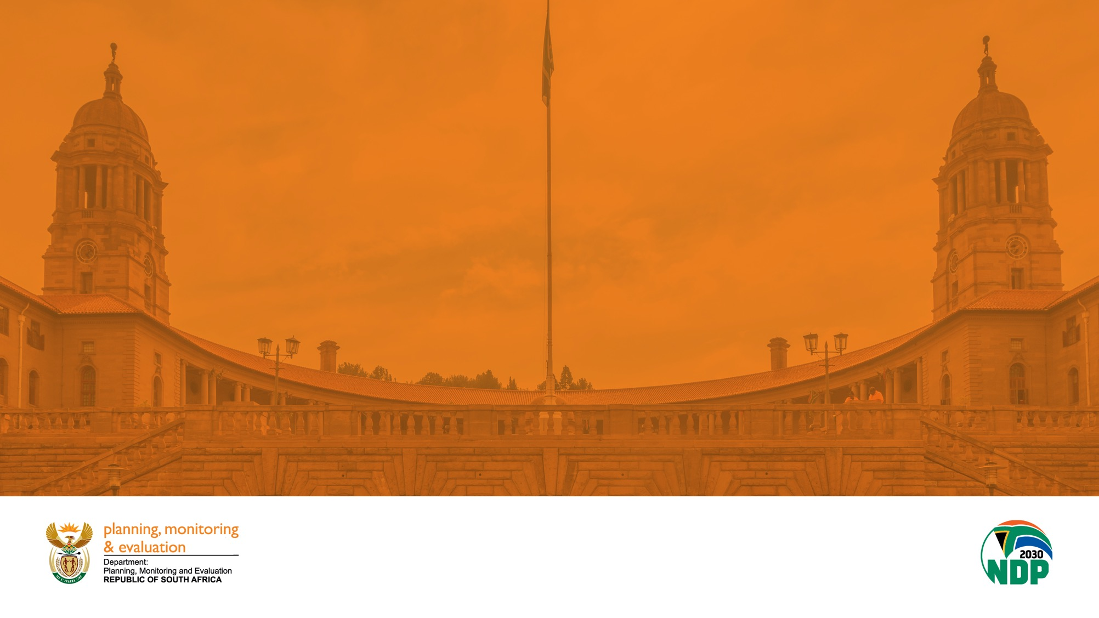
DEPARTMENT OF PLANNING, MONITORING AND EVALUATION
PRESENTATION
TO
WATER AND SANITATION PORTFOLIO COMMITTEE
ON
DEPARTMENT OF WATER AND SANITATION (DWS) ANNUAL PERFORMANCE (2021/22)
11 OCTOBER 2022

Slide 2
Table of Contents
Introduction and purpose
Methodology and Approach
Strategic Intent and Problem Statement
DWS Policy changes and Evaluations
Analysis of DWS Annual Report - period 1 April 2021-31 March 2022
MTSF 2019-2024 Performance - period 1April 2021-31 March 2022
Key Achievements
Key Challenges and Effects on citizenry
Binding Constraints
Recommendations

Slide 3
1. Introduction and Purpose
The purpose of the presentation is to appraise the department of Water and Sanitation on the performance for the year ended 31 March 2022.
The presentation outlines performance of the department of Water and Sanitation focusing on the overview of Monitoring and Evaluation of the work of the department on Priority 5: Spatial integration, Local government and Human Settlements of the Medium Term Strategic Framework (MSTF) 2019-2024
It covers Annual performance for period 1 April 2021 to 31 March 2022 and MTSF outcomes and impacts.
Outlines key achievements, persistent challenges, and binding constraints.
Recommends suggestions to be implemented towards improvement of the performance.

Slide 4
Methodology and Approach

Slide 5
Methodology and Approach
The methodology and approach adopted in this report is anchored on results-based planning, monitoring and evaluation for evidence based decision-making. Results-based management and Theory of Change remain the foundations for impact-based planning, monitoring and evaluation and the achievement of development results. Monitoring and analysis of lower order performance data can predict the achievement of higher order results allowing for early intervention towards intended results. Data collection, verification, validation, analysis, interpretation, synthesis, evaluation etc. - collect the right data at the right time.
DPME uses a variety of data sources including data from government think tanks, research institutions, universities and multilateral organisations to analyse progress
Sources of data include evaluations, research reports, policy briefs, case studies among others
DPME also conducts verification visits to selected sites to understand impact of policy in the lived experience of users government services and from those implementing at ground level
In addition DPME analyses administrative data to track progress and resource usage to achieve MTSF outcomes
Recommendations are made on the basis of evidence. Remedial actions are informed by the weighing of options and risk analysis in terms of potential for implementability and impact
Regular engagements continue with departments, organs of the state and spheres of government to follow through on the implementation of the MTSF targets and Cabinet resolutions.
Performance information from depts
Research, LGMIM & evaluations
Analysis of options & risks for remedial actions
Follow-up on Cabinet decisions

Slide 6
Methodology: Results-Based framework
Goal
(Impacts)
Long-term, widespread improvement in society
  RBM focuses on the achievement of outcomes and impacts (results)
Results
Intermediate effects of outputs on clients
Outcomes
Traditionally
only tracking inputs (resources, strategies), activities (what actually took place) and outputs (the products or services produced)
Interventions, products and services produced
Outputs
Tasks personnel undertake to transform inputs to outputs
Implementation
Activities
Financial, human, and material resources
Inputs

Slide 7
DPME Theory of Change
Inputs
Activities
Outputs
Outcomes
Impacts
OPERATIONS
STRATEGIC
Human Resources
Financial Resources
Knowledge workers
Automated systems
Efficient and effective department
Data collection and analysis, planning, monitoring
Workshops
Forums
Site visits
Citizens and stakeholder engagements
Planning frameworks, instruments, guidelines
Monitoring tools and performance reports
Evidence to support the country’s development agenda generated
Long and medium-term development agenda is institutionalised into a functional, integrated government planning system
+ Poverty, inequality and unemployment reduced
+ Education, health and social services improved
+ Improved spatial justice
+ Improved access to decent shelter and basic services
+ Improved quality of life for all
Outcome: Functional, Efficient and Integrated Government
MTSF Priority
Improved performance in all outcome areas
2

Slide 8
Performance Against MTSF 2019-2024 Target

Slide 9
Strategic Intent and Problem Statement
Strategic Intent
The NDP envisages a South Africa that recognizes the importance of secure and equitable access to water and sanitation as catalysts for socioeconomic development.
South Africa is to prioritize investment in basic services infrastructure including water and sanitation, to support economic growth and social development goals.
It is intended that all citizens will have affordable and reliable access to sufficient safe water and hygienic sanitation by 2030.
Problem Statement
Although South Africa has demonstrated progressive growth in the delivery of basic services, it continues to face difficulties. Many water service authorities are struggling to operate and maintain their water and sanitation infrastructure in a cost-effective and sustainable manner resulting in a rapid deterioration of assets and/or prolonged disruptions to service delivery
Failure to deliver basic services causes immense hardship for the residents of municipalities and has a detrimental impact on social and economic development
The NDP recognizes water scarcity as a binding constraint to national development and highlights the importance of carefully managing this limited resource. This is done by ensuring improved access to water and sanitation services to households.

Slide 10
DWS Policy and Legislative Changes
Policies under development
Draft Mine Water Management
Sustainable Hydropower Generation
Integrated Water Quality Management
National Water Resources Strategy edition three (NWRS-3)
Legislation under development
National Water Amendment Bill
Water Services Amendment Bill

Slide 11
Analysis of Departmental Annual Performance as per tabled Annual Report 2021/22
Performance Measurement
Departmental Budget Programmes
  Programme 1: Administration
  Programme 2: Water Planning and Information Management
  Programme 3: Water Infrastructure Development
 | Target Achieved (100%)
 | Partially Achieved (50% - 99%) Remedial action is needed to avoid this / there is progress, but the target is not yet achieved.
 | Not Achieved (0% - 49%) Certainty that the target will not be achieved or was not achieved in the planned timeframes – major remedial action and urgent intervention is required / the target is far from being reached or not going to be achieved at all
Financial performance
  Department received an financially unqualified opinion with findings on financial statements for the 2021/22 financial year.
  From the appropriated budget of R17 735 million the department materially underspent the budget by R2 531 million (14,3%); which included R243 million on programme 1, R117 million on programme 2 and R2 171 million on programme 3.
This implies that the department has partly achieved the planned projects for the FY amidst the various challenges affecting the service delivery environment such climatic trends and their implications on water resources; the decline in dam levels, reservoir storage and even groundwater levels mostly in the Eastern Cape and Western Cape provinces; the existing infrastructure that needs maintenance, especially with the country experiencing challenges with lack of focus on sustainable asset management.

Slide 12
Analysis of Departmental Annual Performance as per tabled Annual Report 2021/22

Slide 13
Analysis of Departmental Annual Performance as per tabled Annual Report 2021/22
Based on the performance of the 6 Outcome Indicators:
DWS has made significant strides in the fulfilment of projects for:
the protection and restoration of ecological infrastructure (outcome 1) – this has ensured the implementation of interventions to protect water resources and ensure pollution control and rehabilitation;
water and sanitation services are managed effectively (Outcome 4) through the development of strategies and support to water and sanitation services institutions for the provision of sustainable services and the development of new infrastructure, and the refurbishment, upgrading and replacing of ageing infrastructure servicing extensive areas across municipal boundaries.
the enhanced regulation of the water and sanitation sector (Outcome 5)
There following interventions still require attention:
Water redistributed for transformation on Regional Water Utilities Annual and Water User Associations.

Slide 14

Performance against the 2019-2024 MTSF for the period
1 April 2021 - 31 March 2022
OUTCOME
Improve Access to Basic Services
2019-2024 MTSF
TARGETS
MTSF ANNUAL TARGET
2021/22 FY
PERFORMANCE
2021/22 FY
100% of Water Service Authorities (WSAs) receive acceptable scores on functional assessment in the MuSSA | 100% of WSAs assessed | 76% (109 of the 144) Municipal WSAs have completed their functional assessments.
 | 100% of five-year Municipal Priority Action Plans (MPAPs) developed and implemented annually in the WSAs in priority districts | 18% of the Priority Action Plans (MPAPs) developed. 98 are required to develop the MPAPs based on the MuSSA report in the 2021/22 Financial year.
90% access to adequate sanitation and hygiene | Sanitation Situational Analysis Report. 2 Implementation reports per annum on National Sanitation Integrated Plan. | Draft National Sanitation Integrated Plan developed. No implementation reports submitted.

Slide 15
Performance against the 2019-2024 MTSF for the period
1 April 2021 - 31 March 2022
OUTCOME
Improve Access to Basic Services
2019-2024 MTSF Target
MTSF ANNUAL TARGET
2021/22 FY
PERFORMANCE
2021/22 FY
95% reliability of water services | No bucket sanitation systems planned for eradication. | No bucket sanitation systems were eradicated during the period. Construction of bulk infrastructure to connect the water borne sanitation in progress.
 | 9 Refurbishment projects to address the functionality component of the WSA reliability implementation plans | 0 refurbishment projects completed.
 | 1 010 water treatment works assessed for compliance with Blue Drop Regulatory requirements every 2 years – alternating with Green Drop Assessments | 1 186 water treatment works assessed for Blue Drop risk rating (full assessment to be carried out in 2022/23 FY)
 | 371 non-compliant water supply systems monitored | 450 (121%) water supply systems monitored
 | Develop five-year reliability implementation for 5 District Municipalities | 0 reliability implementation plans developed.

Slide 16
Performance against the 2019-2024 MTSF for the period
1 April 2021 - 31 March 2022
OUTCOME
Improve Access to Basic Services
2019-2024 MTSF
Targets
MTSF ANNUAL TARGET
2020/21 FY
PERFORMANCE
2020/21 FY
100% of wastewater treatment works operational and functioning | 56 Bulk water supply and sanitation projects completed | 16 completed
 | 963 wastewater treatment works assessed for Green Drop Regulatory requirements compliance alternating every 2 years with Blue Drop Assessments | 995 (103%) wastewater treatment works assessed
 | 260 non-compliant wastewater systems monitored | 460 (177%) wastewater systems monitored
Amended Regulatory framework on Water Ownership and Governance | Draft National Water Amendment Bill submitted to Cabinet for approval for public consultation Submit Water Services Amendment Bill to cabinet for approval | National Water Amendment Bill: submitted to OCLSA for preliminary certification Water Services Amendment Bill: ready to be sent to OCSLA for preliminary certification
Draft Bill submitted to cabinet for approval | Work underway to develop the Water and Sanitation Bill. Change in scope, from developing a Water and Sanitation Bill to amending the two existing legislation.

Slide 19
Performance against the 2019-2024 MTSF for the period
1 April 2021 - 31 March 2022
Delays in the implementation of the Bucket Eradication Programme is mainly due to the lack of bulk infrastructure to connect the water borne sanitation.
However, over the past two years the department has invested in the construction of bulk infrastructure and the infrastructure is currently at various levels of completion.
There is also a Draft National Sanitation Integrated Plan together with draft provincial action plans for all provinces to address arising issues on sanitation failures.
Interventions relating to the development of the District Municipalities five-year reliability implementation plans and refurbishment projects to address the functionality component of these plans were red-flagged for delayed implementation.

Slide 20
Key Achievements
Through the Infrastructure Fund, work has begun on the Water Infrastructure Programme:
A total of R78 million has been allocated for project preparation.
    A project management office will support municipalities with capacity building and expertise to develop their own blended finance water projects.
    Ongoing support is being provided to the DWS to ensure the right mix of financing resources is adopted.
    Projects are currently at various planning phases
Relaunch of Green Drop Programme - 995 wastewater treatment works assessed for compliance with Green Drop Regulatory requirements contributing towards restoring the functionality of wastewater infrastructure.
Water treatment works assessed for Blue Drop risk rating in preparation for the Blue Drop Assessments to be conducted in the 2022/23 FY.
Non-compliant water and wastewater systems monitored against the regulatory standards, respectively. Increase from 271 (73%) and 282 (108%) since Sept 2021 respectively. Towards improving drinking water quality, effluent control and protection of public health.

Slide 21
Persistent Challenges
Threat of a water crises in South Africa due to insufficient investment in water infrastructure; poor maintenance in existing water infrastructure; recurrent droughts driven by climatic variation; inequities in access to water and sanitation; and a lack of skilled water engineers.
As at the end of March 2022, the MIG has transferred the total 2021/22 allocation to municipalities. Municipalities reported a total expenditure of R11, 8 billion (75%) against to total 2021/22 MIG allocation. (SoLG report, DCoG)
Under-expenditure trend - Inadequate to address huge backlogs for the rehabilitation or replacement of aged infrastructure in South Africa
Underinvestment in repairs and maintenance leading to aging infrastructure with high water losses.
There is lack of capacity to deal with technical and non-technical losses. Losses incurred through tampering with metering equipment and inaccurate metering. The average water loss across the country above the 30% norm stood at 50%.
Altogether, 84% of the 114 municipalities that are water services authorities incurred water distribution losses totalling R9,82 billion.
Some of the challenges are also as a result of rapid and unplanned urbanization which is putting a huge strain on the infrastructure.

Slide 22
Effects of Challenges on Citizenry
The importance of government programs/ interventions and their effects on the lives of South Africans:
Lack of adequate infrastructure leads to poor service delivery and the decline of resources.
Businesses threatening to close-down due to long-standing water and electricity disruptions in municipalities- job losses and overall poor living conditions.
Relationship between poor debt management by municipalities and service delivery – paying residents indirectly affected by the poor payment culture in communities. E.g. Municipal consumer debts increased to R255.2 billion as at 31 March 2022 from R230.7 billion as at 31 March 2021. Households account for the largest component (68%) of this debt. (National Treasury, Section 71 Report)

Slide 23
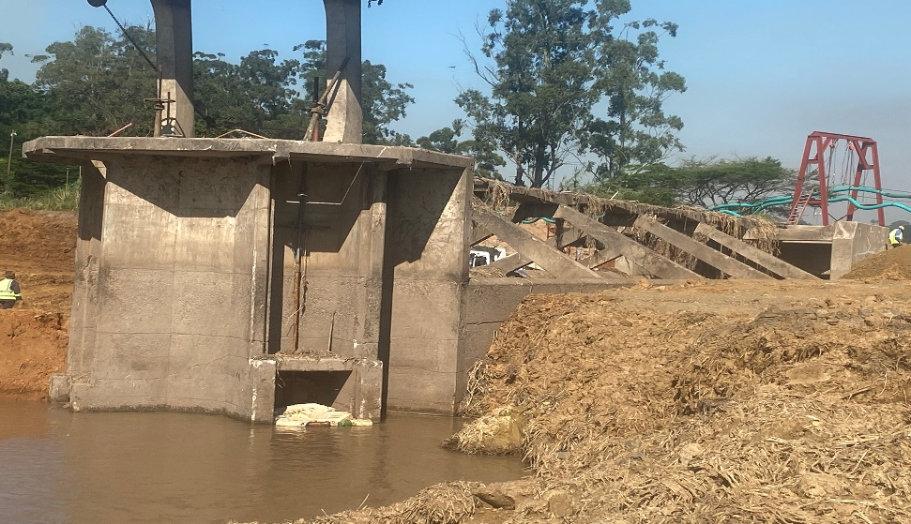
Infrastructure dilapidation: Lessons learnt form impact of floods during the period
In April 2022, parts of KwaZulu Natal encountered what it is described as a, "once in 200 years rainfall event".
DPME visited various sites in Ethekwini Municipality, Tongaat and ILembe Municipality, Stanger and Shakaskraal to review the impact on the water services infrastructure. To determine how municipalities can improve in disaster management; and draw how certain risks can be alleviated to save municipalities from such dreadful circumstances.
Tongaat’s water infrastructure totally wrecked, the Water Treatment Plant and these were the observations:
  The plant had existing problems even prior to the floods.
  The plant lacked compliance with the statutory regulations as stipulated by DWS.
  Poor responsiveness from the municipality to open sluice gates allowing water to pass through when reaching high levels in the water retention facility.
  The sluice gates were heavily corroded and not operational at the time of the floods for flow control. This is reflective of the lack of preventative maintenance and refurbishments that needed to have been regularly scheduled to ensure the infrastructure remains in good condition.
  This case is an eye opener to the possibility of many other critical infrastructure important for disaster control being at a risk of dilapidation due to neglect.
  Municipalities should be equipped to implement municipal disaster risk management strategies that are responsive to the emerging climate change conditions.
DPME site visit, Tongaat, May 2022

Slide 24
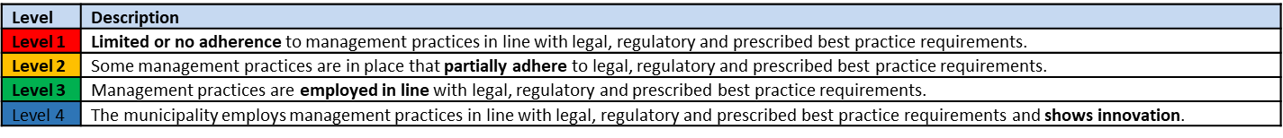
LGMIM State of Management Practices in 22 municipalities as measured during the 2021/22 assessment cycle - Based on evidence documents of the 2020/21 FY
The data contained on this slide is based on the assessment of the LGMIM standards dealing with the Water and Sanitation Services Planning and Performance against the DWS Municipal Strategic Self-assessment (MuSSA) related to Water Services.
In many municipalities the focus on expanding access to water services has come at the expense of repairs and maintenance, leading to unreliable service delivery and high levels of water losses due to leaks
Under the current conditions in relation to the Covid-19 pandemic, the redirection of funding from already poorly and underfunded O&M operations towards the rendering of expanded and/or temporary water and sanitation services can be expected to increase service failures.
If this situation is not rectified it may lead to a collapse of water and sanitation service delivery in some municipalities.
These results suggest that the majority of the WSAs have a high to extremely high vulnerability index.
The WSAs should endeavour to assess water services vulnerabilities on an annual basis and utilise the findings of the assessments to address identified vulnerabilities and implement actions that will allow for continuous improvement against these.

Slide 25
Binding constraints
Dysfunctionality of Water Boards
Governance is a major issue at most water boards. Instability at executive and board management influences all other key areas of performance.
Municipal debt is also one of the primary challenges confronting water boards.
Poor governance and debt management within municipalities has a ripple effect on the viability and sustainability of water boards.
Research on the efficiency of water boards across South Africa (Ngobeni and Breitenbach, 2021) shows that:
    Only 3 of the 9 water boards (Overberg, Rand and Umgeni) were assessed to be technically efficient after the consideration of four variables: expenditure, bulk water tariffs, water losses and volumes sold.
    6 of the smaller water boards (Amatola, Bloem, Lepelle, Magalies, Mhlathuze and Sedibeng Water) showed high levels of inefficiency with wastage in expenditure of R3.7 billion according to 2018/2019 audited annual reports.
    the service of water and sanitation as a business has for a long time not been feasible;
    water resources severely under-priced and the cost recovery is not being achieved;
    high operating expenditure; and
    Poor cashflow results in ineffective operations and poor maintenance of water supply infrastructure.

Slide 26
The Dysfunctionality of Water Boards
Technical efficiency scores of water boards
Water board | Expenditure (R’000) | Water losses (%) | Bulk Water tariffs (R/kl) | Volumes sold (million m3/a) | Technical efficiency score
Amatola Water | 434,914 | 14 | 11 | 31,432 | 0.16
Bloem Water | 757,552 | 9 | 8 | 81,118 | 0.18
Lepelle Water | 656,372 | 5 | 6 | 89,440 | 0.34
Magalies | 609,125 | 6 | 7 | 92,321 | 0.33
Mhlathuze | 624,985 | 4 | 4 | 45,106 | 0.26
Overberg Water | 52,006 | 9 | 7 | 3,265 | 1.00
Rand Water | 12,221,051 | 3 | 9 | 1,714,308 | 1.00
Sedibeng Water | 1,590,743 | 8 | 9 | 122,551 | 0.13
Umgeni Water | 2,388,440 | 2 | 7 | 471,801 | 1.00
Note:
A score of 1 represents the best-performing waterboard when measured against the expenditure, bulk water tariffs, water losses and volumes sold;
A score of less than 1 implies that the waterboard is not performing as well as its efficient peers.
Water boards need to conduct a detailed review of their expenditure and operational costs and benchmarking with the efficient water boards.
Consider merging smaller- to medium-sized water boards operating on less than optimal scale into large regional utilities to achieve efficiency.
In line with the above, DWS has initiated the realignment of Water Boards and proposed the disestablishment of Sedibeng Water.

Slide 27
Recommendations
Portfolio Committee on Water and Sanitation to support:
Critical infrastructure investments in the water sector – Allocated capital expenditure budget is appropriately spent on identified projects within the planned project timelines across the three spheres government.
DWS to establish mechanisms to address the backlog on the maintenance and refurbishment of critical infrastructure across the board – impact on the reliability of water and sanitation provision.
DWS in collaboration with DCoG and MISA to support the urgent need for municipalities to attend to water leaks and reduce water pressure to address issues on water pressure.
DWS to ensure water and sanitation supply management through continuous Blue Drop and Green Drop Programme monitoring.
DWS to fast-track the implementation of the National Water and Sanitation Master Plan is critical to address water security concerns in SA (water investment planning, maintenance of water infrastructure, water quality management etc).
To support the efficiency of water boards, DWS should explore institutional realignment through rationalisation and merging of less optimal water boards into larger regional utilities to unlock expansion of services.

