Slide 1
Annual Report 2021/22
Municipal Infrastructure Support Agent (MISA)
Briefing to the Portfolio Committee on Cooperative Governance and Traditional Affairs (CoGTA)
Presenter: Ntandazo Vimba, CEO: MISA
Date: 10 October 2022

Slide 2
PRESENTATION OUTLINE
1. | Purpose
2. | Vision, Mission and Mandate
3. | MISA’s Functions
4. | Performance Information by Programme
5. | Financial Performance
6. | Audit Outcomes
8. | Conclusion

Slide 3
Purpose
The main objective of this presentation is to brief the Portfolio Committee on Cooperative Governance and Traditional Affairs (CoGTA) on the 2021/22 Annual Report for MISA.
The presentation provides a summary of the approved 2021/22 Annual Report for MISA as tabled in Parliament on 29 September 2022.
It give highlights of performance against Output Targets in the approved Annual Performance Plan (APP) and financial performance for the year.
The presentation further depicts Audit Outcomes for MISA in each of the past five years.

Slide 4
Vision, mission and mandate
Our Vision
Leaders in Municipal Infrastructure Support.
Mission
To provide integrated municipal infrastructure support services to municipalities through technical expertise and skills development towards the efficient infrastructure delivery systems, processes and procedures.
Mandate
To render Technical Advice and Support to municipalities towards the optimisation of municipal infrastructure provision.

Slide 5
KEY FUNCTIONS OF MISA
Supporting municipalities to conduct effective infrastructure planning to achieve sustainable service delivery;
Supporting and assisting municipalities with the implementation of infrastructure projects as determined by the municipal integrated development plans (IDPs);
Supporting and assisting municipalities with the operation and maintenance of municipal infrastructure;
Building the capacity of municipalities to undertake effective planning, delivery, operations and management of municipal infrastructure; and
Performing any function that may be deemed ancillary to those listed above.

Slide 6
Summary of Performance against Planned Targets
MISA achieved performance targets for 30 of the 33 output indicators in the annual performance plan (APP) for 2021/22.
This overall achievement of 91% for 2021/22 performance is an improvement in comparison to the achievement of 81% in the previous financial year (2020/21).

Slide 7
PROGRAMME 1: ADMINISTRATION
PLANNED TARGETS | 6 | ACHIEVED | NOT ACHIEVED
 |  | 6 | 0
Key Achievements: Unqualified audit opinion on the annual financial statements for 2020/21 (Clean Audit) Four quarterly reports on the implementation of approved Communication Strategy, Risk Management Plan, Internal Audit Plan, ICT Operational Plan and Procurement Plan.

Slide 8
PROGRAMME 2: TECHNICAL SUPPORT SERVICES
PLANNED TARGETS | 19 | ACHIEVED | NOT ACHIEVED
 |  | 16 | 3
Key Achievements: 10 Municipal Water Conservation or Demand Management (WC/WDM) strategies implemented. 5 Water Services Authorities (WSAs) supported on alignment of bulk and reticulation projects for water supply. 15 Municipalities supporting with the mainstreaming of Labour-Intensive Construction (LIC) Methods. 8 Districts supported to improve infrastructure asset management practices. 30 Districts supported with implementation of Operations and Maintenance related activities. 44 Districts supported to improve performance on MIG Programme and reduce infrastructure backlogs. 100 Learners enrolled into the Apprenticeship Programme.

Slide 9
PROGRAMME 2: TECHNICAL SUPPORT SERVICES
PLANNED TARGETS | 19 | ACHIEVED | NOT ACHIEVED
 |  | 15 | 4
Key Achievements: 100 Students provided with Bursaries for Technical Professions. 519 Municipal Officials trained in Infrastructure Management. 15 Municipal Capacity Development Plan implemented. 44 Districts supported with the implementation of Integrated Infrastructure Plans through District Development Model (DDM). 30 SPLUMA compliant Municipal Spatial Plans, Policies, Structures,Systems and IDPs reviewed. 10 Districts supported to implement Solid Waste / Integrated Waste Management (IWM) services. 10 Districts supported to improve Capacity and Access to Electricity Services 6 Districts supported with the compilation and implementation of infrastructure functionality assessment reports.

Slide 10
PROGRAMME 2: TECHNICAL SUPPORT SERVICES
Not Achieved
Output Indicator | Planned Target | Actual Achievement | Reasons for deviation
Youth enrolled in the MISA Experiential Learning Programme | 70 | 39 Learners enrolled into the MISA Experiential Leaning Programme | The enrolment of remaining 31 learners could not be completed due to delayed recruitment process as the verification of qualifications and criminal record checks that are conducted by external agencies (SAQA and SAPS) was not concluded timeously as a result of systems challenges.
Youth enrolled in the MISA Young Graduates Programme | 150 | 143 candidates enrolled into the MISA Young Graduates Programme | The enrolment of remaining 7 candidates could not be completed due to delayed recruitment process as the verification of qualifications and criminal record checks that are conducted by external agencies (SAQA and SAPS) was not concluded timeously as a result of systems challenges.

Slide 11
PROGRAMME 2: TECHNICAL SUPPORT SERVICES
Not Achieved
Output Indicator | Planned Target | Actual Achievement | Reasons for deviation
Municipal officials capacitated through Recognition of Prior Learning (RPL) Programme | 100 | 57 Municipal officials enrolled in MISA’s Recognition of Prior Learning Programme | The enrollment of 43 outstanding candidates was not concluded owing to the finalization of an investigation into the procurement of services from public TVETs. Consequently, the services of two training centres was put on hold causing a delay in the assessment of 80 candidates selected for enrollment into the programme.

Slide 12
Programme 3: infrastructure delivery management support
PLANNED TARGETS | 6 | ACHIEVED | NOT ACHIEVED
 |  | 4 | 2
Key Achievements: 8 Municipalities supported with the implementation of Infrastructure Delivery Management System (IDMS). 23 Municipalities supported with the enhancement of Infrastructure Procurement Practices. One (1) Report on the State of Municipality Functionality for Infrastructure Delivery. 10 Municipalities supported to improve infrastructure development through Partnerships. 25 Municipalities supported to pilot implementation of Innovative Technologies and/or Methods for Solid Waste Management Solutions. 7 Municipalities supported on the implementation of Long-Term Infrastructure Investment Plans. 7 Municipalities supported to access Alternative Funding Sources for Infrastructure Development. 5 Municipalities supported to plan and implement Climate Friendly Projects.

Slide 13
FINANCIAL POSITION AS AT 31 MARCH 2022

Slide 14
FINANCIAL PERFORMANCE AS AT 31 MARCH 2022
DETAILS (R’m) | 31 MARCH 2022 | 31 MARCH 2021 | COMMENTS
INCOME | 638.25 | 395.94
TRANSFER | 629.56 | 389.75 | First, second and third transfers received from DCoG. We have also received R284m for solid waste and paid back R117m for 2020/21 surplus that had to be paid back to DCoG.
OTHER | 8.69 | 6.19 | Interest received from investments
EXPENDITURE | 566.26 | 265.13
EMPLOYEE COST | 178.61 | 172.68 | In line with prior year, but below current year budget due to vacancies.
DEPRECIATION FINANCE COSTS | 5.10 - | 5.13 0.52 | Slightly lower than prior year when annualized due to reassessment of assets
FUNDS SURRENDRED TO DCoG CONTRACTED SERVICES | 117.17 220.58 | - 54.65 | Surplus funds surrendered Expenditure is higher than last year as the lockdown impacted on project implementation in the prior year.
GENERAL SERVICES | 44.80 | 32.15 | Higher than prior year due to increased activity after lockdown.
NET SURPLUS | 71.99 | 130.81

Slide 15
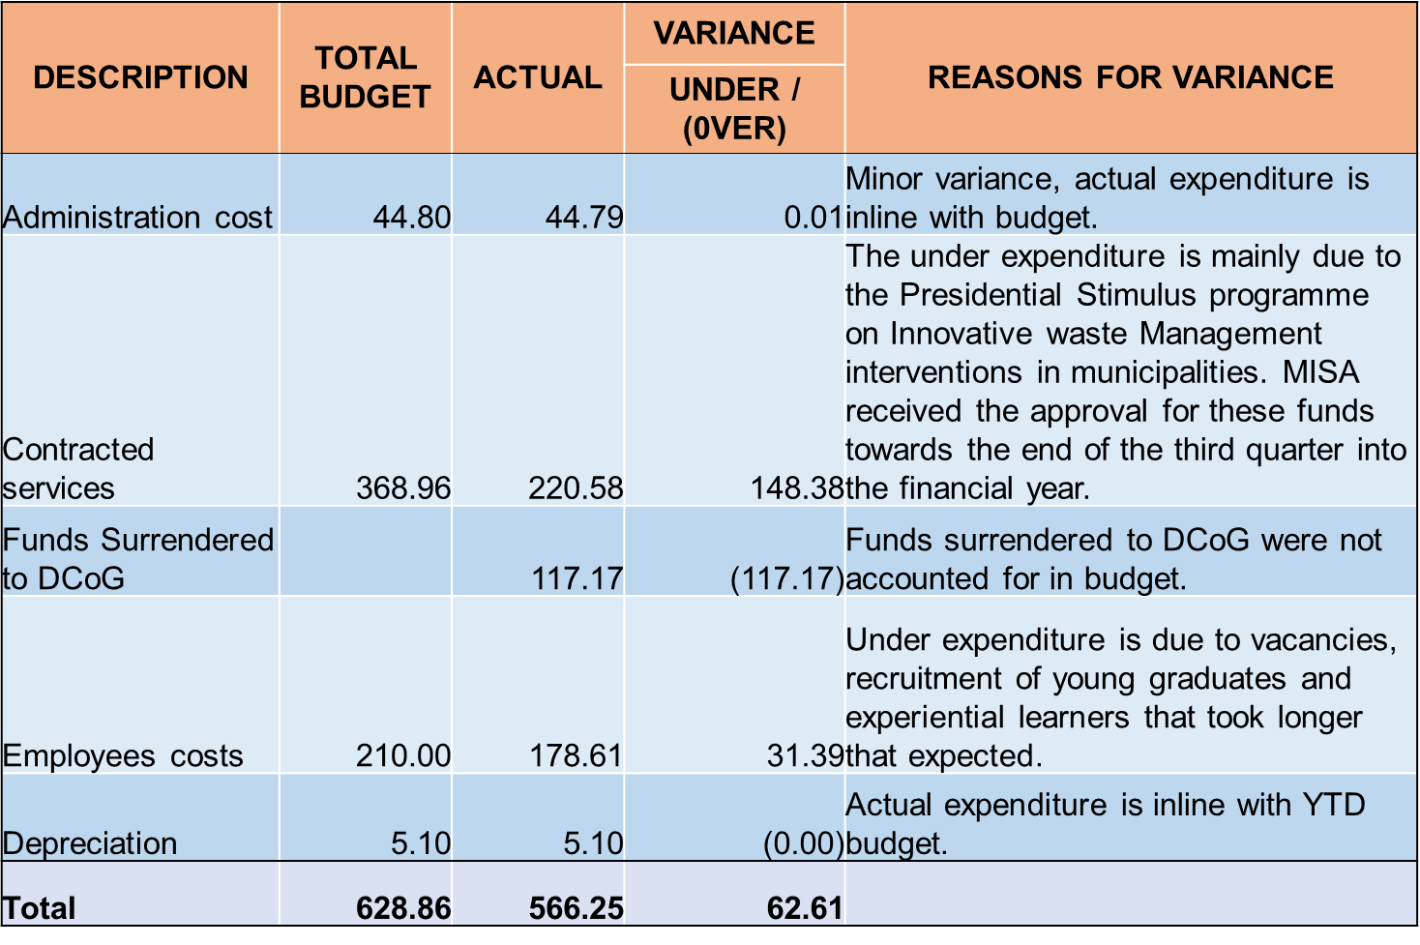
BUDGET VARIANCE REPORT PER COST ITEM AS AT 31/03/2022

Slide 16
CASH FLOW /BANK RECON AS AT 31 MARCH 2022
DESCRIPTION | TOTAL R’million
OPENING BALANCE (01/04/2021) | 215.96
RECEIPTS | 637.55
PAYMENTS | (518.30)
ASSETS PURCHASED | (3.95)
CLOSING BALANCE | 331.26

Slide 17
FRUITLESS AND WASTEFUL EXPENDITURE AS AT 31 MARCH 2022
Description | 2013/14 to 2021/22 R | Total R
SARS penalties and interest | - | 757,321
Salary overpayment | - | 224,871
Interest charged for TV license | 2,058 | 2,058
Interest paid to Service provider | 525,862 | 525,862
TOTAL | 527,920 | 1,510,112
No fruitless and wasteful expenditure was incurred in the financial year under review.
The SARS penalties and interest as well as the salary over payment were written off in 2021/22.
No irregular expenditure was incurred during the year under review and there was no irregular expenditure at the beginning of the year.

Slide 18
PAYMENTS OVER 30 DAYS VS AVERAGE NO OF PAYMENT DAYS FOR THE PERIOD ENDED 31 MARCH 2022
All payments were made within 30 days in the 2021/22 Financial Year.
The average turnaround time for the payment of invoices in the 2021/22 financial year is 14 days.

Slide 19
Five-Year Audit Outcomes Trend
Audit Opinion
Focus Area | 2017/18 | 2018/19 | 2019/20 | 2020/21 | 2021/22
Annual Financial Statements | Unqualified Opinion with Material Findings | Clean Audit | Clean Audit | Clean Audit | Clean Audit
Audit of Predetermined Objectives (AoPO) | Unqualified Opinion without Material Findings | Clean Audit | Clean Audit | Clean Audit | Clean Audit

Slide 20
PROGRESS ON 2020/21 AGSA FINDINGS
Focus Area | Issue / Weakness Identified | Remedial Action | Progress to Date
Details of assets in asset register not accurately reflected | Management should ensure that all details (fields) in the asset register are checked against the details of the assets on the floor when performing the next planned asset verification. All discrepancies identified should be corrected to ensure that the information contained in the asset register is accurately reflected for all the relevant fields. | MISA will be migrating to an automated system for Asset Management to ensure accuracy and clear audit trail. | These AGSA audit concerns raised in 2020/21 annual report were implemented in the 2021/22 financial year.
Incorrect calculation of points during evaluation of quotations | Management must adequately review all calculations to ensure that points reflected are correct to prevent awarding of quotations to incorrect suppliers. | The verification of the scores will be independently checked by the SCM Compliance Unit prior to award for all requests for quotations.
Systems limitation on SAGE VIP and SAGE Pastel to generate user functions modification report | Customization of SAGE Pastel and SAGE VIP systems to log all authorised user function modifications that are performed have been completed. | Customization of SAGE Pastel and SAGE VIP systems to log all authorised user function modifications that are performed have been completed.
Non-compliance with Section 13G (1) of the B-BBEE Act and Regulation 12 (1) & (2) of the B-BBEE Regulations | Management should ensure that the B-BBEE compliance report is completed and submitted to the B-BBEE Commission in the prescribed form obtainable from the gazette B-BBEE Regulations on the B-BBEE Commission’s website within the appropriate timeframe as per Regulation 12 (2). | The final result of the BBBEE verification score as contained on the certificate was NIL for all categories in the score card and submission of the FORM B-BBEE 1 was therefore not necessary as it had no impact.

Slide 21
SUMMARY ON AGSA FINDINGS 2021/22
Performance Area | Number of Findings | Resolved | Not Resolved | Not Due Yet
Property, Plant and Equipment | 1 | 0 | 1 | 0
Procurement and Contract Management | 1 | 1 | 0 | 0
Tax | 1 | 0 | 1 | 0
Revenue from non-exchange transactions | 1 | 1 | 0 | 0
Total | 4 | 2 | 2 | 0

Slide 22
PROGRESS ON 2021/22 AGSA FINDINGS
Focus Area | Issue / Weakness Identified | Remedial Action | Progress to Date
Internal Control: Details of assets in Fixed Asset Register not accurately reflected | Management should ensure that: All details (fields) in the asset register are verified against the details of the assets on the floor during the asset verifications performed. All discrepancies identified are corrected so that the information contained in the asset register is accurately reflected. The excel asset register it updated to reflect the correct details of all the assets before the migration of the data into a new system in 2022-23 financial year (This will ensure accuracy of the transferred data). | MISA is in the process of procuring the ERP system to ensure completeness of the Asset Register | Not Implemented
Awards not published on MISA’s website | Management should ensure that: They monitor compliance with their own policies. Ensure that technical challenges are attended to in a timely manner if they are experienced. | Management will ensure that tender award outcome are publicized on MISA website. | Implemented

Slide 23
PROGRESS ON 2021/22 AGSA FINDINGS CONTD…
Focus Area | Issue / Weakness Identified | Remedial Action | Progress to Date
Exemption from corporate income tax | Management is to follow through with SARS and obtain the required proof of the exemption applicable to the government component in terms of section 10 of the Income Tax Act | Management will be able to respond after engagement with SARS which is scheduled for 22 July 2022. | Not Implemented
Note 12 (Revenue from non-exchange transactions) of the AFS understated with the amount received from the LGSETA Funding | Adequate reviews should be implemented on the annual financial statements, general ledger, trial balance and supporting schedules to ensure that accurate and complete amounts are disclosed in the AFS. | Further reviews to be conducted to ensure that all previously reviewed AFS components remains the same irrespective of new changes made. | Implemented

Slide 24
RECOMMENDATIONS
It is recommended that the Portfolio Committee on COGTA note the 2021/22 Annual Report for MISA depicting the following:
Achievement of 30 of 33 annual targets in the 2021/22 Annual Performance Plan (APP) representing an overall performance for the financial year under review of 91%.
Financial performance report for 2021/22 Financial Year.
Achievement of Unqualified Audit without material findings (Clean Audit) for the past four (4) consecutive years. .

