Slide 1
the WESTERN CAPE PROVINCIAL PARLIAMENT’S STANDING COMMITTEE ON COMMUNITY SAFETY, CULTURAL AFFAIRS AND SPORT
Presentation:
Maintenance and upgrade of saps stations in the western cape
Date: 7 October 2022
Time: 11:00 to 13:00
Venue: Chamber, 6th floor, Wale Street, Cape Town

Slide 2
TABLE OF CONTENTS
Purpose
Current status of the police stations
Current processes towards the construction of new police stations and planned maintenance
SAPS Infrastructure Development Programme 2021/2022 – 2025/2026: Western Cape Province
Capital Works: Projects executed by the Department of Public Works and Infrastructure
Planned Maintenance: Projects executed by the Department of Public Works and Infrastructure
Status Report on the Capital Works priorities for the construction of new police stations
Day-to-day maintenance to police stations: Provincial Budget
Concluding remarks

Slide 3
PURPOSE
The purpose of the presentation is to provide insight to the Western Cape Provincial Parliament’s Standing Committee on Community Safety, Cultural Affairs and Sport into the status of the SAPS’ Capital Works priorities including the Planned Maintenance priorities for execution by both SAPS and the Department of Public Works and Infrastructure.

Slide 4
Current status of the police stations
Kwanokuthula (Leased)
The police station is fully fledged and leased from the Bitou Municipality. 90% of the building consists of pre-fabricated structures (park homes and containers) of which the flooring is decaying. The lease amount is R 564 per month and the contract expires on 2028-08-31.
Kleinvlei (State Owned: Non-Devolved)
The station is a state owned, non-devolved police station, accommodated in a house. As the accommodation is insufficient, the detectives and administration services are accommodated in park homes.
Elands Bay (State Owned: Devolved)
The police station is fully fledged and consists entirely of pre-fabricated structures and containers
Kwanonqaba (Leased)
The station is a fully fledged police station leased from the Mossel Bay Municipality. It consists of 2 small buildings and a number of pre-fabricated structures. The lease amount is R 5 369.77 per month and the contract expires on 2024-03-31.

Slide 5
Current processes towards the construction of new police stations and Planned Maintenance
The Service Level Agreement and Memorandum of Agreement signed between SAPS and the National Department of Public Works and Infrastructure (NDPWI) mandates the SAPS to construct police stations at Devolved (Newly Re-established) police stations but not at current sites
The priorities are identified and signed off by the Provincial Commissioner in consultation with the MEC in the Province in line with the Provincial Infrastructure Management Committee Responsibilities
The signed off priorities are captured within the National User Asset Management Plan (U-AMP) and approved by the National Commissioner and the National Treasury for the implementation of projects
The approved projects are thereafter captured into the SAPS Infrastructure Development Programme in line with the Infrastructure Planning process

Slide 6
SAPS INFRASTRUCTURE DEVELOPMENT PROGRAMME 2021/2022 – 2025/2026 WESTERN CAPE PROVINCE
EXECUTIVE SUMMARY OF SAPS IDP 2021/2022 – 2025/2026
PROGRAMME | FOCUS AREA | 2021/2022 | 2022/2023 | 2023/2024 | 2024/2025 | 2025/2026 | TOTAL PER FOCUS AREA
CAPITAL WORKS | SITE CLEARANCE | 01 | 03 | 02 | 03 | 03 | 12
 | PLANNING & DESIGN | - | - | 03 | 02 | 05 | 10
 | EXECUTION | - | - | - | 01 | 01 | 02
 | REPAIR AND UPGRADE | - | - | - | - | - | -
 | VICTIM FRIENDLY FACILITIES | - | - | - | - | - | -
 | ACCESSIBILITY FOR PERSONS WITH DISABILITIES | 04 | - | - | - | - | 04
 | INSTALLATION OF GENERATORS | 15 | - | - | - | - | 15
 | ELECTRICAL UPGRADES | - | - | - | - | - | -
 | INSTALLATION OF AIR CONDITIONERS | - | 43 | - | - | - | 43
 | SECURITY UPGRADES | - | 14 | 09 | 05 | 02 | 30
SUB-TOTAL CAPITAL WORKS PROGRAMME |  | 20 | 60 | 14 | 11 | 11 | 116
PLANNED MAINTENANCE | PLANNING & DESIGN | - | - | 02 | - | - | 02
 | EXECUTION | - | 01 | - | 04 | 05 | 10
 | ACADEMIES | - | 02 | - | - | - | 02
SUB-TOTAL PLANNED MAINTENANCE PROGRAMME |  | - | 03 | 02 | 04 | 05 | 14
TOTAL SAPS IDP PROJECTS |  | 20 | 63 | 16 | 15 | 16 | 130
CLASSIFICATIONS
N | NEW |  | NRE | NEWLY RE-ESTABLISHED |  | RE | RE- ESTABLISHED |  | R&U | REPAIR & UPGRADE |  | R&R | REPAIRS & RENOVATIONS

Slide 7
SAPS INFRASTRUCTURE DEVELOPMENT PROGRAMME 2021/2022 – 2025/2026 WESTERN CAPE PROVINCE
CAPITAL WORKS PROGRAMME
FOCUS AREA 1: POLICE STATION: CONSTRUCTION: SITE CLEARANCES
PROVINCE | 2021/ 2022 | 2022/2023 | 2023/2024 | 2024/2025 | 2025/2026
WESTERN CAPE | RONDEBOSCH (R&U) | BELHAR (NRE) | BROWNS FARM SATELLITE (N) | KLAPMUTS (NRE) | BONTEHEUWEL (NRE)
 |  | LINGELETHU (NRE) | MASIPHUMELELE (N) | KWANOKATHULA (NRE) | KWANONQABA (NRE)
 |  | STRUISBAAI (N) |  | ELANDS BAY (RE) | VRYGROND (N)
TOTALS | 01 | 03 | 02 | 03 | 03
FOCUS AREA 1: POLICE STATIONS: CONSTRUCTION: PLANNING & DESIGN
PROVINCE | 2021/ 2022 | 2022/2023 | 2023/2024 | 2024/2025 | 2025/2026
WESTERN CAPE |  |  | MAKAZA (N) | GUGULETHU (N) | BELHAR (NRE)
 |  |  | SAMORA MACHEL (N) | PORTERVILLE (R&U) | ELANDS BAY (RE)
 |  |  | WELLINGTON (NRE) |  | LINGULETHU (NRE)
 |  |  |  |  | RONDEBOSCH (R&U)
 |  |  |  |  | STRUISBAAI (N)
TOTALS | - | - | 03 | 02 | 05
FOCUS AREA 1: POLICE STATIONS: CONSTRUCTION: EXECUTION
PROVINCE | 2021/ 2022 | 2022/2023 | 2023/2024 | 2024/2025 | 2025/2026
WESTERN CAPE |  |  |  | TAFELSIG (N) | MAKHAZA (N)
TOTALS | - | - | - | 01 | 01
FOCUS AREA 1: POLICE STATIONS: ACCESSIBILITY FOR PERSONS WITH DISABILITIES
PROVINCE | 2021/ 2022 | 2022/2023 | 2023/2024 | 2024/2025 | 2025/2026
WESTERN CAPE | DE DOORNS (R&U)
 | WOODSTOCK (R&U)
 | WYNBERG (R&U)
 | ZWELETHEMBA (R&U)
TOTALS | 04 | - | - | - | -

Slide 8
SAPS INFRASTRUCTURE DEVELOPMENT PROGRAMME 2021/2022 – 2025/2026 WESTERN CAPE PROVINCE
FOCUS AREA 2: GENERATORS – POLICE STATIONS
PROVINCE | 2021/ 2022 | 2022/2023 | 2023/2024 | 2024/2025 | 2025/2026
WESTERN CAPE | CALITZDORP (N)
 | CLAREMONT (N)
 | FRANSCHOEK (N)
 | GANS BAY (N)
 | HEROLD (N)
 | LADISMITH (N)
 | MACASSAR (N)
 | MURRAYSBURG (N)
 | NUWERUS (N)
 | SEA POINT (N)
 | SUURBRAAK (N)
 | TABLE VIEW (N)
 | UNIONDALE (N)
 | VILLIERSDORP (N)
 | WYNBURG (N)
TOTALS | 15 | - | - | - | -
FOCUS AREA 3: AIR CONDITIONERS – POLICE STATIONS
PROVINCE | 2021/ 2022 | 2022/2023 | 2023/2024 | 2024/2025 | 2025/2026
WESTERN CAPE |  | BONNIEVALE (N)
 |  | DE DOORNS (N)
 |  | FRANSCHOEK (N)
 |  | GANS BAY (N)
 |  | LANGEBAAN (N)
 |  | LUTZVILLE (N)
 |  | MONTAGU (N)
 |  | MCGREGOR (N)

Slide 9
SAPS INFRASTRUCTURE DEVELOPMENT PROGRAMME 2021/2022 – 2025/2026 WESTERN CAPE PROVINCE
FOCUS AREA 3: AIR CONDITIONERS – POLICE STATIONS (continued)
PROVINCE | 2021/ 2022 | 2022/2023 | 2023/2024 | 2024/2025 | 2025/2026
WESTERN CAPE |  | RIVIERSONDEREND (N)
 |  | TOUWS RIVER (N)
 |  | TULBAGH (N)
 |  | VAN RHYNSDORP (N)
 |  | HEIDELBURG
 |  | GROOT BRAK RIVER
 |  | LADISMITH
 |  | CALITZDORP
 |  | LEEU GAMKA
 |  | MERWEVILLE
 |  | PRINCE ALBERT
 |  | HEROLD
 |  | UNIONDALE
 |  | MURRAYSBURG (N)
 |  | BELLVILLE SOUTH
 |  | CAMPS BAY
 |  | CLAREMONT
 |  | DELFT
 |  | FISHHOEK
 |  | HARARE
 |  | KENSINGTON
 |  | KRAAIFONTEIN
 |  | MACASSAR
 |  | MAITLAND

Slide 10
SAPS INFRASTRUCTURE DEVELOPMENT PROGRAMME 2021/2022 – 2025/2026 WESTERN CAPE PROVINCE
FOCUS AREA 3: AIR CONDITIONERS – POLICE STATIONS (continued)
PROVINCE | 2021/ 2022 | 2022/2023 | 2023/2024 | 2024/2025 | 2025/2026
WESTERN CAPE |  | MFULENI
 |  | MOWBRAY
 |  | PHILIPPI EAST
 |  | RONDEBOSCH
 |  | SEA POINT
 |  | SIMONS TOWN
 |  | SOMERSET WEST
 |  | STRANDFONTEIN
 |  | TABLEVIEW
 |  | WYNBERG
 |  | WOODSTOCK
TOTALS | - | 43 | - | - | -
FOCUS AREA 1: POLICE STATION: SECURITY UPGRADES
PROVINCE | 2021/ 2022 | 2022/2023 | 2023/2024 | 2024/2025 | 2025/2026
WESTERN CAPE |  | NYANGA (R&U) | ATLANTIS (R&U) | ELANDS BAY (R&U) | CERES (R&U)
 |  | DELFT (R&U) | DARLING (R&U) | FISANTEKRAAL (R&U) | KLEIVLEI (R&U)
 |  | MITCHELL’S PLAIN (R&U) | DORING BAY (R&U) | HERBERTSDALE (R&U)
 |  | HARARE (R&U) | DURBANVILLE (R&U) | HOPEFIELD (R&U)
 |  | KHAYELITSHA (R&U) | BOTHASIG (R&U) | KAYAMANDI (R&U)
 |  | MFULENI (R&U) | ALBERTINA (R&U)
 |  | KRAAIFONTEIN (R&U) | BELHAR (R&U)
 |  | CAPE TOWN CENTRAL (R&U) | KUILS RIVER (R&U)
 |  | CLANWILLIAM (R&U) | VILLIERSDORP (R&U)
 |  | LADISMITH (R&U)

Slide 11
SAPS INFRASTRUCTURE DEVELOPMENT PROGRAMME 2021/2022 – 2025/2026 WESTERN CAPE PROVINCE
FOCUS AREA 1: POLICE STATION: SECURITY UPGRADES
PROVINCE | 2021/ 2022 | 2022/2023 | 2023/2024 | 2024/2025 | 2025/2026
WESTERN CAPE |  | LANGEBAAN (R&U)
 |  | LUTZVILLE (R&U)
 |  | MALMESBURY (R&U)
 |  | WELLINGTON (R&U)
TOTALS | - | 14 | 09 | 05 | 02
FOCUS AREA 1: POLICE STATION: SECURITY UPGRADES: WESTERN CAPE
PROVINCE | 2021/ 2022 | 2021/2022 | 2023/2024 | 2023/2024
WESTERN CAPE | ATHOLNE | PHILIPPI EAST | ANTI-GANG UNIT | SAMORA MACHEL
 | BISHOP LAVIS | RAWSONVILLE | CERES | BELLVILLE GARAGE
 | CALEDON | SAMORA MACHEL | WILDERNESS | SWELLENDAM
 | CAPE TOWN CENTRAL | SIR LOWREYS PASS | GEORGE | ELSIES RIVER
 | DELFT | STELLENBOSCH | PHILIPPI | GRABOUW
 | MBEKWENI | TABLE BAY HARBOUR | WORCESTER | WOLSELEY
 | GRABOUW | TABLE VIEW | PACALTSDORP | BELLVILLE VCIU
 | GUGULETHU | TOUWSRIVIER | KNYSNA | MFULENI
 | HARARE | TULBAGH | DE DOORNS | OCEAN VIEW
 | HERMANUS | WINEBERG | KLEINVLEI | GRASSY PARK
 | HEROLDS BAY | MFULENI | SOMERSET WEST | BISHOP LAVIS
 | KHAYELITSHA | OUDTSHOORN
 | KIRSTENHOF | PAARL
 | KRAAIFONTEIN | PAROW
 | KUILSRIVIER
TOTALS |  | 29 |  | 22

Slide 12
SAPS INFRASTRUCTURE DEVELOPMENT PROGRAMME 2021/2022 – 2025/2026 WESTERN CAPE PROVINCE
PLANNED MAINTENANCE PROGRAMME
FOCUS AREA 1: PLANNED MAINTENANCE: PLANNING & DESIGN
PROVINCE | 2021/ 2022 | 2022/2023 | 2023/2024 | 2024/2025 | 2025/2026
WESTERN CAPE |  |  | BONNIEVALE (R&R)
 |  |  | WYNBERG (R&R)
TOTALS | - | - | 02 | - | -
FOCUS AREA 1: PLANNED MAINTENANCE: EXECUTION
PROVINCE | 2021/ 2022 | 2022/2023 | 2023/2024 | 2024/2025 | 2025/2026
WESTERN CAPE |  | PHILIPPI ACADEMY (FENCE) |  | UNIONDALE (R&R) | CLAREMONT (R&R)
 |  |  |  | HEILDELBURG (R&R) | GANS BAY (R&R)
 |  |  |  | PHILIPPI (R&R) | KENSINGTON (R&R)
 |  |  |  | SEA POINT (R&R) | MOWBRAY (R&R)
 |  |  |  |  | PA HAMLET (R&R)
TOTALS | - | 01 | - | 04 | 05
FOCUS AREA 1: PLANNED MAINTENANCE: POLICE ACADEMIES: EXECUTION
PROVINCE | 2021/ 2022 | 2022/2023 | 2023/2024 | 2024/2025 | 2025/2026
WESTERN CAPE |  | PHILIPPI (R&R)
 |  | OODTSHOORN (R&R)
TOTALS | - | 02 | - | - | -

Slide 13
Projects executed by the department of public works and infrastructure
Executive Summary of DPWI Projects
Category | Pre-Planning | Planning & Design | Execution | Total
Capital Works | - | 72 | - | 72
Planned Maintenance | 03 | 04 | 02 | 09
Total | 03 | 76 | 02 | 81

Slide 14
CAPITAL WORKS: Projects executed by the department of public works and infrastructure: WESTERN CAPE
TOWN | DESCRIPTION | WCS NO | STATUS | DATE REGISTERED | FINANCIAL TENDER DATE | AGE ANALYSIS
BELLVILLE | REPAIRS TO FIRE DETECTION AND SUPPRESSION EX-SARS BUILDING SAPS DIRECTORATE PRIORITY CRIME INVESTIGATIONS (DPCI) WESTERN CAPE | 049397 | 4 | 2011/07/07 | 2022/08/04 | 10-15 YEARS
FAURE | SHOOTING RANGE SAPS COMPLEX: UPGRADING OF ELECTRICAL INFRASTRUCTURE | 053597 | 4 | 2014/02/19 | 2022/07/01 | 5-10 YEARS
CAPE TOWN HARBOUR | REPAIRS TO SAPS SEA BORDER UNIT (LEASED) | 054134 | 4 | 2014/12/10 | 2022/08/04 | 5-10 YEARS
THMAS BOYDELL | CAPE TOWN THOMAS BOYDELL BUILDING INSTALLATION OF SECURITY GATES,PAINTING OF OFFICES,CHANGE OF GUTTERS,BOOSTER PUMPS AND REPLACEMENT OF MECHANICAL EQUIPME NT SUCH AS KITCHEN EQUIPMENT | 055633 | 4 | 2020/01/17 | 2023/02/18 | 0-5 YEARS
CAPE TOWN | PAINTING OF OFFICES,CHANGE OF GUTTERS,BOOSTER PUMPS,REPLACEM ENT OF MECHANICAL EQUIPMENT SUCH AS KICHEN EQUIPMENT. | 055634 | 4 | 2020/01/17 | 2023/02/18 | 0-5 YEARS
FAURE | POLICE STATION INSTALLATION OF VARIOUS INTERVENTION SERVICES | 055636 | 4 | 2020/01/17 | 2022/09/02 | 0-5 YEARS
FAURE | SHOOTING RANGE INSTALLATION OF VARIOUS SERVICES AT FAURE SHOOTING RANGE | 055637 | 4 | 2020/01/17 | 2023/02/18 | 0-5 YEARS
GEORGE | INSTALLATION OF BURGLAR PROOFING,SECURITY GATES,NEW LOCKS,WA TER TANKS AND STANDS,PAINTING OF OFFICES,NEW BUILD IN CUPBOA RDS,SECURITY LIGHTING AND OTHER SERVICES | 055638 | 4 | 2020/01/17 | 2023/02/18 | 0-5 YEARS
FAURE | UPGRADING OF SECURITY FENCING(CONCRETE) | 055768 | 4 | 2020/01/17 | 2022/08/04 | 0-5 YEARS

Slide 15
CAPITAL WORKS: Projects executed by the department of public works and infrastructure: WESTERN CAPE
TOWN | DESCRIPTION | WCS NO | STATUS | DATE REGISTERED | FINANCIAL TENDER DATE | AGE ANALYSIS
DURBANVILLE | INSTALLATION OF PAINTING OF OFFICES,CHANGE OF GUTTERS,LICENC E OF VARIOUS SYSTEMS AND REPLACEMENT OF MECHANICLA EQUIPMENT SUCH AS KITCHEN EQUIPMENT | 055934 | 4 | 2020/01/12 | 2023/11/14 | 0-5 YEARS
BELLVILLE EX OLD SARS BUILDING | INSTALLATION OF DEHUMIDIFIERS,PAINTING OF OFFICES,CHANGE OF GUTTERS,AND REPLACEMENT OF MECHANICAL E QUIPMENT INCLUDING KITCHEN EQUIPMENT | 055935 | 4 | 2020/01/12 | 2023/11/14 | 0-5 YEARS
KNYSNA | INSTALLATION OF SECURITY GATES,NEW LOCKS,WATER TANKS AND STA NDS,PAINTING OF OFFICES,NEW BUILD IN CUPBOARDS,CHANGE OF WIN DOW FRAMES,ADDITIONAL PLUG POINTS AND OTHER SERVICES | 055936 | 4 | 2020/01/12 | 2023/11/14 | 0-5 YEARS
CAPE TOWN | INSTALLATION OF BURGLAR PROOFING,SECURITY GATES,NEW LOCKS,RE PLACEMENT OF CARPETS WITH TILES,PAINTING OF OFFICES,NEW BUIL D IN CUPBOARDS,ADDITIONAL PLUG POINTS AND OTHER SERVICES | 055937 | 4 | 2020/10/12 | 2023/11/14 | 0-5 YEARS
BELHAR | POLICE STATION PAINTING OF OFFICES,CHANGE OF GUTTERS DEHUMIDIFIERS,REPLACEMENT OF MECHANICAL EQUIPMENT SUC H AS KICHEN EQUIPMENT. | 055939 | 4 | 2020/01/12 | 2023/11/14 | 0-5 YEARS
KLAARSTROOM | INSTALLATION OF PAINTING OF OFFICES,CHANGE OF GU TTERS,DEHUMIDIFIERS AND REPLACEMENT OF MECHANICAL EQUIPMENT AND KITCHEN EQUIPMENT | 055941 | 4 | 2020/10/12 | 2023/11/14 | 0-5 YEARS
DIEPRIVIER | INSTALLATION OF INTERVENTION SERVICES: REPAIR AND UPGRADE | 055943 | 4 | 2020/10/12 | 2023/11/14 | 0-5 YEARS
MALMESBURY | INSTALLATION OF PAINTING OF OFFICES,CHANGE OF GUTTERS,DEHUMI DIFIERS AND REPLACEMENT OF MECHANICAL EQUIPMENT INCLUDING KI TCHEN EQUIPMENT | 055944 | 4 | 2020/10/12 | 2023/11/14 | 0-5 YEARS

Slide 16
CAPITAL WORKS: Projects executed by the department of public works and infrastructure: WESTERN CAPE
TOWN | DESCRIPTION | WCS NO | STATUS | DATE REGISTERED | FINANCIAL TENDER DATE | AGE ANALYSIS
GEORGE | INSTALLATION OF BURGLAR PROOFING,SECURITY GATES,NEW LOCKS,PAI NTING OF OFFICES,NEW BUILD IN CUPBOARDS,ADDITIONAL PLUG POIN TS,SECURITY LIGHTING,DEHUMIDIFIERS AND OTHER SERVICES | 055946 | 4 | 2020/10/12 | 2023/11/14 | 0-5 YEARS
DYSSELSDORP | INSTALLATION OF INTERVENTION SERVICES: REPAIR AND UPGRADE | 055948 | 4 | 2020/10/12 | 2023/11/14 | 0-5 YEARS
RIVERSDALE | INSTALLATION OF INTERVENTION SERVICES: REPAIR AND UPGRADE | 055951 | 4 | 2020/10/12 | 2023/11/14 | 0-5 YEARS
BREDASDORP | INSTALLATION OF BURGLAR PROOFING,SECURITY GATES,REPLACEMENT OF CARPETS WITH TILES,PAINTING OF OFFICES,NEW BUILD IN CUPBO ARDS,SECURITY LIGHTING,DEHUMIDIERS AND OTHER SERVICES | 055952 | 4 | 2020/10/12 | 2023/11/14 | 0-5 YEARS
GENADENDAL | POLICE STATION INTERVENTION OF PAINTING OF OFFICES,CHANGE,DEHUMIDIFIERS AND REPLACEMENT OF MECHANICAL EQUIPMENT SUCH AS KITCHEN EQUIPME NT | 055953 | 4 | 2020/10/12 | 2023/11/14 | 0-5 YEARS
MANENBERG | POLICE STATION SECURITY GATES,PAINTING OF OFFICES,CHANGE OF GUTTERS/ASBESTO S TO ALUMINIUM,REPLACEMENT OF MECHANICAL EQUIPMENT SUCH AS K ITCHEN EQUIPTMENT AND OTHER SERVIES. | 055975 | 4 | 2020/10/12 | 2023/11/16 | 0-5 YEARS
RAVENSMEAD | POLICE STATION SECURITY GATES,PAINTING OF OFFICES,CHANGE OF WINDOW FRAMES S TEEL TO ALUMINIUM OR PVC,INCREASED GEYSER CAPACITY,ADDITIONA L PLUGS POINTS AND OTHER SERVICES. | 055976 | 4 | 2020/10/12 | 2023/11/16 | 0-5 YEARS
MOORREESBURG | BURGLAR PROOFING,SECURITY GATES,CHANGE OF WINDOW FRAMES STEE L,INSTALLATION OF GENERATOR SETS UP TO A KVA EQUAL TO THE QU OTATION THRESHOLD. | 055977 | 4 | 2020/10/14 | 2023/11/16 | 0-5 YEARS

Slide 17
CAPITAL WORKS: Projects executed by the department of public works and infrastructure: WESTERN CAPE
TOWN | DESCRIPTION | WCS NO | STATUS | DATE REGISTERED | FINANCIAL TENDER DATE | AGE ANALYSIS
SWELLENDAM | INSTALLATION OF BURGLAR PROOFING,SECURITY GATES,CHANGE OF GU TTERS,WATER TANKS,REPLACEMENT OF CARPERTS WITH TILES,NEW BUI LD IN CUPBOARDS AND VARIOUS SERVICES | 055978 | 4 | 2020/10/14 | 2023/11/16 | 0-5 YEARS
STEENBERG | POLICE STATION INSTALLATION OF BURGLAR PROOFING,SECURITY GATES,NEW LOCKS,WA TER TANKS AND STANDS,PAINTING OF OFFICES,NEW BUILD IN CUPBOA RDS,CHANGE OF WINDOW FRAMES AND OTHER SERVICES | 055979 | 4 | 2020/10/14 | 2023/11/16 | 0-5 YEARS
PACALTSDORP | POLICE STATION INSTALLATION OF BURGLAR PROOFING,SECURITY GATES,PAINTING OF OFFICES,CHANGE OF GUTTERS,NEW BUILD IN CUPBOARDS,CHANGE OF W INDOW FRAMES,DEHUMIDIFIERS AND OTHER SERVICESL | 055980 | 4 | 2020/10/14 | 2023/11/16 | 0-5 YEARS
PLETTENBERG BAY | INSTALLATION OF BURGLAR PROOFING,SECURITY GATES,WATER TANKS, CHANGE OF GUTTERS,SECURITY LIGHTING AND DEHUMIDIFIERS | 055981 | 4 | 2020/10/14 | 2023/11/16 | 0-5 YEARS
SARON | INSTALLATION OF BURGLAR PROOFING,SECURITY GATES,NEW LOCKS,RE PLACEMENT OF CARPETS WITH TILES,PAINTING OF OFFICES,CHANGE O F GUTTERS AND DEHUMIDIFIERS | 055982 | 4 | 2020/10/14 | 2023/11/16 | 0-5 YEARS
STANFORD | STANFORD INSTALLATION OF INTERVENTION SERVICES: REPAIR AND UPGRADE | 055983 | 4 | 2020/10/14 | 2023/11/16 | 0-5 YEARS
KLAWER | INSTALLATION OF INTERVENTION SERVICES: REPAIR AND UPGRADE | 055985 | 4 | 2020/10/14 | 2023/11/16 | 0-5 YEARS
VREDENDAL | INSTALLATION OF BURGLAR PROOFING,SECURITY GATES,NEW LOCKS,WA TER TANKS,REPLACEMENT OF CARPETS WITH TILES,PAINTING OF OFFI CES,CHANGE OF GUTTERS AND OTHER SERVICES | 055987 | 4 | 2020/10/14 | 2023/11/16 | 0-5 YEARS

Slide 18
CAPITAL WORKS: Projects executed by the department of public works and infrastructure: WESTERN CAPE
TOWN | DESCRIPTION | WCS NO | STATUS | DATE REGISTERED | FINANCIAL TENDER DATE | AGE ANALYSIS
GRABOUW | INSTALLATION OF INTERVENTION SERVICES: REPAIR AND UPGRADE | 055988 | 4 | 2020/10/14 | 2023/11/16 | 0-5 YEARS
LAMBERTS BAY | INSTALLATION OF BURGLAR PROOFING,SECURITY GATES,PAINTING OF OFFICES AND NEW BUILD IN CUPBOARDS | 055989 | 4 | 2020/10/14 | 2023/11/16 | 0-5 YEARS
BISHOP LAVIS | BURGLAR PROOFING (SECURITY MEASURES),SECURITY GATES (SECURIT Y MEASURES) AND PAINTING OF OFFICES. | 055990 | 4 | 2020/10/14 | 2023/11/16 | 0-5 YEARS
PIKETBERG | BURGLAR PROOFING,SECURITY GATES,NEW LOCKS,WATER TANKS AND ST ANDS,REPLACE CARPETS WITH TILES OR WOODEN FLOORS TO CONCRETE FLOORS,PAINTING OF OFFICES AND OTHER SERVICES. | 055991 | 4 | 2020/10/14 | 2023/11/16 | 0-5 YEARS
WORCESTER | POLICE STATION INSTALLATION OF BURGLAR PROOFING,SECURITY GATES,NEW LOCKS,RE PLACEMENT OF CARPETS WITH TILES,PAINTING OF OFFICES,NEW BUIL D IN CUPBOARDS,SECURITY LIGHTING AND OTHER SERVICES | 055992 | 4 | 2020/10/14 | 2023/11/16 | 0-5 YEARS
LAINGSBURG | INSTALLATION OF BURGLA PROOFING,SECURITY GATES,NEW LOCKS,WAT ER TANKS AND STANDS,REPLACEMENT OF CARPETS WITH TILES,PAINTI NG OF OFFICES,NEW BUIILD IN CUPBOARDS AND OTHER SERVICES | 055993 | 4 | 2020/10/14 | 2023/11/16 | 0-5 YEARS
PAARL PAARL-EAST | POLICE STATION INSTALLATION OF BURGLAR PROOFING,SECURITY GATES,WATER TANKS AND STANDS,CHANGE OF GUTTERS AND DEHUMIDIFIERS | 055994 | 4 | 2020/10/14 | 2023/11/16 | 0-5 YEARS
BOTHASIG | BURGLAR PROOFING,SECURITY GATES,NEW LOCKS,WATER TANKS AND ST ANDS,CHANGE OF GUTTERS,NEW BUILD INN CUPBOARDS,CHANGE OF WIN DOW FRAMES STEEL TO ALUMINIUM OR PVC AND OTHER SERVICES. | 055995 | 4 | 2020/10/14 | 2023/11/16 | 0-5 YEARS

Slide 19
CAPITAL WORKS: Projects executed by the department of public works and infrastructure: WESTERN CAPE
TOWN | DESCRIPTION | WCS NO | STATUS | DATE REGISTERED | FINANCIAL TENDER DATE | AGE ANALYSIS
PAARL | POLICE STATION INSTALLATION OF BURGLAR PROOFING,SECURITY GATES,NEW LOCKS,WA TER TANKS AND STANDS,REPLACEMENT OF CARPETS WITH TILES,PAINT ING OF OFFICES,DEHUMIDIFIERS AND OTHER SERVICES | 055996 | 4 | 2020/10/14 | 2023/11/16 | 0-5 YEARS
GEORGE CONVILLE | INSTALLATION OF BURGLAR PROOFING,SECURITY GATES,NEW LOCKS,WATER TANKS AND STANDS,PAINTING OF OFFICES,CHANGE OF GUTTERS,ADDITIONAL PLUG POINTS AND OTHER SERVICES | 055998 | 4 | 2020/10/14 | 2023/11/16 | 0-5 YEARS
GRASSY PARK | INSTALLATION OF BURGLAR PROOFING,SECURITY GATES,NEW LOCKS,WA TER TANKS AND STANDS,REPLACEMENT OF CARPERTS WITH TILES,PAIN TING OF OFFICES,BOOSTER PUMPS AND OTHER SERVICES | 055999 | 4 | 2020/10/14 | 2023/11/16 | 0-5 YEARS
OUDTSHOORN | INSTALLATION OF INTERVENTION SERVICES: REPAIR AND UPGRADE | 056000 | 4 | 2020/10/14 | 2023/11/16 | 0-5 YEARS
MILNERTON | POLICE STATION SECURITY GATES,WATER TANKS AND STANDS AND SECURITY LIGHTING | 056001 | 4 | 2020/10/14 | 2023/11/16 | 0-5 YEARS
ATLANTIS | INSTALLATION OF BURGLAR PROOFING,SECURITY GATES,WATER TANKS, PAINTING OF OFFICES,ADDITIONAL PLUG POINTS AND SECURITY LIGH TING | 056002 | 4 | 2020/10/14 | 2023/11/16 | 0-5 YEARS
MELKBOS STRAND | INSTALLATION OF INTERVENTION SERVICES: REPAIR AND UPGRADE | 056003 | 4 | 2020/10/14 | 2023/11/16 | 0-5 YEARS
KHAYALITSHA | POLICE STATION INSTALLATION OF SECURITY GATES,REPLACEMENT OF CARPETS WITH T ILES,PAINTING OF OFFICES,CHANGE OF GUTTERS,NEW BUILD IN CUPB OARDS,CHANGE OF WINDOW FRAMES AND SECURITY LIGHTING | 056017 | 4 | 2020/10/22 | 2023/11/24 | 0-5 YEARS

Slide 20
CAPITAL WORKS: Projects executed by the department of public works and infrastructure: WETSERN CAPE
TOWN | DESCRIPTION | WCS NO | STATUS | DATE REGISTERED | FINANCIAL TENDER DATE | AGE ANALYSIS
PAROW | POLICE STATION INSTALLATION OF BURGLAR PROOFING,SECURITY GATES,REPLACEMENT OF PARPETS WITH TILES,PAINTING OF OFFICES,NEW BUILD IN CUPBO ARDS,CHANGE OF WINDOWM FRAMES AND OTHER SERVICES | 056019 | 4 | 2020/10/22 | 2023/11/24 | 0-5 YEARS
CALEDON | CALEDON INSTALLATION OF INTERVENTION SERVICES: REPAIR AND UPGRADE | 056020 | 4 | 2020/10/22 | 2023/11/24 | 0-5 YEARS
HOUT BAY | POLICE STATION INSTALLATION OF BURGLAR PROFING,SECURITY GATES,WATER TANKS A ND STANDS,REPLACEMENT OF CARPETS WITH TILES,SECURITY LIGHITN G,DEHUMIDIFIERS AND OTHER SERVICES | 056021 | 4 | 2020/10/22 | 2023/11/24 | 0-5 YEARS
ELSIES RIVER | INSTALLATION OF BURGLAR PROOFING,SECURITY GATES,PAINTING OF OFFICES,CHANGE OF GUTTERS'NEW BUILD IN CUPBOARDS,CHANGE OF W INDOW FRAMES,DEHUMIDIFIERS AND REPLACEMENT OF MECHANICALEQU | 056022 | 4 | 2020/10/22 | 2023/11/24 | 0-5 YEARS
BEAUFORT WEST | BURGLAR PROOFING,SECURITY GATES,NEW LOCKS,WATER TANKS AND ST ANDS,PAINTING OF OFFICES,NEW BUILD INN CUPBOARDS,INCREASED G EYSER CAPACITY,ADDITIONAL PLUG POINTS AMD OTHER SERVICES. | 056023 | 4 | 2020/10/22 | 2023/11/24 | 0-5 YEARS
CLANWILLIAM | INSTALLATION OF INTERVENTION SERVICES: REPAIR AND UPGRADE | 056024 | 4 | 2020/10/22 | 2023/11/24 | 0-5 YEARS
BRACKENFELL | INSTALLANTION OF INTERVENTION SERVICES: REPAIR AND UPGRADE | 056025 | 4 | 2020/10/22 | 2023/11/14 | 0-5 YEARS
SALDANHA | INSTALLATION OF SECURITY GATES,NEW LOCKS,PAINTING OF OFFICES ,NEW BUILD IN CUPBOARDS,SECURITY LIGHTING AND DEHUMIDIFIERS | 056026 | 4 | 2020/10/22 | 2023/11/24 | 0-5 YEARS

Slide 21
CAPITAL WORKS: Projects executed by the department of public works and infrastructure: WESTERN CAPE
TOWN | DESCRIPTION | WCS NO | STATUS | DATE REGISTERED | FINANCIAL TENDER DATE | AGE ANALYSIS
BELLVILLE | POLICE STATION BURGLAR PROOFING,SECURITY GATES,NEW LOCKS,WATER TANKS AND ST ANDS ,REPLACE CARPETS WITH TILES OR WOODEN FLOORS TO CONCRET E FLOORS,PAINTING OF OFFICES,AND VARIOUS SERVICES. | 056060 | 4 | 2020/11/02 | 2023/12/05 | 0-5 YEARS
NELSPOORT | POLICE STATION BURGLAR PROOFING,SECURITY GATES,NEW LOCKS,WATER TANKS AND ST ANDS,PAINTING OF OFFICES,NEW BUILD INN CUPBOARDS,INCREASE GE YSER CAPACITY,ADDITIONAL PLUG POINTS AND OTHER SERVICES. | 056061 | 4 | 2020/11/02 | 2023/12/05 | 0-5 YEARS
CERES | POLICE STATION REPLACE CARPETS WITH TILES OR WOODEN FLOORS TO CONCRETE FLOO RS,PAINTING OF OFFICES,CHANGE OF GUTTERS,NEW BUILD INN CUPBO ARDS,CHANGE OF WINDOW FRAMES STEEL AND OTHER SERVICES. | 056062 | 4 | 2020/11/02 | 2023/11/04 | 0-5 YEARS
WOLSELEY | POLICE STATION BURGLAR PROOFING,SECURITY GATES,NEW LOCKS,REPLACE CARPETS WI TH TILES OR WOODEN FLOORS TO CONCRETE FLOORS,PAINTING OF OFF ICES,SECURITY LIGHTING AND OTHER SERVICES. | 056063 | 4 | 2020/11/02 | 2023/12/05 | 0-5 YEARS
CAPE TOWN | BURGLAR PROOFING,SECURITY GATES,WATER TANKS AND STANDS(2500L TO 10000L - BUT ELEVATED TANKS),SECURITY LIGHTING. | 056064 | 4 | 2020/11/02 | 2023/12/05 | 0-5 YEARS
CAPE TOWN PINELANDS | POLICE STATION INSTALLATION OF BURGLAR PROOFING,SECURITY GATES,NEW LOCKS,PA INTING OF OFFICES,CHANGE OF GUTTERS,NEW BUILD IN CUPBOARDS,C HANGE OF WINDOW FRAMES,DEHUMIDIFIERS AND OTHER SERVICES | 056065 | 4 | 2020/11/02 | 2023/12/05 | 0-5 YEARS

Slide 22
CAPITAL WORKS: Projects executed by the department of public works and infrastructure: WESTERN CAPE
TOWN | DESCRIPTION | WCS NO | STATUS | DATE REGISTERED | FINANCIAL TENDER DATE | AGE ANALYSIS
ATHLONE | BURGLAR PROOFING,SECURITY GATES,REPLACE CARPETS WITH TILES,P AITING OF OFFICES,CHANGE OF GUTTERS,NEW BUILD INN CUPBOARDS, CHANGE OF WINDOW FRAMES STEEL AND OTHER SERVICES. | 056066 | 4 | 2020/11/02 | 2023/12/05 | 0-5 YEARS
MOSSEL BAY | BURGLAR PROOFING,SECURITY GATES,PAINTING OF OFFICES,ADDITION AL PLUG POINTS,SECURITY LIGHTING,UPGRADING OF ELECTRICITY. | 056067 | 4 | 2020/11/02 | 2023/12/05 | 0-5 YEARS
MUIZENBERG | BURGLAR PROOFING,SECURITY GATES,NEW LOCKS,WATER TANKS AND ST ANDS,REPLACE CARPETS WITH TILES,PAINTING OF OFFICES,CHANGE O F GUTTERS,NEW BUILD INN CUPBOARDS AND OTHER SERVICES. | 056068 | 4 | 2020/11/02 | 2023/12/05 | 0-5 YEARS
GROOT-DRAKENSTEIN | BURGLAR PROOFING,SECURITY GATES,NEW LOCKS,PAINTING OF OFFICE S,CHANGE OF GUTTERS,CHANGE OF WINDOW FRAMES STEEL TO ALUMINI UM OR PVC,INCREASED GEYSER CAPACITY AND OTHER SERVICES. | 056069 | 4 | 2020/11/02 | 2023/12/05 | 0-5 YEARS
STELLENBOSCH | INSTALLATION OF BURGLAR PROOFING,SECURITY GATES,NEW LOCKS,WA TER TANKS AND STANDS,PAINTING OF OFFICES,CHANGE OF GUTTERS,U UPGRADING OF ELECTRICITY AND DEHUMIDIFIERS | 056070 | 4 | 2020/11/02 | 2023/12/05 | 0-5 YEARS
CAPE TOWN PINELANDS | BURGLAR PROOFING,SECURITY GATES,NEW LOCKS,WATER TANKS AND ST ANDS,REPLACE CARPETS WITH TILES OR WOODEN FLOORS TO CONCRETE FLOORS,PAINTING OF OFFICES AND OTHER SERVICES. | 056073 | 4 | 2020/11/02 | 2023/12/05 | 0-5 YEARS
BELLVILLE 35 SQUADRON: | INSTALLATION OF BURGLAR PROOFING,SECURITY GATES ,NEW LOCKS,WATER TANKS AND STANDS,REPLACEMENT OF CARPETS WIT H TILES,PAINTING OF OFFICES,DEHUMIDFIERS AND OTHER SERVICE | 056074 | 4 | 2020/11/02 | 2023/12/05 | 0-5 YEARS

Slide 23
CAPITAL WORKS: Projects executed by the department of public works and infrastructure: WESTERN CAPE
TOWN | DESCRIPTION | WCS NO | STATUS | DATE REGISTERED | FINANCIAL TENDER DATE | AGE ANALYSIS
KUILS RIVER | POLICE STATION INSTALLATION OF BURGLAR PROOFING,SECURITY GATES,WATER TANKS AND STANDS,PAINTING OF OFFICES,ADDITIONAL PLUG POINTS,SECURI TY LIGHITNG,DEHUMIDIFIERS,AND OTHER SERVICES | 056075 | 4 | 2020/11/02 | 2023/12/05 | 0-5 YEARS
FAURE | ENHANCEMENT OF LIMITATIONS AT FAURE SHOOTING RANGE | 056221 | 4 | 2021/04/21 | 2022/07/01 | 0-5 YEARS

Slide 24
Planned Maintenance: Projects executed by the department of public works and infrastructure
TOWN | DESCRIPTION | WCS NO | STATUS | DATE REGISTERED | FINANCIAL TENDER DATE | AGE ANALYSIS
CALEDON | CALEDON SAPS: CONDITION BASED MAINTEANCE OF ALL BUILDING ELEMENTS: STRUCTURAL, ELECTRICAL, CIVIL WORKS AND WET SERVICES | 054681 | 3 | 2015/11/30 | 2024/11/08 | 5-10 YEARS
CAPE TOWN | REPAIRS AND RENOVATIONS TO DISA COURT TO INCLUDE STRUCTURAL, ELECTRICAL, CIVIL AND MECHANICAL WORKS TO THE BUILIDING | 050483 | 5B | 2011/10/31 | 2021/09/17 | 10-15 YEARS
PAROW | INTEGRATED FACILITIES MANAGEMENT SERVICES | 050776 | 5B | 2011/09/28 | 2017/11/20 | 10-15 YEARS
PAARL | REPAIR AND RENOVATIONS TO SAPS MARRIED QUARTERS: 15 FLATS AND 5 HOUSES | 050450 | 4 | 2011/10/28 | 2022/07/30 | 10-15 YEARS
SWELLENDAM | REPAIRS AND RENOVATIONS TO THE GARAGE, THENIUS STREET | 050456 | 4 | 2011/10/28 | 2023/02/04 | 10-15 YEARS
CAPE TOWN | REPAIR AND RENOVATIONS TO STRUCTURAL AND CIVIL WORKS INCLUDING LEAKAGES AND THE DRAINAGE SYSTEM AT THE DRIVING TRAINING ACADEMY: BISHOP LAVIS | 050458 | 4 | 2011/10/29 | 2023/04/07 | 10-15 YEARS
GEORGE | CONDITION BASED MAINTENANCE OF ALL BUILDING ELEMENTS | 050460 | 4 | 2011/10/29 | 2022/10/07 | 10-15 YEARS
CERES | CERES SAPS: CONDITION BASED MAINTENANCE OF ALL BUILDING ELEMENTS: STRUCTURAL, ELECTRICAL, CIVIL WORKS AND WET SERVICES | 054683 | 3 | 2015/11/30 | 2024/11/08 | 5-10 YEARS
WORCESTER | WORCESTER POLICE STATION: CONDITION BASED MAINTENANCE OF ALL BUILDING ELEMENTS AT THE WORCESTER POLICE STATION | 054738 | 3 | 2016/01/26 | 2024/11/08 | 5-10 YEARS

Slide 25
Status on the construction OF NEW POLICE STATIONS
Kwanokuthula Police Station (Lease)
Phase | Status | Responsibility | Expected completion date
Site Clearance | The construction of a new police station has been prioritised as number 7 on the top 10 Capital Works priorities for the 2024-2028 financial years | Provincial Commissioner: Western Cape | Finalised
 | The Municipality indicated that vacant land opposite the current lease building is available to the SAPS for the possible construction of a new police station | Division SCM Bitou Municipality | Finalised
 | The Site Identification and Site Clearance process has already been activated for the appointment of consultants during the current financial year for the execution of the site clearance phase as a SAPS project for a Newly Re-established (NRE) police station earmarked for completion during the 2024/2025 financial year | Division SCM | 2025-03-31
Planning & Design | Planning and Design will follow, once the Site Identification, Site Ownership (Donation / Transfer / Procurement) and Site Clearance processes have been finalised. This will be completed during the 2025/2026 financial year. | Division SCM | 2026-03-31
Construction | The Construction process will commence and is anticipated to be finalised during 2027/2028 | Division SCM | 2028-03-31

Slide 26
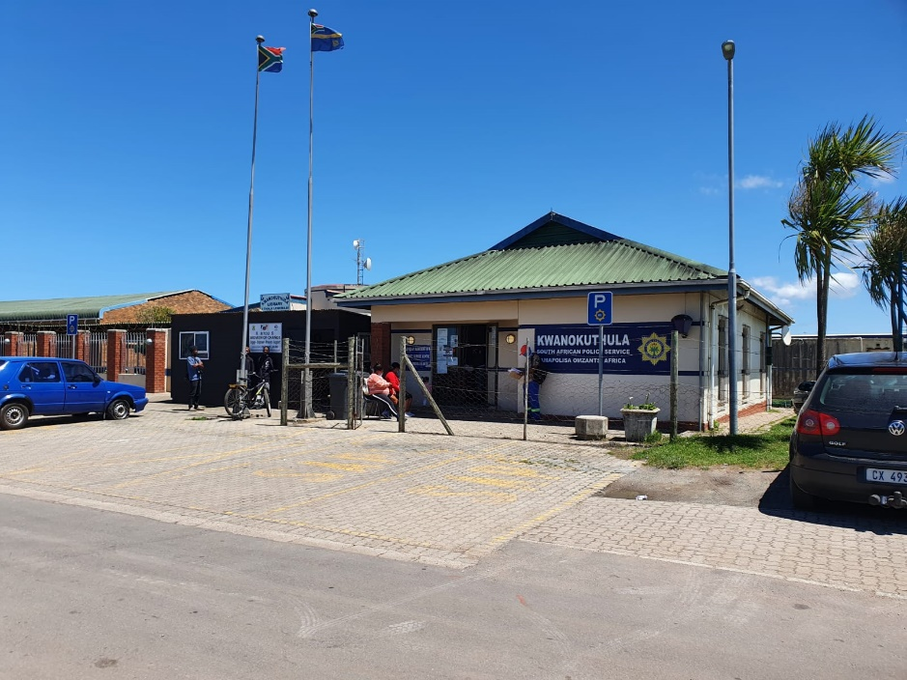
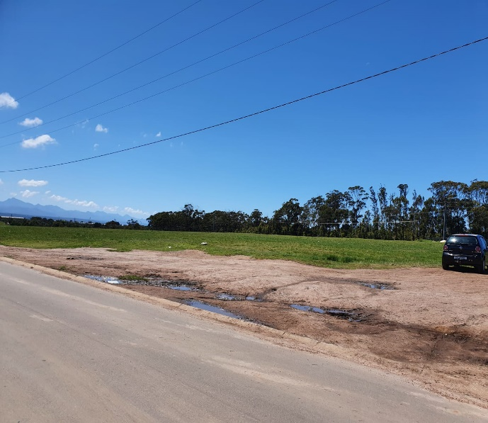
KWANOKUTHULA POLICE STATION
CURRENT LEASE POLICE STATION
PROPOSED NEW SITE ADJACENT CURRENT SITE

Slide 27
Status on the construction OF A NEW POLICE STATIONS
Kleinvlei Police Station (Non-Devolved)
Phase | Status | Responsibility | Expected completion date
Site Clearance | The construction of a new police station is the number 1 priority as signed off by the Provincial Commissioner: Western Cape | Provincial Commissioner: Western Cape | Finalised
 | A Pre-design Information Request was issued by the NDPWI: Town Planning Section on 2020-12-15 | NDPWI: Town Planning Services WCS 055277 | Finalised
 | A Site Report was received from the NDPWI for the confirmation of the preferred site and submitted to the SAPS on 2022-01-15. Technical studies are conducted as the recommended site requires further evaluation. The identified site also needs to be acquired from the Western Cape Provincial Government. The estimated completion date for the Site Clearance process is earmarked for 2025-03-31. The completion of the Site Clearance phase will determine the time frames for the planning and design phase. | NDPWI: Town Planning Services | 2025-03-31
Planning & Design | The project will be registered for completion by SAPS during 2025/2026 financial year | Division SCM | 2026-03-31
Execution | The project for execution will be registered for a contract period of 2 years | Division SCM | 2028-03-31

Slide 28
Status on the construction OF A NEW POLICE STATIONS
Elands Bay Police Station (Devolved)
Phase | Status | Responsibility | Expected completion date
Site Clearance | The construction of a new police station for Elands Bay has been prioritized by the Provincial Commissioner: Western Cape | Provincial Commissioner: Western Cape | Finalised
 | Studies were undertaken by the SAPS for the identification of a suitable site, which was eventually not supported by the Council as the site was not within the Municipal spatial framework | Division SCM | Finalised
 | A new site has been donated by the Cedarberg Municipality which is located closer to the Community. The site clearance phase has been re-activated and is earmarked to be completed during 2024/2025 financial year. | Division SCM | 2025-03-31
Planning & Design | The project will be registered for Planning & Design for completion during the 2025/2026 financial year | Division SCM | 2026-03-31
Execution | The project for execution will be registered for a contract period of 2 years | Division SCM | 2028-03-31

Slide 29
Status on the construction OF NEW POLICE STATIONS
Kwanonqaba Police Station (Lease)
Phase | Status | Responsibility | Expected completion date
Site Clearance | The construction of a new police station has been prioritised as number 8 on the top 10 Capital Works priorities for the 2024-2028 financial years | Provincial Commissioner: Western Cape | Finalised
 | The Municipality offered a centrally located vacant land (Erf 19615) of 10 000 m² for the possible construction of a new police station | Division SCM Mossel Bay Municipality | Finalised
 | The Site Identification and Site Clearance process will be activated during the 2022/2023 financial year for execution as a SAPS project for a Newly Re-established (NRE) police station for completion during the 2024/2025 financial year | Division SCM | 2025-03-31
Planning & Design | Planning and Design will follow once the Site Identification, Site Ownership (Donation / Transfer / Procurement) is finalised and is earmarked for completion during 2025/2026 financial year | Division SCM | 2026-03-31
Construction | The Construction process will commence once the Planning and Design phase has been finalised | Division SCM | 2028-03-31

Slide 30
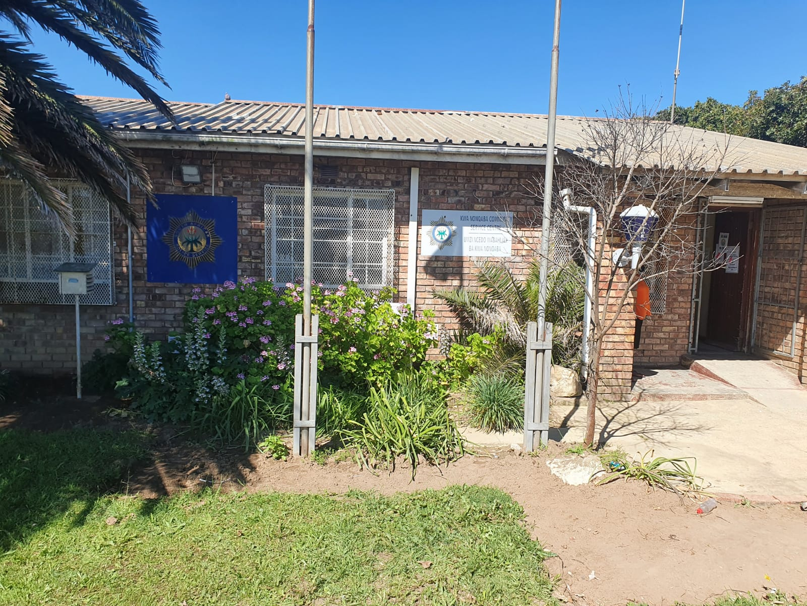
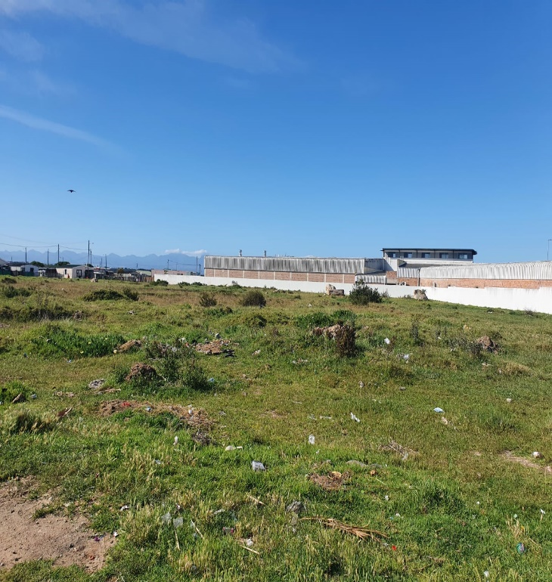
KWANONQABA POLICE STATION
CURRENT LEASE POLICE STATION
PROPOSED NEW SITE ADJACENT CURRENT SITE

Slide 31
SAPS WESTERN CAPE: DAY-TO-DAY MAINTENANCE
Provincial Offices are authorised to undertake Day-to-Day Maintenance Projects on a threshold on R 100 000
Currently the threshold has been increased to R 1 000 000’ however the scope of works is still under review by the Department of Public Works and Infrastructure so as to include Minor Works
SECURITY UPGRADES
During the previous financial year security upgrades were completed at 29 stations
This includes CCTV cameras, electronic gates for vehicles, security gates, access control systems and fencing
Another R2.8 million has been earmarked for security upgrades at priority stations for the current financial year
UPGRADES TO CSC
SAPS Western Cape has embarked on a project to paint the Community Service Centres (CSC) at all police stations as well as the satellite stations
In the last 2 months painting of 20 stations and 1 satellite station have been completed and 2 others are currently in progress. After completion of West and East Metropole stations, it will be extended to the West Coast District
Funds was also ring-fenced to procure furniture for the CSC’s of all police stations

Slide 32
CONCLUDING REMARKS
In view of the information provided above, the following remarks are made:
Western Cape Provincial Government is sensitised on the urgency of the site availability (ERF 952) for Kleinvlei police station as this is the most suitable site from an accessibility perspective
SAPS continue to engage with NDPWI to accelerate the completion of the Site Clearance phase for the new proposed Kleinvlei police station
Western Cape Provincial Parliament’s Standing Committee on Community Safety, Cultural Affairs and Sport take note of the plans for the construction of these police stations and the milestones for each of the stations

Slide 33
Thank you

