Slide 1
Status of COVID-19 and COVID-19 Vaccines
Portfolio Committee Meeting
28 September 2022

Slide 2
Contents
COVID-19 Status
COVID-19 Vaccines
COVID-19 VACCINE PROCUREMENT
COVID-19 VACCINE CONTRACT PAYMENT STRUCTURES
FRAMEWORK FOR VACCINE IMPLEMENTATION
Phase I: Preparation for the vaccine roll-out (Sept 2020 to 17 May 2021)
Phase II: Accelerated Roll-out (17 May 2021 to December 2021)
Phase III: Consolidation and institutionalisation (2022/23)
CHALLENGES WITH COVID-19 VACCINE DELIVERY
COVID-19 VACCINE REIMBURSMENT
COVID-19 VACCINE DOSES AT DISTRIBUTORS BY EXPIRY DATE

Slide 3
COVID-19 STATUS – Daily and Cumulative cases

Slide 4
COVID-19 laboratory confirmation by Province

Slide 5
COVID-19 laboratory confirmation by age

Slide 6
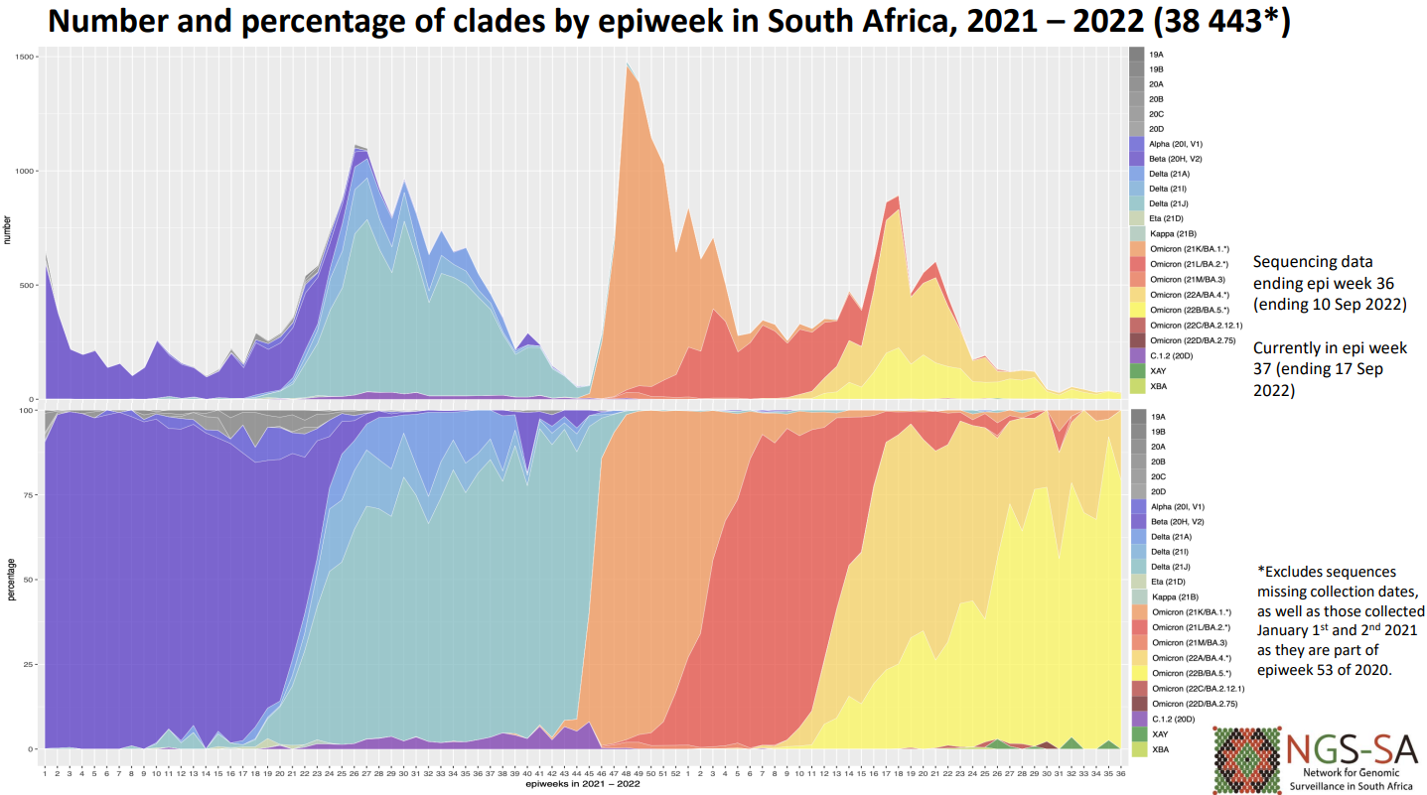
COVID-19 virus is still around
VARIANT OF CONCERN OMICRON IN SOUTH AFRICA
• Omicron continued to dominate in June (99%), July (99%), August (98%), and currently makes up 100% of September sequences although numbers are small.
• Omicron BA.5 was dominant in July (68%) and August (72%), and makes up 83% of September data.
• BA.2.12.1 was detected in South Africa at low prevalence in May, June and July (<1%)
• BA.2.75 has only been detected once in South Africa in July (n=1).

Slide 8
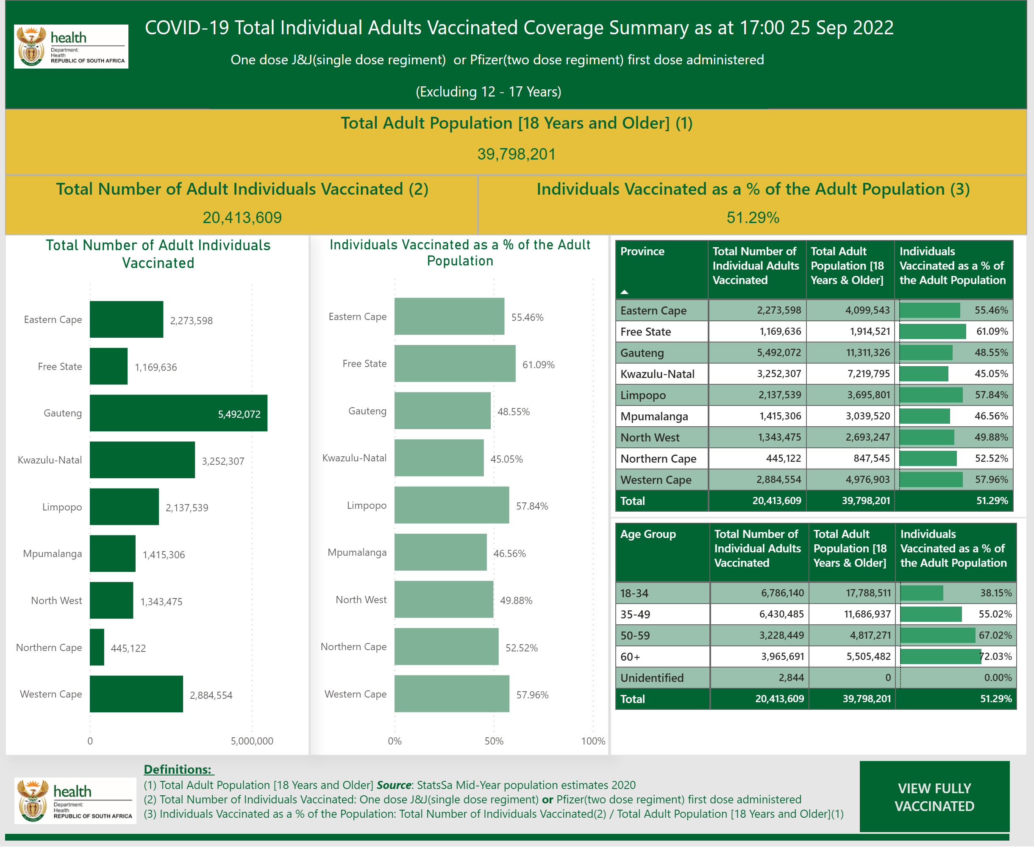

Slide 9
1. COVID-19 VACCINE PROCUREMENT
Historical Overview
The NDoH signed bilateral manufacturing agreements with two manufacturers outside of the COVAX facility.
The Janssen Advance Purchase Agreements were entered into on 26 February 2021 to supply 11 million doses of Johnson & Johnson COVID-19 vaccines, and 18 April 2021 to supply 20 million doses. Delivery only commenced in June 2021 due to Janssen’s operational and regulatory approval issues. To date, we have received a total of 19.6 million doses of the Johnson & Johnson vaccine on this agreement.
The Pfizer Manufacturing and Supply Agreement was entered into on 30 March 2021 for 20 million Pfizer vaccine doses and 04 June 2021 for an additional 10 million doses. Delivery commenced in May 2021 with the last contracted shipment arriving in February 2022.
Doses procured were sufficient for 41 million people on the primary schedule only and 23 million people completing the primary schedule plus one booster dose.
Furthermore, the South African Government received a donation of 7,9 million doses of Pfizer from the US Government, and 1,4 million doses of Pfizer through the COVAX facility.

Slide 10
2. COVID-19 VACCINE CONTRACT PAYMENT STRUCTURES
Both bilateral agreements required upfront payments, namely a down payment and advance payment prior to shipment.
As per the signed agreement, Janssen initially invoiced for a down payment for 31 million doses and then proceeded to invoice for advance payments prior to each shipment. To date, the down payment for 31 million doses has been paid in full and the delivered 19.6 million doses received have also been settled. The balance of the agreement’s 11.4 million doses which were included in the initial down payment, still requires advance payment prior to shipment.
In terms of the Pfizer agreement, Pfizer invoiced for a down payment for the 30 million doses and then proceeded to invoice for the advance payments with each batch allocation for each quarter prior to shipment. To date, all payments and deliveries in terms of this agreement have been made and received.

Slide 11
3. FRAMEWORK FOR VACCINE IMPLEMENTATION (info)
Governance Structures
Communication, stakeholder guidance, training
(provinces, districts, public sector and private sector)
Prioritizing population
Allocation of vaccine
Distribution
(Supplier to Point of Use)
Administration
Safety, Effectiveness, Uptake, Second dose
Supply – Monitor, Track Report
Vaccine Uptake, Use, and Coverage
Data
Adverse Events Following Immunization (AEFI)
Vaccine Effectiveness Monitoring and Reporting
Regulatory Considerations
Budget & Finance
Adapted: From The Factory To The Frontlines: US Department of Health and Human Services)

Slide 12
Total Vaccination Dashboard
Key Dates and Milestones (info)
Phase I: Preparation | 15th September 2000 | Vaccine Ministerial Advisory Committee established
 | December 2020 | Agreement with Covax signed
 | 19th January 2021 | Inter-ministerial Committee on Vaccines established
 | February/March 2021 | Bilateral agreement with Johnson and Johnson and Pfizer signed
 | 17th February 2021 | Launch of Sisonke Study: Health care workers received single dose J&J vaccine
Phase II: Roll-out | 17th May 2021 | Vaccine Roll-out starting with those over 60 years of age, HCWs and other essential workers
 | 1st July 2021 | Eligibility extended to people 50 years and older
 | 1st August 2021 | Eligibility extended to people 35 years and older
 | 20th August 2021 | Eligibility extended to people 18 years and older
 | 20th October 2021 | 12 to 17 year olds eligible for vaccination
 | 9th November 2021 | Booster doses for Sisonke participants
 | 1st December 2021 | Additional doses for immunocompromised individuals
 | 9th December 2021 | Second doses for adolescents (12 to 17 years)
 | December 2021 | Introduction of homologous booster doses for J&J (after 2 months) and Pfizer (after 6 months)
Phase III: Consolidation and sustainability | 14th March 2022 | Introduction of second booster dose after J&J
 | 6th June 2022 | Introduction of 4th doses for persons 50 years and older

Slide 13
Phase I: Preparation for the vaccine roll-out (Sept 2020 to 17 May 2021)
Key preparatory activities
Establishing a service delivery platform
Vaccine supply management: selection, regulation issues, procurement, distribution, storage, ancillary supplies, waste disposal
Development of vaccination guidelines
Health care worker training
Adverse events following immunization surveillance
Recording and reporting through the EVDS
Development of vaccination certification tools
Communication and Demand Generation
Financing and cost recovery mechanisms
Key dates
15th September 2000 | Vaccine Ministerial Advisory Committee (VMAC) established
December 2020 | Agreement with Covax signed
19th January 2021 | Inter-ministerial Committee on Vaccines established
February/March 2021 | Bilateral agreement with Johnson and Johnson and Pfizer signed
17th February 2021 | Launch of Sisonke Study: Health care workers received single dose J&J vaccine

Slide 14
Phase II: Accelerated Roll-out (17 May 2021 to December 2021)
Roll-out began on 17th May 2021
As vaccines became available, there was a rapid increase in:
The number of vaccination sites (and vaccinators)
Eligibility for vaccination
Access to vaccination sites

Slide 15
Increased Number of Vaccination Sites
Public sector
Dedicated large vaccination sites e.g. stadia, conference centre
Sites linked to PHC and other health facilities
Private healthcare providers
Mass sites established by Medical Schemes
Private pharmacy sites – pharmacy chains and independent pharmacies
Workplace occupational health services
Large single employers
Sector dispersed and smaller employers directed to fixed sites (community or private OHS sites)
Public service essential worker programmes: DBE, SAPS, SANDF, DSD, DOJ, DHA and DCS.
Roving/outreach services initially to congregate settings, then to other sites e.g. SASSA queues
Single service delivery platform across all sites/sectors with single service delivery protocols and standards and reporting system (EVDS)

Slide 16
Increased eligibility and access to vaccination
Eligibility for vaccination expanded:
17th May 2021 | People 60 years and older, HCWs and other essential workers
1st July 2021 | Eligibility extended to people 50 years and older
1st August 2021 | Eligibility extended to people 35 years and older
20th August 2021 | Eligibility extended to people 18 years and older
20th October 2021 | 12 to 17 year olds eligible for vaccination
9th November 2021 | Booster doses for Sisonke participants
1st December 2021 | Additional doses for immunocompromised individuals
9th December 2021 | Second doses for adolescents (12 to 17 years)
December 2021 | Introduction of homologous booster doses for J&J (after 2 months) and Pfizer (after 6 months)
Increased access through:
Removal of requirements for pre-registration (walk-in vaccination)
Vaccination of uninsured persons by the private sector (with reimbursement)
Extended opening hours including over weekends (Vooma Vaccination Weekends)

Slide 17
Phase III: Consolidation and institutionalisation (2022/23)
Target: remains reaching 70% of adult population with a particular focus on reaching older persons and other vulnerable groups
Integration into routine health services
Single governance and management structure for all vaccination services
Ensure that health systems supports in place
Integration into Integrated Clinical Services platform at PHC facilities
Facilitate provision of vaccination by private sector
Supplemented by outreach services in schools, congregate settings, workplaces, and areas with low coverage with a focus on priority districts (those with high numbers of unvaccinated or low coverage).
Ongoing demand generation with an emphasis on social mobilisation and clearer linkages between demand and supply
Strengthen use of data (including GIS data) to identify areas of low coverage, and to respond appropriately.

Slide 18
Current and Ongoing Demand Generation activities
Target: remains reaching 70% of adult population
Challenge
Limited demand for vaccines despite coverage of just over 50% amongst adults
Reasons for low demand
Covid fatigue – belief that protection is no longer important
Vaccine hesitancy
Practical barriers to accessing vaccines for some individuals and groups
Current strategies for improving demand
Providing COVID-19 vaccination through routine health services
Supplemented by outreach services in schools, congregate settings, workplaces, and areas with low coverage with a focus on priority districts
Ongoing demand generation with an emphasis on social mobilisation – working with local community-based organisations
Strengthen use of data to identify areas of low coverage, and to respond appropriately.

Slide 19
Ministerial Advisory Committees (MACs)
Three Ministerial Advisory Committees (MACs) were appointed to provide advice to the Minister and the government during the COVID-19 pandemic:
MAC on COVID-19
MAC on COVID-19 Vaccines (VMAC)
Social Behavioural Change MAC
The MACs have played a key role in collecting evidence, evaluating the science and advising the Minister during times of rapidly changing knowledge.
The VMAC produced 46 advisories
These advisories contributed to improved and informed decision-making processes by both the Minister and eventually the president.
In line with the decision by the National Health Council to de-escalate COVID activities, it is proposed that the VMAC functions are transferred to the National Advisory Group on Immunisation (NAGI).

Slide 20
4. CHALLENGES WITH COVID-19 VACCINE DELIVERY
Although the first bilateral manufacturing agreement was signed with Janssen in March 2021, due to various operational and regulatory approval challenges experienced by Janssen, delivery only commenced in June 2021.
The first two Johnson & Johnson vaccine shipments offered were for 1.5 million doses of thawed product with a short shelf life.
Subsequent Johnson and Johnson frozen vaccines were received at the end of July 2021 with deliveries progressively starting to ramp up in September 2021.
Whilst waiting on Janssen to provide a steady stream of shipments, Pfizer vaccine deliveries were obtained from several sources namely the Pfizer bilateral agreement commencing early May 2021, the COVAX facility in June 2021 and the US Government donation delivered between late July and August 2021.

Slide 21
4.1 COVAX Facility (CF) contract
South Africa contracted CF for 12 million doses
Received: 1 392 300 doses of Pfizer vaccine
Still to be received and paid for: 10 607 700 doses
Estimated cost based on the committed amount: R 1 390 351 239 ((R1,4bn)
Requested that USG donation through COVAX Facility be accepted to offset doses to still be received
Payment of outstanding value of the contract: will be around R 71m

Slide 22
4.2 Janssen advance purchase agreement update
Janssen has been seeking to close out their Advance Purchase Agreement with the NDoH by invoicing for the advance payment on the balance of the undelivered 11.4 million doses.
NDoH initially requested deferral of the balance of the 11.4 million doses until demand for Johnson and Johnson vaccinations had increased.
NDoH is in the process of reviewing all plausible options to mitigate the delivery of the balance of the 11.4 million doses.
Due to Janssen’s operational and approval issues in the initial phase of the vaccination programme and the subsequent waning vaccine demand for Covid-19 vaccines, the need for these additional 11.4 million doses no longer exists.

Slide 23
5. COVID-19 VACCINE REIMBURSMENT
A strength of the vaccination programme was the collaboration with the private sector, facilitated through a Joint Committee (JSEC):
Public sites vaccinated private people (insured - medical aid members)
Private sites vaccinated public sector dependent people (uninsured - no medical aids)
Medical schemes agreed to pay for vaccines and vaccination costs from reserves (@ R80.50 VAT incl)
Private sector sites
Claimed full costs from medical schemes for insured members
have been submitting vaccination claims for uninsured people to the NDoH for approval and credit. As of 23 September 2022, a total of ~ R2.04 billion of claims have been received of which R992m paid to end August 2022.
The COVID-19 vaccine distributors (Biovac, DSV and Kawari) are assisting with the cash collection and debt administration services in processing the invoices, credits and statements to private sector customers on behalf of the NDoH.
Public sector sites
Reconciled income received for insured medical aid members was R500m up to end March 2022 and R824m so far 2022/23 FY (R1,3bn so far)

Slide 24
6. COVID-19 VACCINE DOSES AT DISTRIBUTORS BY EXPIRY DATE – 23 September 2022
Pfizer stock on hand at distributors by expiry date before orders (23 September 2022)
Orders to be delivered in the coming week: 30 420 doses
Vaccine | 31-Dec-22 | 31-Jan-23 | Grand Total
Pfizer | 3 910 620 | 4 730 550 | 8 641 170
Weeks to expiry | 14,1 | 18,4
J&J stock on hand at distributors by expiry date (23 September 2022)
Orders to be delivered in the coming week: 2 400 doses
No orders for the smaller pack size of J&J
Vaccine | 30-Jun-23 | 31-Jul-23 | 31-Aug-23 | 30-Sep-23 | Grand Total
J&J | 397 250 | 1 996 750 | 6 817 900 | 907 100 | 10 119 000
Weeks to expiry | 40,0 | 44,3 | 48,6 | 53,1

Slide 25
6.1 Pfizer vaccine – expiry and shelf life extension
The manufacturers’ shelf life from the date of manufacture is:
Comirnaty® (Pfizer) vaccine 9 months when stored at minus 70ºC
COVID-19 vaccine Janssen® 24 months for the when stored at minus 20ºC
However, by the time the vaccine is received in-country, this shelf life is already reduced
Manufacturers conduct ongoing stability studies to ensure the continuing quality safety and efficacy of vaccines
Based on the current data submitted to the South African Health Products Regulatory Authority (SAHPRA), the manufacturers shelf life for the Comirnaty® (Pfizer) vaccine has been extended to 15 months when stored at minus 70ºC
To date, no vaccines stored at central distributors have exceeded the manufacturers shelf life
As stability studies are ongoing and it is expected that further shelf-life extensions will be received

Slide 26
6.2 Attempts to dispose of excess stock
Attempts have been made to terminate agreements with CF and J&J to avoid receipt of vaccines
Many attempts have been made to donate vaccine doses but:
Many countries are donating so there is a glut of vaccine
Most countries that would accept donations are unable to manage the Pfizer vaccine logistics
Recipients of donated vaccine must also have a No-Fault Compensation scheme, but most poorer countries do not
So AVAT, COVAX and ACDC are potential channels for donation
Vaccine safety and potency are tested regularly and so far the vaccines are very stable in central storage conditions so extensions of expiry dates are possible
Destruction of expired vaccines is an absolute last resort

Slide 27
CONCLUSION
The COVID-19 pandemic has settled for now but the virus has not gone away
People are still getting sick but not in large numbers and generally not as sick as before
Despite all the uncertainties and challenges at least 50 % of all adults have received at least one vaccination
Vaccination (with repeated boosting doses) is still the most effective tool against COVID-19 infection
South Africa procured vaccines in a hostile global market and lives with the consequences of very one-sided contracts
Public demand for vaccination is extremely low now that the perceived threat is low so there are millions of excess doses of vaccines
Some of this vaccine is vulnerable to expiry despite increased knowledge of stability
The public are still advised to vaccinate and to get boosters every 120 days while COVID-19 virus is still in circulation

