Slide 1
Briefing to the Public Works and Infrastructure Portfolio Committee on urgent steps taken by the Council for the Built Environment to strengthen its regulatory function over the Councils for the Built Environment Professions
28 September 2022

Slide 2
Table of Contents
Part A: INTRODUCTION
Who is the CBE?
Appointment, Composition, and Term of Council Members
Part B: STEPS TAKEN BY THE CBE TO STRENGTHEN ITS REGULATORY FUNCTION OVER THE CBEP
3. Current Corporate Governance Initiatives
4. Current Governance Challenges
5. Proposed Initiatives / Legislative Reform

Slide 3
PART A INTRODUCTION

Slide 4
1. Who is the CBE?
The Council for the Built Environment (CBE) is a Schedule 3A Public Entity, a juristic body established in terms of section 2 of the Council for the Built Environment Act, 43 of 2000 (Hereafter the CBE Act) reporting to the Department of Public Works and Infrastructure (DPWI)
It is an overarching body that coordinates six Councils for the Built Environment Professions (Architecture, Landscape Architecture, Engineering, Property Valuation, Project and Construction Management, and Quantity Surveying)
Instilling good conduct within the professions,
Promoting Transformation in the professions, and
Advising the South African government on built environment-related issues.
The objective, function, power and duties of CBE are outlined in section 3 and section 4 of the CBE Act.

Slide 5
2. Appointment, Composition, and Term of Council Members
Section 5(1) of the CBE Act authorises the Minister of Public Works and Infrastructure (the Minister) to appoint members of the CBE Council including the Chairperson and Deputy through a prescribed process for a period of four years.
The Council must be comprised of the following representative stakeholders from;
One (1) government department’s representative
Not more than three (3) representatives nominated from various provincial departments within whose functional arears the professions are practiced
Two (2) representatives from council of professions in the built environment with appropriate expertise
Not more than four (4) public nominees nominated through a public process
Representative of a recently established legislative council
Section 7 and 8 of the CBE Act empowers the Minister to remove a Member of the Council from office after inquiry on account of misconduct, disqualification, vacate their office, or due to inability to perform their duties efficiently.

Slide 6
PART B STEPS TAKEN BY THE CBE TO STRENGTHEN ITS REGULATORY FUNCTION OVER THE COUNCILS FOR THE BUILT ENVIRONMENT PROFESSIONS

Slide 7
3.Current Initiatives to strengthen CBE regulatory function over the CBEP
Promote and protect the interest of the public in the built environment (section 3 (a))
act as an appeal body with regard to matters referred in terms of the law regulating the built environment professions
Receive complaint from the public with related to any matter that fall within the built environment
Promote sound governance of the built environment professions (section 3 (f))
Assessments - The CBE adopted a revised Corporate Governance Framework aligned with King IV principles and PFMA to improve compliance standards
Annually, the CBE conducts a corporate governance assessment of the six CBEPs so as to develop improvement programs to raise their compliance levels
The overall objective of these assessments is to ensure that the CBEPs have best policies in place, aligned with the approved ministerial policy frameworks.

Slide 8
3. Current Initiatives to strengthen CBE regulatory function over the CBEP
c. Ensure uniform application of norms and guidelines set by the councils for the professions throughout the built environment and ensure the consistence application of policy by the CBEP (Section 3 (i) and section 4 (k))
Policy Framework develop and approved by Minister
Set out high level principle for CBEP to align their Policies
CBE assess and monitor consistence application of such policies to ensure uniformity
d. Investigate or initiate investigation into matter pertaining to its function and policies with regard to the built environment and, if necessary, recommend legislation in its regard (Section 4 (l))
CBE introduces complaint function to give effect to the Section 4(a) and (l) of the Act which give CBE the power to investigate or initiate an investigation
The complaint function focus on protecting the public or any other person in their dealings with professional councils, as well as public and private role players within the built environment. The CBE serves as a mediator to ensure that issues are resolved amicably and in the best interest of the parties

Slide 9
3. Current Initiatives to strengthen CBE regulatory function over the CBEP
The complaints' function assists with the following:
Influence review of existing policies
Serve as a tool to test if the CBEP implement its policies effectively and adhere to internal processes
Ensure that the CBE performs its advisory role effectively
Assist with aligning policies and internal processes
Ensure the CBEP’ comply with its regulatory framework, regulations and policies
Regular evaluation of the CBEP’ mechanisms that give effect to the Governance Framework
Ensure that corrupt activities are handled in accordance with applicable laws and reported law enforcement

Slide 10
3. Current Initiatives to strengthen CBE regulatory function over the CBEP
e. Promote coordination between the Council on Higher Education and the council for the professions in relation to accreditation of education institution (section 4 (p)
CBE is represented on each panel of CBEP that accredit education institution
f. Receive and assimilate annual reports of the council for the professions and submit a summary to the Minister (section 4 (v))
Strengthening the six CBEP’ capacity and ability to account for their operational and financial activities through:
Development of annual business and performance plans
Timeous submission of quarterly reports to the CBE within 30 days after the end of each quarter
Timeous submission of annual report within five months after the end of the financial year
Quarterly meetings with the Registrars of the six CBEP

Slide 11
Professional Registration Statistics
CBEP | 2021/22
SACAP | 13 405
SACLAP | 310
ECSA | 31 854
SACPVP | 984
SACPMP | 7 266
SACQSP | 2 507
Total | 56 326

Slide 12
Gender Profile of BE Registered Professionals

Slide 13
Racial Profile of BE Registered Professionals

Slide 14
Candidate Registration Statistics
CBEP | 2021/22
SACAP | 4 162
SACLAP | 89
ECSA | 24 555
SACPVP | 711
SACPMP | 3 694
SACQSP | 2 212
Total | 35 423

Slide 15
Gender Profile of BE Registered Candidates

Slide 16
Racial Profile of BE Registered Candidates

Slide 17
Agreements and Partnerships
CBEP | Agreements
SACAP | Internationally, SACAP signed a MoU with Canberra Accord
SACLAP | N/A
ECSA | ECSA is a signatory to three accords: Washington Accord Sydney Accord Dublin Accord ECSA is a member of three Competency Agreements: International Professional Engineers Agreement (IPEA) International Engineering Technologists Agreement (IETA) Agreement for International Engineering Technicians (AIET)
SACPVP | Member of the International Valuation Standards Council (IVSC)
SACPCMP | N/A
SACQSP | Signed a new Mutual Recognition of Professional Competence Agreement with the Royal Institute of Chartered Surveyors (RICS)

Slide 18
Complaints
CBEP | No Received | No Completed | No in Progress | No Withdrawn
SACAP | 34 | 0 | 34 | 0
SACLAP | 1 | 1 | 0 | 0
ECSA | 5 new complaints received | 0 | 13 pre-existing complaints | 0
SACPVP | 33 | 3 | 27 | 3
SACPMP | 3 | 0 | 3 | 0
SACQSP | 4 | 2 | 2 | 0
Total | 80 | 6 | 79 | 3

Slide 19
3. Current Initiatives to strengthen CBE regulatory function over the CBEP
g. Serve as a forum where the built environment professions may discuss various matters (section 3 (h))
CBE has established the following Forumsto share and discuss matters of common interest:
Legal Forum
Registrar’s Forum
President’s Forum
Transformation Collaboration Committees
National Stakeholder Engagements

Slide 20
Transformation Collaborative Committees

Slide 24
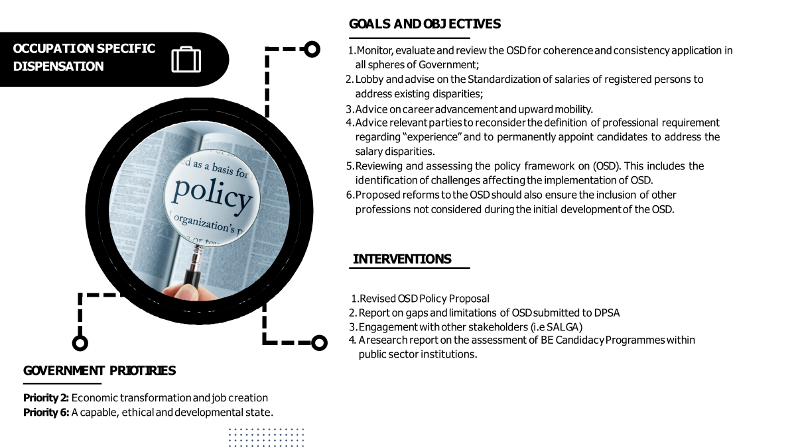

Slide 25
3. Current Initiatives to strengthen CBE regulatory function over the CBEP
h. Identification of Work (IDoW) (section 4 (q))
CBE developed a Framework to assist CBE in developing their detailed Policy on IDoW and Monitor progress
CBE is represented on all stakeholder engagement related to IDoW
CBE is currently engaging the Competition Commission to deal with competition issue regarding IDoW for the six CBEP
I. On recognition of new professions (section):
The following MoU’s were signed in 2021:
South African Council for Planners
Environmental assessment Practitioner Association of South Africa
South African Geomatics Council

Slide 26
5.Current Challenges
Limited powers to enforce compliance - i.e., Enforcement powers not spelt out in the CBE Act.
Disputes caused by unfavourable appeal decisions resulting in a lack of co-operation by the CBEPs.
Lack of capacity within the six CBEP to fully comply with the Governance Framework.
Practice versus Policy - as much as the CBEP may have policies in place, it is challenging to comply with them due to a lack of capacity and resources.

Slide 27
5.Current Challenges
5. Separation of powers - due to a lack of resources, the CBEP normally elects their Council members to serve on committees, which brings on conflict and issues not properly addressed.
6. Lack of adequate mechanisms and measures to deal with unprofessional conduct of Council Members.

Slide 28
6. Proposed Initiatives / Legislative Reform
1. Amendment of the CBE Legislation (CBE to Submit Proposal in 2023 FY)
To vest the CBE with enforcement powers to enforce compliance with its oversight functions – i.e. Compliance Notices, Orders, Administrative Penalties (enforcement mechanisms to promote compliance).
Review the current CBE Act in its entirety as it is written in such a manner that can be subjected to numerous interpretations.
Statutory Review and consolidation of CBE legislation as it is an old legislation.
Legislative Directive Turnaround times for Ministerial approvals of Legislative Frameworks / Delegation of Authority to the CBE.
2. Stakeholder Engagements (Quarterly in 2023) with CBEPs to create awareness of the CBE powers and mandate as a legislated Appeals body.
3. Partnership Developments by CBE Shared Services (Quarterly in 2023) – Policy review, development and compliance training, monitoring and compliance reviews and reporting.
4. Regular workshops to empower CBEPs to deliver on their mandate adequately
5. Development Code of Conduct for Council Members (CBE to Submit Proposal in 2023 FY)

Slide 29
THANK YOU
www.cbe.org.za
info@cbe.org.za
012 3463985

