Slide 1
PRESENTATION TO SCOPA ON 2020-21 IRREGULAR AND FRUITLESS & WASTEFUL EXPENDITURE FOR PMTE
22 FEBRUARY 2022

Slide 2
PHASE 1 – PROJECT TO ASSESS IRREGULAR AND FRUITLESS & WASTEFUL EXPENDITURE – PMTE
REGION | IE ASSESSED & DETERMINED | FWE ASSESSED & DETERMINED | REPLY TO SCOPA
Cape Town | R 230,440,010.00 | R 2,918,226.00 | Assessment and determination completed by 25 October 2021. The transactions were referred to Labour Relations on 29 March 2022. Quality assurance delayed finalization and referral to Labour Relations.
Kimberly | R 3,272,145.00 | R 285,330.23 | Assessment and determination completed by 6 August 2021. The transactions were referred to Labour Relations on 29 March 2022. Quality assurance delayed finalization and referral to Labour Relations.
Polokwane | R 3,389,046.00 | NIL | Assessment and determination completed by 01 October 2021. The transactions were referred to Labour Relations on 5 October 2011. Quality assurance delayed finalization and referral to Labour Relations.
Bloemfontein | R 15,808,503.00 | NIL | Assessment and determination completed by 07 June 2022. The transactions were referred to Labour Relations on 5 August 2022. Quality assurance delayed finalization and referral to Labour Relations.
Pretoria | R 280,917,359.00 | NIL | Assessment and determination completed by 07 June 2022
Umtata | R 38,934,998.00 | NIL | Assessment and determination completed by 20 April 2022
Port Elizabeth | R 55 731 733,00 | NIL | Assessment and determination completed by 18 February 2022
Durban | R 52 123 295,00 | NIL | Assessment and determination completed by 20 April 2022
DPWI applied to NT in August 2022 to condone IE transactions in line with the IE Framework. It is anticipated that feedback will be finalised before end October 2022.

Slide 3
UNRESOLVED 2020/21 AUDIT MATTERS UNDER ASSESSMENT –FRUITLESS & WASTEFUL EXPENDITURE
Incident Description | Amount | Assessment Outcome
Interest on overdue account | R 1 890 943.81 | Amount confirmed as fruitless and wasteful expenditure. It was found that the Department failed to manage and monitor the projects effectively.
Interest on overdue account | R 567.70 | Amount confirmed as fruitless and wasteful expenditure. It was found that delays in processing the payment could have been avoided.
Interest on overdue account | R 6 738 646.85 | Not FWE – payment made to Basil Reed Business Rescue Practioneer as a result of interim judgment. Court further ordered guarantee equivalent to the amount in favour of DPWI until final judgment.
Interest on overdue account | R 192 057.58 | Not FWE - This interest is mora interest. Which is interest upon interest and was not part of judgment obtained against PMTE.
Interest on overdue account | R 2,065.90 | Not FWE - The interest payable was unavoidable as it was paid to the GEPF within a month of receiving the invoice.
Impairment on Receivables | R 118 380 233.10 | Not FWE – Receivables impaired. They are currently being recovered from the affected landlords.
Payment of loss of income suffered by landlord | R 5 347 412.18 | Not FWE - The delay was caused by Statistics SA and this led to a court order being issued in favour of the landlord. A claim has been issued against Statistics SA who should recognize the FWE.
TOTAL | R 132,551,927.12
Above assessments were finalised and audited in 2021/22 Financial Year.

Slide 4
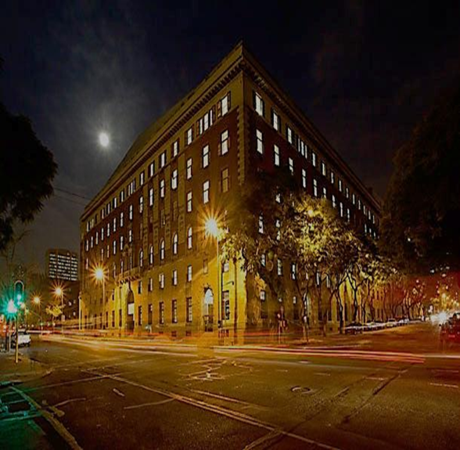
Thank You

