Slide 1
PRESENTATION TO COGTA PORTFOLIO COMMITTEE - MANGAUNG METRO
SECTION 139(7) INTERVENTION
Briefing to Portfolio Committee: 21 September 2022

Slide 2
Purpose
To brief the Portfolio Committee of COGTA on the status of the section 139(7) intervention in Manguang Metro.

Slide 3
OUTLINE
Background
Local Government Performance Areas
Governance and Institutional Capacity
Finance
Service Delivery
3. Conclusion

Slide 4
background
Mangaung Metropolitan Municipality is currently under national intervention in terms of Section 139 (7), of the Constitution of South Africa.
Multi-sectoral teams were deployed in an acting capacity to positions of Heads of Departments and Acting City Manager until the positions are filled or for a six-months period which ever that comes first requested by the Minister of CoGTA as part of the intervention.
The team is constituted by the following persons: Acting City Manager - National CoGTA; Acting Heads of Department for Engineering and Planning - Municipal Infrastructure Support Agent (MISA); Corporate Services - National CoGTA; Chief Financial Officer - National Treasury; Human Settlement - DHS; Waste and Fleet – DFFE. Transport Specialist – DT. The team arrived at MMM at different time periods due to logistical arrangements with their respective Departments.

Slide 5
background
The Terms of Reference for the intervention provided that the intervention will be implemented by National Cabinet Representative supported by technical expects.
The following persons were appointed and joined the team end July 2022
National Cabinet Representative – Mr Paul Maseko; Finance Experts Sanjay Mewalall, Governance and Institutional Mr Lulamile Mapholoba and Service Delivery, Mr Erick Ngomane.

Slide 6
INTERVENTION FOCUS AREAS
Decrease high overtime and “acting” expenditure
Fill vacant positions
Train councillors and administration on recent LG legislation
Appoint Municipal Planning Tribunal and Appeals Authority Tribunal
Formation of the Mangaung Transport Forum to support the development of the City Integrated Transport Plan
Re-use of resurfacing material to re-gravel roads in Metro
Integrated approach on utilization of EPWP / PEP / CWP
Implement Fleet Management System
Strengthen Business partnerships
Put systems & processes in place in all directorates
Review the organisational structure.
Review and implement current FRP.
Improve revenue collection and management.
Implement Job card management System (curb overtime)
Strengthen intergovernmental relations – DDM Model

Slide 7
Governance & institutional capacity
Cause of instability
Mangaung Metro is characterised by elements of lack and poor oversight and governance systems, political instability, factionalism in municipal council, high vacancy rates at senior management level and lower levels, low staff morale, poor work ethics and professionalism, prolonged disciplinary matters, high litigations including costs and poor planning for transitional measures.

Slide 8
Governance & institutional capacity
Status Quo
High vacancy rate at all levels, Municipality failed to develop recruitment plan for filling of vacancies at the end of fixed term contracts.
Organisational structure last reviewed 2016.
Progress to date
The post of City Manager has been advertised with a closing date of 26 August 2022.
The Council meeting scheduled for 31 August 2021 resolved and appointed selection panel for the interview process of the City Manager position. Shortlisting for position of City Manager scheduled for 22 September 2022.
LGSETA approached to provide support with funding for screening and competency assessments
Due to processes underway to review the organizational structure the vacant Heads of Department positions have not been advertised.

Slide 9
Governance & institutional capacity
Status Quo
Lack, misplaced capacity and poor commitment within administration.
Bloated organisational structure in public office bearers.
Dysfunctional LLF
Progress to date
Currently in the process of developing an Individual Performance Management Framework to be able to implement proper consequence management and aiding in capacitating the employees with necessary skills where needed. This document will be in circulation to the relevant forums such as labour representatives and other stakeholders to mention but a few for inputs.
LLF sitting, EMT forging labour peace with LLF.

Slide 10
Governance & institutional capacity
Status Quo
Lack, misplaced capacity and poor commitment within administration.
Bloated organisational structure in public office bearers.
Progress to date
Municipal Staff Regulations (MSR) came into effect from 01 July 2022 - outlines standardised processes and procedures when embarking on staff establishment.
The Macro structure review process commenced during October 2021 and consultations were made with National Treasury and national CoGTA.
Proposed public office bearers and macro-structures (Head of Departments) reduction from nine (9) to seven (7) tabled at LLF and was adopted.
Recently both structures were further refined to be in sync with requirements of the MSR.

Slide 11
Governance & institutional capacity
Status Quo
Lack, misplaced capacity and poor commitment within administration.
Bloated organisational structure in public office bearers.
Council and council committees not sitting.
Progress to date
Refined and aligned structure ready for consultation further with the Public Office Bearers, Executive Management Team (EMT) and LLF. Both macro and public office bearers organizational structures to be tabled to council for approval end of September 2022.
Micro structure (staff below) will be reviewed and consulted with relevant stakeholders.
Audit Committee (AFS, APR & AR reviewed by Audit Committee submitted to the Auditor General on time.
MPAC, s79 and S80 are sitting regularly.
Whippery meetings are sitting although the recall of the chief whip has disturbed the rhythm.

Slide 12
Governance & institutional capacity
Status Quo
Lack of capacity and commitment in administration.
Bloated organisational structure in public office bearers.
Disciplinary Board and risk committees not established
Progress to date
Refined and aligned structure ready for consultation further with the Public Office Bearers, Executive Management Team (EMT) and LLF. Both macro and public office bearers organizational structures to be tabled to council for approval end of September 2022.
Micro structure (staff below) will be reviewed and consulted with relevant stakeholders.
Shortlisting for both DC and risk committee conducted, interviews scheduled for the week of 19 September 2022.

Slide 13
Governance & institutional capacity
Strategic matters
No document management system (DMS) and impacting on audit reports and knowledge-management.
UIFW investigations and consequence management are very slow but MPAC is already seized with the matter.
Headcount of employees and finalisation of placement of former Naledi Municipality employees has not yet been finalised.
Strategic matters
Lack and or poor coordinated corporate calendar for strategic meetings of the municipality [Council meetings, committees and EMT).
Contract management framework and functioning of bid committees and procurements.
Strategic Planning session planned for mid-October 2022.
Policy review inline with MSR underway.

Slide 14
Governance & institutional capacity
Strategic matters
Lack of synergy among political parties and intra-party issues are derailing the achievement that could have been registered.
More synergy is needed among Troika members to drive the vision and mission of MMM.
Weak internal controls and poor focus on fighting incidents of fraud and corruption in the institution is affecting public confidence in the institution.
Low staff morale impacting on efficiency and effective of staff
Strategic matters
Employments costs are ballooning and threatening the survival of the institution.
Poor stakeholders management strategy is affecting the attainment of strategic objectives that the municipality has set itself.
Poor management of capital grants is seriously affecting the provision of basic service delivery which lead to public protests.
CENTLEC governance leaves much to be desired. Majority of the Board members resigned hence there is no quorum. Currently, NCR is monitoring the financial affairs of the entity.

Slide 15
Financial management
Status Quo
Funded Budget Status
Revenue Management Value Chain/revenue raising measures
Customer care, data inaccuracy and incomplete set of data used to account for revenue
Tariffs not cost reflective
The collection rate for the quarter ended 31 March 2022 was 63,48%
Progress to date
Revenue management strategy revised and implemented aggressively.
Disconnections have commenced within the business sector and ongoing
Profiling critical vacancies and ensuring that the revenue value chain activities such as billing are streamlined by conducting meter audits.
Systems being put in place for coordination on meter replacement and installation between finance and Engineering.
Tariff is not cost reflective. The next policy review session will review and revise the current policy.
As of 31 July 2022 collection rate was 74,3%

Slide 16
Financial management
Status Quo
Outdated Indigent Register.
Poor synergy between contract management, supply chain and end user (extensions not in line with MFMA) and no value for money.
Cost containment and realistic cash flow management
Inadequate financial control environment
The payroll department is placed under the wrong component i.e., Corporate Services. It must be place under Finance.
Progress to date
Indigent Register is now being verified and updated for correctness.
Process of restructuring Contracts Management Department and the Bid Committees are currently.
Circular on Cost Containment issued, and strict adherence is being monitored.
Audit undertaken to capacitate payroll unit and movement to finance component for complete control.
Daily managing Cashflow and Expenditure Control.
Finance staff nominated for National Treasury training to obtain the Minimum Standards as per the gazette.
Gross financial misconduct has been detected through duplication of payments and non-compliance with the tariffs on tenders awarded.

Slide 17
Financial management
Status Quo
Unspent Conditional Grants e.g. USDG & Neighbourhood development grant, a total allocation the unspent conditional grants amounted to R508 750 792. The municipality received approximately R300 million during the last quarter of the financial year.
Lack of alignment between procurement Plans and the budget
Preparation of AFS – ensuring timeous submission to AG and other stakeholders
The municipality is unable to pay all creditors within 30 days due to the following reasons:
Cashflow constraints.
Progress to date
Application for Neighbourhood Development Grant submitted to National Treasury for an amount of approximately R30 million, spent R26 million, R4,2 million remains unspent and an application for roll over has been submitted.
Revised Procurement Plans are being aligned to the SDBIP and realistic Cashflows implemented
AFS – finalised and submitted to stakeholders and Auditor-General on August 2022
Arrangements are entered with creditors where required. Invalid and irregular invoices submitted to finance
All grant funded expenditures are paid within 7 days.

Slide 18
Financial management
Status Quo
There are too many operating systems in the municipality, hence no synergy.
Heavy reliance on consultants to perform duties such as compiling financial statements and assets management.
The overtime costs is amounting to R186m per annum.
The acting allowances is also exorbitant at approximately R60m per annum.
Repairs and maintenance works contracted.
Progress to date
Integration process underway to conduct audit and integrate all systems.
Revised Procurement Plans are being aligned to the SDBIP and realistic Cashflows implemented
AFS – finalised and submitted to stakeholders and Auditor-General on August 2022
Arrangements are entered with creditors where required. Invalid and irregular invoices submitted to finance
All grant funded expenditures are paid within 7 days.
Repair fleet and reduce outsourcing. (Address excessive claim of overtime.
Introduction of Shift system at LLF for deliberation.

Slide 19
FINANCIAL MANAGEMENT
OUTSTANDING DEBT
Institution | Total | Action Undertaken
Organ of State (inclusive of all gov dept & parastatals | R1,321bn | Engaged provincial public works through Office of the Premier Commitment made for payment of R86m. Public Works made payment of R33m.
Commercial | R1,577bn | Profile top 100 business owing municipality. Enforcement of credit control and debt collection policy. Disconnection conducted but not effective. Collaboration with CENTLEC for joint disconnections.
Households | R6,019bn | Issued 14 days notices once completed with businesses. Similar approach as commercial.

Slide 20
Service delivery : HUMAN SETTLEMENT
Status Quo:
Brandwaag Social
Hillside View project
Municipal Rental
Vista Park 3
Land Acquisition
Title Deeds
Progress to date
SHRA has taken over management of FRESHCO and placed it under administration. Administrator has concluded the process and will be presenting the final report to MAYCO & Council
Mixed development project is underway. Social Housing Phase concluded but land transfer remains unresolved. Acting City Manager was engaged by SHRA & Developer on the matter. Land belongs to Municipality.
22 rental schemes belonging to the municipality. MMM started with the process of conducting audits in some of the units. One of the old age homes has been audited. Some of the tenants have already signed new agreements and awaiting to be signed by MMM.
Vista Park 3 Developer is still on-site. Internal services installed at extension 261 which is now ready for construction of Top structures.
Developer is currently installing internal services at extension 263 & 263.
Developer awaiting MMM to confirm housing typologies to be constructed in various extensions including student accommodation. Land valuation process has been concluded.
Over 3000 title deeds were issued

Slide 21
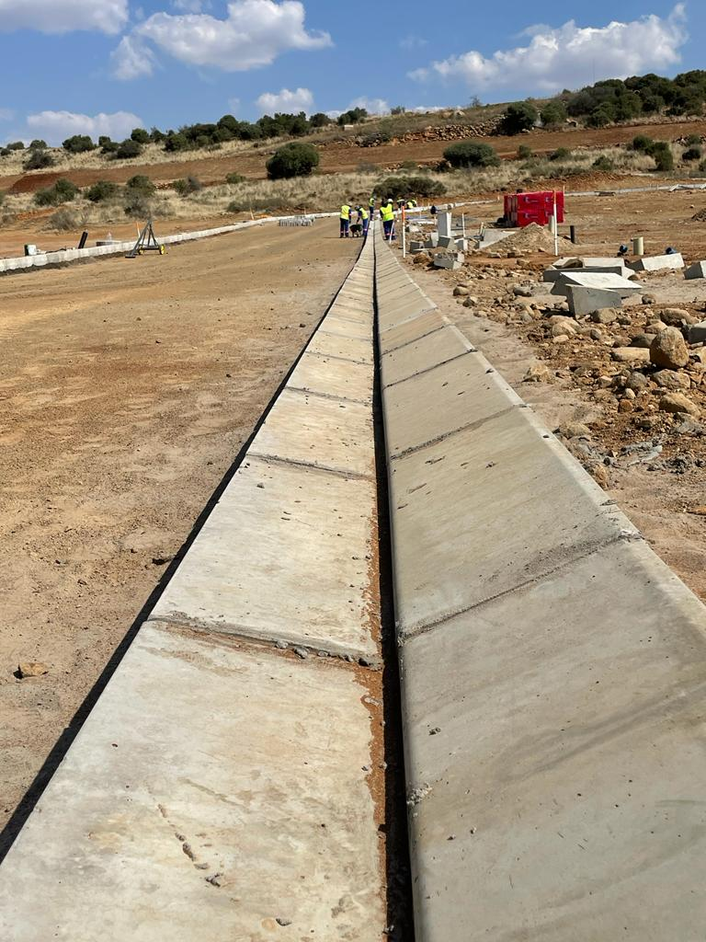
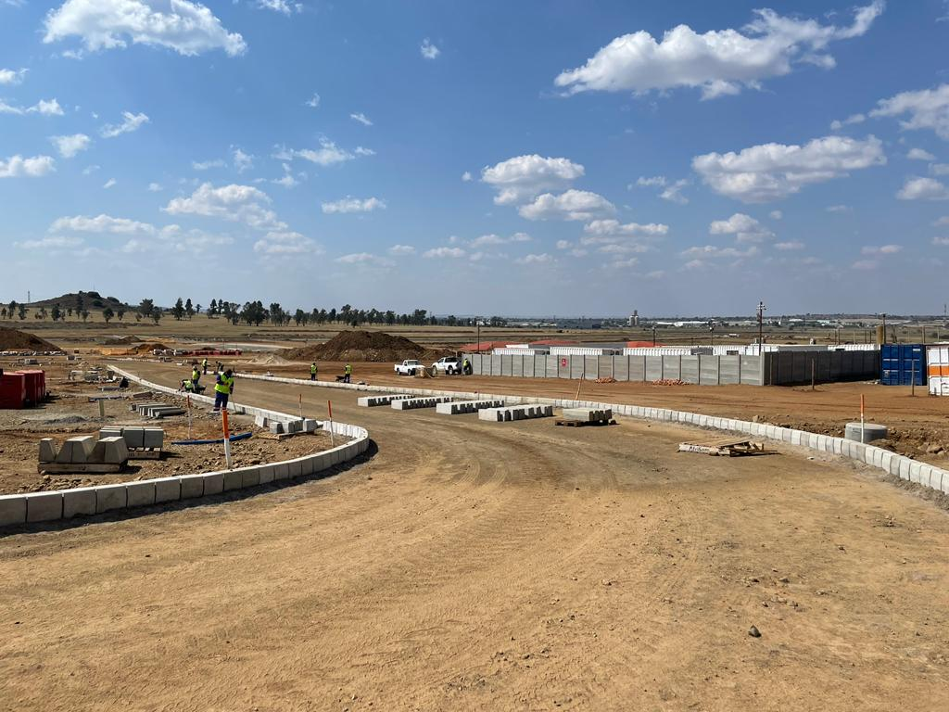
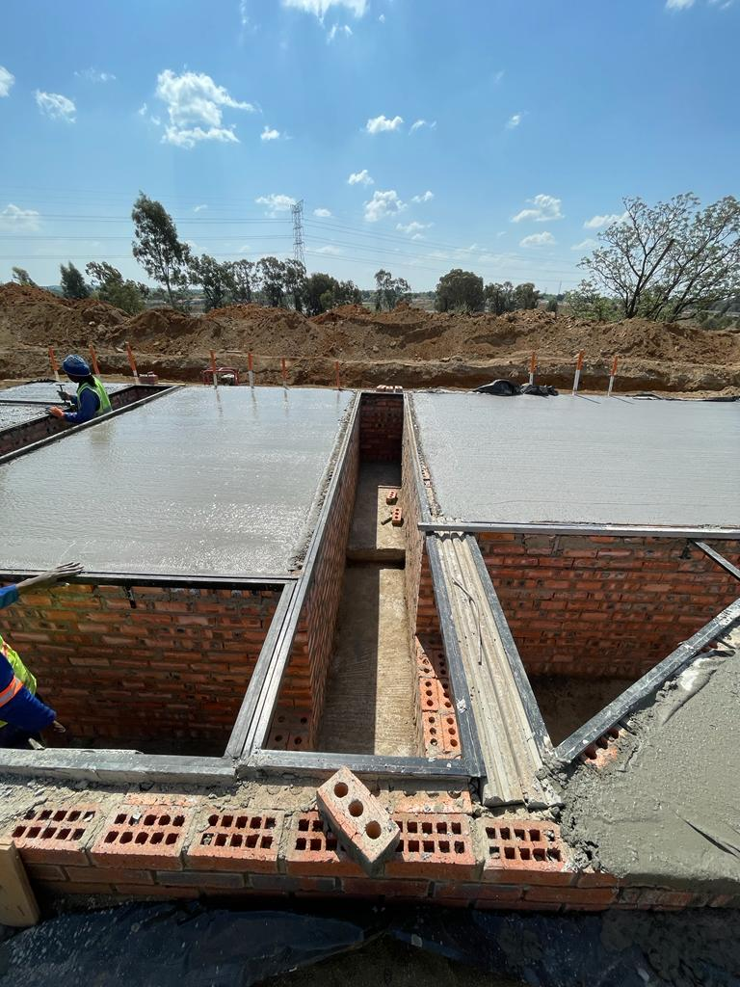
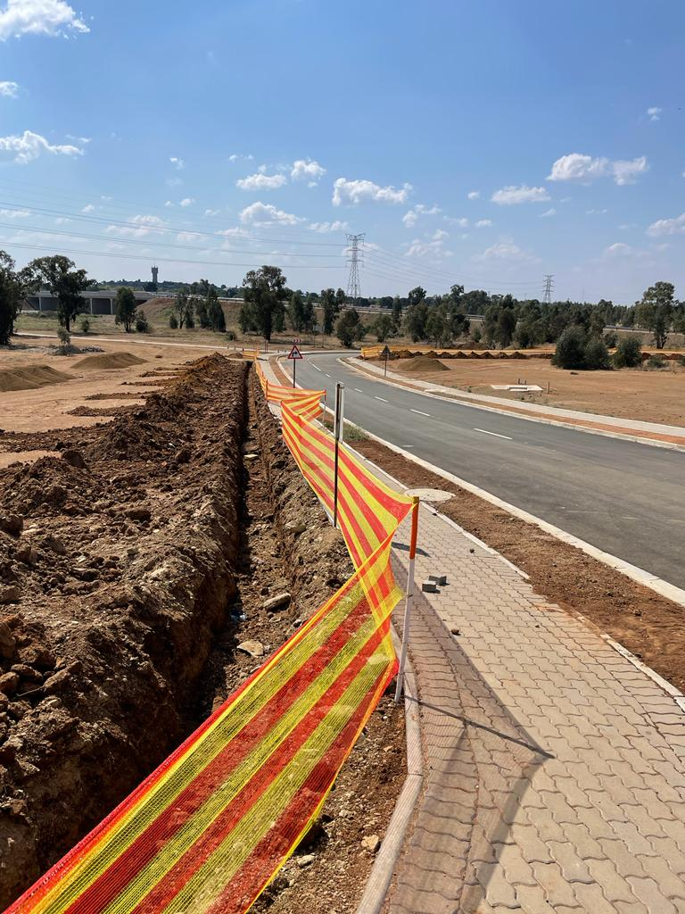
Service delivery: HUMAN SETTLEMENTDS
VISTA PARK 3 CURRENT PROGRESS

Slide 22
Service delivery : planning
Status Quo:
Lack of compliance with SPLUMA to establish Municipal Planning Tribunal, Appeal Tribunal, and Authorised Official.
Backlog on building control.
Progress to date:
The Municipality has approved for the appointment of an Authorised Official, Municipal Planning Tribunal and Appeal Tribunal nominations will be advertised from the end of September.
Electronic submission of plans and TP applications: Orbit system is being reviewed, the system does not meet the needs of the municipality.
Information sharing on building control reform is ongoing with CSP, National Treasury and World Bank. These Stakeholders are assisting with the development of Building Control Reform Action Plan to address backlog in building control.
Building control backlog to be finalised by the 14 October 2022.
Valuers offered to assist with scanning of building plans for ease in scrutinising and valuation.

Slide 23
Service delivery : planning
Status Quo:
Poor contract / lease management at fresh produce market (FPM).
FPM property deteriorated, agents starting to relocate.
Comprehensive Integrated Transport Plan (CITP):
Progress to date:
Refurbishment of Fresh Produce Market (FPM) budgeted for the current financial year..
In the financial year 2021/22, FPM had a turnover of above R529m and generated revenue of over R29.6m which is 93.5% of the annual target.
Request to Municipal to reinvest profits made into developing and maintaining the market.
Comprehensive Integrated Transport Plan was developed by Q&A Consulting Engineering Services and the project was expected to completed on 14 September 2022, extension was granted until December.
Generated highest revenue in the year 2021/22 to an amount of is R 5,5 Million.

Slide 24
Service delivery : SOLID WASTE
Status Quo:
Poor waste and fleet management
Non maintenance of fleet
Over utilisation of service providers.
Staff instability.
Progress to date
Status quo analysis completed - (Waste and Fleet Management)
Vehicle replacement strategy finalised.
Mangaung Clean-up (MMM/ Business Sector) Bloemfontein, Thaba Nchu and Botshabelo
Local Political engagement i.t.o current strategic approach and communication – ongoing
Fleet stabilisation strategy finalised
Continuous engagement with Labour Unions and Senior Management

Slide 25
Service delivery : SOLID WASTE
Status Quo:
Poor waste and fleet management
Non maintenance of fleet
Over utilisation of service providers.
Staff instability
Progress to date
Southern Landfill Site: Access road partially cleaned, Entrances cleared for public access, Law enforcement deployed to assist with illegal dumping; Continuous efforts to keep area clean as well as to increased management oversight.
DFFE appointed contractor – Not adhering to contract conditions. First report received in Sept 2022.
Northern Landfill site: Access road cleared; Entrance cleared; Weekly reporting; Landfill entrance opened and leveraged private sector to provide support. (Put recent pics)

Slide 26
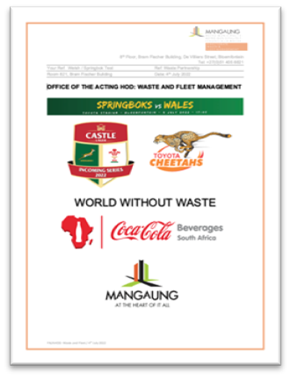
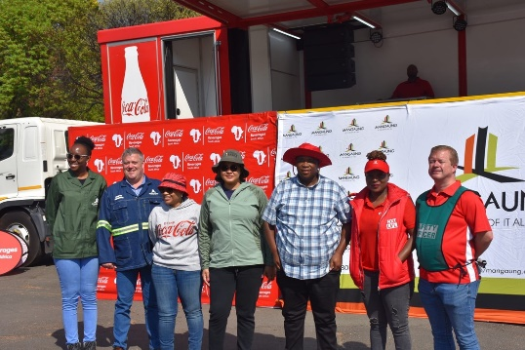
Service delivery: solid waste
Metro Wide – 3 week clean-up of Mangaung initiated on the 27th June 2022
Partnerships with business
PEP utilised for cleaning
Partnership with Cheetah Rugby / MMM / CCBSA
Ongoing partnership with all activities within the stadium - Recycling
Recycling stations (10) strategic points at events
Linking with SMME’s
Partnerships with:
National Real Estate
Government Garage – FS
SENTLEC
PEP
NEW PARTNERSHIPS IN PROCESS
MTN
INTERSTATE
CUT
Anchor of Hope

Slide 27
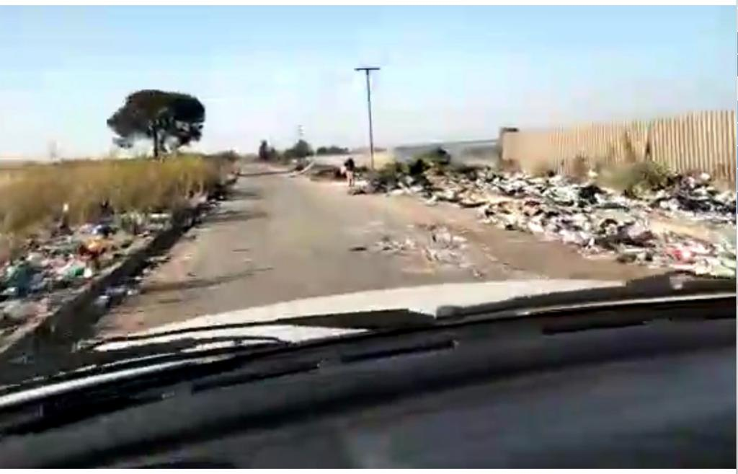
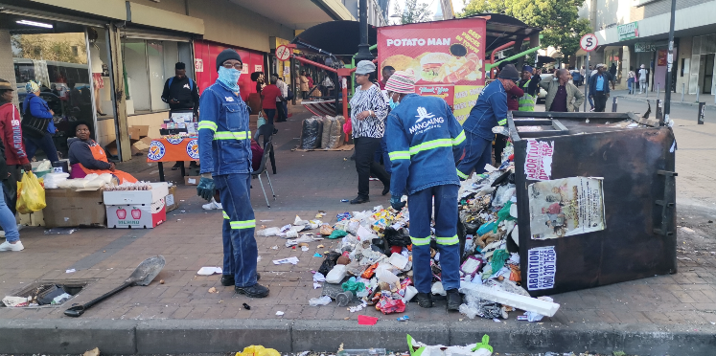
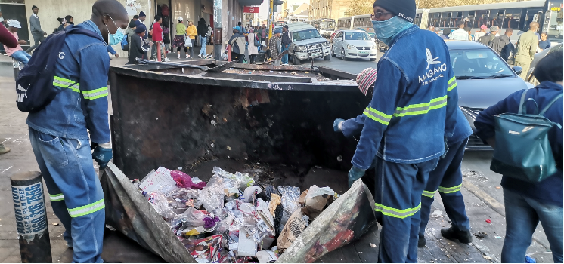
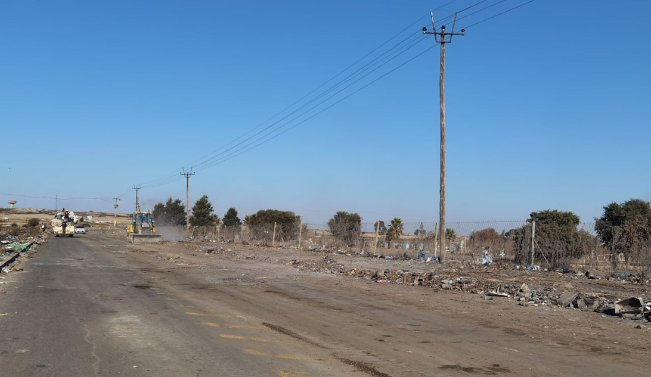
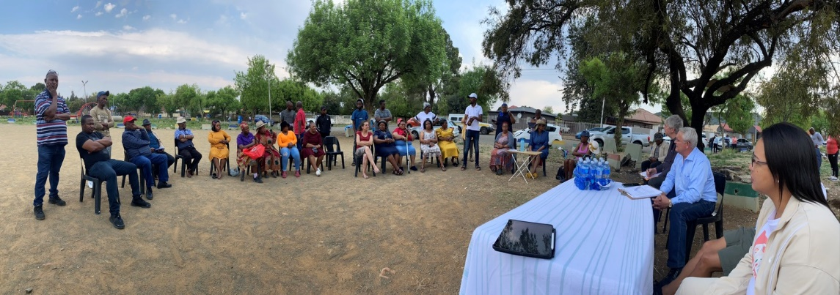
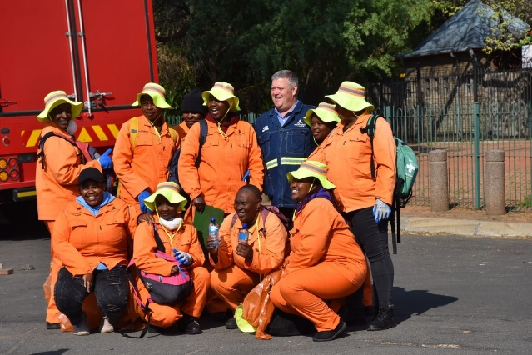
LACK OF RESOURCES
SOUTHERN LADFILL BEFORE
NEW AWARENESS MATERIAL
SOUTHERN LADFILL AFTER
COMMUNITY ENGAGEMENT – SERVICE DELIVERY
PEP UTILISATION - CLEANUP

Slide 28
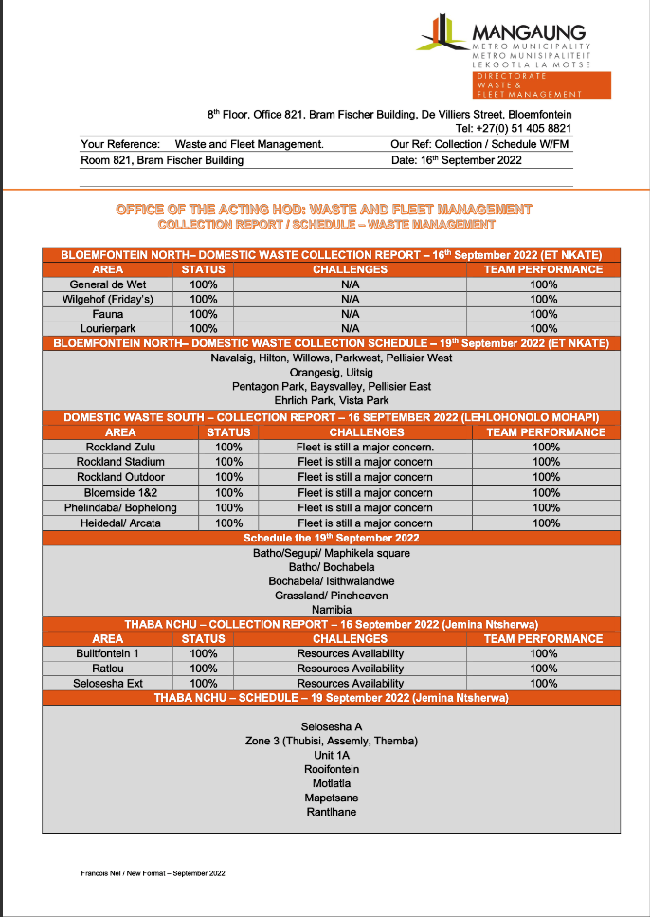
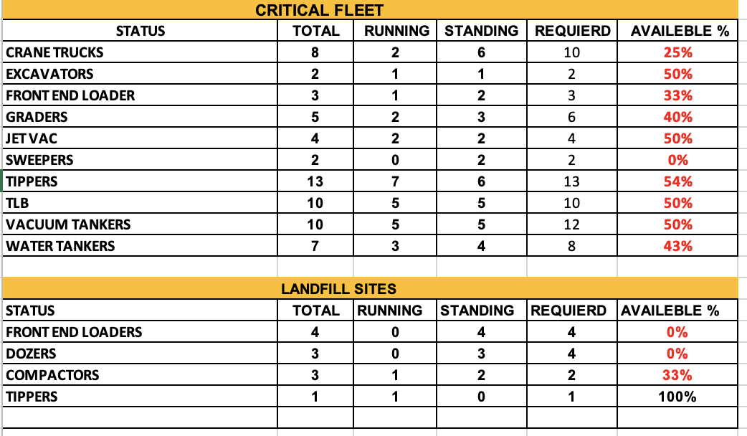
Service delivery : SOLID WASTE
Status Quo still to be addresses:
Development of new collection report / schedule concluded
Will support targets and evaluation of performance
Utilisation to disseminate critical information and requests tabled by political principals
Collection rate increase communication to Public
Utilisation of Social Media platforms to disseminate schedule
Status Quo still to be addresses
Lack of supervision / Management oversight and reporting
Scavengers – Open bags
Erratic collection
Supervisor monitoring and evaluation
Fleet status

Slide 29
Service delivery : WATER & SEWER INFRASTRUCTURE
Status Quo
High risk asbestos water pipes that need urgent replacement attention and funding constraints.
High vacancy rate experienced in water department and other sub-directorates in Engineering Services;
Insufficient budget allocated for operation and capital projects;
Insufficient and unreliable fleet allocated to water department.
New tenders were put into obeyance by National Treasury
Delays due to procurement processes specifically for water and sewer materials
Progress to date
Water and sewer reticulation network study conducted.
Draft water maintenance and rehabilitation report compiled.
Refurbishment of water supply system project is currently addressing pipe bursts through a pipe replacement contract.
Procurement processes fast tracked and contractor appointed to supply material to attend to burst pipes as well as leaks emanating from different types of water infrastructure.
Professional Service Provider (PSP) in process of revising the 10-year Water Conservation and Demand Management plan. One of the sub projects identified is the identification of formal sites which have an incomplete/complete water reticulation system but no meters being installed. This exercise will be done using GIS and estimated costs will be determined. The expected completion of the revised plan will be before the end of December 2022.

Slide 30
Service delivery : WATER & SEWER INFRASTRUCTURE
Status Quo
High risk aged water and sewer pipes urgent replacement and funding constraints.
High vacancy rate Engineering Services;
Insufficient budget allocated for operation and capital projects(WTW & WWTW’s)
Insufficient and unreliable yellow fleet
Delays in procurement processes specifically for water and sewer materials and equipment
Poor road infrastructure
Water leakages (water losses)
Progress to date
Conducted a reticulation network study completed and rehabilitation report has been compiled.
Critical vacant posts identified to be advertised (30Sept)
Prioritise budget and source additional funding (rehabilitation report) – application to DWS (WSIP)
Repairs of fleet ongoing (additional 15% operational)
Procurement processes being streamlined (committees convening regularly)
Resurfacing roads (29,5km); pothole repairs and re-gravelling/grading of gravel roads
Refurbishment of water supply systems project in implementation as well as Water Conservation Demand Management Plan

Slide 31
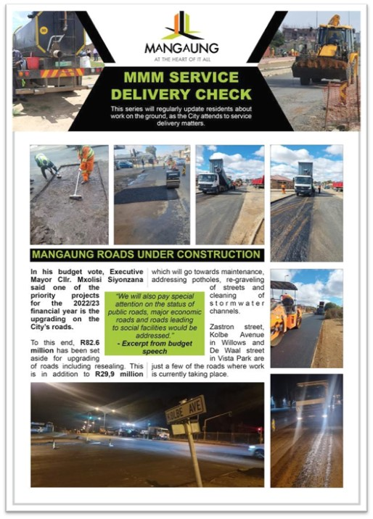
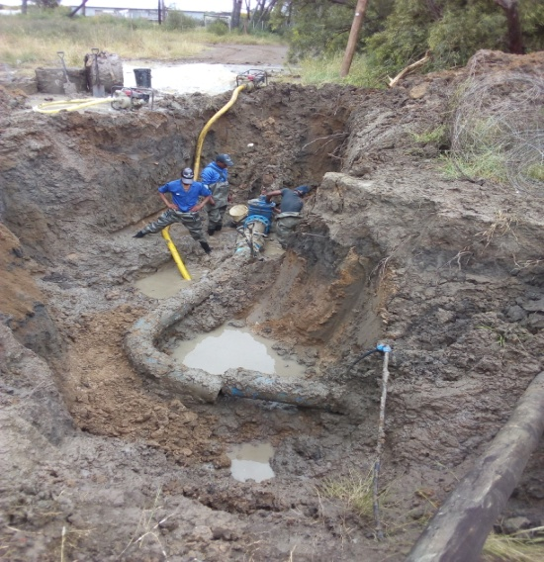
Service delivery : INFRASTRUCTURE PROGRESS

Slide 32
Service delivery: integrated public transport network (iptn)
Progress to date
Forensic Investigation underway by Minister of Transport to be finalised end of September 2022.
Reconfiguration of ITPN underway.
Bus certification of fitness underway to be finalised by 23 September 2022.
Moshoeshoe Road (a) construction of base and surface layer – 1.2km ( four lanes); curbing and storm water drain.
Construction of Moshoeshoe (a) and (b) started 22 August 2022. Appointed 88 workers (locals) on site.
Appointed 20 subcontractors (locals) both Moshoeshoe (a) and (b).
Status Quo
10 buses procured & parked at Fleet Management Workshop
Approximately 16 Staff members seconded/appointed
17,4km of trunk route
R103m for roll-over
R249m (22/23) of Public Transport Network Grant
Incomplete Moshoeshoe Road Part (a) & (b).

Slide 33
Service delivery: integrated public transport network (iptn)
Progress to date
Phase 1(c)
Finalise all outstanding issues on Vehicle Operating Company (VOC) for IPTN trunk route
Signed starter services agreement, Interim Depo and Bus Lease Contract.
Fleet Maintenance Agreement to be signed by end of September 2022.
Hauweng Bus Go-live! Intended to be launched October 2022.
Status Quo:
Incomplete Bus Stops/Shelters on Phase 1(c)
Terminated old contracts for Moshoeshoe Road part (a) & (b) (none performance).

Slide 34
Service delivery: integrated public transport network (iptn)
Pending strategic matters:
VOC Shareholders certificate outstanding
Unity between the VOC Board of Directors and Taxi Association Steering Committee
Procurement of furniture for VOC Offices.
Appointment of Management Staff for VOC.
Illegal parking of private vehicles to addressed.

Slide 35
Service delivery : social services
Status:
No maintenance and upgrades since relocation of the zoo in 2013.
The Zoo is currently still closed and without animals ( there are only 11 buffalos present in Zoo).
Reduction of Capital funding projected for the 2022/23 financial year and insufficient funding projected in the Operational Budget for 2022/23 financial year (e.g. Food for animals not enough for one month just for 11 Buffalo).
Public demands resuscitation of the Zoo.
Progress to date
Library Launch by (LIASA) Library Information Association of South Africa.
Establishment of the Substance Abuse Committee by the Executive Mayor.
Establishment of Heritage Council by the Executive Mayor.
Resuscitation of the District HIV / Aids Council by the Executive Mayor.
Sufficient budget to develop a Comprehensive Risk and Vulnerability Assessment of the City.
Transferred existing Zoo staff to the Natural Resource Management Unit

Slide 36
Service delivery : disaster management
Progress to date:
Procurement of a Disaster Information Management System (requirement in terms with Disaster Management Act).
Procurement of at least one (1) LDV for each region to ensure effective response and recovery interventions.
Participating in a Multi-Disciplinary / Integrated Operations with other Law Enforcement Agencies.
Collaborating with the University of the Free State on Safety & Security Matters.
Progress to date:
Sufficient funding to enable the sub directorate to respond to humanitarian needs of affected households (e.g., blankets, mattresses, temporary shelter [shacks] and etc.)
Immediate replacement of backup batteries of two-way radio repeaters.
Installation of additional two-way radio repeaters.
R300 000 worth of fire and emergency equipment were donated by Sanlam in this month.

Slide 37
Service delivery: MUNICIPAL POLICE SERVICE
Activity | Estimate Revenue Per Month
Reintroduction of Parking meters or parking marshal. | R 250 000,00
Enforcement of by laws to informal traders after formalisation by Economic Development Directorate. | R 100 000,00
Creation of Animal and vehicle pounds in Botshabelo, Thaba’Nchu, Wepener and Soutpan, Dewetsdorp and Van Stadensrus. | R 100 000,00
Taking over testing and licensing centres that are within Mangaung Municipal area from Provincial Government. | R 16 650 000,00
Consider building weighbridges in two strategic Northern Cape entry points to Bloemfontein (long-term) or secure the use of mobile vehicle weighbridge. | R 250 000,00
Traffic Contravention System- Roadblocks for Outstanding Warrant of Arrests. | R 500 000,00
Handheld Speed Cameras / Static or Automated Speed Cameras. | R 500 000,00
Revive the use of Section 341 Notices and Commence. Impoundment of Motor Vehicles transgressing the Road Traffic Laws. | R 1 000 000,00
Utilization of Wheel Clamps for non moving Violations. | R 250 000,00
Control and Enforce Laws and By Laws regarding Construction on the Road Network. | R 250 000,00
TOTAL | R 19 625 000,00

Slide 38
recommendations
It is recommended that the Portfolio Committee for Cooperative Governance to take note of the content and progress made on the intervention.

Slide 39
THANK YOU

