Slide 1
Provincial Treasury and Department of the Premier
FIRST QUARTER PERFORMANCE FOR THE 2022/23 FINANCIAL YEAR
BUDGET COMMITTEE
20 September 2022

Slide 2
Reporting Reform Journey – Quarter 1 of 2022/23
Deepening of Information
Performance Data: Including Provincial Strategic Implementation Plan (PSIP)
Financial Information: Compensation of Employees (CoE) and Infrastructure
Working towards
Providing more information to assist oversight and improve the system of accountability
Creating an institutional view, which builds every quarter towards an annual performance card for the WCG

Slide 3
Outline of Presentation
Provincial First Quarter Performance Information
Provincial Performance Overview
Provincial Performance towards the Provincial Strategic Implementation Plan (PSIP)
Financial Performance, Compensation of Employees (CoE), Infrastructure, Public Entities and Revenue

Slide 4
2022/23 First Quarter Performance Information

Slide 5
Introduction to the Quarterly performance
Globally
Q1 2022/23 Financial Year was a turbulent one with the advent of the war in the Ukraine.
Fuel and food prices have risen steeply and one government – Sri Lanka – has fallen due to high inflation.
The WC has not been immune
Fuel and food prices increased significantly
South Africa’s inflation rate accelerated to 7.4% by June 2022 (7.1% for the WC).
Continued loadshedding
Continued impact of COVID-19
WC population increased to 7,2 million
WC unemployment rate increased to 27.5% by the end of June
SAPS recorded 994 murders reported in the WC for the period from April to June 2022.
WCG overall on track with its delivery, with most targets being met.

Slide 6
Provincial Performance Overview

Slide 7
Overview of summary WCG performance
It summarises the findings of the 1st Quarterly Release on Performance Data (non-financial) as it relates to the APPs and the PSIP tabled within the 2022/23 financial year
A total of 804 performance indicators are confirmed in the tabled APPs of the 13 provincial departments for the 2022/23 reporting period
A further 156 performance indicators have been identified from the APPs of the 11 provincial entities.
The PSIP Centralised Reporting Tool (CRT) was also compiled to track progress against specific performance indicators linked to interventions of the PSIP
The CRT comprises of 134 PSIP indicators: 40 outcome indicators (Jobs: 22; Safety: 6; Wellbeing: 12) and 94 output indicators (Jobs: 53; Safety: 23; Wellbeing: 18).

Slide 8
Overview of the socio-economic picture as measured by the outcomes in the PSIP
Jobs
GDP growth rate for the Western Cape stood at 2% during Q1:2022/23
Number of people employed increased by 1.5%,
Official unemployment rate stood at 25.5%.
Safety
Stabilisation in violent crime, with homicides in the Western Cape decreasing by 1%
11 priority areas in the Cape Metro recorded an 8% decrease in homicides
This accounted for 40.5% of all homicides in the Province
Almost half of all homicides occur during weekends and continue to be committed by firearms.
Well-being
76.12% of Grade 1 learners received formal Grade R education in Public Ordinary Schools.
NEETs (Youth Not in Education, Employment or Training) aged 15 – 34 has risen by 22% since Q1:2020/21
Sharp surge in NEETS was more pronounced between Q1:2021/22 and Q1:2022/23, with an increase of 12%

Slide 9
Overview of delivery trends for performance indicators
Overview of Provincial APP performance
That overall, 388 of the 485 targets (or 80%) were achieved through:
Departments - 324 out of 407 targets (or 80%); and
Public Entities - 64 out of 78 targets (or 82%).
Overview of Provincial Departmental APP performance
Departments achieved 324 out of 407 targets (or 80%) with 3 out of 13 departments achieving all their targets. Furthermore, 52 (or 13%) of Quarter One’s (1) targets were partially achieved, and 31 (or 8%) were not achieved. The departmental clusters performed as follows:
Governance Cluster = 94%
Social Cluster = 72%
Economic Cluster = 80%
Overview of Provincial Entity APP performance
Public Entities achieved 64 out of 78 targets (or 82%) with 5 out of 11 public entities achieving all their targets, with 1 public entity not having a first quarterly target. Furthermore, eight (8) (or 10%) of the total of 78 quarter one (1) targets were partially achieved, and six (6) (or 8%) were not achieved. The public entities clusters performed as follows:
Governance Cluster = 100%
Social Cluster = 76%
Economic Cluster = 80%

Slide 10
Overall achievement: Departmental performance indicator targets
KEY: Achieved = 100 percent or more of target achieved; Partially Achieved = 50 percent or more but less than 100 percent; Not Achieved = below 50 percent.
NOTE: Health uses 95 percent and above to reflect “achieved” due to many of the indicators being demand driven and therefore unpredictable
Due to rounding, percentages do not always add up to 100.
*The targets reflected as” 0” were not taken into account
eQPR system does not allow for round off decimal points

Slide 11
Overall achievements: Department’s average

Slide 12
Overall achievements: Entity performance indicator targets
KEY: Achieved = 100 percent or more of target achieved; Partially Achieved = 50 percent or more but less than 100 percent; Not Achieved = below 50 percent.
*The targets reflected as” 0” were not taken into account
eQPR system does not allow for round off decimal points

Slide 13
Overall achievements: Entity’s average

Slide 14
Overview of departmental APP indicators linked PSIP thematic areas
A total of 394 (or 46%) performance indicators were aligned to the following PSIP thematic areas:
Jobs = 153
Safety = 107
Wellbeing = 206
Innovation, Culture and Governance = 3
For quarter 1, the performance of 211 of the 394 indicators were reported on.
Overall, the WCG average on performance against APP targets linked to the PSIP thematic areas is 71%. Departmental performance on PSIP liked indicators against the provincial average were the following:
Jobs: 49 (65%) of the 77 APP targets were achieved. DOA and DTPW were the biggest contributors
Safety: 63 (85%) out of 74 APP targets were achieved. DOCS and DSD were significant contributors
Wellbeing: 74 (68%) out of 109 APP targets were achieved. The DOH and DSD were significant contributors. Wellbeing also had the highest number of linked targets for the first quarter.
Innovation, Culture and Governance: Only one (1) first quarter APP target was linked to this area. This target was achieved

Slide 15
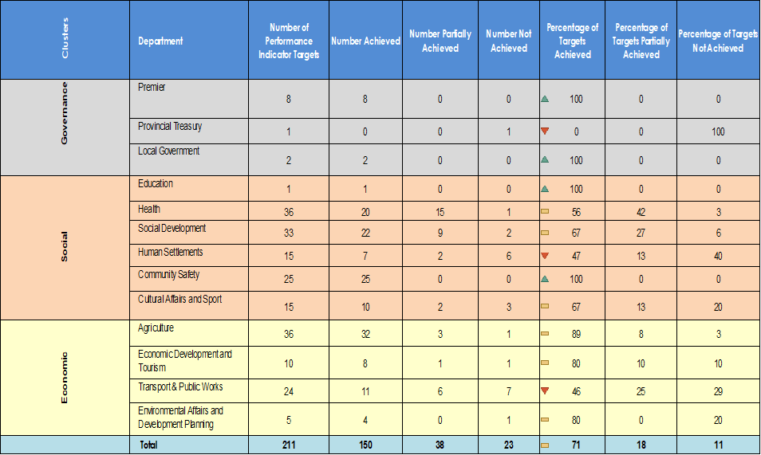
Overall achievement: PSIP performance indicator targets
KEY: Achieved = 100 percent or more of target achieved; Partially Achieved = 50 percent or more but less than 100 percent; Not Achieved = below 50 percent.
NOTE: Health uses 95 percent and above to reflect “achieved” due to many of the indicators being demand driven and therefore unpredictable
Due to rounding, percentages do not always add up to 100.
*The targets reflected as” 0” were not taken into account
eQPR system does not allow for round off decimal points

Slide 16
Overall achievements: PSIP average performance

Slide 17
Provincial performance towards the Provincial Strategic Implementation Plan (PSIP)
*To note: PSIP Central Reporting Tool is a separate reporting process from the eQPRS.

Slide 18
Performance towards PSIP
Institution | Quarterly Performance | PSIP
PT | Initiated developing and implementing an in-house eProcurement System for WC. All RFQs advertised via eProcurement System and 11 839 business opportunities advertised during Q1:2022/23. | Jobs
DLG | 325 000 service requests were processed through Thusong Service centres Q1:2022/23. | Wellbeing
DEA&DP | Finalised 58 Environmental Impact Assessment (EIA) applications within legislated time frames | Jobs
 | RSEP programme implemented in 8 WC towns. | Safety
DCAS | WC Library Service presented 5 149 literacy interventions. 229 libraries continued support through Rural Libraries Connectivity Project providing public internet access. Created 2 163 youth in service opportunities. | Wellbeing
DOH | Advanced planning stage of the Violence Prevention Unit | Safety
 | Immunisation under 1 years old dropped from 89% to 82.7% being immunised in the first quarter. Training healthcare workers completed in Garden Route District (300) and Central Karoo (40). 74.5% of pregnant women had their first antenatal visit before 20 weeks, exceeding the quarterly target of 73.6%. Drug-sensitive clients lost to follow-up rate (DS-TB client LTF) was much higher than the quarterly target of 13.7%, at 18.94% -TB Response plan in place to address. | Wellbeing
WCED | 95 ECD centres across WC supported. Implemented by two social service organisations (SSOs) funded by WCED to run ‘Blocks 4 Growth’ (4–5-year-olds) and ‘Step Up’ (5-6 year olds) - in identified facilities/entities/sites to support children to achieve their developmental milestones. 240 schools trained in Growth Mindset programme Q1:2022/23. | Wellbeing

Slide 19
Performance towards PSIP
Institution | Quarterly Performance | PSIP
DOCS | 1 141 LEAP members being deployed to different areas and functions. CoCT indicated vehicles delivered by end July 22. LEAP members carried out 1 751 arrests targeting drivers of crime, against a target of 300. Confiscated 44 firearms, against a target of 33. Forensic Pathology Services unit sends weekly reports on road traffic accidents and homicides to SAPS. Safety Dashboard is updated twice a week and made available to key safety stakeholders. Department accredited 69 Neighbourhood Watch structures. Signed contract with NGO APCOF to produce 6 policy briefs comprising Policing Needs and Priorities report for this financial year. Arranging 5 stakeholder engagements, one in each District Municipality Leading the alcohol harms reduction task team. On 6 April 2022, Cabinet approved the drafting of legislative amendments to the WC Liquor Act, 2008, to provide for minimum unit pricing (MUP) and to set trading time parameters Cabinet recommended DoCS conduct a Regulatory Impact Assessment (RIA) on the two proposed legislative amendments. This will be supported by DoTP: Policy and Strategy and Legal Services and DoH, DoA, DEDAT and WCLA. Following the RIA, DoCS will develop drafting instructions with the support of DoTP: Policy and Strategy and Legal Services | Safety
WCLA | Conducted 55 enforcement operations with other agencies. | Safety

Slide 20
Performance towards PSIP
Institution | Quarterly Performance | PSIP
DOA | 291 participants were trained in agricultural skills development programmes. Further 10 people provided with internships or workplace experience. Food Gardens project supported 498 households with agricultural food production initiatives. SMME Booster Fund received 54 applications following a call for proposals advertised on 26 May 2022. Food Security Project supported 64 agricultural producers with business development. 1 304 farmers and businesses provided with agro-processing support. Agriculture export programme supported 21 agri-businesses with firm-level marketing services. Programme issued 3168 export veterinary certificates and conducted 36 export establishment audits. DoA Eco-Infrastructure: Land Care programme rehabilitated 5 446 hectares of land during Q1:2022/23. | Jobs
 | Supported 2 safety structures in rural areas. | Safety
 | Supported 505 food gardens (including household, community and school food gardens) | Wellbeing
DSD | Funded 858 parents and caregivers who completed parent education and other family support programmes. Referred 4178 children assessed to be at risk to various targeted interventions. Chrysalis Academy supported 190 youth. Funded 3298 service users who completed substance abuse treatment programmes. Facilitated access to psychosocial support services for 5960 victims of gender-based violence. | Safety
 | Provided meals to 11 476 people Provided 2308 subsidised beds in shelters for homeless adults Recorded 3 092 youth participating in skills development programmes. | Wellbeing

Slide 21
Performance towards PSIP
Institution | Quarterly Performance | PSIP
DEDAT | Red Tape Reduction Unit had five interventions underway during Q1:2022/23 to improve the regulatory environment. Funded 24 improvements in business-facing government services. Assisted 190 tourist guides through development and permit registration interventions. Reported 1 initiative to grow the tourism sector, i.e. the review and development of the Cape of Great Events strategy. Tourism Safety sub-programme supported 46 establishments or individuals. Green Economy Unit in DEDAT supported 32 businesses and 25 municipalities with resilience projects and related matters. Implementing five interventions to diversify energy supply and reduce water intensity. In-depth support offered to select municipalities for the implementation of pioneering projects in the Municipal Energy Resilience (MER) initiative. Scoping the transaction advisory support needed by CoCT for its IPP procurement process. MER funded projects completed include Swartland (Electricity Master Plans (EMPs)), George (EMPs), Mossel Bay (CoSS) and Overstrand (CoSS). Energy update presented at a recent MinMay to all municipalities Stellenbosch Municipal Council resolved to proceed with the embedded project for Municipal Independent Power Producer Procurement (MIPPP). Green Economy Unit held an engagement with CoCT regarding its IPP procurement process. | Jobs

Slide 22
Performance towards PSIP
Institution | Quarterly Performance | PSIP
Wesgro | Investment promotion realised 60 jobs during Q1:2022/23 and one investment with an estimated value of R100 million (and 60 jobs created). Participated in or sponsored over ten events to promote investment in the WC during the reporting period Concluded four trade agreements with an estimated Rand value of R10.8 million. Tourism Marketing secured 12 bids and 3 joint marketing agreements. Estimated economic impact of the bids amounts to R95 million | Jobs
DTPW | 66 654 EPWP work opportunities are targeted across WCG departments. Further 23 688 Full-Time Equivalent job opportunities are targeted for the WC through the EPWP for the financial year. Targeted the creation of 8 337 work opportunities through infrastructure builds outside of the EPWP. 1 371 abnormal load applications were processed during Q1:2022/23 PRE processed 71% of transport operating licences within legislated timeframes during the reporting period. 5 new infrastructure projects (1 education and 4 general facilities) were completed during Q1:2022/23. The total spend was reported at R251 million (R198 274 777 on education and R52 733 343 on general facilities). Reported 26 public infrastructure maintenance and upgrade projects completed (13 education projects and 13 general facilities) with a total spend of R115 million (R89 330 274 on education and R26 121 020 on general facilities). Sustainable Infrastructure Development and Financing Facility (SIDAFF) Programme is currently in the 2nd phase of its development. | Jobs
 | Conducted 313 targeted operations relating to arresting of drivers for drinking and driving, reckless and or negligent driving, habitual driver offenders, transportation of illegal substances, and false documentation. | Safety

Slide 23
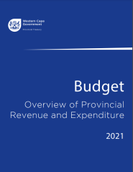
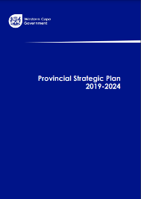
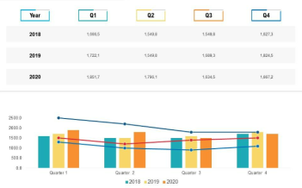
Take Home Points
This report is the 1st joint release for Q1 as part of our performance data reform journey to expand the depth and breath of performance data.
This release provides the Budget Committee with the quarterly outcome for the province in terms of performance indicators and an institutional performance overview.
It provides the first overall view of WCG performance from a reporting perspective, noting further work towards streamlining the integration of non-financial performance data.
The consumption of this release quarter on quarter, is to build an annual performance report card for the WCG.
For the budget committee to note:
Socio-economic trends cannot be seen in isolation of the broader socio-economic trends required to understand the service delivery context for the WC.
Performance delivery trends should be seen in relation to its contribution to the provincial strategic priorities.

Slide 24
2022/23 First Quarter Financial Performance
Financial Resources utilized to achieve Performance Targets

Slide 25
Provincial Expenditure as at 30 June 2022
Local Government – ICT rollover request.
Health: projected impact of the re-introduction of clinical services that was scaled down during the Covid-19 period and impact of inflation.

Slide 26
Implementation: Main emerging matters
Departments are adapting, reprioritising and adjusting to …
Context | Main Emerging Matters
Governance | Conflicting application and interpretation of National SCM Prescripts Readiness to implement and comply with the revisions in the supply chain and asset management regulatory regime that can result in negative/compromised audit outcomes
Refresh | Managing the refresh process and current year delivery
Wage Agreement | Uncertainty regarding the outcome and funding of the 2022/23 wage agreement. The latest offer to labour includes a 3% salary increase plus a R1 000 non-pensionable allowance that will impact the province by approximately R985 million
Growing demand for services in the current economic climate | Growing impact on departments, whilst trying to stabilize staff numbers
Loadshedding, increased fuel cost, rising inflation | Additional costs placing burden on budget and increasing government service needs of citizens in all votes

Slide 27
Implementation: Main emerging matters (continued)
Context | Main Emerging Matters
Growing burden on Social services sector | Leaner growth, Grade R universalization and Early Childhood Development budget risks in the education environment Escalating mental health burden, malnutrition and increased incidences of violence in the health environment, as well as re-escalating critical services, including addressing surgery backlogs and ensuring TB and immunisation catch-ups Critical shortage of staff in social development and the impact of financial pressure on the NPO sector
Infrastructure environment | Inability to unlock adequate affordable housing opportunities, poor contractor performance, protests, vandalism and land invasions, as well as technical capacity of municipalities to plan and implement projects in the human settlements environment
Increasing municipal service costs and rates and taxes | Crowding out the public works expenditure budget
Public Transport System | Attacks on busses undermining the service and the need to get the rail service online to decrease pressure on other parts of the transport system

Slide 28
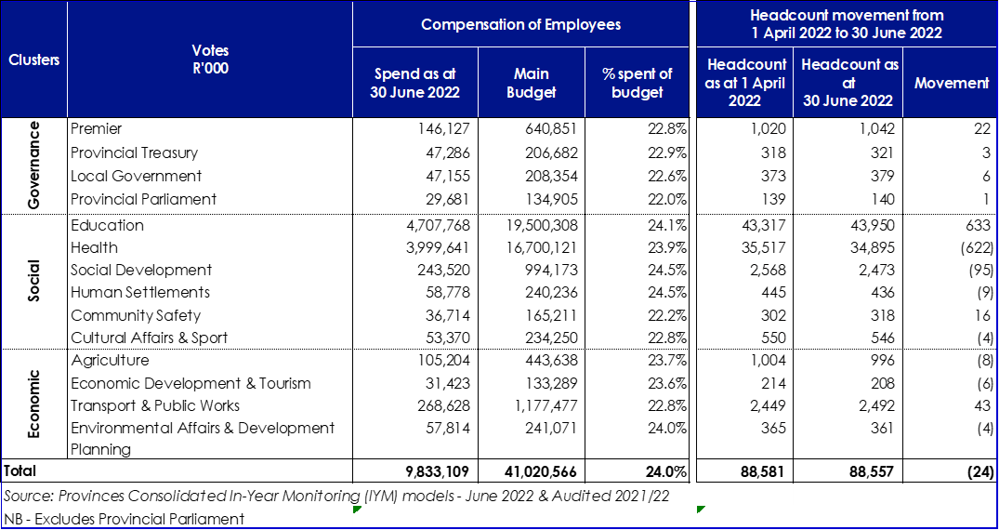
Compensation of Employees – Focus area for 2022/23
Risk:
2022/23 Wage negotiation not finalised; 3% salary offer not budgeted for and WC costs amount to R985m
WC position communicated at National level

Slide 29
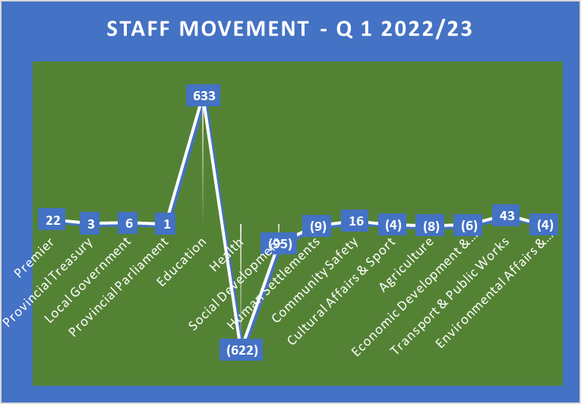
Compensation of Employees: Headcount
CoE spent 24 per cent of the budget, as departments are implementing their bespoke CoE strategies
Overall headcount of the Western Cape decreased by 24 for Q1, this will change over the year pending the varied recruitment processes
Service delivery pressures has increased need for staff and leading to pockets of burnout
Education increases - uptake of temporary and relief teachers and administrative staff at schools
Health reductions relate to mainstreaming Covid-19 contract posts and budget management

Slide 30
Overall Infrastructure Percentage Expenditure as at end of June 2022
Infrastructure expenditure amounts to 16.6 per cent of budget
Key challenges includes; delayed procurement processes, poor performance by contractors and/ or professional service providers (PSPs)
Response to challenges includes; re-prioritisation of budgets towards alternative projects and acting against non-performing contractors and/ or PSPs

Slide 31
Infrastructure Expenditure as at 30 June 2022

Slide 32
Infrastructure Project Status as at end of June 2022
The project pipeline at the end of June 2022, comprised of 585 projects
Approximately 51 per cent of projects are in planning, i.e., Project Initiation, Pre-Feasibility, Feasibility, Design, or Tender phase;
Approximately 26 per cent are in Construction Stage;
While 7 per cent are in the Practical or Final Completion Stage; and
A total of 96 Packaged Programmes and non‑infrastructure, i.e., Compensation of Employees, Health Technology, administration, etc. make up 16 per cent of the Quarter 1 expenditure;
Project Status for each sector provided

Slide 33
Quarterly information per Department: Education as an example
Above information to be provided from Quarter 2 onwards
The figure above is extracted from the Quarterly Publishing Report on the Infrastructure Reporting Model (IRM) as at the end of August 2022.
Spending performance for Education improved from 16 per cent as at 30 June 2022 to 22 per cent during August 2022.

Slide 34
Infrastructure South Africa (ISA): Western Cape Projects Portfolio Overview
Background:
The ISA projects portfolio in the Western Cape consist of 62 projects of which 48 are from the public sector and 14 are from the private sector. The value of these projects amounts to R312.84 billon. The stages of the projects are categorised according to the 5 Case Model Stages of ISA. The stages of the projects are reflected as follows:
Origination = 30;
Registration = 4;
Early Business Case = 12;
Intermediated Business Case = 11; and
Full Business Case = 5.

Slide 35
Public Entities
ASEZCo :
Relates to unspent funds from the prior financial year
Intention to utilize funds for VAT on land transfer from CoCT and community-, skills- and enterprise development programmes.

Slide 36
Provincial Own Revenue
At the end of June 2022 own receipts amounted to R558.015 million, or 22.8 per cent of the budget.
Provincial taxes amounted to R230.370 million or 26.5% of the budget.

Slide 38
Education Infrastructure Project Status as at end of June 2022
Approximately 40 per cent of projects are in planning, i.e., Project Initiation, Pre-Feasibility, Feasibility, Design, or Tender phase;
Approximately 26 per cent are in the Implementation Stage; and
While 34 per cent are COE and Packaged Programmes.

Slide 39
Health Infrastructure Project Status as at end of June 2022
Approximately 48 per cent of projects are in planning, i.e., Project Initiation, Pre-Feasibility, Feasibility, Design, or Tender phase;
Approximately 23 per cent are in the Implementation Stage;
Approximately 8 per cent are in the Completion Stage;
While 21 per cent are COE and Packaged Programmes.

Slide 40
Transport/ Roads Infrastructure Project Status as at end of June 2022
Approximately 17 per cent of projects are in planning, i.e., Project Initiation, Pre-Feasibility, Feasibility, Design, or Tender phase;
Approximately 44 per cent are in the Implementation Stage;
Approximately 22 per cent are in the Completion Stage; and
While 17 per cent are COE and Packaged Programmes.

Slide 41
Public Works Infrastructure Project Status as at end of June 2022
Approximately 25 per cent of projects are in planning, i.e., Project Initiation, Pre-Feasibility, Feasibility, Design, or Tender phase;
Approximately 44 per cent are in the Implementation Stage;
Approximately 3 per cent are in the Completion Stage; and
While 28 per cent are COE and Packaged Programmes.

Slide 42
Human Settlements as at end of June 2022
Department of Human Settlements | 2022/23 Target (HSDG & ISUPG) |  | Quarter 1: 2022/23
 |  |  | Actual (HSDG) |  | Actual (ISUPG) | Total (HSDG & ISUPG)
 | Housing Units | Serviced Sites | Housing Units | Serviced Sites | Serviced Sites | Serviced Sites
Cape Winelands District | 816 | 258 | 41 | 0 | 0 | 0
Central Karoo District | 0 | 0 | 0 | 0 | 0 | 0
City of Cape Town | 1 803 | 0 | 68 | 0 | 0 | 0
Departmental Projects | 997 | 342 | 96 | 0 | 0 | 0
Financial Interventions | 2 240 | 0 | 454 | 0 | 0 | 0
Garden Route | 1 326 | 680 | 58 | 0 | 0 | 0
Overberg District | 544 | 1 120 | 0 | 0 | 0 | 0
West Coast District | 737 | 347 | 78 | 0 | 0 | 0
Total | 8 463 | 2 747 | 795 | 0 | 0 | 0
It is noted that the actual housing units delivered are at 795, as at the end of June 2022.

