Slide 1
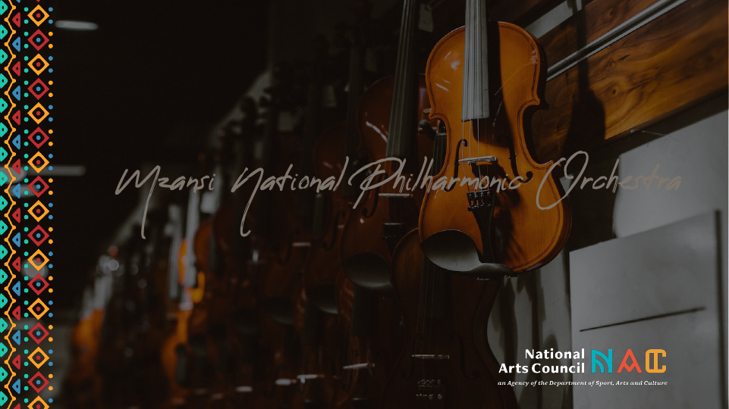
MZANSI NATIONAL PHILHARMONIC ORCHESTRA
Presentation to the Portfolio Committee: Department of Sports, Arts and Culture
16 September 2022

Slide 2
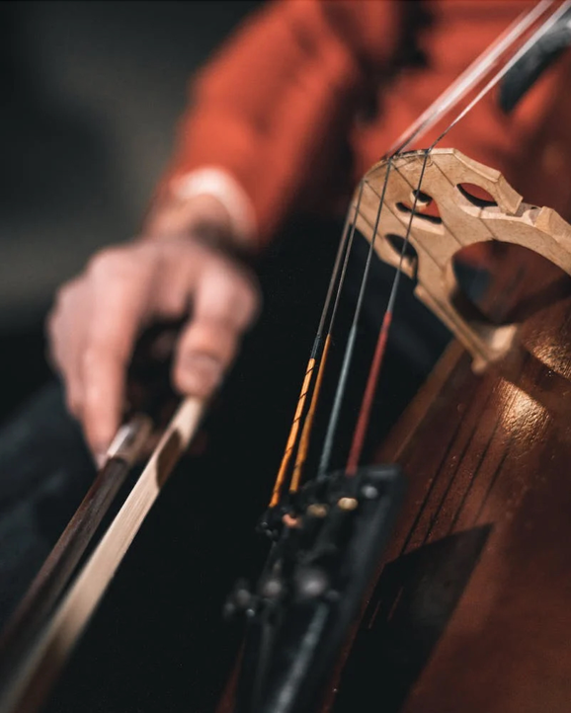


Table of Contents
Background on Orchestra Funding in South Africa
Mzansi National Philharmonic Orchestra
Governance
Implementation Report
Report on funding disbursed to Mzansi National Philharmonic Orchestra
2

Slide 3
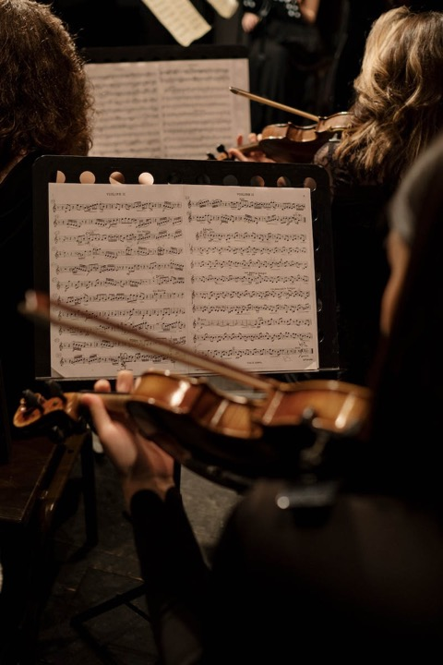
ORCHESTRA ON FUNDING IN SOUTH AFRICA
Prior to 1994 major orchestra companies were attached to the former Performing Arts Councils in the four (4) provinces (Artscape, Playhouse, PACOFS and State Theatre).
The orchestras were directly supported through these Performing Arts Councils.
They presented various concerts and rendered musical support to the opera, ballet and other performances.
3

Slide 4
ORCHESTRA ON FUNDING IN SOUTH AFRICA - continued
4. The country also had the National Symphony Orchestra
(NSO) fully supported directly by government based at
the South African Broadcasting Corporation (SABC).
5. After 1994 the Performing Arts Councils were required
to transform in accordance with the directives of the
White Paper on Arts, Culture and Heritage (1996).
6. All companies had to be independent companies
detached from the Performing Arts Councils.
7. Not only were the orchestra companies required to
register as independent entities but had to transform
as well in terms of management, orchestra players,
genre, training development, etc.
4

Slide 5
ORCHESTRA ON FUNDING IN SOUTH AFRICA - continued
8. Political Pressure and outcry from the orchestra sector
encouraged the Department of Sports, Arts & Culture to
concede to the continued funding of orchestras in the
interest of the country’s legacy, reconciliation and nation
building.
9. DSAC responded by allocating “ring-fenced” funding for
the existing orchestras to the NAC each year.
10. Orchestra companies supported over the years included
the KwaZulu-Natal Philharmonic Orchestra, Cape
Philharmonic Orchestra, Cape Town Jazz Orchestra and
Johannesburg Philharmonic Orchestra.
5

Slide 6
ORCHESTRA ON FUNDING IN SOUTH AFRICA - continued
11. The NAC does not have jurisdiction and/or influence in
selecting the beneficiaries of “Ring Fenced” funding as
that is determined by the Funder
12. Its main role is to distribute funding to the already
identified beneficiaries, due to its mandate as per the
NAC Act.
13. Orchestra companies supported over the years by the
Department of Sport, Arts and Culture through the NAC
have included the KwaZulu-Natal Philharmonic Orchestra,
Cape Philharmonic Orchestra, Cape Town Jazz Orchestra
and Johannesburg Philharmonic Orchestra.
6

Slide 7
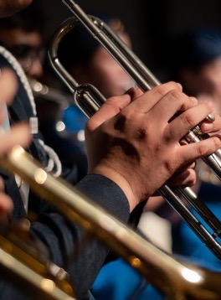
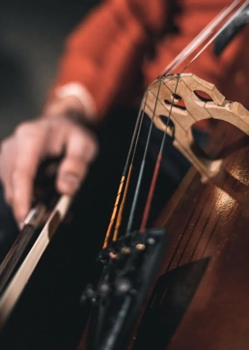
MZANSI NATIONAL PHILHARMONIC ORCHESTRA
1.During the 2021/2022 financial year, the NAC entered into a Memorandum of Agreement with DSAC as well as Memorandum of Understanding with Mzansi National Philharmonic Orchestra.
2.DSAC is the “Funder” of orchestra companies in South Africa.
3.Mzansi NPO implements orchestra programmes.
4.The NAC distributes this “Ring-Fenced” funding on behalf of the Department to Mzansi NPO.
THE NACs ROLE
is to provide oversight and review relevant compliance requirements before funds are released to Mzansi NPO.
7

Slide 8
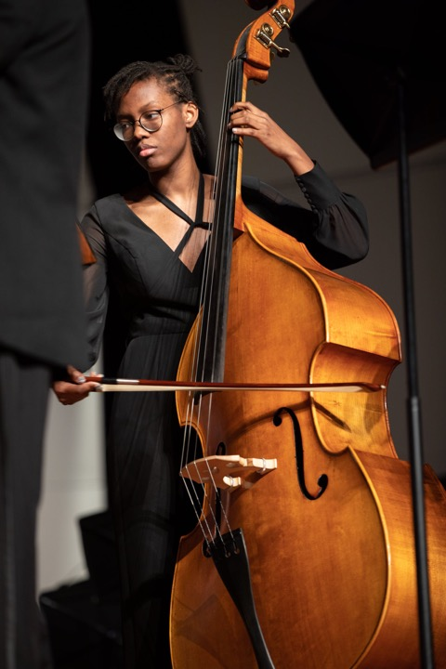
7
GOVERNANCE AT THE NAC
1. As per the NAC Act, Council Members, Panel Members and Staff of the National Arts Council (NAC) are not eligible to receive grants from the NAC funds in their personal capacity or through their organisations.
2. This policy does not apply to “Ring-Fenced” funds (such as the Mzansi NPO) which are not adjudicated by the NAC since the conflict of interest principle does not arise in circumstances where the NAC is not involved in deciding the recipients of funds, but is merely processing the grant on behalf of a Funder.
8

Slide 9
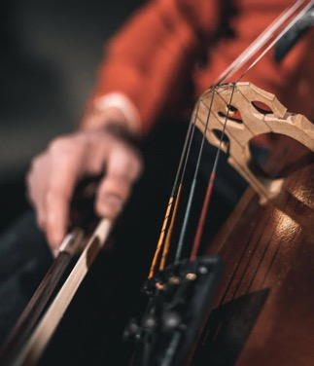
4
IMPLEMENTATION REPORT
In 2019 a sum R1 000 000 was transferred into the KZNPO’s account for the purpose of establishing the Mzansi NPO as per request by the Department of Sport, Arts & Culture.
These costs included administration and operational costs i.e, Company Secretarial Services, legal fees, Travel, Task Team staffing costs and Accommodation amongst others.
To date, this initial funding has been used for the purpose it was intended for.
These funds are audited annually as part of the KZNPOs annual audit and submitted to the NAC and the Department of Sport, Arts and Culture.
9

Slide 10
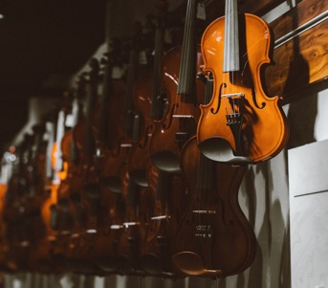
REPORT ON FUNDING DISBURSED
TO MZANSI NATIONAL PHILHARMONIC ORCHESTRA
The first installment of
R41 557 256.00 was disbursed by the NAC last year.
The Mzansi Philharmonic Orchestra submitted their Progress Report during
June 2022.
The Financial Statements are expected to be received at the end of
September 2022.
The second instalment will be processed once all contractual obligations have been met.
10

Slide 11
