Slide 9
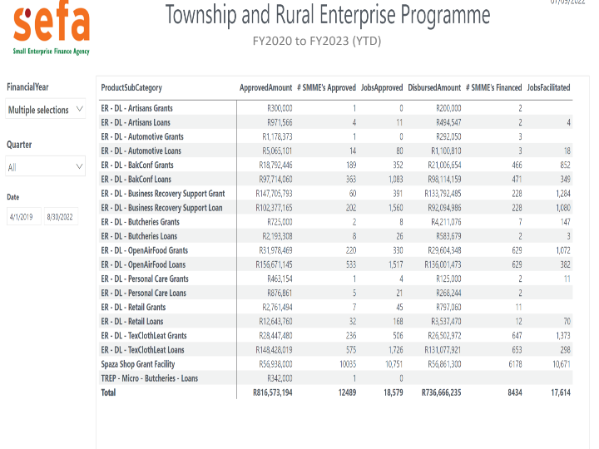

Slide 10
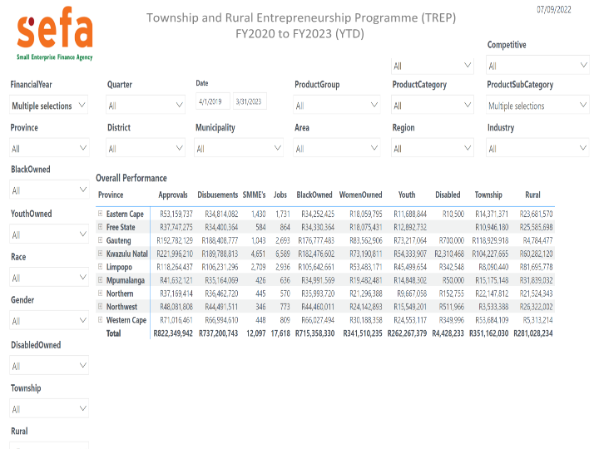

Slide 15
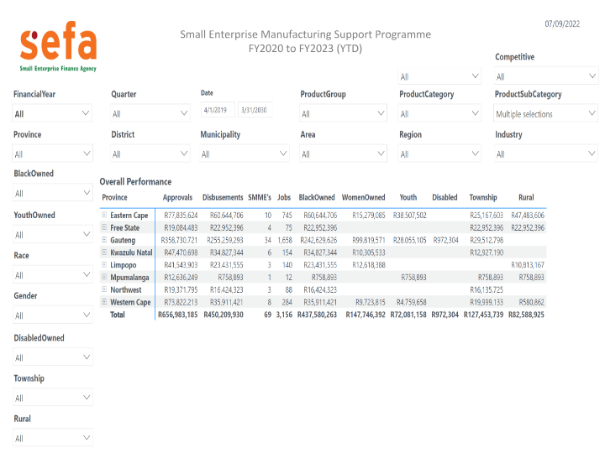

Slide 19
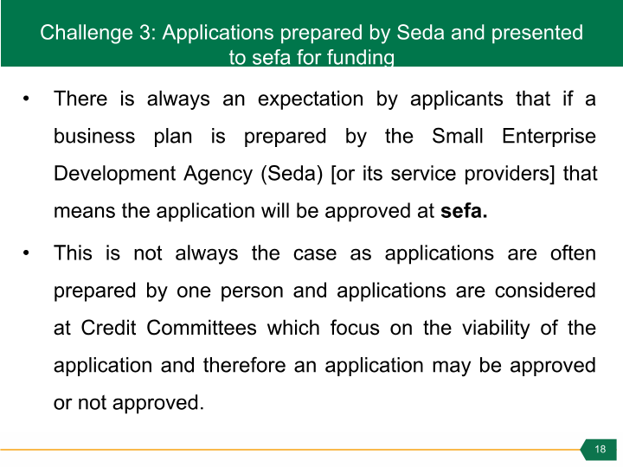

Slide 20
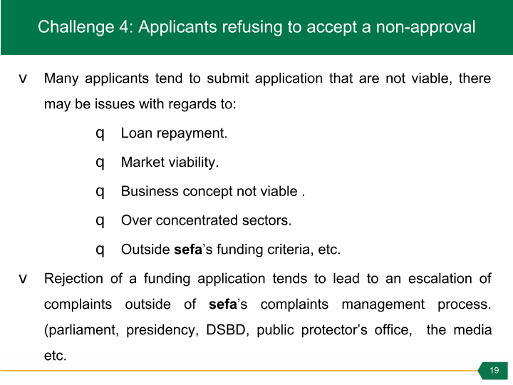

Slide 29
Seda Products and Services
Support offered | Key Interventions | Supported Sectors
Access to Market | Local exhibitions Supplier development Marketing support – signage, branding & marketing plan International trade missions Export compliance support | Agriculture Agro processing Automotive Chemicals Construction ICT Manufacturing Metal Fabrication Mining & Beneficiation Mixed high Tech Renewable Energy Services Tourism Wholesale & Retailers
Access to Finance | Business plan preparation Feasibility study support Application for funding Business pitching Funding referrals
Business Management Training | Business start up training Business improvement training (HR & Finance) Quality training Empretec training Export training Productivity improvement training
Business Development Interventions | Business mentorship and coaching Technology support Business specific need intervention.
Incubation | Structured and comprehensive mentorship and coaching Access to working space Access to technology and industry insights Access to markets

Slide 30
IMPACT OF SEDA BUSINESS
DEVELOPMENT SUPPORT

Slide 31
Impact of Seda business development support
Indicator | 2019 -20 FY | 2020 -21 FY | 2021 -22 FY | 2022-23 Quarter 1 Achievement
Total SMMEs & Cooperatives supported | 89 113 | 45 850 | 185 987 | 40 398
Jobs Created | 6 709 | 2 292 | 5 176 | 640
Jobs Sustained | 22 230 | 8 283 | 8 584 | 1 630
Turnover Increase | R 2,1 Billion | R 1,1 Billion | R 289 Million | 263 SMMEs & Cooperatives

Slide 32
Flood Relief Impact
R50 000 000
Estimated Budget
120
Applications Approved
R43 937 867,67
Total Value of Applications Approved
106
Applications Returned to Provinces for Procurement
1306
Total Jobs supported in Approved businesses

Slide 33
Seda Performance Success
Indicator | 2019 -20 FY | 2020 -21 FY | 2021 -22 FY | 2022-23 Quarter 1 Achievement
Total SMMEs & Cooperatives supported | 89 113 | 45 850 | 185 987 | 40 398
Enterprises reached through awareness | 48 866 | 8 576 | 67 029 | 28 060
SMMEs & Cooperatives supported (Excluding TREP) | 28 173 | 21 596 | 87 501 | 8 465
Township & Rural Enterprises Programme (TREP) | 12 074 | 15 678 | 31 457 | 3 873
Incubators supported | 96 | 104 | 110 | 110

Slide 34
SEDA CHALLENGES AND PROPOSED SOLUTIONS

Slide 35
Challenges and proposed Solutions
Category | Challenges | Solutions
Businesses formalisation | Most of the targeted informal businesses are not ready for formalisation Do not have the required document which is causing delays in finalising their funding applications.
 | Lack of awareness that registering an informal businesses as (Pty) Ltd, comes with additional burden since businesses are required to submit tax returns at the end of the year, which requires compilation of financial statements. | Proper advice should be given to business owners in order to understand cost implications and compliance requirements that comes with being a formal business.
Cost of compliance | The cost of compliance is too high, as there are many documents that needs to be prepared before funding is granted. The cost of obtaining business/operating permits from the municipalities was exorbitant and not within the affordability of the applicants. | Seda has changed its processes to provide free business registrations to all TREP clients
Municipal bylaws | Delays in acquiring permits due to municipal by-laws and zoning requirements. | DSBD is addressing this through the red-tape reduction project
 | Its difficult for Seda to verify the validity of permits because municipal requirements are not the same across the country. | DSBD is addressing this through the red-tape reduction project

Slide 36
Challenges and proposed Solutions
Category | Challenges | Solutions
Funding applications submissions | Lack of integration between the e-Services portal and existing Sefa and Seda systems and processes The e-Services portal was difficult to utilize due to poor connectivity in certain areas and infrastructure constraints on the hosting platform | The email system was put in place as an alternative, to avoid utilising e-Services portal. Seda and Sefa are currently using a portal for the Youth Challenge Fund to avoid a similar problem.
Application feedback | Lack of feedback and delays which created a negative perceptions about entities and the schemes | Seda and Sefa have assigned relevant Executives to manage the collaboration between the 2 entities.
Funding access for applicants | Some towns do not have Nedbank and Standard Bank branches, which posed challenges for collecting bank cards for the Spaza shop programme. There are beneficiaries that are still waiting for their cards | Explore different approach to enable applicants to access the cards.

Slide 37
Challenges and proposed Solutions
Category | Challenges | Solutions
Limited Capacity at Seda Branches | The organisation has limited number of Business Advisors to service a high number of TREP clients The pending merger has restricted additional appointments of Business Advisors this results in few employee's service big numbers. | The organisation should employ temps and Interns to augment branch capacity Increase the utilization of intermediaries/ Service Providers to compensate for limited capacity
Applicants readiness to start and run businesses | Most of the applicants for TREP are survivalist/ necessity-driven and not opportunity-driven entrepreneurs. This requires a lot of time to take them through orientation of starting and running a business, compliance requirements and other forms of training before they are assisted with applications. | Applicants are taken through business awareness training session and receive training on Small Business orientation
Low uptake of some programmes | There are few butcheries that still existing in the townships The after sale automotive support programme was not addressing the needs of the relevant target market | The butcheries support programme has been combined with the Tshisanyama in the 2022/23FY. The scheme has been amended to address the challenges that were raised.

Slide 38
Challenges and proposed Solutions
Category | Challenges | Solutions
Seda Accessibility | Insufficient financial resources to expand underservices areas more especially in districts where Seda does not have branch or an incubator. | Enter into partnership with districts and local municipalities and employ a cost sharing approach to provide business development services in their locality.
Pending merger | A moratorium was enacted on filling vacant positions, only critical positions were filled for twelve (12) months on fixed contract. This has contributed to performance challenges where some positions are vacant for longer periods. Employees who are on fixed contract do not stay for the entire duration of the contract; they tend to exit Seda when they find permanent jobs in other organisations. | The duration of appointments of fixed-term contracts was extended to twenty-four (24) months to enable business continuity within the organisation.
Executive management positions | Most people occupying Executive management positions are acting, this limit decision making and making long term commitments on key projects and plans. | Accelerate the recruitment process to fill vacant Executive Managers positions to ensure stability within the organisation.

Slide 39
MEASURES TO ENSURE
SUSTAINABILITY OF SMMES

Slide 40
Measures to ensure sustainability of SMMEs
Indicator | SMMEs & Cooperatives Supported in Quarter 1
Access to international market (Localisation) | 456
Access to international market (Exports) | 214
Technology Assistance (Equipment Grant) | 32
Productivity Improvement (Production Capacity) | 907
Product Quality Improvement | 1 079
Priority Sectors Support (Scale up) | 51
Training, Mentorship and Coaching | 4 202

Slide 44
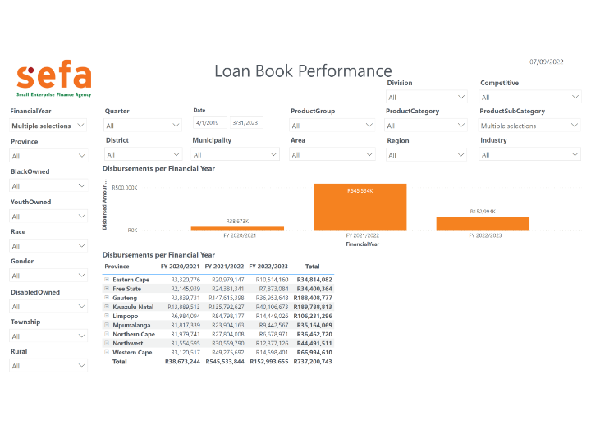

Slide 46
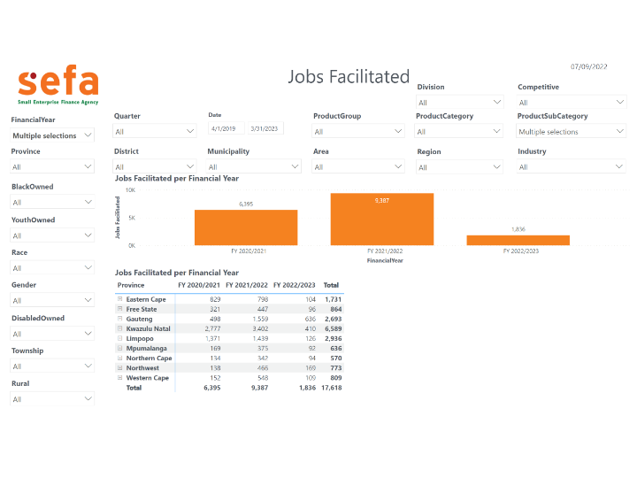

Slide 47
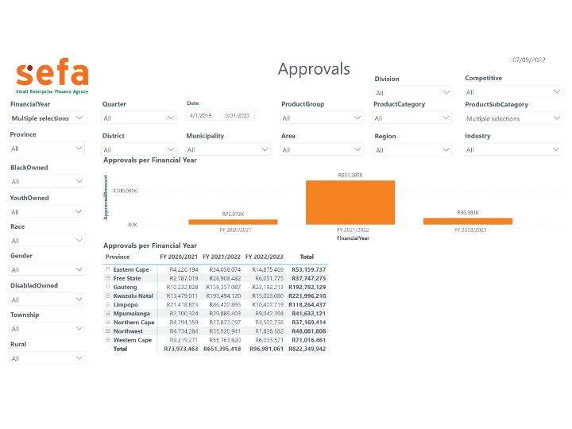

Slide 48
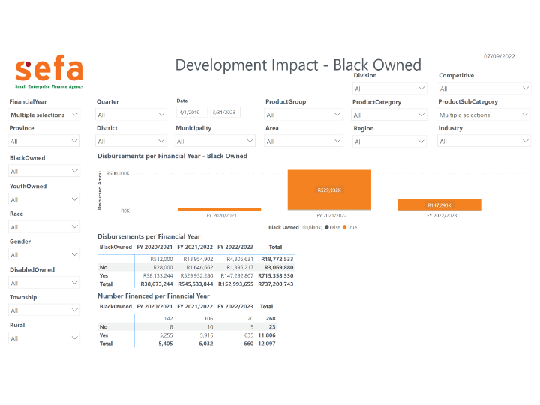

Slide 49
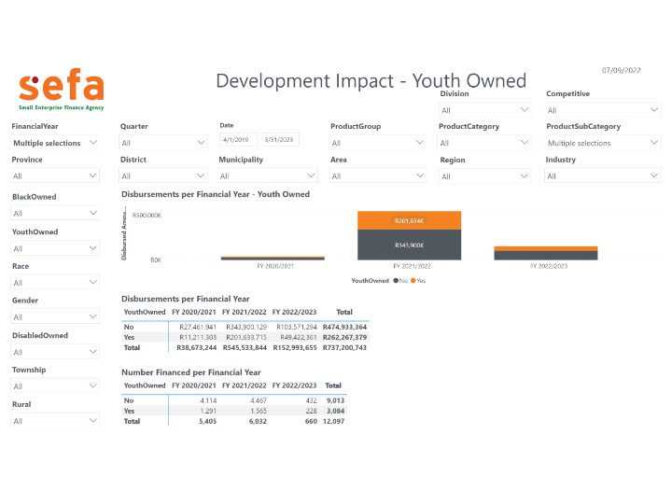

Slide 50
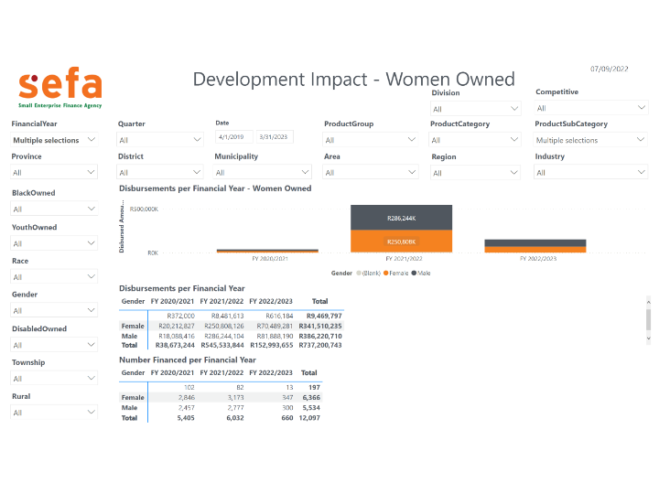

Slide 52
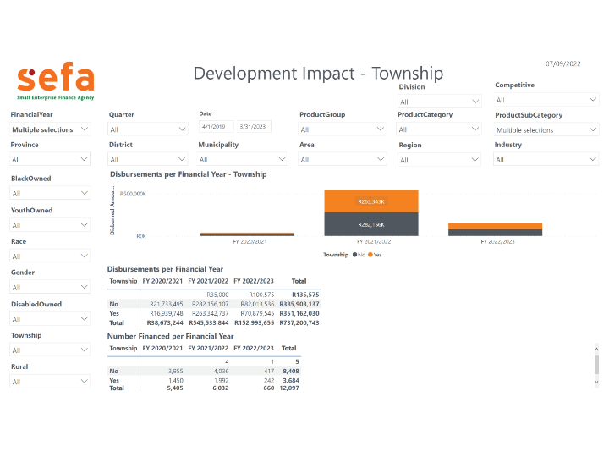

Slide 53
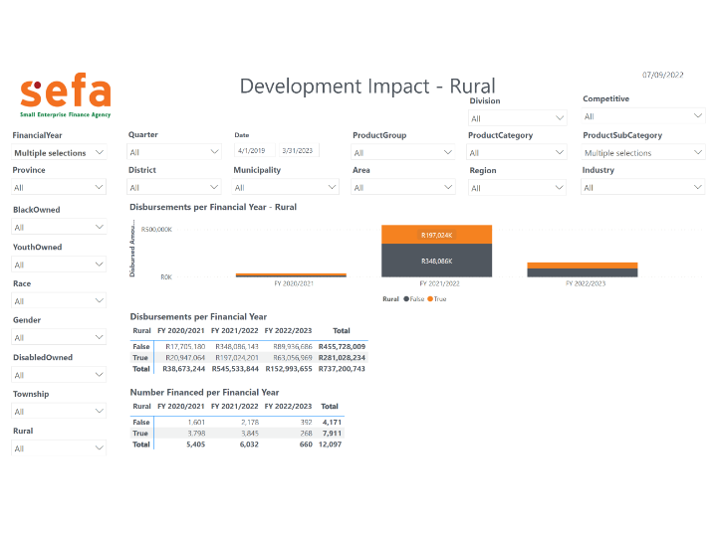

Slide 99
