Slide 1
PROGRAMME
Human settlements
FARM resident subsidies
SEPTEMBER 2022

Slide 2
Contents
Purpose
MTSF Targets
Summary of Code Programmes
Beneficiaries registered on the National Housing Needs register (NHNR)
Farm Resident Subsidies
Qualification criteria
Policy Intent
Allocation Formulae
Human Settlements Priorities
Delivery Statistics
Challenges & Interventions
Recommendations

Slide 3
Background: MTSF Targets
The housing backlog is estimated to be about 2.3 million.
More than 4 million housing opportunities have been delivered since 1994 .
MTSF 2019 – 2024 outcomes are
  Adequate housing and improved quality living environments
  Security of tenure.
  Spatial transformation through multi-programme integration in priority development areas.
Typology | MTSF Targets | Unit Cost
Houses | 300 000 | 141 293
FLISP | 20 000 | 131 505
Stands | 300 000 | 55 596
Social Housing | 18 000 | 328 000
Hostels | 12 000 | 350 000

Slide 4
Human Settlements Priorities
Policy Priorities | Description
Priority 1 | Digital transformation- Waiting List
Priority 2 | Targeted Housing Designated Groups Emergency & Mud Housing Asbestos Blocked Projects
Priority 3 | Title Deeds
Priority 4 | Provision of land/ services sites
Priority 5 | Upgrading informal settlements
Priority 6 | Provision of Affordable housing
Priority 7 | Provision of Affordable Rental
Priority 8 | Provision of Socio – economic amenities

Slide 5
Current Housing Code Programmes
VOL 1 : SIMPLIFIED GUIDE | VOL 2: TECHNICAL SPECIFICATIONS & VARIATION | VOL 3: FINANCIAL INTERVENTION | VOL 4: INCREMENTAL INTERVENTION | VOL 5: SOCIAL & RENTAL | VOL 6: RURAL INTERVENTION
 |  | Non Credit Linked Individual | Emergency Housing | Social Housing | Farm Residents Subsidies
 |  | Credit Linked Individual | Integrated Residential Development | Community Residential Programme | Communal Land Rights Programme
 |  | Finance Linked Individual Subsidy (FLISP)/ | Upgrading of Informal Settlements | Institutional Subsidies
 |  | Rectification-Pre 1994 | Enhanced PHP
 |  | Social & Economic | Consolidation
 |  | Land Acquisition
 |  | EEDBS
 |  | Housing Chapter of IDP
 |  | OPSCAP
 |  | Accreditation

Slide 6
Housing Needs Registered - September 2022
Province | Farm worker and domestic worker on farm
EC | 3259
FS | 5321
GP | 330
KZ | 256
LP | 9
MP | 2999
NC | 999
NW | 36
WC | 4
Total | 13213

Slide 7
Farm Resident Subsidies
Farm Resident is a farm occupier, any farm worker residing on the farm and any labour tenant described in this section and who qualify as beneficiaries.
Farm residents and occupiers as defined in Extension of Security Tenure Act 1997 (ESTA)
The Programme endeavors to provide a practical approach to the housing needs of farm residents through:
  Development options – on farm & off farm (By Province, Developer and private developer of choice)
  Provision for rental as well as ownership options;
  Protection of land and other rights;
It will fund houses and residential engineering services where required;
The subsidy will be granted to individual households - in the context of a project based approach
Not for seasonal workers

Slide 8
Farm Resident Subsidies
Provides access to adequate housing, including basic services and secure tenure
Promotes the development of sustainable human settlements through:
  Catering a variety of farm residents housing needs;
  The empowerment of farm residents’ to participate in the provision of their own housing needs;
  Where possible, promoting access to social and economic amenities;
  The settlements should not place an additional service delivery burden on municipalities;

Slide 9
Qualification Criteria
A lawful resident of South Africa or in possession of permanent residence status and any farm workers employed by a farm owner
Labour tenant
Legally competent to contract;
Not yet benefited from government assistance;
Not yet owned a fixed residential property
Further requirements:
  Married or cohabiting;
  Single with financial dependents – must reside permanently with applicant;
  Single persons without financial dependants – apply for rental accommodation;
  Monthly household income (proof of income required):
    R0 – R3500 full subsidy
    R3501 – R 22 000 Help me Buy a Home.

Slide 10
Qualification criteria
Further requirements:
  Persons classified as military veterans;
  Persons classified as aged with or without financial dependents;
  Persons classified as disabled may be awarded with variation of the subsidy; or becomes disabled or dependents become disabled after receiving a house, the variation will be applied.

Slide 11
Policy intent
  The use of local labour and
  The development of skills in both developing and maintaining farm resident settlements; and
  The upgrading of existing farm resident housing and improving tenure security where feasible and practicable.
  Where commuting is impossible workers should be housed close to place of employment providing security of tenure including rental (sub-division and transfer of land, share block schemes, and long term (99 year) lease agreements;
  Where rental agreements are entered into with beneficiaries, the farm owner/institution must to the satisfaction of the MEC, ensure that the beneficiaries are fully informed of their rights and obligations regarding the rental agreements.

Slide 12
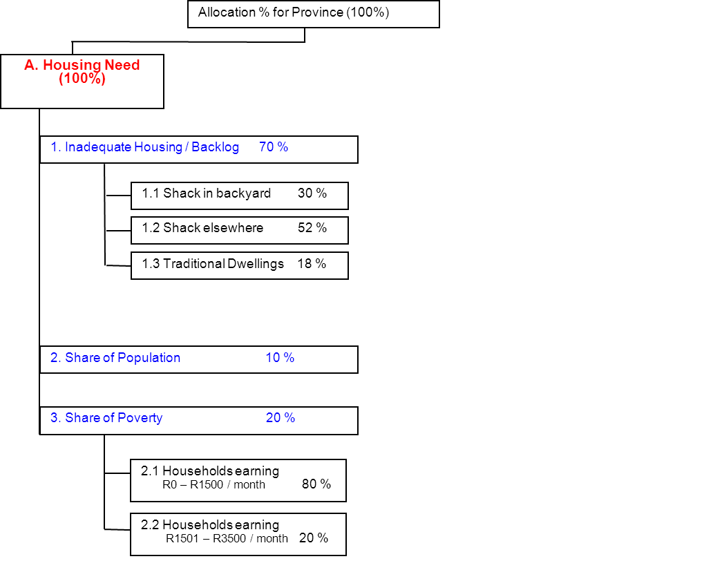

Slide 13
HSS Delivery Statistics – September 2022
Province | Count of Project Phase | Sum of Number of Beneficiaries | Paid Amount
EC | 4 | 244 | R19 387 705,00
FS | 6 | 418 | R25 044 897,59
GP | 6 | 833 | R89 722 096,37
LP | 1 | 70 | R3 709 073,40
MP | 15 | 465 | R45 092 563,09
NW | 2 | 452 | R46 298 085,22
NC | 18 | 36 | R46 244 694,32
Grand Total | 52 | 2518 | R275 499 114,99

Slide 14
Challenges & Proposed Interventions
Challenges | Proposed Solutions
Sector determination in the farms is set at R13 625 | Create a programme similar to Military Veterans where DALRRD will be contributing towards a top up or an alternative option with a means test to confirm details on population register & establish if they are South Africans and are alive. To check records at the deeds office to establish it they don’t own a property; To check records UIF system to establish
2. The housing income qualification criteria: R0 - R3500 R3501- R22 000

Slide 15
Challenges & Proposed Interventions
Challenges | Proposed Solutions
3. The numbers registered on the National Needs Register (NNR) are low | Farm residents need to register a need on the NHNR or and Create a digital platform for persons in farms to improve access
4. A single system of monitoring evictions does not exist. DHS a records and monitors cases of disputes between landlords and tenants through Rental Housing Tribunals. Evictions go through Courts and not recorded on HSS
5. The Housing Code provides that households facing imminent evictions qualify for alternative housing in terms of the Housing Emergency Housing programme | Business plans must cover and provide budget estimates
6. Lack of Interdepartmental and inter sphere monitoring of evictions | Set up an interdepartmental forum led by DARDLR to draft a monitoring strategy

Slide 16
THANK YOU!

