Slide 1
MINERALS COUNCIL SOUTH AFRICA
ORAL SUBMISSIONS ON THE DRAFT TAXATION LAWS AMENDMENT BILL
Standing Committee on Finance
14 September 2022

Slide 2
Outline of the presentation
About the Minerals Council
Focus of Submissions
Snapshot of the Mining Sector Contribution to the SA Economy
Comments on the Proposed Amendments to the Carbon Tax Act
  Carbon tax rate trajectory for 2023 to 2025, 2026, 2027 to 2029 and 2030
  Extension of the first phase of the carbon tax rate from 1 January 2023 to 31 December 2025: Energy efficiency savings tax incentive extension
  Limitation of electricity price neutrality deductions to electricity generation from fossil fuels
  Limiting carbon sequestration deduction to activities within the operational control of the taxpayer

Slide 3
About the Minerals Council
The Minerals Council is a voluntary membership, private sector employer organisation founded in 1889. it exists as the principal advocate of major policy positions endorsed by the mining industry employers and represents these policy positions to various organs of the South African national and provincial governments and to other relevant policy making and opinion-forming entities both within South Africa and abroad.
The Minerals Council represents mining companies producing about 90% of South Africa’s mineral production and employing about 90% of the employees employed in the mining sector.

Slide 4
Focus of the Presentation
The Minerals Council will focus on the issues pertaining to the proposed amendments to the Carbon Tax Act.

Slide 5
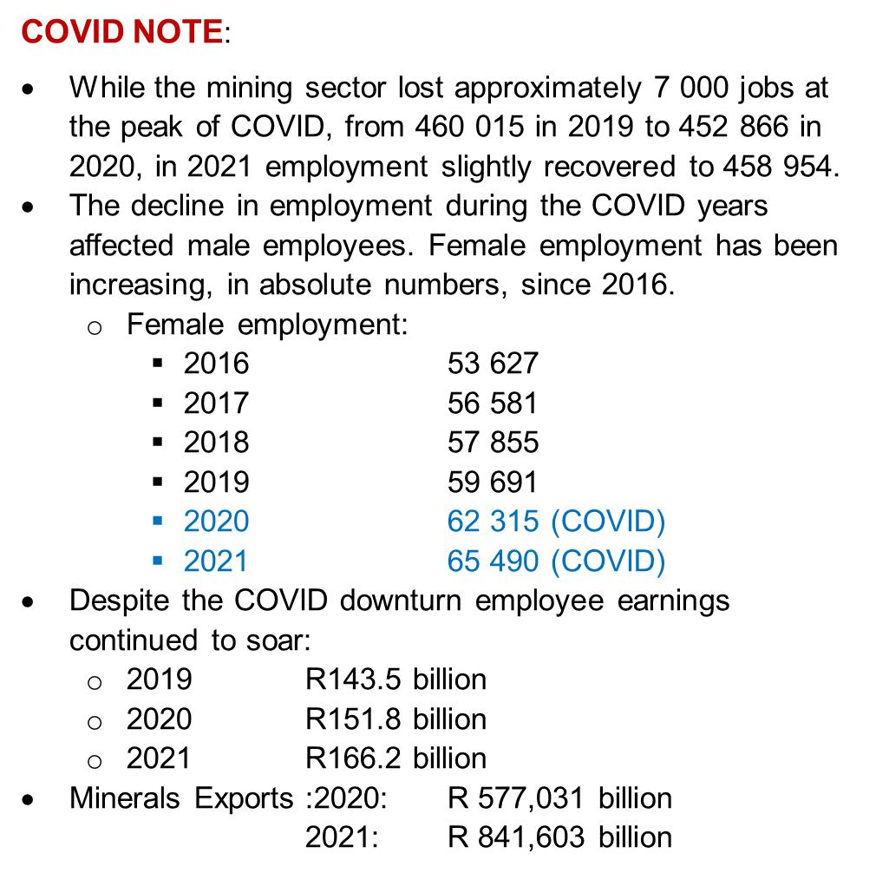
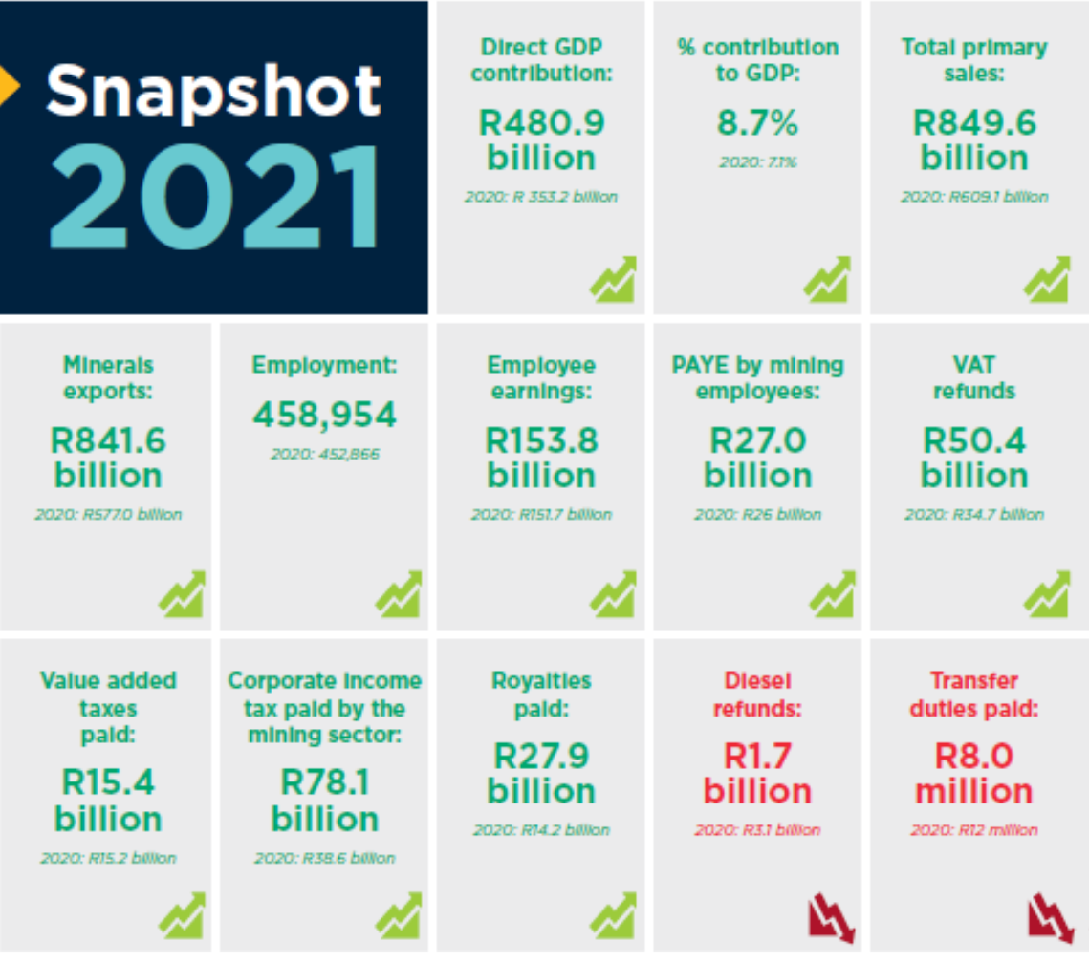
MINING SECTOR CONTRIBUTION TO SA ECONOMY

Slide 6
Minerals Council Position on Climate Change
Climate change is a serious global challenge that has long term implications for all life and infrastructure on earth.
Minerals Council supports long terms goals and actions sets through Paris Agreement and Glasgow Climate Pact under the UN Framework Convention on Climate Change to significantly reduce the risks and impacts of climate change.
Contributing to the South Africa’s response through implementation os various policies, instruments and measures such as the goal to net zero in the Nationally Determined Contributions, Climate Change Bill, Carbon Tax, Just Energy Transition Framework etc.
In principle the Minerals Council agrees with the rationale of the introduction and implementation of the carbon price through a carbon tax.

Slide 7
Comments on proposed amendments to the Carbon Tax Act

Slide 8
A. Carbon tax rate trajectory
Setting the carbon tax rate to the rand/dollar exchange:
  Adverse and unintended consequences for mining taxpayers. The constant volatility of the rand/dollar exchange rate will hinder the ability of mining companies to plan and budget effectively for their tax liabilities.
  The rand has depreciated more than 100% since 2008. Setting the carbon tax rate to the USD will result in a mammoth surge in the carbon tax in the coming years therefore severely impacting the viability of mining operations.
  No rationale provided on why carbon tax rate is set at US Dollar as opposed to SA Rands
  Setting the carbon tax rate to the rand/dollar exchange demonstrates National Treasury’s lack of confidence in the rand as our currency.
  This contradicts the importance of the principle of certainty and predictability highlighted in the explanatory memorandum.

Slide 9
A. Carbon tax rate trajectory cont.
ii. Financial Impact of the proposed higher tax rate
Mining companies are implementing significant mitigation measures to reduce carbon emissions requiring them to incur substantial upfront capital investment costs, which they have absorbed. Removing the allowances contained in the CTA 2019 will erode the capita investments aimed at the implementation of the mitigation measures.
This proposed higher tax rate would severely impact the viability of mining operations, especially those that are energy and carbon intensive and have little window of opportunity for cost effective mitigation options
Increase in the input costs of mining companies seen indirectly through a forced increase in supplier pricing as a result of the rising carbon tax rate, to which they will also be subject.
The mining industry is a price taker and will therefore be unable to transfer the costs of carbon tax to the price of commodities. Suppliers to the mining industry will however be able to transfer their costs of the tax to the mining industry.
Dire impact on the viability of marginal mines, and may even be enough to render a mining company unprofitable and cause premature shut down.

Slide 10
A. Carbon tax rate trajectory cont.
ii. Financial Impact of the proposed higher tax rate
Mining companies are implementing significant mitigation measures to reduce carbon emissions requiring them to incur substantial upfront capital investment costs, which they have absorbed. Removing the allowances contained in the CTA 2019 will erode the capita investments aimed at the implementation of the mitigation measures.
This proposed higher tax rate would severely impact the viability of mining operations, especially those that are energy and carbon intensive and have little window of opportunity for cost effective mitigation options.
The mining industry is a price taker and will therefore be unable to transfer the costs of carbon tax to the price of commodities. Suppliers to the mining industry will however be able to transfer their costs of the tax to the mining industry.

Slide 11
A. Carbon tax rate trajectory cont.
ii. Financial Impact of the proposed higher tax rate
SA international trade competitiveness and the proposed European Union Carbon Border Adjustment Mechanism (“CBAM”), South Africa should look at the common ground carbon price that makes its trade competitive internationally and which also encourages socio-economic development and growth.
Increased mitigation costs, rising input costs, the lack of governmental support in the form of rebates or incentives, and the imminent removal of the available allowances for carbon taxpayers, will irrevocably cripple a sector that contributes hugely to the economy, and pose a threat to the economic sustainability of mining companies.
The adverse effects of carbon taxes in many foreign countries has been alleviated through government support through incentives or financial aid (United Kingdom, Canada and European Union). No assistance is offered by the South African government.
Domestic carbon price must be aligned with the international carbon price, but this must take into consideration South Africa’s unique socio-economic circumstances.

Slide 12
A. Carbon tax rate trajectory cont.
Recommendations
Carbon tax rate to the rand/dollar exchange demonstrates National Treasury’s lack of confidence in the rand as our currency
Carbon tax rate to be set in SA rand. National Treasury to continue with an annual increase of the Consumer Price Index rate plus 2% during the first phase.
Any potential increases in carbon tax rate be accompanied by additional measures to assist and support mining industry, for example: incentives, grants, allowances.

Slide 13
Industry Specific Impacts
The impacts of the direct carbon tax and the passthrough cost implications of the mining industry sub-sectors are shown below.
Note the high impact of the passthrough of carbon tax from other industries to the mining industry.
Carbon Tax Act
2019
TLAB 2022

Slide 14
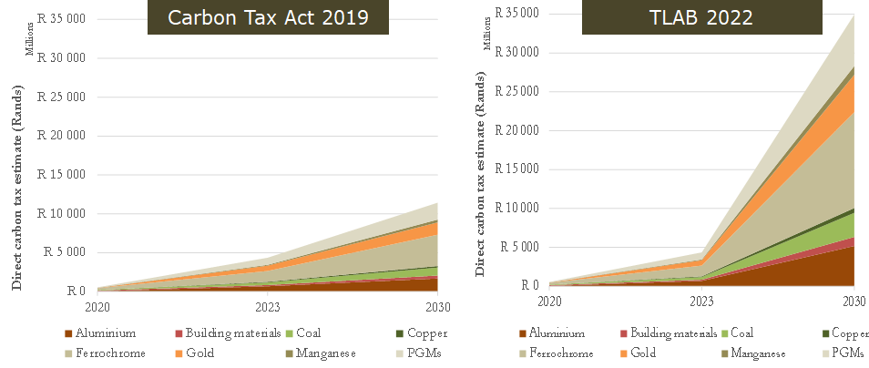
Industry wide analysis
The projected total impact of the carbon based on the direct tax payable, as well as the carbon tax passthrough in electricity and other commodities, in 2030, increased from
  R 11.8 based on the 2019 Carbon Tax Act to
  R36.3 billion based on the 2022 TLAB.
This represents a 308% increase from the existing carbon tax rates

Slide 15
B. Interaction between the carbon tax and the carbon budget
Climate Change Bill will regulates for carbon budget aimed at curtailment of GHG emissions which each taxpayer may permissibly emit.
Lack of information on a punitive carbon tax rate will be imposed on those taxpayers that produce in excess of their budget hinders financial planning
Recommendation
Clarity be provided on the alignment of the current pricing and proposed pricing of the emissions which exceed the carbon budget.

Slide 16
C. Energy efficiency savings tax incentive extension
Promotion of energy efficiency is crucial to decarbonising South Africa. Should be permanently incentivised.
Energy efficiency rate of 95c/kWh was introduced in 2015 and has not been updated accordingly. Considering the increased electricity price, rate should have increased to R1.55/kWh.
A failure to increase section 12L savings will make energy efficiency projects less viable and less attractive to implement.

Slide 17
C. Energy efficiency savings tax incentive extension cont.
Recommendations
Section 12L energy efficiency savings tax incentive extension should be retained indefinitely.
Section 12L energy efficiency rate should be increased to R1.55/kWh to align with rising electricity prices.

Slide 18
Electricity price neutrality commitment extension
Support the extension of electricity price neutrality commitment extension to end of 2025
The removal of this deduction in 2026 will result in electricity producers passing through their increased costs to consumers. This will result in further increases in input costs on the strained taxpayer, including the mining industry.
Electricity producers will not be pressurised to decarbonise their operations.
Recommendation
The electricity price neutrality commitment should be retained within the carbon tax regime indefinitely at least, until such time that the electricity production industry has been decarbonised.

Slide 19
Carbon sequestration deduction
The term “operational control” is not defined to align with GHG regulations.
The proposed policy on carbon sequestration contained in the Methodological Guidelines refers to 3rd parties but makes no reference to “operational control”.
Annexure C of the Budget Review 2022 stated that National Treasury would gazette the rules for sequestration deduction for public comment and that the amendments would take effect on 1 January 2022. these rules have not been gazetted by National Treasury.

Slide 20
Carbon sequestration deduction cont.
Recommendations
The TLAB to be explicit in the alignment of the operational control with the definition in the national green house gases regulations.
Submits that the carbon sequestration deduction be extended to other sectors beyond the forestry further methodological guideline on how this will be attained.

Slide 21
Conclusions
Whilst the Minerals Council acknowledges the importance of the carbon market mechanism in the form of a carbon tax being a critical instrument aimed at influencing the reduction of greenhouse gases, we are concerned of the following:
Dire socio-economic implications of the proposed high carbon tax rate in the absence of allowances, deductions, incentives, subsidies and support in al already declining sector due to other various reasons i.e. policy uncertainty, ever rising costs of conducting business
potentially render many mining operations non-viable and cause premature mine closure, the aftermath which will entail exponential job loss (which will further exacerbate South Africa’s structurally high unemployment rate), and cause a decline in the mining sector’s critical contribution to the South African economy

Slide 22
Thank you

