Slide 1
SA ARMY
Umzimvubu Regiment

Slide 2
INTRODUCTION
Following the, July 2021 unrest, the SA Army had to be deployed in the Provinces of KZN and Gauteng in order to stabilize the situation. Presidential Minutes and Operational Directives were issued for the SA Army to deploy in the affected areas.

Slide 3
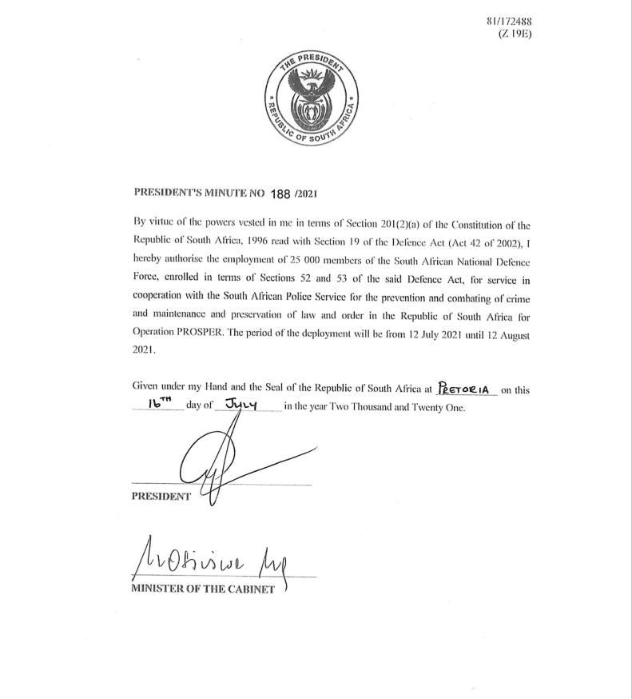
Authorisation for Deployment – Presidential Minutes
Following the, July 2021 unrest, the SA Army had to be deployed in the provinces of KZN and Gauteng in order to stabilize the situation. Presidential Minutes and Operational Directives were issued for the SA Army to deploy in the affected areas.

Slide 4
SA Army Media Statement
The SA Army Issued a Media Statement for the Call-Up of Reserves dated 14 July 2021.
Media Statement
Date: Wednesday 14 July 2021
Embargo: Immediate
URGENT: IMMEDIATE REPORTING TO UNITS: SA ARMY RESERVE FORCE MEMBERS
As directed by chief of the SA Army, Lieutenant General Lawrance Khulekani Mbatha all reserve members are to report for duty at first light tomorrow morning 15 July 2021 at their respective units.
The members to report ready with necessary equipment.
Issued by: South African National Defence Force
Enquiries: 012 355 1903
Cellphone: 082 051 8789
Colonel Sammy Mosiane

Slide 5
Provisions of the Defence Act
The Defence Act, Act 42 of 2002 (as amended), section 11 makes provisions for the employment of the following categories of people:
Members of the Regular Force which serves full-time until reaching their age of retirement expiry of contracted term of service or otherwise discharged from Defence Force in accordance with the law.
Members of the Reserve Force which serve on a part-time basis for which such periods as they have been contracted for, unless their service is terminated in accordance with the law.
Section 16 The Minister may establish and designate for the purpose of support to the Defence Force the Auxiliary services as may be necessary. They serve for such period as the Minister may determine and other provisions.

Slide 6
The General Regulations for the Reserves Dated 02 June 2017
The enlistment procedure include the following:
Prohibition on enrolment of certain former Defence Force members. The Chief of the Defence Force may not enrol a former member of the Defence Force as a member of the Reserve Force if:
that former member resigned from or left the Defence Force on the condition that he or she would not accept or seek re-appointment;
the original grounds for termination of service in the Defence Force militate against enrolment;
the services of the former Regular Force member were terminated in terms of section 59(1)(d) or (e) or (2) of the Act; or [discharge/imprisonment/dismissal]
that former member left the Defence Force for medical or psychological reasons and cannot produce recent and conclusive evidence of recovery that is verified by the Surgeon-General

Slide 7
The Call-Up
Subsequent to the SA Army media release, an SA Army and the SA Army Infantry Formation Instructions were issued for the activation of Reserve call ups to be utilised in OP PROSPER.
Members of the Reserves should report to their respective units and enlistment should carry on (as contained in the General Regulations dated 02 June 2017).
Further to the Infantry Formation Call-Up Instruction, there was a “voice note” that was circulated on the Umzimvubu Regiment group. The voice note stated that all those who were soldiers should take the opportunity to report at Umzimvubu Regt whether enlisted or not.
There was a total of 808 members who reported at the Regiment and could not be be enlisted. This category consisted of people who were former soldiers (ex-members, civillians and those who did not integrate) but never enlisted in the Reserves.
There were Reserves members of the Regiment that also reported and were deployed as intended. These were already enlisted members of Umzimvubu Regiment.

Slide 8
The Call-Up
Some of those members (808) came from other Provinces while the Call was members of the Reserves who are supposed to report in their own Unit.
The members who reported were accommodated at the Regiment even though they were not enlisted (voice note) as members of the Reserves (and could not be enlisted).
There were also allegations of new appointees to manage the Reserves administration.
These members were kept in the Regiment since reporting with effect from mid-July to August 2021. They were thereafter transported (as per their request) back to their different destinations since they could not be enlisted (immediately) for different reasons:

Slide 9
Identified Administrative Challenges
In mid-August 2021 , it was brought to the attention of the Army Headquarters through the HR Section and D Army Reserves that there are administrative challenges at Umzimvubu Regiment which included the administration and some people who were not eligible for enlistment.
On 15th to 22 August, a team of senior officers were sent to Umzimvubu Regiment to access the nature of the problem.
HR team conducted a “feet on the ground” exercise and discovered that the actual number of people under discussion is 808.
The team found that there were former members with Criminal records, members that have transgressed the Military Disciplinary Code, those who did not integrate (and civillians).
Then a decision was taken that all members that do not meet the enlistment criteria must be sent home with immediate effect. Further to this it was the proper verification of files for enlistment.

Slide 10
Alleged Non-Payment
Upon the completion of the verification of files for the enlistment, payment were activated for those who qualified.
The first payments came out in December 2021 and resulted in allegations of non-payment of members at Umzimvubu Regiment.
Members not meeting the enlistment criteria were the main reasons for the non-payment.
Following these developments, a decision was taken to convene an Inquiry dated 28th December 2021. Any intended payment to the affected members was stopped pending the outcome of the investigation.
While some of the members of the Umzimvubu Regiment (enlisted Reserves) were deployed in KZN, payments were being effected.

Slide 11
Progress Regarding the BOI
The Inquiry was completed and handed over to the Convening Authority. It has been referred back due to some short comings as identified. Such short comings had to be addressed.

Slide 12
Payment Status of the 808 Members
The following is the current status with regards to the Payment of the 808 members who reported at Umzimvubu Regiment:
135 were eligible for paid: Were accordingly enlisted.
673 Members were excluded: Reasons - Previous convictions in the SANDF and civilian criminal records.
- Former Forces members who did not integrate.
- Members whose enlistment were completed after the BOI was convened (68).
TOTAL ENLISTED OUT OF 808 = 203
TOTAL OF 605 – Not enlisted

Slide 13
Preliminary Findings
State resources were utilised in the day to day accommodation, feeding and all other social wellbeing of keeping the members within unit lines.
The State incurred the following costs during the whole process:
Enlistee bus tickets on departure home — R 233 000.00.
Military transport costs taking members home — R 81 342.00.
Ration costing (Commercialized mess) — R 4 275 490.00.
Administration and logistical needs/requirements — R 54 498.00.
Enlistee salary projections — R 23 920 148.82.
Total costs to date - R 28 564 478.82

Slide 14
CONCLUSION
The BOI is at this stage under legal review for advice to the Convening Authority.
It is anticipated that the legal review will be completed by end of September to be handed over to the Convening Authority.

Slide 15
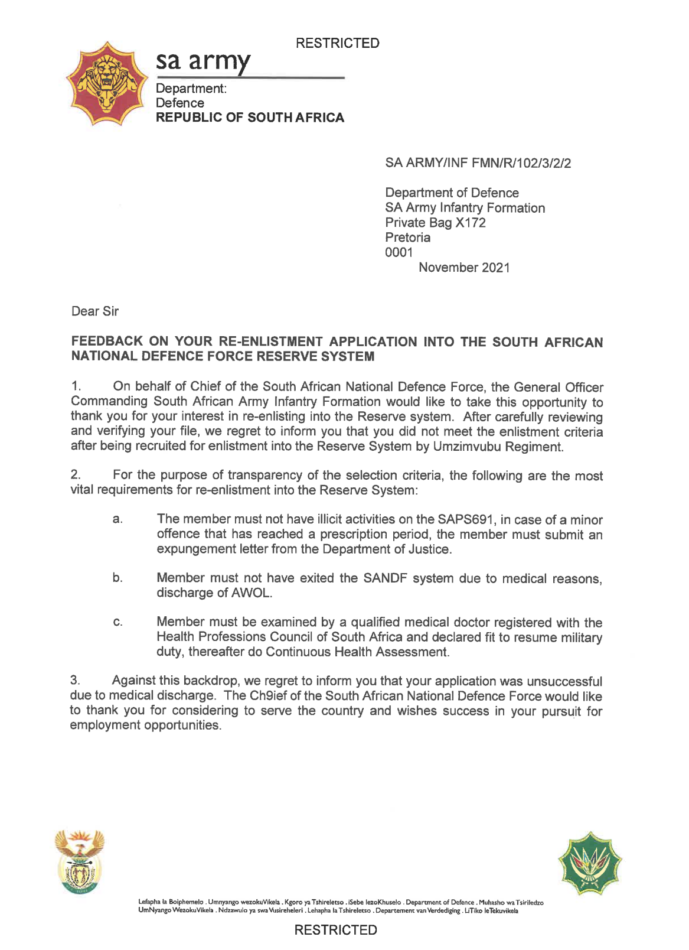
CONCLUSION
Members who did not meet the enlistment requirement were furnished with individual letters stating the reasons for non-enlistment into the Reserves.

