Slide 1
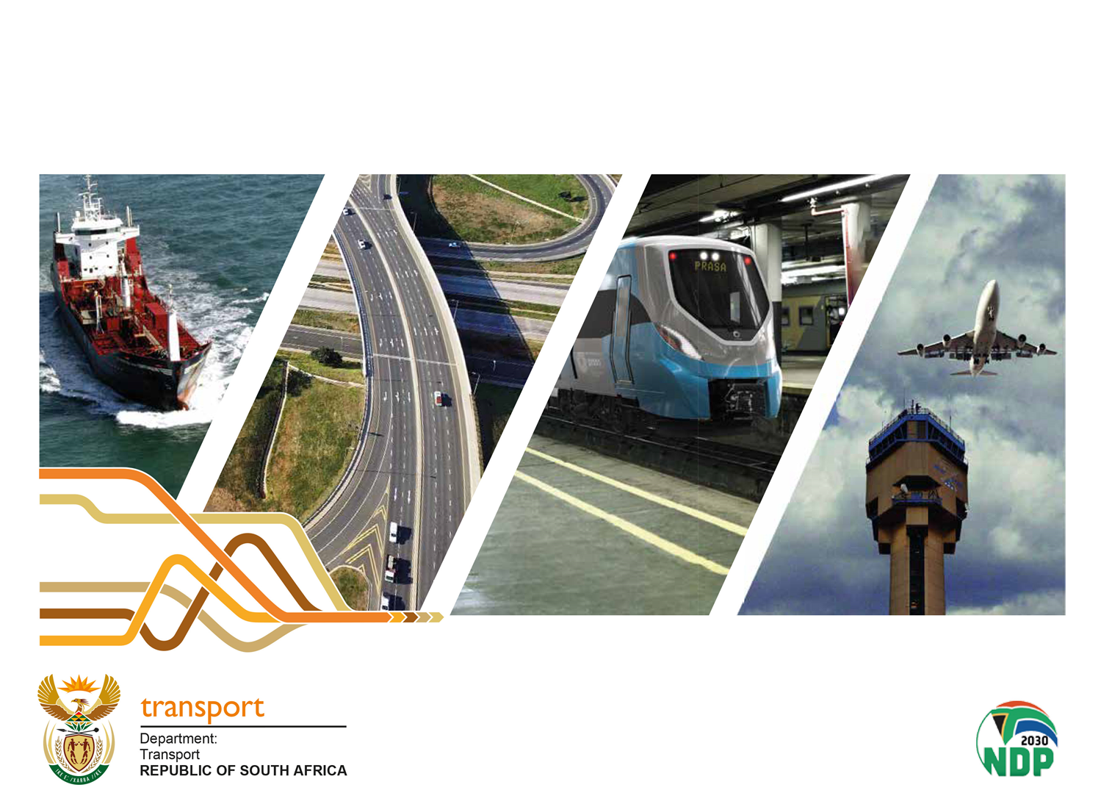
ATTACKS ON LONG DISTANCE BUS OPERATORS
13 September 2022

Slide 2
Contents
Introduction
Initiatives and interventions
Legislative recourse
Conclusion

Slide 3
Introduction
Attacks on buses are increasing and seems to be coordinate and ever changing
Targeting long-distance buses and other services such as commuter, scholar, staff etc.
Alleged to be perpetrated by the taxi industry
Extortion, intimidation and violence in the taxi industry is widespread across all provinces
The following incidents of intimidation on long distance buses have been reported in the Western Cape and Eastern Cape:
  Pressure is applied on bus companies to reduce the number of buses operating
  Companies told to cease operating from certain routes/towns (eg. in the Eastern Cape)
  Flooding of ranks and routes with illegal operators
  Forcing bus companies to increase fares to bring them in line with taxi fares (price-fixing)
  Threatening shopping centres and outlets if they sell bus tickets
  Intimidation and attacks on bus drivers
There is limited success in terms of arrests and convictions of perpetrators
There is a court case initiated by Intercape in the Eastern Cape High Court (in Makhanda), CASE NO: 2099/2022, on the matter

Slide 4
Initiatives and Interventions
The following initiatives have been taken to deal with these challenges:
  The Western Cape Department of Transport and Public Works (DTPW) and SAPS co-chair ProvJoints’ Transport Priority Committee to coordinate planning, regulation and enforcement
  SAPS, NPA, CoCT and DTPW prepared ‘Extortion SOP’ with focus on Transport Sector
  Western Cape wrote to the President to request a coordinated intervention to combat extortion and racketeering
  The President assigned Security Cluster Ministers and Minister of Transport to develop a response under leadership of the Minister of Police
  Metro Police, CT Traffic enforcing Operating Licence conditions at all ranks and interchanges
  SAPS Flying Squad and Provincial Traffic continue to monitor all national routes for rapid response in the event of attacks on buses
  Comprehensive review of technology with CoCT and SAPS, including CCTV, LPR cameras to monitor known hotspots

Slide 5
Initiatives and Interventions…
  Law enforcement entities have employed a co-ordinated approach derived from their integrated plans involving SAPS, Provincial and municipal traffic entities
  Provincial traffic law enforcement entities and SAPS Highway Patrol units conduct patrols on affected routes
  Roadblocks and roadside checkpoints are conducted with specific focus on public transport (busses and minibuses)
  Operational plans are reviewed jointly by SAPS, provincial and local municipal traffic law enforcement entities to assess impact and efficiency.
  The Eastern Cape province established a ProvJoints which includes the Department of Transport, provincial SAPS and Intelligence, Department of Co-operative Governance, Municipal representatives
  A Priority Committee on transport was established comprising a cluster of provincial departments which include SAPS, Transport, Provincial Intelligence Services and Metro Police Traffic leadership to coordinate solutions for the ongoing disputes between buses and taxis
  The Priority Committee compiled a joint operational and deployment plan involving SAPS, Provincial Traffic Officers and applicable Municipal Traffic Officer

Slide 6
Initiatives and Interventions…
  The joint operation focused on the R61 road between the areas of Mthatha, Engcobo, Cofimvaba and Queenstown as well as on the N2 where there were reported issues between Butterworth, Idutywa, Ngqamakhwe and Tsomo
Extortion and intimidation are pure acts of criminality at the hands of unidentified third parties purporting to be taxi operators
Perpetrators must be apprehended and unmasked so that they face the full might of the law
The Minister has consistently and forcefully condemned these acts of criminality and violence within the taxi industry and continuously collaborated with provinces in engaging the taxi industry to resolve some of the challenges that results in violence
The Minister is mindful of the limitations of the Department to prevent such occurrences and to ensure safety of operators and passengers
The statutory obligation of dealing with criminality and ensuring safety lies with the SAPS and other law enforcement agencies and the Department is always in support

Slide 7
Initiatives and Interventions…
However the Department is collaborating with relevant authorities such as the National Joint Operational and Intelligence Structures in developing a coordinated response to this challenge
Already the National Minister of Transport has:
  Convened a Taxi Lekgotla in October 2019;
  Held several meetings with CODETA and CATA in the Western Cape;
  Held several meetings with UCNCEDO both in the Western and Eastern Cape;
  Sent the Department, led by the Acting Director-General to the Western Cape Legislature on 4 August 2022 wherein Intercape was represented; and
  Was recently involved in resolving the Hammanskraal conflict together with Gauteng Province.

Slide 8
Legislative Recourse - NLTA
Where perpetrators are apprehended and it is proven that they are legal taxi operators the NLTA provides the following punitive measures that have been implemented in the past by provinces:
Withdrawal, suspension or amendment of operating licence or permit:
79. (2) Subject to subsection (3), in the case of an operating licence or permit that has not been granted on the basis of a contract, the relevant entity may, at any time, withdraw, amend or suspend the operating licence for such a period as it may deem fit, if the holder or employee of the holder—
(a) has been convicted of an offence under this Act or under a law relating to motor vehicles or the regulation of traffic or occupational safety or labour relations, or an offence due to fraud or dishonesty;
(b) in the opinion of the entity, has not carried out faithfully the conditions of the
operating licence or permit
Extraordinary measures in declared areas:
Section 91 provides that: "if any area in the relevant province the MEC considers that because of violence, unrest or instability in any sector of the public transport industry in the area or between operators in the area, the safety of passengers, residents or any other persons has deteriorated to an unacceptable level, the MEC may, after consulting relevant planning authorities, by notice in the Provincial Gazette, define the area and declare it to be an area in respect of which the notification prescribing the extraordinary measures contemplated in subsection (2) may be applied". The extraordinary measures provided in subsection (2) includes closing of ranks, routes and suspension of operating licences
NB: The Minister has collaborated with relevant MECs to implement some of these punitive measures in the past and will continue to do so in future, however, this remains the domain of the MECs

Slide 9
Conclusion
  It is proposed that a multi disciplinary team should be established including SAPS, SARS, National Prosecuting Authority, National Intelligence Agency who should investigate perpetrators of these violence
  An Integrated Stabilisation Plan should also be developed by the NATJOINTS Transport Priority Committee to respond to these challenges
  Law enforcement agencies should establish a joint task team to deal with violations of the law and intelligence should be shared and agencies should foster a collaborative spirit rather than acting in a compartmentalised way
  These proposals will be tabled at the meeting of the Security Cluster Ministers for consideration

Slide 10
THANK YOU

