Slide 1
EMFULENI SECTION 63 PROGRESS REPORT
PORTFOLIO COMMITTEE MEETING
13 September 2022

Slide 2

PURPOSE
The Purpose of the Presentation is to:
Provide the current status of Rand Water’s intervention at Emfuleni Local Municipality as per the Section 63 Directive:
“DIRECTIVE TO RAND WATER TO BE AN IMPLEMENTING AGENT FOR THE VAAL RIVER SYSTEM INTERVENTION AND SECTION 63 OF WATER SERVICES ACT, ACT 108 of 1997 INTERVENTION WHICH ENTAILS TAKING OVER WATER SERVICES FUNCTION AT EMFULENI LOCAL MUNICIPALITY TO UNDERTAKE MANAGEMENT, OPERATIONS AND MAINTENANCE OF THE WATER AND SANITATION INFRASTRUCUTRE, REFURBISHMENT, UPGRADE FOR THE RETICULATION SYSTEM AND BULK WATER SERVICES INFRASTRUCTURE, WATER CONSERVATION WATER DEMAND MANAGEMENT (WCWDM) AND CAPACITATION OF METSI-A-LEKOA”

Slide 3
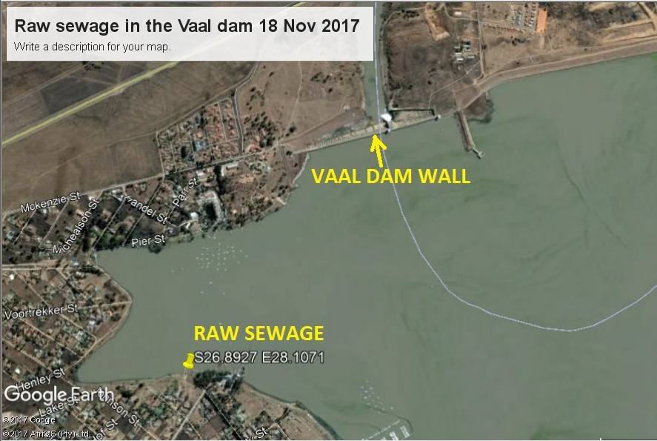
WHAT IS THE MAIN PROBLEM WITH THE VAAL SYSTEM
Ageing Infrastructure, sewage spillages into the Vaal River and demand that exceed the design capacity of the wastewater treatment capacity in the Sedibeng Region has necessitated the implementation of the Sedibeng Regional Sewer Scheme Project for both Midvaal and Emfuleni Local Municipalities ( Sedibeng Region).
The objectives of the projects include; delivery of an effective solution that will eradicate pollution in the Vaal River and its tributaries and eradication of water and sanitation service delivery challenges, inhibiting both social and economic development in the region.

Slide 4
SECTION 63 SCOPE

Slide 5
MILESTONES SLIDES
SECTION 63 ROAD MAP
Remove Sewer
(Unblocking).
STEP 01
STEP 02
Repair WWTWs & Pumpstations
Refurbish WWTWs, Pumpstations & Collapsed Pipelines.
STEP 03
Upgrade WWTWs, Pumpstations & Pipelines
STEP 04

Slide 6
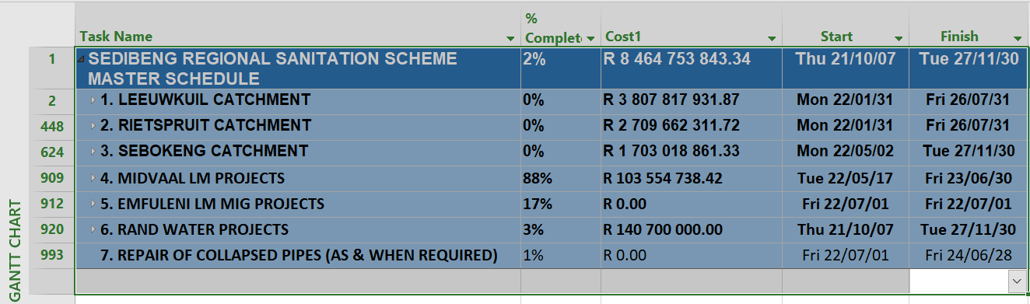
SECTION 63 COSTED PLAN

Slide 7
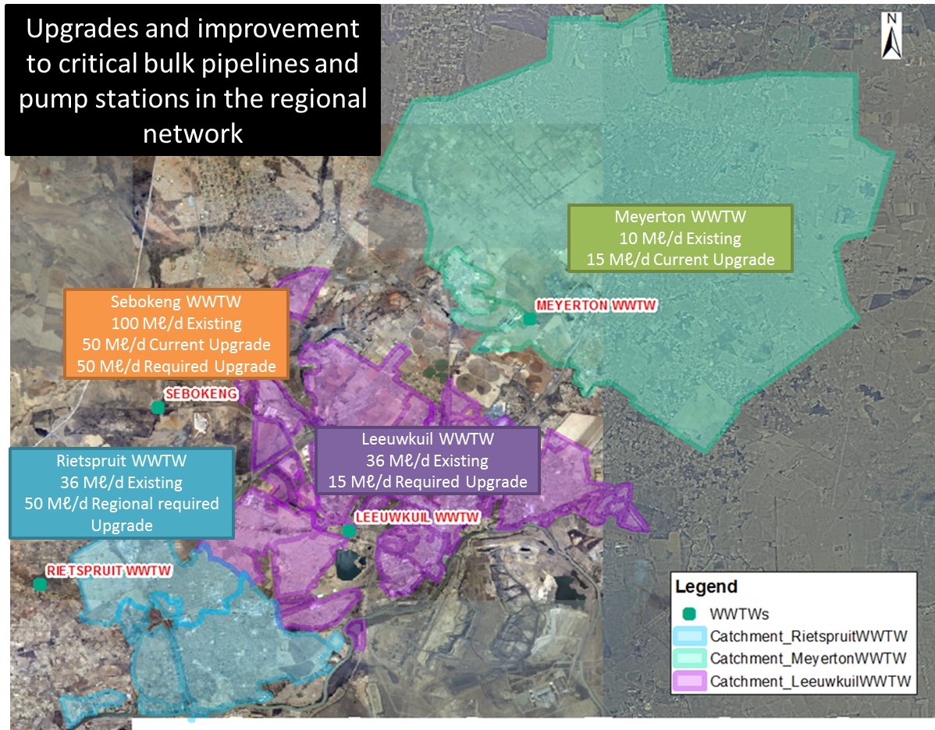
SCOPE OF WORK – PRIORITY 1

Slide 8
STREAMS:CRITICAL SUCCESS FACTORS
ELM Section 63 Intervention
Stream 1
Refurbishment/ Repairs & Upgrades
Repair/Refurbish PS & Plants (VRSI)
Stream 5
M & E
Water & Wastewater Quality Monitoring
Stream 4
Advocacy
Stream 3
Sustainability
Stream 2
O & M;
Capacitate Metsi
Corporatise (Metsi-a-Lekoa)
Resource Metsi
Sell Treated Effluent/Structure by-laws
Reduce NRW/WCDM
SBK Module 7; MYTN 15 Ml/d (80% Complete); LWK 15 Ml/d; RTS 50 Ml/d - 35 under Constr. (SRSS); Rothdene Rising Main (WK)
Energy Usage Monitoring
Leak repairs
Installation of Pre-paid meters; PRVs; Revenue enhancement strategy.
Education Programmes
Stakeholder & Comms Man.
Unblocking/
Biosolids
(DWS)
Upgrade laboratory @ Leeuwkuil
Draft Methodologies/Procedure
Assessment/ Optimisation & Energy Strategy

Slide 9
INSTITUTIONAL ARRANGEMENT
DEPARTMENT OF WATER & SANITATION
RAND WATER
SEDIBENG DISTRICT
EMFULENI LM

Slide 10
INSTITUTIONAL ARRANGEMENT. . .CONT.
DWS has appointed RW as Implementing Agent (IA).
DWS has appointed Civil, Mechanical & Electrical contractors to start with the works in order to fast track the implementation of the intervention.
DWS contractors are working with Rand Water on the programme.
Rand Water is the IA on behalf of the DWS.
Sedibeng District is a beneficiary of the Section 63 intervention.
Emfuleni LM, a Municipality within Sedibeng, is a primary beneficiary of the intervention.
In a addition, some minor works will be undertaken in the Midvaal LM – Upgrade of the Waste Water Works.

Slide 11
DWS APPOINTED CONTRACTORS
Contractor appointments | Scope | Objectives | Progress with appointments to date | Time Frames
Electrical & Mechanical Framework contractors | Pump Stations Refurbishment of the 4 critical pump stations (PS 2,8, 9 & 10) | To get the pump stations functional to pump the sewer to the waste water treatment works | 2 Contractors appointed on 3rd Aug. 2022 | Contractors started on site on 15 August 2022
Civil Framework contractors | 1,3 km gravity line to pump station 2 Construction of the gravity main to pump station 2 | To get the sewage to pump station 2 and to the waste water treatment works | Contractor appointed on 16 Aug 2022 | Contractors took site 19 August 2022
Civil Framework contractors | Pipe replacements Replacement of the damaged and leaking pipes | To stop sewage from leaking into streets and houses | 5 Contractors appointed on 25 July 2022 All contractors have established on site and continuing with pipe replacements | Contractors took site on 05 August 2022 The contractors were meant to take site much earlier and were delayed by unclear objectives by Business Forums.
Operations & Maintenance | Unblocking and bio-solids | To enable sewerage to flow freely through the pipes and not leak into houses and streets. | 10 unblocking and 8 bio-solids were appointed May 2021 | Contractors have been on site for 15 months.

Slide 12
REFURBISHMENT & UPGRADE – STREAM 1
WWTWs | UPGRADES | O & M | PROGRESS TO DATE
SEBOKENG | MODULE 6 50 Mℓ/day ≈ 100% MODULE 7 (50Mℓ/day) ≈ DESIGNS 100%. Construction to start approximately in April 2023 | PLANT OPERATIONAL | Replaced cables Biosolids Process controllers & Maintenance teams
LEEUWKUIL | DESIGNS 100 % COMPLETE 20 Mℓ/day. Construction to start approximately in April 2023 | PLANT OPERATIONAL | Replaced cables Biosolids Process controllers & Maintenance teams
RIETSPRUIT | DESIGNS 100% COMPLETE 35 Mℓ/day. Construction to start approximately in April 2023 | PLANT DYSFUNCTIONAL | Replaced Cables Biosolids Process controllers & Maintenance teams

Slide 13
REFURBISHMENT & UPGRADE – STREAM 1
WWTWs | UPGRADES | PROGRESS TO DATE
ROTHDENE PUMP STATION | 100% completed | O & M
MEYERTON | 80 % COMPLETE 15 Mℓ/day. Project to completed approximately in June 2023. | Tender documentation (Civil contractor liquidated)
ROTHDENE RISING MAIN | Construction work is at 97%. Project to completed approximately in March 2023. | Expected completion date 19 September 2022

Slide 14
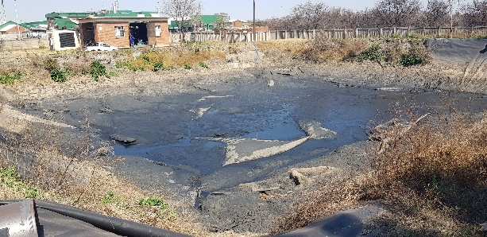
REFURBISHMENT&UPGRADE –STREAM 1
WWTWs | UPGRADES | PROGRESS TO DATE
PUMP STATION 2 | Site Handover Meeting – 15 August 2022 Contractor: Mulbert | The open manholes, water filled holes and emergency dam were barricaded with safety net by the 31 August 2022. The Rand Water ISD personnel introduced the Contractor to the Ward Councillor, on the 29 August to Map out a plan to deal with Employment of Local labour and SMMEs. The Contractor attended the Community meeting on the 31 August 2022 whereat Ward Councillor and Rand Water ISD Personnel introduced the Contractor to the Community. Removal and assessment of Pump 2A done on the 31 August 2022. Pump station 2A cleaned by biosolids contractor, Titanium.

Slide 15
REFURBISHMENT & UPGRADE – STREAM 1
WWTWs | UPGRADES | PROGRESS TO DATE
PUMP STATION 9 | Site Handover Meeting – 15 August 2022 Contractor: Mulbert | Scoping exercise for activities that need designs and drawings for the pump station completed on the 31 August 2022. The open manholes, water filled holes and emergency dam were barricaded with safety net by the 31 August 2022. The Rand Water ISD personnel introduced the Contractor to the Ward Councilor, on the 29 August to Map out a plan to deal with Employment of Local labour and SMMEs. The Contractor attended the Community meeting on the 31 August 2022 whereat Ward Councilor and Rand Water ISD Personnel introduced the Contractor to the Community.

Slide 16
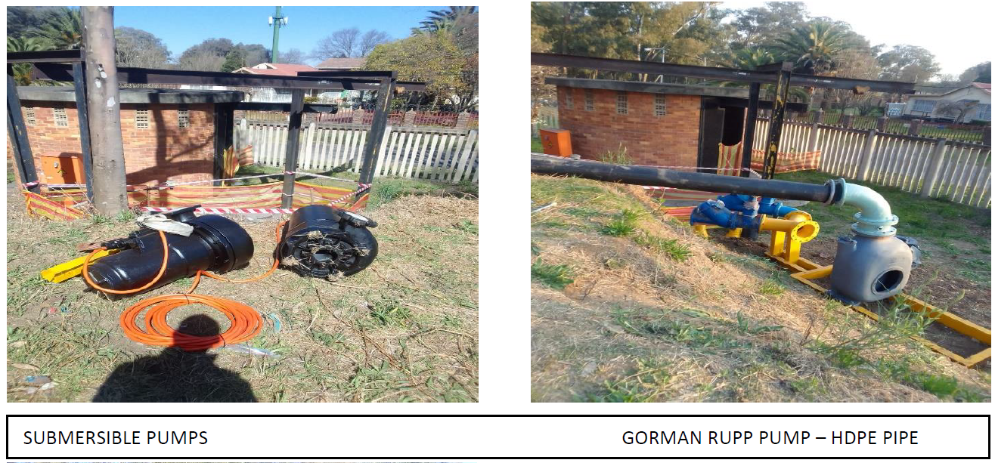
REFURBISHMENT&UPGRADE –STREAM 1
WWTWs | UPGRADES | PROGRESS TO DATE
PUMP STATION 8 | Site Handover Meeting – 15 August 2022 Contractor: Belta Services | Assessment of the pump station including feeding lines and rising mains. Compliance with occupational health and safety act, making the area safe for work including barricading openings, installing safety signs and fire equipment. Uninstalling the existing mechanical equipment including grinding off the corroded fasteners and electrical components that are not functional. Tested motors for possible re-use. Stripped the cables inside pump station including small electrical installations in preparation for cleaning. Refurbished and installed gate for access control and safety of equipment. Fabricated temporary pumping pipes including procurement of pumps, valves, pipe specials. Built MCCs for temporary pumping systems with variable speed drives. Assess generator, stripped and to quote for repairs. Installed the pump base for temporary pumping system.

Slide 17
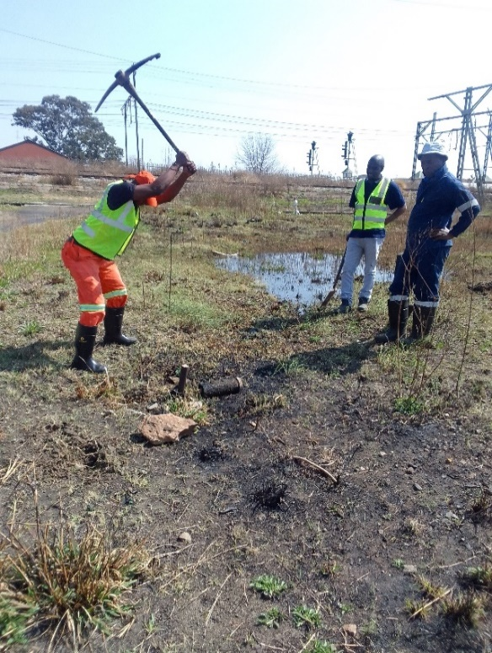
REFURBISHMENT & UPGRADE –STREAM 1
WWTWs | UPGRADES | PROGRESS TO DATE
PUMP STATION 10 | Site Handover Meeting – 15 August 2022 Contractor: Belta Services | Assessment of the pump station including feeding lines and rising mains. Compliance with occupational health and safety act, making the area safe for work including barricading openings, installing safety signs and fire equipment. Uninstalling the existing mechanical equipment including grinding off the corroded fasteners and electrical components that are not functional. Tested motors for possible re-use. Stripped the cables inside pump station including small electrical installations in preparation for cleaning. Refurbished and installed gate for access control and safety of equipment. Fabricated temporary pumping pipes including procurement of pumps, valves, pipe specials. Built MCCs for temporary pumping systems with variable speed drives. Assess generator, stripped and to quote for repairs. Installed the pump base for temporary pumping system.
Hand excavations for potable water connection

Slide 18
PIPELINES
Additional 165 Collapsed Pipelines – Identified (Instruction to be issued by 26th July 2022 – Justice M)
44 – Emergency: Assessments 100% Complete & Designs (7 DWS Contractors – Vetting completed – Contractors to be on site by 27th July 2022 – Justice M)
1.35 KM – PS 2 link (Contractor yet to be appointed, @ BEC – DWS CFO to drive the process. To be concluded by the 27th July 2022)
8 Pipelines completed & Additional 10 Pipelines are in progress (ELM)
RW declared emergencies - 1 Pipe replacement complete & another at 47% completion
Additional RW Emergencies - Evaton & Sebe Street at 20%

Slide 19
REFURBISHMENT & UPGRADE - PIPELINES
165 Pipelines collapsed – Identified
44 – Emergency: Assessments 100% Complete & Designs
8 Pipelines completed
10 Pipelines are in progress (ELM)
Evaton & Sebe Street at 20%
1.35 Km Gravity Main to Pump Station 2 – DWS appointed contractor on site.

Slide 20
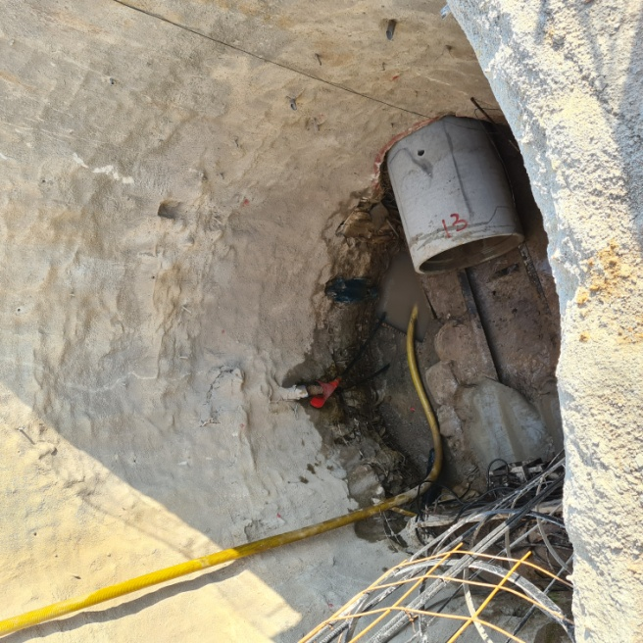
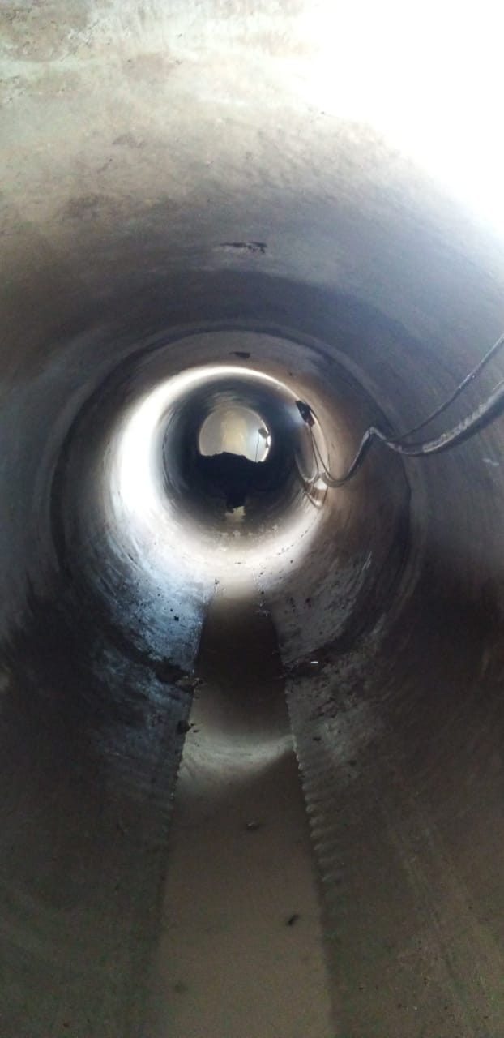
REPAIR OF THE COLLAPSED SEWER PIPELINE IN UNION STREET, VEREENIGING
(EMERGENCY DECLARATION)
Project description: Repair of the collapsed section of the sewer pipeline feeding to pump
station No.10 along the Union Street in Vereeniging
New pipeline specifications: HDPE, Gravity flow, L: 81, OD: 355mm, ID: 328 mm, depth: 7 m, MHx2
Method of repairing: Pipe Jacking
Contractor appointment date: 31 December 2021
Construction Start Date: 04 January 2022
Revised Completion Date: 17 October 2022
Challenges: Dolomitic soil conditions, underground water streams (these conditions
are not permissible for maximum production onsite)
Total distance jacked to date: 38m of the 81m
Overall progress: 53% (end August 2022)
Local beneficiation: 8 Local labourers and a consortium of SMME’s have been appointed
Jacking in progress
(Sleeve 13)
Inside Jacked sleeves
(underground)

Slide 21



PROGRESS – STREAM 2
DESIGNS CAPACITIES AND CLASSIFICATION OF THE WASTEWATER TREATMENT WORKS
All works are classified as Class A (Regulation 2834)
Extract from Green Drop Report, 2022
Process Controllers & Maintenance team

Slide 22
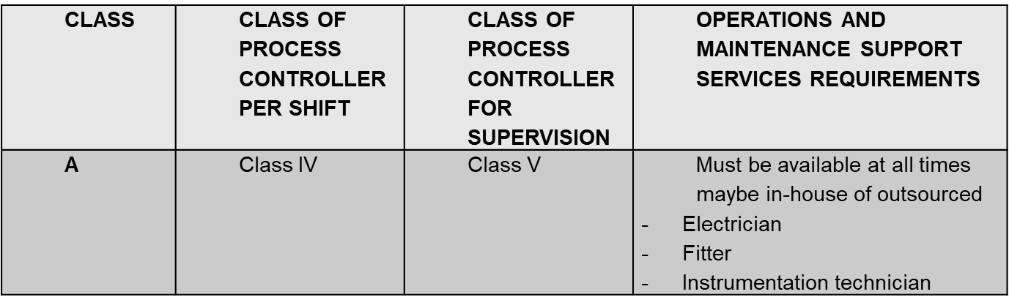
PROCESS CONTROLLER REQUIREMENTS:
PER REGULATION 283/DRAFT REGULATION 813
Skill gap – Process Controllers
54

Slide 23
PROGRESS – STREAM 2
Wastewater Treatment Works
Placement of Class V Process Controllers
Maintenance - pump stations & sewer networks
A total of 145 staff complement needed in Emfuleni to manned the pump stations & networks
Vaaloewer and Network works
Cleaning of 12 Mℓ/da water reservoir in Vaaloewer
Supply of chemicals for treatment
Placement of learnership (NQF level 2) – Water & Sanitation from Emfuleni LM
Placement of learnership (NQF level 3) – Water & Sanitation from Emfuleni LM
35 staff temporarily placed with the balance in progress to be recruited ( 1x Engineers, 7x Supervisors, 7x Artisans (electrical & mechanical), 6x operators, 1x Data Capturer, 12x general workers
Appointed Service provider to refurbish Pressure Reducing Valves (PRV) n Vereeniging- curtail water losses
8 x Pump stations are being manned 24/7
4x major water leaks on steel pipes have been fixed in Sebokeng and Evaton.
Procurement process underway to repair - 700mm dia Asbestos pipe in Rossini Street in Vanderbijlpark

Slide 24
MAINTENANCE STATUS OF THE WASTEWATER TREATMENT WORKS
Preventative maintenance
Maintenance consumables procured, to be delivered end of August. Emfuleni doesn’t have this budget. Its needed going forward
Ad-Hoc Maintenance
M&E contract tender sourcing on hold (site briefing stopped 3 times) due to Business Forum Demands which include allocation of 30% scope of work by the civil and M&E contractors appointed by DWS.
Maintenance Planning
X 2 data captures appointed, busy capturing asset list and maintenance schedules
X2 Maintenance planners recruitment in progress
Maximo (CMMS) to be used for maintenance planning and issuing of Job cards

Slide 25
MAINTENANCE STATUS OF THE WASTEWATER TREATMENT WORKS. . Cont.
Scope of work on hold due to business forum demands:
Leeuwkuil WWTW
BNR repairs bid ready for advert
Inlet works repairs bid ready for advert
Settling tanks repairs bid ready for advert
Chlorine system repairs bid ready for advert
Rietspruit WWTW
BNR repairs bid ready for advert
Inlet works repairs bid ready for advert
Settling tanks repairs bid ready for advert
Chlorine system repairs bid ready for advert
Sebokeng WWTW
Module 6 Preventative maintenance continuous ( Details as captured on the maintenance monthly report)

Slide 26
MAINTENANCE STATUS OF THE WASTEWATER TREATMENT WORKS . . Cont.
Sebokeng WWTW
Module 3&4 BNR repairs bid ready for advert
Module 3&4 Inlet works repairs bid ready for advert
Module 3&4 Settling tanks repairs bid ready for advert
Module 3&4 Chlorine system repairs bid ready for advert
Module 5 repairs bid ready for advert
Module 6 de watering plant repairs bid ready for advert
Vehicles, Equipment & yellow Fleet
Procurement of 35 vehicles for O&M through transversal process RT 57 approved by NT

Slide 27
UNBLOCKING AND BIO-SOLIDS
FOREIGN OBJECTS FOUND IN SEWER PIPES

Slide 28
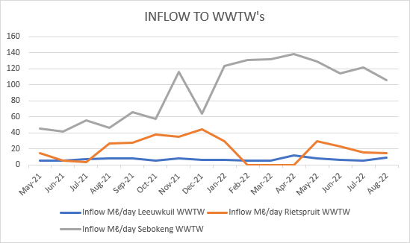
INFLOWS TO THE WASTEWATER TREATMENT WORKS
WWTW Leeuwkuil Rietspruit Sebokeng

Slide 29
Water Conservation and Demand Management – STREAM 3
Identification of priority Pressure Reducing Valves (PRV’s) which are currently limiting water supply to communities.
Appointment of a service provider to fully refurbish and set 5 identified PRV’s and reestablish associated DMA zones. Service provider is currently on site
Challenges currently being experienced include:
  Lack of PRV data and associated supply DMA’s
  No as-built drawings
  Unknown isolating valve locations and status
Leak detection initiatives are currently following through SCM processes
  Satellite leak detection which will cover the entire municipal area and assist to prioritize focus areas as well as required interventions
    Leak and municipal services detection at the pipe-jacking site in Union Street

Slide 30
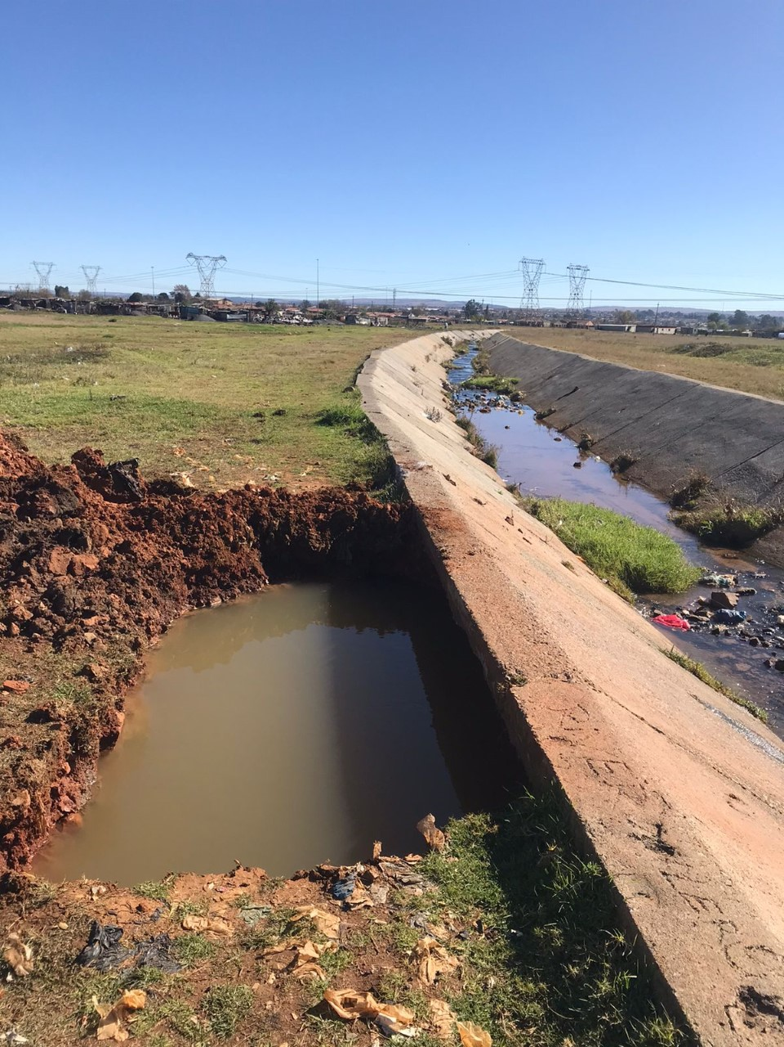
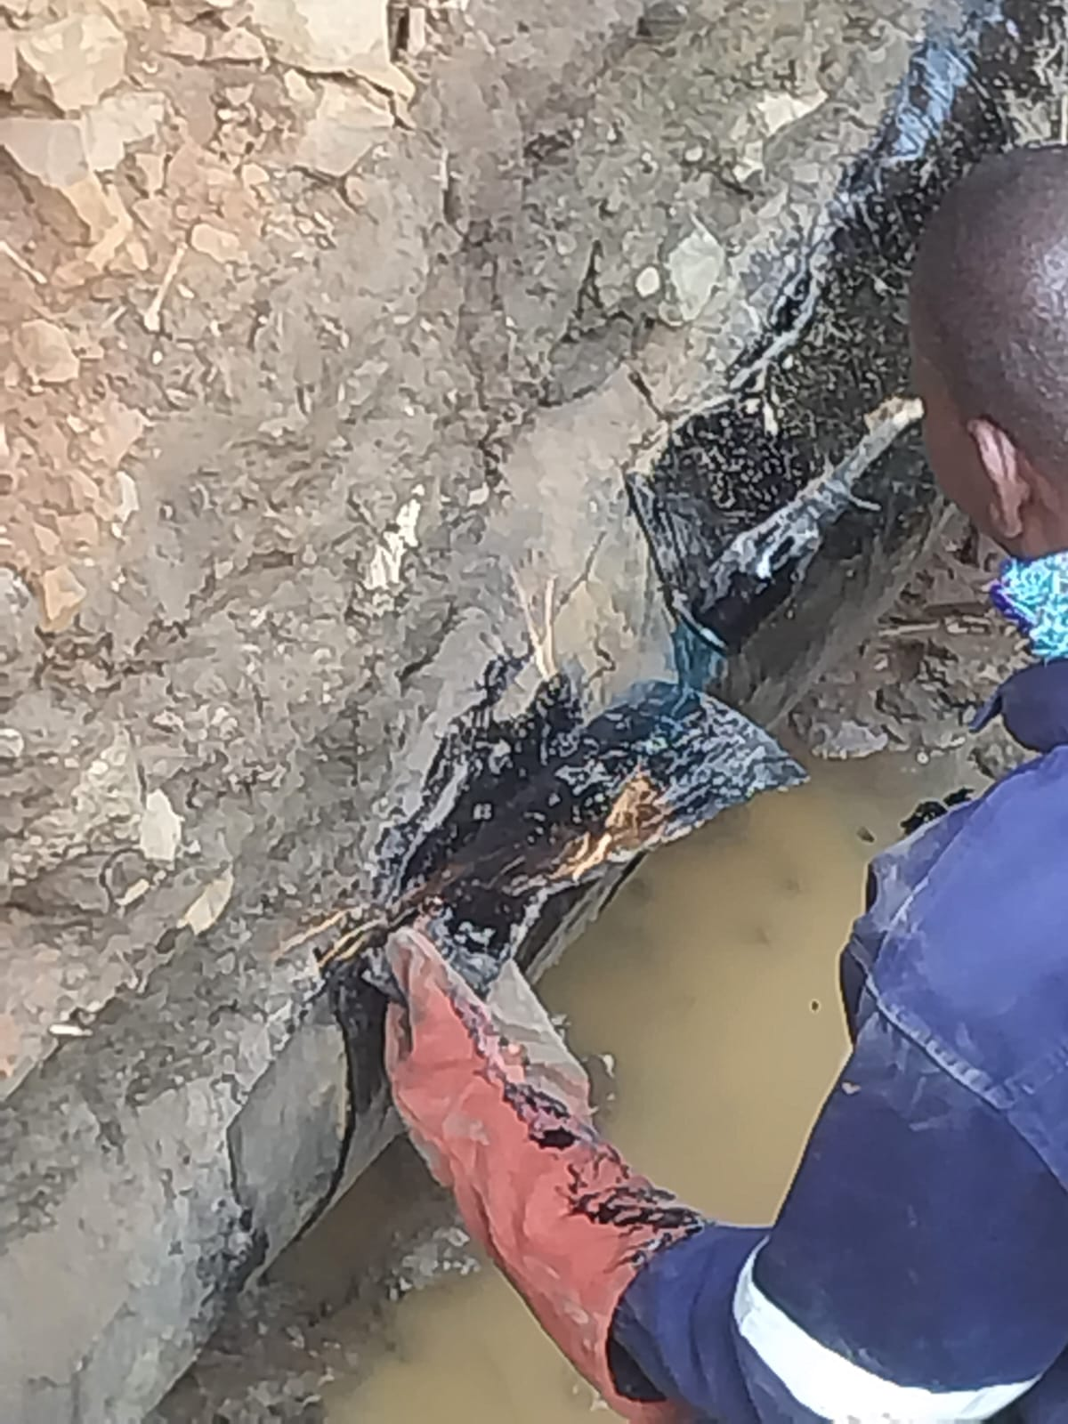
WATER CONSERVATION WATER DEMAND MANAGEMENT – STREAM 3
(4 Major leak repairs in Sebokeng & Evaton)
Leak 1(Before) Leak 1 (work in progress)

Slide 31
WASTEWATER RECLAMATION PROGRAMME
  As part of the Emfuleni Water Services Intervention Business Case, Rand Water conducted a Technical Feasibility Studies for the construction of a reclamation plant in Sebokeng Wastewater Treatment Works to supply industries in the Vaal area
  Rand Water commissioned a business case with an external service provider to assess the viability of the scheme.
  The scheme was confirmed to be technical and financially viable to supply industrial grade water to surrounding industries
  Total of 100 Mℓ/day will be reclaimed for industrial grade water
  and the necessary regulatory and statutory approvals in progress
  MOU between Rand Water & ELM is in progress

Slide 32
PROGRESS – STREAM 5
WATER QUALITY ANALYSIS
Wastewater Treatment Works
Weekly analyses are done at Rand Water Accredited laboratory
On-site analysis
On-line monitoring on the process adjustment done at Sebokeng WWTW only
Rietspruit & Leeuwkuil WWTW monitoring system to be refurbished
Industrial Effluent Monitoring
Monthly sampling is done
“as and when” inspection conducted on wet industries compliance with Trade effluent by-laws of the municipality
Leeuwkuil Laboratory to be revamped to assist with operational monitoring.
Additional portable measuring instruments procured awaiting delivery
Potable water quality analysis
A total of 21 water network points are sampled & analyzed monthly (SANS241)
Operational & compliance monitoring performed at Vaaloewer Water Treatment Works

Slide 33
METSI-A-LEKOA
  Metsi a Lekoa operating as a water and Sanitation Unit/Department of ELM
  Sections :Water Networks ,WWTW, Sanitation, Water Demand, Customer Care & Planning Section
  Current vacancy rate is 61%
  ELM has Microstructure currently being reviewed with the Macro Structure placing the Unit under the municipality.
  The proposed Business Plan is for the Unit to be developed as an entity under Section 63 intervention
  Council item on Sect 63 is going for Sect.80 on 15 September 2022

Slide 34
CAPACITATION OF METSI-A-LEKOA
Resources | Vehicles Materials Tools and Equipment Safety
Staff | Filling of Critical Vacancies
Control & Planning Systems | Master Pans Systems (CMMS) Reservoirs vs Direct Feeds
Procurement Processes | Responsive to Projects

Slide 35
CAPACITATION OF METSI-A-LEKOA
Implementation of Section 63 of the Water Services Act: There is heavy reliance on Section 63 Budget. DWS to intervene and assist with expediting operational instability within the Water and Sanitation unit through the current Section 63 process that has been invoked on the municipality. Processes must allow for rapid deployment of contractors on the ground. Emfuleni does not have adequate budget to fill all the critical posts on organogram. For 2022/2023 only 15 posts have been budgeted to be filled.

Slide 36
SECTION 63 CHALLENGES
  Resources (Financial, Human, Equipment, Materials and Consumables) must be made available to execute ongoing O&M functions in a sustainable manner.
  Funding for effective operations and maintenance of the water and sanitation infrastructure to be made available/ELM to budget appropriately for sustainability.
  The socio/economic expectations of the Community arising from the project must be managed
  The Project must be able to procure Construction Contractors in a quick and efficient manner without “Red Tape”
  Community awareness programme to deal sewer blockages & water leaks
  Delays on the Sebokeng effluent reuse MOU – Council resolution required
  Cable theft, safety & Security is a major risks for all sites which needs urgent intervention

Slide 37

THANK YOU.

