Slide 1

AUDITOR-GENERAL’S SPECIAL REPORT ON COVID-19 FUNDS
06th September 2022
Presentation by MEC for Finance
Ms. M.Z. Rosho

Slide 2
Outline
Background
Adjustment to the 20/21 Provincial Fiscal Framework
Special Adjustment Allocations for 2020/21
2020/21 COVID-19 Expenditure
2021/22 COVID-19 Expenditure
Support by PT on the management of COVID 19 Funds
PT Support to municipalities to implement the recommendations by the AG
Concluding Remarks

Slide 3
Provincial Departmental
Covid-19 Funding

Slide 4
Background
The State President declared COVID-19 as a National Disaster on the 15th March 2020 and subsequently announced the COVID-19 response package of R500 billion, of which R30 billion was reprioritised from the current budgets of provinces;
In line with the equitable share formula, North West reprioritised R2.1 billion for COVID interventions;
The Executive Council convened a Special Meeting on the 3rd May 2020 and considered the Provincial Response plan and its funding needs;
During that meeting, EXCO resolved on the following:
  Appreciated the socio-economic measures announced by the President including the extraordinary budget and noted the expected R2.1 billion contribution from North West to the identified R30 billion to be contributed by provinces;
  Agreed to protect the Department of Health from the budget cut;
  Agreed to the reduction of targeted expenditure items such as ‘Accommodation, Catering, Venues and Facilities, S&T, rental and hiring, consumables, entertainment etc.’

Slide 5
Background
  The Provincial Treasury led by the MEC for Finance engaged the provincial departments from the 12th to the 21st May 2020.
  The Special Adjustment Budget was tabled on 24 June 2020 includes a Division of Revenue Amendment Bill and it included the following:
  Additions to new COVID-19 component of the HIV, TB, Malaria and Community Outreach Grant
  Additions of R11 billion to the local government equitable share
  Downward adjustments to some conditional grants (to fund other COVID-response activities)

Slide 6
Adjustment to 20/21 Provincial Fiscal Framework – Equitable Share
The Provincial Equitable share remained unchanged at R37.547 billion;
Departmental equitable share allocations were amended and reduced, except for Health, to make funds available for the COVID-19 Provincial response plan.
Reduction of departmental equitable share allocation targeted specific items that were mainly affected by the restrictions and limitations of COVID-19 as per EXCO resolution.
Reductions were also implemented on CoE and Infrastructure projects while ensuring sustainability of key government programmes and projects.

Slide 7
Adjustment to 20/21 Provincial Fiscal Framework –
Conditional Grants
Conditional Grant allocations reduced by R459.383 million on aggregate from R7.743 billion to R7.284 billion;
Changes to the conditional grants allocations included reductions, repurposing and additional funds specifically for COVID-19 within Health;
An amount of R661 million is a net reduction from the Conditional grants as follows:
  R36.019 million suspended from the Comprehensive Agricultural Support Programme Grant, R14.811 million suspended from the Ilima/Letsema Projects Grant.
  R197.260 million suspended from the Education Infrastructure Grant, R4.057 million suspended from the HIV and AIDS Life Skills Education Grant, R5.892 million suspended from the Maths, Science and Technology Grant.

Slide 8
Adjustment to 20/21 Provincial Fiscal Framework –
Conditional Grants
Conditional Grants Reductions:
  R158.311 million reduced from the Human Settlements Development Grant, R34.760 million reduced from the Title Deeds Restoration Grant.
  R34.800 million reduced from the Community Library Services Grant,
  R14.698 million reduced from the Mass Participation and Sport Development Grant,
  R160.415 million reduced from the Provincial Roads Maintenance Grant.
Conditional Grants Additions:
  Provincial Disaster Relief Grant:- R18.540 million for Health and R8 million for Agriculture and Rural Development;
  for Health R175.1 million for the COVID-19 Component within the HIV, TB, Malaria and Community Outreach Grant.

Slide 9
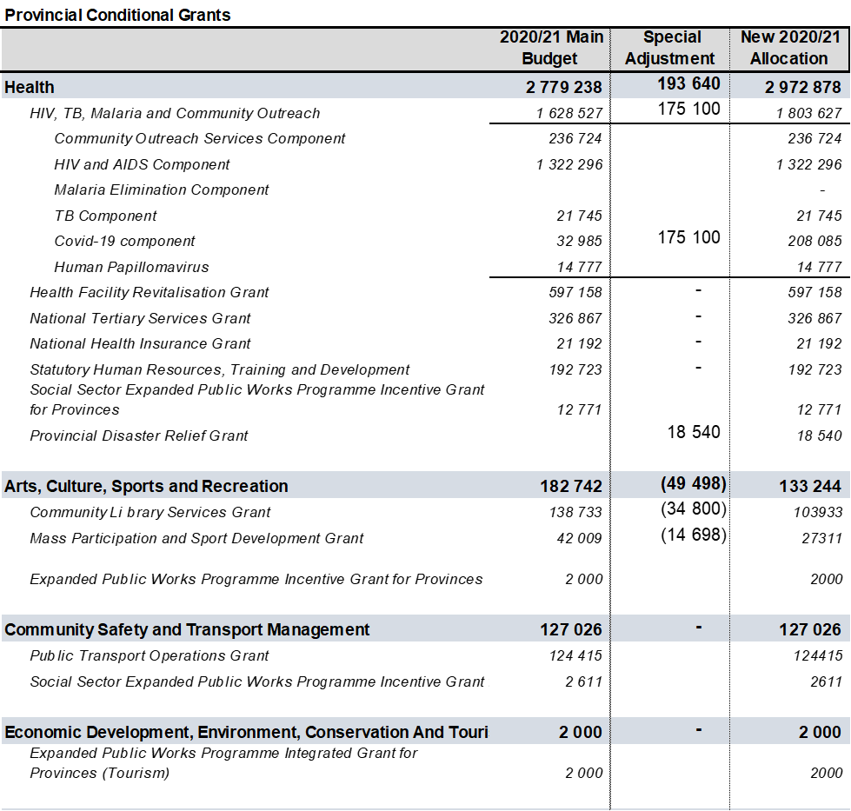
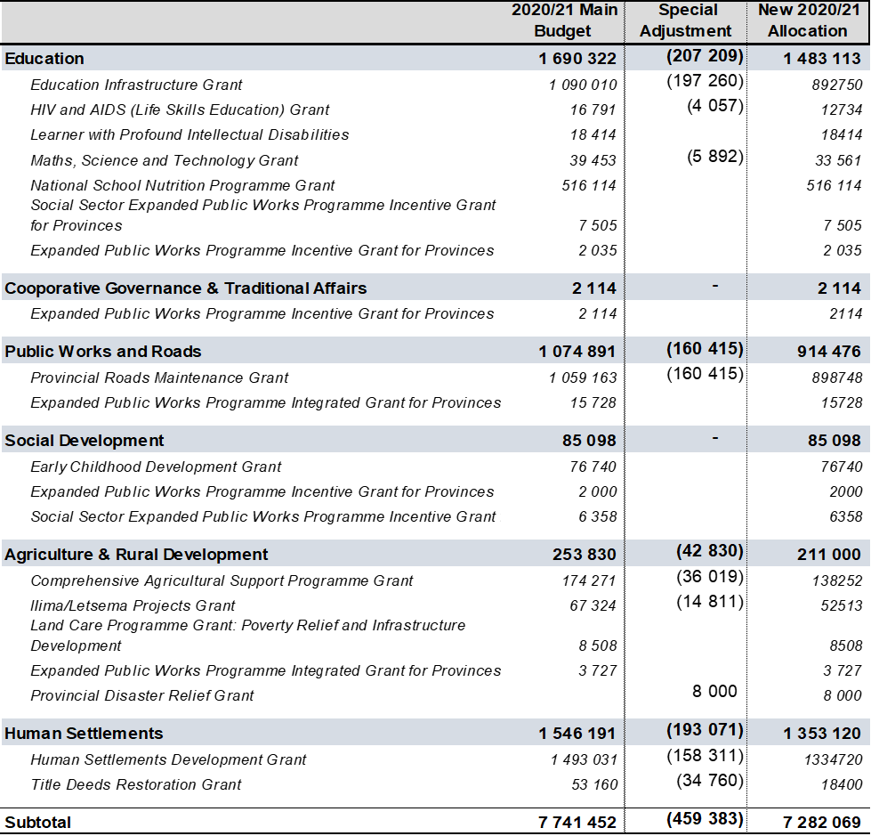
Adjustment to 20/21 Provincial Fiscal Framework –
Conditional Grants

Slide 10
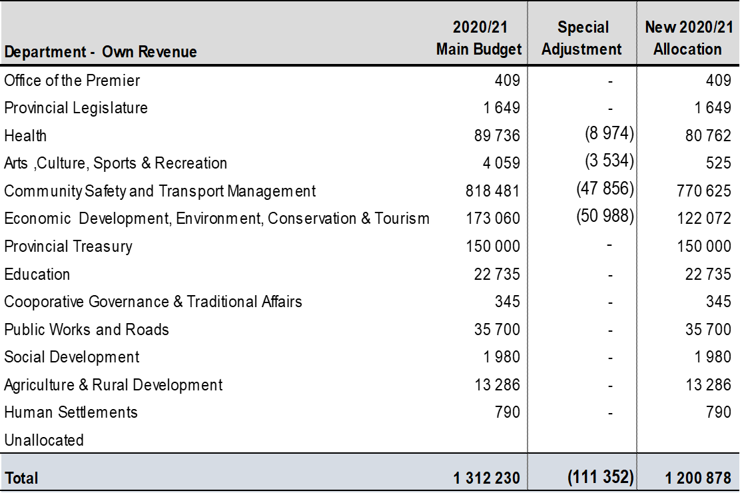
Adjustment to 20/21 Provincial Fiscal Framework –
Provincial Own Revenue
Own revenue targets for four departments were affected by the COVID-19 Restrictions;
The reduced revenue target have a direct impact on the Provincial Fiscal Framework and specifically the expenditure budgets of the respective departments;

Slide 11
Adjustments to the 2020/21 Budget
In line with EXCO resolution, the Provincial Treasury engaged departments and identified possible areas for budget reduction for COVID-19 fund.

Slide 12
Special Adjustment Allocations for 2020/21
Department of Health
Health received an additional R1.1 billion from the Equitable share and R193.640 million from conditional grants;
Health reprioritised R399 million from the internal baseline allocation towards COVID-19;
In total, an amount of R1.693 billion was dedicated for COVID-19 within the Department of Health;
The allocation was intended to amongst others address the following:
  Human Resources capacity to respond to the pandemic: included health professionals inclusive of the capacity in the form of cleaners, porters, mortuary attendants, laundry aids, data capturers, etc.
  Increased bed capacity: more field hospitals than initially planned in view of the increasing cases and treatment to respond to the surge and to contain the spread;
  COVID-19 interventions: Prevention was a fundamental component and encompassed the issues of personal protective equipment (PPE), health education, screening and management of contacts by quarantining confirmed persons through isolation.

Slide 13
Special Adjustment Allocations for 2020/21
Department of Arts, Culture, Sports and Recreation
The departmental recreational facilities was used as accommodation facilities for homeless;
The department was allocated an amount of R10 million to assist with the cost of running facilities used as quarantine sites.
An amount of R1.650 million from National Heritage Center was allocated for three heritage sites namely; Moses Kotane National Memorial Heritage site, Onkgopotse Tiro Grave and Dinokana Village and Dr. Ruth Mompati;
Department of Economic Development, Environment, Conservation and Tourism
An additional R50 million was allocated to DEDECT for COVID-19 intervention with special reference to the provision of quarantine sites;
The allocation was intended to assist with the running of the facilities and the department must ensure that reasonable rates are paid for these government facilities to benefit more patients.

Slide 14
Special Adjustment Allocations for 2020/21
Department of Education
The department was allocated an amount of R200 million to assist with COVID-19 intervention especially at school level;
The grant framework of Education Infrastructure grant was amended to allow the department to reprioritise and use funds for COVID interventions;
Department of Agriculture and Rural Development
Food security was threatened by the prevalence and the spread of the coronavirus;
The department was allocated an additional R30 million to improve food security in the province;
The allocation was intended to ensure that critical programmes aimed at ensuring food security are explored and supported;
An amount of R8 million from Provincial Disaster Relief grant was allocated for draught relief measures,

Slide 15
Special Adjustment Allocations for 2020/21
Department of Social Development
The department received an additional R40 million for the Social Relief of Distress Programme to respond to the challenges of disasters, extreme poverty and destitution;
This programme included food parcels and cooked meals, blankets, sanitary dignity packs and any other appropriate interventions as a short-term measure to respond to the emergency needs of individuals and households;
The department provided social relief to the homeless during this time of Disaster;
The grant framework for Early Childhood Development grant was amended to allow the department to reprioritise funding for COVID-19 intervention plans specifically for ECD sites;
These included preparation for reopening, procurement of mask and sanitizers.

Slide 16
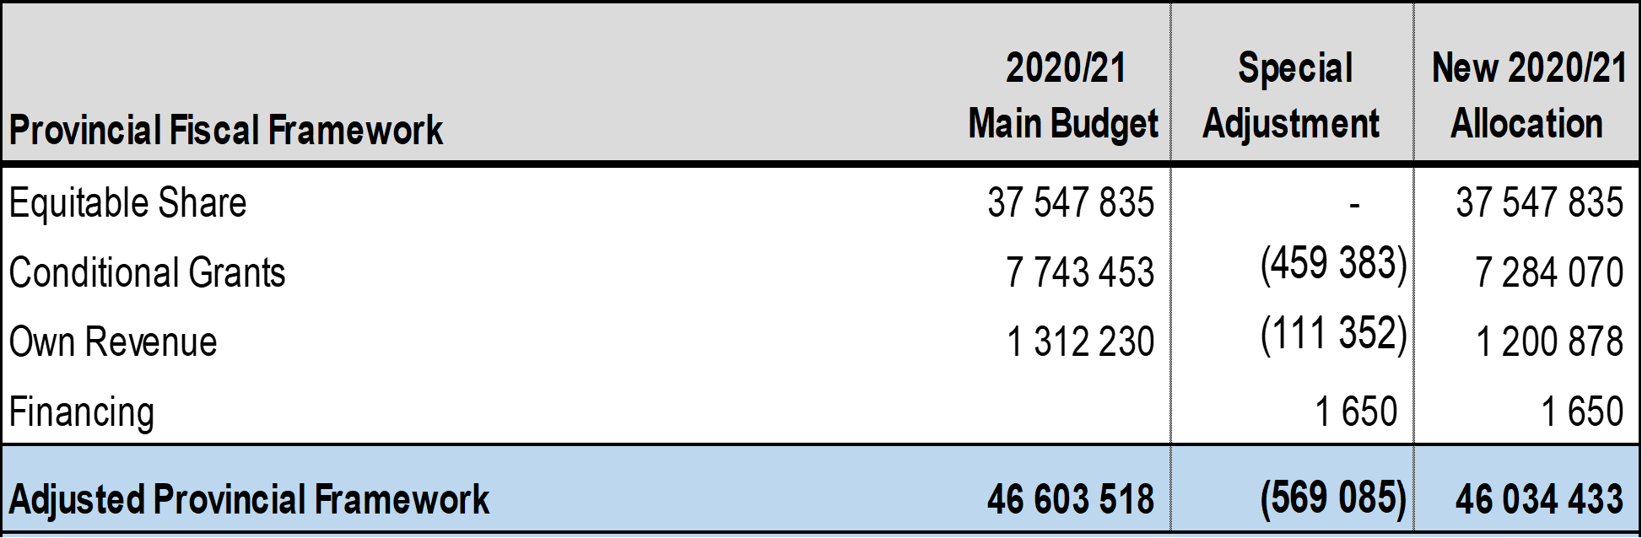
Special Adjustment for 2020/2021 Provincial
Fiscal Framework

Slide 17
2020/21 COVID-19 Expenditure per Department

Slide 18
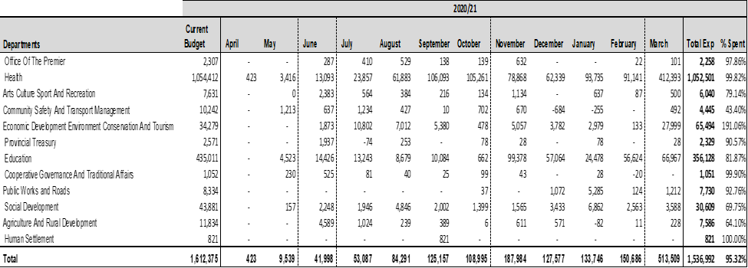
2020/21 COVID-19 Expenditure per Department
Over and above the reductions and additions that were effected, provincial departments reprioritised their baselines and load funds earmarked for the internal departmental response to COVID-19.
The Department of Health constituted 68.48 per cent of total COVID-19 expenditure, followed by Education at 23.17 per cent.

Slide 19
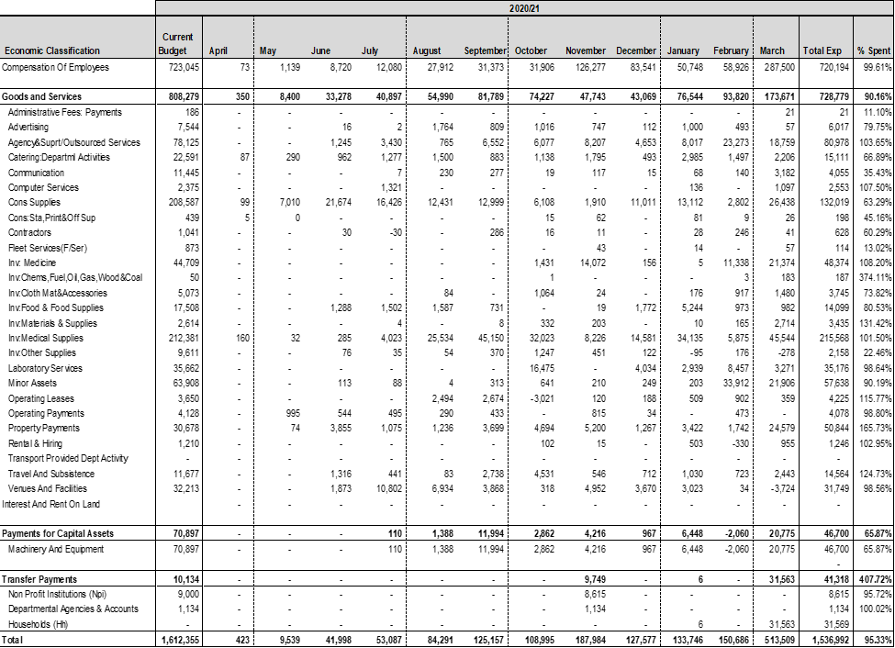
Provincial COVID-19 Expenditure per Economic Classification in 2020/2021
Health, Education and Social Development incurred COVID-19 spending on social responsibility, majority of departments were mainly spending for internal interventions to curb the spread of the disease within the respective departments.
The largest share of expenditure was allocated to COE and G&S at 46.86 per cent and 47.42 per cent respectively. COE was for health care workers, community development workers, screeners, general workers, etc.
G&S items that recorded the highest spending was: medical supplies (gloves and disposable sundries) agency and outsourced services, consumables supplies (medical supplies, washing & cleaning detergents), medicines, laboratory services, minor assets, and venues & facilities.

Slide 20
2021/22 COVID-19 Expenditure per Department

Slide 21
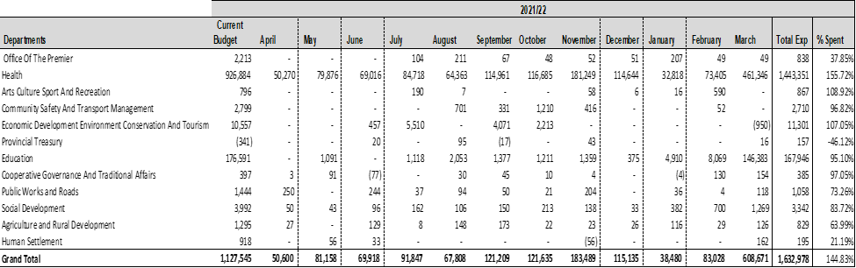
2021/22 COVID-19 Expenditure per Department
Health consuming 88.39 per cent of total expenditure. As at 31st March 2022, the province spent R1.633 billion 145 per cent, against the budget of R1.128 billion.
The expenditure was mainly under Health, DEDECT, Education and Social Development.

Slide 22
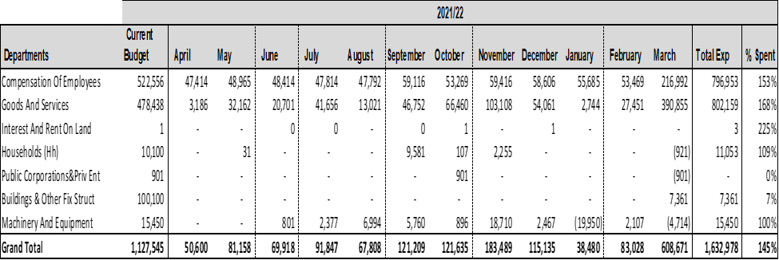
Provincial COVID-19 Expenditure per Economic Classification in 2021/2022
Similarly to the 2020/21 financial year, expenditure is largely consumed by Goods and Services and Compensation of Employees.

Slide 23
municipalities management of the Covid-19 Funds

Slide 24
Support by PT on the management of COVID 19 Funds
    The MEC engaged municipalities on virtual platforms to assess the impact of COVID 19 on their operations. Municipalities reflected on the following key issues:
      Budget re- prioritization of 2019/20 Budget allocations to response to the COVID-19 state of National Disaster;
      Procurement processes followed to procure COVID-19 related goods and services;
      Status and Implementation of Business Continuity Plan.
    The Office of the Chief Procurement Officer issued National Treasury Instruction No. 11 and MFMA Circular 105 of 2020/21 which introduced mandatory reporting requirement for COVID-19 transactions.
    Provincial Treasury developed and issued a reporting template to be used by all municipalities in the province for reporting weekly and monthly expenditure on COVID 19 which required the municipalities to indicate the description of items purchased, quantity, the total value of items purchased and the procurement method used by the municipalities.
    Provided guidance to municipalities on how to report on the COVID-19 specific funding allocations and expenditure using the mSCOA chart.

Slide 25
Support by PT on the management of COVID 19 Funds
    Provincial Treasury monitored reporting by municipalities to National Treasury on weekly basis and non-compliance letter were issued for municipalities not reporting.
    Municipalities were required by Circular 99 to record and ring-fence all funding and expenditure pertaining to COVID-19 pandemic for the 2020/21 MTREF when budgeting and transacting.
    National Treasury further issued mSCOA Circular 9, which guides municipalities to identify and report on COVID-19 expenditure and related projects.
    Municipalities were guided and trained on compiling special adjustment to reprioritize the 2020/21 budget to respond to the impact of the COVID 19 pandemic on the budget. Provincial Treasury provided continuous training on mSCOA circular 19 to ensure correct transacting on mSCOA related expenditure.

Slide 26
PT Support to municipalities to implement the recommendations by the AG

Slide 27
PT Support to municipalities to implement the recommendations by the AG

Slide 28
PT Support to municipalities to implement the recommendations by the AG

Slide 29
Concluding Remarks
There was a compelling need to respond to the devastating impact of COVID-19;
At the time the Province was experiencing the peak in terms of number of cases reported daily, which required strategic and prompt response from government to save lives;
The identified funds demonstrated the Provincial Government’s resolve to curb the spread of the coronavirus and flatten the curve;
In addition to reprioritising for the Provincial COVID-19 response plan, departments further reprioritised for internal COVID-19 intervention and preventative measures;
The impact of COVID-19 to the Provincial Budget was in excess of R3 billion considering reprioritisation of internal departmental intervention and the repurposing of conditional grants;
It was critical to ensure value for money as the COVID-19 funds were utilised and departments were requested to report bi-weekly on COVID-19 spending.

Slide 30
Thank You!
BAIE DANKIE!

