Slide 1
Water and Sanitation Operations
City of Ekurhuleni
Response to a Petition

Slide 2
Table of content
Background
Causes of Blockages
Intervention
Environmental Compliance
Conclusion

Slide 3
THE PC ON COOPERATIVE GOVERNANCE RECEIVED THE FOLLOWING PETITION:
BRIEFING TO PC ON COGTA ON A PETITION
Ms H Ismail on behalf of the residents of Alphen Park, Farrarmere and surround suburbs in the City of Ekurhuleni calling on the assembly to investigate the failing sewer infrastructure that is causing spillage into the wetland which feeds Benoni lakes and dams (ATC 22 October 2020).

Slide 4
RESPONSE FROM DEPARTMENT
Background:
According to our “as built” records, the sewer services / infrastructure in Alphen Park, Farrarmere and surrounding areas was installed around the year 1967. The pipe material used for these services is generally an earthenware pipe. The sewer pipes generally runs in the midblocks (at the back of the properties inside) as indicated below.

Slide 5
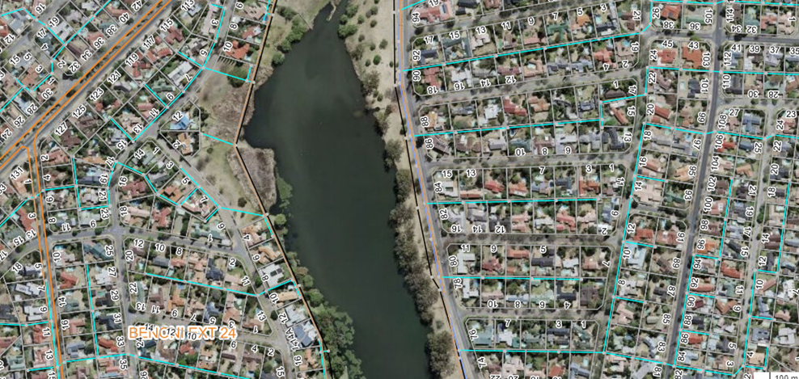
Homestead Lake

Slide 6
Causes of Sewer Blockages
Aging Infrastructure:
As indicated above the sewer infrastructure in this area is aging and therefore experiences a lot of failures such as collapsed pipelines. However where it is suspected that a line has collapsed, repairs are conducted as soon as possible to curb prolonged sewer blockages.

Slide 7
…Causes of Sewer Blockages
2.Tree Roots Intrusion:
Generally, the sewer lines in this area runs in the mid-blocks, within the two (2) meters servitude from the boundary wall/fence. In this area there are cases of residents planting trees within the servitude, encroaching the servitude. Overtime the tree roots penetrate the sewer pipes and cause blockages. Problematic lines are identified and roots are cut during sweeping and cleaning of the lines.

Slide 8
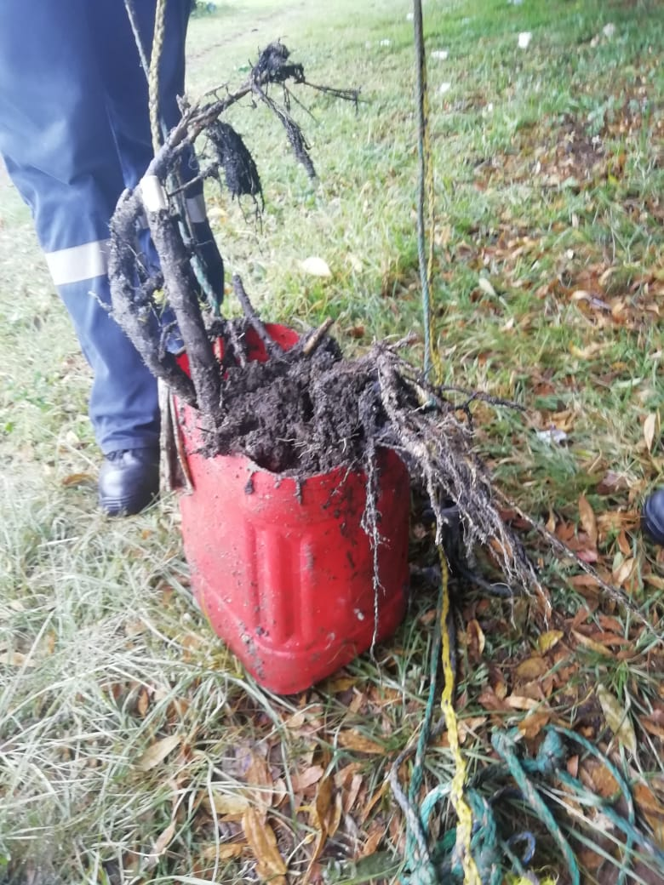
Roots removed from Sewer Line

Slide 9
…Causes of Sewer Blockages
3. Foreign Objects:
There is generally an abuse of sewer system by some customers/residents who deposit foreign objects in the sewer system such as rugs, stones, wood logs, building rubble, nappies, etc. Some of the objects such as nappies end up at the pumpstation and cause serious damage to the pumps as they clog the pumps.
And these foreign object generally causes blockages even on the pipe lines.

Slide 10
Intervention
Education and awareness campaigns are being carried out by Water and Sanitation department, Support section and communication is being done through Communications and Branding department on all social media platforms. But more communication and awareness needs to be intensified.

Slide 11
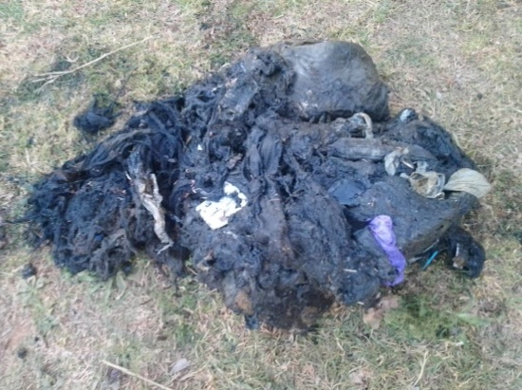
Foreign objects removed form sewer system

Slide 12
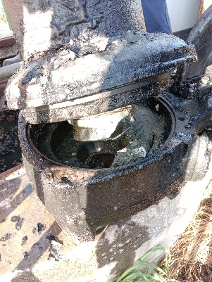
…Foreign objects removed from sewer pumpstation

Slide 13
Cause of overflows
4. Power outages (loadshedding) affecting Brentwood Park Pumpstations:
During loadshedding or power outages the pumpstation cannot operate and as the result it overflows. Department is looking at installing back-up generators on critical pumpstations to curb the sewer overflowing during power outages. However a long-term solution for Brentwood Park pumpstation is that it will eventually be phased out and replaced with a gravity sewer line.
The project is at Preliminary Design Report stage (PDR). However the project implementation still need to plan and budget for this project.

Slide 14
…Causes of Sewer Blockages
5. Manhole Covers Theft:
Theft of sewer manhole covers is rife and remains a challenge for the department. A lot of budget is spent on replacement of stolen manhole covers. Department opted to use concrete and polymer covers instead of steel ones, but the theft continues. However, the stolen covers are being replaced as and when they become missing.

Slide 15
…Causes of Sewer Blockages
6. Fats from Nearby Restaurants:
The other cause of sewer blockages in this area is fat found inside manholes. This fat is deposited into the sewer system from the restaurants in the area. The City’s By-Laws requires restaurants to have fat traps and have them serviced on regular basis. Water and Sanitation department, Operations division is working together with Water Quality section in cases such as this to conduct inspections to check if restaurants comply with the City’s By-Laws.

Slide 16
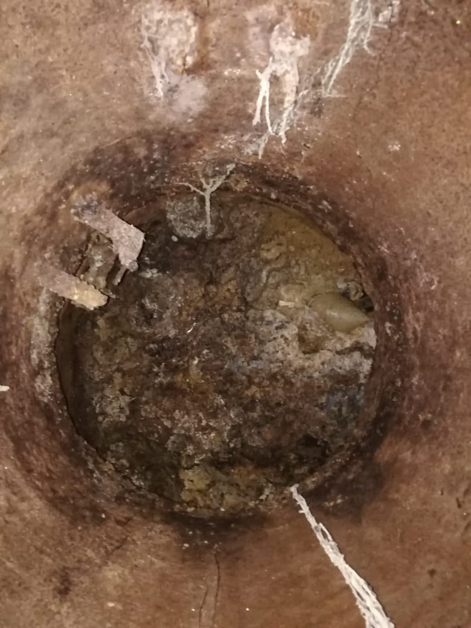
Picture of Manhole

Slide 17
Conclusion:
The department has resources such as internal teams and “as and when” sewer maintenance contractor working 24/7 including holidays to attend to all complaints. The department conducts regular inspections on sewer manholes around the area to attend to sewer overflows around the dam. It must be noted that natural streams and dams are being sampled and tested for environment compliance by the City’s Water and Sanitation department, Water Quality section on monthly basis.

Slide 18
Environmental Compliance
Below is the latest Environment Compliance Sample Report for Homestead dam for April 2022, May 2022, June 2022, July 2022, which indicates that faecal coliforms count were and are within the parameters.

Slide 19
Environmental Compliance sample Report for 2021/07/01 – 2022/0731
COMPANY | DATE | COD | CONDUCTIVITY | FCOLI | N | NOX | P
Benoni Homestead Lake Inlet | 2022/0419 | 13mg/1 | 23ms/m | 490 Counts/100mL | 0.6mg/1 | 0.4mg/1 | 0.1mg/1
Benoni Homestead Lake Inlet | 2022/05/16 | 12mg/1 | 29ms/m | 10 Counts/100mL | 0.3mg/1 | 0.3mg/1 | 0.1mg/1
Benoni Homestead Lake Inlet | 2022/06/02 | 5mg/1 | 29ms/m | 5 Counts/100mL | 0.3mg/1 | 0.4mg/1 | 0.1mg/1
Benoni Homestead Lake Inlet | 2022/07/21 | 5mg/1 | 29ms/m | 12 Counts/100mL | 0.4mg/1 | 0.4mg/1 | 0.1mg/1

Slide 20
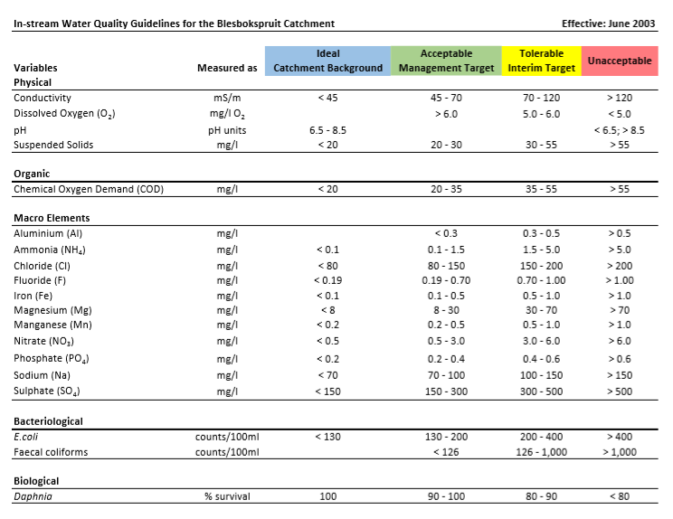
Water Quality Guidelines

Slide 21
Thank you

