Slide 1

SASSA BRIEFING TO THE PORTFOLIO COMMITTEE ON SOCIAL DEVELOPMENT ON AUDIT ACTION PLANS 2020/21
31 August 2022

Slide 2
Presentation Outline
Purpose
AGSA audit outcome 2020/21 dashboard
Summary of the 2020/21 Audit Action Plans
Detailed breakdown of the consolidated audit action plan per affected areas
Audit findings 2020/21 – work in progress
Irregular expenditure cases still with Treasury @ 31 July 2022
Disciplinary corrective actions not yet finalised as at 31 July 2022
Recommendations
2

Slide 3
Purpose
The purpose of the presentation is to brief the Portfolio Committee on Social Development on SASSA Audit Action Plans 2021/22
3

Slide 4
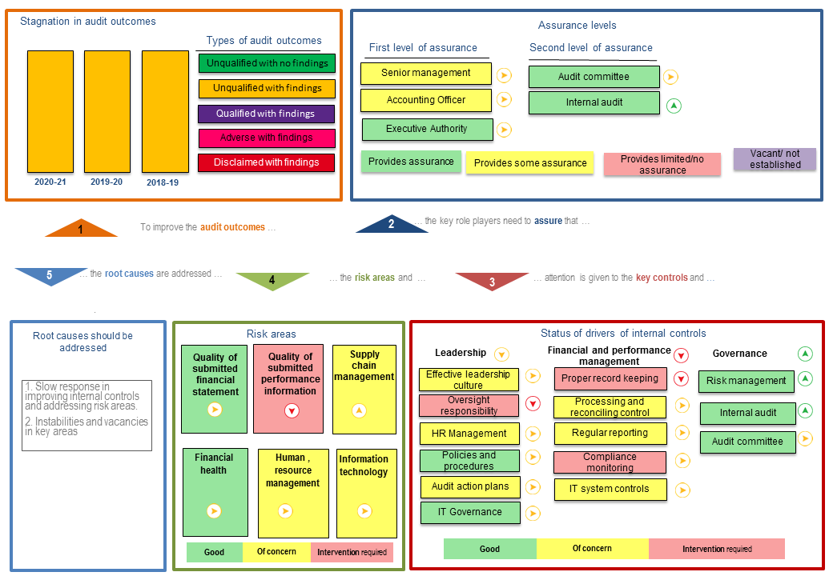
AGSA audit outcome 2020/21 dashboard

Slide 5
SUMMARY PROGRESS REPORT ON IMPLEMENTATION OF CORRECTIVE ACTIONS AT @ 31 JULY 2022
5

Slide 6
FINANCE
6

Slide 7
FINANCE Cont…….
7

Slide 8
FINANCE Cont………
8

Slide 9
GRANT ADMINISTRATION
9

Slide 10
ICT BRANCH
10

Slide 11
11

Slide 12
AUDIT FINDINGS 2020/21 – WORK IN PROGRESS
Area | Commitment | Challenges | Progress to date
Irregular Expenditure– Long outstanding cases not resolved and finalized within a reasonable time | Develop and implement project plan(s) to finalise backlog cases | Complexity of cases Cases being investigated by third parties No of backlog cases affected investigations as some officials are no longer with SASSA Postponement and additional information required during hearings | 88.47% (829 of 937) of financial misconduct cases (Irregular expenditure, Fruitless and wasteful expenditure, Damages and losses) were finalised (backlog) during 2021/22 95% (730 out 771) of irregular expenditure cases’ disciplinary corrective measures finalised. Residual cases (2020/21 and 2021/22) as at the end of March 2022 will be finalised during 2022/23
12

Slide 13
AUDIT FINDINGS 2020/21 – WORK IN PROGRESS
Area | Commitment | Challenges | Progress to date
Fruitless and Wasteful expenditure– Long outstanding cases not resolved and finalized within a reasonable time | Develop and implement project plan(s) to finalise backlog cases | Complexity of cases – investigations extended Cases being investigated by third parties Cases that are before the court | 63% (24 of 38) of fruitless and wasteful cases finalised Residual cases (2020/21 and 2021/22) as at the end of March 2022 will be finalised during 2022/23
13

Slide 14
AUDIT FINDINGS 2020/21 – WORK IN PROGRESS
Area | Commitment | Challenges | Interventions to date
Lack of External Quality Assessment (EOA) of the Internal Audit Unit | To procure services of and external service provider and to conduct quality assessment review of the internal Audit function | Non responsive bids when appointing external quality assessment Three (3) attempts were made to appoint the service provider: Quotation process became above the threshold Deviation not approved by NT Open tender process –Bid non-responsive | Reviewed approached, currently SASSA is engaging NT for status of readiness- NT confirmed to assist on SASSA readiness The NT outcome will now guide on the way forward- Confirm readiness or improvement plan before TOR review and implementing a new open competitive bidding process to be embarked upon during 2022/23
14

Slide 15
AUDIT FINDINGS 2020/21 – WORK IN PROGRESS
Area | Commitment | Challenges | Progress to date
Network security: firewall assessment. Firewall rules were not adequately restricted and allowed access to clear-text protocols. | Firewall rules should be locked down to allow access to only hosts that require access. Management should avoid the use of clear-text protocols, where possible on the SASSA firewall services. Replace HTTP with HTTPS, SMTP with STMPS, FTP with SFTP and disable X-windows. Firewall rules should be accompanied by meta-data or comments that describe the purpose of the firewall rule to assist administrators in maintaining an accurate list of rules that are required for business operations. | This is a major configuration/ change which impacts on a number of system environments within SASSA, such as Oracle, biometrics etc. | The ICT team is implementing the changes slowly - ensuring that proper testing is conducted after the changes. ICT is also considering the best periods within the year, as well as the specific months to ensure the least possible disruption to core business functions. The change is earmarked for completion by 31 December 2022
15

Slide 16
AUDIT FINDINGS 2020/21 – WORK IN PROGRESS
Area | Commitment | Challenges | Current Interventions
Updated R350 Grants exceptions as at 31 March 2021 | SASSA and AGSA to have continuous discussions on the audit findings, the differences and how both can contribute to resolve same. | Difference of opinion with AGSA on approach on recognition of databases and timing in the validation of data. | Engaged with DSD and AGSA on availability and usage of databases. Investigating any alleged inclusion errors Signed MOUs with the key affected organizations SASSA share information with Continue to engage AGSA to use same database used for payment processing to audit
16

Slide 17
IRREGULAR EXPENDITURE CASES STILL WITH NATIONAL TREASURY

Slide 18
IRREGULAR EXPENDITURE CASES STILL WITH TREASURY @ 31 JULY 2022

Slide 19
NATURE OF CASES SUBMITTED TO NATIONAL TREASURY

Slide 20
NATURE OF CASES SUBMITTED TO NATIONAL TREASURY

Slide 21
CORRECTIVE ACTIONS NOT YET FINALISED 31 JULY 2022

Slide 22
Recommendations
It is recommended that the Portfolio Committee on Social Development take note of SASSA’s;
  Progress on 2020/21 Audit Action Plan.
  Nature of Irregular Expenditure Cases submitted to National Treasury
22

Slide 23
Thank you
Notes:
23

