Slide 1
South Africa Works because of Public Works
Presentation to the Portfolio Committee of Public Works and Infrastructure
DPWI EPWP briefing on progress with improving management of employment opportunity data; the effort to get a clean audit report through the use of ICT software and innovative strategies to improve data collection, verification, and reporting from departments, provinces and municipalities so that a uniform standard is maintained and compliance is strengthened
31 August 2022

Slide 2
Content
Purpose
Department of Public Works and Infrastructure (DPWI’s) coordination role
Role played other Departments
Funding – Other Public Bodies
EPWP Reporting System (EPWP-RS)
Measures undertaken to obtain a clean audit
Audits - Other Public Bodies

Slide 3
Purpose
The DPWI to brief the Portfolio Committee of Public Works and Infrastructure on progress with improving management of employment opportunity data; the effort to get a clean audit report through the use of ICT software and innovative strategies to improve data collection, verification, and reporting from departments, provinces and municipalities so that a uniform standard is maintained and compliance is strengthened.
Clarify the role of DPWI and Other Departments from a budget and accountability perspective.

Slide 4
DPWI – Coordination Role
DPWI, as the responsible overall coordinating department undertakes the following activities:
Creating a supportive and enabling environment for the implementation of EPWP.
Providing regular guidance and support, as and when needed, to public bodies in the implementation of EPWP.
Transferring Officer for the EPWP Incentive Grant (i.e. R1,6 billion in 2022/23)
Developing and implementing policies for the management of training support and enterprise development
Providing monitoring, evaluating and reporting support.
Developing and maintain the EPWP Reporting System (EPWP RS).
Providing quarterly reports in terms of performance based on the information reported by public bodies
Providing training to officials implementing EPWP and those that report on the EPWP RS.
Undertaking data validation, cleaning and reporting with regards to the EPWP RS.
DPWI is the transferring officer for the EPWP incentive grants, which is R1,6 billion (2022/23) for: EPWP Integrated Grant for Municipalities (R778,4 million), EPWP Integrated Grant for Provinces (R433,1 million) and EPWP Social Sector Incentive Grant for Provinces (R424,8 million). This equates to 8% of expenditure on the EPWP, as reporting in the EPWP Reporting System by public bodies.
DPWI also receives the allocation for the NPO Programme (R1,1 billion) on the departmental vote, which is earmarked funds for the Independent Development Trust (IDT), with the IDT be accountable for programme implementation.

Slide 5
Roles played by other Departments
The design of the EPWP relies on public bodies using own funds (i.e. equitable share and conditional grants) to implement EPWP. In total 358 public bodies are assigned work opportunity targets, which collectively equates to the 5 million work opportunity target for EPWP Phase IV. The table below disaggregates the number of participating public bodies that have targets assigned to them:
Nr of Public Bodies with EPWP Targets | EC | FS | GP | KZN | LP | MP | NC | NW | WC | Grand Total (All Spheres)
Municipalities | 39 | 23 | 11 | 54 | 27 | 20 | 31 | 22 | 30 | 257
Provincial Depts | 10 | 10 | 11 | 12 | 9 | 9 | 9 | 9 | 8 | 87
National Departments | n/a |  |  |  |  |  |  |  |  | 14
Total | 49 | 33 | 22 | 66 | 36 | 29 | 40 | 31 | 38 | 358
In September 2021, the Medium Term Strategic Framework (MTSF) (2019- 2024) was revised to indicate that the above mentioned public bodies account for the EPWP targets.
Implementing bodies are responsible for: using own funds (equitable share, conditional grants – including EPWP incentive grants for implementing projects; designing and implement EPWP programmes in line with the EPWP theory of change; reporting accurate data onto the EPWP RS, maintain evidence of the data reported onto the system for audit purposes, monitor the quality of EPWP programme assets and service delivery, all Public Bodies implementing EPWP programmes or projects are required to report their performance onto the EPWP RS. The data collected from the EPWP RS forms the foundation for overarching performance reporting.

Slide 6
Funding – Other Public Bodies
The key funding sources in EPWP – on other department votes include the following:
Division of Revenue Act (DORA) Schedule 5B and 6B: Municipal Infrastructure Grant – R17.6 billion in 2023/24. The EPWP work opportunity targets assume that 30% of the Municipal Infrastructure Grant will be used to create EPWP work opportunities.
Vote 3: COGTA: Community Work Programme: Allocation in 2023/24: R4.4 billion. CWP WO target 2023/24: 252 818.
Vote 32: DFFE – Environmental Programmes: Allocation: – R3.9 billion in 2023/24. These programmes focus on infrastructure related projects that contribute towards the environmental protection, conservation and sustainability, whilst creating work opportunities, and providing skills development to enable beneficiaries to secure permanent employment. Some programmes address responsibilities relating to water resource management, biological diversity and the functioning of natural systems.
DORA Schedule 5B: Integrated National Electrification (Municipal) Grant (Mineral Resources & Energy Vote) – R2.2 billion in 2023/24.
DORA Schedule 6B: Integrated National Electrification (Eskom) Grant (Mineral Resources & Energy Vote) – R3.8 billion in 2023/24.
DORA - Integrated Urban Development Grant (COGTA Vote) – R1.1 billion in 2023/24.
Vote 38 – Dept. of Tourism – under Destination Development Branch.
Vote 19: Dept. of Social Development – under the Special Projects and Innovation Branch. This Branch coordinates the EPWP.
Vote 40: Dept. of Transport – Provincial Roads Maintenance Grant (PRMG) – R13 billion in 2023/24. The EPWP work opportunity targets assume that 25% of the PRMG will be used to create EPWP work opportunities. The allocation relates to road & bridge infrastructure maintenance.
The other Public Bodies also are to use equitable share for EPWP.

Slide 7
EPWP Reporting System (EPWP-RS) & feautures
The EPWP developed an online reporting system to collate EPWP performance data.
The EPWP Reporting System is a digital system.
Participant data that fails any of the above mentioned validation rules is not reported but remains in the system for the implementing body to remedy. Corrected data is published in the next quarterly report.
Value-add features of the EPWP RS are utilised to assist public bodies in ensuring quality of the reported data.
Biometric system feature: The EPWP RS allows the utilization of facial recognition for date-stamped verification of participants on-site. This feature will assist with the collection of attendance data and will eliminate the need for attendance registers for projects where it is implemented. Utilisation of the feature will be piloted after the migration of all public bodies to EPWP RS Version 2.
Linkage between the EPWP RS and other public body systems: The EPWP RS links with the National Population Register the Department of Home Affairs to verify EPWP participants ID numbers and associated data. Also note the current work to link with the ESSA system of the Department of Labour. The ESSA system is a vacancy and work seeker database which acts as an intermediation mechanism to match job seekers with employers. Linkage with the system will create a mechanism of linking the EPWP exited workers with opportunities beyond their participation in the EPWP.
Standard/uniform templates: The EPWP Branch is currently reviewing and standardizing templates in terms of attendance registers, payment registers and employment contracts. For public bodies that adopt the usage of such standardized template, electronic checks in terms of checking the uploaded information have been developed.

Slide 8
Measures undertaken to obtain a clean audit
The DPWI has in the past made several attempts to resolve these findings. These included:
Reporting of only participants tested as valid based on uploaded documentation since 2015/16 (which leads to findings for underreporting).
Development of an EPWP Audit Standard Operating Procedure in 2017/18. The SOP informs public bodies on the important requirements when reporting on the implementation of EPWP projects and guide the public bodies on how to perform audits or verification of EPWP performance information.
Introduction of a customised indicator for DPWI Provincial Coordinating Departments in 2018/19.
Development of a Practice Note in 2019/20.
In 2021/22 the DPWI, on advice received from the AGSA and DPME, undertook the following processes to ensure appropriate placement for responsibility for the audit findings:
Revision of customised indicators for DPWI Provincial Coordinating Departments.
The MTSF indicator was changed from “Number of work opportunities reported through other public employment programmes” to “Number of validated EPWP work opportunities reported by public bodies into the EPWP-RS”. This indicator now reflects that EPWP work opportunities are created by various public bodies and not solely by DPWI.
Furthermore the lead and contributing departments, as reflected in the above MTSF indicator was changed from being solely DPWI to reflecting that the following public bodies also contribute to the EPWP:
EPWP Lead Sector Departments;
Provincial Departments; and
Municipalities.
Reflection of the coordination function of the EPWP Branch in the DPWI APP.

Slide 9
Audits - Other Public Bodies
The EPWP projects should be audited by the AGSA at the reporting public bodies and the responsible Accounting Officers should be held accountable for audit findings on non-compliance to EPWP guidelines.
DPME advised that public bodies should include APP indicators for which public bodies have direct responsibility.
DPME advised that public bodies should be accountable for allocated budgets and resources. Chapter 5 of the PFMA provides the responsibilities of accounting officers.

Slide 10
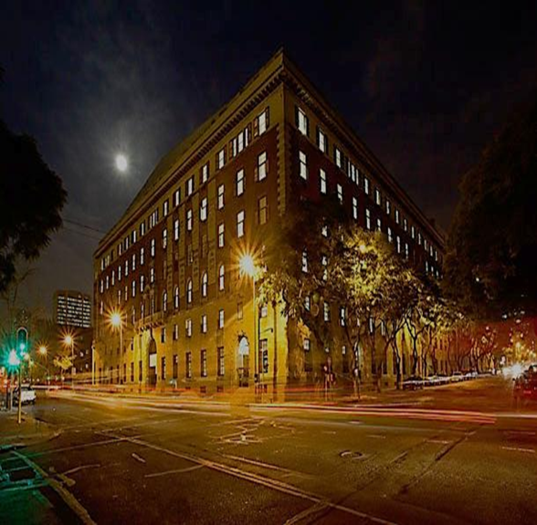
THANK YOU
Department of Public Works & Infrastructure
Head Office: Public Works CGO Building Cnr Bosman and Madiba Pretoria Central Private Bag X65 Pretoria 0001
Website: http://www.publicworks.gov.za

