Slide 1
PRESENTATION TO THE PORTFOLIO COMMITTEE ON COOPERATIVE GOVERNANCE AND TRADITIONAL AFFAIRS
DCOG 4th QUARTER PERFORMANCE REPORT 2021/22 FY
31 August 2022
Presented by Ms. Avril Williamson- Director-General

Slide 2
PRESENTATION OUTLINE
Purpose
Overview- Summary of performance
Part A: DCOG Annual Performance Report for 2021/22 FY
Part B: DCOG Annual Financial Performance for 2021/22 FY
Report on the extent, and the cost of private security employed/procured in the past five years
Recommendations

Slide 3
PURPOSE
To present to the Portfolio Committee on Cooperative Governance and Traditional Affairs, Quarter 4 Performance for the Department of Cooperative Governance and report on the cost, of private security employed/procured in the past five years by the department of COGTA.

Slide 4
Summary Dashboard Performance for quarter 4
 | Q4 | Achieved | Not Achieved
Admin | 7 | 7 | 0
LGSIM | 12 | 8 | 4
ID | 9 | 7 | 2
NDMC | 4 | 4 | 0
CWP | 2 | 1 | 1
TOTAL | 34 | 27 | 7
The overall performance of the Department for 4th quarter is 79% (27 out of 34) targets achieved and seven (7) not achieved. this shows a slight increase from last previous quarterly performance
Quarterly Comparison
Q1 | Q2 | Q3 | Q4
62% | 60% | 75% | 79%

Slide 5
PART A
QUARTER 4 PERFORMANCE INFORMATION REPORT FOR 2020/21 FY
TARGETS ACHIEVED

Slide 6

List of ACHIEVED targets administration
1.1 Achieved The Department has received a qualified audit opinion for 2020/21 financial year.
1.2 Achieved Q3 Corporate Service Improvement Programme (CSIP) progress Report was developed and submitted to Exco on 17 January 2022 and CSIP annual progress report was submitted to Exco on 14 March 2022
1.3 Achieved The targeted 70% implementation of CSIP targets for Q3 was done on 31 March 2022
1.4 Achieved Q3 Financial Service Improvement Programme (FSIP) progress Report was developed and submitted to Exco on 17 January 2022 and FSIP annual progress report was submitted to Exco on 14 March 2022
1.5 Achieved 70% implementation of FMIP as contained in Q3 progress report was done by 31 March 2022
1.6 Achieved 92% implementation of the Internal Audit Plan by 31 March 2022. (i.e., 24 audits out of the 26 planned audits were finalised and signed-off)
1.7 Achieved For the period under review, 2021/22 financial year, there were no investigations commissioned arising out of a request from external parties nor initiated by the Department, covering elements of misconduct, fraud and corruption allegations.

Slide 7
List of ACHIEVED targets local government support and interventions management
2.2 Achieved The DDM Implementation framework is revised to incorporate the gender responsive targets and indicators
2.3 Achieved The Integrated Monitoring and Evaluation Framework (IM&E Framework) for the DDM has been developed. The final draft of both Framework and Manual was discussed in the PSC meeting of 15 March 2022 with endorsement of both documents. The IM&E Framework with findings, recommendations, and implications for implementation to be formally considered by the DCoG
2.4 Achieved The DDM One Plan Prototype has been developed as the first release of a DDM priority module. The demonstration of the One Plan Prototype was presented to members of the Project Technical, Project Steering and Operational Steering Committees, on 24, 29 and 31 March 2022, respectively and was endorsed by committee members.
2.5 Achieved Final report on alignment of IDPs to the One Plans submitted and approved by Minister.
2.6 Achieved Final Report on the Integration of Economic Recovery Plans in the DDM One-Plans finalized and submitted for Ministers approval
2.8 Achieved 60,3% of the targeted 60% MIG allocations was spent on municipal infrastructure by the end of Mar 2022
2.9 Achieved Report on priority water infrastructure projects identified, funded and included in DDM One-Plans was submitted to the Minister in March 2022)
2.11 Achieved Quarterly report on implementation of Section 139 improvement plans developed by 31 March 2022

Slide 8
List of ACHIEVED targets local government support and interventions management
2.6 Achieved Final Report on the Integration of Economic Recovery Plans in the DDM One-Plans finalized and submitted for Ministers approval
2.8 Achieved 60,3% of the targeted 60% MIG allocations was spent on municipal infrastructure by the end of Mar 2022
2.9 Achieved Report on priority water infrastructure projects identified, funded and included in DDM One-Plans was submitted to the Minister in March 2022)

Slide 9
List of ACHIEVED targets institutional development
Output Indicators
3.1 Achieved Funding Model for Local Government was developed jointly with NT by 31 March 2022
3.2 Achieved Municipal Financial Viability Assessment and Improvement Tool developed and approved by Minister by 31 March 2022.
3.5 Achieved Close out report on support provided to stakeholders on the 2021 local government elections was compiled by 31 March 2022
3.6 Achieved Draft Integrated local government capacity building strategy developed by 31 March 2022 consulted with key stakeholders
3.7 Achieved Reports on National Responsible Citizenry Campaign implementation. Stakeholder engagements conducted and reports developed
3.8 Achieved Four MPAC functionality assessment reports developed by 31 March 2022
3.9 Achieved Report on the implementation of actions to address issues raised by the AGSA in line with section 134 of the MFMA submitted to form part of sec 48 report/ state of local government report by 31 December 2021

Slide 10
List of ACHIEVED targets National Disaster Management Centre
4.1 Achieved Disaster Management Plans of 3 Municipalities in priority disaster areas were assessed to support the prevention preparedness and mitigation of disaster risks i.e. Madibeng, uThukela, and uMzinyathi District Municipalities
4.2 Achieved A consolidated report indicating two sector departments (Transport and Human Settlements) supported in the implementation of disaster funding arrangements has been prepared and approved by the HOC by 31 March 2022.
4.3 Achieved Annual report on the performance and expenditure of the disaster grants by 31 March 2022
4.4 Achieved Report on one priority national sector department assessed and supported to implement disaster management function developed by 31 March 2022

Slide 11
PART A
QUARTER 4 PERFORMANCE INFORMATION REPORT FOR 2020/21 FY
TARGETS NOT ACHIEVED

Slide 12

List of targets not Achieved local government support and interventions management
2.1 Not Achieved 40 district and 6 metro One Plans developed which is 88% of the planned 52 district spaces by 31 March 2022
2.7 Not Achieved No Hub Manager and administrative staff were appointed in the 21 WSA Districts Implementation challenges relating to the DDM hubs establishment concept were identified relating to: Lack of proper costing of employment costs for Hub managers and staff; Insufficient budget for Hubs establishment and operations over a multi-year period; Lack of clarity on how in practice the narrative of Hubs being an extension of COGTA can be successfully applied within the employment and recruitment strategies of COGTA.
2.10 Not Achieved Draft One-Plan targets and indicators for three smart cities were developed but still to be submitted to Minister for approval
2.12 Not Achieved Intergovernmental Monitoring, Support and Interventions Bill was summitted to office of the State Law Advisor (SLA) in October 2021, for purposes of obtaining a Cabinet compulsory SLA’s constitutional compliance certificate. - In December 2021, an engagement with the SLA was undertaken, and comprehensive oral and written comments were obtained from the SLA. The Bill was revised accordingly, and a preliminary constitutional compliant certificate was obtained on the Bill, providing a green light to process the Bill in Cabinet. On the other hand, the Bill was subjected to another Cabinet compulsory “socio-economic impact assessment” undertaken by the DPME from September 2021. The final “socio-economic impact assessment certificate was only obtained on 19 March 2022, including approval of the Monitoring and Evaluation Framework, as well as an Implementation Plan of the Bill

Slide 13
List of targets not achieved Institutional Development
3.3 Not Achieved 33 (63% of 52) municipalities have included a target to reduce non-revenue electricity losses on their SDBIPs Report on the Number of Municipalities with Non- Revenue Water and Non-Revenue Electricity Reduction in their Service Delivery Budget Implementation Plans in 2021/22 developed
3.4 Not Achieved 29 (20% of 144) municipalities have included a target to reduce non-revenue water as a target on the SDBIPs Report on the Number of Municipalities with Non- Revenue Water and Non-Revenue Electricity Reduction in their Service Delivery Budget Implementation Plans in 2021/22 Developed

Slide 14
List of ACHIEVED targets Community Work Programme
5.1 Achieved 273 848 people participated in the programme by 28 February 2022.
5.2 Not Achieved No CWP training conducted for the period under review due to the change

Slide 15
PART B
FINANCIAL PERFORMANCE

Slide 16
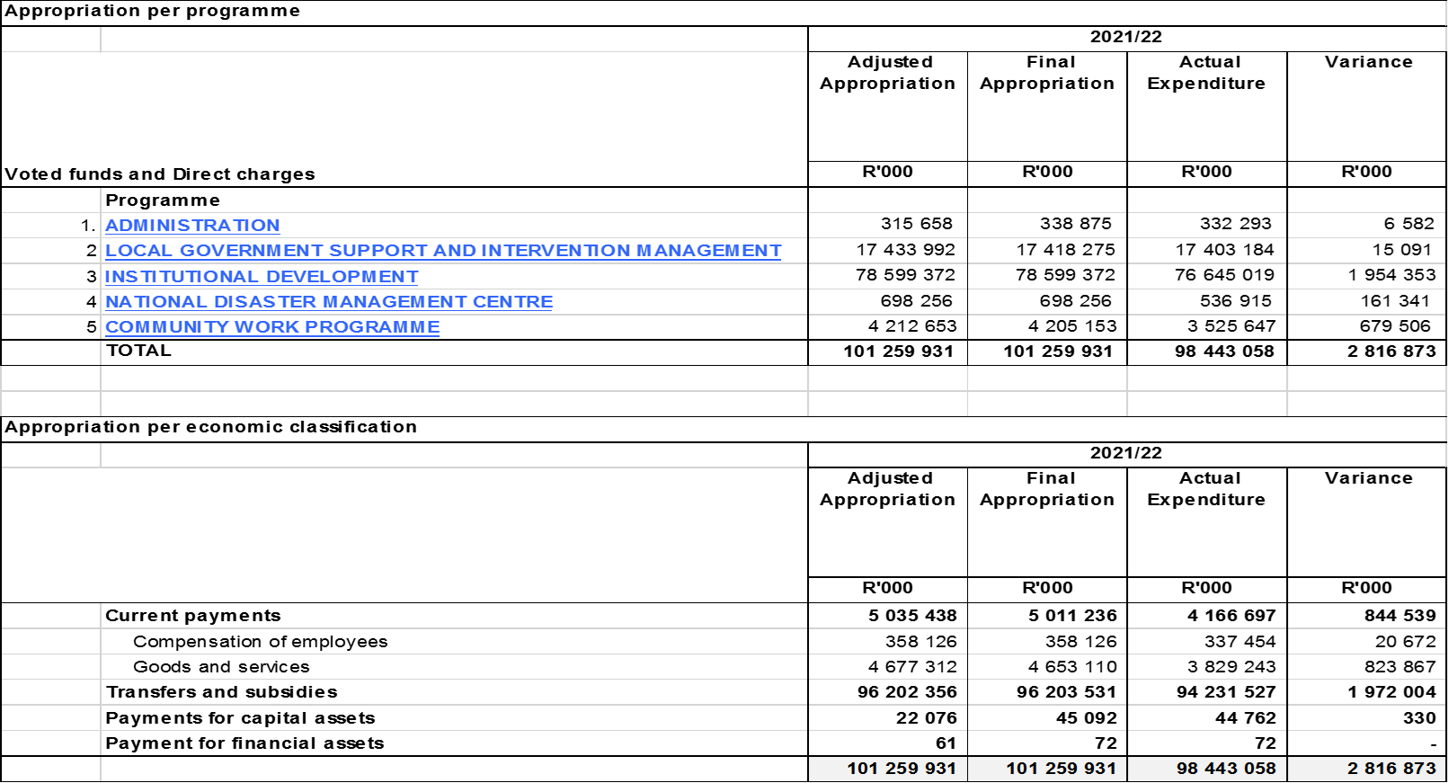
Summary OF FINANCIAL PERFORMANCE for quarter 4

Slide 17
PREVIOUS FINANCIAL EXPENDITURE PERFORMANCE
The department Compensation of employees (COE) had underspend with 6% in the period under review which attributed to vacancies in the Office of the Deputy Minister after the redeployment of the former Deputy Minister and high turnover of staff especially at the SMS level.
The goods and services (G&S) underspending with 18% items for the period under review and major contributors are (Consultants, Contractors, Inventory, Consumables and Travel & Subsistence).
They mostly include the CWP on-site support, funding the project management fees of implementing agents, tools and materials and participants’ protective gear and wages due to suspension of PPPFA regulations.
Most other grants have transferred 100% of their allocation for the period under review except the following:
Local Government equitable share had underspend with 2.3% and this is mainly attributed by the withholding and stoppages imposed due to non compliance by municipalities with conditions of other grants as defined in DORA.
Disaster relief also underspending with 4.1% since they are only transferred once province and municipalities have depleted their allocation and there is a request to National.
MSIG underspend with 63% due to delay in consultations to endorse business plans and procurement of required services to selected municipalities.

Slide 18
REPORT ON EXTENT AND COST OF SECURITY COMPANIES FOR PAST 5 FY
The Department of COGTA appoint the Private Security Service Provider to renders the following services:
Provide physical security services by doing access control to five (5) buildings and two houses for National House of Traditional Leaders Chairperson and Deputy Chairperson
Provide Tactical Response Team in case of strike or unrest to all five buildings
Provides security equipment such hand metal detectors, handcuffs, button sticks, X-ray machine, Walk through metal detectors, Non-contactless access control system with scanners, two way radios, and Press to Talk (base radios).
The abovementioned services are rendered on 24/7 basis including weekends and public holidays. The private security company further render emergency response services as and when required by the Department.

Slide 19
REPORT ON EXTENT AND COST OF SECURITY COMPANIES FOR PAST 5 FY
The table below provide report on the cost of private security employed/procured in the past five years by the department:
Service Provider | 2017/18 | 2018/19 | 2019/20 | 2020/21 | 2021/22 | Total
Wenzile Company |  | 8,016,094.43 | 11,779,876.79 | 12,726,715.09 | 7,402,781.21 | 39,925,467.52
Prime Security |  |  |  |  | 4,062,184.10 | 4,062,184.10
Enforce Security | 9,403,353.59 | 1,577,976.51 |  |  |  | 10,981,512.10
 | 9,403,353.59 | 9,594,070.94 | 11,779,876.79 | 12,726,715.09 | 11,464,965.31 | 54,969,163.72

Slide 20
RECOMMENDATIONS
It is recommended that the Portfolio Committee note:
DCoG Quarter 4 performance report for the financial year 2021/22 and
Report on the cost of private security employed/procured in the past five years by the department of COGTA.

Slide 21
THANK YOU!

