Slide 1

2022/23 QUARTER 1
SPENDING OUTCOMES
STANDING COMMITTEE ON APPROPRIATIONS
Presenter: Dr Mampho Modise | Public Finance, National Treasury | August 2022

Slide 2
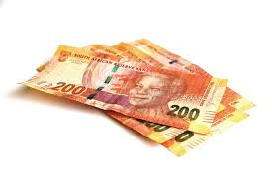
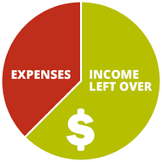

Contents
Spending summary
Higher than projected expenditure
Personnel expenditure
Lower than projected expenditure

Slide 3
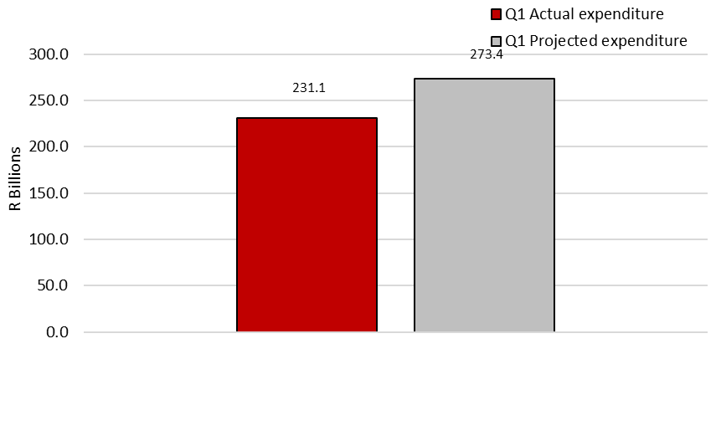
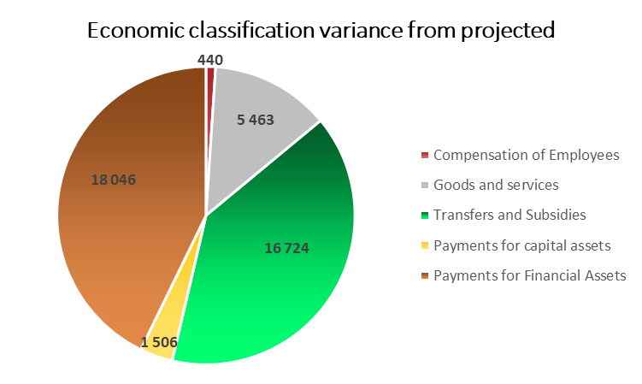
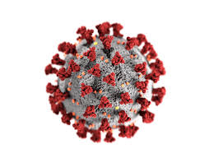
Summary of spending
R42,3 billion or 15,5 per cent lower than projected spending against the projected expenditure of R273,4 billion.
R2.2 billion at the end of the first quarter
Notes:
The preliminary data for the first quarter of 2022/23 shows spending of R231.1 billion, which is lower by R42.3 billion or 15.5 per cent against the projected expenditure of R273.4 billion. Payments for financial assets contributed to largest proportion of the lower than projected spending (R18 billion), followed by transfers and subsidies (R16.8 billion), goods and services (R5.5 billion), payments for capital assets (R1.5 billion) and compensation of employees (R440.3 million). While interest and rent on land spent higher than projected by (R2.1 million). COVID-19 expenditure amounted to R2.2 billion at the end of the first quarter mainly under the department of Social Development relating to the R350 social relief of distress grant.

Slide 4
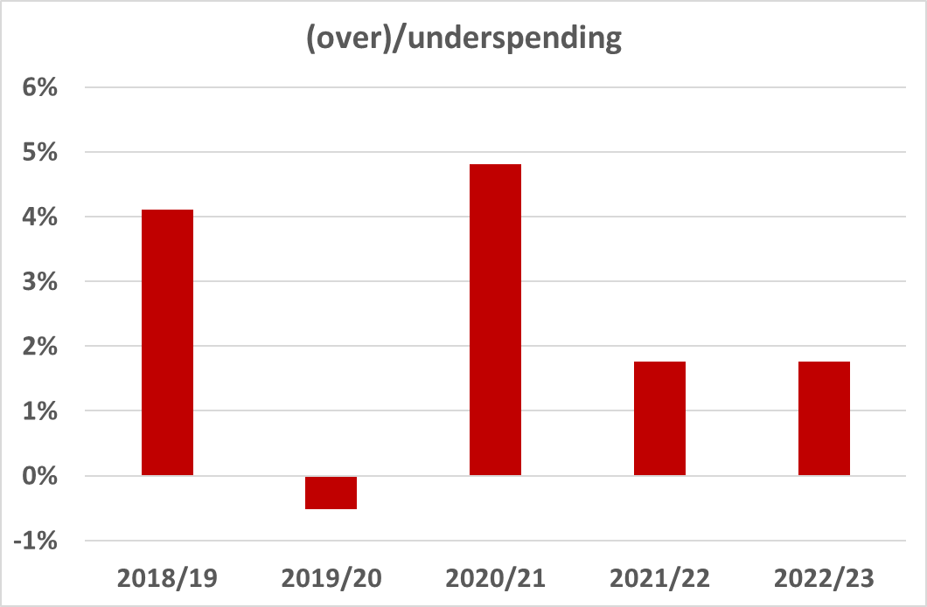
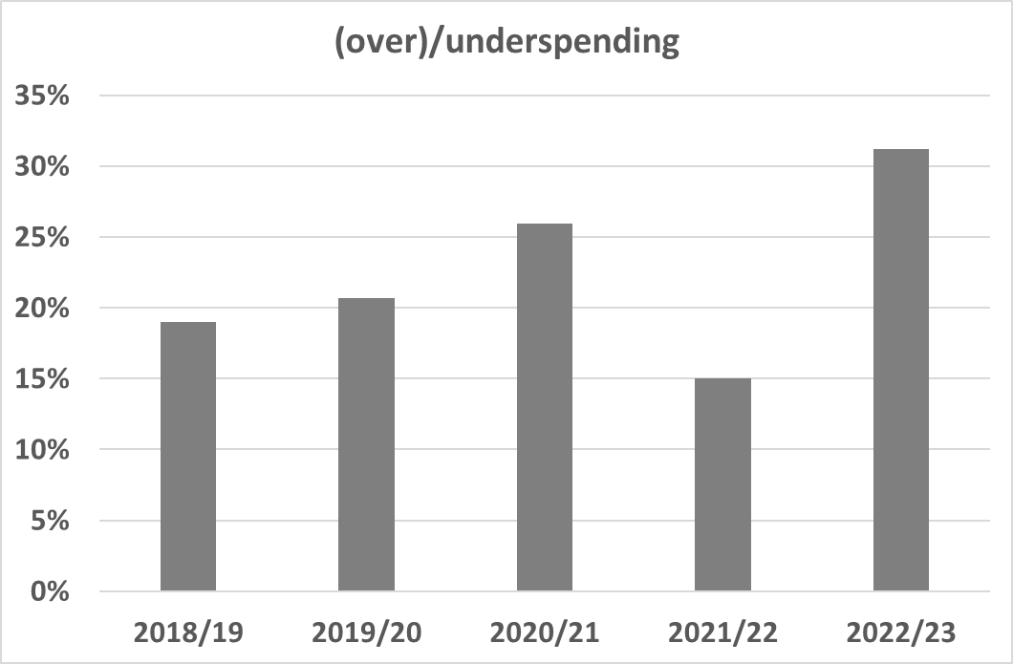
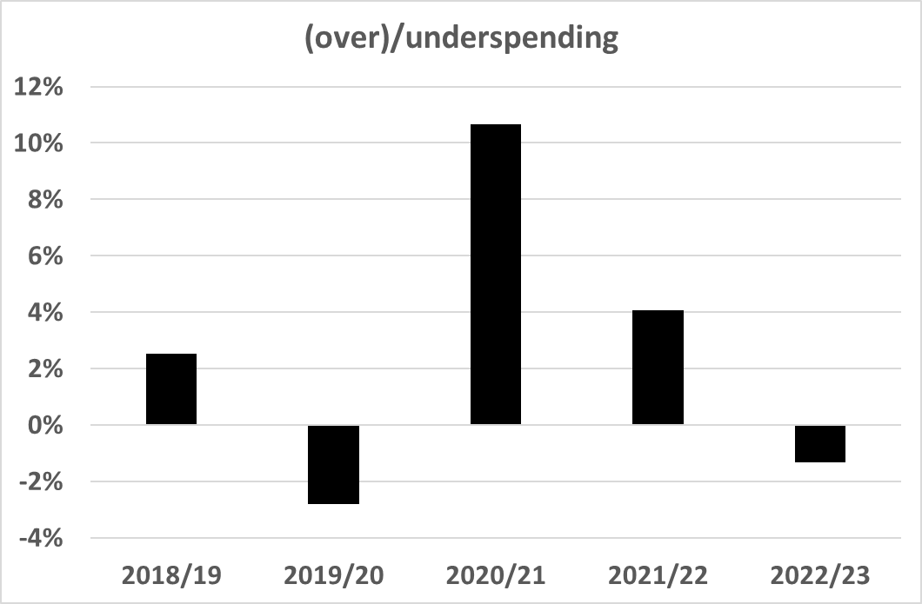
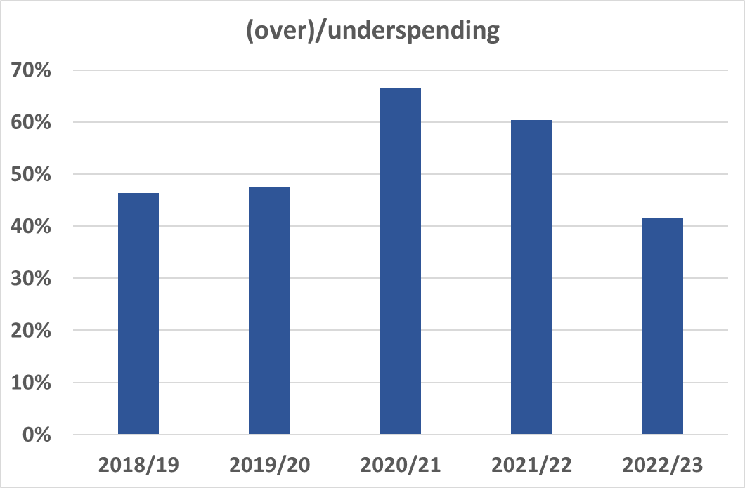
Summary of spending (Q1 for each year)
Compensation on employees
Goods and services
Interest and rent
Payments for capital assets
Notes:
The preliminary data for the first quarter of 2022/23 shows spending of R231.1 billion, which is lower by R42.3 billion or 15.5 per cent against the projected expenditure of R273.4 billion. Payments for financial assets contributed to largest proportion of the lower than projected spending (R18 billion), followed by transfers and subsidies (R16.8 billion), goods and services (R5.5 billion), payments for capital assets (R1.5 billion) and compensation of employees (R440.3 million). While interest and rent on land spent higher than projected by (R2.1 million). COVID-19 expenditure amounted to R2.2 billion at the end of the first quarter mainly under the department of Social Development relating to the R350 social relief of distress grant.

Slide 5
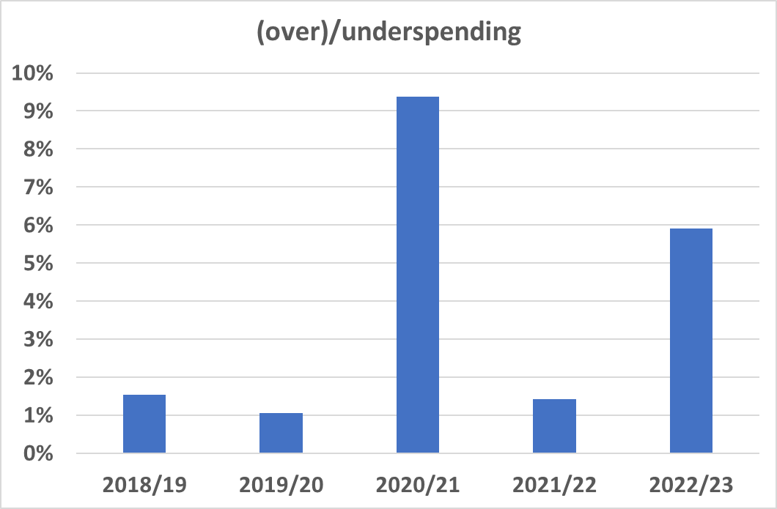
Summary of spending (Q1 for each year)
Transfers and subsidies
Notes:
The preliminary data for the first quarter of 2022/23 shows spending of R231.1 billion, which is lower by R42.3 billion or 15.5 per cent against the projected expenditure of R273.4 billion. Payments for financial assets contributed to largest proportion of the lower than projected spending (R18 billion), followed by transfers and subsidies (R16.8 billion), goods and services (R5.5 billion), payments for capital assets (R1.5 billion) and compensation of employees (R440.3 million). While interest and rent on land spent higher than projected by (R2.1 million). COVID-19 expenditure amounted to R2.2 billion at the end of the first quarter mainly under the department of Social Development relating to the R350 social relief of distress grant.

Slide 6
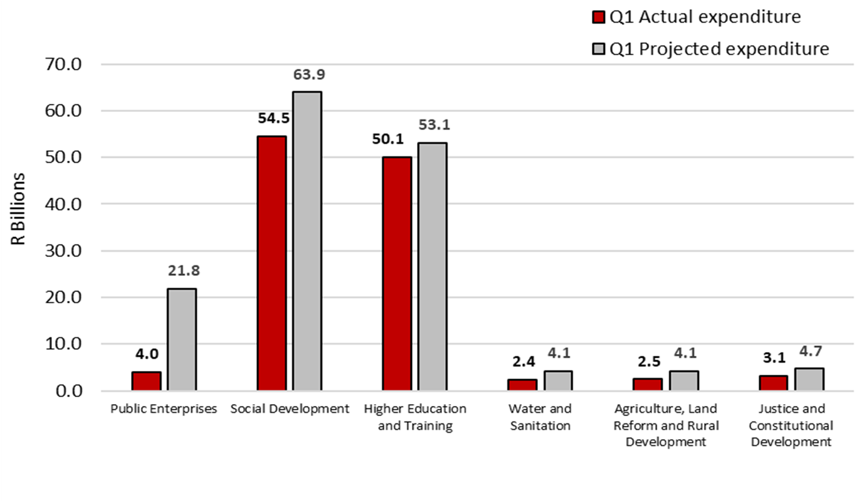
Summary of spending
R17,8 billion or 81,5 per cent lower than projected spending
R9,4 billion or 14,7 per cent lower than projected spending
R3 billion or 5,7 per cent lower than projected spending
R1,7 billion or 41,6 per cent lower than projected spending
R1,6 billion or 39,8 per cent lower than projected spending
R1,6 billion or 33,4 per cent lower than projected spending

Slide 7
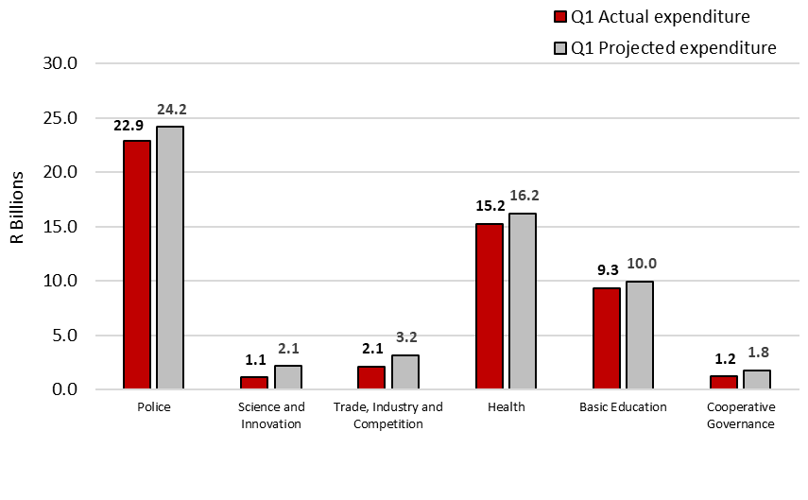
Summary of spending
R1,3 billion or 5,4 per cent lower than projected spending
R1,1 billion or 48,9 per cent lower than projected spending
R1 billion or 32,7 per cent lower than projected spending
R1 billion or 6,4 per cent lower than projected spending
R625,2 million or 6,3 per cent lower than projected spending
R553,3 million or 31,5 per cent lower than projected spending

Slide 8

Summary of spending
 | 2018/19 | 2019/20 | 2020/21 | 2021/22 | 2022/23
Actual spending | 49 327 | 53 755 | 1 126 308 | 20 094 791 | 4 047 206
Initial projection | 65 352 | 73 996 | 7 645 119 | 20 066 939 | 21 849 041
(Over)/Under Initial projection | 16 025 | 20 241 | 6 518 811 | -27 852 | 17 801 835
% Variance on Initial projection | 24,5% | 27,4% | 85,3% | -0,1% | 81,5%
Running projection | 65 352 | 73 996 | 7 645 119 | 25 066 939 | 21 849 041
(Over)/Under Running projection | 16 025 | 20 241 | 6 518 811 | 4 972 148 | 17 801 835
% Variance on Running projection | 24,5% | 27,4% | 85,3% | 19,8% | 81,5%
Payments for financial assets
-Lower than the projected expenditure is due lower than planned disbursement of funds to Eskom, as the funds are disbursed in terms of the liquidity needs of the entity
R17,8 billion or 81,5 per cent lower than projected spending
Notes:
The following departments recorded the most significant lower than projected expenditure for the first quarter of the 2022/23 financial year.
Public Enterprises: the lower than projected spending is mainly attributed to payments for financial assets due to lower than planned disbursement of funds to Eskom, as the funds are disbursed in terms of the liquidity needs of the entity. The entity was able to settle debt using own generated funds.
Agriculture, Land Reform and Rural Development: Goods and services and transfers and subsidies mainly contributed to the lower than projected expenditure due to outstanding office accommodation charges’ payments as a result of the disputes on invoices submitted by the Department of Public Works; under transfers and subsidies is mainly due to delay in the payment of conditional grants to provinces and slow movement of land claims settlements.
Justice and Constitutional Development: Lower than planned spending outcome on goods and services and payments for capital assets mainly under programmes Administration and Court Services is attributed to a payment error encountered on the Basic Accounting System when processing invoices for private leases in June 2022, and underperformance by the Department of Public Works and Infrastructure (DPWI) on courts infrastructure projects, respectively.
Science and Innovation: the lower than projected spending is mainly attributed to transfers and subsidies due to administrative delays and late submission of progress reports to the Department of Science and Innovation by its public entities and various service providers.

Slide 9

Summary of spending
 | 2018/19 | 2019/20 | 2020/21 | 2021/22 | 2022/23
Actual spending | 42 200 425 | 44 740 818 | 43 525 715 | 54 568 595 | 54 533 450
Initial projection | 42 524 617 | 45 882 644 | 59 584 001 | 52 535 006 | 63 938 757
(Over)/Under Initial projection | 324 192 | 1 141 826 | 16 058 286 | -2 033 589 | 9 405 307
% Variance on Initial projection | 0,8% | 2,5% | 27,0% | -3,9% | 14,7%
Running projection | 42 526 309 | 46 162 760 | 59 584 001 | 52 534 852 | 63 936 059
(Over)/Under Running projection | 325 884 | 1 421 942 | 16 058 286 | - 2 033 743 | 9 402 609
% Variance on Running projection | 0,8% | 3,1% | 27,0% | -3,9% | 14,7%
Transfers and Subsidies
-Due to delayed payment of the social relief of distress R350 grant because of re-registration of beneficiaries and finalisation of contracts with banks to conduct means tests
R9,4 billion or 14,7 per cent lower than projected spending
Notes:
The following departments recorded the most significant lower than projected expenditure for the first quarter of the 2022/23 financial year.
Public Enterprises: the lower than projected spending is mainly attributed to payments for financial assets due to lower than planned disbursement of funds to Eskom, as the funds are disbursed in terms of the liquidity needs of the entity. The entity was able to settle debt using own generated funds.
Agriculture, Land Reform and Rural Development: Goods and services and transfers and subsidies mainly contributed to the lower than projected expenditure due to outstanding office accommodation charges’ payments as a result of the disputes on invoices submitted by the Department of Public Works; under transfers and subsidies is mainly due to delay in the payment of conditional grants to provinces and slow movement of land claims settlements.
Justice and Constitutional Development: Lower than planned spending outcome on goods and services and payments for capital assets mainly under programmes Administration and Court Services is attributed to a payment error encountered on the Basic Accounting System when processing invoices for private leases in June 2022, and underperformance by the Department of Public Works and Infrastructure (DPWI) on courts infrastructure projects, respectively.
Science and Innovation: the lower than projected spending is mainly attributed to transfers and subsidies due to administrative delays and late submission of progress reports to the Department of Science and Innovation by its public entities and various service providers.

Slide 10

Summary of spending
 | 2018/19 | 2019/20 | 2020/21 | 2021/22 | 2022/23
Actual spending | 36 850 496 | 45 444 416 | 43 112 447 | 48 756 512 | 50 105 700
Initial projection | 38 964 458 | 46 236 964 | 49 942 748 | 50 587 838 | 53 142 300
(Over)/Under Initial projection | 2 113 962 | 792 548 | 6 830 301 | 1 831 326 | 3 036 600
% Variance on Initial projection | 5,4% | 1,7% | 13,7% | 3,6% | 5,7%
Running projection | 40 388 806 | 47 079 198 | 50 555 634 | 41 635 374 | 61 086 598
(Over)/Under Running projection | 3 538 310 | 1 634 782 | 7 443 187 | - 7 121 138 | 7 429 810
% Variance on Running projection | 8,8% | 3,5% | 14,7% | -17,1% | 12,2%
Transfers and subsidies,
CoE
-Due to the delays in the transfer payments of grants to some higher education institutions as initially projected and outstanding claims from examiners and moderators that were not received as projected
R3 billion or 5,7 per cent lower than projected spending
Notes:
The following departments recorded the most significant lower than projected expenditure for the first quarter of the 2022/23 financial year.
Public Enterprises: the lower than projected spending is mainly attributed to payments for financial assets due to lower than planned disbursement of funds to Eskom, as the funds are disbursed in terms of the liquidity needs of the entity. The entity was able to settle debt using own generated funds.
Agriculture, Land Reform and Rural Development: Goods and services and transfers and subsidies mainly contributed to the lower than projected expenditure due to outstanding office accommodation charges’ payments as a result of the disputes on invoices submitted by the Department of Public Works; under transfers and subsidies is mainly due to delay in the payment of conditional grants to provinces and slow movement of land claims settlements.
Justice and Constitutional Development: Lower than planned spending outcome on goods and services and payments for capital assets mainly under programmes Administration and Court Services is attributed to a payment error encountered on the Basic Accounting System when processing invoices for private leases in June 2022, and underperformance by the Department of Public Works and Infrastructure (DPWI) on courts infrastructure projects, respectively.
Science and Innovation: the lower than projected spending is mainly attributed to transfers and subsidies due to administrative delays and late submission of progress reports to the Department of Science and Innovation by its public entities and various service providers.

Slide 11

Summary of spending
 | 2018/19 | 2019/20 | 2020/21 | 2021/22 | 2022/23
Actual spending | 2 261 898 | 2 584 096 | 1 768 624 | 2 254 730 | 2 422 602
Initial projection | 3 332 462 | 3 173 080 | 3 488 399 | 2 910 950 | 4 149 920
(Over)/Under Initial projection | 1 070 564 | 588 985 | 1 719 775 | 656 220 | 1 727 318
% Variance on Initial projection | 32,1% | 18,6% | 49,3% | 22,5% | 41,6%
Running projection | 3 442 967 | 3 171 194 | 3 870 905 | 2 910 450 | 4 149 920
(Over)/Under Running projection | 1 181 069 | 587 099 | 2 102 281 | 655 720 | 1 727 318
% Variance on Running projection | 34,3% | 18,5% | 54,3% | 22,5% | 41,6%
Transfers and Subsidies
-Mainly due to slow spending on indirect Regional Bulk Infrastructure and the Water Services Infrastructure Grants
R1,7 billion or 41,6 per cent lower than projected spending
Notes:
The following departments recorded the most significant lower than projected expenditure for the first quarter of the 2022/23 financial year.
Public Enterprises: the lower than projected spending is mainly attributed to payments for financial assets due to lower than planned disbursement of funds to Eskom, as the funds are disbursed in terms of the liquidity needs of the entity. The entity was able to settle debt using own generated funds.
Agriculture, Land Reform and Rural Development: Goods and services and transfers and subsidies mainly contributed to the lower than projected expenditure due to outstanding office accommodation charges’ payments as a result of the disputes on invoices submitted by the Department of Public Works; under transfers and subsidies is mainly due to delay in the payment of conditional grants to provinces and slow movement of land claims settlements.
Justice and Constitutional Development: Lower than planned spending outcome on goods and services and payments for capital assets mainly under programmes Administration and Court Services is attributed to a payment error encountered on the Basic Accounting System when processing invoices for private leases in June 2022, and underperformance by the Department of Public Works and Infrastructure (DPWI) on courts infrastructure projects, respectively.
Science and Innovation: the lower than projected spending is mainly attributed to transfers and subsidies due to administrative delays and late submission of progress reports to the Department of Science and Innovation by its public entities and various service providers.

Slide 12

Summary of spending
 | 2018/19 | 2019/20 | 2020/21 | 2021/22 | 2022/23
Actual spending | 3 567 640 | 4 160 022 | 2 258 295 | 2 417 479 | 2 487 162
Initial projection | 4 486 582 | 4 958 140 | 4 066 863 | 4 238 871 | 4 133 974
(Over)/Under Initial projection | 918 942 | 798 118 | 1 808 568 | 1 821 392 | 1 646 812
% Variance on Initial projection | 20,5% | 16,1% | 44,5% | 43,0% | 39,8%
Running projection | 6 026 331 | 6 475 094 | 4 066 863 | 4 529 699 | 4 116 895
(Over)/Under Running projection | 2 458 691 | 2 315 072 | 1 808 568 | 2 112 220 | 1 629 733
% Variance on Running projection | 40,8% | 35,8% | 44,5% | 46,6% | 39,6%
Transfers and Subsidies and G&S
-Mainly due to delay in the payment of conditional grants to provinces and slow movement of land claims settlements.
-due to outstanding office accommodation charges’ payments
R1,6 billion or 39,8 per cent lower than projected spending
Notes:
Trade, Industry and Competition: the lower than projected spending is mainly attributed to transfers and subsidies due to low disbursement on incentives scheme than anticipated, and transfers to agencies that could not be effected as planned due to non-compliance.
Water and Sanitation: the lower than projected spending is mainly attributed to transfers and subsidies and the payments for financial assets due to slow spending on indirect Regional Bulk Infrastructure and the Water Services Infrastructure Grants because of low capacity of contracted implementing agents and contract disputes.
Basic Education: the lower than projected spending is mainly attributed to goods and services and payments for capital assets due to accruals from 2021/22 that the department anticipated and projected to spend in 2022/23 and payments for capital assets in the school infrastructure backlogs grant respectively.
Higher Education and Training: the lower than projected spending is mainly attributed to transfers and subsidies and CoE due to the delays in the transfer payments of grants to some higher education institutions as initially projected and outstanding claims from examiners and moderators that were not received as projected; and delays in implementing the post-provisioning norms at TVET colleges respectively.

Slide 13

Summary of spending
 | 2018/19 | 2019/20 | 2020/21 | 2021/22 | 2022/23
Actual spending | 4 434 018 | 4 485 289 | 4 189 076 | 4 292 278 | 3 120 500
Initial projection | 4 651 438 | 4 789 240 | 5 285 660 | 5 080 873 | 4 687 900
(Over)/Under Initial projection | 217 420 | 303 950 | 1 096 584 | 788 594 | 1 567 500
% Variance on Initial projection | 4,7% | 6,3% | 20,7% | 15,5% | 33,4%
Running projection | 4 843 013 | 4 837 902 | 5 314 751 | 4 964 888 | 5 491 532
(Over)/Under Running projection | 408 995 | 352 612 | 1 125 675 | 672 610 | 1 819 667
% Variance on Running projection | 8,4% | 7,3% | 21,2% | 13,5% | 33,1%
G&S, CAPEX
-Is attributed to a payment error encountered on the Basic Accounting System when processing invoices for private leases in June 2022
R1,6 billion or 33,4 per cent lower than projected spending
Notes:
Trade, Industry and Competition: the lower than projected spending is mainly attributed to transfers and subsidies due to low disbursement on incentives scheme than anticipated, and transfers to agencies that could not be effected as planned due to non-compliance.
Water and Sanitation: the lower than projected spending is mainly attributed to transfers and subsidies and the payments for financial assets due to slow spending on indirect Regional Bulk Infrastructure and the Water Services Infrastructure Grants because of low capacity of contracted implementing agents and contract disputes.
Basic Education: the lower than projected spending is mainly attributed to goods and services and payments for capital assets due to accruals from 2021/22 that the department anticipated and projected to spend in 2022/23 and payments for capital assets in the school infrastructure backlogs grant respectively.
Higher Education and Training: the lower than projected spending is mainly attributed to transfers and subsidies and CoE due to the delays in the transfer payments of grants to some higher education institutions as initially projected and outstanding claims from examiners and moderators that were not received as projected; and delays in implementing the post-provisioning norms at TVET colleges respectively.

Slide 14

Summary of spending
 | 2018/19 | 2019/20 | 2020/21 | 2021/22 | 2022/23
Actual spending | 20 611 279 | 23 306 136 | 23 953 827 | 22 295 170 | 22 854 055
Initial projection | 22 369 547 | 23 685 797 | 24 365 260 | 23 033 546 | 24 160 611
(Over)/Under Initial projection | 1 758 268 | 379 661 | 411 433 | 738 376 | 1 306 556
% Variance on Initial projection | 7,9% | 1,6% | 1,7% | 3,2% | 5,4%
Running projection | 22 369 546 | 23 679 755 | 24 201 973 | 23 280 231 | 24 510 611
(Over)/Under Running projection | 1 758 267 | 373 619 | 248 146 | 985 061 | 1 656 556
% Variance on Running projection | 7,9% | 1,6% | 1,0% | 4,2% | 6,8%
COE and G&S
-Mainly due to delays in the finalisation of HR processes such as promotions and grade progressions; and Microsoft license fees that were not paid in the first quarter as initially projected
R1,3 billion or 5,4 per cent lower than projected spending
Notes:
Trade, Industry and Competition: the lower than projected spending is mainly attributed to transfers and subsidies due to low disbursement on incentives scheme than anticipated, and transfers to agencies that could not be effected as planned due to non-compliance.
Water and Sanitation: the lower than projected spending is mainly attributed to transfers and subsidies and the payments for financial assets due to slow spending on indirect Regional Bulk Infrastructure and the Water Services Infrastructure Grants because of low capacity of contracted implementing agents and contract disputes.
Basic Education: the lower than projected spending is mainly attributed to goods and services and payments for capital assets due to accruals from 2021/22 that the department anticipated and projected to spend in 2022/23 and payments for capital assets in the school infrastructure backlogs grant respectively.
Higher Education and Training: the lower than projected spending is mainly attributed to transfers and subsidies and CoE due to the delays in the transfer payments of grants to some higher education institutions as initially projected and outstanding claims from examiners and moderators that were not received as projected; and delays in implementing the post-provisioning norms at TVET colleges respectively.

Slide 15

Summary of spending
 | 2018/19 | 2019/20 | 2020/21 | 2021/22 | 2022/23
Actual spending | 2 120 076 | 1 211 040 | 1 065 876 | 1 122 340 | 1 096 936
Initial projection | 1 778 932 | 1 509 466 | 2 028 454 | 1 652 093 | 2 148 617
(Over)/Under Initial projection | -341 144 | 298 426 | 962 578 | 529 753 | 1 051 681
% Variance on Initial projection | -19,2% | 19,8% | 47,5% | 32,1% | 48,9%
Running projection | 1 727 868 | 1 509 466 | 2 028 454 | 1 652 296 | 2 148 497
(Over)/Under Running projection | -392 208 | 298 426 | 962 578 | 529 956 | 1 051 561
% Variance on Running projection | -22,7% | 19,8% | 47,5% | 32,1% | 48,9%
Transfers and subsidies
- Mainly due to administrative delays and late submission of progress reports to the Department of Science and Innovation by its public entities and various service providers
R1,1 billion or 48,9 per cent lower than projected spending
Notes:
Trade, Industry and Competition: the lower than projected spending is mainly attributed to transfers and subsidies due to low disbursement on incentives scheme than anticipated, and transfers to agencies that could not be effected as planned due to non-compliance.
Water and Sanitation: the lower than projected spending is mainly attributed to transfers and subsidies and the payments for financial assets due to slow spending on indirect Regional Bulk Infrastructure and the Water Services Infrastructure Grants because of low capacity of contracted implementing agents and contract disputes.
Basic Education: the lower than projected spending is mainly attributed to goods and services and payments for capital assets due to accruals from 2021/22 that the department anticipated and projected to spend in 2022/23 and payments for capital assets in the school infrastructure backlogs grant respectively.
Higher Education and Training: the lower than projected spending is mainly attributed to transfers and subsidies and CoE due to the delays in the transfer payments of grants to some higher education institutions as initially projected and outstanding claims from examiners and moderators that were not received as projected; and delays in implementing the post-provisioning norms at TVET colleges respectively.

Slide 16

Summary of spending
 | 2018/19 | 2019/20 | 2020/21 | 2021/22 | 2022/23
Actual spending | 1 954 497 | 2 811 985 | 2 650 807 | 2 907 358 | 2 123 953
Initial projection | 2 354 496 | 3 452 846 | 3 818 072 | 3 396 943 | 3 154 243
(Over)/Under Initial projection | 399 999 | 640 861 | 1 167 265 | 489 585 | 1 030 290
% Variance on Initial projection | 17,0% | 18,6% | 30,6% | 14,4% | 32,7%
Running projection | 2 886 373 | 5 122 857 | 4 095 863 | 3 721 379 | 5 059 560
(Over)/Under Running projection | 931 876 | 2 310 873 | 1 445 055 | 814 021 | 2 935 607
% Variance on Running projection | 32,3% | 45,1% | 35,3% | 21,9% | 58,0%
Transfers and subsidies
-due to low disbursement on incentives scheme than anticipated, and transfers to agencies that could not be effected as planned due to non-compliance
R1 billion or 32,7 per cent lower than projected spending
Notes:
Health: the lower than projected spending is mainly attributed to goods and services and payments for capital assets mainly from inventory: medicines since there has not been a need to purchase additional COVID-19 vaccines as the demand has declined and slow kick-off of various projects for the NHI Indirect Grant: Health Facility Revitalisation respectively.
Police: the lower than projected spending is mainly attributed to CoE and goods and services due to delays in the finalisation of human resource processes such as promotions and grade progressions; and Microsoft license fees that were not paid in the first quarter as initially projected and; slow spending on operating leases due to the non-receipt of the quarterly invoice for accommodation charges from the Department of Public Works and Infrastructure respectively.
Social Development: the lower than projected spending is mainly attributed to transfers and subsidies due to delayed payment of the social relief of distress R350 grant because of re-registration of beneficiaries and finalisation of contracts with banks to conduct means tests, in line with the new regulations.
Cooperative Governance: the lower than projected spending is mainly attributed to goods and services due to delays in processing invoices of claims from Community Work Programme implementing agents.

Slide 17

Summary of spending
 | 2018/19 | 2019/20 | 2020/21 | 2021/22 | 2022/23
Actual spending | 11 455 549 | 12 475 471 | 13 074 124 | 18 013 316 | 15 244 454
Initial projection | 11 710 527 | 12 514 929 | 13 693 584 | 15 261 270 | 16 281 100
(Over)/Under Initial projection | 254 978 | 39 458 | 619 460 | - 2 752 046 | 1 036 700
% Variance on Initial projection | 2,2% | 0,3% | 4,5% | -18,0% | 6,4%
Running projection | 11 715 467 | 12 514 929 | 14 029 220 | 15 692 914 | 16 266 490
(Over)/Under Running projection | 259 918 | 39 458 | 955 096 | - 2 320 402 | 1 022 036
% Variance on Running projection | 2,2% | 0,3% | 6,8% | -14,8% | 6,3%
G&S,
CAPEX
-Due to inventory: medicines since there has not been a need to purchase additional COVID-19 vaccines as the demand has declined and slow kick-off of various projects for the NHI Indirect Grant
R1 billion or 6,4 per cent lower than projected spending
Notes:
Health: the lower than projected spending is mainly attributed to goods and services and payments for capital assets mainly from inventory: medicines since there has not been a need to purchase additional COVID-19 vaccines as the demand has declined and slow kick-off of various projects for the NHI Indirect Grant: Health Facility Revitalisation respectively.
Police: the lower than projected spending is mainly attributed to CoE and goods and services due to delays in the finalisation of human resource processes such as promotions and grade progressions; and Microsoft license fees that were not paid in the first quarter as initially projected and; slow spending on operating leases due to the non-receipt of the quarterly invoice for accommodation charges from the Department of Public Works and Infrastructure respectively.
Social Development: the lower than projected spending is mainly attributed to transfers and subsidies due to delayed payment of the social relief of distress R350 grant because of re-registration of beneficiaries and finalisation of contracts with banks to conduct means tests, in line with the new regulations.
Cooperative Governance: the lower than projected spending is mainly attributed to goods and services due to delays in processing invoices of claims from Community Work Programme implementing agents.

Slide 18

Summary of spending
 | 2018/19 | 2019/20 | 2020/21 | 2021/22 | 2022/23
Actual spending | 7 785 856 | 8 308 554 | 7 621 239 | 8 186 319 | 9 327 652
Initial projection | 8 069 008 | 8 682 157 | 8 200 835 | 8 479 659 | 9 952 834
(Over)/Under Initial projection | 283 152 | 373 603 | 579 596 | 293 340 | 625 182
% Variance on Initial projection | 3,5% | 4,3% | 7,1% | 3,5% | 6,3%
Running projection | 8 371 027 | 9 062 675 | 8 201 288 | 8 479 659 | 10 010 604
(Over)/Under Running projection | 585 171 | 754 121 | 580 049 | 293 340 | 682 952
% Variance on Running projection | 7,0% | 8,3% | 7,1% | 3,5% | 6,8%
G&S,
CAPEX
-Due to accruals from 2021/22 that the department anticipated and projected to spend in 2022/23 and payments for capital assets in the school infrastructure backlogs grant respectively
R625,2 million or 6,3 per cent lower than projected spending
Notes:
Health: the lower than projected spending is mainly attributed to goods and services and payments for capital assets mainly from inventory: medicines since there has not been a need to purchase additional COVID-19 vaccines as the demand has declined and slow kick-off of various projects for the NHI Indirect Grant: Health Facility Revitalisation respectively.
Police: the lower than projected spending is mainly attributed to CoE and goods and services due to delays in the finalisation of human resource processes such as promotions and grade progressions; and Microsoft license fees that were not paid in the first quarter as initially projected and; slow spending on operating leases due to the non-receipt of the quarterly invoice for accommodation charges from the Department of Public Works and Infrastructure respectively.
Social Development: the lower than projected spending is mainly attributed to transfers and subsidies due to delayed payment of the social relief of distress R350 grant because of re-registration of beneficiaries and finalisation of contracts with banks to conduct means tests, in line with the new regulations.
Cooperative Governance: the lower than projected spending is mainly attributed to goods and services due to delays in processing invoices of claims from Community Work Programme implementing agents.

Slide 19

Summary of spending
 | 2018/19 | 2019/20 | 2020/21 | 2021/22 | 2022/23
Actual spending | 1 034 021 | 930 498 | 863 897 | 903 629 | 1 204 419
Initial projection | 1 495 939 | 1 588 669 | 1 600 277 | 1 628 687 | 1 757 753
(Over)/Under Initial projection | 461 918 | 658 172 | 736 380 | 725 058 | 553 334
% Variance on Initial projection | 30,9% | 41,4% | 46,0% | 44,5% | 31,5%
Running projection | 1 495 847 | 1 588 669 | 1 690 211 | 1 649 867 | 1 757 753
(Over)/Under Running projection | 461 826 | 658 172 | 826 314 | 746 238 | 553 334
% Variance on Running projection | 30,9% | 41,4% | 48,9% | 45,2% | 31,5%
G&S
-Due to delays in processing invoices of claims from Community Work Programme implementing agents
R553,3 million or 31,5 per cent lower than projected spending
Notes:
Health: the lower than projected spending is mainly attributed to goods and services and payments for capital assets mainly from inventory: medicines since there has not been a need to purchase additional COVID-19 vaccines as the demand has declined and slow kick-off of various projects for the NHI Indirect Grant: Health Facility Revitalisation respectively.
Police: the lower than projected spending is mainly attributed to CoE and goods and services due to delays in the finalisation of human resource processes such as promotions and grade progressions; and Microsoft license fees that were not paid in the first quarter as initially projected and; slow spending on operating leases due to the non-receipt of the quarterly invoice for accommodation charges from the Department of Public Works and Infrastructure respectively.
Social Development: the lower than projected spending is mainly attributed to transfers and subsidies due to delayed payment of the social relief of distress R350 grant because of re-registration of beneficiaries and finalisation of contracts with banks to conduct means tests, in line with the new regulations.
Cooperative Governance: the lower than projected spending is mainly attributed to goods and services due to delays in processing invoices of claims from Community Work Programme implementing agents.

Slide 20
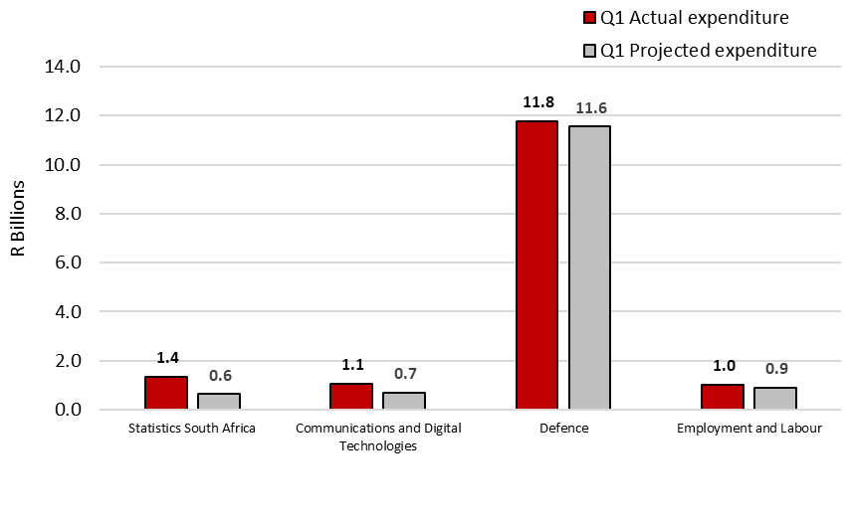
Summary of spending
R713,9 million or 111,5 per cent higher than projected spending
R342,2 million or 48,2 per cent higher than projected spending
R217,5 million or 1,9 per cent higher than projected spending
R106,9 million or 11,8 per cent higher than projected spending

Slide 21

Summary of spending
 | 2018/19 | 2019/20 | 2020/21 | 2021/22 | 2022/23
Actual spending | 491 420 | 550 927 | 487 132 | 531 819 | 1 354 264
Initial projection | 573 752 | 636 683 | 585 026 | 644 892 | 640 338
(Over)/Under Initial projection | 82 332 | 85 756 | 97 894 | 113 073 | -713 927
% Variance on Initial projection | 14,3% | 13,5% | 16,7% | 17,5% | -111,5%
Running projection | 581 297 | 639 361 | 585 555 | 785 930 | 701 814
(Over)/Under Running projection | 89 877 | 88 434 | 98 423 | 254 111 | -652 451
% Variance on Running projection | 15,5% | 13,8% | 16,8% | 32,3% | -93,0%
G&S
--Due to activities relating to the Census 2022. The Census collection was extended from the 2021/22 to May 2022 due to challenges of the recruitment of fieldworkers and shortage of rental vehicles in the market.
R713,9 million or 111,5 per cent higher than projected
Notes:
The following departments recorded the most significant higher than projected expenditure for the first quarter of the 2022/23 financial year.
Statistics South Africa: Goods and services is the main contributor to the higher than projected expenditure due to activities relating to the Census 2022. The Census 2022 commenced in the last quarter of 2021/22 and was planned for finalisation by the end of the financial year. However, due to challenges relating to the recruitment of fieldworkers and unavailability of rental vehicles for field work, activities related to the Census were carried over to the 2022/23 financial year and only concluded on 30 May 2022. The Census activities are not funded in the current year. The department has, therefore, requested to rollover its 2021/22 underspending of R283 million.
Communications and Digital Technologies: transfers and subsidies contributed to the bulk of higher than projected spending mainly due to transfer payment to the South African Post Office for a subsidy to cover costs related to Universal Service Obligations made earlier than anticipated. While the department received approval from National Treasury to amend the drawings schedule to make the payment, the variance in the table is calculated based on the original projections.
Employment and Labour: transfers and subsidies mainly contributed to the higher than projected expenditure due to transfer payment to the Government Technical Advisory Centre in respect of the Presidential Youth Employment Initiative Phase 3. The department had not included this transfer in their original quarter 1 projections submitted and approved by National Treasury.
Defence: the higher than projected spending is mainly attributed to the compensation of employees (CoE) and the payments for financial assets due to the compensation of employees ceiling which does not support the current personnel numbers of the department and regarding payments for capital assets it was due to the accrual payment related to transport equipment such as trucks, busses, and operational vehicles used in the 2021/22 during both internal and external operations/deployment of the South African National Defence Force (SANDF) members.

Slide 22

Summary of spending
 | 2018/19 | 2019/20 | 2020/21 | 2021/22 | 2022/23
Actual spending | 721 335 | 785 850 | 680 178 | 848 370 | 1 052 486
Initial projection | 762 285 | 847 074 | 911 270 | 954 966 | 710 244
(Over)/Under Initial projection | 40 950 | 61 224 | 231 092 | 106 597 | -342 242
% Variance on Initial projection | 5,4% | 7,2% | 25,4% | 11,2% | -48,2%
Running projection | 941 186 | 1 219 397 | 911 270 | 954 966 | 710 244
(Over)/Under Running projection | 219 851 | 433 547 | 231 092 | 106 597 | -342 242
% Variance on Running projection | 23,4% | 35,6% | 25,4% | 11,2% | -48,2%
Transfers and Subsidies
-Mainly due to transfer payment to the South African Post Office for a subsidy to cover costs related to Universal Service Obligations made earlier than anticipated
R342,2 million or 48,2 per cent higher than projected spending
Notes:
The following departments recorded the most significant higher than projected expenditure for the first quarter of the 2022/23 financial year.
Statistics South Africa: Goods and services is the main contributor to the higher than projected expenditure due to activities relating to the Census 2022. The Census 2022 commenced in the last quarter of 2021/22 and was planned for finalisation by the end of the financial year. However, due to challenges relating to the recruitment of fieldworkers and unavailability of rental vehicles for field work, activities related to the Census were carried over to the 2022/23 financial year and only concluded on 30 May 2022. The Census activities are not funded in the current year. The department has, therefore, requested to rollover its 2021/22 underspending of R283 million.
Communications and Digital Technologies: transfers and subsidies contributed to the bulk of higher than projected spending mainly due to transfer payment to the South African Post Office for a subsidy to cover costs related to Universal Service Obligations made earlier than anticipated. While the department received approval from National Treasury to amend the drawings schedule to make the payment, the variance in the table is calculated based on the original projections.
Employment and Labour: transfers and subsidies mainly contributed to the higher than projected expenditure due to transfer payment to the Government Technical Advisory Centre in respect of the Presidential Youth Employment Initiative Phase 3. The department had not included this transfer in their original quarter 1 projections submitted and approved by National Treasury.
Defence: the higher than projected spending is mainly attributed to the compensation of employees (CoE) and the payments for financial assets due to the compensation of employees ceiling which does not support the current personnel numbers of the department and regarding payments for capital assets it was due to the accrual payment related to transport equipment such as trucks, busses, and operational vehicles used in the 2021/22 during both internal and external operations/deployment of the South African National Defence Force (SANDF) members.

Slide 23

Summary of spending
 | 2018/19 | 2019/20 | 2020/21 | 2021/22 | 2022/23
Actual spending | 10 692 487 | 11 713 308 | 12 181 540 | 10 339 041 | 11 773 589
Initial projection | 10 507 180 | 11 326 681 | 11 954 795 | 11 114 626 | 11 556 053
(Over)/Under Initial projection | -185 307 | -386 627 | -226 745 | 775 585 | -217 536
% Variance on Initial projection | -1,8% | -3,4% | -1,9% | 7,0% | -1,9%
Running projection | 10 507 180 | 11 326 681 | 11 954 795 | 11 114 626 | 11 556 053
(Over)/Under Running projection | -185 307 | -386 627 | -226 745 | 775 585 | -217 536
% Variance on Running projection | -1,8% | -3,4% | -1,9% | 7,0% | -1,9%
CoE,
payments for financial assets
-Due to the compensation of employees ceiling which does not support the current personnel numbers of the department and accrual payment related to transport equipment such as trucks, busses
R217,5 million or 1,9 per cent higher than projected spending
Notes:
The following departments recorded the most significant higher than projected expenditure for the first quarter of the 2022/23 financial year.
Statistics South Africa: Goods and services is the main contributor to the higher than projected expenditure due to activities relating to the Census 2022. The Census 2022 commenced in the last quarter of 2021/22 and was planned for finalisation by the end of the financial year. However, due to challenges relating to the recruitment of fieldworkers and unavailability of rental vehicles for field work, activities related to the Census were carried over to the 2022/23 financial year and only concluded on 30 May 2022. The Census activities are not funded in the current year. The department has, therefore, requested to rollover its 2021/22 underspending of R283 million.
Communications and Digital Technologies: transfers and subsidies contributed to the bulk of higher than projected spending mainly due to transfer payment to the South African Post Office for a subsidy to cover costs related to Universal Service Obligations made earlier than anticipated. While the department received approval from National Treasury to amend the drawings schedule to make the payment, the variance in the table is calculated based on the original projections.
Employment and Labour: transfers and subsidies mainly contributed to the higher than projected expenditure due to transfer payment to the Government Technical Advisory Centre in respect of the Presidential Youth Employment Initiative Phase 3. The department had not included this transfer in their original quarter 1 projections submitted and approved by National Treasury.
Defence: the higher than projected spending is mainly attributed to the compensation of employees (CoE) and the payments for financial assets due to the compensation of employees ceiling which does not support the current personnel numbers of the department and regarding payments for capital assets it was due to the accrual payment related to transport equipment such as trucks, busses, and operational vehicles used in the 2021/22 during both internal and external operations/deployment of the South African National Defence Force (SANDF) members.

Slide 24

Summary of spending
 | 2018/19 | 2019/20 | 2020/21 | 2021/22 | 2022/23
Actual spending | 683 262 | 758 642 | 746 345 | 759 715 | 1 016 350
Initial projection | 816 799 | 830 709 | 883 298 | 883 559 | 909 452
(Over)/Under Initial projection | 133 538 | 72 067 | 136 953 | 123 844 | -106 898
% Variance on Initial projection | 16,3% | 8,7% | 15,5% | 14,0% | -11,8%
Running projection | 1 218 015 | 843 889 | 943 780 | 979 271 | 1 283 255
(Over)/Under Running projection | 534 753 | 85 246 | 197 435 | 219 557 | 266 905
% Variance on Running projection | 43,9% | 10,1% | 20,9% | 22,4% | 20,8%
Transfers and Subsidies
-Due to transfer payment to GTAC in respect of the Presidential Youth Employment Initiative Phase 3, it had not included this transfer in their original quarter 1 projections submitted and approved by NT
R106,9 million or 11,8 per cent higher than projected spending
Notes:
The following departments recorded the most significant higher than projected expenditure for the first quarter of the 2022/23 financial year.
Statistics South Africa: Goods and services is the main contributor to the higher than projected expenditure due to activities relating to the Census 2022. The Census 2022 commenced in the last quarter of 2021/22 and was planned for finalisation by the end of the financial year. However, due to challenges relating to the recruitment of fieldworkers and unavailability of rental vehicles for field work, activities related to the Census were carried over to the 2022/23 financial year and only concluded on 30 May 2022. The Census activities are not funded in the current year. The department has, therefore, requested to rollover its 2021/22 underspending of R283 million.
Communications and Digital Technologies: transfers and subsidies contributed to the bulk of higher than projected spending mainly due to transfer payment to the South African Post Office for a subsidy to cover costs related to Universal Service Obligations made earlier than anticipated. While the department received approval from National Treasury to amend the drawings schedule to make the payment, the variance in the table is calculated based on the original projections.
Employment and Labour: transfers and subsidies mainly contributed to the higher than projected expenditure due to transfer payment to the Government Technical Advisory Centre in respect of the Presidential Youth Employment Initiative Phase 3. The department had not included this transfer in their original quarter 1 projections submitted and approved by National Treasury.
Defence: the higher than projected spending is mainly attributed to the compensation of employees (CoE) and the payments for financial assets due to the compensation of employees ceiling which does not support the current personnel numbers of the department and regarding payments for capital assets it was due to the accrual payment related to transport equipment such as trucks, busses, and operational vehicles used in the 2021/22 during both internal and external operations/deployment of the South African National Defence Force (SANDF) members.

Slide 25
Summary of disaster spending
Notes:
Police: The lower than projected spending is mainly due to delays in the finalisation of human resource processes such as promotions and grade progressions which were scheduled for the first quarter of 2022/23.

Slide 26

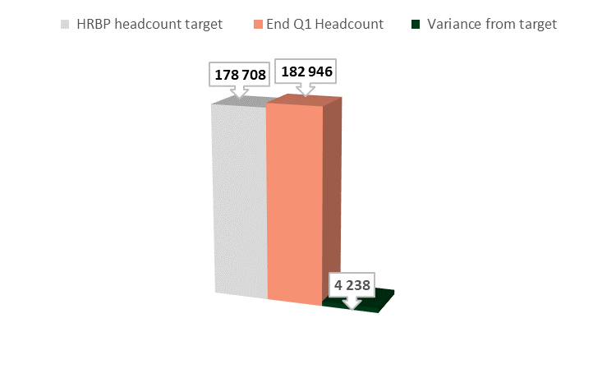
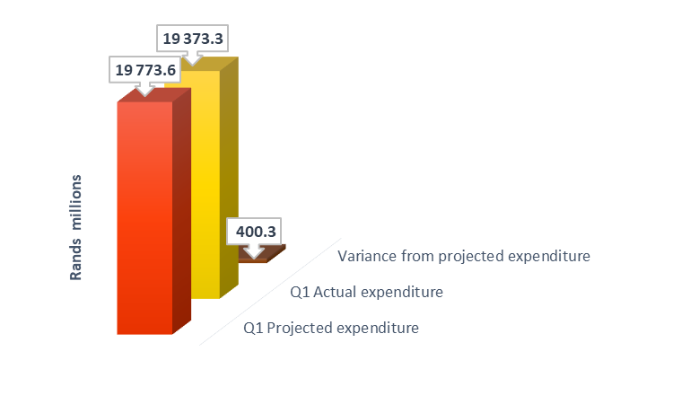
Summary of spending
Personnel spending and vacancy rates
The lower than projected spending is mainly due to delays in the finalisation of human resource processes such as promotions and grade progressions which were scheduled for the first quarter of 2022/23.
Notes:
Police: The lower than projected spending is mainly due to delays in the finalisation of human resource processes such as promotions and grade progressions which were scheduled for the first quarter of 2022/23.

Slide 27
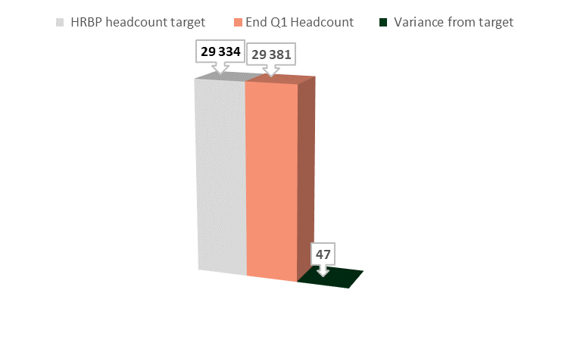
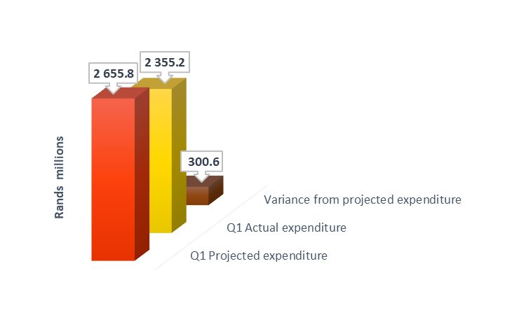
Summary of spending
Personnel spending and vacancy rates
The lower than projected spending is mainly due to outstanding claims from examiners and moderators that were not received as projected and delays in implementing the post-provisioning norms at TVET colleges.
Notes:
Higher Education and Training: The lower than projected spending is mainly due to outstanding claims from examiners and moderators that were not received as projected and delays in implementing the post-provisioning norms at TVET colleges.

Slide 28

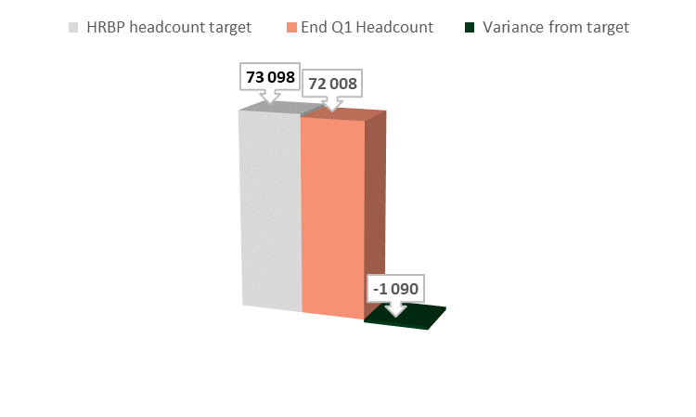
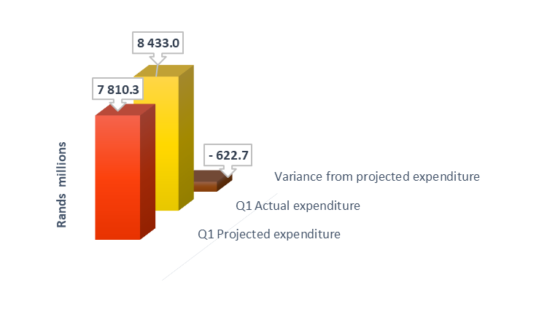
Summary of spending
Personnel spending and vacancy rates
The higher than planned spending is mainly due to the compensation of employees ceiling which does not support the current personnel numbers of the department.
Notes:
Defence: The higher than planned spending is mainly due to the compensation of employees ceiling which does not support the current personnel numbers of the department.

Slide 29

Thank you

