Slide 1
SA Connect Phase 2 Programme
Broadband Connectivity
Portfolio Committee Presentation
Connecting the nation

Slide 2
Table of Content
Phase 1 Scope
Strategic focus of SA Connect Phase 2
Key Objectives of the SA Connect Phase 2
Progress on Community & Households Connectivity
Progress on Government Sites Connectivity
Progress on Universal Service Obligation Connectivity
Conclusion – Key Matters for Resolution

Slide 3
SA Connect Phase 1 Connected Sites
713 new facilities were completed under Phase 1 .
257 existing facilities were upgraded to 10Mbps by SITA.
District Municipality | School | Health | Government | Thusong | Health Upgrade | Gvt Upgrade | Total Upgrade | Total
Eastern Cape | 139 | 22 | 0 | 1 | 2 | 14 | 16 | 178
Free State | 99 | 23 | 0 | 0 | 6 | 43 | 49 | 171
Mpumalanga | 63 | 14 | 0 | 0 | 10 | 56 | 66 | 143
North West | 123 | 2 | 0 | 0 | 0 | 11 | 11 | 136
Northern Cape | 15 | 38 | 1 | 0 | 4 | 13 | 17 | 71
Kwazulu Natal | 109 | 13 | 0 | 0 | 10 | 64 | 74 | 196
Limpopo | 46 | 5 | 0 | 0 | 5 | 19 | 24 | 75
Total | 594 | 117 | 1 | 1 | 37 | 220 | 257 | 970

Slide 4
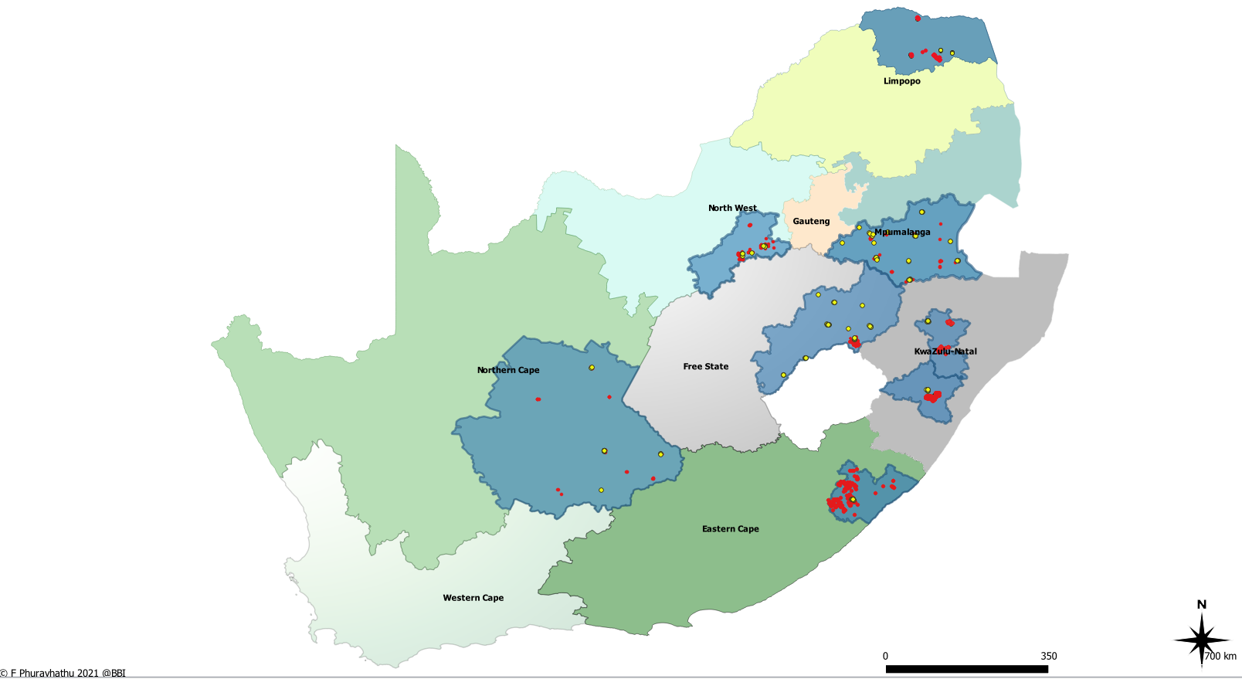
Phase 1 SA Connect Overview Scope
Zimbabwe
LEGEND
Vhembe
SA Connect Sites (Connected)
SITA Upgrade Sites
SA Connect District
Botswana
Mozambique
Dr Kenneth Kaunda
Gert Sibande
eSwatini
Thabo Mofutsanyane
Namibia
uMzinyathi
Lesotho
uMgungundlovu
District | Province | Phase 1A & 1B sites | SITA Upgrade sites | Total
Dr Kenneth Kaunda | NW | 125 | 11 | 136
Gert Sibande | MP | 77 | 71 | 148
OR Tambo | EC | 162 | 16 | 178
Pixley ka Seme | NC | 54 | 17 | 71
Thabo Mofutsanyane | FS | 122 | 48 | 170
uMgungundlovu | KZN | 87 | 54 | 141
uMzinyathi | KZN | 35 | 16 | 51
Vhembe | L | 51 | 24 | 75
Total |  | 713 | 257 | 970
Pixley Ka Seme
O.R.Tambo

Slide 5
Strategic focus of SA Connect Phase 2
In line with the NDP, MTSF ERRP, etc. the intended outcomes of the project are:
affordable and universally accessible broadband nationally, to meet the diverse needs of public and private users, both formal and informal, consumers and citizens;
policy and regulatory conditions that enable public and private sector players to invest and contribute in other ways to reaching South Africa's broadband ambitions;
80% of population have access to the internet by 2024
This then necessitates the development of strategies and plans to ensure that the department achieves these objectives.
Following the 2013 SA Connect policy the department started with the SA Connect project to implement the objectives of the policy.
In September 2021, the Department embarked on a process to consider an alternative approach to ensure rapid broadband roll-out within a period of three years and with due regard to fiscal constraints.
In October 2021, a Project Steering Committee was established by the Minister, which provide a revised model and implementation plan for the SA Connect Phase 2.
Through the SA Connect Phase 2, the Government of South Africa wishes to launch a national project which will mobilise the capabilities, resources and energy of both the public and private sectors, together with civil society, in order to connect South Africans to each other and the world.

Slide 6
Approach to SA Connect Phase 2
The revised SA Connect Phase 2 is divided into three streams:
Connectivity to Government Sites
Universal Service Obligations Connectivity;
Connectivity to Communities and Households

Slide 7
Key Objectives
SITA will connect Government Sites (National and Provincial departments – including SAPS); and excluding Schools and Clinics (unless they are part of existing Broadband initiatives)
SITA to connect at a minimum of 10Mbps (total of 14 742 government sites)
Existing budgets from line departments must be utilised for maintenance and the extension of services provided by SITA.
Telecommunication companies through the awarded ICASA High Demand Spectrum licenses will be mandated as part of their Service Obligations within 36 months to provide 10Mbps (uplink and downlink), uncapped and upgradable for the same duration that the entities are licensed to utilize the spectrum broadband services to connect a total of:
18 520 Schools
1764 Hospitals & 3967 Clinics
567 South African Police Services; and
8241 Traditional & Tribal Authority Centres
Broadband Infraco and SENTECH, under the planned merged entity named State Digital Infrastructure Company (SDIC) will provide broadband infrastructure to enable more broadband connection possibilities at a minimum of 5Mbps for the 5 830 208 households:
­840 Open Access Base stations
33 539 community Wi-Fi hotspots to connect 5 830 208 households
1 600 households VSAT connections in (EC, KZN & NC mountainous areas)
The local Small Medium Micro Enterprises (SMMEs), Internet Service Providers (ISPs), Wireless Access Service Providers (WASPs) and Mobile Virtual Network Operators (MVNOs) will lease capacity and provide connectivity to those households and Community Wi–Fi hot spots, with the applicable metering and support. SDIC and the ICT industry will aggregate and backhaul the SA Connect traffic using state owned and private sector infrastructure .

Slide 8
PROGRESS ON 33 539 COMMUNITY & WI-FI HOTSPOTS
Subject | Description | Status
FUNDING | Presidential Employment Stimulus (R200m) Balance of Phase 1 (R48m) Phase 2 Funding (R2.5 bn) USAASA Funding (R219m) | Application for roll-over submitted to National Treasury (NT). Awaiting feedback. Terms of Reference in progress for Fund Management. Application for roll-over submitted to National Treasury (NT). Awaiting feedback. Funding application including Financial Analysis was submitted to National Treasury. Awaiting feedback. This funding has been made available and the project is in implementation mode. Procurement is in progress.

Slide 9
SDIC High Level Scope (Base Stations and VSAT)
PROVINCE | Planned VSAT | Completed VSAT (To-Date) | Budgeted Base Stations | Extended Planned Base Stations (To-Date) | Comments
Eastern Cape | 586 | 53 | 138 | 350 | Complete
Free State |  | 29 | 55 | 312 | Complete
Gauteng |  | 16 | 71 | 140 | Complete
KwaZulu-Natal | 789 | 33 | 189 | 2351 | Complete
Limpopo |  | 77 | 152 | 582 | Complete
Mpumalanga |  | 11 | 74 | 269 | Complete
Northern Cape | 225 | 72 | 32 | 59 | Complete
North West |  | 21 | 74 | 495 | Complete
Western Cape |  | 13 | 55 | 359 | Complete
Total | 1600 | 325 | 840 | 4917
High level base station planning has been completed for all provinces.
Fibre route and detailed designs are in progress.
Actual deployment will only start once the funding has been made available by National Treasury (slide 6).

Slide 10
14 742 Government Sites Connectivity
Index | Province / Dept | No. of Sites Planned | Agreed Sites Per Province | Progress Update 27/07/2022
1 | EC | 3,484 | EC BB 2700 | 629/2700 connected to date
2 | FS | 572 | Libraries (to confirm number and site list) | Engagements in progress to confirm lists.
3 | GP | 2,317 | GP BB 1000+ | Engagements in progress
4 | KZN | 1,007 |  | Engagements in progress
5 | LP | 466 |  | Engagements in progress
6 | MP | 381 |  | Engagements in progress
7 | NW | 488 | NW BB 230, 1324 Schools and 103 Clinics | Procurement currently in progress for 230 sites. 1324+103 sites are currently in planning as tasking was received in May 2022.
8 | NC | 93 |  | Engagements in progress
9 | WC | 3,538 | WC BB 2015 | Engagements in progress
10 | SAPS | 2396 | SAPS Migration | Proposal signed off
 | Total Sites | 14,742 | 7441

Slide 11
Progress on Social Obligations
Subject | Description | STATUS
TELCO OBLIGATIONS | Telco Social Obligations - ICASA Social Obligations Site lists: DBE - 18520 Schools DoH - 1764 Hospitals & 3967 Clinics 567 Libraries (SAPS Replacement sites) 8241 Traditional & Tribal Authority Centres Site Lists Inputs | Several engagements were held with ICASA to allocate sites for Telcos. Site lists required from beneficiaries ICASA is engaging with Telcos and DCDT to finalise the requirements and obligatory agreements. Awaiting full list responses from: DBE (NW, LP, EC, GP) DoH (NW, LP, EC, GP) COGTA (EC, FS, NW, GP, LP, WC, NC, KZN, MP) well short of 8241 sites. COGTA (33 539 WiFi HotSpots).

Slide 12
Progress to Date
Provincial and Departmental engagements are in progress (see slide 9 for updates).
All submissions to National Treasury for Funding have been made and DCDT is following up regularly so that the roll out to start in earnest. Feedback expected around October 2022.
Prioritization of sites to be rolled out is in still in progress, in conjunction with DoH, DoE, COGTA, Provinces etc.
ICASA has started engagements with the Operators to agree on the definition of connectivity to be provided, as well as allocating the requisite sites for each operator.
Rapid Deployment policy finalized.
All infrastructure from private and public institutions Non-ICT SOCs (like Eskom, Transnet, PRASA etc.) has been factored into the designs.

Slide 13
National, Provincial and other Engagements
Subject | Item Description | Stakeholders | Challenges
Provincial, Departmental and other engagements | Departmental Engagements Provincial Engagements Other Engagements | Engagements were done with: DBE (Schools) DoH (Clinics & Hospitals)) COGTA (Traditional Authorities) Engagements were completed with: Free State Limpopo Mpumalanga Eastern Cape KZN Western Cape North West Northern Cape Gauteng Engagements were done with: ISP Forums MISA National Treasury/ Intergovernmental Technical Committee on Finance (including provincial Treasuries) Eastern Seaboard/ Smart City KZN PGITOC | Conclusion on CAPEX Funding

Slide 14
Key Matters for Resolution
National Treasury Funding availability is a necessary prerequisite before programme can begin (queries on private sector funding vs fiscal funding being put forward by NT).
Discussions of definition of connectivity are ongoing between ICASA and the Operators.
Location of the 33 539 Wi-Fi Hotspots required – COGTA to assist in identifying these areas as part of the District Development Model.

