Slide 1
BRIEFING BY THE DEPARTMENT OF COMMUNICATIONS AND DIGITAL TECHNOLOGY ON SEVERAL ISSUES
PCC MEETING
30 August 2022

Slide 2
PRESENTATION OULTINE
Vetting of the SABC Executives and turnaround strategy
Progress towards implementation of controls to improve audit findings of the portfolio
Progress on configuration of State entities
Merger of regulatory authorities

Slide 3
VETTING OF SABC EXECUTIVES
Pre-employment vetting
The SABC does conduct vetting for all new employees, including Executives, through a vetting agency.
This vetting includes credit checks, qualification verification, and criminal record checks.
Post-appointment vetting
The only executives who are vetted by SSA are the three (3) Executive Directors – all done
The SABC has 8 Group Executives – all completed their forms & submitted.
Of these, there are 3 which final reports from the Agency are due ( GE Sales, GE TV & New Head of Audit).

Slide 4
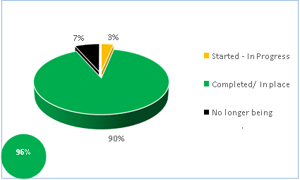
PROGRESS ON IMPLEMENTATION OF SABC TURNAROUND PLAN
PROGRESS – OVERALL TURNAROUND IMPLEMENTATION
PROGRESS ON IMPLEMENTATION OF SABC TURNAROUND PLAN
PROGRESS ON IMPLEMENTATION OF SABC TURNAROUND PLAN

Slide 5
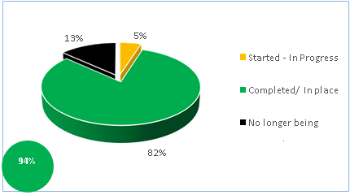
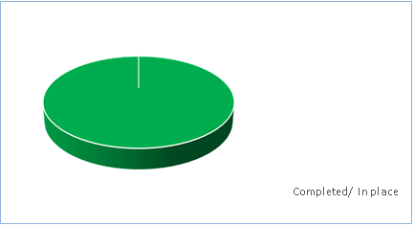
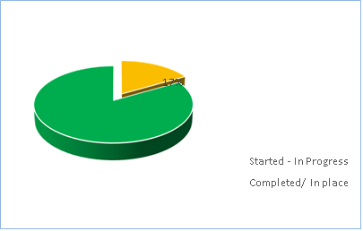
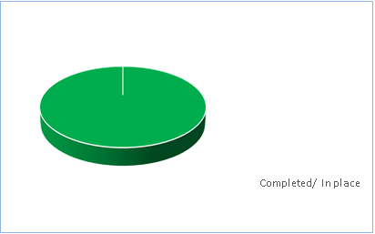
PROGRESS ON IMPLEMENTATION OF SABC TURNAROUND PLAN
FINANCIAL SUSTAINABILITY AND GOVERNANCE
CONTENT AND PLATFORMS
100%
TRANSMISSION AND DIGITAL MIGRATION
HUMAN RESOURCES
100%
83%

Slide 6
PROGRESS ON IMPLEMENTATION OF SABC TURNAROUND PLAN
Financial Sustainability:
SABC must still complete the following under this pillar (i) the development a costed time-bound implementation plan based on transparent revenue enhancements and cost savings; (ii) website enhancements to improve online payments; and (iii) Implementation of TV Licence Amnesty.
Financial sustainability initiatives have not yet yielded positive impact on targeted revenue performance
In effect, SABC reported a net loss of R210 million as at 30 June 2022 due to declining audience shares resulting in poor revenue performance

Slide 7
PROGRESS ON IMPLEMENTATION OF SABC TURNAROUND PLAN
Human Capital:
While all initiatives have been completed, vacancy rate remains high.
Total of 489 vacancies resulting in cost savings of R42.5 million as at 30 June 2022
Critical vacancies in Radio and Sales Divisions continued to hamper revenue growth
Content and Platforms
Spent R833 million against a total budget of R1.2 billion allocated for the procurement and acquisition of new compelling TV content as 30 June 2022
Currently in the process of developing SABC OTT Platform

Slide 8
PROGRESS ON IMPLEMENTATION OF SABC TURNAROUND PLAN
Transmission and Digital Migration:
Completed radio frequency network plan - next in the process is the application to ICASA for the identified transmitters to be repurposed
Outstanding initiatives related to obtaining chart of accounts for signal distribution costs from SENTECH
Dispute between SABC and SENTECH on signal distribution before Competition Commission for mediation
Mediation sessions on SABC and SENTECH matter schedule to take place in due course

Slide 9
GOVERNMENT FUNDING ALLOCATION AND UTILIZATION
ANNEXURE 1: BAIL-OUT UTILISATION SUMMARY AS AT 30
June 2022 (R3.2bn)
Description | Balance as of 30 Sep 2019 (RM) | Cross reference Annex. | Split of Funding Received Oct '19 & March '20 (RM) | Funds Utilisation as at 30 June 2022 (RM) | Cross reference Annex. | Remaining Funds (RM)
TRADE & OTHER PAYABLES
Trade Payables | - 975 290,9 | 2.1 |  | 974 401,8 | 3.1
Accruals | - 296 485,0 | 2.3 |  | 274 512,9 | 3.2
GRIR Clearing | - 25 173,6 | 2.2 |  | 25 164,6 | 3.3
Royalties | - 92 500,0 |  |  | 92 500,0
TOTAL | - 1 389 449,5 |  | 1 400 000,0 | 1 366 579,3 |  | 33 420,7
NEW EXPENDITURE CONTRACTED AFTER 30 SEP 2019
TV Content | - |  | 1 200 000,0 | 833 176,0 | 3.4 | 366 824,0
Long term Capex | - |  | 600 000,0 | 191 298,0 | 3.5 | 408 702,0
GRAND TOTAL |  |  | 3 200 000,0 | 2 391 053,3 |  | 808 946,7

Slide 10
Progress towards implementation of controls to improve audit findings of the portfolio

Slide 11
MONITORING AUDIT FINDINGS
The department follows up with entities through audit action plans and monitors implementation progress
It is ensured that action plans deal with root causes and not the symptoms
Part of the resolution of findings include development and implementation of internal controls to avoid recurrence of findings
Findings are summarized hereunder in terms of number and status (resolved, in progress or not yet started)

Slide 12
PROGRESS TOWARDS IMPLEMENTATION OF CONTROLS TO IMPROVE AUDIT FINDINGS OF THE PORTFOLIO
SOE | No of findings | Resolved | In progress | Not yet started
BBI | 8 | 4 | 1 | 3
FPB | 8 | 2 | 6 | -
ICASA | 43 | 33 | 5 | 5
NEMISA | 22 | 18 | 4 | -
SABC | 94 | 87 | 7
SAPO | 255 | 60 | 191 | 11
SENTECH | 19 | 15 | 3 | 1
SITA | 151 | 66 | 20 | 65
USAASA | 16 | 9 | 7 | -
USAF | 16 | 10 | 6 | -
ZADNA | 53 | 48 | 5 | -

Slide 13
PROGRESS ON CONFIGURATION OF ENTITIES:

Slide 14
Acquisition of BBI by SENTECH
Over the years the Department envisaged the merger between BBI and SENTECH to form the State Digital Infrastructure Company (SDIC).
Legal opinions have suggested that first and foremost, the transaction can be done through the Companies Act and perhaps later promulgate an SDIC Bill.
On 18 of November 2021 the Board of SENTECH submitted expression of interest for the acquisition of Broadband Infraco (BBI).
According to this process the Board of SENTECH must be the one that takes the decision (through the Board resolution) to acquire BBI and inform, in writing, National Treasury (in accordance to section 54 of the PFMA) and Minister (DCDT) of the transaction and submit details of the transaction to the Minister.
Thus on 1 March 2022 SENTECH submitted the acquisition Plan for the transaction, which the Minister approved on 22 April 2022.
In accordance with the Companies Act, the board of SENTECH must table the agreement that sets out the terms of the acquisition at a shareholder’s meeting requiring a 75% of the vote in support of the transaction.
2

Slide 15
Acquisition of BBI by SENTECH
The proposed transaction will be undertaken in terms of the Companies Act, 2008.
From a legislative perspective, it may not be necessary to develop a dedicated new Act for the SDIC, since Sentech and BBI will continue to exist, albeit that shareholding will change.
It will be considered whether any amendments are required to either the BBI Act or the Sentech Act, though it is unforeseen at this stage.
2

Slide 16
OTHER RECONFIGURATIONS
The development of the disestablishment plan of USAASA is underway – the Electronic Communications Act will need to be amended for this.
SITA to reposition and shift focus from a procurement agency to a centre of excellence for government digital services.
SAPO and Postbank to be separated (while utilizing the same infrastructure) to facilitate the application for the banking licence – the Postbank Amendment Bill is under consideration by the Portfolio Committee.

Slide 17
Merger of regulatory authorities
1

Slide 18
MERGER OF REGULATORS
The decision to merger of FPB and ICASA is being reviewed.
The two regulatory authorities will no longer be merged.
The FPB Amendment Act has widened the scope of the FPB into a fully fledged content regulator
Accordingly, has developed its strategy which aligns to the Act.
A budget request has been made in line with this expanded mandate.

