Slide 1
Brief to the JSC DMV – Presidential Authority Extension
Op CHARIOT
J Ops Div – Maj Gen K. Nompetsheni

Slide 2
AIM
To brief the Joint Standing Committee on Defence and Military Veterans on the Presidential Authority for the extension of Op CHARIOT in KZN

Slide 3
SCOPE
Background
Current Force Levels
Roles of the SANDF
Reason for Extension
Contribution by the SANDF
Photo Evidence
Presidential Minutes
Discussion

Slide 4
BACKGROUND (1/3)
During April 2022, the province of Kwa-Zulu Natal, and to a lesser extent the North West and Eastern Cape provinces, were hit by torrential rains and downpours that caused a humanitarian disaster.
The floods caused serious damage to critical infrastructure (roads and bridges), infrastructure for essential services (water and electricity supply) as well as destroyed industrial and commercial business facilities.
More than 30 000 people were seriously affected by the disaster which also caused the loss of lives and considerable disruption of livelihood. Several hundred people have lost their homes and belongings.
This situation led to the President of the country declaring a National State of Disaster for Kwa-Zulu Natal as well as the Eastern Cape and North West Provinces.

Slide 5
BACKGROUND (2/3)
The DOD was requested to support the whole of government response effort aimed at bringing the situation under control. This disaster management government effort was, and is, led by the Cooperative Governance and Traditional Affairs Department (COGTA) to effect appropriate relief, response and recovery.
Consequently the DOD/SANDF, as per Presidential Authority, contributed to this whole of government effort by deploying force elements to KZN and North West with the appropriate capabilities (personnel and equipment) under Op CHARIOT (Disaster Management and Humanitarian Relief) for an initial period of two (2) months over the period 14 April to14 June 2022 (Presidential Minute No. 121/2022).
The deployment was further extended for a period of three (3) months from 15 June to 15 September 2022 dates (Presidential Minute No. 63/2022.

Slide 6
BACKGROUND (3/3)
In support of these objectives, the DOD has deployed capabilities (personnel and equipment) as its contribution to the government effort in the affected areas.
The deployment of the SANDF was initially for a period of two (2) months, subject to extension for further period depending on the evolution of the operational situation on the ground which was extended for a further 3 months ending in September 2022 due to the high load of work that needed to be done to ensure the provision of essential services to the communities in the affected areas.

Slide 7
ROLES OF THE SANDF
Primary focus of the SANDF during the Disaster:
Repair and rehabilitation of roads, bridges and essential infrastructure
Provision and distribution of water to affected communities
Force protection
Protection of shelters
Mobile and visible patrols
Search and Recovery

Slide 8
CURRENT FORCE LEVELS
Engineer Element
Regional Works Unit KZN Element.
Logistic Supply Support Element .
Water distribution Elements (For water delivery)
Cargo Transport Elements.
Area Military Health Unit (AMHU) KZN Element
One (1) SA Army Sub-Unit .
One (1) Light Utility Helicopter (A109).
One (1) Operational Communication Team (OPCOMM)
Current Total Strength 409

Slide 9
REASON FOR EXTENSION
Interim Interventions undertaken – Not Completed
Not in Isolation but in conjunction with Local Government
Road repair at Izwelibomvu and LaMercy
Backfilling and compacting of sand washed away on important beaches
Water purification plant at Inanda Dam and bottling plant Hazemere
Provision of bottled and sachet water for the community.
Provision of purified water to affected communities and schools bmo water bunkers (tankers)
Refurbishment of damaged bridges Izingolweni, Umbilo Park, Queensburgh, Westwood Westville,Umziwabantu
Repair of On-ramps
Repacking of gabions to prevent further erosion.
Bridge clean-up

Slide 10
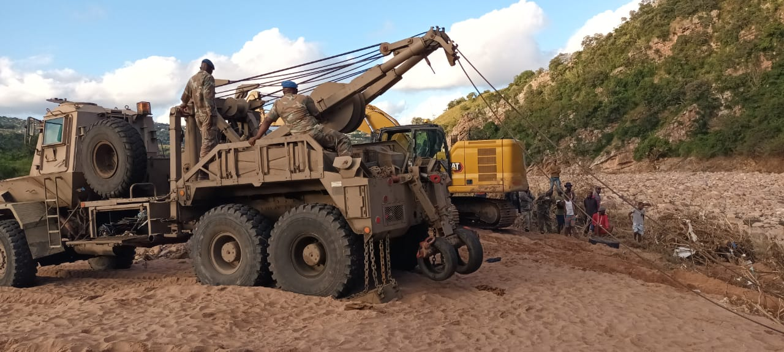
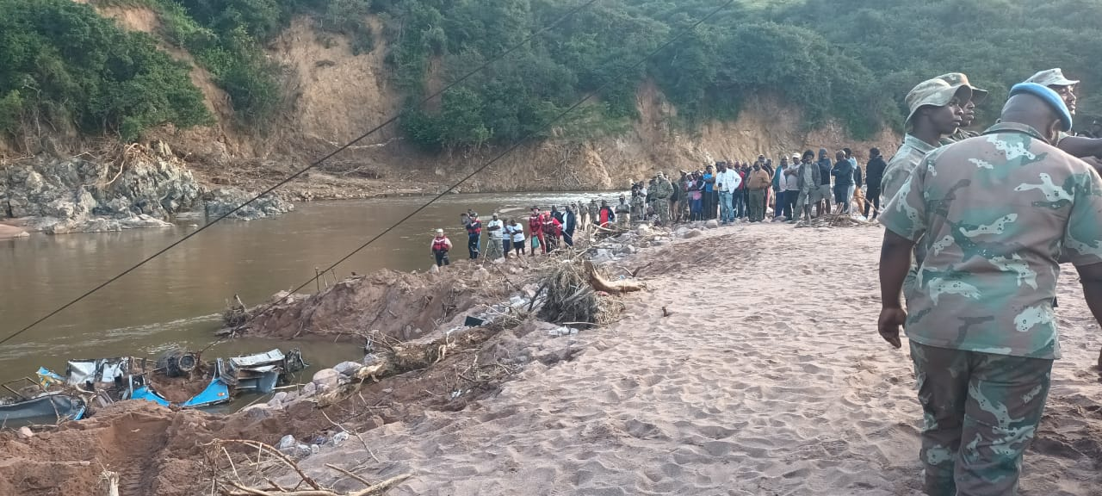
CONTRIBUTION BY THE SANDF
The unit assisted the community of Intake to recover a bus that was washed away.

Slide 11
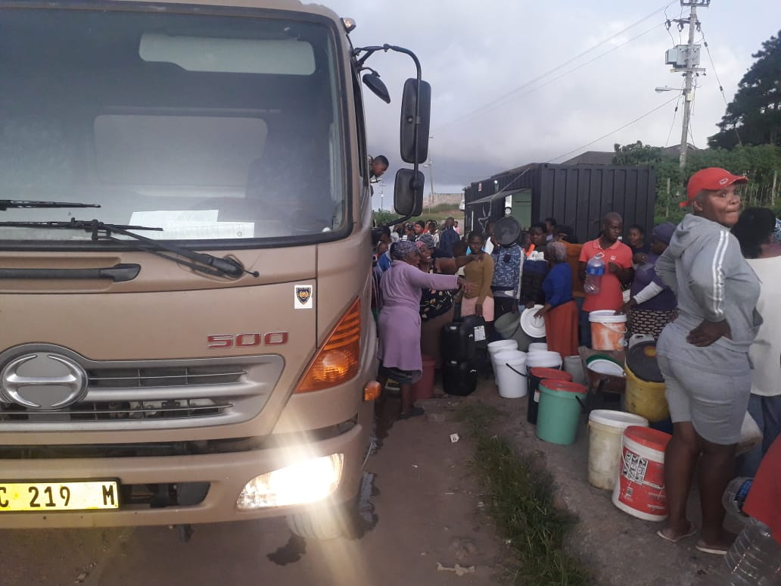
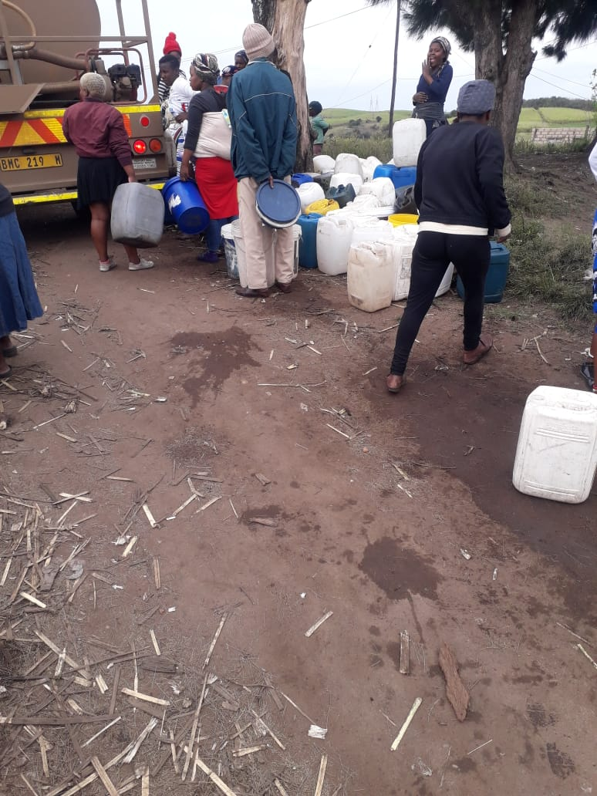
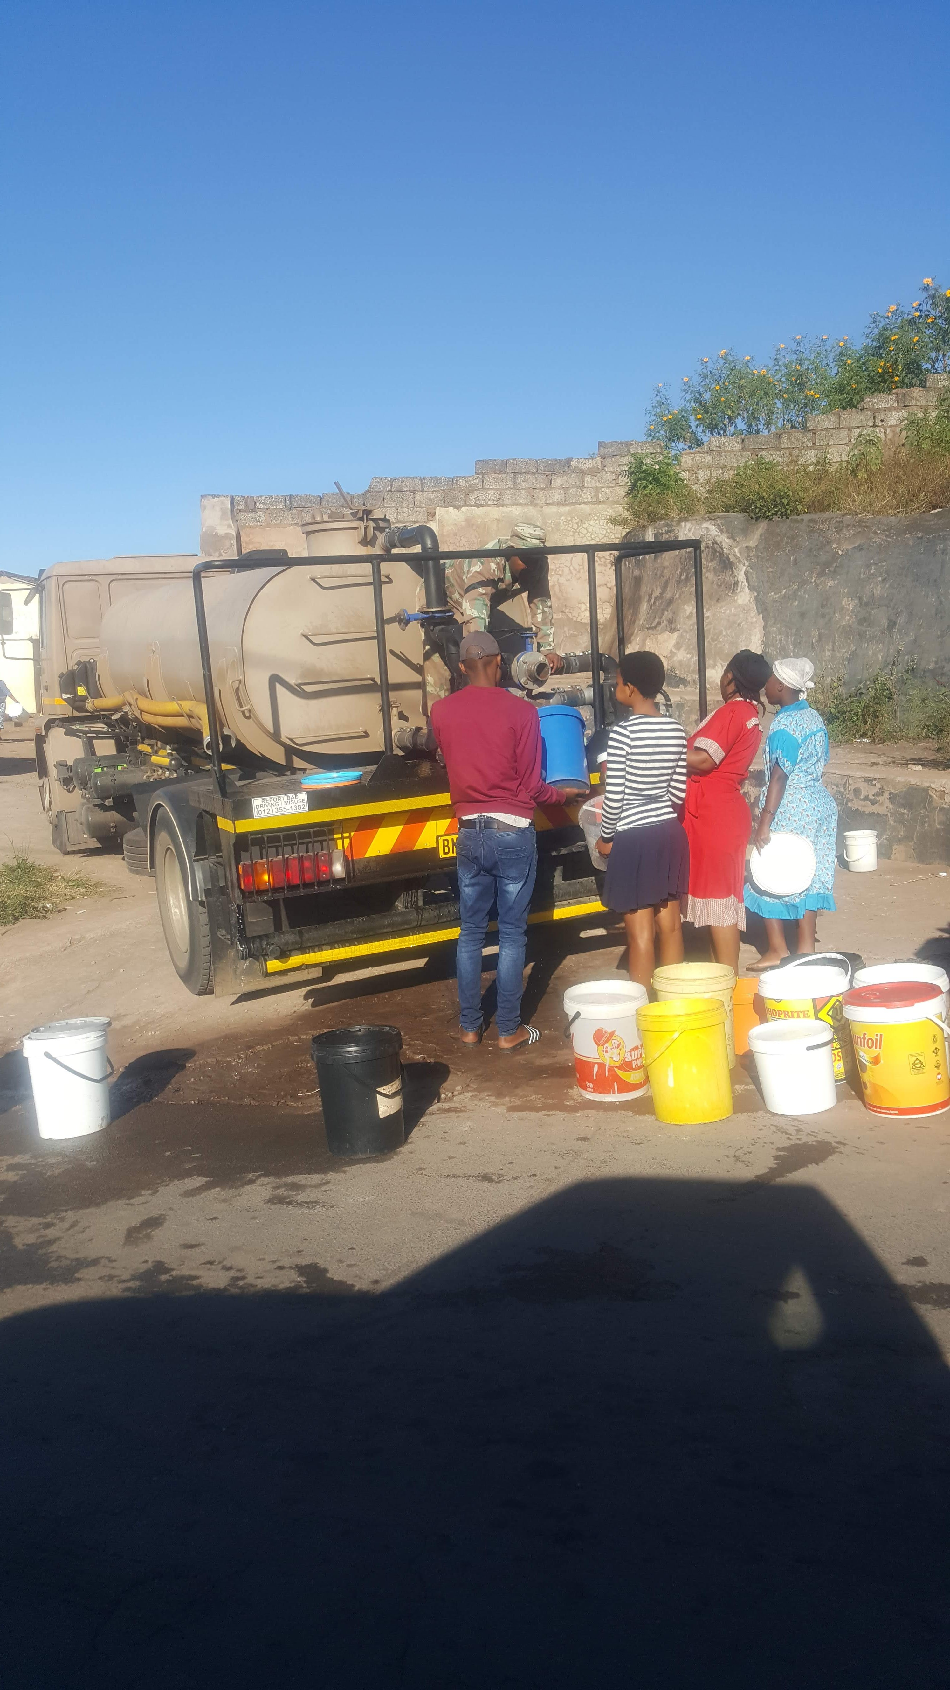
WATER DELIVERY TO LOCAL COMMUNITIES 1/2
The SANDF has delivered water to the following areas 20 000lt daily:
Intake
Kwamashu
Sizela
Tongaat
Kwamadikazi
Dududu
Ndengezi
Nanda
Senzeleni
Imbilo
Pinetown
La Mercy
We are still delivering water at Kwamashu, Tongaat, Sizela and Intake.

Slide 12
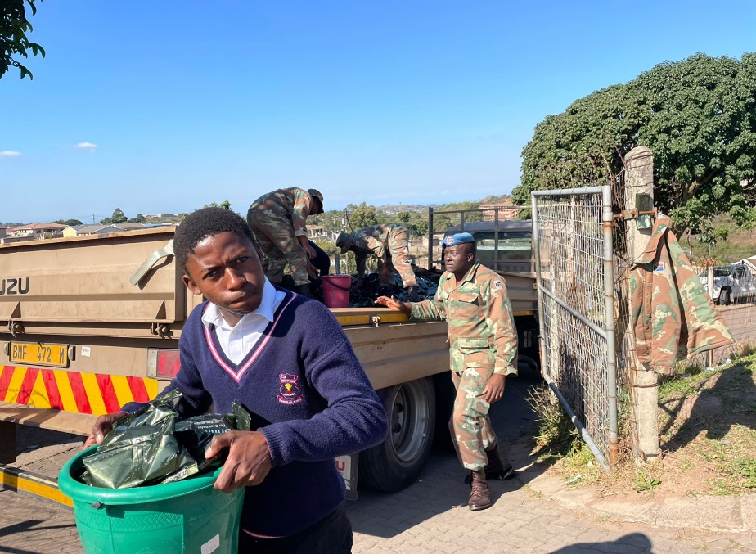
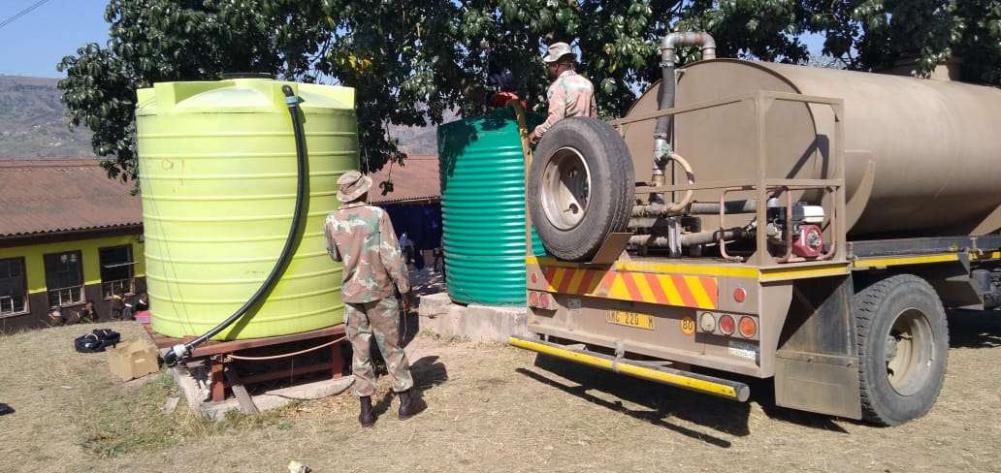
BULK WATER DELIVERY TO LOCAL SCHOOLS 1/3
The SANDF delivered water to affected local schools 5000lt twice in week:
Sinenhlanhla Primary School
Vusukukhanya Primary School
Sarasvati Primary School
Umthala Primary School
Kwandengezi High School
Gezingane Primary School
Phakathi Secondary School
We are still delivering water to the local school on daily bases.

Slide 13
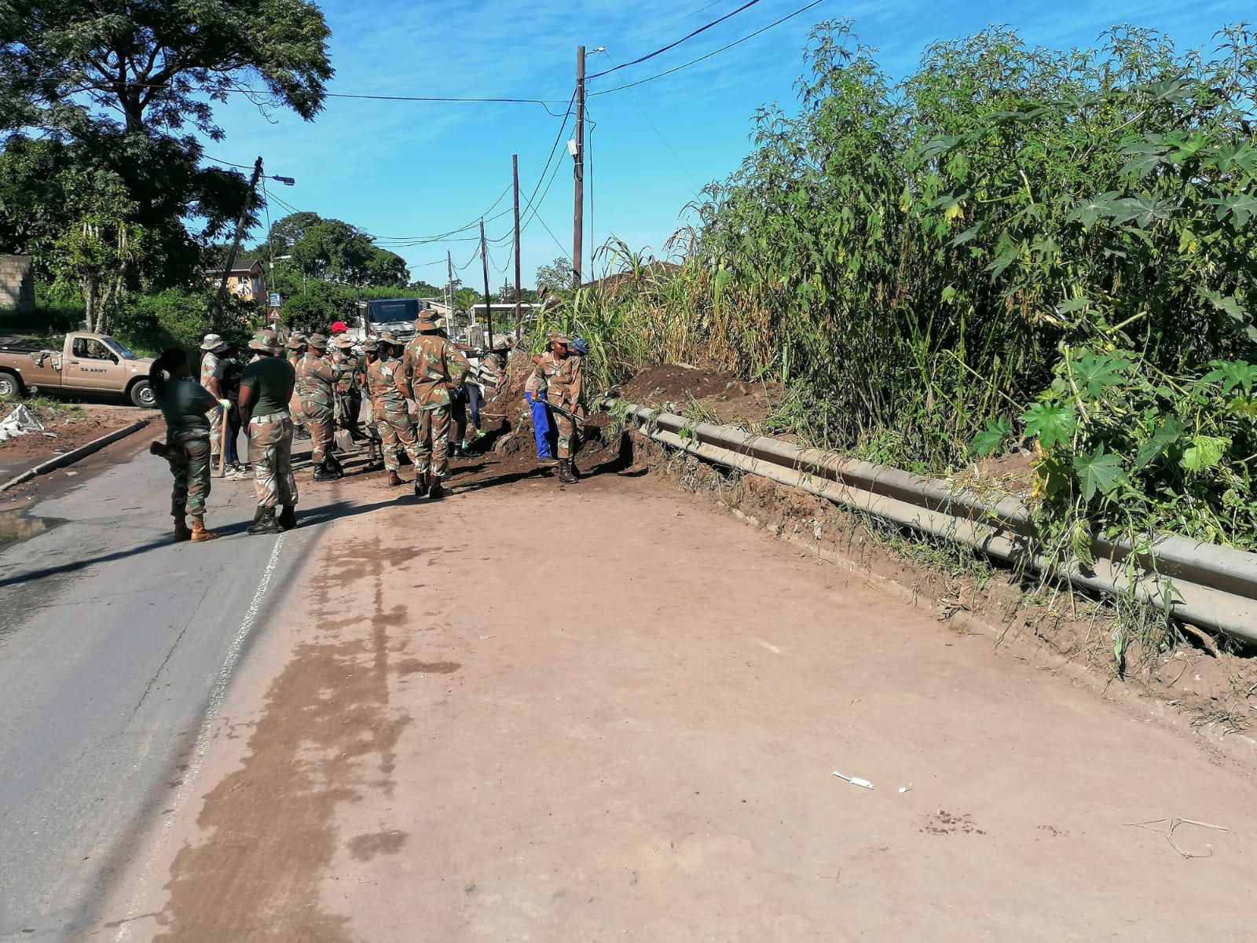
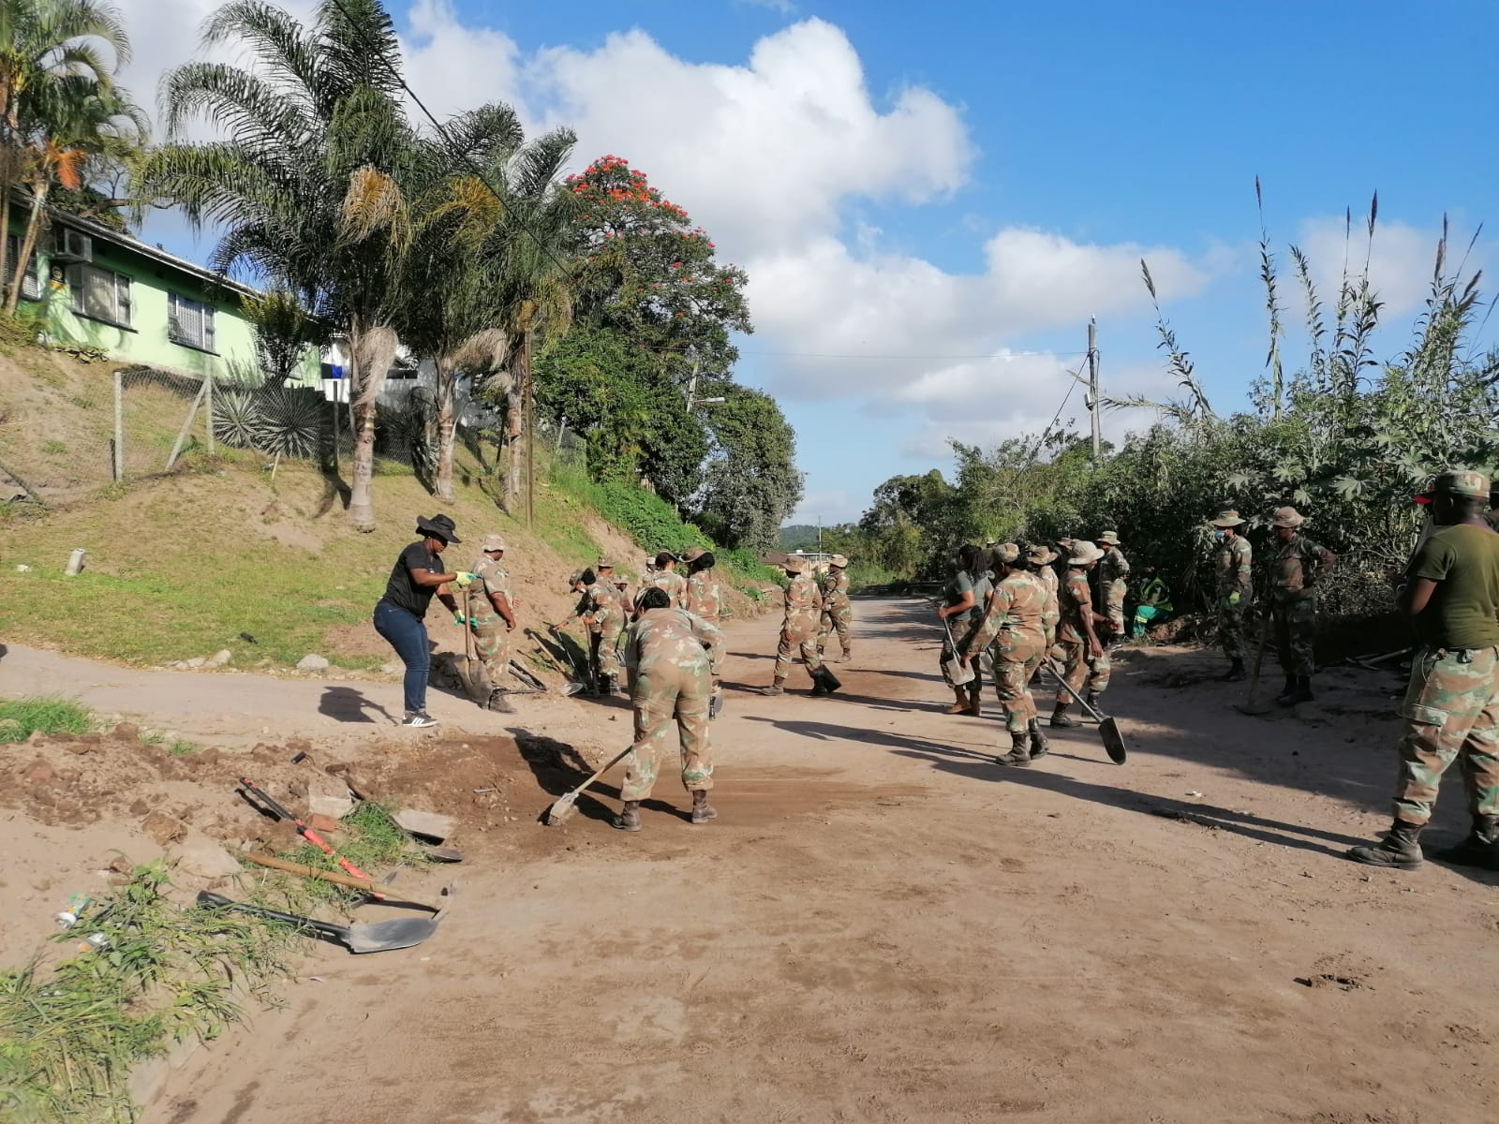
MOP UP OPERATION 1/4
The SANDF deployed members at Pinetown to clean and clear the roads that were closed by mud and sand.

Slide 14
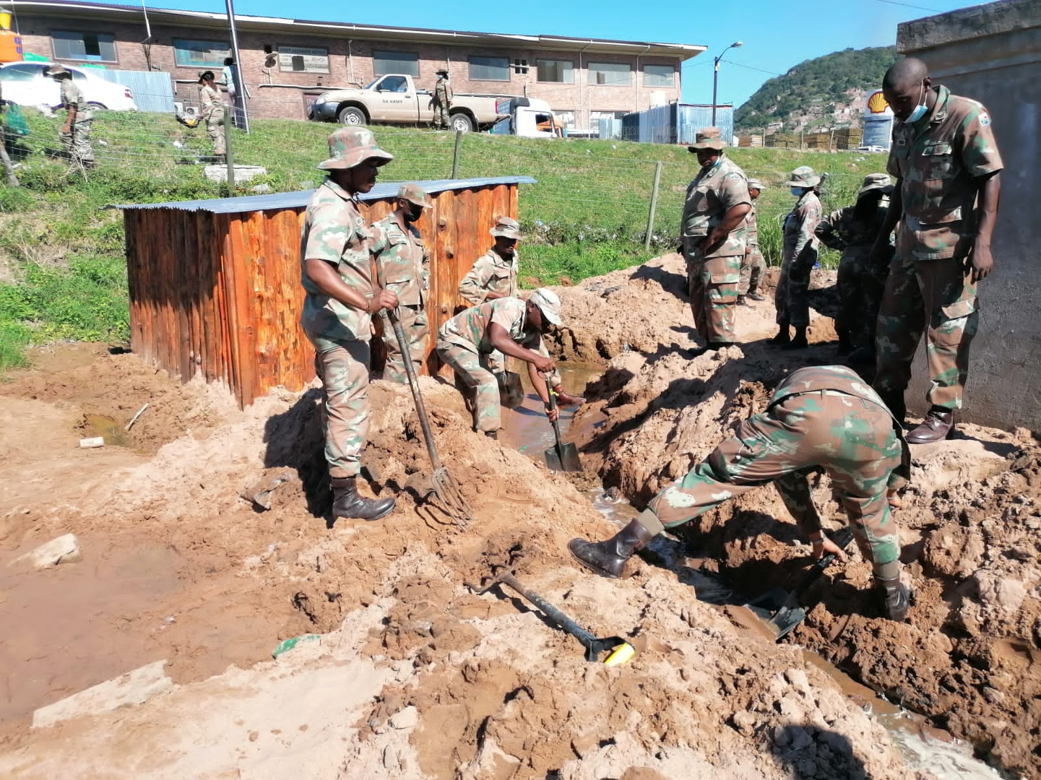
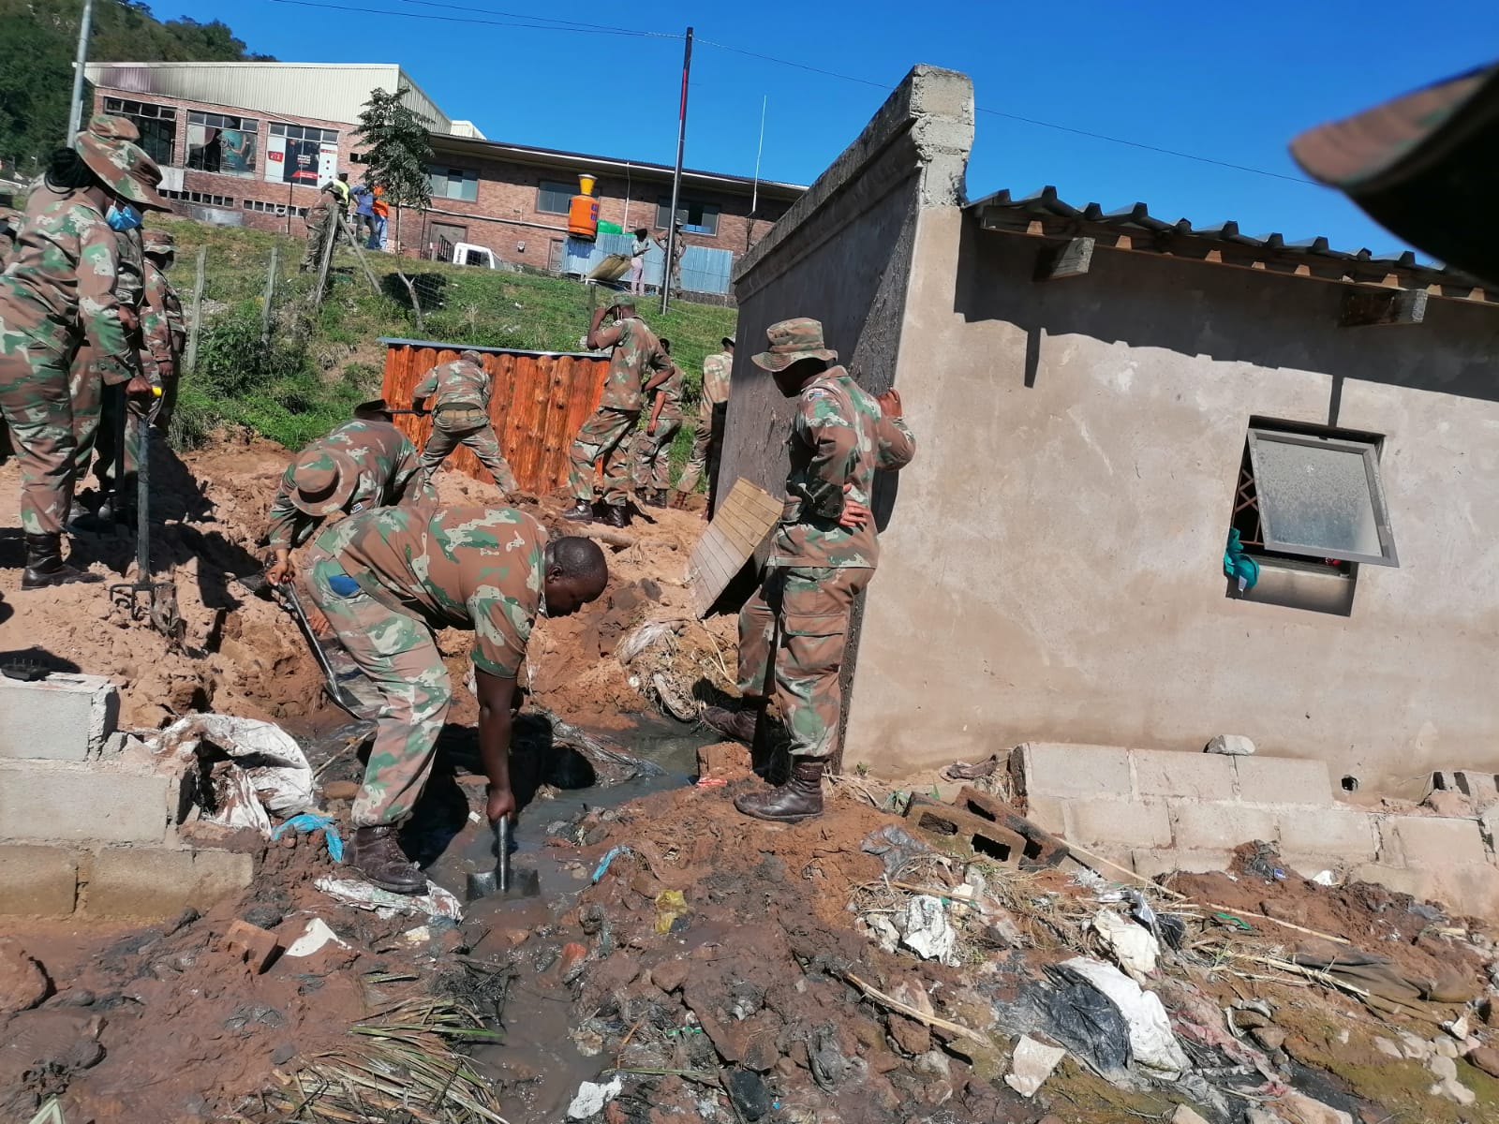
MOP UP OPERATION 1/5
The SANDF conducted mop up operations at Kwamadikazi at a house that was affected by floods.

Slide 15
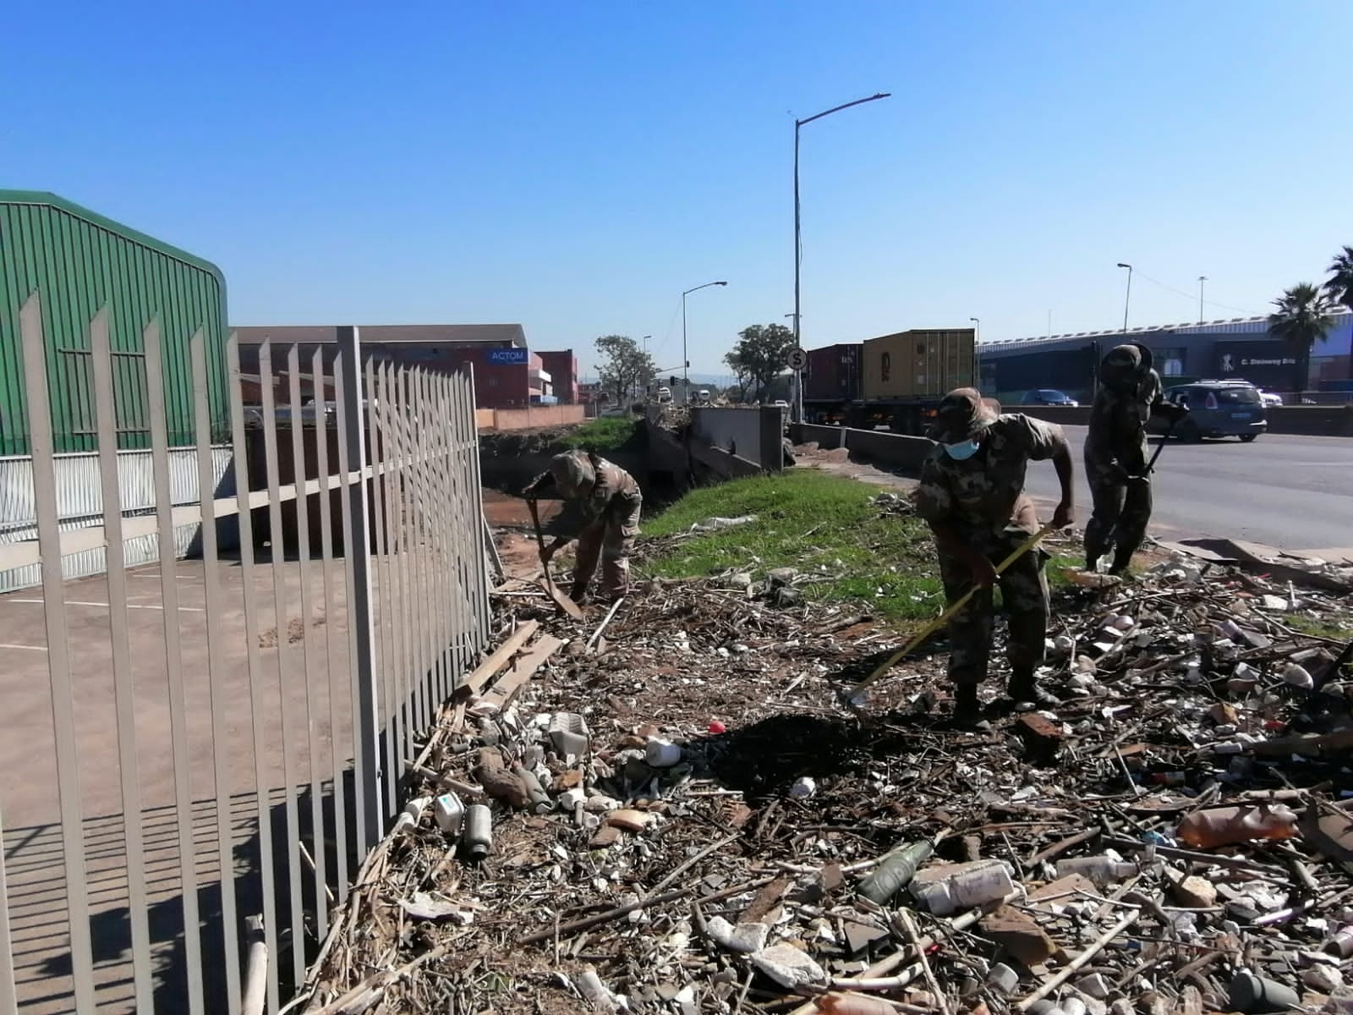
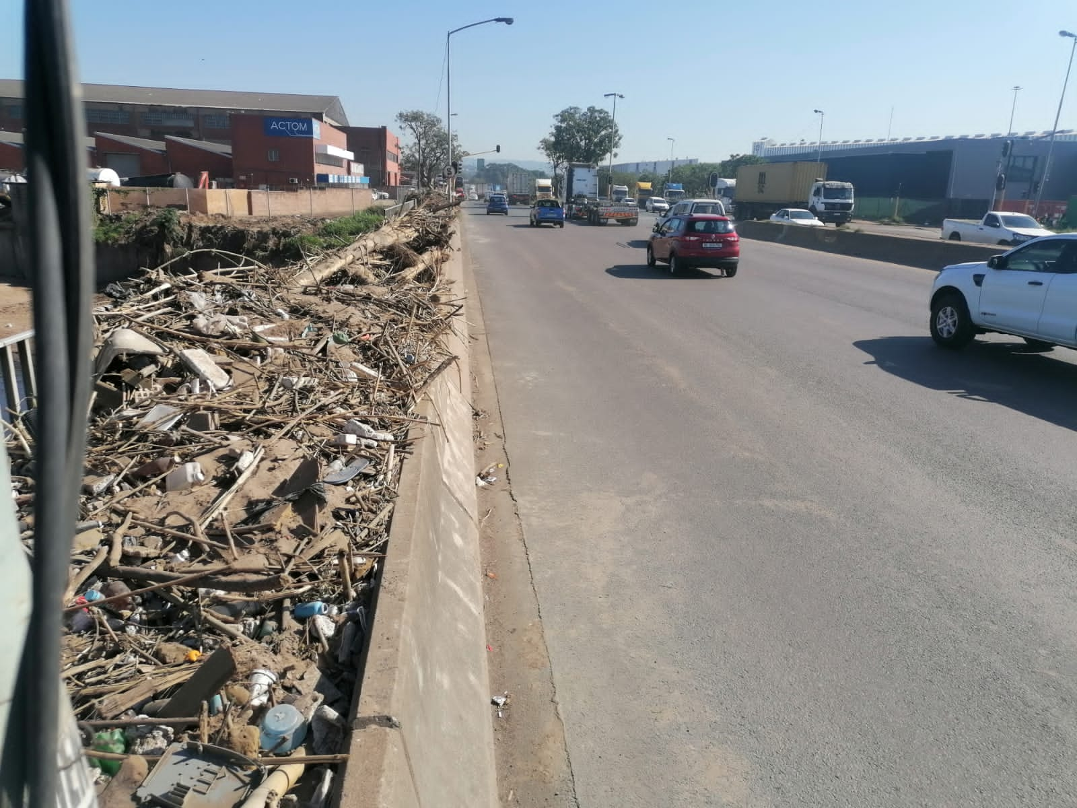
MOP UP OPERATION 1/6
SANDF deployed at Bluff next to Toyota dealership to clean and clear the roads that was blocked by send and dirt due to floods .

Slide 16
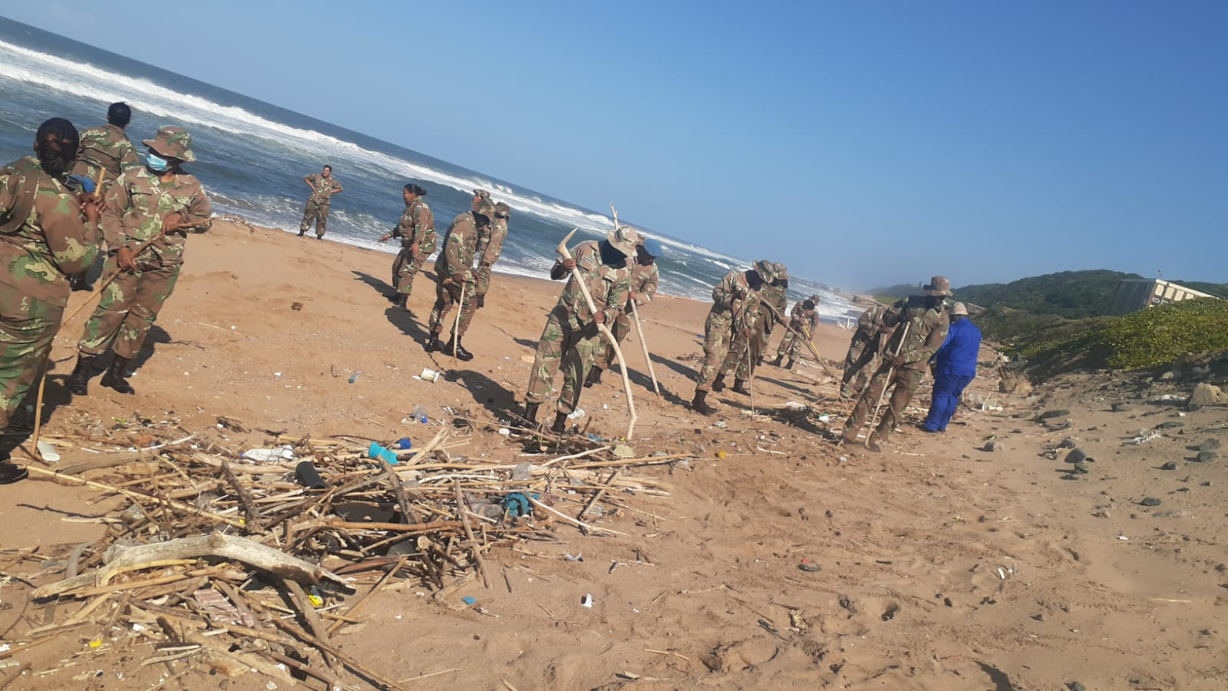
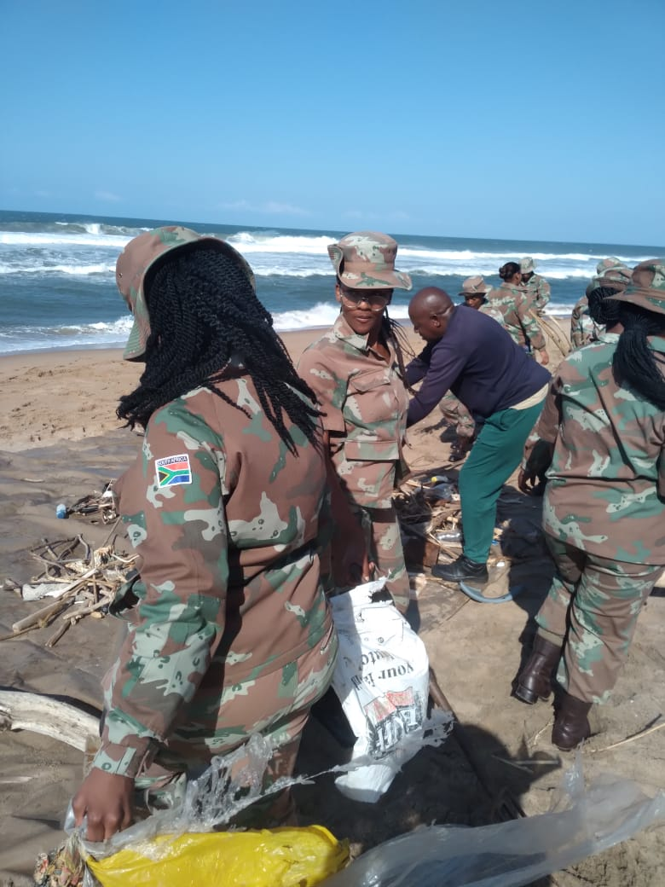
MOP UP OPERATION 1/7
SANDF deployed at Bluff military at the shooting range to clean and clear the beach area that was affected by floods .

Slide 17
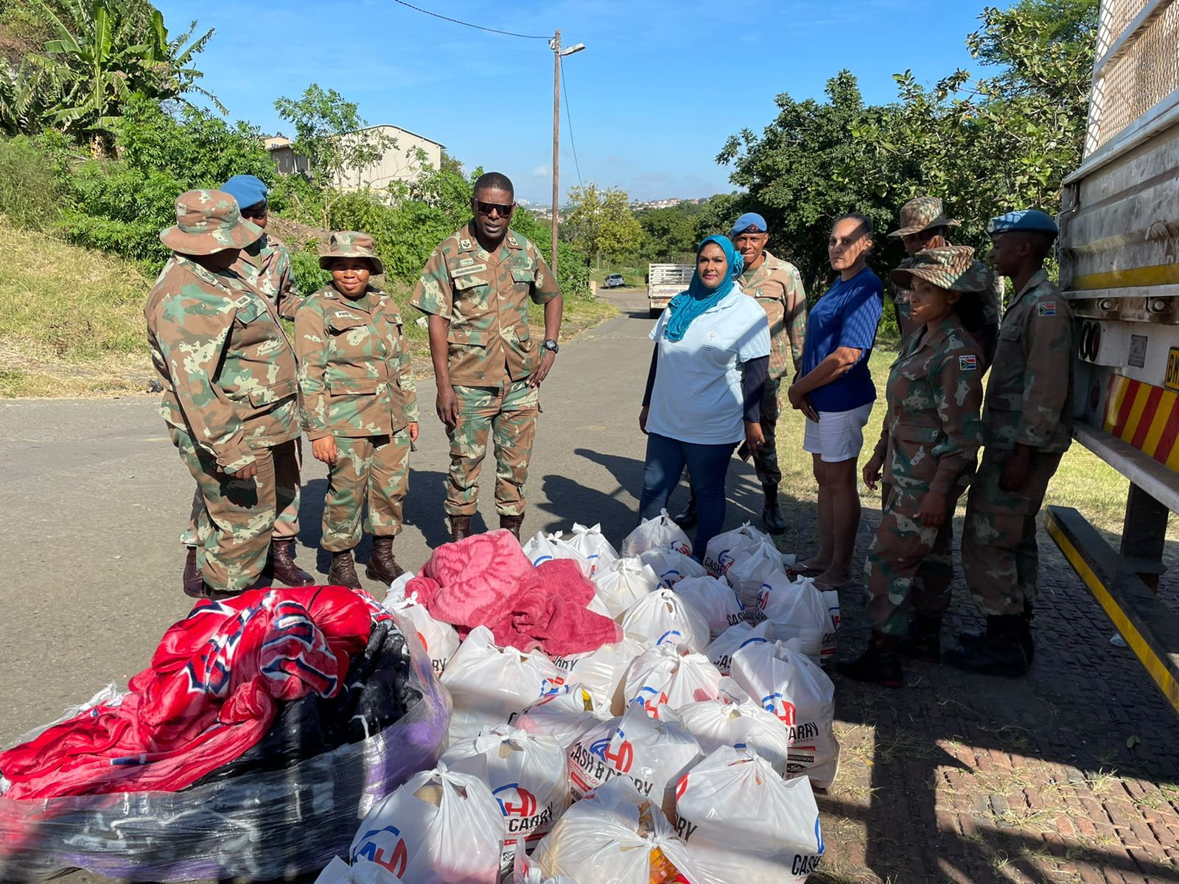
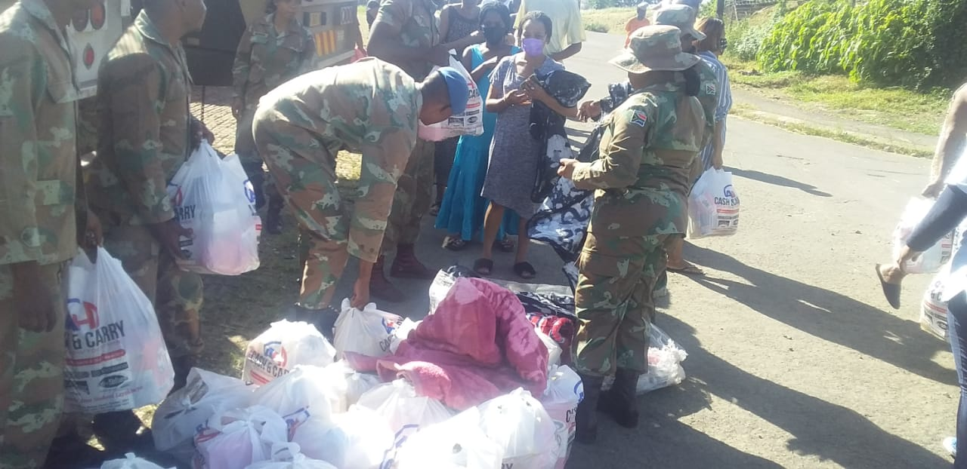
DISTRIBUTION OF DONATED ITEMS TO AFFECTED AREAS 1/8
The SANDF visited Inanda to deliver food items, sanitary pads and blankets.

Slide 18
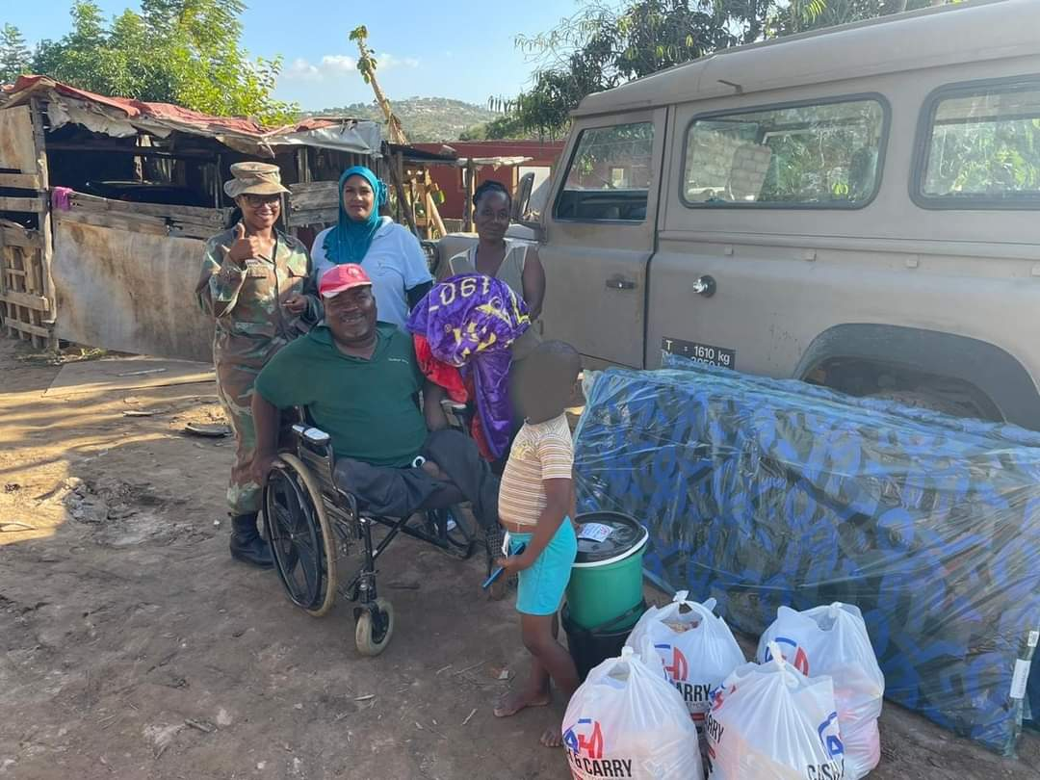
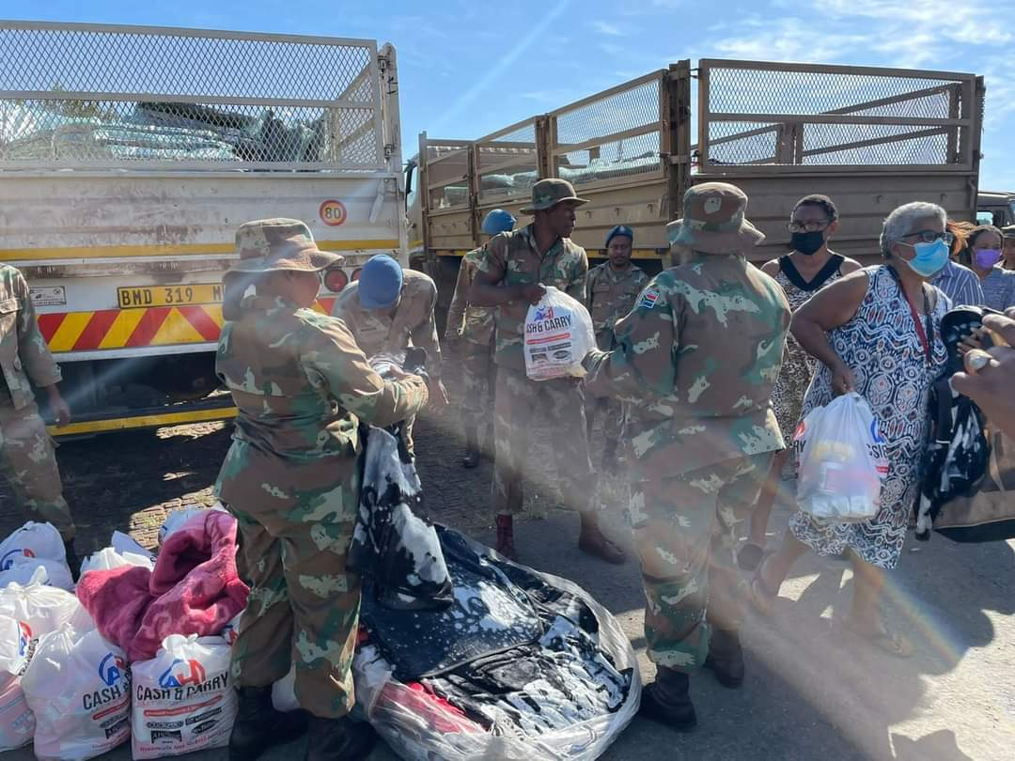
DISTRIBUTION OF DONATED ITEMS TO AFFECTED AREAS 1/9
The unit visited Hammardale and Kwangqolosi to deliver food items, mattresses and blankets.

Slide 19
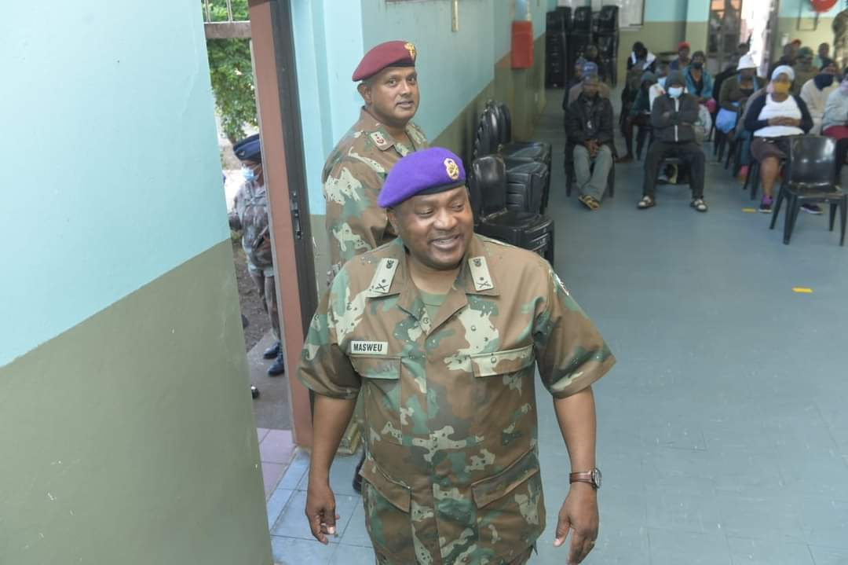
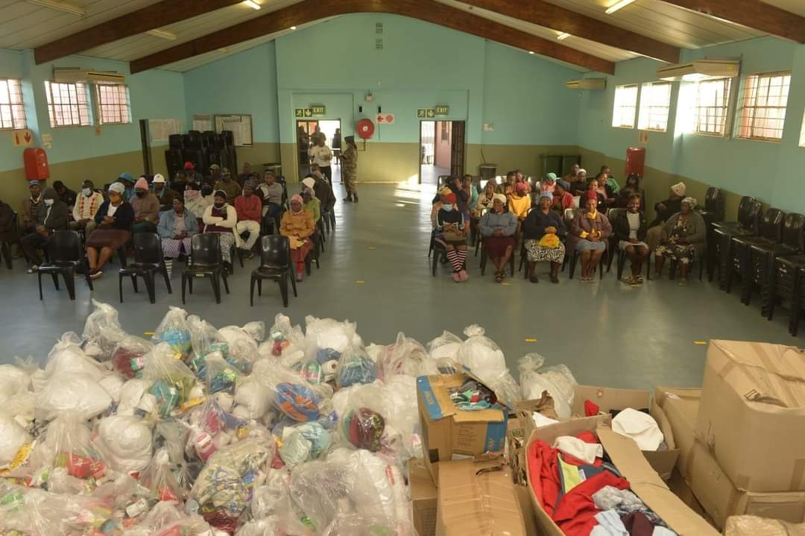
DISTRIBUTION OF DONATED ITEMS TO AFFECTED AREAS 1/10
The unit assisted the Chaplain Division of the SA National Defence Force when they were distributing humanitarian aid to Kwamashu and Faith life Ministries .

Slide 20
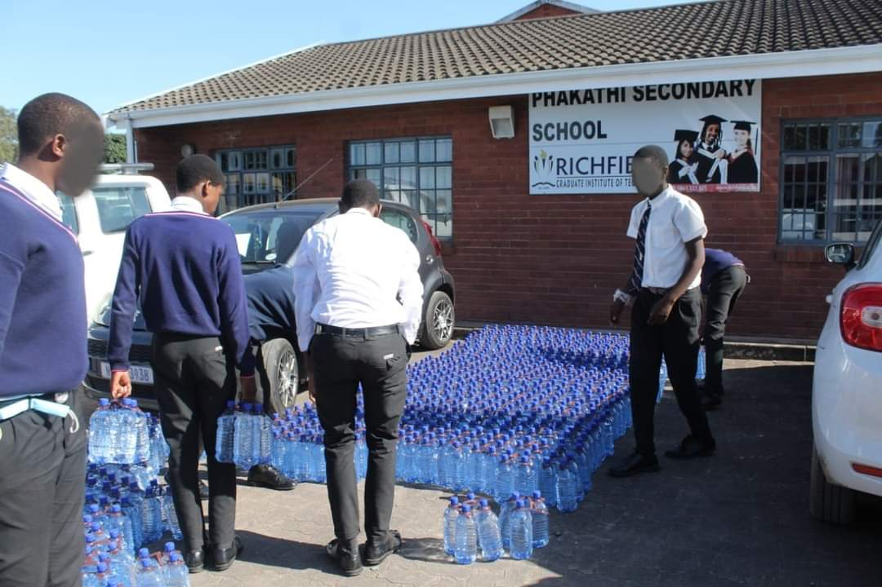
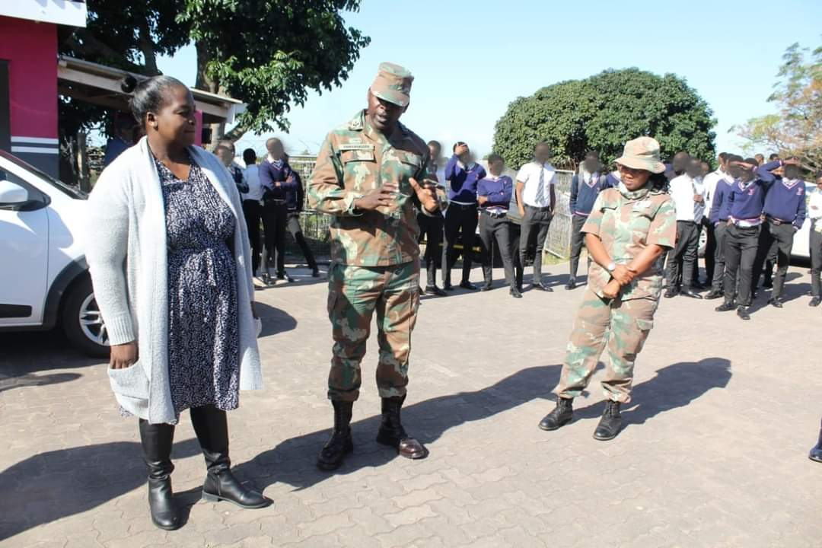
ISSUING OF BOTTLED WATER TO THE LOCAL PRIMARY SCHOOL 1/11
The unit delivered 3000 x bottled water to Phakathi Secondary School.

Slide 21
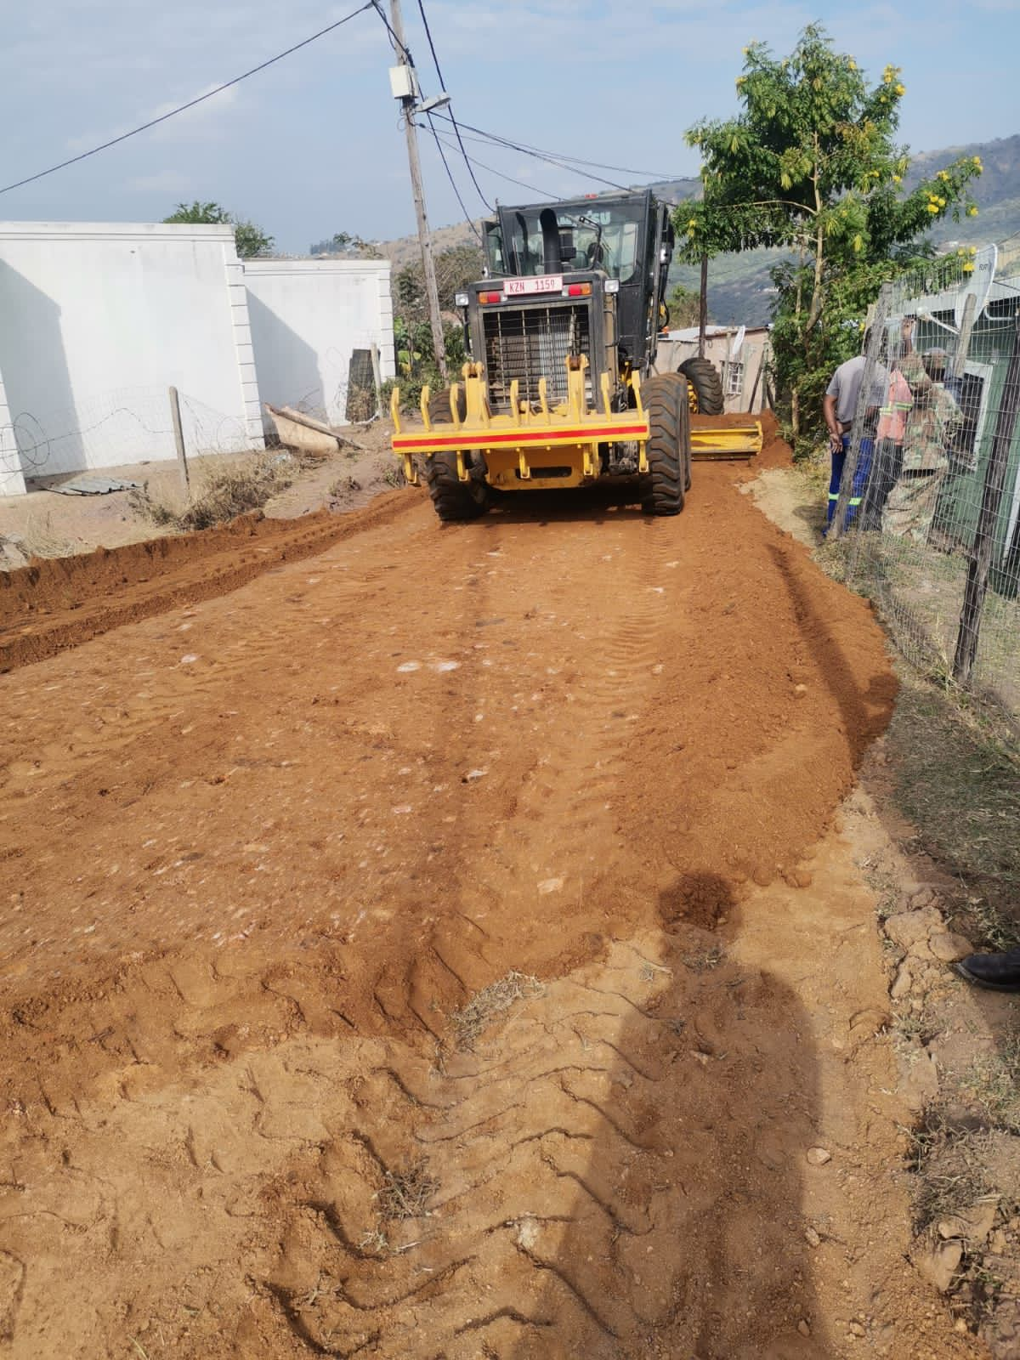
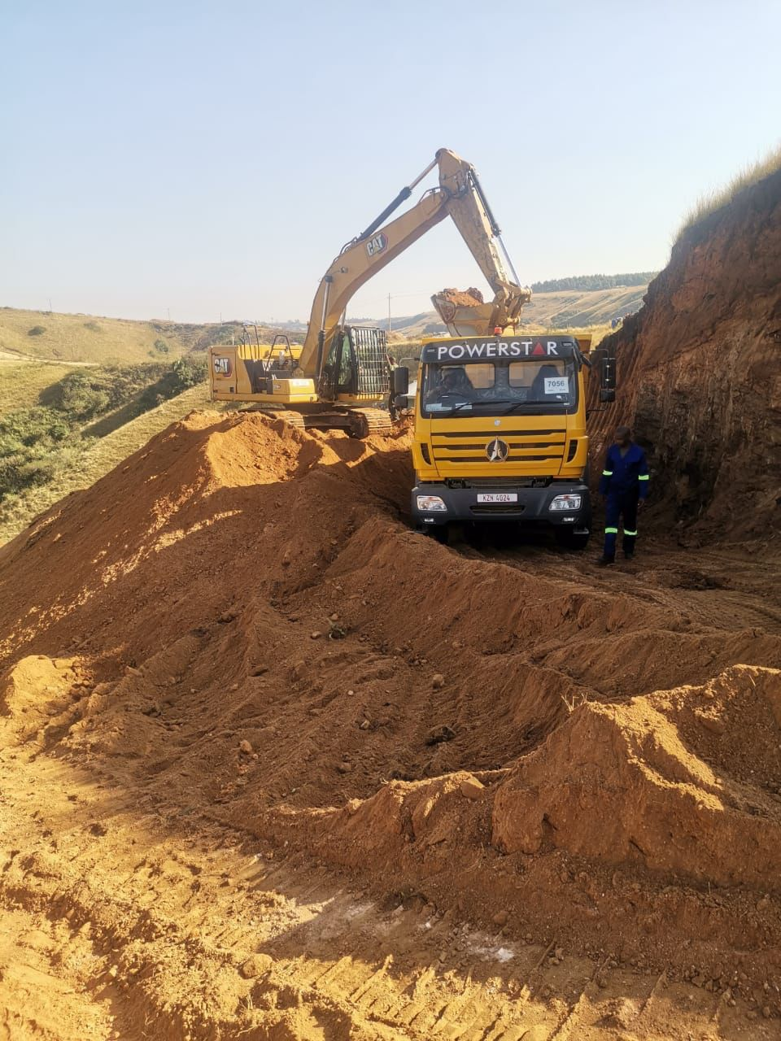
PHOTO EVIDENCE

Slide 22
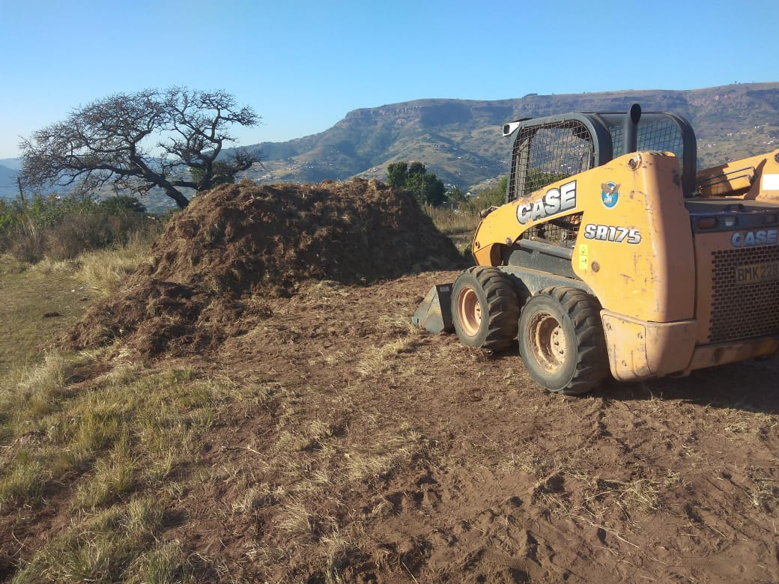
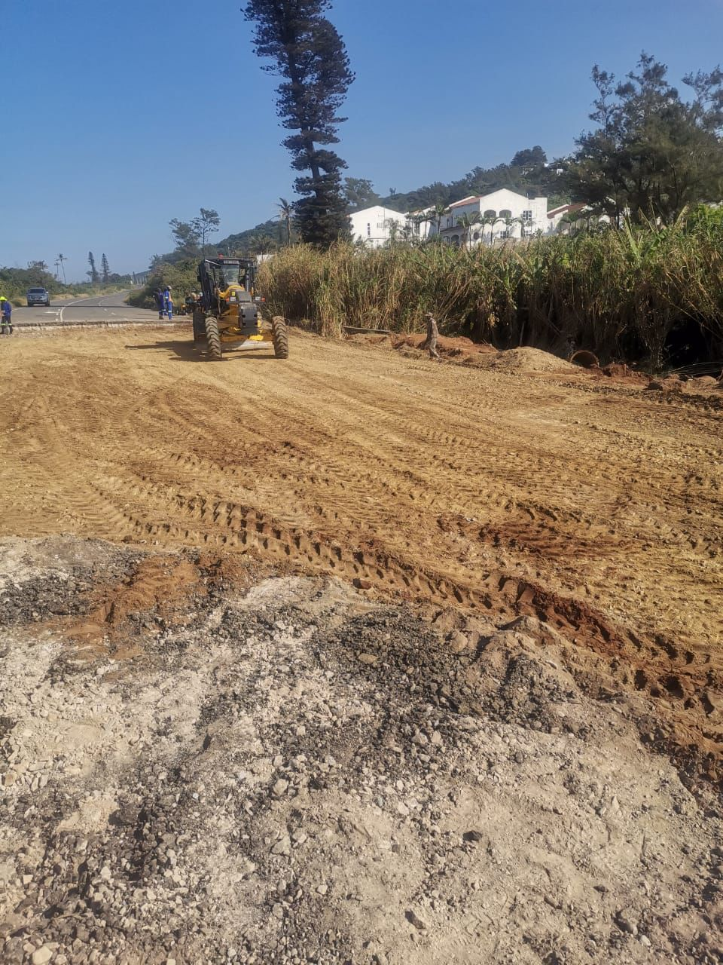
PHOTO EVIDENCE

Slide 23
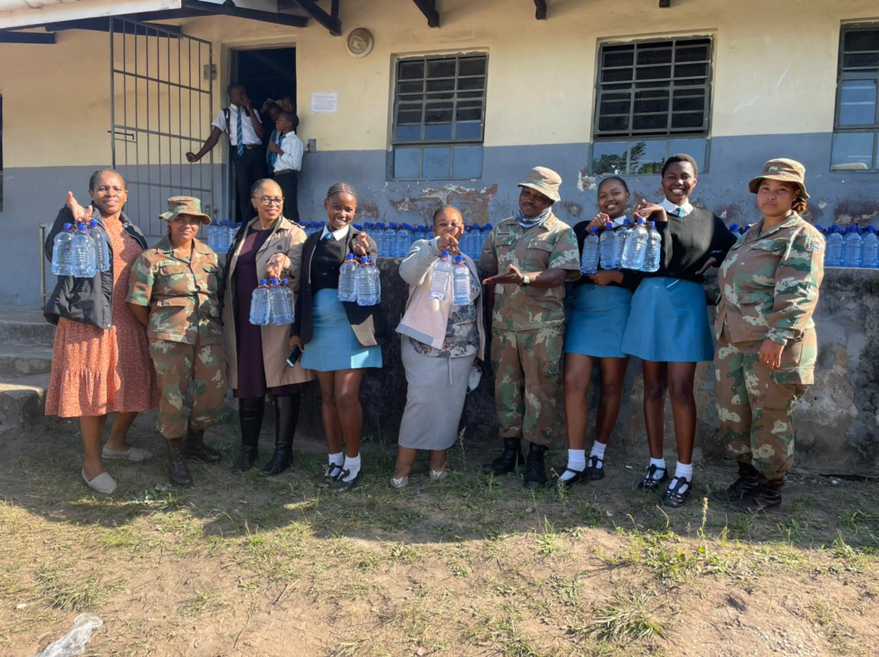
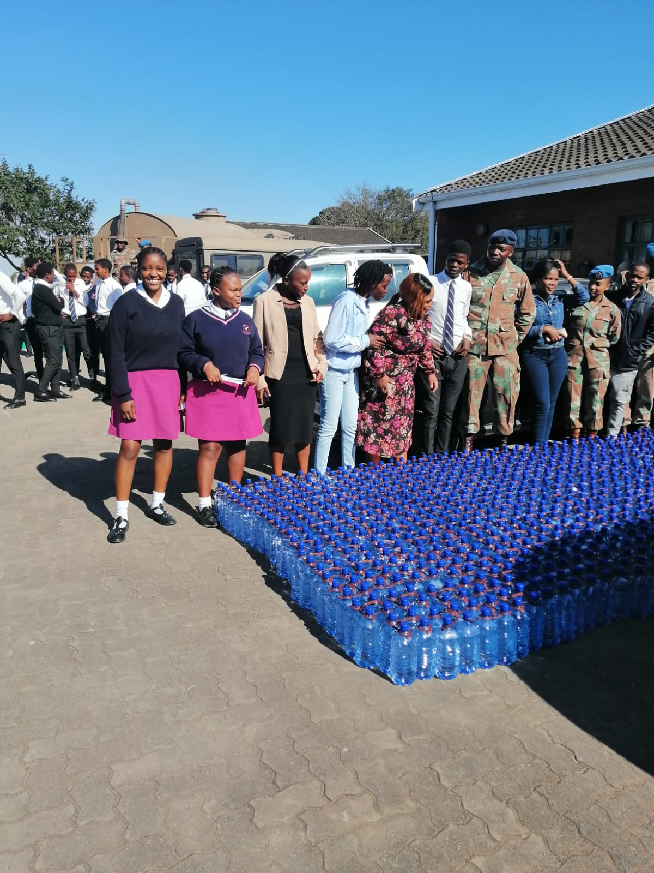
PHOTO EVIDENCE

Slide 24
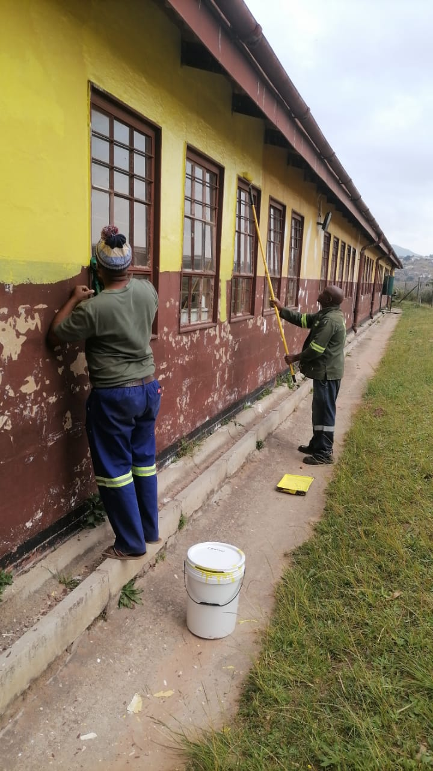
PHOTO EVIDENCE

Slide 25
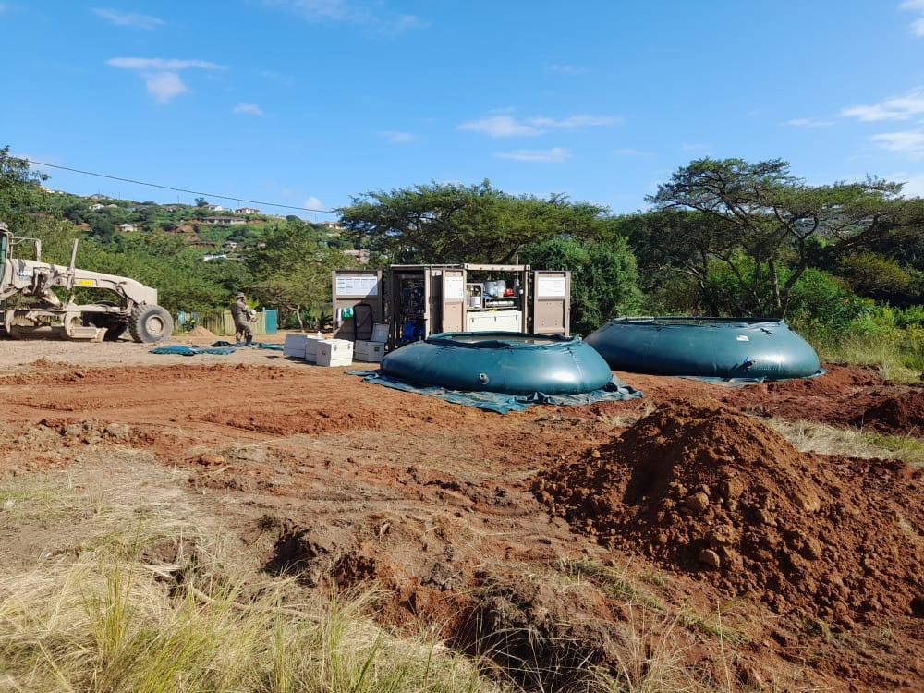
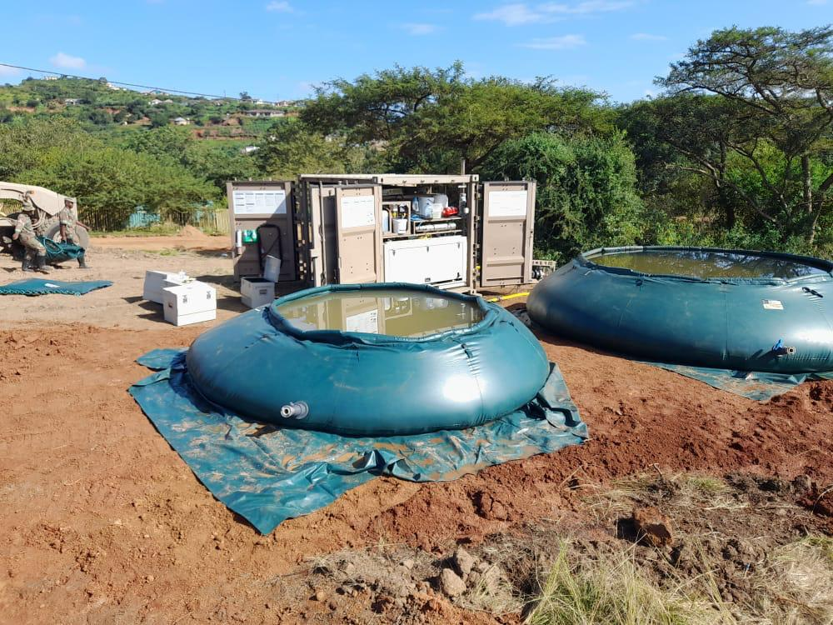
PHOTO EVIDENCE

Slide 26
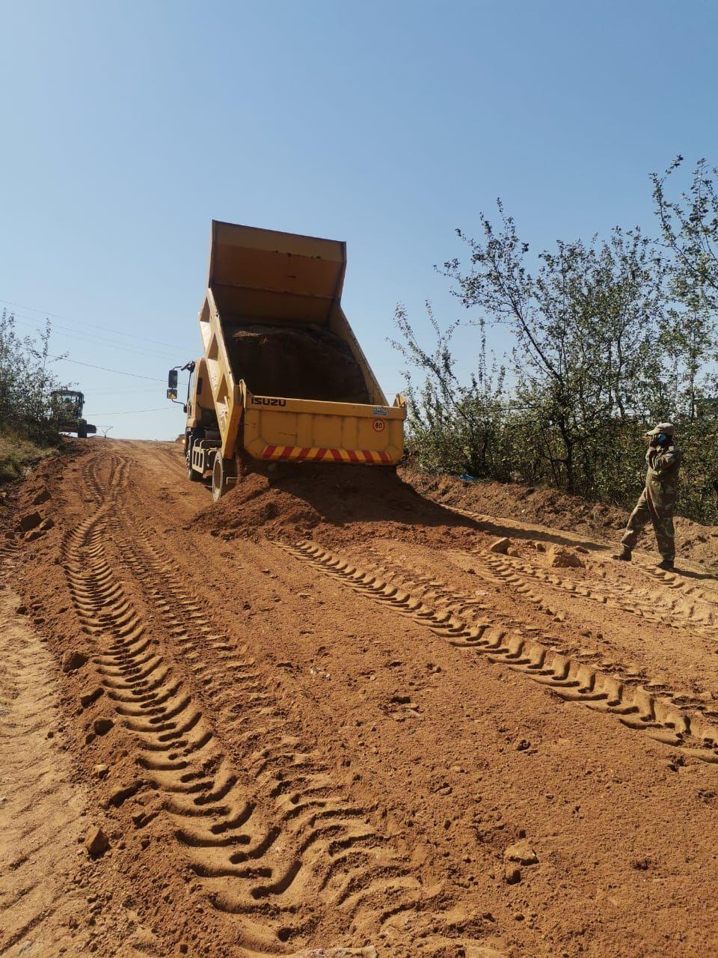
PHOTO EVIDENCE

Slide 27
PRESIDENTIAL MINUTES

Slide 28
PRESIDENTIAL MINUTES

Slide 29
DISCUSSION

