Slide 1
The Arts Programme in Schools Date: 3 August 2022
Select Committee

Slide 2
TABLE OF CONTENTS
BACKGROUND AND CONTEXT
DSAC AND DBE COLLABORATION
CREATIVE ARTS PROGRAMMES FOR YOUTH
THE ARTISTS IN SCHOOLS PROGRAMME
THE IMPLEMENTATION OF THE PROGRAMME
CREATIVE ARTS GENRES
NUMBER OF ARTS PRACTITIONERS PLACED IN THE SCHOOLS/PROVINCE
CHALLENGES

Slide 3
Background and Context
The Revised White Paper on Arts, Culture and Heritage reiterates commitment by DSAC to assist DBE with regard to a number of issues that include amongst others;
teacher development, improving the quality of content and its delivery to the learners
Learning and Support Material
Curriculum Development, implementation and Enrichment in the creative arts subject, etc.
NDP also affirms the two Departments to collaborate in improving the subject matter
AIS is an initiative by the Department and positions the community arts practitioners across all the 4 genres as invaluable resources and catalysts to the transformation of creative arts teaching experience in the public schools.
NDP 2030 affirms DSAC and DBE to partner in the promotion and implementation of arts, education and training in the public schools

Slide 4
DSAC and DBE Collaboration
Both DSAC and DBE have collaborated well in the design, development and implementation of arts education and training programmes which seek to improve the quality of creative arts and culture learning in the public schools at least since 2003
Curriculum Assessment Policy Statement (CAPS) by DBE provides direction and guidance on the four main creative arts genres, viz. Music, Dance, Visual Arts and Drama
DSAC continues to device creative and innovative ways of promoting all arts genres as mentioned and these will all be included and discussed in the next few slides.
The process of the Signing of the MoU that incorporates both Sport and Arts & Culture between the DSAC and DBE is underway

Slide 5
YOUTH-FOCUSED PROGRAMMES AS REMODELLED
Arts Education & Training Prog and Artists in Schools
The Debut Fund, The Schools Arts Championships & Youth In Arts Platforms in CACs Prog
The Arts Access Prog
The Young Patriots Prog
DSAC Provincial & National Schools Arts Championship & Youth In Arts Platforms Pilot project in CACs – done through SCM and Transfers policy respectively, supporting AiS and CACs & NYDA
DSAC Debut Fund - sdone in collaboration with BASA for emerging CCI entrepreneurs, developing & mentoring them launching their CCI Business Entrepreneurs
Curriculum Assessment Policy Statement (CAPS -Creative Arts Learning Area) –workshops in Indigenous Instruments (Marimba)
South African Schools Choral Eisteddfod (SASCE) – a DBE collaboration mass participation in Choral & Indigenous music project
Arts Access -a 2nd Chances Prog, skilling juvenile offenders in CICs and Culture & Heritage for rehabilitation & reintegrate youth in their communities in collaboration with DCS
National Youth Service Programme - promotion of National Symbols, civic participation, social cohesion, nation building & national pride,
IN SCHOOL YOUTH
OUT-OF SCHOOL YOUTH
DSAC YOUTH-FOCUSED DEVELOPMENT PROGRAMMES - REMODELLED

Slide 6
The Artists in Schools Programme
Artists in Schools (AiS) programme
Supports the promotion of the creative arts in the public schools by recruiting and appointing arts practitioners who are proficient in variety of genres and their sub-genres
This programme can be viewed to be dealing with very critical areas with cross-cutting themes that include Teacher Development, Curriculum Enrichment and Implementation as well as Social Cohesion
The programme does not only promotes the creative arts, but it is importantly geared towards unearthing, developing new and raw talent amongst the learners
In addition to all the above mentioned factors, AiS creates sustainable job opportunities for the unemployed arts practitioners who are placed in the schools to assist creative arts subject teachers in the delivery of the curriculum to the learners in the classrooms

Slide 7
The Artists in Schools Programme cont..
The programme responds to capacity constraints that are highly prevalent amongst the majority of the creative arts teachers, who have been assigned this subject in addition to the core areas such as English, Science, Mathematics etc.
The subject has become one of the most difficult to teach for the teachers as they do not have both theoretical and practical skills on the 4 prescribed main genres (music, dance, drama and visual arts)
The implementation happens within the framework of the Curriculum Policy Statement (CAPS) Creative Arts subject by the Department of Basic Education

Slide 8
Implementation of AiS programme
AIS programme is implemented by experienced Agencies in the areas of community development through arts, culture and heritage interventions, and importantly interfacing with the DBE and its relevant policies
The appointment of these agencies initially followed consultation processes and recommendation by the DSAC in the provinces.
As a result, all the agencies on the programme have been identified and appointed from each province. This was a deliberate strategy by DSAC to ensure beneficiation in all areas or throughout the value chain of the implementation process
There is a regular consultations with provincial DBEs as custodians of the education system that includes policies, leadership, schools teachers and learners
Active participation and endorsement of the programme varies from Department to the other in all the 9 provinces

Slide 9
Placement of Arts Practitioners in the Schools
Participation by the Schools in the AIS programme is voluntary
Appointment and placement of arts practitioners follows a rigorous process that includes amongst others; placement of advertisement in the provincial news and social network platforms, interviews, auditions, submission of portfolios etc
The Arts practitioners' residence play a role in the participating schools to avoid unnecessary confrontation with the communities
A typical arts practitioner is an individual (within the legally allowed working age), including the pensioners that are proficient, confident and articulate and is passionate about community development, especially working with school children
As per DSAC MoAs, all agencies have to undertake capacity building workshops for the practitioners who are also joined in some cases by the creative arts teachers and subject advisors
(National) Placement of practitioners is generally informed by the DSAC’s annual APP Target which is then divided more or less equally amongst all the Provinces
Target for 2021/2022 was 300 which will also be repeated in 2022/2023

Slide 10
Creative Arts Genres offered
The implementation of AIS in the public schools follows CAPS Creative Arts Subject which proposes 4 main genres namely Music, Visual Arts, Drama and Dance
The policy also allows for the various sub – genres to be explored during the lessons as informed by the curriculum
Sub-genres are normally implemented based on the strengths of the individual schools in terms of capacity
Music – African and Indigenous, Western Classical and Opera, Jazz, Hip-Hop etc
Visual Arts – drawing, painting, sculpture, crafts, design etc
Dance – African Traditional, Contemporary South African/universal, ballet, etc
Drama – stage and film acting, script writing, directing, etc
Normally the capacity to offer the above will be provided solely by the arts practitioners

Slide 11
Provincial Championships/Festival
DSAC MoA prescribes that the implementation of the AIS programme should culminate into a Provincial Festival / Championship
The objective of the festival is to gauge progress and impact by showcasing learners and practitioners and teachers’ collaborative hard-work.
The championship/competition component of the programme encourages participants to really work hard and impress so that they can be selected to represent their respective provinces at National Level
All festivals/championships are themed around the National Days e.g. Heritage, Youth, Human Rights, etc
Provide the learners with the semi (professional) space (performance and exhibition) to express their talent
Parents and communities are invited as audience to support and affirm the learners during the performance
The content of the festival is informed by the genres as prescribed through CAPS and normally takes place in the theatres based on availability or outdoor spaces
In most cases all these genres are presented in the same space. Visual Arts works will provide the background and ambience and importantly, learners are given opportunities to share details for creations through the microphones

Slide 12
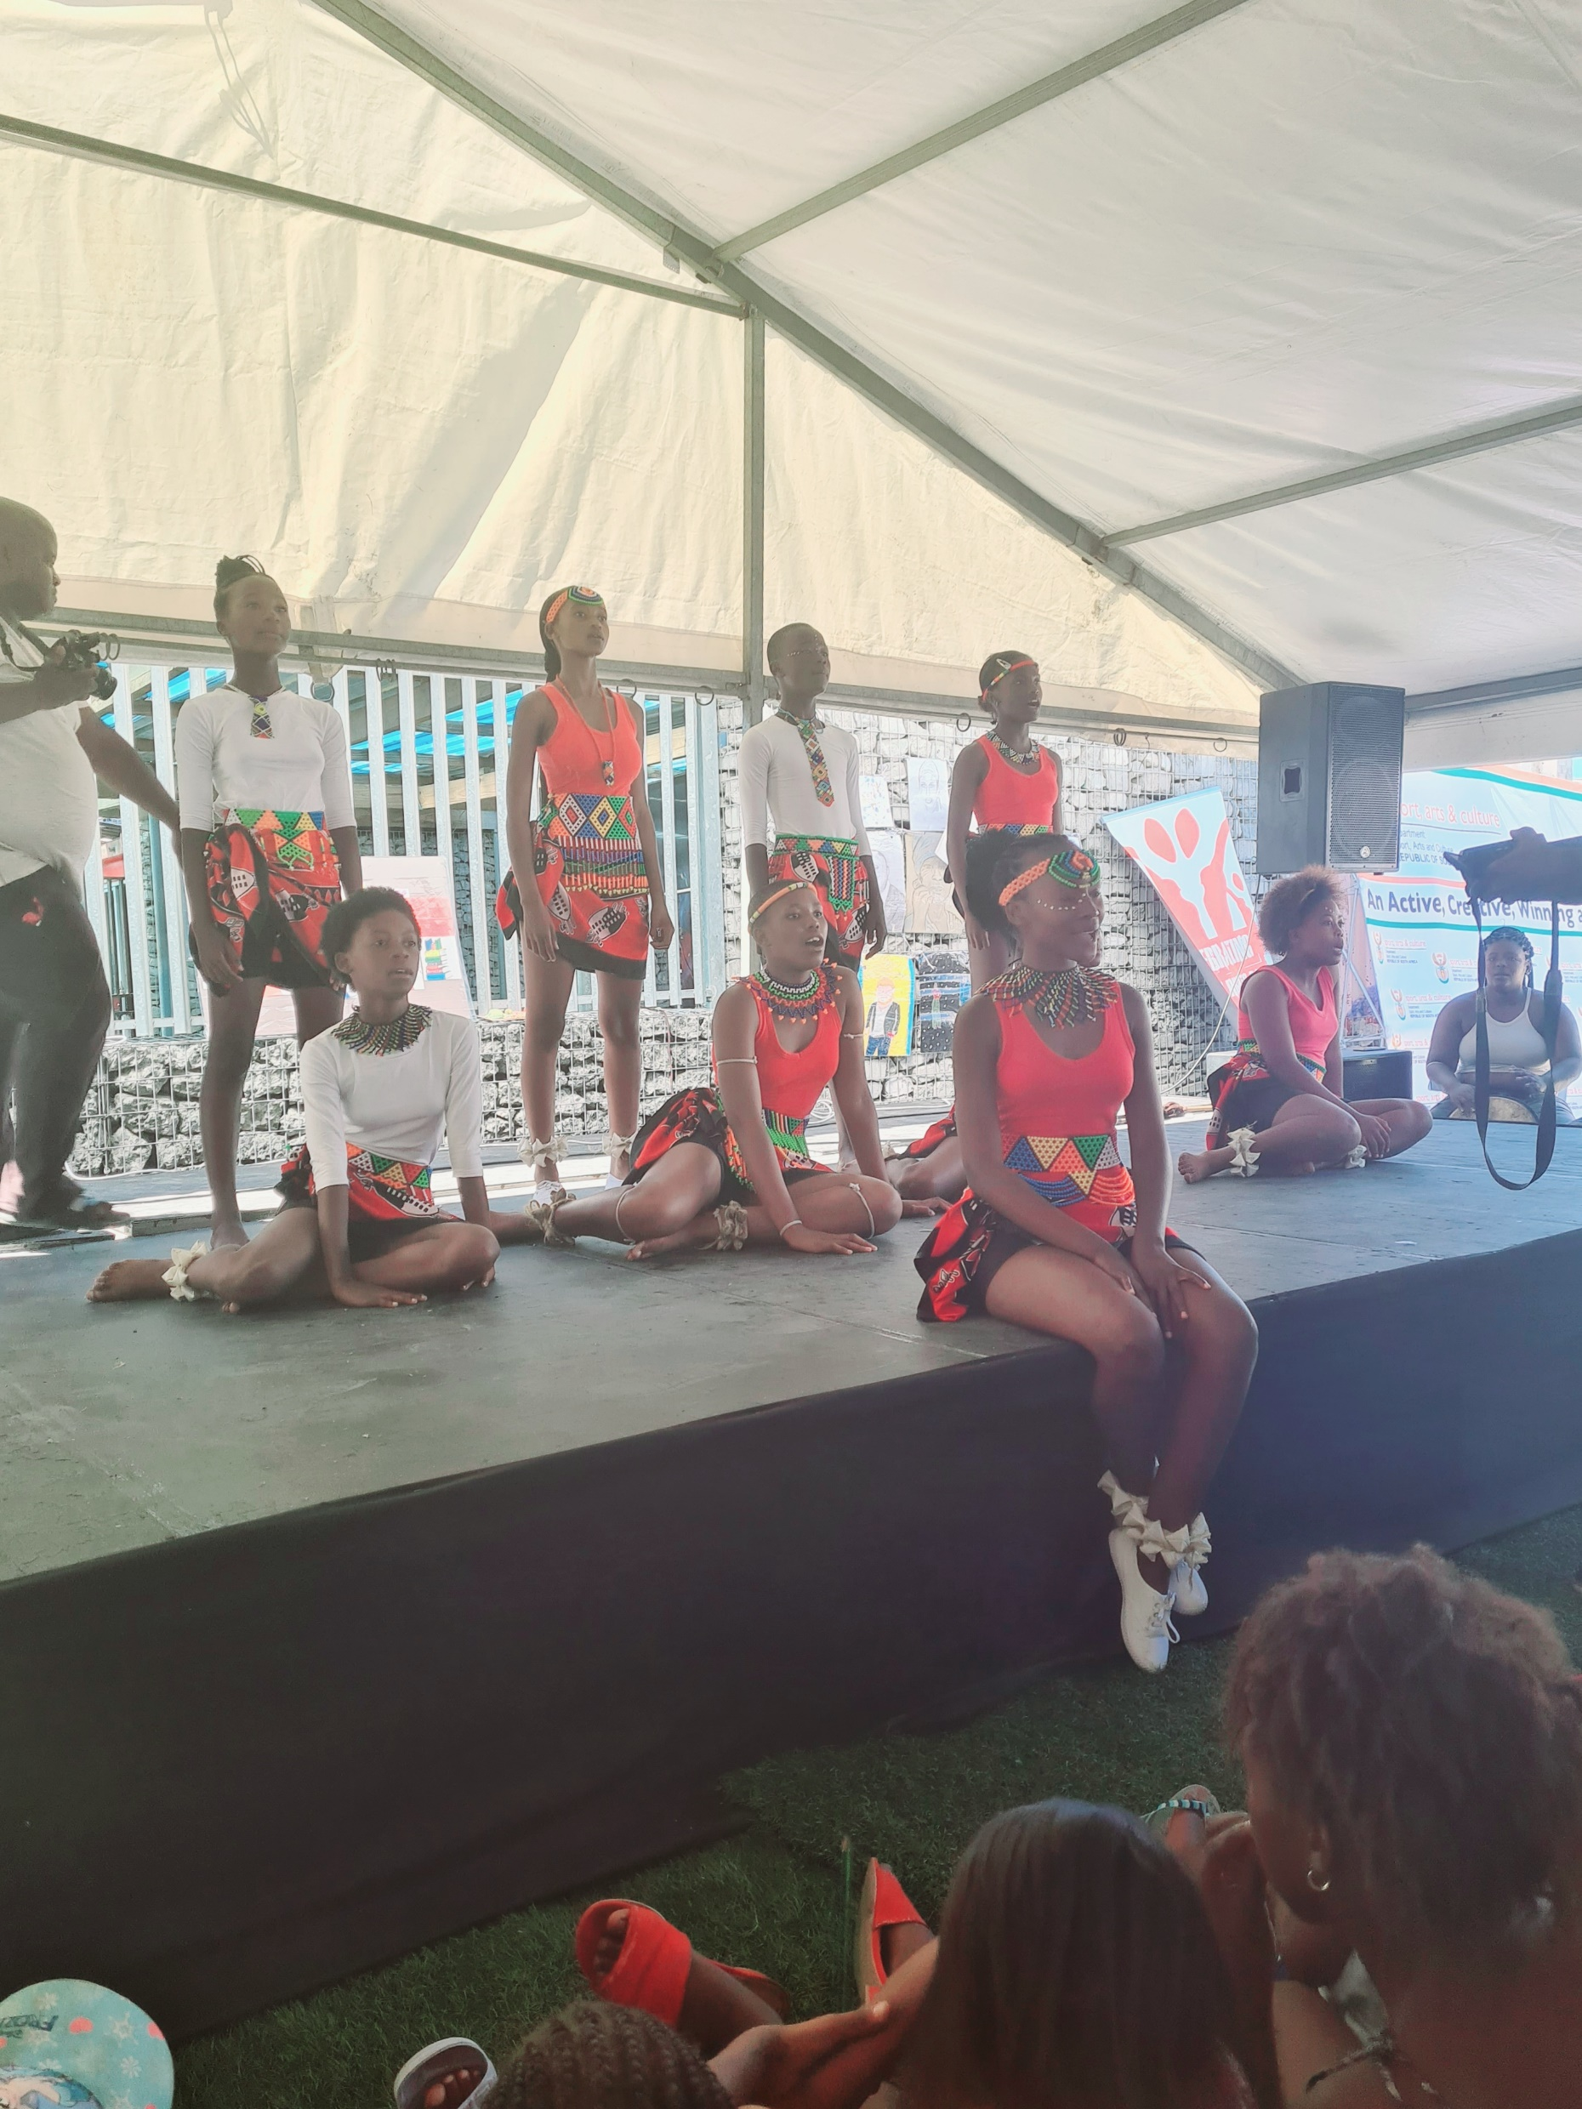
Provincial Showcase in Nyanga – Western Cape

Slide 13
No. of Arts Practitioners placed in the Provinces in 2021/2022
PROVINCE | Number of Artists placed in the Schools | Implementation Agency | Contact Name
Gauteng | 35 | Sibikwa Arts Centre | Michael Mabena
KZN | 35 | Wushwini Arts Centre | Jerry Pooe
Eastern Cape | 41 | East London Guilt Theatre | Reginald Danster
LImpopo | 40 | TLZ Development Projects | Patricia Mashau
Northern Cape | 36 | Galeshewe Theatre Organization | Phemelo Sediti
Western Cape | 35 | Nyanga Arts Development Centre | Nosisana Nama
Mpumalanga | 35 | Emthonjeni Rural Development | Windy Mthembu
Free State | 38 | Free State Arts and Culture Council | Mario Sefo
North West | 35 | Tswelelopele Kalekgotla NPO | Mighty Mokgatle

Slide 14
Challenges
High demand for the programme in the province
Lack of formal endorsement through Policy by DBE
Majority of 26 000 (and growing) schools do not have appropriately qualified teachers
Universities continue to produce quite a miniscule number of qualified arts teachers
More and more arts graduates are unemployed, despite high demand for their services in the public schools
Creative Arts Subject is not prioritized in terms resourcing (human/material)
Arts practitioners are continuously being used by most schools to lead in teaching the subject – contrary to the DBE Policy
Insufficient support from most of the Provinces
The programme is being categorized as an extra-mural activity by DBE, despite its rich curriculum orientation

Slide 15
THANK YOU

