Slide 1
DSAC BRIEFING TO SELECT COMMITTEE ON:
INSTALLATION OF SA FLAGS IN SCHOOLS
Presented by: Director-General
03 August 2022

Slide 2
TABLE OF CONTENTS
1. PURPOSE OF PROVISION OF FLAGS TO SCHOOLS
MANDATE & BACKGROUND
REPLENISHING OF FLAGS TO SCHOOLS
IMPLEMENTATION APPROACH
PERFORMANCE IN 1ST QUARTER OF 2022/2023
ANTICIPATED ANNUAL PERFORMANCE IN 2022/2023
2

Slide 3
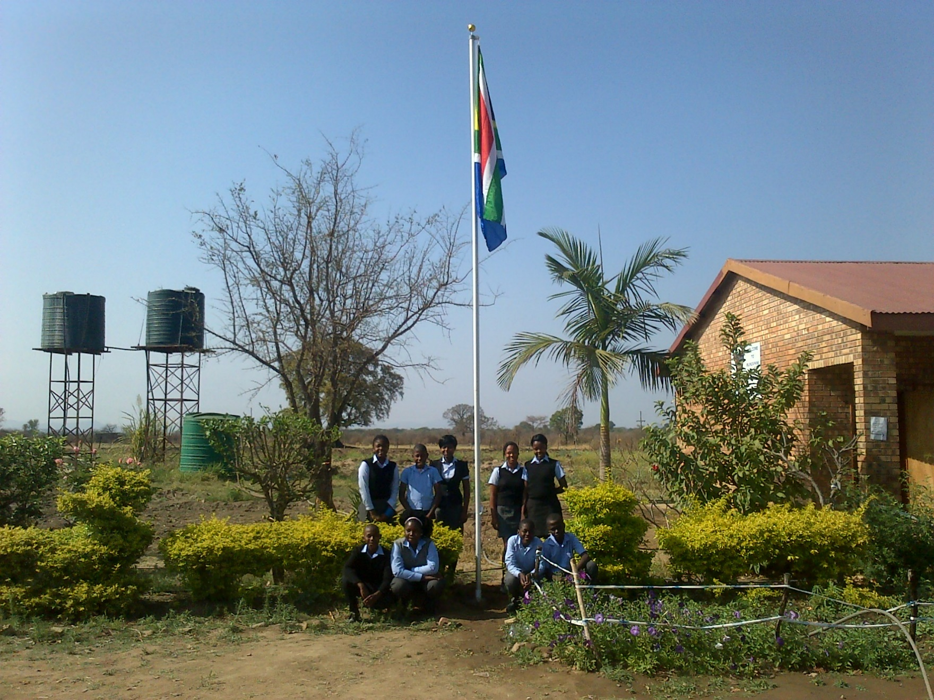
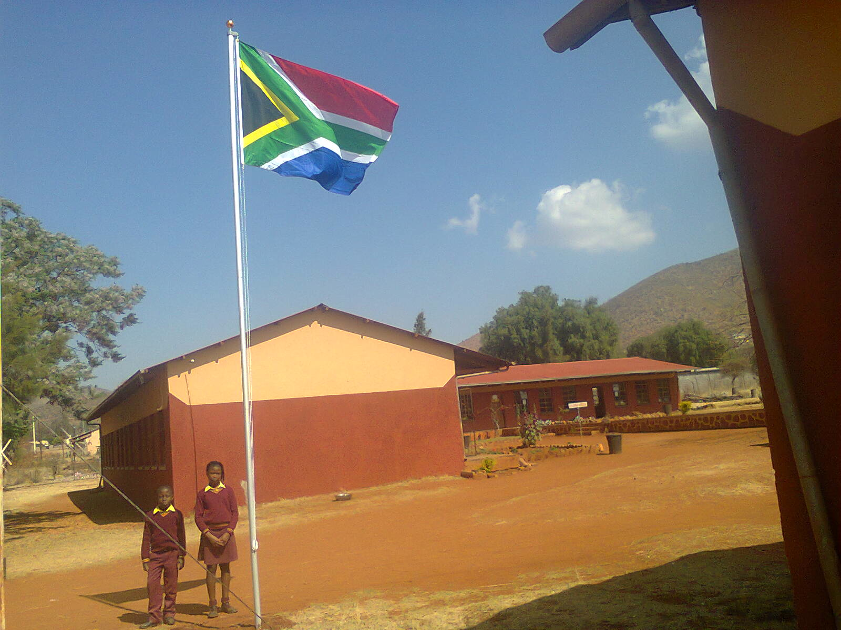
1. PURPOSE OF PROVISION OF FLAGS TO SCHOOLS
The Flag in Every School Project is aimed at equipping all schools in the Education Management Information System (EMIS) database with South African National Flags. This is part of the campaign to promote national identity, and nation building in the country.
3

Slide 4
2. MANDATE & BACKGROUND OF PROVISION OF FLAGS TO SCHOOLS
The Department of Sport, Arts and Culture is mandated to popularise national symbols to schools.
To this effect the Department initiated the Flag in School Project in 2007.
Since then more than 25 241 flags and flagpoles were installed in schools in an attempt to ensure that all schools in the country can fly flags.
4

Slide 5
3. REPLENISHING OF FLAGS TO SCHOOLS
Due to exposure to natural elements such as rain, wind and sun, the flag cloth deteriorates.
The flag does not last more than 24 months and thus needs to be replenished overtime.
The lifespan of the flag is even shorter in windy areas.
The Department currently has an annual target to supply 100 schools with new flags each performance year of the MTSF.
5

Slide 6
3. REPLENISHING OF FLAGS TO SCHOOLS Cont.
Using the Database compiled from the Young Patriots Schools Audit reports, the department was able to deduce that the main need of the schools is replenishment of the flags that are worn out.
Few schools, especially in urban and peri-urban areas have lost their flag poles due to crime, especially in areas where metal and aluminium recycling is rife.
6

Slide 7
4. IMPLEMENTATION APPROACH
The Department is working with its provincial stakeholders to gather more information on the schools that need new flag poles and will be servicing the schools based on the size of the scope within a given performance year.
The department clusters a limited number of schools within a certain geographic spread in a province to contain costs of replenishing the flags or the flags poles.
7

Slide 8
5. PERFORMANCE IN 1ST QUARTER OF 2022/2023
The Department, working with its provincial counterparts has been replenishing flags in various schools across the country.
In the 1st quarter of 2022/2023 performance year the department was able to deliver 33 flags against a target of 30.
The bulk of the schools that were serviced were in the Alfred Nzo district (Eastern Cape) and were serviced by the Young Patriots Programme in that district with the support of the Department.
8

Slide 9
6. ANTICIPATED ANNUAL PERFORMANCE IN 2022/2023
The Department is currently working with various provinces to reach more schools in the outer quarters of the Performance Year.
Due to the Partnership with the Young Patriots Programme in various Provinces, the Department will reach more schools than initially planned for the current performance year.
9

Slide 10
THANK YOU
10

