Slide 1
REPORT ON THE COVID-19 SOCIAL RELIEF OF DISTRESS PROVISION AND INTERVENTIONS
Select Committee on Health and Social Services
23 AUGUST 2022
BUILDING A CARING SOCIETY. TOGETHER.
www.dsd.gov.za

Slide 2
Presentation outline
Summary of the new iteration of the COVID-19 SRD
Applications by gender and province
Application by non citizens
Applications by age
Educational profile
Payments
Appeals
Additional statistics
Challenges of the COVID SRD

Slide 3
Summary of how the new iteration of the Social Relief of Distress (SRD) grant will be implemented
President announced in his SONA that the COVID-19 SRD will be extended
Regulations were promulgated on 22 April 2022; and applications channels were opened on 23 April 2022
The COVID-19 SRD (cSRD) is derived from the COVID-19 R350 SRD, which was a modification of the SRD provided by the department through SASSA within the Disaster Management legislative framework.
The third iteration involved shifting this modified form of SRD back to the Social Assistance legislative framework.
By implication, all existing applicants will be required to reapply for the cSRD
It’s a new provision made within a different regulatory framework
The previous provisions came to an end – as per the directions published
New criteria were added, requiring new consent to be obtained

Slide 4
Summary continued – application and screening
For the third iteration that grant will be administered in a similar fashion to the manner in which it was administer under the Disaster Management Act; however some additional areas have been added in an attempt to reduce inclusion and exclusion errors.
The grant only be applied for through digital application channels, which are zero rated for data. These include:
WhatsApp Channel
Website
SASSA Mobile App (still in development and will be introduced gradually during the course of the year)
A new screening questionnaire was introduced to improve the screening of applicants, which includes:
Personal Information to be provided
ID Number, Names and Surname, Address etc.
Contact details
Educational details
Expanded declaration and consent form to be signed
Banking details
New questions on
When the client last worked,
How client usually sustain himself/ herself
Whether client is employed, receiving other forms of income etc.

Slide 5
Summary continued – data checks
The applications will be validated monthly through digital channels, these include:
National Population register (personal info / deceased status)
Socpen (grants other than child grants)
SARS IRP5 data (income indicator)
UIF (contributor or benefitting)
NSFAS (in receipt of stipend)
Persal, Persol (Government employees)
GEPF (Government pensioners)
Correctional Services (inmates)
Banks (means testing) – new

Slide 6
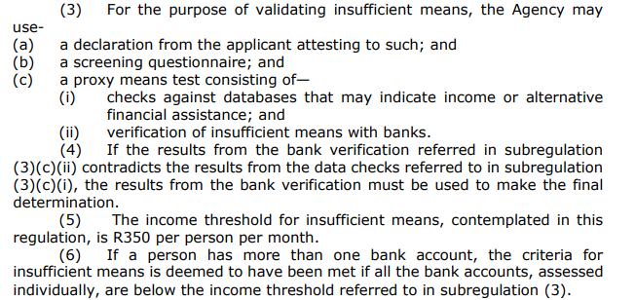
Summary continued – proxy means testing

Slide 7
Summary continued – bank checks
In the previous iteration, SASSA only verified income though bank accounts for appellants. In the new iteration, SASSA will means test all applicants.
To implement this, a new definition for income (insufficient means) has been crafted in the regulations to include all forms of income, even support from family members.
At the time it was noted that there would be an implementation risk in that it has not been done at a large scale before and SASSA has experienced some teething challenges with implementation
Design of the system took till mid June
Error with one of the banks scripts
Error with CSG income exclusion algorithm
Given the limited budget, for the new iteration of the provision was set at R350 (equivalent to the value of the grant).
Previously a threshold of R0 was used (1st iteration); but soon dropped and kept “unemployed” as a criteria
In the second iteration unemployment was kept and introduced a threshold of R595 for appeals only (~1m people) as an alternative verification.
In the third iteration appeals and applications will be aligned to follow the same rules.
Everyone will be assessed on the same threshold and unemployment as a criteria dropped; but included as a condition/ support criteria.
A threshold of R350 was set at onset to keep within in the 10.5 million cap for the COVID SRD, however a commitment was made to review should it be found to be to low.
If this is successfully implemented at scale, it will enable future improvements in the administration of all social grant benefits. It may also render the other database check irrelevant.

Slide 8
Summary continued – new requirements
A new requirement was be inserted into the regulations requiring clients to confirm every 3 months whether or not they still require the provision.
This is to enable SASSA to pick up changes to the clients status which may be missed through only data checks.
It will encourage more active engagement between the client and SASSA (using digital platforms)
It defaults the client to “not requiring the grant” if they do not re-engage every three months.
A new condition has been added to the regulations requiring clients not to unreasonably refuse to accept employment or educational opportunities.
SASSA is in the process of entering into a Memorandum of Understanding with the department of Public Works as well as the Employment and Labour to facilitate data sharing and exchanges between the parties.

Slide 9
Amended Regulations – August 2022 –
Subsequent to the lifting of the State of National Disaster in March 2022, the Department had to develop new Regulations under the Social Assistance Act instead of the Disaster Management Act.
Since implementation SASSA has experienced challenges implementing some of the provisions.
This resulted in amendment of the following clauses in the Regulations to promote effective implementation and reduce exclusion errors:
deletion of Regulation 2(4) which empowers the Agency to use bank verifications to make final determination in the event there are contradicting outcomes of data checks. The change will enable SASSA to consider all databases equally when conducting data checks for the purpose of validating insufficient means..
amendment of sub-regulation (5) by revision of the mean test threshold in from R350 to R624 per person per month in line with the food poverty line. This amendment was also informed by the low initial uptake and it is likely to increase the number of beneficiaries in the system, and
deletion of Regulation 5(2) which requires all applicants for the Covid-19 SRD to reapply for the benefits every three months. Thus reducing the burden on beneficiaries to confirm their need for the provision within a short period of time and allowing for seamless processing of application for the entire duration of the third iteration.
The amended Regulations were operationalized by publication in Government Notice No. R 2381 on the 16 August 2022.
PROGRAM OUTCOMES
Government had to rapidly implement the policy and introduced on-line digital application platforms which saw over 10.9m persons applying.
Payment to applicants without a bank account were able to receive payment via their cellphones
Rapid Assessment Study by the Department revealed that the programme is well targeted as the majority of beneficiaries used the money towards food and basic necessities.

Slide 10
Implementation

Slide 11
Total Applications by gender and province as at 02 August 2022
Province | Female | Male | Total
Eastern Cape | 883 900 | 656 018 | 1 539 918
Free State | 380 812 | 286 700 | 667 512
Gauteng | 1 268 386 | 1 080 332 | 2 348 718
KwaZulu Natal | 1 530 866 | 1 154 960 | 2 685 826
Limpopo | 950 985 | 700 580 | 1 651 565
Mpumalanga | 615 483 | 454 140 | 1 069 623
North West | 474 492 | 363 797 | 838 289
Northern Cape | 125 166 | 100 236 | 225 402
Western Cape | 463 789 | 333 032 | 796 821
Total | 6 693 879 | 5 129 795 | 11 823 674
% | 57% | 43% | 100%

Slide 12
Total Applications by non- citizens as at 02 August 2022
Province | Angola SPH | Asylum seeker | Lesotho SPH | Zimbabwe SPH | Total
Eastern Cape | 542 | 247 | 1 488 | 281 | 2 558
Free State | 56 | 132 | 2 034 | 33 | 2 255
Gauteng | 120 | 505 | 5 516 | 401 | 6 542
KwaZulu Natal | 571 | 405 | 2 555 | 526 | 4 057
Limpopo | 276 | 222 | 3 550 | 386 | 4 434
Mpumalanga | 147 | 175 | 1 554 | 255 | 2 131
North West | 150 | 147 | 1 737 | 71 | 2 105
Northern Cape | 65 | 77 | 179 | 29 | 350
Western Cape | 133 | 570 | 355 | 96 | 1 154
Total | 2 060 | 2 480 | 18 968 | 2 078 | 25 586
% | 8% | 10% | 74% | 8% | 100%
*SPH – special permit holders

Slide 13
Total Applications Age and Gender as at 02 August 2022
Age group | Female | Male | Total | %
Under 20yrs | 460 074 | 441 874 | 901 948 | 7.6%
20-24 | 1 178 938 | 1 103 466 | 2 282 404 | 19.3%
25-29 | 1 087 832 | 871 946 | 1 959 778 | 16.6%
30-35 | 1 147 286 | 857 461 | 2 004 747 | 17.0%
36-39 | 662 007 | 479 742 | 1 141 749 | 9.7%
40-44 | 643 701 | 454 671 | 1 098 372 | 9.3%
45-49 | 556 916 | 366 799 | 923 715 | 7.8%
50-54 | 495 145 | 295 171 | 790 316 | 6.7%
55-59 | 440 821 | 246 667 | 687 488 | 5.8%
60 and above | 20 855 | 11 995 | 32 850 | 0.3%
Unknown | 304 | 3 | 307 | 0.0%
Grand Total | 6 693 879 | 5 129 795 | 11 823 674 | 100%

Slide 14
Level of education of applicants as at 02 August 2022
Province | No schooling | Primary school | Grade 10 | Grade 12 | Tertiary | Total
Eastern Cape | 132 018 | 231 077 | 664 708 | 449 837 | 62 278 | 1 539 918
Free State | 36 938 | 60 255 | 273 097 | 263 888 | 33 334 | 667 512
Gauteng | 105 015 | 109 667 | 888 911 | 1 077 343 | 167 782 | 2 348 718
KwaZulu Natal | 198 181 | 194 176 | 947 613 | 1 219 465 | 126 391 | 2 685 826
Limpopo | 139 611 | 86 289 | 678 633 | 646 919 | 100 113 | 1 651 565
Mpumalanga | 84 356 | 64 769 | 383 052 | 486 689 | 50 757 | 1 069 623
North West | 74 038 | 87 242 | 323 049 | 319 708 | 34 252 | 838 289
Northern Cape | 15 737 | 28 736 | 91 911 | 80 288 | 8 730 | 225 402
Western Cape | 29 292 | 87 956 | 391 411 | 258 639 | 29 523 | 796 821
Total | 815 186 | 950 167 | 4 642 385 | 4 802 776 | 613 160 | 1 1823 674
% | 6.9% | 8.0% | 39.3% | 40.6% | 5.2% | 100%

Slide 15
Payments
Total approved vs paid as at 02 August 2022
Province | Approved 202204 | Paid 202204 | % Paid Apr | Approved 202205 | Paid 202205 | % Paid May | Approved 202206 | Paid 202206 | % Paid Jun
Eastern Cape | 622 120 | 494 226 | 79.44% | 795 439 | 620 760 | 78.04% | 872 584 | 543 436 | 62.28%
Free State | 293 873 | 234 584 | 79.82% | 369 970 | 293 924 | 79.45% | 391 638 | 249 352 | 63.67%
Gauteng | 835 972 | 685 601 | 82.01% | 1 015 577 | 818 385 | 80.58% | 1 189 659 | 751 292 | 63.15%
KwaZulu-Natal | 1 147 123 | 882 490 | 76.93% | 1 423 636 | 1 073 844 | 75.43% | 1 566 716 | 938 125 | 59.88%
Limpopo | 767 047 | 658 712 | 85.88% | 726 282 | 610 456 | 84.05% | 938 320 | 606 431 | 64.63%
Mpumalanga | 470 712 | 389 783 | 82.81% | 491 643 | 399 814 | 81.32% | 610 970 | 383 253 | 62.73%
North West | 323 104 | 260 876 | 80.74% | 446 225 | 348 714 | 78.15% | 463 578 | 292 888 | 63.18%
Northern Cape | 68 876 | 55 539 | 80.64% | 106 363 | 83 314 | 78.33% | 112 842 | 70 942 | 62.87%
Western Cape | 236 212 | 190 480 | 80.64% | 336 749 | 266 348 | 79.09% | 370 843 | 242 471 | 65.38%
Total | 4 765 039 | 3 852 291 | 80.84% | 5 711 884 | 4 515 559 | 79.06% | 6 517 150 | 4 078 190 | 62.58%

Slide 16
Appeals – new iteration of Covid-19 SRD, 2022
The SRD-R350 Appeals Website, hosted by the Department, was activated on 27 June 2022. This new SRD-R350 appeals process is integrated with the electronic & automated platform used for the lodging, verification & processing of the SRD-R350 by SASSA.
By integrating the existing electronic platform, the burden on declined applicants will be lessened as their personal information are already loaded on the system and the lodging of an appeal will accordingly be quick and easy.
As at 11 August 2022 a total number of 2 455 607 appeals were received via the SRD-R350 Appeals Website (as from 27 June 2022) in relation to SRD-350 declines consisting of:
April – 769 399
May – 401 170
June – 1 285 038
The processes governing the consideration of an appeal for SRD-R350 is that the Independent Tribunal would, when considering an appeal, reassess the decision of the Agency against the relevant and updated information at its disposal, provided that such information was relevant to the applicant’s status during the month of assessment to which the specific appeal relates.
The Department will start with the adjudication process upon the updated databases of source information from the Agency. In terms of the regulatory framework the Tribunal is required to adjudicate these appeals within a period of 90 days from date of receipt thereof. (Tribunal however aims to improve it to period of between 60 – 90 days).

Slide 17
Additional statistics

Slide 18
Additional statistics

Slide 19
Additional statistics

Slide 20
Payments
The system only went live from June 2022.
SASSA started with June payments, leaving a backlog for April and May.
April will be paid with July, and May with August payments.
July payments were put on hold due to reconfirmations (awaiting the amendment of the regulations).
August payments may be slightly delayed due to the amended regulations (threshold increase).
Unpaid for April to June on hold until further guidance to be provided by DSD on how to treat self exclusion questions. Practice note was issued on 11 August 2022, however department requested we wait until this week when they will issue a revised note

Slide 21
Challenges
Two errors were picked up in the algorithms
One bank has incorrectly allocated “income below threshold status” to people with income. Script has been corrected and re-run. The extent of the over payment is still being determined
CSG income has incorrectly been accounted for in the scripts, resulting in many CSG beneficiaries being excluded. The scripts need to be rewritten and should be ready for the August run. Will have to do a re-run of all the files from April to July.
No funding has been allocated to SASSA for these services.

Slide 22
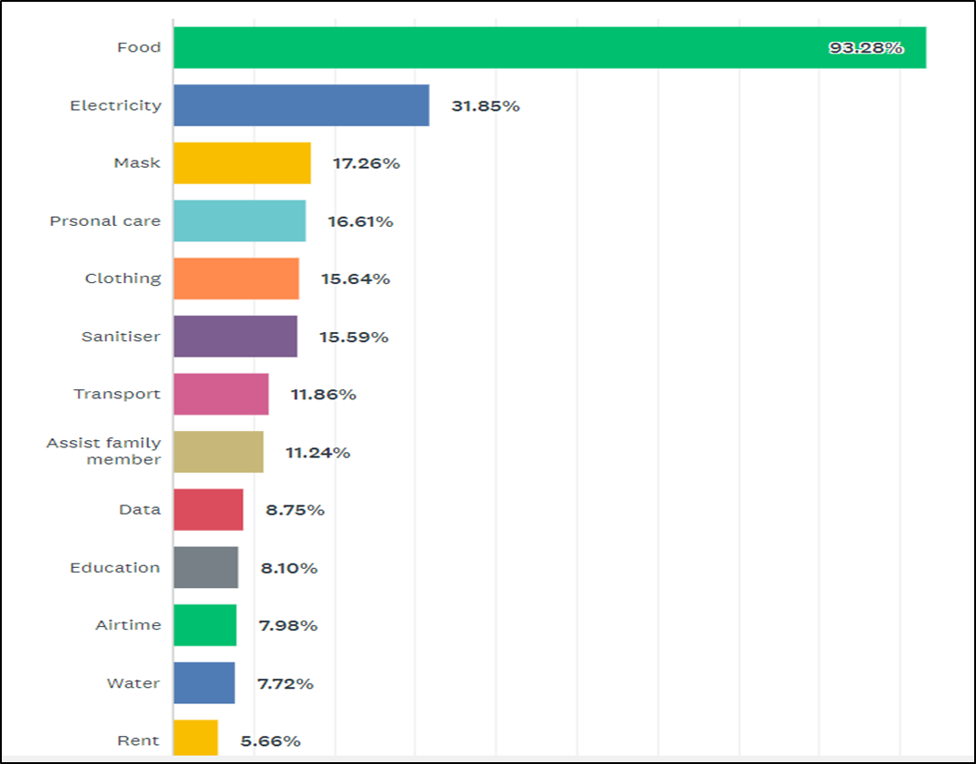
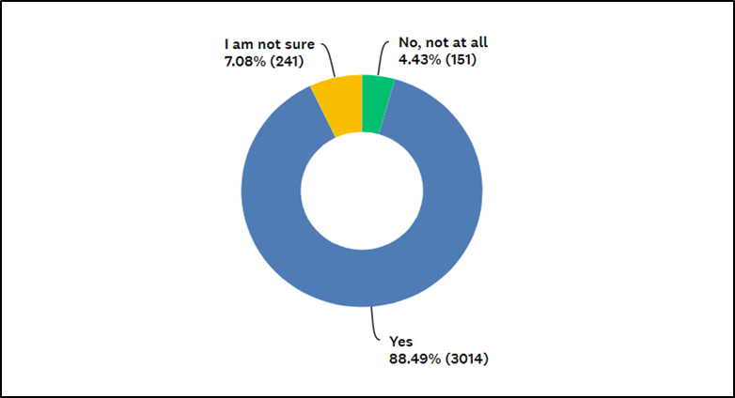
Rapid Assessment of the COVID SRD
The grant was mainly used to buy food; electricity, clothing and for transport.
These are all goods that can support local economies.
80% thought, that even though the grant was small, it made a positive difference in their lives as well as their households.
More than 88% of the recipient believed that the grant should be given to those who applied.
The main reasons cited was the high levels of poverty in the country, followed by the high cost of living (food and transport costs) and low wages.
The grant, even though small, has made a significant impact on poverty, and even inequality.
Utilisation
Did the grant make a difference?

Slide 23
Recommendation
It is recommended that the Select Committee notes the update on the COVID SRD

