Slide 1
UPDATE ON IMPLEMENTATION OF BORDER MANAGEMENT AUTHORITY
Dr. Mike Masiapato, Commissioner: BMA
Secure Borders for Development
23 Aug 2022

Slide 2
FPURPOSE OF THE PRESENTATION
The purpose of this presentation is to update members of the Portfolio Committee on Home Affairs on the operationalization of Border Management Authority (BMA) as a Schedule 3(A) Public Entity,
Slide 2 of 21
Secure Borders for Development

Slide 3
OUTLINE OF THE PRESENTATION
PART A: BACKGROUND [RECAP FROM PREVIOUS BRIEF]:
PART B: UPDATE ON THE INTEGRATION PROCESS:
PART C: UPDATE ON THE CAPACITATION PROCESS:
PART D: UPDATE ON NATIONAL & PORT TARGETING CENTRES:
Secure Borders for Development

Slide 4
PART A:
BACKGROUND [RECAP FROM PREVIOUS BRIEF]
RECAP OF PROBLEM STATEMENT
RECAP OF LEGISLATIVE FRAMEWORK
APPROVED TRANSITIONAL STRUCTURE & INCUBATION
Slide 4 of 21
Secure Borders for Development

Slide 5
PART A: RECAP ON THE PROBLEM STATEMENT:
Since 1994, we deployed a multi-agency approach: 7 organs of state conducting border law enforcement in Ports of Entry & borderline,
As a result, about five coordination iterations emerged:
Border Affairs Coordinating Committee (BACC - 1996)
National Inter-Departmental Structure on Border Control (NIDS – 1997)
Border Control Operational Coordinating Committee (BCOCC - 2001)
Inter-Agency Clearing Forum (IACF - 2010)
National Border Management Coordinating Committee (NBMCC - 2013)
In 28 years, it is clear this multi-agency approach, depending on informal coordination created fragmentation, silo realities, corruption,
Now, we are moving away from this multi-agency approach to an integrated border management approach with a single command and control,
BMA assumes all frontline functions, while departments retain policy & legislative,
Secure Borders for Development

Slide 6
PART A: RECAP ON THE BMA LEGISLATIVE MANDATE:
Based on Section 5 of the BMA Act, the Authority is expected to fulfill the following legislated mandate:
Facilitate and manage the legitimate movement of persons within the border law enforcement area and at ports of entry;
Facilitate and manage the legitimate movement of goods within the border law enforcement area and at ports of entry;
Co-operate and co-ordinate its border law enforcement functions with SAPS, SARS & SANDF, border communities or any other persons.
Section 4 (2) emphasizes that border law enforcement functions should be exclusively performed by the officers of the BMA,
BMA’s is overseen by the Border Technical Committee (BTC) & Inter-Ministerial Consultative Committee (IMCC) – (No Board).
Secure Borders for Development

Slide 7
PART A: TRANSITIONAL STRUCTURE & INCUBATION:
Work undertaken towards for approval of the Transitional Structure (capacitation of the structure to be reflected on later slides):
Work undertaken for the incubation of BMA as a special Branch within the Department of Home Affairs:
Work undertaken to engage Labour through the Public Service Coordinating Bargaining Council (PSCBC) on the integration process:
Work undertaken to source the funding from National Treasury to assist in the operationalization of the BMA towards a Schedule 3(A) public entity:
Signed Service Level Agreement (SLA) between Commissioner & DG to facilitate the application of shared service delivery model:
Secure Borders for Development

Slide 8
PART B:
UPDATE ON THE INTEGRATION PROCESS:
MODALITIES OF THE INTEGRATION PROCESS
MODALITIES OF THE USED INTEGRATION MODEL
UPDATE ON SIGNING OF IMPLEMENTATION PROTOCOLS
UPDATE ON SIGNING OF SERVICE LEVEL AGREEMENTS
Slide 8 of 21
Secure Borders for Development

Slide 9
INTEGRATION OF 5 FUNCTIONS INTO AN INTEGRATED BORDER MANAGEMENT PLATFORM,
PART B: COMPLEXITIES OF THE INTEGRATION PROCESS
Departments and Entities | Functions to be transferred
Department of Home Affairs | Immigration function
Department of Health | Port Health function
Department of Forestry, Fisheries and the Environment | Biosecurity (fauna and flora)
Department of Agriculture, Land Reform and Rural Development | Agriculture/plants functions
South African Police Service (SAPS) | Border control/access control
South African National Defence Force (SANDF) | Operate on the borderline (Implementation Protocol)
South African Revenue Service (SARS) | Operate PoE outside BMA (Implementation Protocol)
Integrated BMA
Border Management Authority
Work Streams
BMA
Integrated Platform
One command and control
One Port Commander
Port Commander
Immigration
Port Health
Biosecurity
Agriculture
Border control
Specialists
Generalists
(Insignia)
SAPS - BMA on Crime Prevention: (CI, PoP, Detectives), (Protocol)
Co-operate
Cooperate with BMA at border law enforcement areas
Border Guards
Vulnerable segments
Community crossing point
Cooperate with BMA at PoE
Border Guards
Facilitate trade, goods
Secure Borders for Development

Slide 10
PART B: COMPLEXITIES OF INTEGRATION MODEL: NMOG
Model: National Micro-organization of government (NMOG),
Negotiated with Labour & used in various occasions (PSCBC),
INTER-MINISTERIAL CONSULTATIVE COMMITTEE (IMCC)
BORDER TECHNICAL COMMITTEE (BTC)
Legal Stream
(Identified functions)
HR, OD, LR & Change Management Stream
(Identified people)
Finance
Stream
(Identified budgets)
Infrastructure
Stream
(Identified infrastructure)
ICT
Stream
(Identified systems)
Communications
Stream
(Facilitate communication)
Secure Borders for Development

Slide 11
PART B: IMPLEMENTATION PROTOCOLS:
Department/Entity | Point of interface, | Status of the Protocol,
South African Revenue Services (SARS) | Port of Entry | Completed: November 2021,
South African National Defense Force (SANDF) | Borderline, | Completed: May 2022,
South African Police Services (SAPS) | Port of Entry & Borderline, | Completed: June 2022,
Started to co-ordinate, collaborate and co-operate at the operational levels,
Secure Borders for Development

Slide 12
PART B: DRAFTING OF SERVICE LEVEL AGREEMENTS:
Department/Entity | Nature of agreements, | Status of SLA
National Dept. of Health, | Service Level Agreement, | Signed on 20 July 2022,
Dept. Forestry, Fisheries & the Environment, | Service Level Agreement, | Discussions started,
Dept. Agriculture, Land Reform & Rural Development, | Service Level Agreement, | Discussions started,
Dept. Home Affairs, | Service Level Agreement, | Discussions started,
Cross-Border Road Transport Authority (CBRTA) | Service Level Agreement, | Discussions started.
Other stakeholders would be engaged as we move along, such as SAHPRA, ACSA
Secure Borders for Development

Slide 13
PART C:
UPDATE ON CAPACITATION PROCESS:
RECRUITMENT OF LEADERSHIP
ON-BOARDING & DEPLOYMENT OF BORDER GUARDS
Slide 13 of 21
Secure Borders for Development

Slide 14
PART C: RECRUITMENT OF LEADERSHIP:
Since the appointment of Commissioner and the two Deputy Commissioners (Operations & Corporate Services);
Processes underway for recruitment of National Commanders: Border Control, National Commander: National Targeting Centre (NTC): (73 PTC);
Later, we shall be recruiting 5 Regional Commanders (post-integration);
Later, we shall recruit the 72 Port Commanders (Post- integration);
Commissioned a study on the categorization of Ports of Entry (for determination of ranks for Port Commanders);
Appointment of the Allowed for the recruitment of the 200 Border Guards, (deployment matrix on the next slide);
Operational Sub-Committee of the National Border Management Coordinating Committee (NBMCC) continues to coordinate current model:
Secure Borders for Development

Slide 15
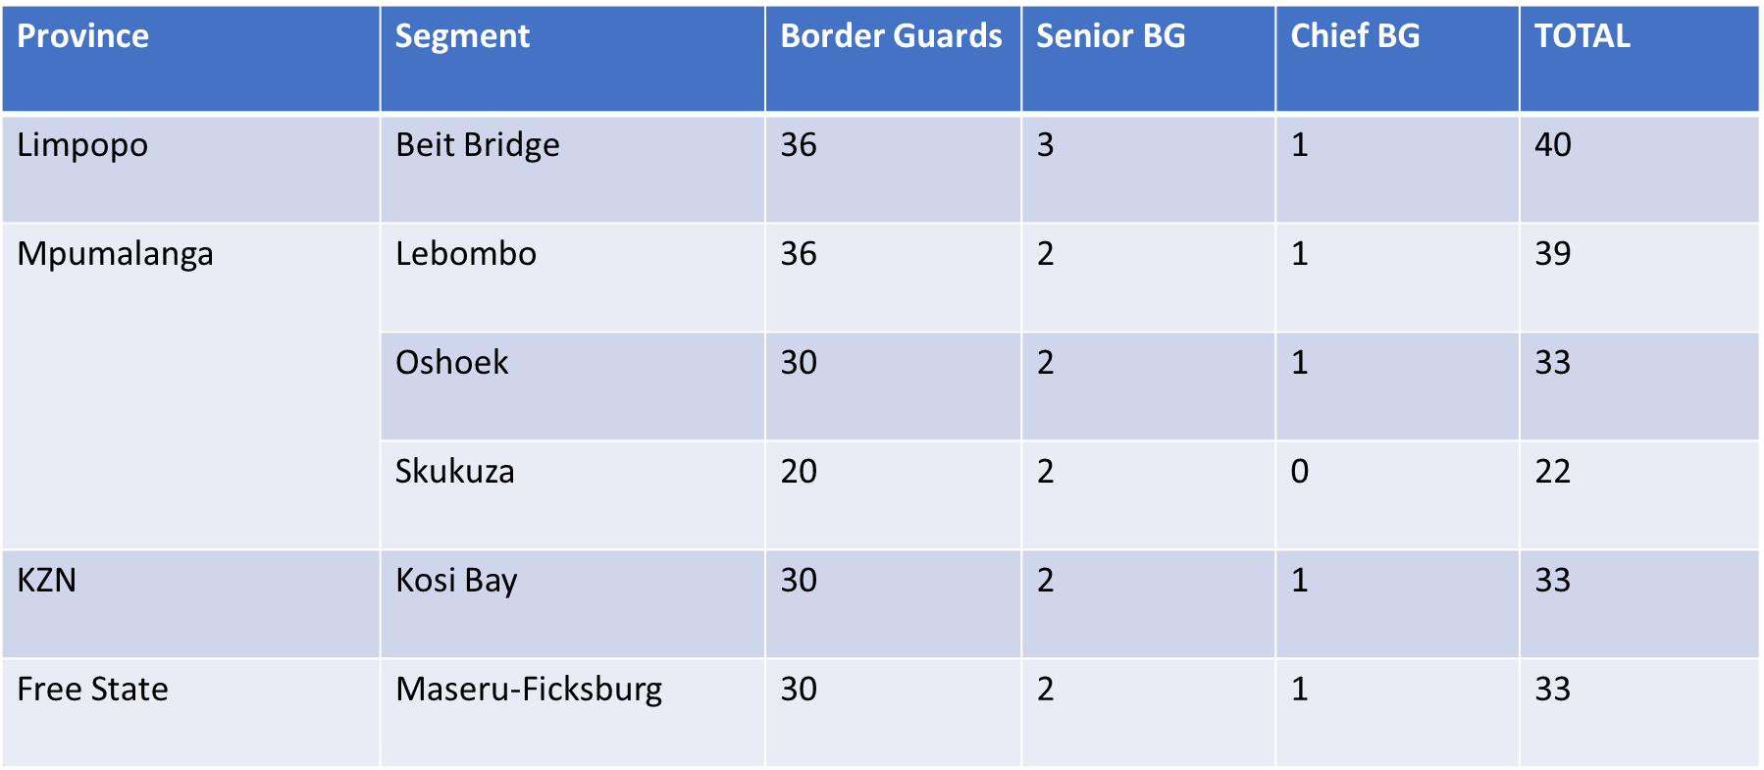
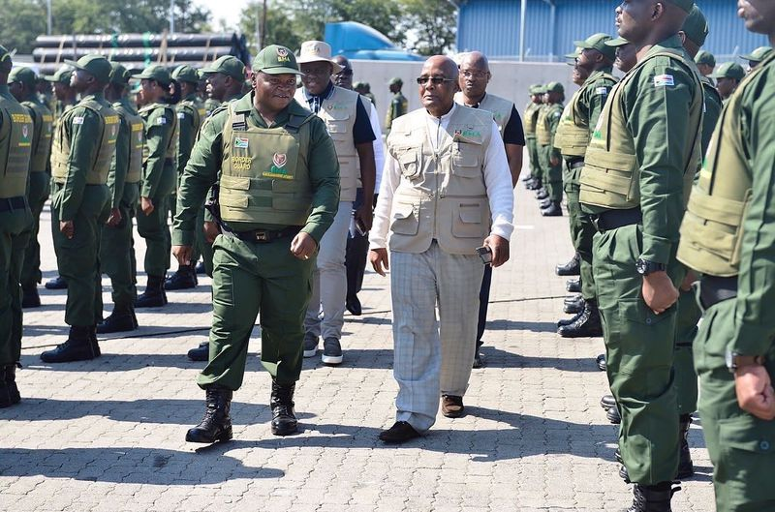
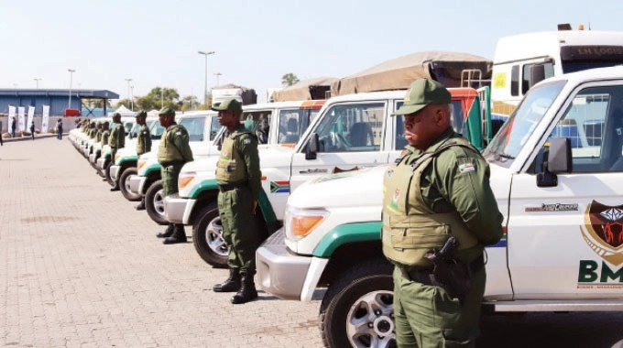
PART C: ONBOARDING & DEPLOYMENT OF GUARDS
Secure Borders for Development

Slide 16
PART C: DEPICTING VULNERABLE SEGMENTS
Secure Borders for Development

Slide 17
PART D:
UPDATE ON NATIONAL & PORT TARGETING CENTRES
OPERATIONAL DYNAMICS OF TARGETING CENTRES
UPDATE ON OTHER CRITICAL MATTERS
Slide 17 of 21
Secure Borders for Development

Slide 18
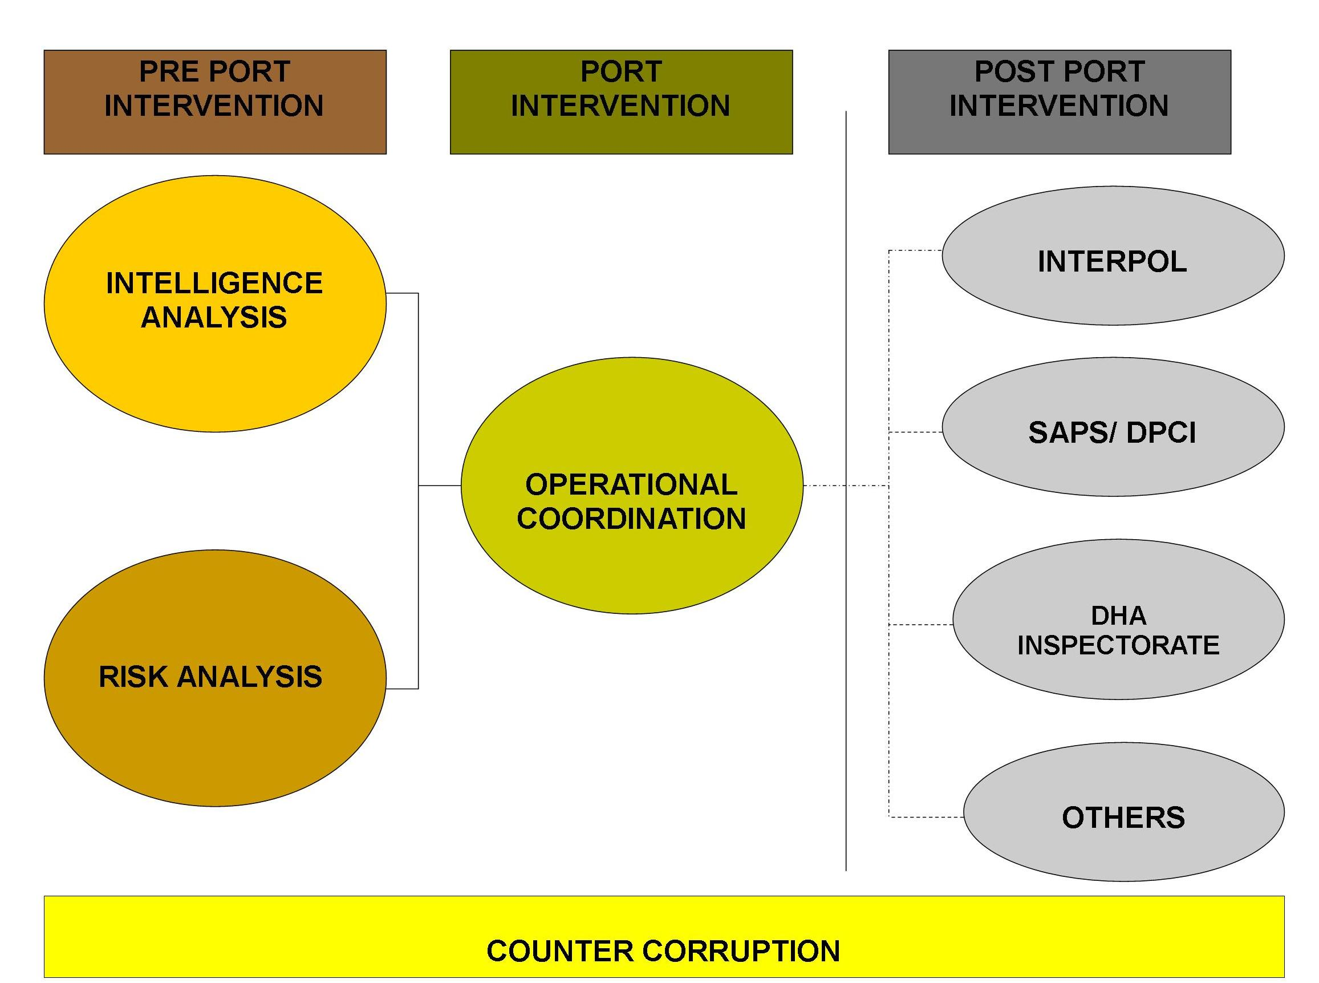
PART D: OPERATIONAL DYNAMICS OF TARGETING CENTRES
National Commander: National & Port Targeting Centre
Director: Data Analysis
Director: Risk Targeting
Slide 18 of 21

Slide 19
PART D: UPDATE ON OTHER CRITICAL MATTERS:
DPWI has finalized the auditing process of 50 percent of the 31 identified Ports of Entry infrastructure for transfer to BMA (remainder is 22):
Discussions with National Treasury on the Medium Terms Expenditure Framework (MTEF), in preparation for the MTBPS at advanced stages:
The onboarding of the Audit, Risk and Remuneration Committees to be finalized in the last quarter of this financial year:
Recruitment process is underway to onboard another 23 Border Guards for deployment at the KZN-Lesotho & Eastern Cape-Lesotho segments:
Capacitation to converge with Integration on 31 March 2023- (ready for the 01st of April 2023)
Secure Borders for Development

Slide 20
RECOMMENDED WAY-FORWARD
Based on the afore-presented slides, members of the IMS leadership are urged to:
Note the progress made towards the operationalization of BMA into a schedule 3 (a) public entity through integration & capacitation,
Support the work and were possible assist to smoothen any challenges experienced along the way,
Champion the assertion that BMA seeks to secure borders for development through people & trade facilitation, enhanced tourism, counter illicit trade, human smuggling & trafficking,
Articulate correct and factual details on the rationale for the establishment of the BMA, including the anomaly that BMA seeks to address,
Secure Borders for Development

Slide 21
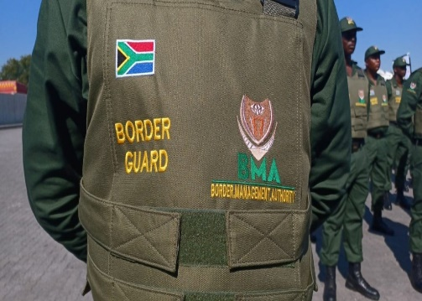
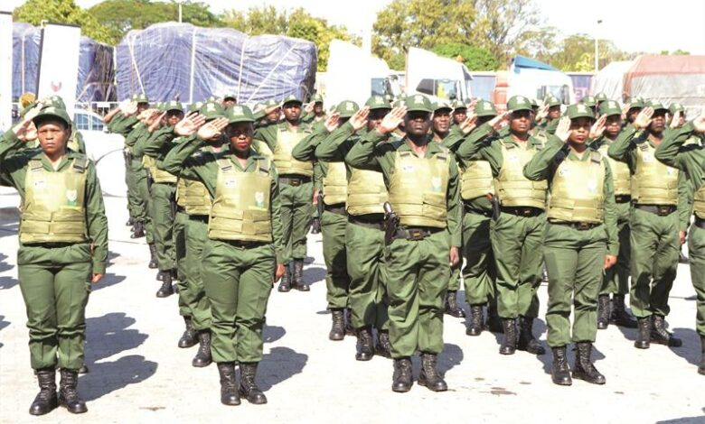
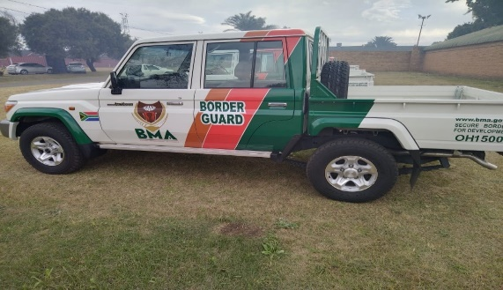
THANK YOU,
Slide 21 of 21
Secure Borders for Development

