Slide 1
SA POST OFFICE
Performance for Quarter 3 2021/22
As at 31 December 2021

Slide 2
Contents
Overview
Financial Performance
KPI Performance Summary
KPI Performance Overview
KPI Detail Performance

Slide 3
Overview – Q3 2021/22
Q3 has remained extremely challenging with economic recovery remaining sluggish, negatively impacting SA Post Office revenue and business recovery
Revenues of R825m for Q3 – R361m (30%) below budget, contributing to cash deficits of approximately R200m
Expenditure target of R1 732m for Q2 achieved at R1 426m, below budget by R304m (18%)
Staff costs remain the key cost driver at R922m (63%) during Q3
Q3 net loss position of R473m against projected net loss of R403m, negative variance of R69m (17%)
15 KPIs measured only 3 KPIs achieving target, overall performance of 20%
300 New confirmed Covid-19 cases during December 2021 compared to the 22 cases recorded in November 2021 and 5 new cases in October 2021
The Covid-19 numbers indicate a high increase for the month due to the new variant
At the end of December SAPO had 2678 confirmed cases on record with a 93.1% recovery rate

Slide 4
Overview – Q3 2021/22
Q3 crime related incidents increased YOY by 302 incidents (12%) to 2 583 incidents
Q3 crime related reported losses increased YOY by R12.9m (13%) to R83m
Total of 15 250 employees (SAPO and Docex) reported at end Q3, reduction of 193 employees from Q2
SASSA beneficiaries increased by 14 885 beneficiaries in December 2021 to 7 370 813
SASSA withdrawal transaction volumes for December 2021 was approximately 17.9 million transactions
Total of 159 708 beneficiaries paid through 1 593 CPPs at end of December 2021
1 407 901 beneficiaries were paid SRD grants during December, an decrease from November 2021 at 298 803 beneficiaries
Training activities have declined since the implementation of the Covid-19 lockdown, however during the quarter, 2 819 employees were trained on various interventions. During Q3 a total of 307 misconduct cases were recorded of which 190 were finalised and 117 pending

Slide 5
Overview – Q3 2021/22
DTT / BDM Phase 1, FS, NC and NW has been successfully switched off by end December 2021
An agreement with Medipos was reached with regards to the minimum monthly payment required to maintain medical cover for SA Post Office employees. Payment is being made in accordance with the minimum required amount
A temporary Tax Compliance Certificate has also been issued by SARS which will enable SAPO to conduct business with Government entities
The first phase of the VSP has been finalised and approximately 500 employees have been approved and will leave the organisation early 2022
The organisational restructure as required is currently being finalised, aimed at flattening and optimising the organisational structure in line with and to support the implementation of the Post Office of Tomorrow Strategy
A number of meetings were held with the Ministry during Q3 to resolve matters relating to Irregular Expenditure and Fruitless & Wasteful Expenditure
The final report from the Auditor General for the 2020/21FY was received during December, with a Disclaimer of Opinion issued

Slide 6
Financial Performance
Revenue recovery slow and insufficient to meet all operating costs
Revenue shortfall contributes to monthly cash deficits to meet all liabilities
The net loss position for Q3 has improved against PY by R 160 million (25%).

Slide 7
Revenue Performance
The revenue performance for Q1 to Q3 has remained flat
Revenue for Q3 at R825.1m, marginally higher than Q2 revenue at R813.4m
Revenue performance at 30.4% below budget by R361m

Slide 8
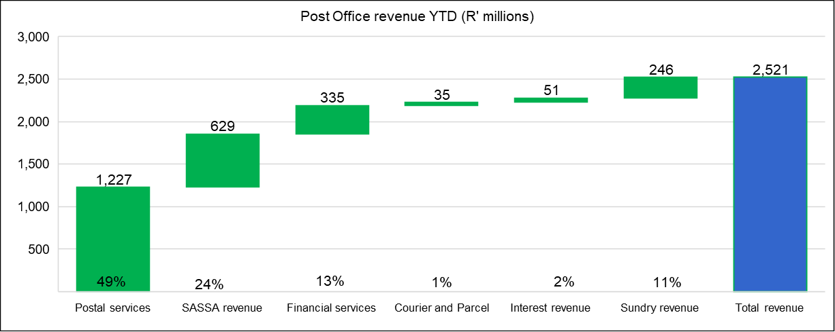
Revenue Performance
Postal services remains the key revenue contributor

Slide 9
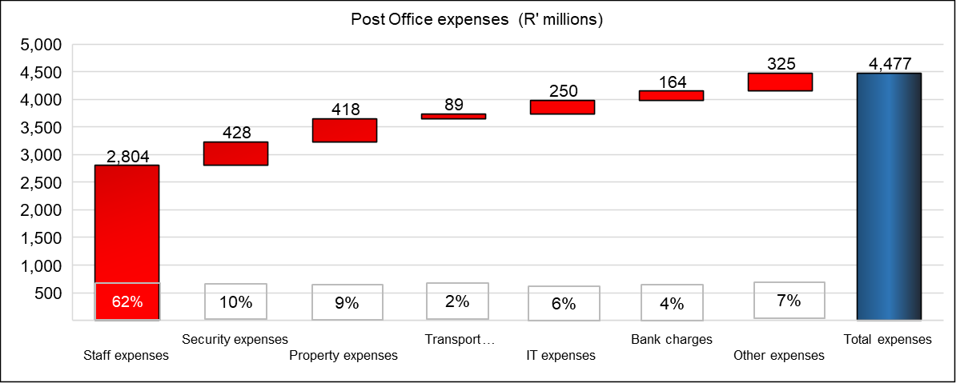
Expense Performance
The key cost driver remains staff costs with 62% contribution of total expenses

Slide 10
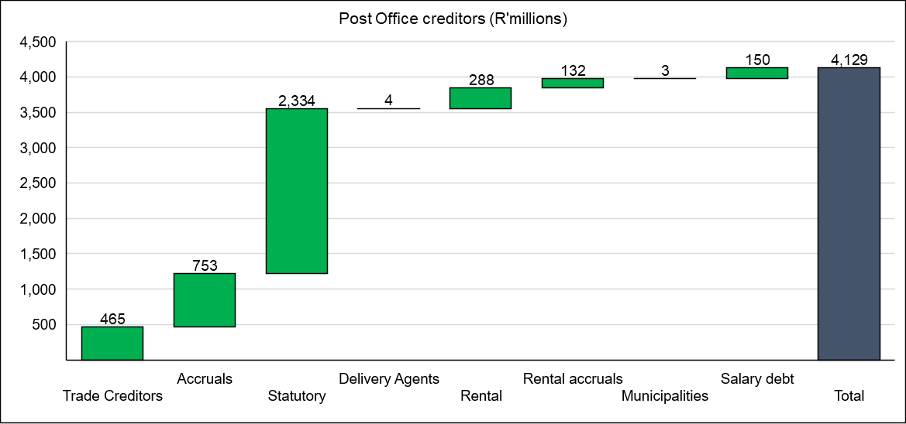
Creditors
Excludes R2.2 billion owed to Postbank
The increasing liabilities and backlog in supplier payments threatens business continuity

Slide 11
Performance on Targets
Corrective actions being implemented to improve Q3 Performance
No change in overall performance on KPIs at 20%, from Q2
Financial performance and recovery remains weak
Greater oversight through the Business performance Committee to improve performance

Slide 12
KPI Performance Overview – Q3 2021/22
No. | Corporate Key Performance Indicator (KPI) | Annual Target | Q3 Target | Q3 Performance
 |  |  |  | Actual | Variance | % Achieved
1.1 | Attain the planned revenue target | 100% | 100% | 69.6% | (30.4%) | 70%
1.2 | Attain the planned expense budget | 100% | 100% | 82.4% | 17.6% | 82%
2.1 | Implement security upgrades and install equipment items at Post Office branches and Mail Centres | 1680 | 120 | 16 | -104 | 13%
2.2 | Optimisation of the Property Infrastructure | 265 000 | 147 000 | 19 255 | (127 745) | 13%
3.1 | Resolution of customer complaints recorded at the call centre within 7 days | 100% | 100% | 74.0% | (26.0%) | 74%
3.2 | Improve customer satisfaction | 75% | Implement corrective actions for 25% of survey findings | 0.0% | Implement corrective actions for 25% of survey findings | 0%
4.1 | Achieve the regulated Mail Delivery standard | 92% | 92% | 78.1% | (13.9%) | 85%
4.2 | Maintain system uptime at online Post Office branches | 98% | 98% | 98.1% | 0.1% | 100%
4.3 | Rollout IPS equipment | 100% | No target | N/a | N/a | N/a
5.1 | Automation of Mail Centres | 100% | 75% | 47.9% | (27.1%) | 64%
5.2 | Launch digital solutions for products and services | 2 | 1 | 1 | 0 | 100%
5.3 | Implement Omni-channel platform | 100% | 100% | 74.0% | (26.0%) | 39%
6.1 | Improve Employee satisfaction | 70% | Implement corrective actions for 25% of survey findings | 0% | Implement corrective actions for 25% of survey findings | 0%
6.2 | Improve productivity levels | 80% | Implement productivity monitoring | Existing productivity model for Mail Centres & Depots being reviewed | Implement productivity monitoring | 0%
6.3 | Implement BU strategic Initiatives | 100% | 75% | 69.0% | (6.0%) | 92%
7.1 | Improve the Audit Opinion | Unqualified audit opinion | 90% of the material audit findings resolved | 0.0% | 90% of the material audit findings resolved | 0%
7.2 | Provide inputs to the amendments of Postal Legislation (SAPO Act, Postal Services Act, Postbank Act, 4IR) | Inputs Submitted to Shareholder | No target | N/a | N/a | N/a
TOTAL |  | 17 | 15 | 3 | 12 | 20%

Slide 13
KPI Performance – Q3 2021/22
Objective | Goal | KPI Ref | Key Performance Indicator | Q3 Performance
 |  |  |  | Target | Actual | Variance | Achieved/ | Actual Performance and Reason for Target Variance/Deviation | Mitigation and Recovery Plans
 |  |  |  |  |  |  | Not Achieved
1. Financial Sustainability | To be financially sustainable and | 1.1 | Attain the planned revenue target | 100% | 70% | -30% | Not Achieved | The revenue target for Q3 at R1 186 million has not been attained at R825 million (70%). The lower than projected revenue performance is due to the lingering effects of the Covid-19 lockdown and the associated business impact, increased customer migration to digital alternatives and transaction volumes, together with the weak financial position of the SA Post Office and suppliers not having been paid, thus withdrawing services, further impacting revenue generation. Covid-19 lockdown and associated business slowdown Customer migration and transaction volumes Digital substitution Lack of technology Investment System and hardware instability Tools of trade Operational performance Product offering Stock levels Closure of branches | Account managers are focusing on maintaining existing clients whilst seeking new revenue streams. Maintain and grow existing business, recover lost business where possible. Focus on opening municipality accounts for the AARTO rollout Improve stock levels to cater for demand Delivery of mail is adhered to as per delivery standards Activation of dormant Speed Services and CFG database is in progress through Sales support Engagement of small courier companies for co-loading specifically focusing on B2B service Calling all government Franking Machine and Messenger Services to upload their machine and to renew their contract Working with Private Bag and Boxed for Government as to increase our revenue DOT / AARTO - Increase in Hybrid Mail (Engagements underway to use eRegistered mail) Warehousing and distribution of medication eCommerce - parcel distribution and online transactions Expand MVL offering and transactions Fast-track DTT STB Subsidised Market Registration and Distribution for the DCDT DTT STB Retailing – unsubsidised market Digital Post-box/email Electronic Mail and SMS
 |  | 1.2 | Attain the planned expense budget | 100% | 82% | 18% | Achieved | The expense budget for Q3 is R1 731 million and has been attained at R1 426 million (82%).Staff cost of R2 803 million is below budget by R280 million (9%) with a year on year decrease of R76 million (3%) and includes R96 million for Post-Retirement Medical Aid. Staff costs contributes 63% towards total expenses. Transport cost of R89 million includes costs of R24 million for vehicle leases and R34 million for fuel and R19 million for national Linehaul costs.IT costs of R250 million is below budget by R84 million (25%) and includes data line costs of R189 million, software costs of R37 million and telephone expenses of R22 million. | Continued focus on prudent cost management together with cost saving initiatives: Procurement contracts Infrastructure as a Service Last mile The freeze on procurement will be maintained, focusing on critical items only.

Slide 14
KPI Performance – Q3 2021/22
Objective | Goal | KPI Ref | Key Performance Indicator | Q3 Performance
 |  |  |  | Target | Actual | Variance | Achieved/ | Actual Performance and Reason for Target Variance/Deviation | Mitigation and Recovery Plans
 |  |  |  |  |  |  | Not Achieved
2. Optimised Assets and Infrastructure | Achieve a positive return on assets | 2.1 | Implement security upgrades and install equipment items at Post Office branches and Mail Centres | 120 | 16 | -104 | Not Achieved | The target of installing 120 security devices/equipment for Q3 was not met with 16 installations having taken place during Q3. The status of the security infrastructure upgrade program as reprioritised, remains challenged due to financial constraints being experienced. With the inability of being able to conclude the contracted installations, SA Post Office will not be able to reduce the intended Guarding and CIT costs, which once implemented, will apart from improving security at Branches, and bring about reduced costs for such services. Reasons for deviation include the Non-payment of supplier and funding availability | To prioritise those security measures that will apart of enhancing effective security at branches, bring about reduced costs pertaining to CIT and Guarding Services
 |  | 2.2 | Optimisation of Property Infrastructure | R147m | R19.2m | -R127.7m | Not Achieved | During Q2, a saving of R4.48 million for rental expenses was generated due to the amalgamation / consolidation and closure of branches, however no initiatives were committed in terms of the revenue optimisation program and no sale of properties took place. Procurement process has delayed the rental income initiative | Bid Evaluation completed and recommendation to BAC. Assess all Company owned buildings that have potential for generating income

Slide 15
KPI Performance – Q3 2021/22
Objective | Goal | KPI Ref | Key Performance Indicator | Q3 Performance
 |  |  |  | Target | Actual | Variance | Achieved/ | Actual Performance and Reason for Target Variance/Deviation | Mitigation and Recovery Plans
 |  |  |  |  |  |  | Not Achieved
3. Customer and Communities First | Continued service provision in underserviced communities, improve customer experience at all point of presence & enhanced brand equity | 3.1 | Resolution of customer complaints recorded at the call centre within 7 days | 100% | 74% | -26% | Not Achieved | The target of 100% resolution of customer complaints within the required 7 days has not been attained, at 74% for Q3, a negative variance of 26% on target., due to: Delayed implementation of the call centre management system Lack of funding for the new call centre system Poor delivery standards Non-scanning of items Tracking errors since introduction of new system - in transit, incoming, not on system Delayed feedback from BUs Feedback accountability in BUs Delays in approval of compensation to customer’s results in customers referring their complaints to ICASA Branch related problems – attitude, general performance caused by parcel location, slowness of connection of parcels from province to province especially with internationally parcels. Branch closures | Upgrade of the Customer Call Centre and Remedy system Inclusion and involvement of the RGMs is gradually helping Customer Services with speedy feedback from the Regions Administering of Regional Customer Services by Regional Management is assisting National Customer Services
 |  | 3.2 | Improve customer satisfaction level | Implement corrective actions for 25% of survey findings | 0% | Implement corrective actions for 25% of survey findings | Not Achieved | The target for Q3 has not been achieved due to the delayed implementation of the CSS findings for 2020/21FY. | Implementation of the findings of the CSS Conduct CSS for annual target for 2021/22FY

Slide 16
KPI Performance – Q3 2021/22
Objective | Goal | KPI Ref | Key Performance Indicator | Q3 Performance
 |  |  |  | Target | Actual | Variance | Achieved/ | Actual Performance and Reason for Target Variance/Deviation | Mitigation and Recovery Plans
 |  |  |  |  |  |  | Not Achieved
4. Efficient Systems & Processes | Improved service delivery to all customers | 4.1 | Achieve the regulated Mail Delivery standard | 92% | 78% | -14% | Not Achieved | The performance for Q3 is at 78.08%, 13.92% below target. There has been a slight improvement from Q2 at 73% to Q3 at 78%, an increase of 5% quarter on quarter. Logistics now running according to a new temporary schedule which is showing some improvement but are still not achieving the standard as all routes do not run daily. Central Region switched vehicles with KwaZulu-Natal due to hi-jacking’s taking place in KwaZulu-Natal. However the contracted monthly kilometres is less than required to run the routes daily. When maximum kilometres are reached we need to stop utilising the vehicles. This often happens in the first week of the month. Daily carry-overs in the Logistic arena cause a see-saw effect at Hubs when the mail arrives. During the last week of December very few vehicles were running. Additional vehicles have been withdrawn. In some areas we only have large trucks which cannot be utilized effectively to transport mail to and within the last mile. Maintenance on motor-bikes taken long due to payment issues to suppliers. Shortage of vehicles at certain times of the month is still problematic e.g. during SASSA payments. Some of the mail sorting machines are not operational and parts are hard to come by, this effects the processing speed and productivity at DURMAIL, CAPEMAIL, WITSPOS and TSHWANEMAIL is especially affected by this. Awaiting parts inter alia belts, mother boards and ink. Volumes lodged especially dated mail is still very low -small sample sizes recorded when testing. Closure of Hubs, Depots Lobbies, Box Sections and Branches when positive cases of COVID-19 are detected for decontamination results in loss of time within the value chain. Upington and Nelspruit Hub was locked out due to non-payment of rent. A shortage of bicycle spares still a concern. Some of the Delivery Agents contracts were not renewed and we re-aligning these areas with Postmen and alternative delivery options. Shortage of staff at some work areas especially postmen. On some day’s delivery could not take place due to the bad weather conditions. A number of work areas were closed in the last week of December due to low volumes. | Increase sampling where possible when volumes increase. Awaiting larger volumes to be lodged to ensure cost effective movement of mail. Continues review of the time of collections and drop-offs at branches to see if the routes can be covered with less vehicles. Sweep teams were introduced in the Delivery area to assist with reducing carry-overs. However this will be limited as additional vehicles are been extracted from the fleet. Some personnel utilise their private vehicles to assist and we also utilise public transport where possible for postmen Continuously requesting Finance to pay suppliers that impact on the delivery standards, including delivery agents where we still have them. Submitted critical positions to be filled for approval. Management and support staff still assisting whenever possible to clear carry-overs. Reviewing Mail Test results to show short comings.
 |  | 4.2 | Maintain system availability uptime at online Post Office branches | 98.00% | 98.09% | 0.09% | Achieved | The system availability uptime target of 98% for Q3 has been achieved at 98.09%, a variance of 0.09% on target. On 23 December 2021 around 10:00am an issue was reported on one of SAPO’s Internet routers. Upon investigation it was determined that the hardware was faulty and had to be replaced. On 24 December 2021 the router was replaced. After router replacement SAPO experienced connectivity issues to various servers/systems on the network. This matter was resolved through fixing routing configuration after Internet router replacement. This resulted in downtime of 26 hours between 23 -25 December 2021. SharePoint challenges as documented still remains. | Upgrade of Data Centre. Technology is in the process of reviewing the Top 10 applications based on new applications deployed and changes in business model (e.g. Postbank split) and where required, additional systems will be added for tracking purposes. A total of 1 270 of 1 329 sites have been fully commissioned with new equipment and upgraded connectivity, a 97% achievement of the network upgrade project. 59 sites remain to be completed of which with 20 are workable sites but require alternative solutions and 39 non-workable due to outstanding Landlord Approvals and viable infrastructure availability at remote sites.

Slide 17
KPI Performance – Q3 2021/22
Objective | Goal | KPI Ref | Key Performance Indicator | Q3 Performance
 |  |  |  | Target | Actual | Variance | Achieved/ | Actual Performance and Reason for Target Variance/Deviation | Mitigation and Recovery Plans
 |  |  |  |  |  |  | Not Achieved
5. Business Modernisation and Digital Transformation Digital Transformation | Improved market relevance through business modernisation, digital transformation and increased customer access to digital services | 5.1 | Automation of mail Centres | 75% | 48.20% | -1.80% | Not Achieved | The target for Q3 has not been achieved with 47.9% against the target of 75% with a negative variance of 27.10%. 19 million items were machine sorted of the total of 39.8 million standard mail items. Machine parts are not available at Durmail and therefore the machine is not functional. No machine-able mail was recorded for KZN in October and December 2021, impacting negatively on the overall performance | Management intervention is to be prioritised in order to optimise machine usage and increased machine throughput. Purchasing of spare parts in progress – specification document completed. Tracking of this KPI will ensure renewed focus to minimise manual sorting. As part of broader Automation of Mail Centre program, research on Open Source IoT technology was initiated through Unisa as part of the broader design of internet of things.
 |  | 5.2 | Launch digital solutions for products and services | 1 | 1 | 0 | Achieved | The target for Q3 was achieved with one solution launched during Q2. Items for development and implementation include: Electronic Messaging Services was launched in October 2021 for the RTIA. | Remote /Mobile Customer Declaration System (CDS) is moving to the Cloud and processes are underway.
 |  | 5.3 | Implement Omni Channel Platform | 100% | 74% | -26% | Not Achieved | The Q3 target at 100% has not been achieved with performance of 74%. Project status Enterprise Application Integration and Modernisation A RFI has been published to gather industry and related input to enable SA Post Office to prepare a RFP. Await outcome of the RFI report SAPO in collaboration with Postbank implemented a new payment channel for SRD-350 which enables grant recipient to transact at various merchants (Pick & Pay, Checkers, and Boxer etc.) SAPO went out on an RFP for eRegistered mail solution to enable a customer to submit electronic data or mail to the South African Post Office SAPO in collaboration with SITA, is in the process of implementing an electronic eRegistered mail service for the Infringement Notice to RTIA/RTMC Clients Sub-projects supporting the Omni-channel strategy E-Commerce Market Place – SA Post Office has identified the nop-Commerce solution for implementation Integration Platform and API Management - Upgrade of the Integration Platform and Migration of the Platform are in the planning stages Onboarding e-Commerce clients for Logistics -The following customers have been successfully integrated on IPS: Wish.Com, Mail Americas, Signature Mail, ICE, CNE | Enterprise Application Integration and Modernisation - Review the submitted RFI responses & submit report. Sub-projects: E-Commerce Market Place - Commence configuration of e-Commerce Market Place. Integration Platform and API Management - Upgrade to the supported version of the Integration platform. Awaiting response from SITA with regard to Integration Platform as a Service. The estimated implementation date is anticipated in Q4 of 2021/22FY. This is dependent on procurement approval and availability of funding.

Slide 18
KPI Performance – Q3 2021/22
Objective | Goal | KPI Ref | Key Performance Indicator | Q3 Performance
 |  |  |  | Target | Actual | Variance | Achieved/ | Actual Performance and Reason for Target Variance/Deviation | Mitigation and Recovery Plans
 |  |  |  |  |  |  | Not Achieved
6. Culture of Excellence | Improved Organisational Performance, engaged and high performing employees | 6.1 | Employee satisfaction assessment | Implement corrective actions for 25% of survey findings | 0% | Implement corrective actions for 25% of survey findings | Not Achieved | The Q3 target for 25% of the findings of the previous Employee Satisfaction Survey (ESS) conducted during 2020/21FY to be implemented has not been achieved. Many of the factors that influence the ESS are outside the scope and control of Human Resources, and are of a repetitive nature, requiring capital funding to address | Funding availability to address ESS aspects.
 |  | 6.2 | Improve productivity levels | Implement productivity monitoring | Existing productivity model for Mail Centres & Depots being reviewed | Implement productivity monitoring | Not Achieved | The Q3 target was not achieved. Currently Operations uses a productivity model for Mail Centres and Depots. This is currently being reviewed with applicable productivity measures and standards and will be further enhanced to include a productivity management suite. | Completion of the productivity model
 |  | 6.3 | Implement BU strategic initiatives | 75% | 69% | -6% | Not Achieved | The implementation of BU strategic initiatives is not progressing well and the Q3 target has not been attained. To date, 91 initiatives of a total of 131 initiatives (69%) are at various stages of implementation. The performance has slowed due to a number of the initiatives being funding dependent for implementation. | Group Strategy will actively drive and monitor the process of BU strategic initiative implementation, where not funding dependent.

Slide 19
KPI Performance – Q3 2021/22
Objective | Goal | KPI Ref | Key Performance Indicator | Q3 Performance
 |  |  |  | Target | Actual | Variance | Achieved/ | Actual Performance and Reason for Target Variance/Deviation | Mitigation and Recovery Plans
 |  |  |  |  |  |  | Not Achieved
7. Corporate Governance | Strengthened Organisational Governance, entrenched and consistently applied Governance principles in managing the organisation | 7.1 | Achieve an unqualified Audit Opinion | 90% of the material audit findings resolved | 0% | 90% of the material audit findings resolved | Not Achieved | The target for the resolution of material audit findings is 90% by end of Q3 and was not achieved. A total of 29 Category A audit findings was reported for the Post Office South Africa and this is the basis of measurement. 0 findings of the 29 findings were resolved as at 31 December 2021. As the AG audit process was only completed in October/November 2021 and the final Management letter was only issued in December 2021, no work could be started as long as the audit process was not complete. | Plans are in place to ensure that all the items are resolved and tracked over the next 3 months being January to March 2022. Discussions and detailed actions are already in the process of being developed. Weekly reporting of the status to the SAPO Exco will commence in February 2022.
 |  | 7.2 | Provide inputs to the amendments of Postal Legislation (SAPO Act, Postal Services Act, Postbank Act, 4IR) | No Target

Slide 20
THANK YOU

