Slide 1
Access to diversified media for alla
PRESENTATION
Portfolio Committee on Communications
Quarter 3 and 4 performance and expenditure report 2021/22

Slide 2
CONTENTS
INTRODUCTION
OVERVIEW OF THE ORGANISATIONAL ENVIRONMENT
SUMMARY OF ORGANISATIONAL PERFORMANCE
SUMMARY OF ACHIEVEMENTS
INTERNAL ENVIRONMENT HIGHLIGHTS
NOT ACHIEVED/DELAYED TARGETS
PROGRAMME PERFORMANCE INFORMATION
MDDA BOARD OF DIRECTORS
FINANCIAL INFORMATION

Slide 3
Introduction
The legal requirement related to the production of quarterly performance reports is reflected in the Treasury Regulations. Section 5.3.1, which states that the Accounting Officer of an institution must establish procedures for quarterly reporting to the Executive Authority to facilitate effective performance monitoring, evaluation and corrective action.
Quarterly performance reports function as an ‘early warning system’ to alert departments to areas of weak performance, potential problems and where corrective action is required. This in-year monitoring report also serves as an oversight tool to the Department of Planning, Monitoring and Evaluation (DPME) and National Treasury (NT) and, as a management tool for departments.
The 2021/22 Third and Fourth Quarter Performance Report provides achievements against the targets set in the 2021/22 Annual Performance Plan.
The reported performance information has been verified by Internal Audit for validity and accuracy.

Slide 4
Overview of Organisational Environment
The Agency complied with the legislative requirements of National Treasury, DPSA and DPME by submitting the following documents:
The third and fourth quarter 2021/22 performance report was submitted to National Treasury and Executive Authority according to prescribed legislation.
The third and fourth quarter 2021/22 financial reports were compiled and submitted to National Treasury according to prescribed legislation.
The MDDA is reporting against the MDDA Strategic Plan for 2020/2021 – 2024/25 and Annual Performance Plan for 2021/2022 as tabled in Parliament in March 2021.

Slide 5
2021/22 Q3 Staff Establishment
ORGANISATION
ADDITIONAL POSTS
FIXED TERM AND SECONDED STAFF:
1
APPROVED
POSTS:
41
LEADERSHIP
FILLED POSTS:
37
% OF FILLED POSTS:
90.2%
EXECUTIVE COMMITTEE
APPROVED: 4
FILLED : 4
VACANT POSTS
4
VACANCY RATE
9.8%
MANAGEMENT
APPROVED: 10
FILLED : 08

Slide 6
2021/22 Q4 Staff Establishment
ORGANISATION
ADDITIONAL POSTS
FIXED TERM AND SECONDED STAFF:
1
APPROVED
POSTS:
42
LEADERSHIP
FILLED POSTS:
37
% OF FILLED POSTS:
88.1%
EXECUTIVE COMMITTEE
APPROVED: 4
FILLED : 4
VACANT POSTS
5
VACANCY RATE
11.9%
MANAGEMENT
APPROVED: 10
FILLED : 08

Slide 7
2021/22 Q3 Staff Establishment per Occupational Classification
Occupational levels | Approved headcount | Quarter 3 2021/22 (Permanent) | Fixed Term and Seconded
Top Management | 4 | 4
Management | 10 | 8
Professional qualified | 22 | 20
Skilled level | 4 | 4 | 1
Semi-skilled (1-5) | 1 | 1
Total | 41 | 37 | 1

Slide 8
2021/22 Q4 Staff Establishment per Occupational Classification
Occupational levels | Approved headcount | Quarter 4 2021/22 (Permanent) | (Contractor and Seconded)
Top Management | 4 | 4
Management | 10 | 8
Professional qualified | 23 | 20
Skilled level | 4 | 4 | 1
Semi-skilled (1-5) | 1 | 1
Total | 42 | 37 | 1

Slide 9
2021/22 Q3 Recruitment Progress

Slide 10
2021/22 Q4 Recruitment Progress

Slide 11
2021/22 Q3 Employment Equity Per Occupation
Occupational Levels | Male |  |  |  | Female |  |  |  | Total | Disability | Foreign Nationals
 | A | C | I | W | A | C | I | W |  | All | Male | Female
Top management | 1 | 0 | 1 | 0 | 2 | 0 | 0 | 0 | 4 | 0 | 0 | 0
Management | 4 | 0 | 0 | 0 | 3 | 0 | 1 | 0 | 8 | 0 | 0 | 0
Professionally qualified | 7 | 0 | 0 | 0 | 13 | 0 | 0 | 0 | 20 | 0 | 0 | 0
Skilled level | 2 | 0 | 0 | 0 | 2 | 0 | 0 | 0 | 4 | 1 | 1 | 0
Semi-skilled | 0 | 0 | 0 | 0 | 1 | 0 | 0 | 0 | 1 | 0 | 0 | 0
TOTAL PERMANENT | 14 | 0 | 1 | 0 | 21 | 0 | 1 | 0 | 37 | 0 | 0 | 0
TOTAL FIXED-TERM-EMPLOYEES | 1 | 0 | 0 | 0 | 1 | 0 | 0 | 0 | 1 | 0 | 0 | 0
GRAND TOTAL | 15 | 0 | 1 | 0 | 22 | 0 | 1 | 0 | 38 | 1 | 1 | 0

Slide 12
2021/22 Q4 Employment Equity Per Occupation
Occupational Levels | Male |  |  |  | Female |  |  |  | Total | Disability | Foreign Nationals
 | A | C | I | W | A | C | I | W |  | All | Male | Female
Top management | 1 | 0 | 1 | 0 | 2 | 0 | 0 | 0 | 4 | 0 | 0 | 0
Management | 4 | 0 | 0 | 0 | 3 | 0 | 1 | 0 | 8 | 0 | 0 | 0
Professionally qualified | 7 | 0 | 0 | 0 | 13 | 0 | 0 | 0 | 20 | 0 | 0 | 0
Skilled level | 2 | 0 | 0 | 0 | 2 | 0 | 0 | 0 | 4 | 1 | 1 | 0
Semi-skilled | 0 | 0 | 0 | 0 | 1 | 0 | 0 | 0 | 1 | 0 | 0 | 0
TOTAL PERMANENT | 14 | 0 | 1 | 0 | 21 | 0 | 1 | 0 | 37 | 0 | 0 | 0
TOTAL FIXED-TERM-EMPLOYEES | 1 | 0 | 0 | 0 | 0 | 0 | 0 | 0 | 1 | 0 | 0 | 0
GRAND TOTAL | 15 | 0 | 1 | 0 | 21 | 0 | 1 | 0 | 38 | 1 | 1 | 0

Slide 13
2021/22 Q3 Summary Of Organisational Performance
MDDA 2021/2022 APP has 22 Output Indicators. Of these
16 had targets for Q3 of 2021/2022
13 of these targets were achieved, ie 81% achievement
Programme | Q3 targets | Achieved | Not achieved
Programme 1 Administration | 6 | 6 | 0
Programme 2 Grant & Seed Funding | 4 | 2 | 2
Programme 3 Partnerships, Public Awareness & Advocacy | 3 | 3 | 0
Programme 4 Capacity Building & Sector Development | 2 | 2 | 0
Programme 5 Innovation, Research & Development | 1 | 0 | 1

Slide 14
2021/22 Q4 Summary of Organisational Performance
MDDA 2021/2022 APP has 22 Output Indicators. Of these
15 had targets for Q3 of 2021/2022
13 of these targets were achieved, ie 87% achievement
Programme | Q 4 targets | Achieved | Not achieved
Programme 1 Administration | 6 | 6 | 0
Programme 2 Grant & Seed Funding | 4 | 3 | 1
Programme 3 Partnerships, Public Awareness & Advocacy | 3 | 3 | 0
Programme 4 Capacity Building & Sector Development | 1 | 1 | 0
Programme 5 Innovation, Research & Development | 1 | 0 | 1

Slide 15
2021/22 Q3 Summary of the Achievements

Slide 16
2021/22 Q3 Summary of the Achievements

Slide 17
2021/22 Q4 Summary of the Achievements
STAKEHOLDER ENGAGEMENT
The MDDA has remained committed to implementing training interventions aimed at Capacity Building and Sector Development. To this end, the Research and Training unit in partnership with projects unit conducted content generation training for digital hubs to equip community media. Furthermore, during Quarter four (4), the unit partnered with the Film and Publication Board (FPB) in implementing Safer Internet Day (SID) 2022 activities. Moreover, the unit collaborates with NEMISA in hosting Future Proofing Community Radio Workshop in Gauteng and Western Cape during the quarter. The The MDDA managed to launch four (04) brand new state of the art-studios such as Radio Turf, uKhahlamba FM, Tubatse FM, and Motheo FM.

Slide 18
2021/22 Q4 Summary Of The Achievements
FUNDING PROPOSALS
The MDDA also made good progress in its stakeholder and partnership initiative, the agency’s hosted its Annual Funders Breakfast session in Emperors Palace. The MDDA Funders Break-fast is an annual event held with current and prospective funders on MDDA key interventions, report on previous funding commitments and presentation of future projects for consideration. The Funders Breakfast is also an opportunity for MDDA to fundraise for future projects.

Slide 19
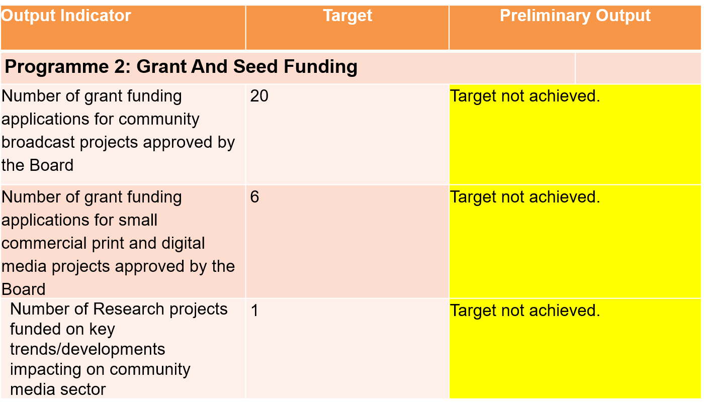
2021/22 Q3 Not Achieved Targets

Slide 20
2021/22 Q4 Not Achieved Targets
Output Indicator | Target | Preliminary Output
Sub-Programme 2.2: Monitoring and Evaluation
Annual evaluation report on funded projects identifying thematic findings from M&E reports approved by the Board | Final annual evaluation report approved by the Board | Target not achieved.
PROGRAMME 5: INNOVATION, RESEARCH, AND DEVELOPMENT
Community Media Sustainability Model developed | Submission of draft research report on Community Media Sustainability Model | Target not achieved.

Slide 21
Programme Performance Information
The 2021/2022 MDDA Annual Performance Plan has five programmes, with in total 22 output indicators.
OUTCOME
An accessible, developmental, diversified and sustainable media
Programme 1 - Governance and Administration
Programme 2 - Grant and Seed Funding
Programme 3 - Partnerships, Public Awareness and Advocacy
Programme 4 - Capacity Building and Sector Development
Programme 5 - Innovation, Research and Development

Slide 22
Programme 1: Governance and Administration
Programme 1:
Governance and Administration
Purpose
The programme ensures effective leadership, strategic management and operations, through continuous refinement of organisational strategy and the implementation of the appropriate legislation and best practice.
Outcome
Capable, effective, and ethical organisation in support of the delivery of the MDDA mandate by 2024.

Slide 23
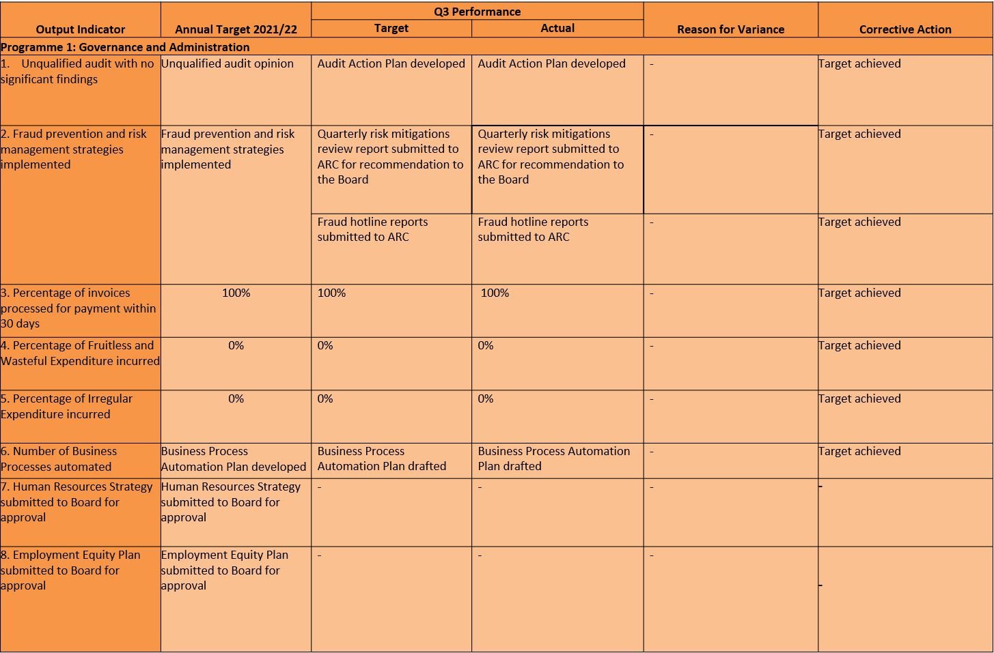
Programme 1: Governance and Administration

Slide 24
Programme 1: Governance and Administration
Output Indicator | Annual Target 2021/22 | Q4 Performance |  | Reason for Variance | Corrective Action
 |  | Target | Actual
Programme 1: Governance and Administration
1. Unqualified audit with no significant findings | Unqualified audit opinion | Audit Action Plan submitted to Audit & Risk Committee | Audit Action Plan submitted to Audit & Risk Committee | - | Target achieved
2. Fraud prevention and risk management strategies implemented | Fraud prevention and risk management strategies implemented | Quarterly risk mitigations review report submitted to ARC for recommendation to the Board | Quarterly risk mitigations review report submitted to ARC for recommendation to the Board | - | Target achieved
 |  | Fraud hotline reports submitted to ARC | Fraud hotline reports submitted to ARC | - | Target achieved
3. Percentage of invoices processed for payment within 30 days | 100% | 90% | 100% | Positive variance is a result of the implementation of controls over 30 days, the payment register is reviewed regularly, and communication is held with suppliers to ensure invoices are paid on time | Target achieved
4. Percentage of Fruitless and Wasteful Expenditure incurred | 0% | 0% | 0% | - | Target achieved
5. Percentage of Irregular Expenditure incurred | 0% | 0% | 0% | - | Target achieved
6. Number of Business Processes automated | Business Process Automation Plan developed | Business Process Automation Plan finalised | Business Process Automation Plan finalised | - | Target achieved
7. Human Resources Strategy submitted to Board for approval | Human Resources Strategy submitted to Board for approval | - | - | - | -
8. Employment Equity Plan submitted to Board for approval | Employment Equity Plan submitted to Board for approval | - | - | - | -

Slide 25
Programme 2: Grant and Seed Funding
Programme 2:
Grant and Seed Funding
Purpose
The programme promotes media development and diversity through financial and non-financial support for community broadcasting as well as community and small commercial print projects. The programme consists of two strategic objectives, encapsulated in two sub-programmes.
Outcome
Digital responsive community-based media sector by 2024

Slide 26
Programme 2: Grant and Seed Funding Sub-programme: Community and Small Commercial Media
Output Indicator | Annual Target 2021/22 | Q3 Performance |  | Reason for Variance | Corrective Action
 |  | Target | Actual
Programme 2: Grant and Seed Funding
Sub-Programme 2.1: Community and Small Commercial Media
8. Number of grant funding applications for community broadcast projects approved by the Board | 20 | 20 | 0 | The Board meeting which has the authority to approve projects was deferred to the fourth quarter. | The board to approve broadcast projects in Q4
9. Number of grant funding applications for small commercial print and digital media projects approved by the Board | 6 | 6 | 0 | The Board meeting which has the authority to approve projects was deferred to the fourth quarter. | The board to approve print and digital media projects in Q4
10. Number of media projects provided with digital support | 13 | 3 | 7 | Overachievement was due to high demand for digital support from our beneficiaries, intensified by Covid 19. | Target achieved

Slide 27
Programme 2: Grant and Seed Funding Sub-programme: Community and Small Commercial Media
Output Indicator | Annual Target 2021/22 | Q4 Performance |  | Reason for Variance | Corrective Action
 |  | Target | Actual
Programme 2: Grant and Seed Funding
Sub-Programme 2.1: Community and Small Commercial Media
8. Number of grant funding applications for community broadcast projects approved by the Board | 20 | - | - | - | -
9. Number of grant funding applications for small commercial print and digital media projects approved by the Board | 6 | - | - | - | -
10. Number of media projects provided with digital support | 13 | 3 | 4 | Variance is due to the high demand for digital support needed by beneficiaries | Target achieved

Slide 28
Programme 2: Grant and Seed Funding Sub-programme: Monitoring and Evaluation
Output Indicator | Annual Target 2021/22 | Q3 Performance |  | Reason for Variance | Corrective Action
 |  | Target | Actual
Programme 2: Grant and Seed Funding
Sub-programme 2.2: Monitoring and Evaluation
11. Annual evaluation report on funded projects identifying thematic findings from M&E reports approved by the Board | 1 | - | - | - | -
12. Number of monitoring reports on compliance to MDDA grant-in-aid contract produced | 65 | 20 | 20 | - | Target achieved
13. Number of evaluation reports produced | 1 | - | - | - | -

Slide 29
Programme 2: Grant and Seed Funding Sub-programme: Monitoring and Evaluation
Output Indicator | Annual Target 2021/22 | Q4 Performance |  | Reason for Variance | Corrective Action
 |  | Target | Actual
Programme 2: Grant and Seed Funding
Sub-programme 2.2: Monitoring and Evaluation
11. Annual evaluation report on funded projects identifying thematic findings from M&E reports approved by the Board | 1 | Final annual evaluation report approved by the Board | 0 | The final annual evaluation report was earmarked to be produced at the end of March 2022; however, the board is sitting on 22 April 2022. | The future report will be in line with the board meeting schedule. Target not achieved.
12. Number of monitoring reports on compliance to MDDA grant-in-aid contract produced | 65 | 5 | 6 | Relaxation of COVID-19 regulations enabled the Unit to cover more projects on-site visits conducted | Target achieved
13. Number of evaluation reports produced | 1 | 1 | 1 | - | -

Slide 30
Programme 3: Partnerships, Public Awareness and Advocacy
Programme 3:
Partnerships, Public Awareness and Advocacy
Purpose
This programme seeks to position the MDDA as a leading influencer and authoritative voice in the community and small commercial media, by playing a key role in the national dialogue on the sector, through implementation of strategic partnerships to carry out media development and diversity interventions.
Outcome
A diverse and sustainable community-based media

Slide 31
Programme 3: Partnerships, Public Awareness And Advocacy
Output Indicator | Annual Target 2021/22 | Q3 Performance |  | Reason for Variance | Corrective Action
 |  | Target | Actual
Programme 3: Partnerships, public awareness and advocacy
14. Number of stakeholder engagements held | 4 | 1 | 4 | Met with SAASTA to review our partnership agreement on placement of interns in community media. Met with the AIP about the Economic Development Fund (Competition Commission – on how the Publishers could benefit from it. Met with Corruption Watch on media buying. | Target achieved
15. Number of media engagements held | 12 | 3 | 16 | More projects were launched during the quarter because of an accumulated backlog of 20 stations due to Covid. More interview requests were received from various media houses to explain the role of community media in the local government election. | Target achieved
16. Number of proposals for funding and support presented to potential and existing stakeholders | 6 | 2 | 2 | - | Target achieved

Slide 32
Programme 3: Partnerships, Public Awareness And Advocacy
Output Indicator | Annual Target 2021/22 | Q4 Performance |  | Reason for Variance | Corrective Action
 |  | Target | Actual
Programme 3: Partnerships, public awareness and advocacy
14. Number of stakeholder engagements held | 4 | 1 | 4 | More stakeholder engagements were organised and conducted for the Deputy Minister's visits to several Provinces | Target achieved
15. Number of media engagements held | 12 | 3 | 12 | More requests were received for interviews from various media houses | Target achieved
16. Number of proposals for funding and support presented to potential and existing stakeholders | 6 | 1 | 1 | - | Target achieved

Slide 33
Programme 4: Capacity Building and Sector Development
Programme 4:
Capacity Building and Sector Development
Purpose
One of the objectives of the Agency outlined in the MDDA Act of 2002 is to “encourage the development of human resources, training and capacity building within the media industry, especially amongst historically disadvantaged groups”. In response to this, the Agency has developed capacity building programmes, which aim to provide community and small commercial media with necessary skills needed for effective performance in day-to-day work.
Outcome
Capacitated, digital responsive community-based media sector by 2024.

Slide 34
Programme 4: Capacity Building and Sector Development
Output Indicator | Annual Target 2021/22 | Q3 Performance |  | Reason for Variance | Corrective Action
 |  | Target | Actual
Programme 4: Capacity building and sector development
17. Number of training interventions aimed at capacitating the community media with skills aligned to the findings of the 2020/21 skills assessment | 6 | 2 | 2 | - | Target achieved
18. Number of media literacy workshops conducted | 2 | 1 | 1 | - | Target achieved
19. Number of reading initiatives held | 1 | - | - | - | Target achieved
Output Indicator | Annual Target 2021/22 | Q1 Performance |  | Reason for Variance | Corrective Action
 |  | Target | Actual
Programme 4: Capacity building and sector development
17. Number of training interventions aimed at capacitating the community media with skills aligned to the findings of the 2020/21 skills assessment | 6 | - | - | - | -
18. Number of media literacy workshops conducted | 2 | 1 | 2 | The Unit partnered with the Film and Publications Board (FPB) in commemorating Child Protection Week (CPW) from 30/05/2021 to 06/06/2021. Events were held in Polokwane and the Waterberg District -Mogalakwena Municipality. The Unit was only able to partner on two events in Polokwane and Mokopane repsectively. | Target achieved
19. Number of reading initiatives held | 1 | - | - | - | -

Slide 35
Programme 4: Capacity Building and Sector Development
Output Indicator | Annual Target 2021/22 | Q4 Performance |  | Reason for Variance | Corrective Action
 |  | Target | Actual
Programme 4: Capacity building and sector development
17. Number of training interventions aimed at capacitating the community media with skills aligned to the findings of the 2020/21 skills assessment | 6 | 2 | 3 | The Unit was able to overachieve on its APP targets as a result of partnerships and collaborations. These collaborations were both internally and externally. The Unit partnered with the project’s unit on the implementation of content generation training for digital hubs. Furthermore, the unit partnered with NEMISA in hosting Future Proofing Community Radio Workshop in Gauteng and Western Cape | Target achieved
18. Number of media literacy workshops conducted | 2 | - | - | - | Target achieved
19. Number of reading initiatives held | 1 | - | - | - | Target achieved
Output Indicator | Annual Target 2021/22 | Q2 Performance |  | Reason for Variance | Corrective Action
 |  | Target | Actual
Programme 4: Capacity building and sector development
17. Number of training interventions aimed at capacitating the community media with skills aligned to the findings of the 2020/21 skills assessment | 6 | 2 | 7 | There was effective project management from both Projects Unit and R&T. It was imperative to close the Brandvlei grant how-ever this could not be done as the training component of the grant was yet to be completed. | Target achieved
18. Number of media literacy workshops conducted | 2 | - | - | - | -
19. Number of reading initiatives held | 1 | 1 | 1 | - | Target achieved

Slide 36
Programme 5: Innovation, Research and Development
Programme 5:
Innovation, Research and Development
Purpose
The MDDA Act 14 of 2002 on Section 3 (VI) outlines the objectives of the Agency to include (amongst others) to “encourage research regarding media development and diversity”. There is also a lack of research and information specific to the sectors that inform programme development and strategic focus (e.g., not much information on the number of indigenous language newspapers in SA, number of readers of such newspapers, etc.). The purpose of this programme is therefore to champion research, development and innovation to create a media development and diversity body of knowledge by 2024.
Outcome
A diverse and sustainable community-based media.

Slide 37
Programme 5: Innovation, Research & Development
Output Indicator | Annual Target 2021/22 | Q3 Performance |  | Reason for Variance | Corrective Action
 |  | Target | Actual
Programme 5: Innovation, Research and Development
20. Number of Research projects funded on key trends/developments impacting on community media sector | 2 | 1 | 0 | Entity experienced challenges with Moonraises Strategic Solutions Pty Ltd, the service provider appointed during the financial year 2020/21 to conduct content monitoring research on community media’s coverage on the Local Government Elections. The service provider was due to submit a draft report with findings on 30 November 2021. The service provider has indicated that they had challenges with the acquisition of POEs and therefore were unable to submit a draft report. | A memorandum requesting a contract extension has been submitted to the CEO for approval.
21. Community Media Sustainability Model developed | Community Media Sustainability Model draft research report submitted by the service provider | - | Literature review and Inception report submitted by the service provider | - | -

Slide 38
Programme 5: Innovation, Research & Development
Output Indicator | Annual Target 2021/22 | Q4 Performance |  | Reason for Variance | Corrective Action
 |  | Target | Actual
Programme 5: Innovation, Research and Development
20. Number of Research projects funded on key trends/developments impacting on community media sector | 2 | - | - | - | -
21. Community Media Sustainability Model developed | Community Media Sustainability Model draft research report submitted by the service provider | Submission of draft research report on Community Media Sustainability Model | o | There was a Procurement delay which resulted to project to kickstart late. The unit met with Redflank on the 24th of March 2022 therefore the service provider commenced with a mapping exercise and engagements with stakeholders. Currently, the service provider is preparing data collection instruments. | The unit requested the service provider to expedite data collection and assign more human resources for this assignment in order to complete the project timeously. Target not achieved.

Slide 39
2021/22 Q3 MDDA Board of Directors
The MDDA Act states that the MDDA Board shall comprise nine members.
The Board consists of nine members; six members are appointed on the recommendation of Parliament, following a public nomination process which is open, transparent, and with the publication of a shortlist of candidates for appointment.
Three members are appointed by the President, taking into consideration the funding of the Agency, one of whom is appointed from the commercial print media, and another appointed from the commercial broadcast media.
The President of the Republic of South Africa appoints one of the members as Chairperson of the Board. Members are appointed on a non-executive basis and are required to commit to fairness, freedom of expression, openness, and accountability. Members take an oath or affirmation before performing duties, committing themselves to uphold and protecting the Constitution and the other laws of the Republic.
The third quarter of the financial year saw the appointment of Mr Hoosain Karjieker to the Board of Directors as a commercial print media representative, in line with section 4 (c) of the MDDA Act. Mr. Karjiekar is currently Mail & Guardian Media’s Chief Executive Officer and serves as Chairperson on the Board of Publishers Support Services (PSS). He brings to the Agency a wealth of knowledge and expertise built on an illustrious career in the sector.

Slide 40
2021/22 Q3 MDDA Board of Directors
The Agency has two vacancies for publicly nominated members of the Board. The vacancies are a concern to management and the Board. The MDDA has keenly followed the recruitment proceedings by the Portfolio Committee on Communications (PCC). At its last sitting, the PCC reported that it was awaiting the reports and security clearance from the State Security Agency on the shortlisted candidates.
During its meeting on the 9th of November 2021, the Parliamentary Portfolio Committee on Communications (PCC) examined the MDDA's 2020/21 Annual Report and Financial Statements. Strategic planning sessions were held on the 21st of October and the 25th of November 2021 in which the updated Strategic Plan 2020/21 – 2024/25 was considered. Short interviews of Board Members with an independent facilitator preceded the strategic planning session to determine areas of focus for the session. The interviews were crucial in ensuring that the strategic planning sessions were as effective as possible.
On the 19th of November 2021, the Board met with the Ministry in the Presidency. The meeting focused on Strategic Developments at the MDDA and served as an introductory meeting between the Minister and the MDDA Board. A Board representative and members of the Management Team accompanied the Deputy Minister in the Presidency to the unveiling of Vibe FM's and Radio 7441's state-of-the-art broadcast studios.
The Board of Directors Subcommittee on the MDDA Amendment Bill held a meeting to consider the progress on the draft Amendment Bill on the 3rd of December 2021. Management received several important recommendations from the subcommittee during the meeting, which are being implemented accordingly.

Slide 41
2021/22 Q3 Board Meetings
Board
Name | Position | Meeting Attendances (1)
Mr Hlengani Mathebula | Board Chairperson | 1
Ms Zanele Mngadi | Member | 1
Ms Nadia Bulbulia | Member | 1
Ms Andiswa Ngcingwana | Member | 1
Ms Marina Clarke | Member | 1
Ms Brenda Leonard | Member | 1
Audit and Risk
Name | Position | Meeting Attendances (1)
Mr Fortune Mkhabela | Committee Chairperson | 1
Ms Margaret Phiri | Member | 1
Ms Matseliso Shongwe | Member | 1
Mr Simon Mankgaba | Member | 1
Ms Brenda Leonard | Alternate Board Representative | 1
Internal Audit | Standing Invitation | 1
External Audit | Standing Invitation | 1

Slide 42
2021/22 Q4 MDDA Board of Directors
The MDDA Act states that the MDDA Board shall comprise nine members.
The Board consists of nine members; six members are appointed on the recommendation of Parliament, following a public nomination process which is open, transparent, and with the publication of a shortlist of candidates for appointment.
Three members are appointed by the President, taking into consideration the funding of the Agency, one of whom is appointed from the commercial print media, and another appointed from the commercial broadcast media.
The President of the Republic of South Africa appoints one of the members as Chairperson of the Board. Members are appointed on a non-executive basis and are required to commit to fairness, freedom of expression, openness, and accountability. Members take an oath or affirmation before performing duties, committing themselves to uphold and protecting the Constitution and the other laws of the Republic.
The Board assumes ultimate accountability and responsibility for the performance and affairs of the Agency and in so doing effectively represents and promotes the legitimate interests of the Agency. The Board, at all times, retains full and effective control over the MDDA and directs and supervises the business affairs of the Agency.

Slide 43
2021/22 Q4 MDDA Board of Directors
The Agency presently has two vacancies for publicly nominated members of the Board. The MDDA keenly follows the recruitment procedure for the vacancies. The National Assembly (NA) at its plenary sitting resolved to recommend Ms. Martina Della-Togna and Ms. Carol Mohlala as candidates for consideration to serve on the Media Development and Diversity Agency (MDDA). The recruitment process is anticipated to be finalised in due course.
The Board of Directors held several meetings during the fourth quarter, its ordinary meeting was on the 26th of January 2022 wherein the performance of the organisation was considered, as well as other matters of importance such as policies and various project proposals from management.
The Board continues to enjoy the support and leadership of the Executive Authority. Meetings with the Board and management to deliberate on matters of significance took place during the period under review. Board representatives and Management accompanied the Deputy Minister in the Presidency to various studio launches including Radio Turf in Limpopo on the 5th of February 2022, Ukhahlamba FM in KwaZulu Natal on the 19th of March 2022, and Motheo FM in the Free State on the 19th of March 2022.

Slide 44
2021/22 Q4 MDDA Board of Directors
The MDDA also successfully held its Annual Funders Breakfast on the 11th of March 2022, the Deputy Minister in the Presidency, Board members, and Management were in attendance.
On the 8th of March 2022, the Portfolio Committee on Communications meeting was held, and the Chairperson of the Board accompanied by MDDA management made presentations to the Committee.

Slide 45
2021/22 Q4 Board Meetings
Board
Name | Position | Meeting Attendances (3)
Mr Hlengani Mathebula | Board Chairperson | 3
Ms Zanele Mngadi | Member | 2
Ms Nadia Bulbulia | Member | 2
Ms Andiswa Ngcingwana | Member | 2
Ms Marina Clarke | Member | 3
Ms Brenda Leonard | Member | 3
Mr Hoosain Karjiekar | Member | 3
Audit and Risk
Name | Position | Meeting Attendances (3)
Mr Fortune Mkhabela | Committee Chairperson | 2
Ms Margaret Phiri | Member | 3
Ms Matseliso Shongwe | Member | 2
Ms Andiswa Ngcingwana | Member | 1
Ms Brenda Leonard | Alternate Member | 2
Mr Simon Mankgaba | Member | 3
Internal Audit | Standing Invitation | 2
External Audit | Standing Invitation | 2

Slide 46
2021/22 Q3 Finance Information (Budget vs Actual )
Table No.3: Operating Revenue
Description (R Values) | BUDGET |  | Actual 2021/22 Financial Year |  | Full Year Forecast
 | 2021/22 Budget | YTD Budget | YTD Actual | % Variance
Broadcast Funders | 64 948 917 | 48 711 688 | 62 915 428 | 29% | 64 948 917
Grants income | 60 187 627 | 45 140 720 | 24 796 661 | -45% | 60 187 627
Other Income: Interest | 3 601 039 | 2 700 779 | 1 586 709 | -41% | 3 601 039
Total Income | 128 737 583 | 96 553 187 | 89 298 798 | -8% | 128 737 583

Slide 47
2021/22 Q3 Budget vs Actual (Cont)
MDDA earns revenue mainly from three sources: Transfers from Department of Communications, contribution from the broadcasters and interest from short term investments. Table below depicts revenue earned from beginning of the 2021/22 financial year up to the 31st of December 2021 compared to the projected budget.
Interest earnings were lower than anticipated for the first three quarters of 2021/22 financial year. An error on the Reserve bank account was discovered and communication was issued to the bank. The erroneous interest income will be corrected on the fourth quarter. Multichoice has already paid its contribution and other broadcast contributions are expected to be received by the end of December 2021 and early fourth quarter. The revenue of the EDF will be recognised as and when the conditions are met. Quarterly payments from GCIS are still outstanding.

Slide 48
2021/22 Q3 Budget vs Actual (Cont)
Table No.4 : Operating Expenditure
Description (R Values) | Budget |  | Actual 2021/22 Financial Year |  | Full Year Forecast
 | 2021/22 Budget | YTD Budget | YTD Actual | % Variance
Grant Expenditure | 89 374 998 | 67 031 248 | 59 545 785 | -11% | 89 374 998
MDDA Board costs | 1 308 442 | 981 332 | 949 867 | -3% | 1 308 442
Administration Costs | 12 659 187 | 9 494 390 | 6 864 052 | -28% | 12 659 187
Employee Costs | 35 444 896 | 26 583 672 | 24 136 887 | -9% | 35 444 896
Total Expenditure | 138 787 523 | 104 090 642 | 91 496 591 | -12% | 138 787 523

Slide 49
2021/22 Q3 Budget vs Actual (Cont)
Grant expenditure - has had lower than anticipated expenditure as a result of Sentech fees being paid recently, the call for applications has not been concluded yet, the Board is set to sit at the end of January 2022.
Board costs depicts slightly lower than budgeted expenditure as these meetings have been held virtually which cuts down on traveling and all other costs. The budget depicts a full complement of the Board.
Administrative costs depict favourable variance mainly due to cost containment measures being implemented as well as most staff members working from home. Administration cost include depreciation.
Salaries budget is underspent as a result of vacant positions.
MDDA has been filling in Vacant posts, as at the 31st of December only four vacant position remains.

Slide 50
2021/22 Q4 Finance Information (Budget vs Actual )
Table No.3: Operating Revenue
Description (R Values) | BUDGET |  | Actual 2021/22 Financial Year |  | Full-Year Forecast
 | 2021/22 Budget | YTD Budget | YTD Actual | % Variance
Broadcast Funders | 64 948 917 | 64 948 917 | 64 663 968 | 0% | 64 948 917
Grants income | 60 187 627 | 60 187 627 | 33 051 661 | -45% | 60 187 627
Other Income: Interest | 3 601 039 | 3 601 039 | 3 519 247 | -2% | 3 601 039
Total Income | 128 737 583 | 128 737 583 | 101 234 876 | -21% | 128 737 583

Slide 51
2021/22 Q4 Budget vs Actual (Cont)
MDDA earns revenue mainly from three sources: Transfers from the Department of Communications, contributions from the broadcasters, and interest from short-term investments. The table below depicts revenue earned from the beginning of the 2021/22 financial year up to the 20th of March 2021 compared to the projected budget.
Interest earnings were slightly higher than anticipated for the fourth quarter of the 2021/22 financial year, interest rates were increased towards the end of the year, however, the first few quarters suffered from the reduced interest rate which resulted in the reduced interest income, Multichoice has already paid its contribution and other broadcast contributions are expected to be received by the end of March 2022. The revenue of the EDF will be recognised as and when the conditions are met.

Slide 52
2021/22 Q4 Budget vs Actual (Cont)
Table No.4: Operating Expenditure
Description (R Values) | Budget |  | Actual 2021/22 Financial Year |  | Full-Year Forecast
 | 2021/22 Budget | YTD Budget | YTD Actual | % Variance
Grant Expenditure | 89 374 998 | 89 374 998 | 70 876 626 | -21% | 89 374 998
MDDA Board costs | 1 308 442 | 1 308 442 | 1 223 429 | -6% | 1 308 442
Administration Costs | 12 659 187 | 12 659 187 | 10 955 630 | -13% | 12 659 187
Employee Costs | 35 444 896 | 35 444 896 | 33 538 770 | -5% | 35 444 896
Total Expenditure | 138 787 523 | 138 787 523 | 116 594 454 | -16% | 138 787 523

Slide 53
2021/22 Q4 Budget vs Actual (Cont)
Grant expenditure - has had lower than anticipated expenditure as a result of Sentech fees being paid recently, the call for applications has not been concluded yet, the Board sat at the end of January 2022 to approve projects, the Board Chairperson is expected to sign the grant agreements at the end of March 2022. There were slower payments on the EDF as anticipated.
Board costs depict slightly lower than budgeted expenditure as these meetings have been held virtually which cuts down on traveling and all other costs. The budget depicts a full complement of the Board.
Administrative costs depict favorable variance mainly due to cost containment measures being implemented as well as most staff members working from home.
MDDA has been filling in Vacant posts, as of the 20th of March only five vacant position re-mains (the New HR Manager and the Print Manager have been appointed and would be starting at the beginning of the new financial year).

Slide 54
Thank you

