Slide 1
Education
STANDING COMMITTEE ON EDUCATION
WCED DATA USAGE
16 August 2022

Slide 2
PRESENTATION BRIEF
16 August 2022
13:00-16:00- SC on Education
Venue: Virtual (MS Team)
Agenda:
Briefing by the Western Cape Education Department on how the WCED utilise data; what type of data and what are the contributions that the WCED are making through the National Data-driven District project as part of the South African School Administration and Management System (SA-SAMS).

Slide 3

CONTENT
WCED Landscape
Policy environment
Education data
WCED Systems for collection of Education data
Provincial Systems vs National Systems
Data collection process (including Data Quality)
Data utilization (Strategic, Tactical, Operational)
Reporting – Various levels
Future data initiatives

Slide 4

WCED Landscape

Slide 5

Quality Education
for every child
in every classroom
in every school
in the province.

Slide 6
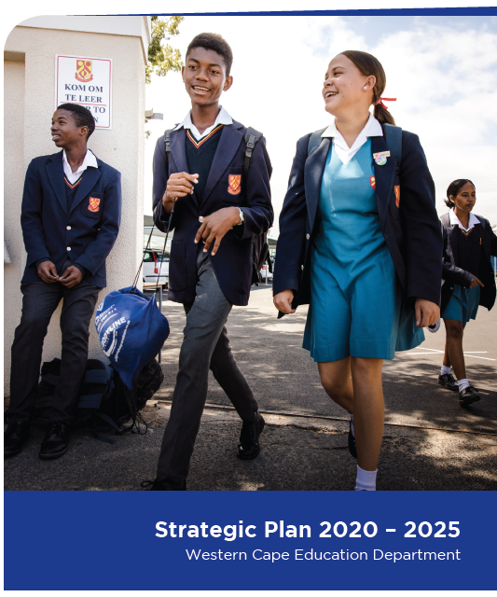









STRATEGIC PRIORITIES OF THE DEPARTMENT
Collaboration
between Directorates
and Departments
Expand efficiencies
and modify our
approach to
audit outcomes
Decrease
administrative
burden
3 Priorities
Improve resource
allocation in terms
of budget
Online blended
digital learning
1
2
Foundation Phase learning
(Language + Maths)
Develop new and
innovative delivery
modalities
3
Transform
the User
experience
design
Well-being and
psycho-social support
OUTCOME: 2024
Efficiency
Resilience
Creativity

Slide 7




WCED LANDSCAPE
43 129
NUMBER OF STAFF EMPLOYED
7 243 536
POPULATION IN WESTERN CAPE
Online & Blended Learning
Decrease Administrative Burden
Immediate
focus areas in
support of policy
priorities
21%
Administrative Support
79%
Educator professionals
129 462 km²
SIZE OF WESTERN CAPE
Foundation Phase Learning (Math & Lang)
Well-being & Psycho-social Support
SPECIAL SCHOOLS
ORDINARY SCHOOLS
PRIMARY SCHOOLS
1003
SECONDARY SCHOOLS
359
COMBINED SCHOOLS
34
SCHOOL GOVERNING BODY
HEAD OFFICE & DISTRICTS
INTERMEDIATE SCHOOLS
60
SPECIAL SCHOOLS
75
PRE-PRIMARY SCHOOLS
8
EARLY CHILDHOOD DEVELOPMENT CENTRES
ECD
CENTRES
1566
1.2 million LEARNERS
SERVICE DELIVERY PLATFORM
Notes:
Season workers
Cross border visitors

Slide 8
MIGRATION TO THE WESTERN CAPE
Population increase: Population by Province
28,8% population increase 2001 – 2011.
Trajectory continues 2013 – 2024

Slide 9
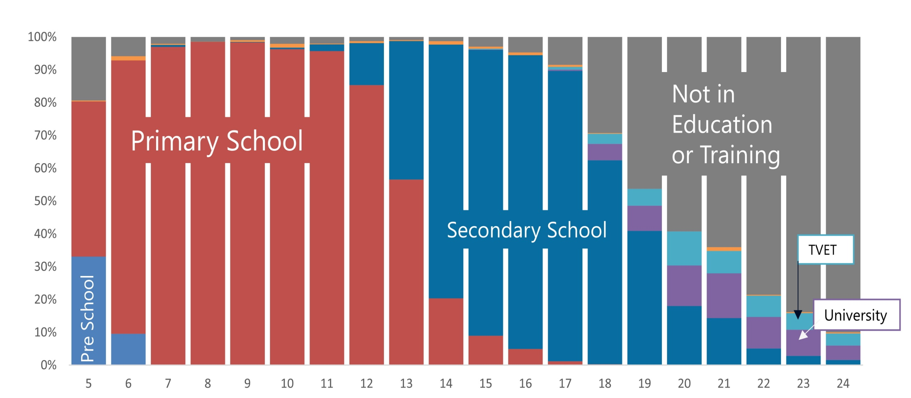
UNIVERSAL ACCESS TO EDUCATION
Source: General Household Survey, 2021

Slide 10

Policy Environment

Slide 11


NATIONAL AND PROVINCIAL LEGISLATION (DATA MANDATE)
South African Schools Act
  Section 59 - “Duty of schools to provide information”
    A school must make information available for inspection by any person, insofar as such information is required for the exercise and protection of such person’s rights.
    Every school must provide such information about the school as is reasonably required by the Head of Department or the Director-General of the national Department of Education in consultation with the Head of Department.
South African Schools Act
  Section 3(4)
    (4) Subject to the provisions of subsections (1) to (3), the Minister shall determine national policy for the planning, provision, financing, co-ordination, management, governance, programmes, monitoring, evaluation and well-being of the education system and, without derogating from the generality of this section, may determine national policy for—
      education management information systems, including the provision of data in accordance with the international obligations of the government;

Slide 12

derived
Enumeration
basic
User defined
Data Types

Slide 13
DATA TYPES
Learners
Biographical
Infrastructure
Educators
Register of Schools
Biographical
Feeding
Performance
Repairs
New Projects
Renumeration
Business Processes
LTS
LTSM
Attendance

Slide 14

Provincial System vs National System

Slide 15



WCED DATA SYSTEMS
CEMIS vs SA-SAMS
CEMIS is a Learner Tracking and Provincial School Management System. Schools access the solution via the internet and transact around the following business process:
Learner Enrolment – allows for the registration of new learners(real-time transaction)
Transfer of learners – facilitates the transfer of learners between schools(real-time transaction)
Unlike CEMIS, SA-SAMS is a standalone system which does not allow for learner real-time transacting or learner tracking
EIS vs DDD
EIS allows for Business Intelligence (BI) Reporting off the data collected via CEMIS
Reports are available to Schools, Circuits, Districts and Head Office and allows for transparency, oversight and accountability with regards to data input.
Notes:
Set the scene that WCED utilizes CEMIS as appose to SA-SAMS. CEMIS is a transactional system which is online, live. Key Feature – Learner tracking due to the online capability SA-SAMS used by rest of the PEDs. Standalone, offline – Tracking only possible via centralized LURITS system – all PEDS upload data to LURITS - problematic due to timing of the uploads

Slide 16

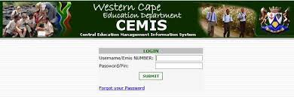
CONTRIBUTIONS WCED MAKES IN TERMS OF SA-SAMS
      CEMIS remain mandatory system for transacting and reporting for WCED schools
      WCED supports 23 schools using SA-SAMS;
      SA-SAMS used for localized school usage;
      Support structures in liaison with DBE;
      DBE currently in process of replacing SA-SAMS with online solution; and
      WCED providing input and CEMIS expertise to contribute to the Education Management Information Systems (EMIS) context.

Slide 17


CONTRIBUTIONS WCED MAKES IN TERMS OF DDD PROJECT
The WCED does not used SA-SAMS and has it own BI solution to process and analyze the data
The DBE and MSDF engaged the WCED on placing data on the DDD however after evaluation - not feasible to replace the WCED solution with DDD
EduInfoSearch is currently the sole portal (web interface) for publication and access to common WCED reports. Webfocus, the BI software tool, allows integration of datasets from all WCED primary applications in real time. Thus, it instantaneously turns raw data into useable information assets from a credible data source.
The WCED Operational BI system has the following capabilities:
    Departmental-wide historical reports and dashboards, i.e., answers the question “What happened?”
    Business process automation of critical business processes such as grade changes, enabled by workflow functionality between identified transactional systems and the BI system
    Real-time reporting from selected systems
    Near real-time reporting (from replicated data repositories)
    A certain level of self-service capability (custom build functionality)
    Provision of attribute data to the Provincial GIS
Notes:
WCED only has a footprint of 23 schools – Schools not transacting to DDD – National tool developed by MSDF

Slide 18

WCED Systems for collection of Education data

Slide 19
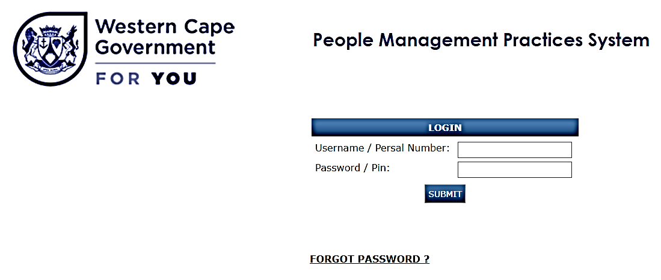
WCED DATA COLLECTION SYSTEMS
CEMIS
    School
    Learner Information (Biographical, Learner performance, Attendance, etc.)
PMPS
    Educator Information (Biographical, Attendance, Etc.)
Notes:
WCED only has a footprint of 23 schools – Schools not transacting to DDD – National tool developed by MSDF

Slide 20
DATA COLLECTION PROCESSES
      SNAP
      10th day school day survey(Ordinary Schools)
      1st Tuesday in March (SNE Schools)
      Annual Schools Survey
      1st Tuesday in March (Ordinary Schools and ECD Centers)
      1st Thursday in March (SNE Schools)
      Quarterly Learner attendance
      Quarterly Learner performance

Slide 21
DATA QUALITY
Schools capture data
Principal validates via sign-off
CM validates via sign-off
Data validation rules via system and KM unit
Data presented to HoD for ratification
Education Data Quality Audit (Bi-Annually)

Slide 22

Data utilization

Slide 23




WCED DATA USAGE
Strategic
Education data is analyzed to establish trends and inform new strategies for improving the system.
Tactical
Education data is used to determine the most efficient use of available resources.
Operational
Education data is used to Monitor progress on implementation plans (derived form the strategic and tactical interventions) as well as evaluate the impact of these interventions.

Slide 24

HOW THE WCED UTILISES DATA
Strategic
Evidenced-based Planning and Reporting:
    Institutions (Schools – Ordinary, Special, ECD)
    Learner enrolment, attendance, subjects, etc…
    APP, QPRs, APR, WCED Strategic Plans
Resourcing and provisioning:
    Finance: Norms and standards
    Staff establishment (Basket of post)
    Learner and Teaching Support Material (including textbooks, etc...)
    Feeding Scheme
    Learner Transport Scheme

Slide 25

HOW THE WCED UTILISES DATA
Tactical
  COVID-19 statistics
  Inter-departmental collaboration:
    integrated data management – Mental Health Data Alignment
    School Safety reports and initiatives
    Wellness MANCO data provisioning/presentations/reports
  Responses to Media and Parliamentary queries/reports
  Research Data requests and initiatives

Slide 26

HOW THE WCED UTILISES DATA
Operational
Data systems:
    WCED CEMIS – provincial school admin system for real-time learner tracking data;
    DBE LURITS – Upload of CEMIS data (not in real-time);
    PMPS - Educator related information (Appointments, Attendance, etc.);
    National Exams system (NSC); and
    Transversal Finance, HR and SCM systems (BAS, PERSAL, LOGIS – managed by PT)
Automated business processes
    GIS: LTS, Infrastructure, YeBo, HomeLearning, etc…
    Gr12 registrations; and
Management reporting
    EIS : Business intelligence reporting tool
    Data sources: ASS (static), SNAP (static) , CEMIS (live)

Slide 27

Future data initiatives

Slide 28
STRATEGIES
Digital Transformation
Digitizing business for improved education delivery
i-EMIS
Integration of data across platforms (Data Harmonization)
SAMS
3rd Party School Management Systems Integration for improved data collection

Slide 29

Develop and upskill
key staff in WCED in management and analysis of data
Strengthen data at source & review how data flows through the department
Dashboarding and secondary use of data - a move towards M&E and evidence-based decision making
Data Collaboration inside the department as well as strengthening partnerships outside of the department

Slide 30
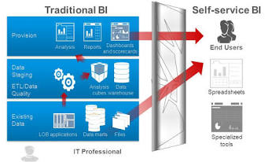

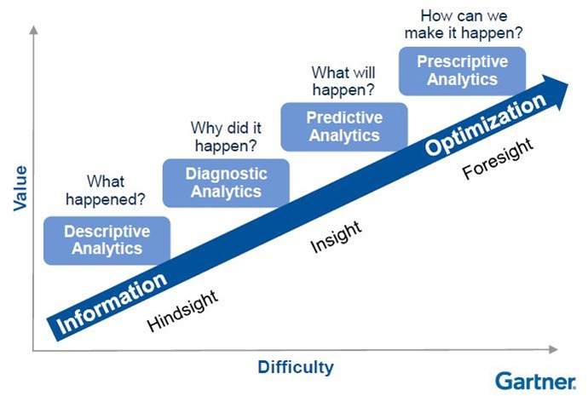
ENHANCE BUSINESS INTELLIGENCE CAPABILITIES
The following capabilities have been identified that the future BI must be able to provide:
    Self-service BI (users can interact and analyse data without the need to have extensive IT knowledge)
    Spatial analytics (leverage the location-based information in datasets)
    Predictive analytics (analyse current and historical facts to make predictions about the future)
    Mobile BI accessible on multiple devices
Notes:
SELF-SERVICE BI
Not all WCED users will require self-service BI. Self-service BI should be rolled out as per stakeholder needs analysis. Where the need is identified the users must be provided with tools and training.
Complements the enterprise or traditional BI by delivering data to department level
SPATIAL ANALYTICS
Spatial analytics adds a geographical dimension to data, analytics and visualization. In terms of WCED spatial analytics can add a geographical or location dimension to data and improve insight and decision making.
Comments from meeting: Spatial capability must be leveraged off the provincial spatial capability. Understand what we need to do to link with the provincial spatial programme (Transversal GIS Strategy].
Make the capability relevant to why capability is needed and how it could work, i.e., the context and extent to which it could work.
ANALYTICAL CAPABILITIES
Descriptive analytics (Answers “What happened?”. Current functionality.)
Diagnostic analytics (Answers “why did it happen?”)
Predictive analytics (Answers “what will happen?”)

