Slide 1
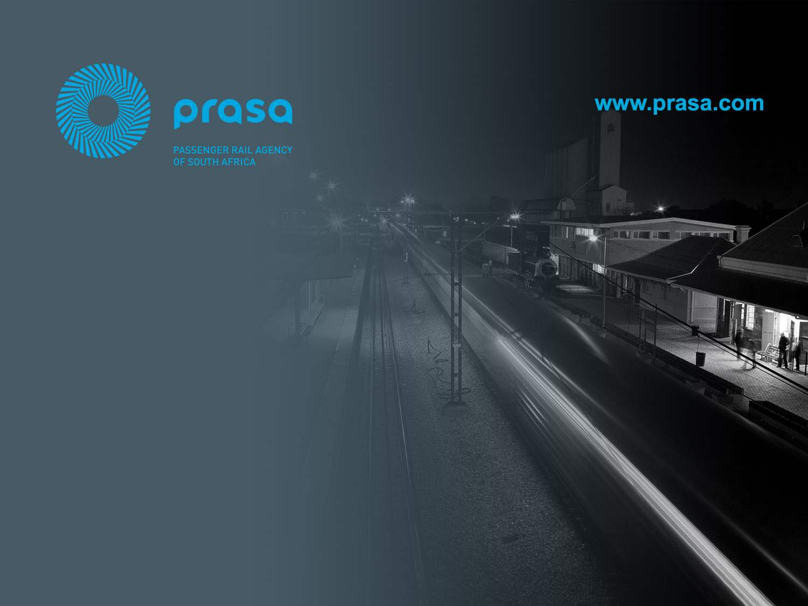
Marketing and Communication
Roll-Out Plan
Presentation:
Select Committee on Transport, Public Service and Administration,
Public Works and Infrastructure
22 June 2022

Slide 2
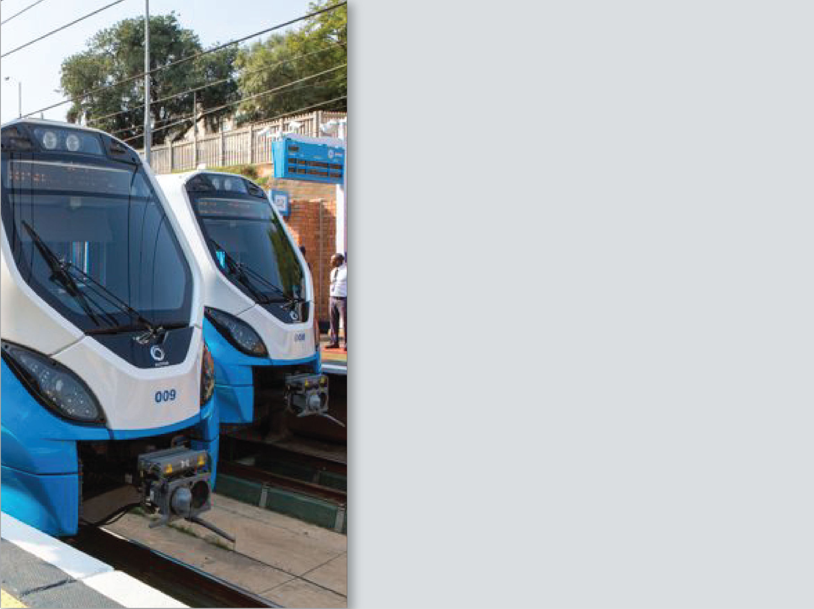
Contents:
Introduction and Context
Modernisation Programme
    2.1 Rolling Stock General Overhaul
    2.2 Rolling Stock Fleet Renewal Programme
    2.3 Signalling and Comms
Rehabilitation of the Passenger Rail Network
    3.1 Status
    3.2 Challenges
    3.3 Progress
Funding Required

Slide 3
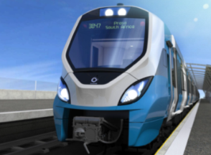
1. Introduction and Context

Slide 4
1.1 Introduction:
This presentation addresses the progress on PRASA’s modernisation programme and as progress made in rebuilding and recovery of PRASA’s rail system.
The report is set against the backdrop of the challenges PRASA is facing.
PRASA key challenges may be summarised into three main categories (PRASA’s Triple Challenge):
  Security: - Securing and protection of our assets
  Rebuilding and Service Recovery: - Reconstruction of our corridors, and resumption of train services to level stipulated in our mandate.
  Funding: - Operational Funding to Sustain the mandate, and the heightened security challenge.
Security
Funding: Operational & Capex
Rebuilding & Recovery
The Triple Challenge

Slide 5
  2. Modernization Programme
  2.1 Rolling Stock General Overhaul
  2.2 Rolling Stock Fleet Renewal Programme
  2.3 Signalling and Comms

Slide 6
2.1 Rolling Stock General Overhaul:
Strategic Infrastructure
Mega Projects: Greenview Track work
2.1.1 Rolling Stock
Heavy Maintenance Program
General Overhaul Program
Planned heavy maintenance, the primary objective is to ensure that coaches are returned to revenue-earning service in as-near-as-possible state to their original delivered standard. It is a planned maintenance, commonly referred to as ‘General Overhaul’ (GO). This maintenance is carried out periodically on a coach on a 9 to 11 years cycle.
Wrecks and Accident Damage
Wrecks: coaches destroyed as a result of arson occurrences. These coaches often require to be completely rebuilt. Accident Damage: coaches damaged in collisions and derailments. Where damages are limited corrective maintenance is carried out As and When the need arise. A percentage of these coaches form part of the annual allocation to the GO contractors.
Ad-hoc Maintenance Program
These are coaches often vandalized in our staging yards, they suffer damages such as cable cuts, components stolen, etc. Also through this program, repairs as a result of High Tension burns are carried out. This is corrective maintenance carried out As and When the need arise This maintenance is outsourced to the Technical Maintenance Support Contractors.

Slide 7
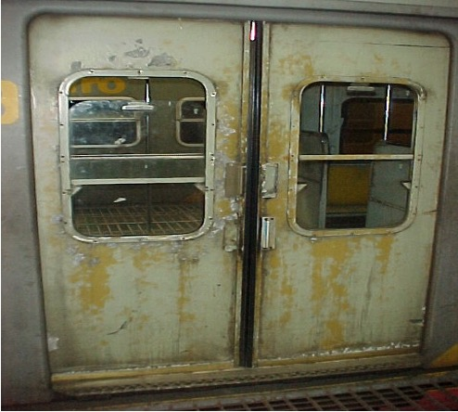
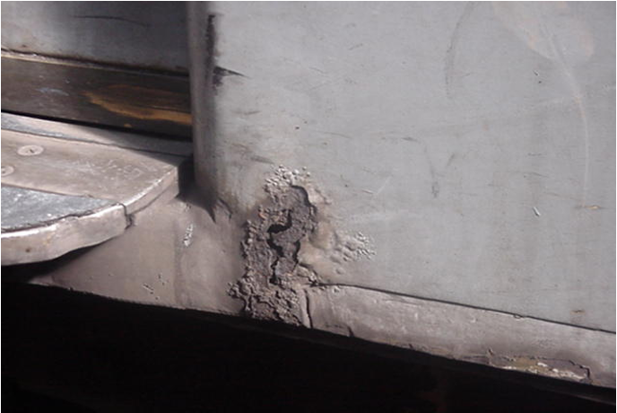
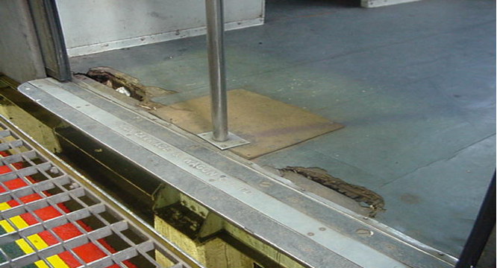
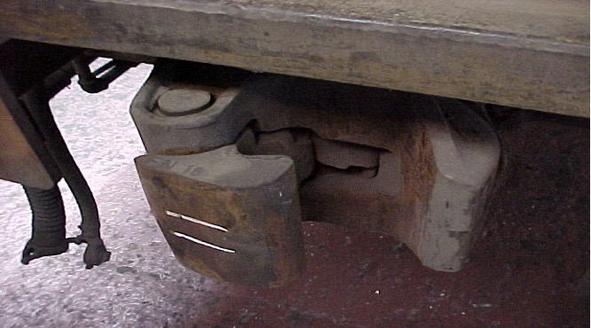
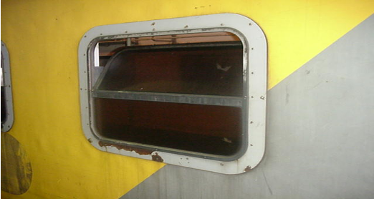
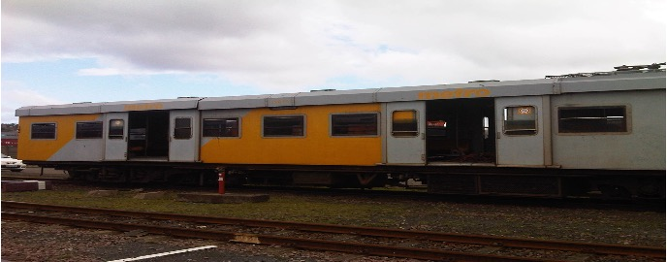
Typical Coach due for GO
…continued

Slide 8
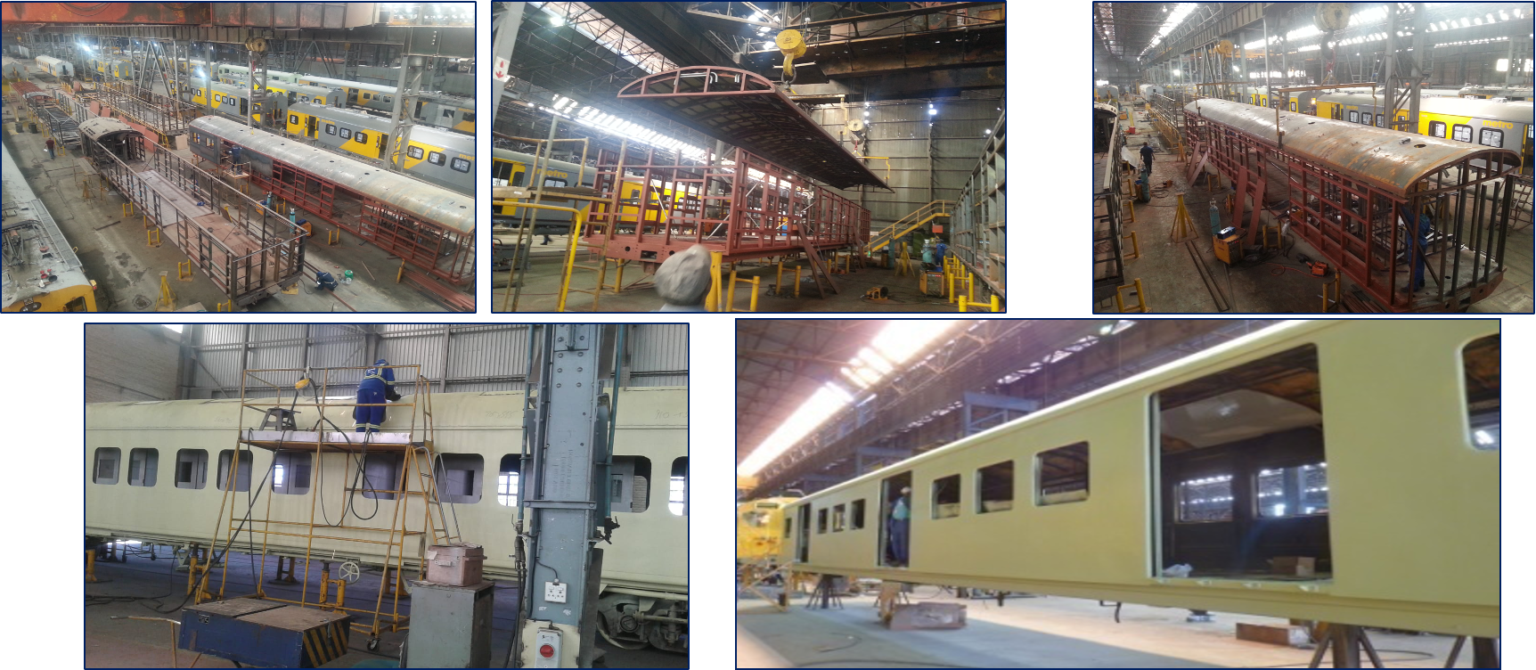
…continued
Wreck Repairs

Slide 9
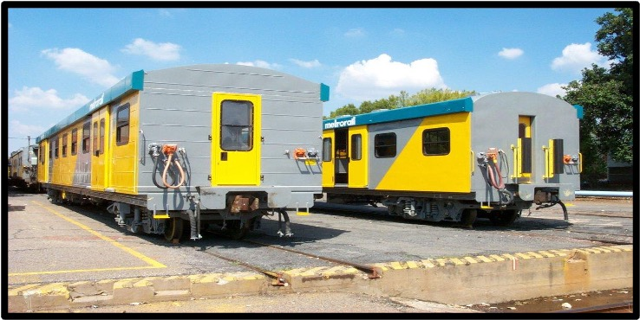
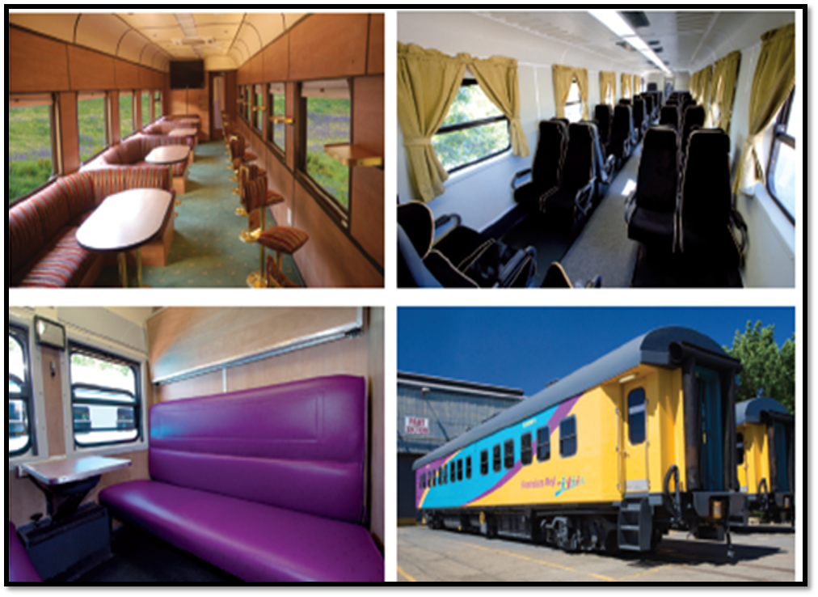
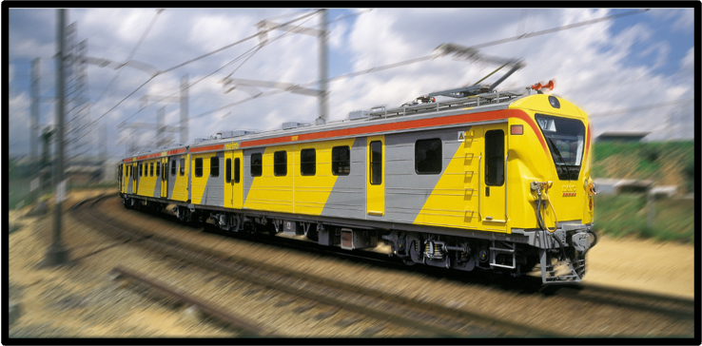
…continued
Final Product
Metrorail
Mainline Passenger Service

Slide 10
2.1.2 Appointed Contractors
…continued
Region | Gauteng | Western Cape | KwaZulu Natal | Eastern Cape
Appointed Contractors: | X2 Contractors | X1 Contractors | X2 Contractors | X2 Contractors
Note:
Four of the five contractors appointed are new entrants, which will require to be developed.
As part of the asset life cycle management, individual coaches need to undergo general maintenance every 9 to 10 years.
The plan therefore is to refurbish at least about 380-400 coaches each year for the next five years at approx. R7.5bn
The program has the potential to create up to 2000 direct jobs.
Each contractor will be required to train at least 20 youth each year.

Slide 11
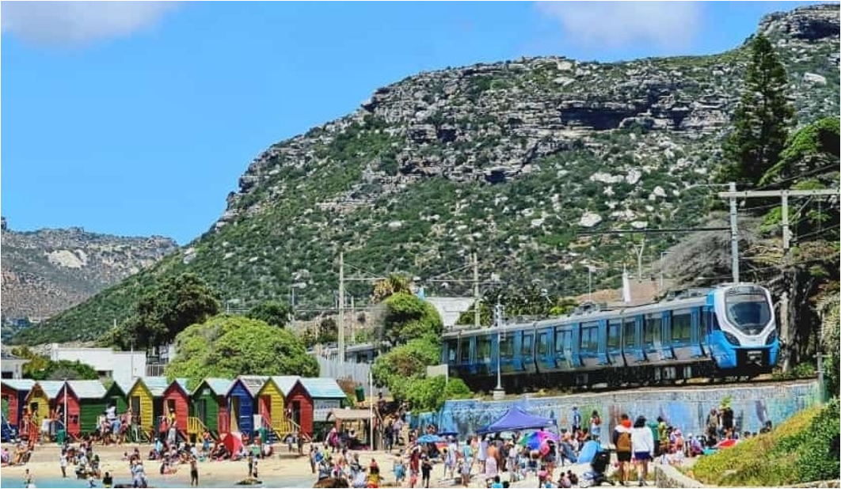
2.2 Rolling Stock Fleet Renewal Programme:
96 New Trains Provisionally Accepted (PAC) to date.
7 New Trains delivered to Wolmerton (30 April to 3 June) with 2 more expected by end June – PACs were delayed due to UHF Radio programming functionality/fit-for-purpose issue which is being resolved (June / July 2022)
GIBELA is aiming to at minimum delivering 4 new train sets per month and after doubling part of the production line may deliver 5 new train sets per month from 2023/24

Slide 12
2.2.1 GIBELA skills development achievements:
…continued
SKILLS DEVELOPMENT​ | DESCRIPTION​ | ACHIEVED TO DATE​
Bursary​ | Full bursaries are given to previously disadvantaged individuals on engineering studies through universities and TVETs​ | 858​
Transfer of Technology​ | This is work-based training focusing on employees, includes retraining of different skills category. The training is conducted at GIBELA and some of its key suppliers.​ | ​ ​ 633​
Artisans (apprenticeship)​ | This programme is focused on the youth from marginalized communities, capacitating them with artisan skills. The programme is linked to the recruitment plan of the Contractor.​ | ​ 65​
Internships​ | This programme seeks to recruit graduates and provide them with experiential training.​ | 89​
Railway Introduction Course​ | This programme is aimed at introducing the attendees (engineering students) in the railway industry, absorb them in other junior or learning positions.​ | ​ ​ 300​
Research Chair​ | The initiative focuses on research and innovation, supplier development and other innovative initiatives. The implementation partner is TUT with post graduate learners.​ | ​ 50​
Community Artisans​ | This programme is focused on the youth from marginalized communities, capacitating them with artisan skills. The programme is linked to revitalization of the manufacturing industries in South Africa.​ | ​ 160​
Community Skills Programme​ | The initiative focuses on Skills Programme which addresses the scarce skills gap​ | ​1676​

Slide 13
2.3 Signalling and Communications:
 | Project Gauteng 1 | Project Gauteng 2 | Western Cape
Description: | Design, Construction & Implementation of a New Railway Signalling System on PRASA’s Gauteng commuter rail network and Gauteng Nerve Center (GNC) |  | Design, Construction and Implementation of a New Railway Signalling System and Installation of the New Cape Town Centralized Traffic Control in Bellville
Scope | 18 interlockings to be replaced 1 New control centre GNC. 11 New equipment rooms 2 Pilot ETCS stations | 71 interlockings to be replaced 1 New CTC/Technical centre at GMR 2 New equipment rooms 52 sites have Track & OHTE works 5 + 2 ETCS stations – Pienaarspoort Corridor | 55 interlockings to be replaced 1 New Control Center Rail Management and Train Control Centre (RM&TCC). Track & OHTE Upgrades
Contract Effective Date: Duration: | April 2011 60 Months Extension – April 2022 - Complete | December 2013 60 Months Extension – 30 March 2023 | March 2012 60 Months Extension – June 2021 – Concluded (excl. Central Line)

Slide 14
2.3.1 Progress to date
…continued
Gauteng (99.13% Complete)
- 85 stations of 88 in total commissioned with new electronic interlocking systems
- 22 interfaces complete, with 13 clusters complete out of 14 clusters
- Track and OHTE Works: 47 stations complete, 3 Stations descoped ID, DLT, DER/ANG
- GNC is complete – 100%
- Level Crossing Solution in progress and Kliptown SER Bunker
- Descope of ETCS Solution for PTA – Pienaarspoort due to delay of restoration of the corridor
Western Cape (92.31% Complete)
- 35 stations of 51 in total commissioned with new electronic interlocking systems
- Southern Corridor (100%)
- Central Control Centre is Complete (100%) – RMTCC
- Central Line Re-signalling – Awaiting approval for execution and relocation of illegal settlement
Kwa-Zulu Natal (73% Complete)
- 6 stations in total commissioned of 33
- Upgrade of Central Control Centre on ground floor is almost complete,
- Pinetown Line (100%)
- Contract has been terminated. New RFP closed and Bid Evaluation Committee (BEC) appointment in progress

Slide 15
…continued
No | Task | Advert Date | Comment | Target Bid Award
1 | Kwa-Zulu Natal PRASA Train Control System | 05 Oct 2021 | Tender Closed – Evaluation to commence | 31 Dec 2022
2 | GAUTENG AND & WESTERN CAPE OPTICAL TRANSMISSION NETWORK | 08 Nov 2021 | Tender Closed – Evaluation to commence | 31 Dec 2022
3 | NATIONAL GSM-R REDUNDANCY NETWORK | 08 Nov 2021 | Tender Closed – Evaluation to commence | 31 Dec 2022
4 | GAUTENG AND & WESTERN CAPE PRASA TRAIN CONTROL SYSTEM | 01 Apr 2022 | Advertisement on hold | 31 Dec 2022
5 | NATIONAL ELECTRONIC AUTHORISATION SYSTEM | 01 Apr 2022 | Advertisement on hold | 31 Oct 2022
6 | NATIONAL GSM-R OPERATIONAL PORTABLE RADIO HANDHELD | 01 Apr 2022 | Advertisement on hold | 31 Dec 2022

Slide 16
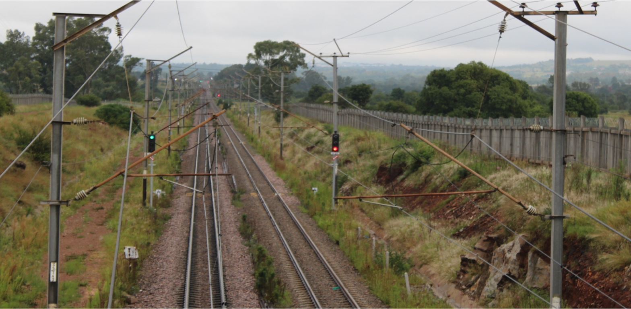
Kaalfontein – Olifantsfontein Signalling Installation
…continued

Slide 17
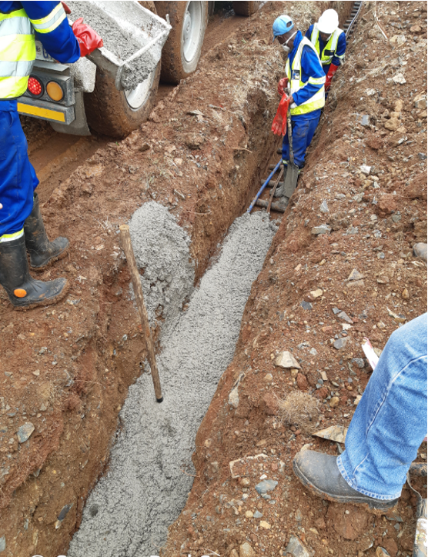
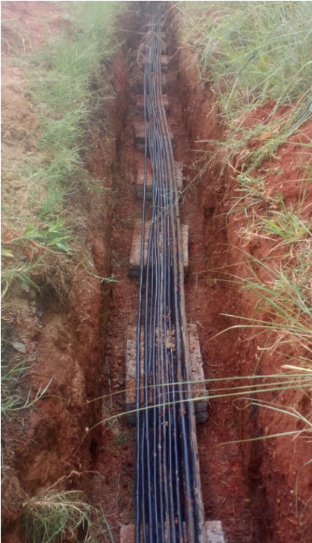
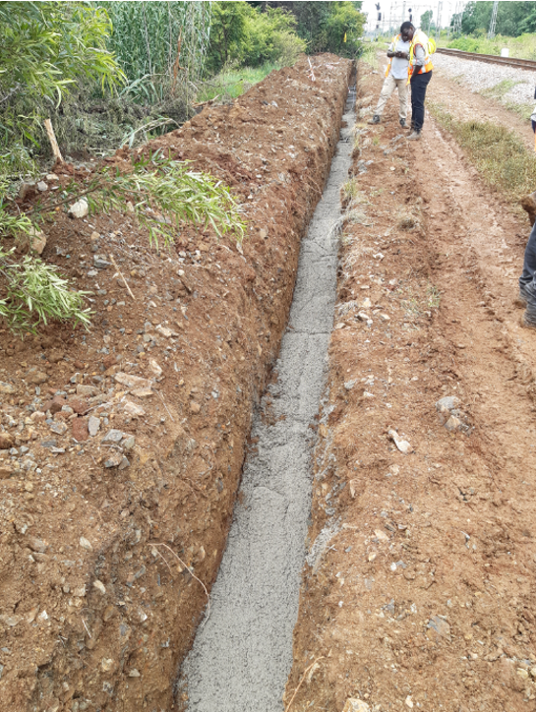
Cable Encapsulation with Concreting Solution
…continued

Slide 18
  3. Rehabilitation of the Passenger Rail Network
  3.1 Status
  3.2 Challenges
  3.3 Progress

Slide 19
3.1 Status:
Security
Funding: Operational & Capex
Rebuilding & Recovery
We have 40 corridors/lines and 18 functional since the opening after COVID-19 Lockdown
17 Gauteng - 7 Functional (2 Electric and the rest Diesel)
9 KZN - 3 Functional before Floods (recovery underway)
2 Eastern Cape - 2 Functional ( both Diesel traction)
12 Western Cape - 6 Functional (all Electric)
The Triple Challenge

Slide 20
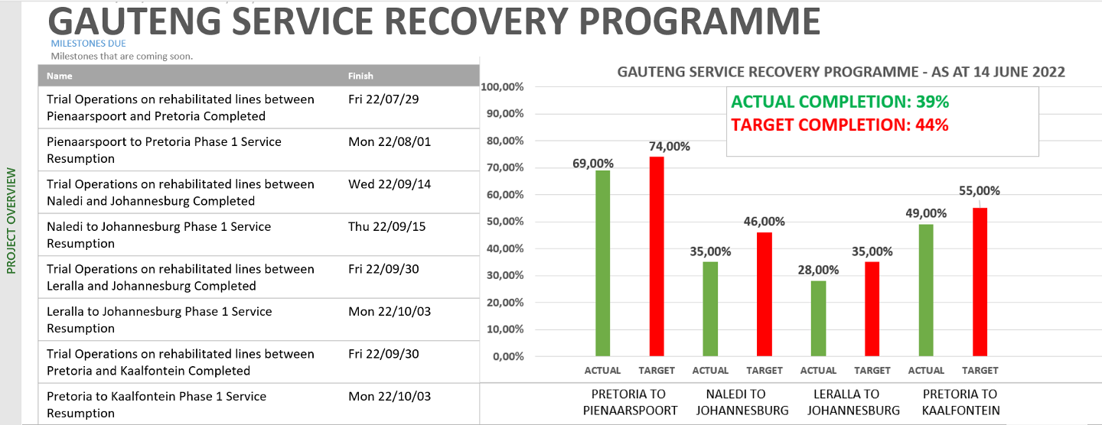
3.1.1
Status Of Priority Corridors – Gauteng
…continued
Plan | In Progress
Complete | Delayed

Slide 21


…continued
Target:
KwaMashu – Durban Corridor ready to run Trains service = 28 September 2022
Trial Operations = 21 September 2022
Plan | In Progress
Complete | Delayed
1
Flood Clean Ups (TFR):
Umgeni – Duffs Road
BSC: OHTE
15 June 2022
Oct 21
4
Projected Employment
> 100 temporary
OHTE Award
20 July 2022
5
OHTE Advert –
20 June 2022
2 months – OHTE
3.1.2
Status Of Priority Corridors – KwaZulu Natal
Flood Clean Ups (PRASA):
Duffs Rd-KwaMashu
20 Sept 2022
14 days
Duffs Road –Thembalihle:Repairs to embankment failure
EMU Trial Operations
6
30 May 2022
21 Oct 2022
15 July 2022
Trial
Operations
7 days
2
Stakeholder
Management
8
EMU Resumption of service
22 October 2022
7
Total 10 on Rehabilitation
7 - Stations operational
10 - On Rehabilitation
3
Service Resumption:
28 Sept 2022
Intro – Diesel Service:
06 June 2022
Stations
31 August 2022

Slide 22


…continued
Target:
Umlazi – Durban Corridor ready to run Trains service = 01 September 2022
Trial Operations = 17 August 2022
Plan | In Progress
Complete | Delayed
1
Flood Clean Ups: Durban – Merebank
3
BSC: OHTE
15 June 2022
Projected Employment
> 200 temporary
BSC: Subs
21 June 2022
04 May 2022
OHTE
26 Aug 2022
4
OHTE Advert –
20 June 2022
OHTE Award
20 July 2022
2
14 days
1 month acceleration-OHTE
Stakeholder
Management
Substation Award
26 July 2022
Subs Advert
26 June 2022
Subs
26 Sept 2022
14 days
2 months acceleration – Subs
5
Merebank –Reunion: Repairs to embankment failure + OHTE
Service Resumption
Durban-Merebank
1 June 2022
Reunion-Umlazi Flood Repairs
16 Aug 2022
EMU Trial Operations
Trial
Operations
30 June 2022
Reunion Station: repairs to formation, track work, signals & telecoms
13 days
Total 6 on Rehabilitation
14 - Stations operational
6 - On Rehabilitation
6
8
9
7
01 Sept 2022
27 October 2022
Service Resumption
30 June 2022
Stations
31 August 2022
Service Resumption

Slide 23
…continued
Target:
The Central Line Phase1 Corridor ready to run Trains service = 26 July 2022
Trial Operations = 19 July 2022
Plan | In Progress
Complete | Delayed
1
12 .month (ON-GOING)
Stakeholder Management
OHTE-Contractors on Site
2
3 months acceleration - OHTE
OHTE
Projected Employment
> 200 temporary employment
8 July 22
3.1.3
Status Of Priority Corridors – Western Cape
RNC-Contractor on Site
2 months acceleration -PERWAY
Perway
18 July 2022
3
Total 15 on Rehabilitation
1 - Stations operational
10 - On Rehabilitation
STATIONS
15 Jul 22
2 months
STATIONS
4
4
5
1 week
Telecoms
22 Jul 22
6
TO
26 July 22
Trial
Operations 16 26 July 2022
7
Service Resumption
8
Relocation of Settlement: Langa
30 Nov 22

Slide 24

…continued
Plan | In Progress
Complete | Delayed
Target:
The Central Line Phase1 Corridor ready to run Trains service = 12 December 2022
Trial Operations = 18 November 2022
1
12 .month (ON- GOING)
Stakeholder Management
2
5 months - OHTE
OHTE
31 Oct 22
Projected Employment
> 220 temporary
3
3 months acceleration -PERWAY
Perway
18 Oct 22
Total 15 on Rehabilitation
0 - Stations operational
11 - On Rehabilitation
STATIONS
30 Oct 22
4
2.month
5
1 week
Telecoms
6
30 Oct 22
Trial
Operations 18 11 Dec 22
6
Service Resumption
7
12 Dec 22
8
Relocation of Settlement: Section of Philippi

Slide 25
3.2 Challenges:
Security
Funding: Operational & Capex
Rebuilding & Recovery
The three challenges are interrelated, and the requires an integrated response.
Security is fundamental in the Rebuilding and Service recovery efforts for PRASA.
The rebuilding programme recognises this fact, however the security capacity must be matched to respond to the recovery needs, as well as operational needs.
The funding needs and model to support the base operating requirements of the recovered business, as a foundation for modernisation.
The Triple Challenge

Slide 26
…continued
Rebuilding PRASA Business is a Journey, that requires
  Personal Commitment to CHANGE (To DO what we never Did Before),
  Disciplined EXECUTION and
  Problem Solving Orientation.
The Goal is to rebuild the total system and business corridor by corridor and line by line.
This includes the support functions, as enabling environment, while responding to the service as required by the Customers.
As the service is recovered per corridor or line, it needs to be secured and protected (Secure the base), until we recover the total system.
Security
Funding: Operational & Capex
Rebuilding & Recovery
MODERNISATION
Full Service
Full Service
Full Service Recovered
Limited Service recovery
(In progress)
The Triple Challenge
Limited Service
Limited Service recovery
(In progress)
Recovered Limited Service: Current Operations
Time Period

Slide 27
…continued
The following key challenges impact on the recovery efforts:
Security
Funding: Operational & Capex
Rebuilding & Recovery
High-level Challenge | Mitigation
Execution: Implementation Capacity ~ (Scares Skills & Retention) | Sourcing (SOE assistance, Fixed term contract workers – retirees, training programmes)
Security : Open System Encroachment Theft & Vandalism of recovered areas | Current Integrated Security Deployment Plan (as discussed above) Engagement and assistance from Cities Walling of rail boundaries and technology – Long term.
“Tender Hijacking & demands” – prolonged communities engagements. | Proactive Community & Stakeholder Engagements Collaboration & Assistance from Cities Legislation review – Long term
Rapid Climate Changes Flooding (e.g. KZN & Cape Flats) Wash aways | Rail Industry technology and standards reviews Infrastructure Assessments e.g. embarkments & bridges structural integrity
Sourcing of material: long lead-times (e.g. Covid, strikes, KZN Harbour etc) Market readiness for the volumes of material required for rebuilding | Accelerated programmes with appointed suppliers Joint engagements and negotiations with manufacturers were applicable.
The Triple Challenge

Slide 28
…continued
Operational Subsidies
  Metrorail paying passengers has decreased from 646 million in 2008/09 to 147 million 2019/20
  MLPS passengers has declined from 3 million in 2008/09 to only 276 400 in 2019/20
  Autopax passengers declined from 2,4 million in 2008/09 to 1,6 million in 2019/20
  As the number of paying passengers declines, so do operational revenues, making it more difficult to fund the maintenance, refurbishment and maintain levels of services, which lead to further loss of paying customers
  PRASA’s passenger revenue has thus decline at a much higher rate than which Government could affordably increase the operational subsidies
Fare revenue
  The ticket prices were last increased in 2015 and the potential revenue that is generated is not aligned to the cost of running rail. This simply exacerbates the cash flow funding issues at PRASA and its inability to pay creditors.
Operational subsidy formula
  The following is the formula required to properly fund rail: Operating costs less fare revenue = operating subsidy. This has been a major contributor to underfunding at PRASA. – there is no incentive to operate efficiently with such a subsidy formula (deficit subsidy)
  It is an imperative that we fully understand the economic return of our rail activities/
Security
Funding: Operational & Capex
Rebuilding & Recovery
The Triple Challenge

Slide 29
…continued
Security
Funding: Operational & Capex
Rebuilding & Recovery
MAINLINE PASSENGER SERVICES (SHOSHOLOZA MEYL)
  The MLPS business now only transports 7.5% of the passengers it did a decade ago. The decrease is not due to Covid, but changing passenger preferences
  MLPS RELIES ON TRANSNET Infrastructure which is also going through serious attacks. The attacks which lead to instability/unavailability of the Transnet infrastructure, lead to our own inability to deliver the LONG DISTANCE SERVICE
Transnet debt
Operational debt – This is a major issue at PRASA as we are unable to pay the R2.4 billion owed to Transnet. The DOT and National Treasury are requested to assist in developing an approach to addressing this debt. As part of any solution there needs to be a renegotiation of agreements between PRASA and Transnet as they currently wholly favour Transnet whereas PRASA seeks a more equitable relationship.
A set-off agreement has been finalised between the two entities which led to debt reduction of R1.8billion as PRASA had posted a debt of R581million against Transnet
Capital debt – This is largely under control and there is no real issue in paying the outstanding capital balances.
The Triple Challenge

Slide 30
3.3 Progress:
Security
Funding: Operational & Capex
Rebuilding & Recovery
Province | Recovery Status – Limited Service with Electric Traction
Gauteng | PTA - Mabopane line limited service recovered in January 2022. PTA - Saulsville line limited service recovered in February 2022 Four Lines / corridors in progress for limited recovery from Sept 2022. Pienaarspoort – PTA; Leralla – Kaalfontein – JHB; PTA – Kaalfontein Naledi - JHB
Western Cape | Cape Town - Simons Town, Cape Town to Retreat via Athlone & Cape Town – Bellville are operational with limited recovery Central Line: Phase 1: Cape Town – Bellville Line in progress, targeting July 2022 Central Line: Phase 2: Nyanga to Kapteinsklip and to Chris Hani in progress, targeting December 2022.
KZN | Services were disrupted by the recent floods, setting the province backwards. Durban – Umlazi corridor in progress for recovery in September 2022 (Dalbridge) Durban – Kwamashu in progress for recovery in September 2022 (Diesel Traction introduced)
The Triple Challenge

Slide 31
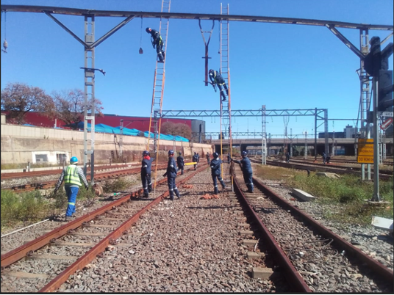
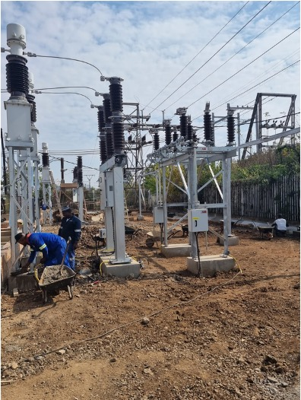
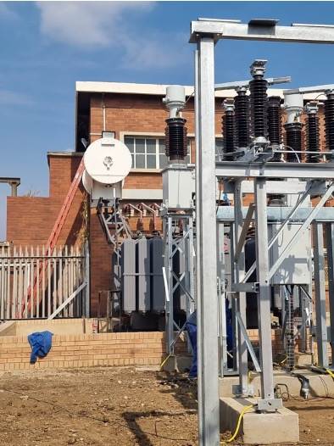
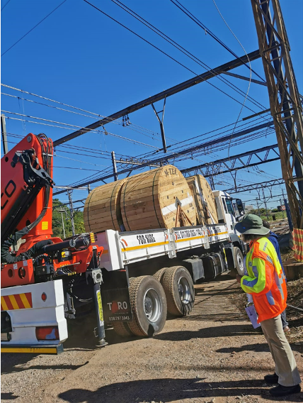
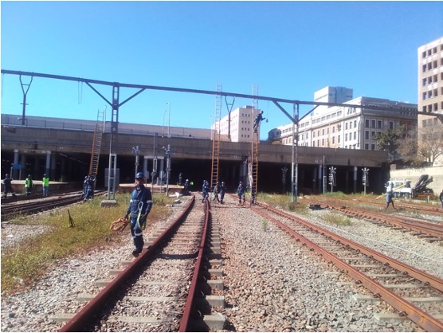
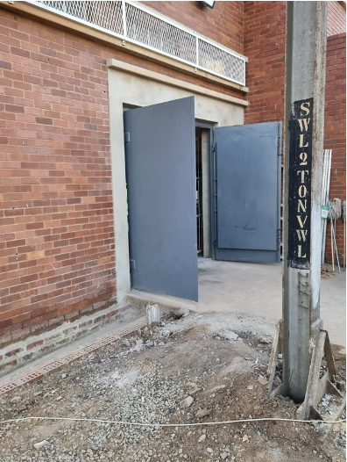
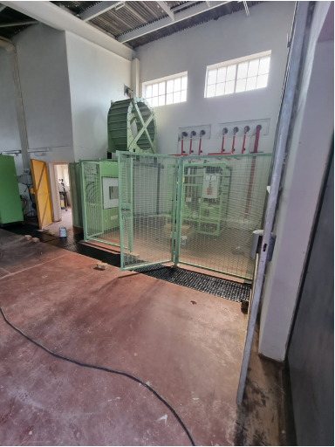
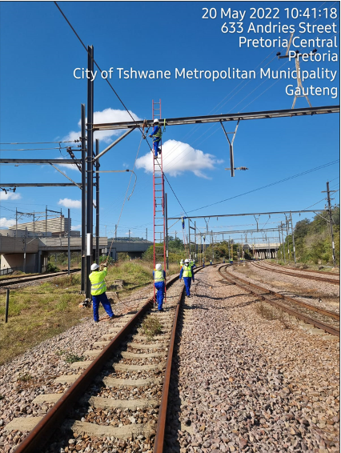
3.3.1 Gauteng Region
…continued
Gauteng : Substation Contractors - Pienaarspoort
Gauteng: Overhead Traction Work

Slide 32
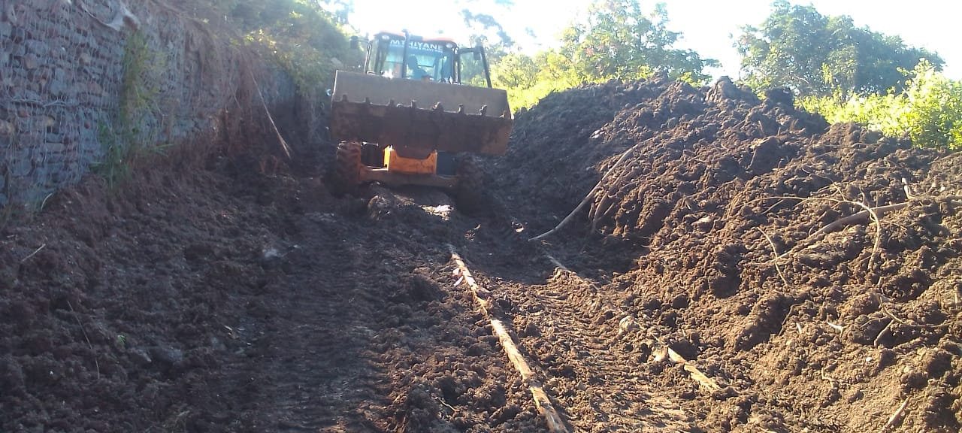
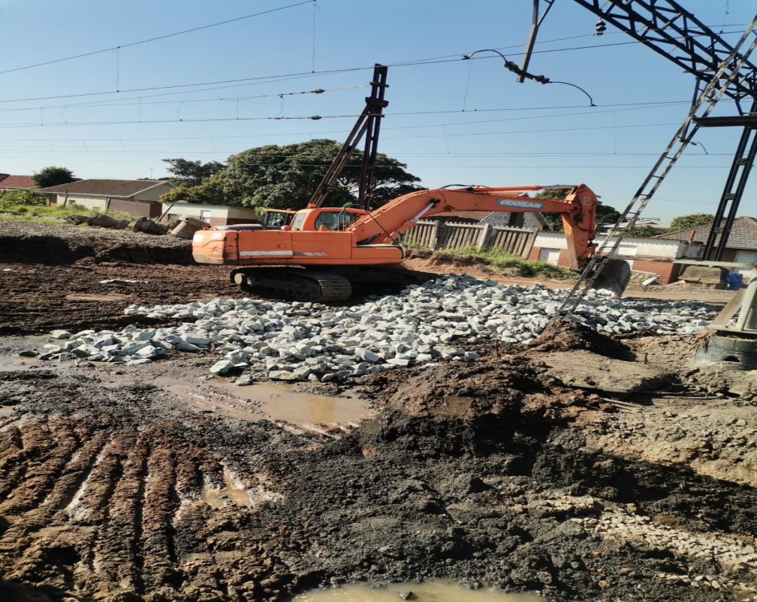
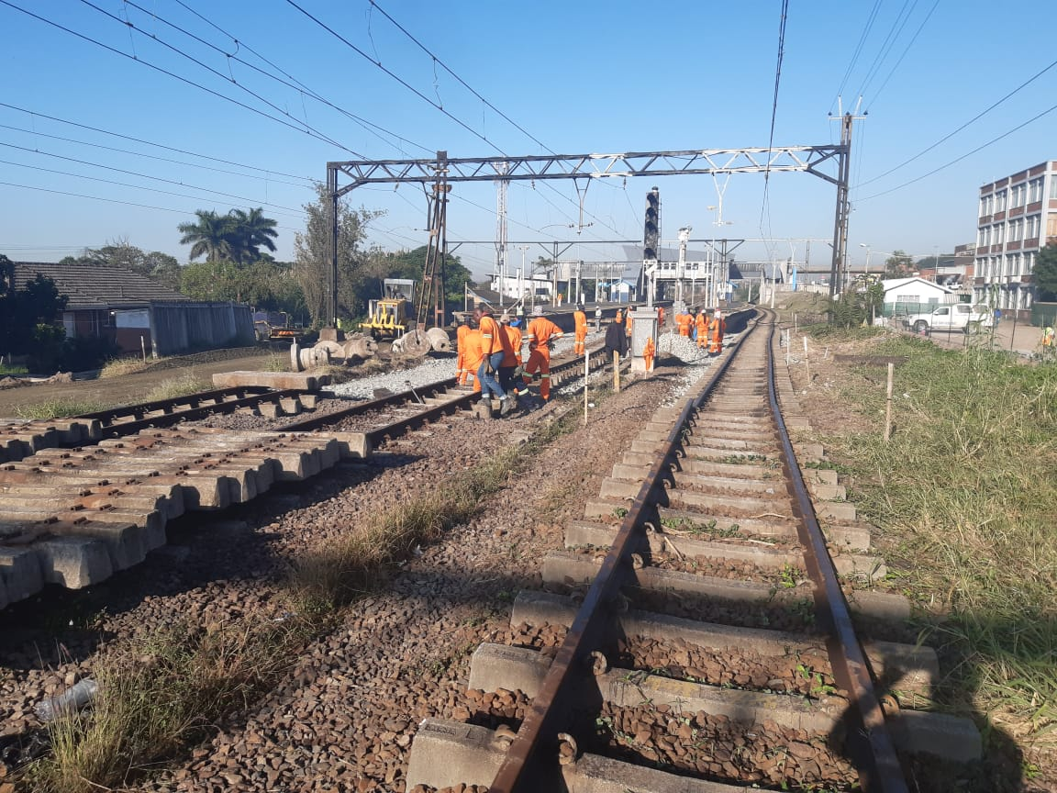
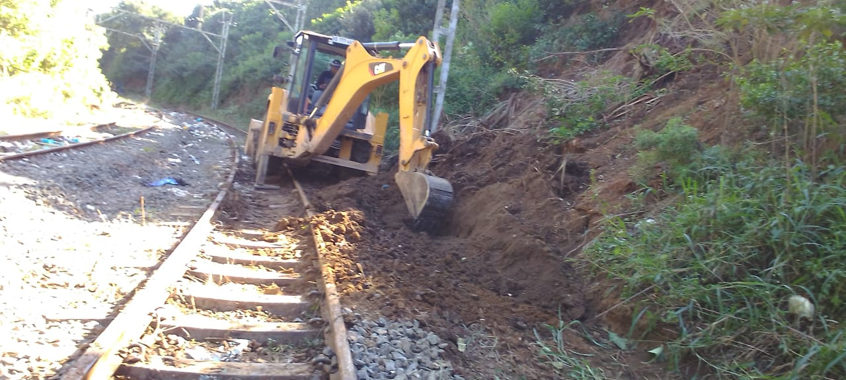
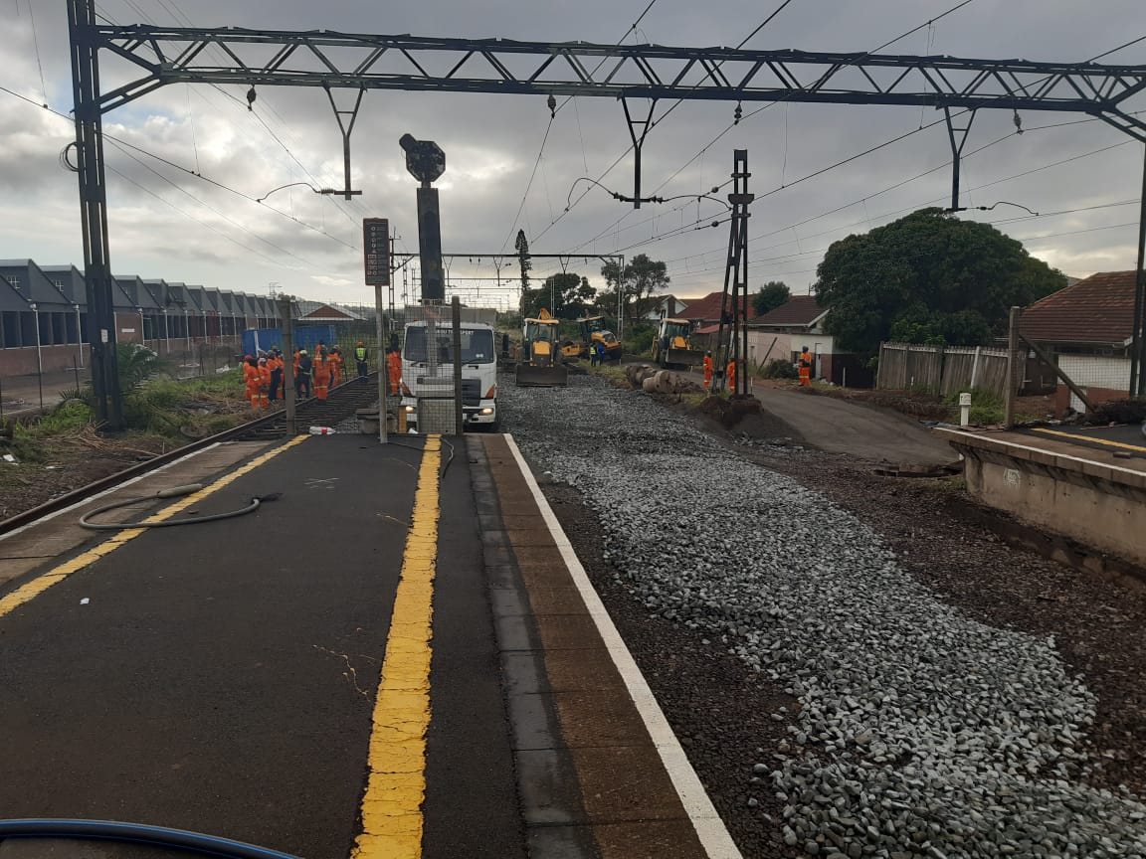
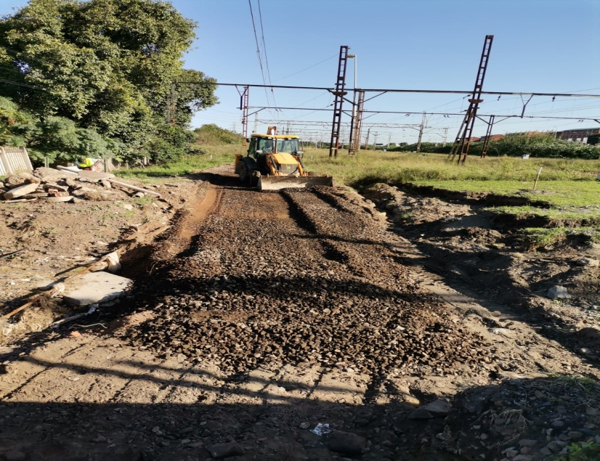
3.3.2 KwaZulu Natal Region
…continued
RNC
In-House Teams

Slide 33
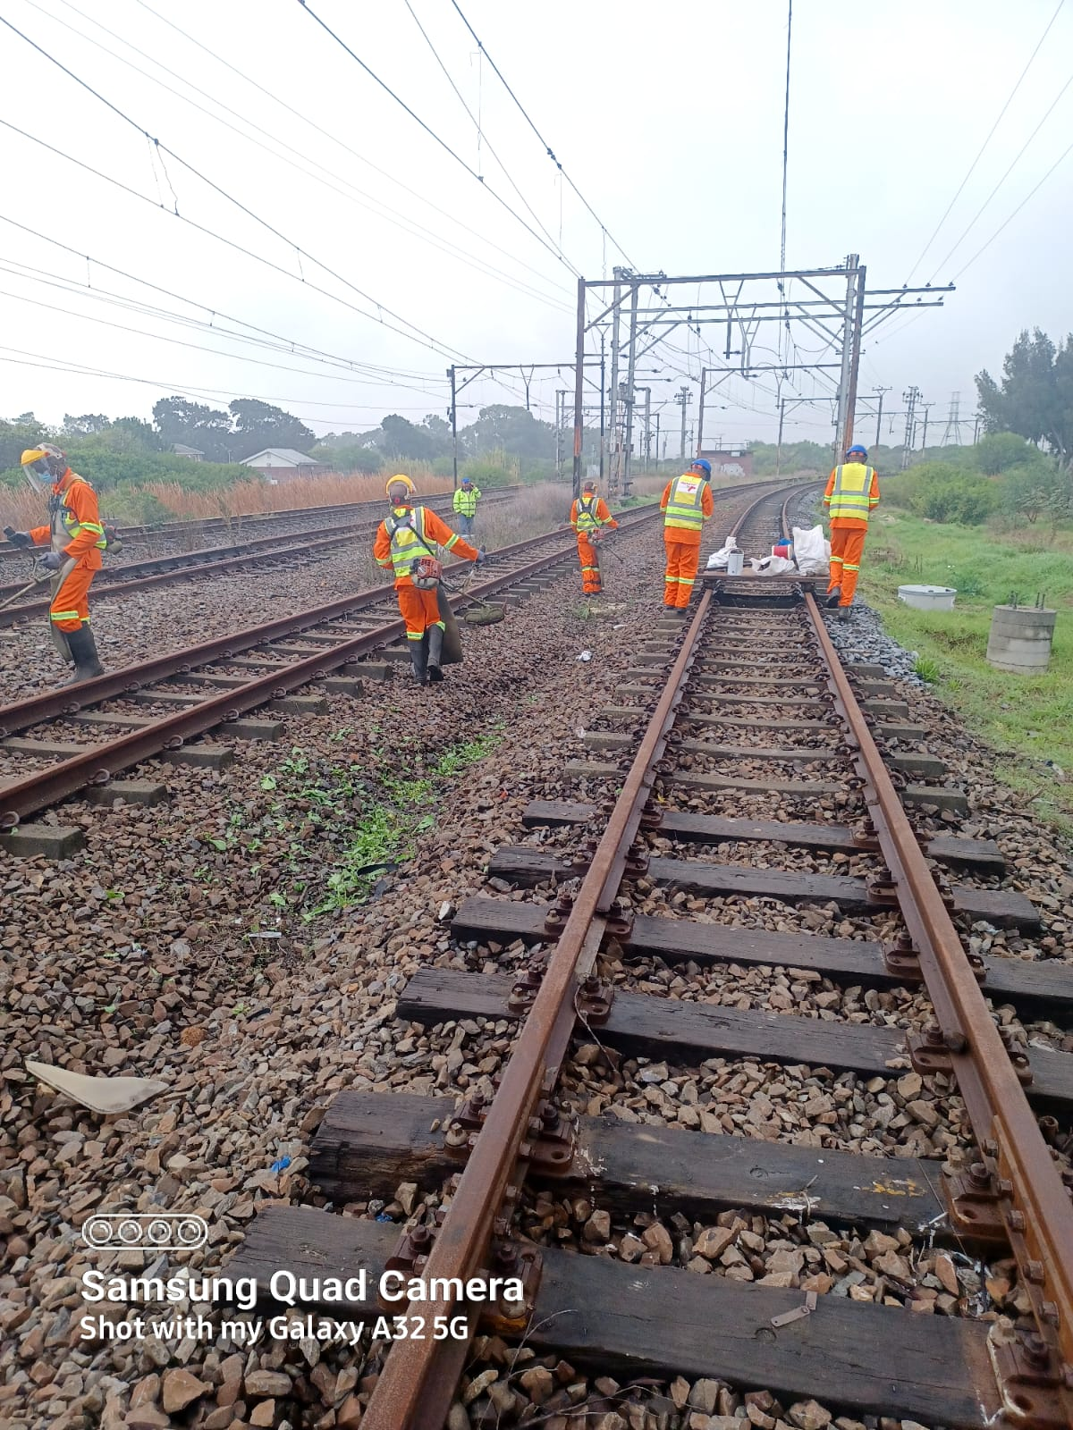
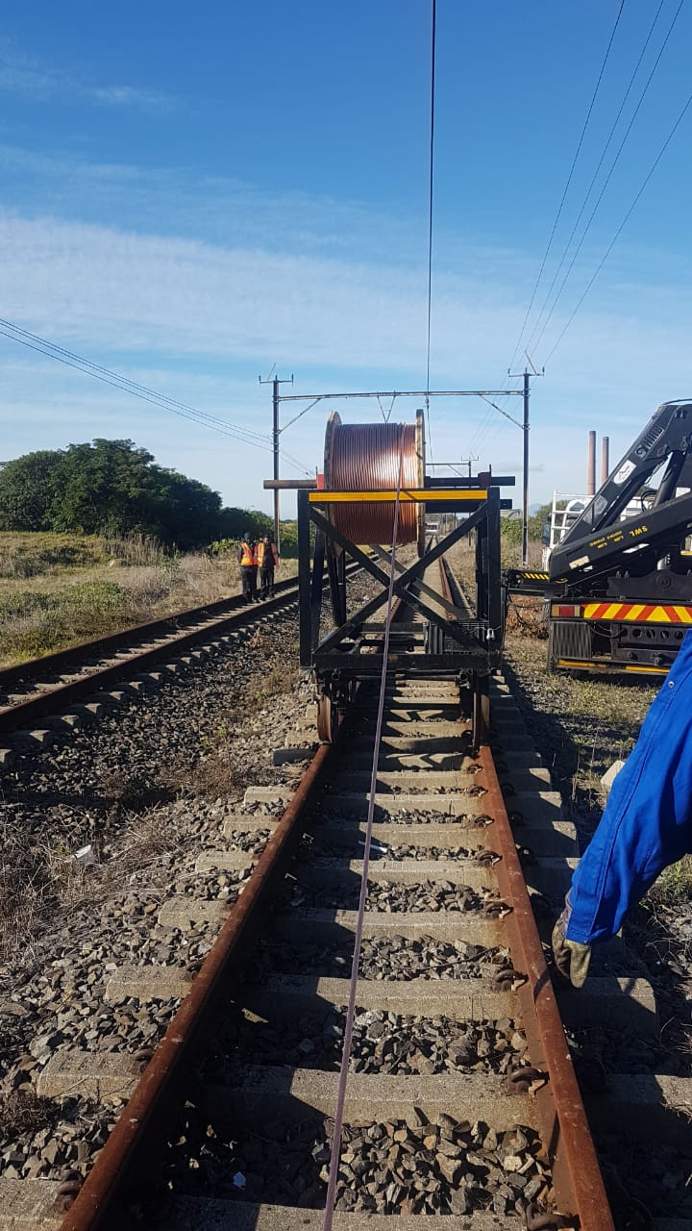
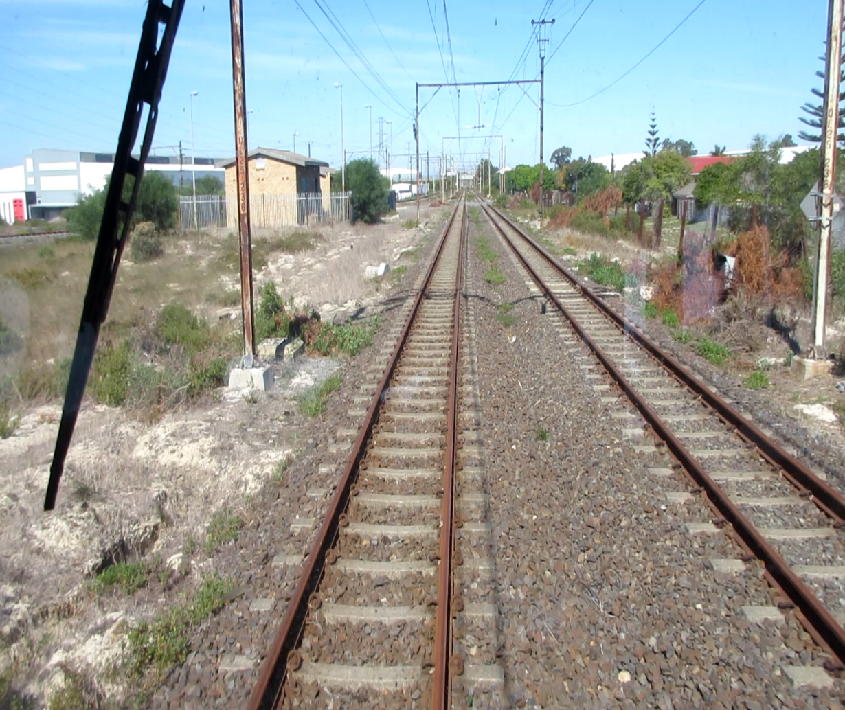
3.3.3 Western Cape Region
…continued
In-House Teams
Phase 1

Slide 34
  4. Funding Required

Slide 35
4.1 Required Support:
PRASA Security requirements need approximately One Billion Rand in funding yearly for the next three years.
As the corridor recovery efforts gain momentum, so is the need to protect the recovered assets, to secure the base until the service is fully operation.
This condition places an added pressure on the OPEX funding needs for PRASA.
Results in the Mabopane corridor have proven that there is a solution.
PRASA security needs the funding support (Department of Transport, as well as National Treasury) to operationally fund the security plans. This would allow the take back of PRASA infrastructure and the necessary resources deployed with an oversight of command and control.
Physical deployments are needed to prevent access to the infrastructure and the network as majority of the network is still open. Once PRASA has fully deployed the personnel needed to stabilise the infrastructure, can the divisions get on with their work to fully restore services.
As previously mentioned , PRASA protection services will then be able to follow through on Phase 2: namely the security technology projects.
Part of the security solution is walling solutions for the Presidential corridors.
Protection of the assets in short to long term needed to enable PRASA to provide consistently reliable train services.
Security
Funding: Operational & Capex
Rebuilding & Recovery
The Triple Challenge

Slide 36
4.1.1 Funding Table
…continued

Slide 37
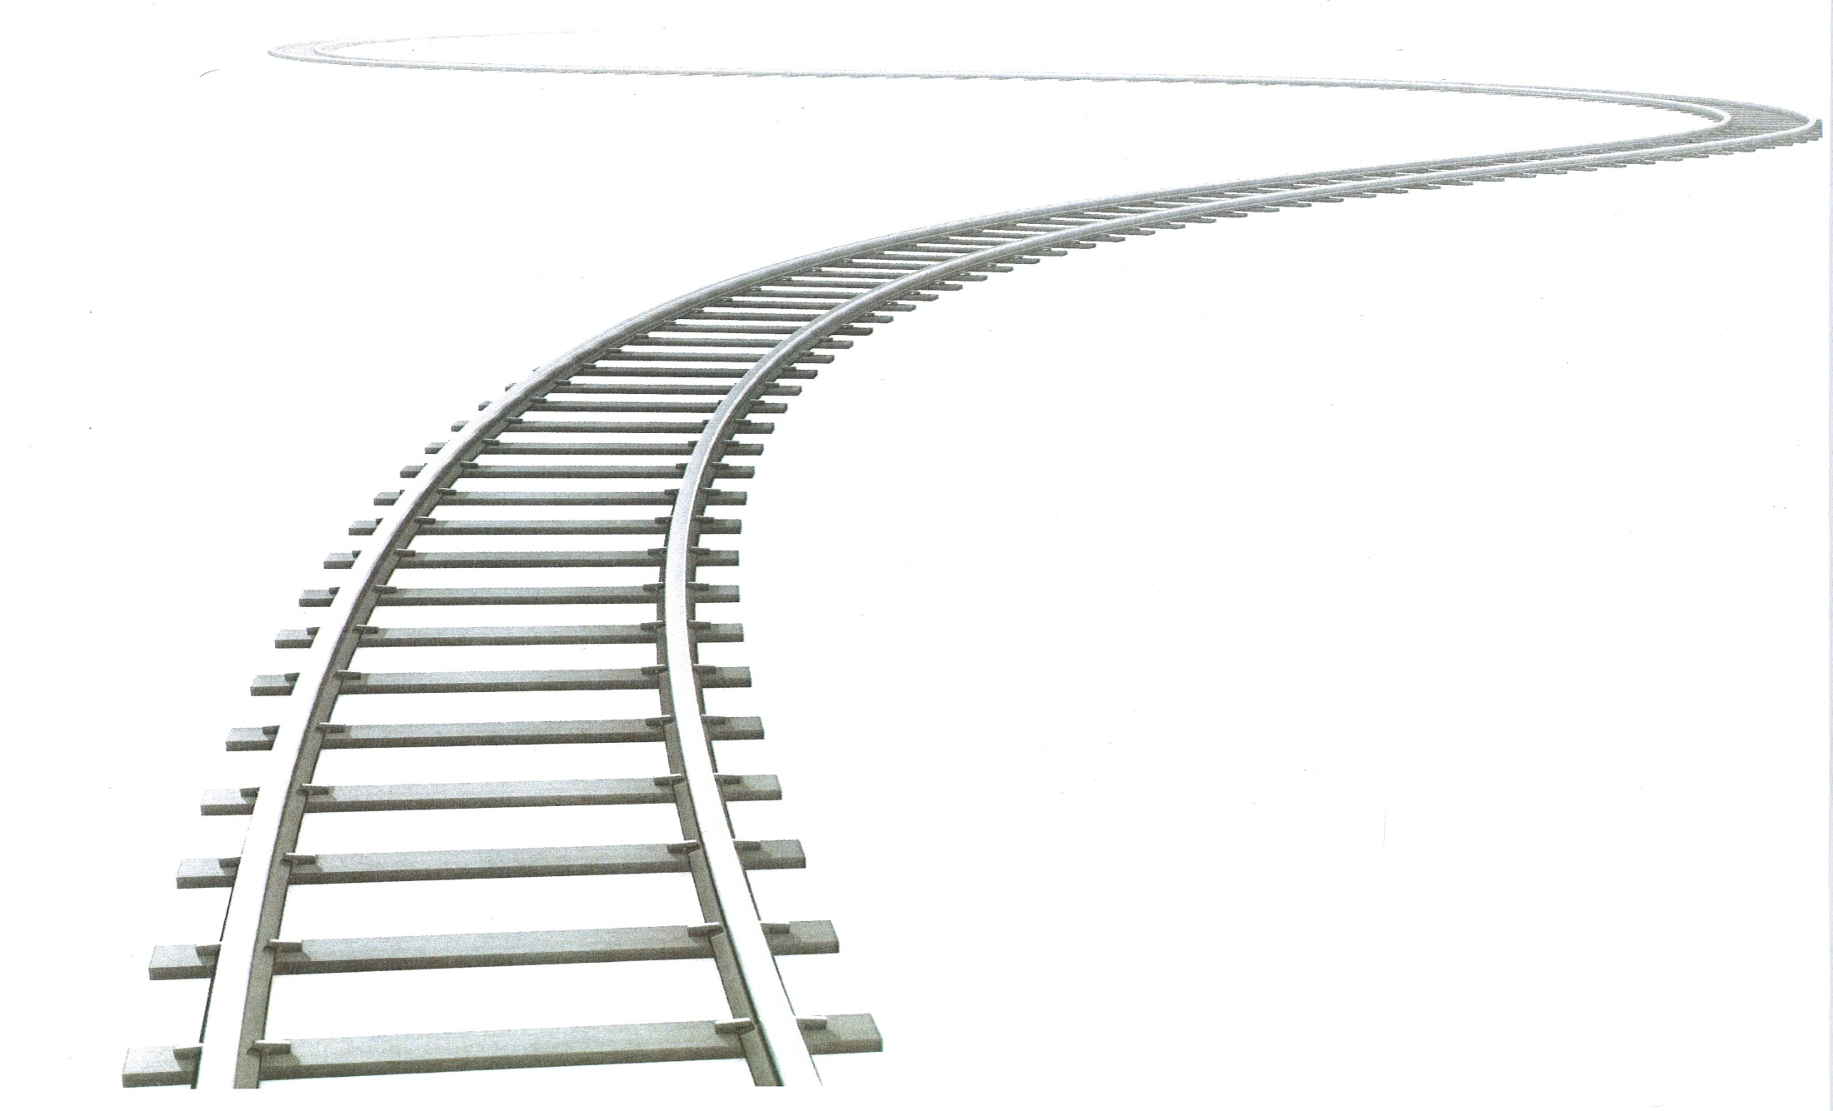
Thank You

