Slide 1
BRIEFING TO THE PARLIAMENTARY PORTFOLIO COMMITTEE ON INTERNATIONAL RELATIONS AND COOPERATION
ACHIEVEMENTS IN ADDRESSING SOUTH AFRICA’S TRIPLE CHALLENGES OF POVERTY, UNEMPLOYMENT, AND INEQUALITY THROUGH STRUCTURED BILATERAL MECHANISMS WITH THE PEOPLE’S REPUBLIC OF CHINA
08 JUNE 2022

Slide 2
PRESENTATION OVERVIEW
Brief background: SA-China relations
Four pillars of SA-China bilateral relations
  Political relations and multilateral cooperation (FOCAC and BRICS)
  Economic Trade and Investment and Tourism
  Technical Cooperation
  People-to-People Cooperation
Structured Bilateral Mechanisms
  Bi-National Commission
  Strategic Dialogue Forum
  Joint Working Group
  People-to-People Exchange Mechanism
Achievements, Challenges and Improvements on the Structured Bilateral Mechanisms
Conclusion
SECRET

Slide 3
BACKGROUND: SA-CHINA RELATIONS
Diplomatic relations between South Africa and China were established in 1998 and are underpinned by a Comprehensive Strategic Partnership of 2010 and a newly signed 10-Year Strategic Programme on Cooperation (2020-2029).
South Africa fully adheres to the One China policy – recognising the PRC as the sole Government representing the whole of China and China’s position that Taiwan, Hong Kong and Tibet are inalienable parts of China.
Relations with China are anchored on four pillars:
  Pillar I - Political bilateral relations and multilateral cooperation through FOCAC and BRICS
  Pillar II - Economic Trade and Investment and Tourism
  Pillar III - Technical Cooperation
  Pillar IV - People-to-People Cooperation

Slide 4
PILLAR I - Political bilateral relations and multilateral cooperation through FOCAC and BRICS
Political Engagements:
High-level engagements include annual reciprocal State visits and virtual meetings between HoS
Ministerial meetings and high-level visits across different Government Ministries and Departments
These engagements support South Africa’s foreign policy objectives and the achievement of its domestic imperatives, as well as promoting the broader socio-economic development goals of the Continent.
FOCAC:
SA instrumental as founding member of FOCAC – co-chaired twice and continue to engage China with regard to the priorities of the African Union Agenda (AU Agenda 2063).
China allocated funding of over R1 billion to proposed infrastructural development projects. Funding modalities, however, are still being considered for SA.
At the 8th FOCAC Ministerial in Nov 2021, China announced 9 FOCAC goals to be implemented bilaterally in: healthcare, poverty reduction, agricultural development, trade and investment, digital innovation, green investment development, capacity building, people-to-people exchanges, and peace and security.
China committed to provide Africa with 1 billion doses of Covid-19 vaccines, to be partly manufactured through joint ventures with African countries.

Slide 5
PILLAR I (cont.)
BRICS:
SA joined BRICS in 2010 - chaired in 2013 and 2018 and scheduled to chair in 2023.
SA’s strategic engagement in BRICS provides a key platform for the achievement of SA’s national interest, its foreign policy objectives and the African Agenda.
SA’s participation in BRICS provides tangible benefits for in key sectors such as health, science, technology, education, and health, as well as through BRICS financing for infrastructure development, capacity building, research, educational and skilling opportunities.
The virtual BRICS Vaccine Research and Development Centre was launched in March 2022, implementing a key deliverable of South Africa’s Chairship of BRICS in 2018.
The New Development Bank (NDB) has approved eleven projects for South Africa, valued at approximately $5.4 billion, which aim to improve our service delivery in critical areas.
In 2019, total intra-BRICS trade amounted to US$354 billion. The aim is to reach a target of $500 billion in 2022.

Slide 6
PILLAR II - Economic trade and investment and tourism
South Africa remains China’s number one trading partner in Africa. Total bilateral trade increased from less than R1 billion (1998) to R544 billion in 2021, (figures include trade with Hong Kong, Taiwan, and Macao). South Africa’s long-standing trade deficit with China maintained its downward trend despite Covid-19 pandemic.
In 2019, a China procurement delegation signed 93 trade agreements with SA in multiple sectors (R27 billion) to address the bilateral trade imbalance.
China’s cumulative investment in South Africa exceeds R100 billion, creating an estimated 200,000 direct and indirect jobs. Chinese investment is directed inter alia at infrastructure development, manufacturing, information technology, digital economy and the automotive industry.
South Africa became the first African country to export beef to China. Several MoU’s have facilitated access to the Chinese market for SA agricultural produce, maize and animal products, including dairy products, soyabeans and avocado pears.
South Africa and China signed an MoU on cooperation on Belt and Road Initiative in 2015 – exploring areas of cooperation.

Slide 7
PILLAR III
Technical Cooperation:
The following projects, which are in varying stages of readiness, will be prioritised and actioned to ensure that all obstacles pertaining to the potential Chinese grant funding under FOCAC are addressed:
  Refurbishment of the two Training, Vocational and Educational centres in Tshwane (at implementation phase)
  Small Harbour Infrastructure Development Project (Team of Chinese Experts expected from 6 July - 10 August 2022)
  High-Speed Rail Project (The first Technical Working Group took place on 25 January 2022)
  Focus Schools Project (Application for Grant Funding submitted on 31 May 2022)
It remains important that FOCAC projects funded (or soft-loaned) by China be aligned to the AU’s Agenda 2063, create jobs, address critical skills and the disconnect on technical aspect of feasibility and funding modalities.

Slide 8
PILLAR IV
People-to-People Cooperation
The purpose of people-to-people cooperation is to deepen mutual understanding between the peoples of SA and China and to enhance exchanges and cooperation in the areas of culture, education, communication, health, science and technology, sport, tourism, women affairs and youth.
This will be further outlined under the PPEM structured bilateral mechanism.

Slide 9
STRUCTURED BILATERAL MECHANISMS
In line with the NDP and the ERRP, and the comprehensive strategic partnership, the areas prioritised in SA-China bilateral relations include, economic transformation in science and technology, the ocean’s economy, agriculture, energy, mining, infrastructure and industrial capacity development as well as strengthening trade and investment relations.
Other areas of priority include increased job creation, education, technology exchanges, health and skills development (in more specialized sectors) opportunities with a concerted effort to support SMMEs, women and youth.
The bilateral structured mechanisms serve as a vehicle to facilitate the four pillars and to strengthen relations with China at various levels. SA’s structured bilateral mechanisms with China include:
  Bi-National Commission (BNC at Deputy Presidential level);
  Strategic Dialogue Forum (SDF at Ministerial level);
  Joint Working Group (JWG at Deputy Ministerial level); and
  High-Level People-to-People Exchange Mechanism (PPEM at the level of the Minister of DSAC).

Slide 10
ACHIEVEMENTS OF STRUCTURED BILATERAL MECHANISMS WITH PRC
Areas | Value or achievement over the 5 years | Challenges
Trade (including Taiwan, HK & Macao) | 2017 – R 367,3 billion 2018 – R 372,1 billion 2019 – R 413,6 billion 2020 - R 440,5 billion 2021 - R 544,3 billion | Trade deficit in China’s favour Export of commodities and not value-added goods Market access and trade barriers
Investment | According to FDI Markets between January 2003 and January 2021, a total of 68 Chinese companies invested R 124 billion in SA with 92 projects | Adherence to BBBEE and other local legislation including labour law Volatility of the ZAR
Job creation | 5,694 over 18 years | No full transfer of skills for projects – adherence to local content.

Slide 11
ACHIEVEMENTS OF STRUCTURED BILATERAL MECHANISMS WITH PRC
Areas | Value or achievement over the 5 years | Challenges
Tourism | 2017 - 97271 2018 - 96915 2019 - 93171 2020 - 12 592 2021 - 6 577 | Covid-19 restrictions Visa processing challenges Crime rate Limited frequency of direct airlift between China and South Africa
Scholarships | 2017-23 2018-26 2019-17 2020-13 | Covid-19 restrictions and border closures Language barrier DHET funding where applicable, meaning, only a certain number of students that DHET has funds to top up can benefit from scholarships Virtual classes – internet connection and data required Time difference and impracticality of virtual classes Medical students without clinical training due to language barrier and challenges with registration with HPCSA.

Slide 12
ACHIEVEMENTS OF STRUCTURED BILATERAL MECHANISMS WITH PRC
Areas | Value or achievements over the 5 years
Education | In 2018, the Chinese Government offered 180 scholarships for non-degree Chinese language studies, Bachelor’s, Master’s, and Doctoral degrees in various fields. DHET is currently supporting 57 students of these Chinese Government Scholarships. From 2018 to present, approximately, 2000 South African officials and technicians have been trained under the Training Seminars provided by the Chinese Government to South Africa. 6 Confucius Institutes and 3 Confucius Classrooms operating in South Africa, with the University of the Western Cape (UWC) Confucius Institute being the latest one to be established in September 2019 as part of the PPEM.

Slide 13
ACHIEVEMENTS OF STRUCTURED BILATERAL MECHANISMS WITH PRC
Areas | Value or achievements over the 5 years
Education (continued) | From 2018 to present, over 10 000 South African students have participated in the learning of Chinese language and cultural events administered by the institutes. China contributed water tanks to the Department of Basic Education, to support safe re-opening of schools during the COVID-19 pandemic. DBE also received 50 000 masks and 400 thermometers donated by the Chinese People's Association for Friendship with Foreign Countries, for use by the most needy schools in South Africa. National Teaching Awards (NTA) with fully paid study visits to China. Recently sponsorship of around R1.1 million covering Maths, Science and Technology as the key subjects of interest in our cooperation.

Slide 14
ACHIEVEMENTS OF STRUCTURED BILATERAL MECHANISMS WITH PRC
Areas | Value or achievement over the 5 years
Human Resources Development and R&D | China offered to train 25 South African artists in digitization in 2020. Joint research programmes involving South African research institutions and counterparts in China, on fields such as smart manufacturing, education science and technology (ICT for education), renewable energy and transportation technology. Training of 20 South African tourism practitioners (front-line staff and tourist guides) in Mandarin language efficiency. 25 South Africans in the tourism sector participated in the online training on Sustainable Tourism Development.

Slide 15
ACHIEVEMENTS OF STRUCTURED BILATERAL MECHANISMS WITH PRC
Areas | Value or achievement over the 5 years | Challenges
Agriculture, Forestry and Fisheries | Four Agreements/MOUs concluded in the areas of Agricultural; Sanitary and Phytosanitary (SPS) protocols; Aquaculture; and Forestry. They guide cooperation between the two countries in the field of Agriculture, Forestry and Fisheries. Activities in these Agreements/MOUs include capacity building through university training programmes and mission exchanges through delegation visits. Bilateral exports, conducted on a ”most favoured nation” basis, was enhanced by SA gaining market access into China for agricultural goods, such as table grapes, citrus, tobacco, maize, apples, Lucerne [alfa-alfa], pears and citrus. On animal products, health certificates were concluded for the following SA products: beef, raw hides and skins wool and mohair, fishmeal and fish oil for animal use, different animals like giraffes and others. South Africa has received several full scholarships from China in the fields of Agriculture, Forestry and Fisheries, from which SA students have benefited. | China evaluates new agricultural market access requests on a “one-product-at-time” basis Market access and trade barriers

Slide 16
WAY FORWARD AND IMPROVEMENT
South Africa should leverage its good friendship and comprehensive strategic partnership with China to reap the full potential benefits from the structured bilateral mechanisms, including to gain advantage from China’s growing international profile, its political and economic prowess and its technological expertise across many sectors.
Improved inter-governmental coordination through implementation of 10 Years Strategic Programme on Cooperation and China country strategy.
Facilitate market access into China for more SA-manufactured/value-added goods and agricultural products.
Promote inward trade visits to South Africa post Covid-19 – close the trade gap.
Local job creation remains a key SA priority and China should support such SA efforts.
Promote conservation and cultural tourism.
Work on the strict criteria applicable to grant-funding, concessional loans, and other funding modalities, both sides, and requires vigorous engagement before projects can be implemented.

Slide 17
CLOSING
South Africa and China are comprehensive strategic partners. Through the BNC, the Strategic Dialogue, the Joint Working Group and the PPEM, tangible contributions towards the achievement of SA’s long-term strategic priorities, as outlined in the National Development Plan, has been made.
SA’s bilateral partnership with China, which is managed through various structured mechanisms at different levels, will aid SA’s developmental objectives and assist the country in its recovery efforts and growth trajectory, in a complex world that remains defined by the impact of the COVID-19 pandemic and other geo-strategic issues.
DIRCO is the coordinating Department and implementation lies with other SA Government Departments. The responsibility for implementation of the MoUs, agreements and outcomes of these mechanisms lies with the relevant line Department and DIRCO only serves as the coordinator.

Slide 18
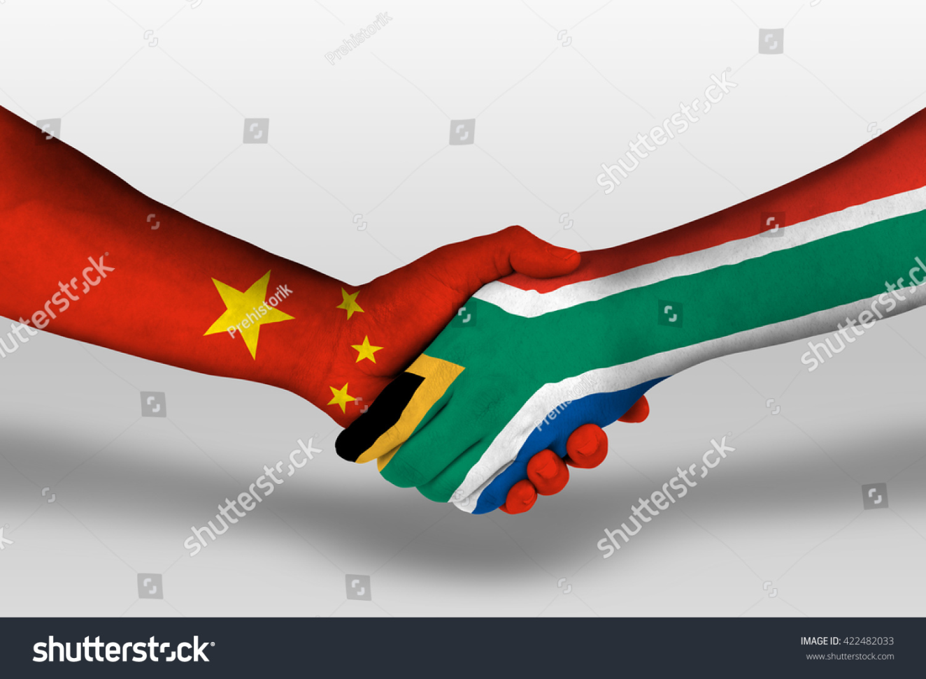
THANK YOU

