Slide 1
SAPS MIGRATION REPORT INTO TELKOM TOWERS BUILDING
BRANCHES: REMS, UDM, FM and CPM
DATE: 08 JUNE 2022

Slide 2
TABLE OF CONTENT
TELKOM TOWER ANALYSIS AND CONTEXT – PART 1 [ DDG:REIS]
PROGRAMME TIMELINES
PHASE 1 PROJECT REQUIREMENTS AND CHALLENGES – PART 2 [DDG: CM]
LEASE PROGRESS– PART 3 [DDG: REMS]
MAINTENANCE MANAGEMENT – PART 4 [DDG: FM]
CONCLUSION

Slide 3
PART 1
[FEASIBILITY STUDY DEVELOPMENT]
3

Slide 4
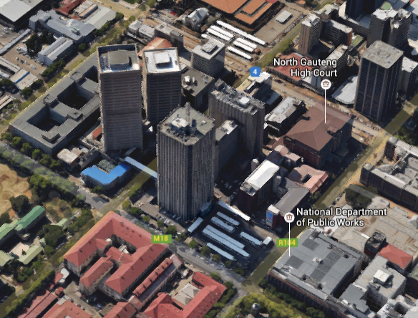
1. TELKOM TOWERS COMPLEX BUILDINGS ANALYSIS
The Telkom Towers Complex consists of 9 buildings with a gross lettable office accommodation area of 106,495m² and 2,234 parking bays to the total of 60,624m². The 10th building that formed part of the Telkom Tower Complex is known as the PPR Building, which is a National Key Point Building and is used by Telkom.
NORTH BLOCK – Phases 1 & 2
Phase 2
Phase 1
Phase 2
Phase 1
Telkom Tower West
Lettable area
1,021m²
Telkom Tower North
Lettable area
26,981m²
Telkom Tower East
Lettable area
14,722m²
Annex
Lettable area
5,547m²
PPR – National Key Point
EXCLUDED
Telkom
Building | Grade | Gross Lettable Area | Age | Condition
South Tower | B | 38,707 m² | 40 | Good, the air-conditioning system must be refurbished
West Block - Heritage | B | 1,021 m² | 70 | Good, recently renovated
East Tower | B | 14,722 m² | 30 | Good
North Tower | B | 26,981 m² | 24 | Good, houses the executive floor
Somerset House - Heritage | C | 4,358 m² | 83 | Poor - to be renovated
Central Building - Heritage | D | 3,675 m² | 40 | Condemned – due to contamination of the water reticulation in the building
Annex Building | B | 5,547 m² | 30 | Good
IT Building | B | 7,218 m² | 30 | Good
PR Building | B | 4,266 m² | 35 | Good
Parking Garages – 2234 bays |  | 60,624 m² | 40 | Very Good – equipped with a parking management system as per OR Tambo International Airport
176,104 m² GLA including Parking 106,495m² GLA Office Accommodation only
Telkom Tower South
Lettable area
38,707m²
IT Building
lease to Telkom
Lettable area
7,218m²
PR Building
lease to Telkom
Lettable area
4,266m²
Central Building
Lettable area
3,675m²
Somerset House
Lettable area
4,358m²
SOUTH BLOCK

Slide 5
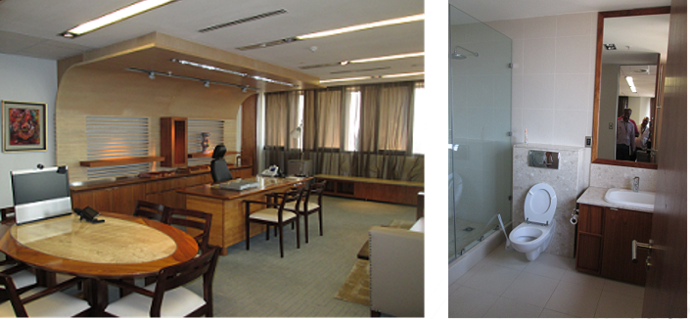
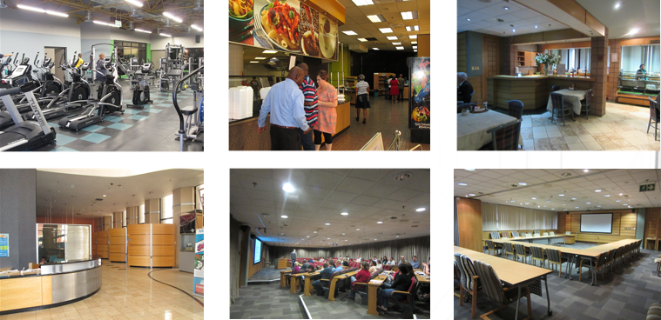
1. TELKOM TOWERS COMPLEX BUILDINGS ANALYSIS continued
Total accommodation requirement for SAPS is 279,638.75m²
106,495m² of SAPS needs can be accommodated at the Telkom Towers Complex.
The additional needs can be accommodated with the development of the state-owned properties within proximity, to create a SAPS precinct.
BUILDING | GRADE | PHASES TO IMPLEMENT
TTN | B grade | Phase 1
TTE | B grade | Phase 2
ANNEX | B grade
WEST WING | B grade
TTS | B grade | Phase 3
IT (2yr lease from 2015) | C grade | Phase 4
PR (3yr lease from 2015) | C- grade | Phase 5
SOMERSET HOUSE | C- grade | Phase 6
CENTRAL BUILDING | Condemned
The executive suits were upgraded to A+ grade accommodation.
5

Slide 6
1. FEASIBILITY STUDY: FINANCIAL ANALYSIS AND IMPLICATIONS
The Asking Price was R954,000,000.00 excluding Vat – R1,087,560,000.00 including VAT.
The Land Affairs Board Approved DPW Valuation was R645,000,000.00, to a maximum of R677,250,000.00 for negotiation purposes.
Negotiated Purchase Price as agreed upon was R650,000,000.00 excluding VAT, for the 10 Buildings at the Telkom Towers Complex. Telkom exercised their right to purchase the PPR Building at a negotiated price of R41,000,000.00 (LAB approved at R36,340,000.00. The final Purchase price paid for the 9 Buildings were R609,000,000.00 excluding VAT – R645,260,000.00 including VAT. DPWI paid R150,301,145.00 and SAPS contributed R543,958,855,00 including VAT.
The Replacement Cost of the Telkom Towers Complex is R3,709,329,303.12, excluding the cost of land. There is no vacant land available within the Pretoria CBD to support a development of this scale to accommodate the consolidated needs for the SAPS Head Office accommodation.
Rental Savings over 10 years amounts to R1,623,501,812.25, which would have been leased from the private sector.
The Feasibility Study date June 2015 noted that a sum of approximately R150,000,000.00 will be required for upgrading purposes, rehabilitation and renewal of the 2 heritage buildings and the air-conditioning system at the Telkom Towers Complex. Note from Feasibility Study: “The air-conditioning system is currently operational but will need to be replaced in the future due to the age of the installation. The lift system has recently been upgraded in the TTN and TTS buildings.”
6

Slide 7
1. FEASIBILITY STUDY: FINANCIAL ANALYSIS AND IMPLICATIONS
The table below further provides for the breakdown of costs for the purchase.
Payment | Responsible Department for Payment | Payment Date | Portion Paid against Purchase Price | 14% VAT | TOTAL
Conveyancing Fee (including 14% VAT) | DPW / PMTE | September 2015 |  |  | R 572,280.00
Payment 1 (2015/16) | SAPS | Sept 2015 | R 131,314,785.09 | R 18,384,069.91 | R 149,698,855.00
 | DPW / PMTE |  | R 131,843,109.65 | R 18,458,035.35 | R 150,301,145.00
Payment 2 (2015/16) | SAPS | March 2016 | R 200,000,000.00 | R 28,000,000.00 | R394,260,000.00
TOTALS |  |  | R 609,000,000.00 | R85,260,000.00 | R694,260,000,00
7

Slide 8
1. FEASIBILITY STUDY: FINANCIAL ANALYSIS AND IMPLICATIONS continued
SAPS gained unfretted access to the office complex as from the 1st of September 2015 for the purpose of completing the tenant installation.
Occupation Rent was due to the Telkom Retirement Fund, as the owner, at an amount of R6,000,000.00 excluding VAT per month from 1 September 2015, until the property is registered in the name of the National Government of the Republic of South Africa, which subsequently occurred on 7 April 2016.
NBAC approved the FM submission to appoint the existing service provider, Bidvest (as the facility manager of the Telkom Towers Complex under the Telkom Retirement Fund), for a period of 12 months to keep the complex operational.
SCM compiled the tender documents on 14 September 2015 and it was sent to Bidvest to price the tender.
NBAC approved the FM contract on 8 October 2015, after which it was submitted to Legal Services on 9 October 2015 for concurrence. It was proposed to apply for a VO to assist in the Space planning and setting out of a conditions report with action plan relating to maintenance and tenant installations.
A steering committee comprising of members from SAPS and DPW was constituted
The user charges to relate to the respective building grading. The estimated rates are structured to accommodated SAPS’s initial capital investment in the acquisition which will allow for SAPS to recover their investment through the discounted rental rate for a period of 10 years, hereafter the user charges will revert back to market related rental rates excluding discounts. The user charges are subject to 5.5% inflation and also provides for Facilities Management costs including rates and taxes, however excludes water and electricity charges.
8

Slide 9
2. PROGRAMME TIMELINES
June 2015: Feasibility Study
April 2016: Property Registered under Government
November 2018: Procurement Instruction Issued for Phase 1(Only)
2018 DBSA Appointed as Implementing Agents
September 2018: PSP Appointed for Planning & Design
April 2019: Contractor Appointed
June 2018 : Site handover
April 2020: Initial Completion
2020: Delays due to Site Disruptions and Covid-19
September 2021: Practical Completion
December 2021: Works Completion
Final Account : R159M
IT Building 2021 DPWI Internal Engineers Appointed for Planning & Design
9

Slide 10
PART 3
[INFRASTRUCTURE DEVELOPMENT]
10

Slide 11
3. PHASE 1 PROJECT REQUIREMENTS AND CHALLENGES
The main scope of work executed by the contractor was for the repair and maintenance of Telkom Towers Phase 1: Telkom Tower North and Annex building.
Ensuring mainly compliance of electrical, mechanical, wet services, HVAC, fire systems and vertical transportation.
The initial tender that went out to the market in May 2019, the construction estimate was at R144,089,159.79. Assessment was conducted, and quantities were re-measured. The final account was R 159,030,994.96
Ruwacon(Pty) Ltd were appointed on 10 April 2019 by Development Bank of Southern Africa(DBSA) as per Annexure S Pretoria Region Project under the NDPWI Programme. Ruwacon’s was appointed under the form of contract “JBCC PRINCIPAL BUILDING AGREEMENT (Edition 4.1 CODE2101 MARCH 2005)“. The appointment was for the repairs, renovation and maintenance of Telkom Towers Phase 01
11

Slide 12
3. PHASE 1 PROJECT REQUIREMENTS AND CHALLENGES Continues
Challenges Encountered | How Challenges were Solved
Work Stoppages by local community members - At the beginning of the project members of the community stopped work on site as they were unhappy with the project and wanted to be informed of how the community would be involved in the project. The recorded stoppages were on the 22 August 2019 and the impact on the schedule was for 13days. | The PSC was then introduced to the project to be the mediator and represent the community. From the PSC the CLO was then appointment.
Work stoppages by the PSC- Work stoppages happened on many occasions on site due to the PSC being unhappy about subcontractor appointments and rates being offered by the contractor. The recorded stoppages were on the 27 November 2019, 24 February 2020, 5 March 2020, 2 June 2020, 7 July 2020 and the impact on the schedule was for 22 days, 33 days, 5 days, 3 days and 64 days respectively. | The Contractor and Principal agent were proactive and demonstrating market related rates in order for the PSC to see that the rate was reasonable and market related.
PSC subcontractor appointments- It was the PSC’s responsibility to appoint local subcontractors but the contractor experienced challenges as the appointments of the subcontractor was taking longer than expected. This contributed to the project progress being very slow as works could not commence without subcontractors. The aggregated delays due to the value chain backlog in orders, steel shortages and delivery of iron monger for fire doors had an impact on the schedule for 42 days | Contractor and Principal agent proactively engaged with CLO & PSC to obtain quotes should they fail to appoint on time. Contractor was instructed to assist with providing subcontractors were necessary.
Covid 19 - This was the biggest challenge which impacted the site as it was unforeseen. It contributed to the site being closed due to the Lock down imposed by Government. This also impacted the delivery of material e.g., delivery of ceiling tiles was delayed as they had to come from abroad and shipments were delayed in all countries | Contractor was instructed to produce a catch-up plan. This consisted of a weekly plan which had to be monitored through weekly meetings to ensure it is on schedule. Contractor had to work weekends to ensure they catch up.
12

Slide 13
3. FLOORS OCCUPIED BY THE CLIENT: SAPS moved into Telkom Towers North in a phased approach between November 2021 and March 2022.
FLOORS OCCUPIED BY CLIENT
FLOOR NUMBER | DIVISION/UNIT
Floor 25 | Ministry
Floor 24 | Deputy Minister
Floor 23 | National Commissioner
Floor 22 | Deputy National Commissioner/ Executive Support
Floor 21 | Corporate Support
Floor 20 | Supply Chain Management
Floor 19 | Strategic Management Unit
Floor 18 – 16 | Legal Services
Floor 15 – 14 | Internal Audit
Floor 14 | Chief Financial Officer
Floor 13 | Plant/Equipment/Chiller System
Floor 12 | Legal Sevices
13

Slide 14
3. FLOORS OCCUPIED BY THE CLIENT…continued
FLOOR OCCUPIED BY CLIENT
FLOOR NUMBER | DIVISION/UNIT
Floor 11 | Corporate Communication/ Media Liaison
Floor 10 | Media Monitoring
Floor 9 | Component Research
Floor 8 | Programme and Project Management
Floor 7 | Risk & Integrity Management
Floor 6 | Empty (Inspectorate)
Floor 5 | Empty (Inspectorate)
Floor 4 – 3 | Organizational Development
Floor 2 | Central Fire Arm Register
Floor 1 | Auditorium / Boardrooms / Kitchen
Floor 0 | Reception
14

Slide 15
3. IT BUILDING PROJECT REQUIREMENTS
Procurement certificate (DPW 19) was signed by town planning on Monday the 19th of July 2021
Procurement processes were put in abeyance pending the approval of budget required to implement the project by the PMBC and Infrastructure Budget Committee (IBC) on the 03rd of August 2021.
PMBC and IBC meetings were held on the 02nd and 09th of September 2021 respectively. The application for budget allocation was successively approved on the 16th of September 2021
Before budget approval process, we were anticipating to advertise the project as early as on the 23th of July 2021, but this could not be realised due to the administrative working relating to the budget approval process.
Bid Specification Committee meeting (Procurement Strategy Development) was held on the 06th of October 2021.
First procurement was presented to the NBAC on the 16th of November 2021.
The strategy was however referred back due to the pending directive from the National Treasury regarding the administrative requirements. Circular relating to this matter was subsequently signed by the accounting officer on the 1st of December 2021 and issued by the DPW SCM branch on the 02nd of December 2021.
Due to builders break, the procurement strategy approval by NBAC was referred to the first sitting of NBAC which was scheduled for the 11th of January 2022.
Subsequently the proposed procurement strategy served before the NBAC on the 16th of January 2022.
The NBAC referred the documentation back due to national treasury not supporting tenders that are disqualified due to non-administrative responsiveness criteria and sketch plan approval.
The sketch plan approval through departmental in-house processes is underway
The revised procurement strategy was expected to be re-presented to the NBAC and advertised before end of May 2022 however it was delayed due to further communication on constitutional court judgment regarding preferential procurement regulations, on Monday the 30th of May 2022.
Anticipated contract duration is eight (8) months from the date site is handed over to the successful bidder.
15

Slide 16
3. ANNEX BUIDING ADDITIONAL PROJECT REQUIREMENTS
The condition assessment of the Annex building was completed in Q4 2021/22 as they have been problems of water ingress into the building
The condition assessment identified the following key matters:
Damaged joint sealant and joints not sealed properly (wear and tear) were noted between the wall and barrier concrete beam.
Damaged joint sealant was noted between the concrete wall panels of the building.
Evidence of water ingress were noted on the testing pit inside the building.
Cracks on the basement slab with evidence of water leakages were noted.
Cracks on the parking area floor slab were noted.
Evidence of standing water on the parking area floor slab were noted
New Service to be registered and Procurement Instruction to be issued by Q2 2022/23 FY. UDM / KAM management to expedite the issuing of the Procurement Instruction for a new service to ensure that a PI is issued within 6 weeks in July 2022.
Professional Service Providers to be assembled for the scope of works and costing.
Anticipated implementation of the water ingress project in Q4 2022/23 FY (March 2023).
16

Slide 17
PART 4
[LEASE MANAGEMENT]
17

Slide 18
4. REMS LEASING
The following private leases shall be terminated during phase 1 on relocation of SAPS to Telkom Towers:
1. Presidia Building: The lease expired on 31-03-2022 client is still in occupation as no confirmation of migration has been received. The building is fully occupied and the lease has been extended for 12 months with a condition that the lease will be terminated with a notice period of one (1) month once Telkom Towers is ready for occupation.
2. Opera Plaza Building:
Landlord served the client with the notice to vacate the building with effect from 31st December 2021. SAPS could not vacate the building on the said date. An inspection was conducted on 31 March 2022 and it was discovered that the client is still in occupation even after the letter of termination was issued.
Vacated floors are; 1, 2, 5, 6, 7, 10, 11 and 12 floors. However, furniture is still being cleared in some of these offices. The following floors are still occupied; 3, 4, 8 and 9 floors.
The building needs to be fully vacated for assessment of damages and releasing the property back to the landlord.
18

Slide 19
4. REMS LEASING
Veritas lease: The lease has been extended for beneficial occupation while the alternative accommodation is sourced from the space within the Telkom Tower precinct.
La Rochelle Building: which expired on 31-03-2022, was initially earmarked for cancellation, however that decision has been rescinded due to pressing operational requirements. The lease has been extended for twelve (12) months and the building is still fully occupied by the SAPS.
All these leases stand to benefit from the completion of phase 1 of Telkom Towers Refurbishment project as they will be terminated thereby reducing expenditure on operating lease budget.
19

Slide 20
PART 5
[MAINTENANCE MANAGEMENT]
20

Slide 21
PART 5. TTN and ANNEX MAINTENANCE
FM has so far received TTN and Annex buildings to carry out maintenance following the compliance project undertaken by CPM.
Total Facilities Management (TFM) is a chosen maintenance delivery mechanism for the precinct due to the extensive investment deployed and also the technical complexity of the services in the buildings.
The update on TFM implementation is as follows:
TFM scoping exercise has been conducted, the budget is approved by relevant committees and the Procurement Instruction (PI) is issued. The next steps are specification drafting, NBAC ratifications, tendering, evaluation and awarding. Anticipated TFM commencement is October 2022.
FM has interim maintenance measures in place through:
Day-to-day maintenance and DPWI Workshops,
There are five site-based technical personnel to carry out first line maintenance,
There is a R1 million delegation assigned to the client.
21

Slide 22
THE END
National Department of Public Works and Infrastructure (NDPWI)
Head Office: Public Works CGO Building Cnr Bosman and Madiba Pretoria Central Private Bag X65 Pretoria 0001
Website: http://www.publicworks.gov.za
THANK YOU
22

