Slide 1
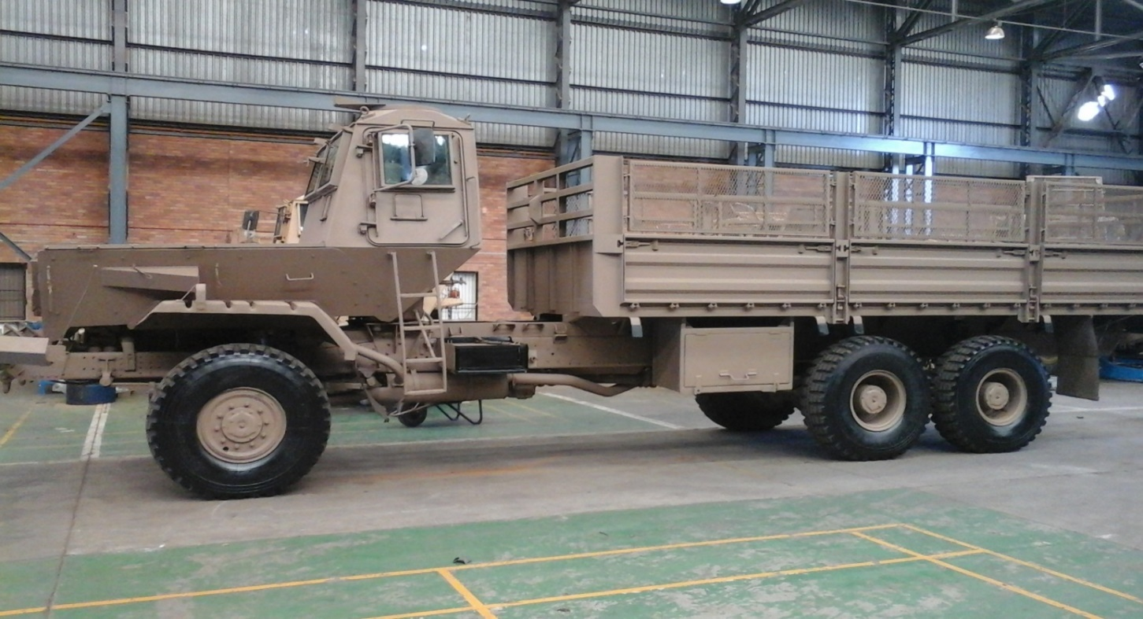
PROJECT THUSANO COMPREHENSIVE REPORT
1
of uMhlonyane
PRESENTED BY: BRIG GEN B.G. MTSWENI DATE: 08 JUNE 2022

Slide 2
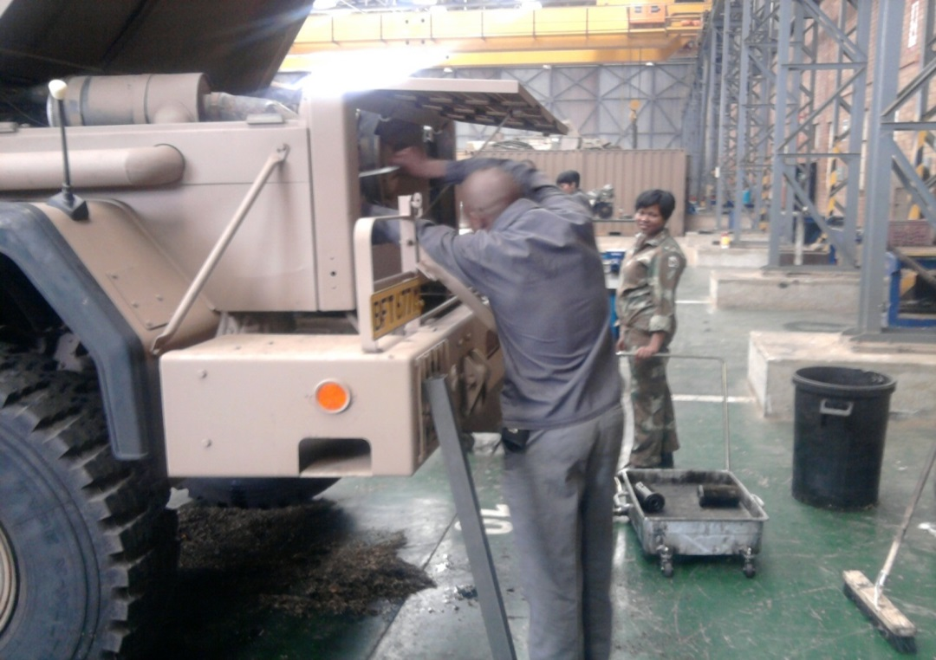
AIM
2
Is to provide a comprehensive status report on Project THUSANO to the Portfolio Committee on Defence and Military Veterans.
Notes:
2

Slide 3
SCOPE (1/2)
3
Background
Contracts
Skills Transfer
Distribution of Members with Skills Transfer.
Vehicles Repaired
Components Repaired
Vehicles in Preservation
Simulators Project
Capability Building

Slide 4
SCOPE (2/2)
4
Expenditure
Comparison Between Industry and Project THUSANO
Projected Expenditure for the Remainder of the Contract.
Deployment of Cuban specialists.
Contractual Options in RSA
Achievements.
RFI from AGSA
Conclusion.
Discussion.

Slide 5
BACKGROUND (1/3)
5
Since the year 2000, the South African National Defence Force (SANDF) just like any other state Department, started experiencing huge budget cuts which was due to the declining Gross Domestic Products (GDP) and current economic climate. This affected the SANDF’s ability to ensure that Prime Mission Equipment (PME) is maintained optimally. As a result this had an adverse impact on the force readiness of the SANDF.
Furthermore, most of the SANDF’s skilled members were poached by the private sector who enticed them with lucrative packages. The exodus of scares skills and budget cuts led to the decline in serviceability of PME. As a result, the Department of Defence was forced to rely on the industry for maintenance and repairs of its PME. However, the industry took advantage of the situation and charged exorbitant prices.
Leadership of the DOD had to device new initiatives intended at arresting the declining of serviceability of PME and resuscitation of the current aging SANDF fleet of vehicles and equipment.

Slide 6
BACKGROUND (2/3)
6
Project THUSANO was then established in terms of the Memorandum of Understanding between the government of South Africa and the government of the Republic of Cuba on 10 January 2012.
The bilateral that took place between Cuba and South Africa is based on developmental needs, and sharing of expertise. This was motivated by the fact that Cuba has a unique maintenance and preservation system of old PME dating back to 1954.
Furthermore, this was aimed at reducing expenditure of repairing PME at private industries that were billing the SANDF exorbitant prices during the prevailing National Budget cuts. The SANDF opted to procure spares and repair its own PME with the assistance of Cuban specialists and their SANDF counterparts, whilst ensuring there is adequate skills transfer between the two countries.

Slide 7
BACKGROUND (3/3)
7
To date this relationship has ensured that the SANDF covers wide strides at ensuring that old and obsolete PME are restored to their prime.

Slide 8
CONTRACTS (1/4)
8
As part of the MOU between SANDF and The Cuban Revolutionary Armed Forces, the two countries entered into contractual obligations. The following contracts were agreed upon:
Contract T1 17-001- South Africa: To provide Professional and Technical Services
SA Army
Training of technicians in the organisation of transport technique.
Technical assistance in the organisation of the system of technical security.
Technical assistance in the deactivation (dismantling) of war material.
Technical assistance in the conservation (preservation) of war material.
Repair and maintenance service of the transport technology.

Slide 9
CONTRACTS (2/4)
9
Contract T1 17-001- South Africa: To provide Professional and Technical Services
SAAF
Technical assistance in the organisation of the maintenance system, repair and maintenance of aviation equipment.
Technical assistance in the preservation of aviation armament.
SAMHS
Repair and maintenance service of medical equipment.

Slide 10
CONTRACTS (3/4)
10
Contract T1 17-002: This contract entails the provision of vocational learning to South African students in Cuba. The following are courses offered by Cuba to the South African learners:
SA ARMY COURSES
Middle level on Transport and Tank Technicians.
Mechanical Engineering on Transport and Tanks.
Artisan Training.
SA AIR FORCE COURSES
General Military training for future pilots.
Aviation Technicians.
Aviation Engineers.
Air Traffic Control.

Slide 11
CONTRACTS (4/4)
11
SA MILITARY HEALTH SERVICES
Military medical training (Medicine).
Training course in Social Science (Psychology).
Military Medicine (Biomedical).
SENIOR COURSES FOR THE SANDF
Strategic Defence and Security Programme (SDSP).
Joint Senior Command and Staff Programme (JSCSP).

Slide 12
SKILLS TRANSFER FROM FEB 14 TILL NOV 21 (1/9)
12
Ser No | Services | Course | Number of Learners
 | a | b | c
Courses Completed in Cuba
1 | SA Army | Special Course in Security and National Defence (SDSP) | 32
 |  | Post Graduate Course in Strategic Operations (JSCSP) | 32
 |  | Mechanical Engineer on Transport and Tanks | 45
 |  | Middle Level Transport and Tank Technician | 52
 |  | Artisan Training | 54
Total 215

Slide 13
SKILLS TRANSFER (2/9)
13
Ser No | Services | Course | Number of Learners
 | a | b | c
Courses Completed in Cuba
2 | SAAF | Special Course in Security and National Defence (SDSP) | 16
 |  | Post Graduate Course in Strategic Operations (JSCSP) | 16
 |  | Aviation Engineer | 15
 |  | Aviation Technician | 22
 |  | Air Traffic Controller | 29
 |  | Pilot | 25
 |  | Aircraft Preservation | 9
 |  | Simulator Developer | 5
 |  | Software Developer | 4
Total 141

Slide 14
SKILLS TRANSFER (3/9)
14
Ser No | Services | Course | Number of Learners
 | a | b | c
Courses Completed in Cuba
3 | SA Navy | Special Course in Security and National Defence (SDSP) | 16
 |  | Post Graduate Course in Strategic Operations (JSCSP) | 16
Total |  |  | 32

Slide 15
SKILLS TRANSFER (4/9)
15
Ser No | Services | Course | Number of Learners
 | a | b | c
Courses Completed in Cuba
4 | SAMHS | Special Course in Security and National Defence (SDSP) | 16
 |  | Post Graduate Course in Strategic Operations (JSCSP) | 16
 |  | Medical Training | 76
 |  | Psychology | 16
 |  | Bio Medical | 3
 |  | Technical Training | 4
Total 131

Slide 16
SKILLS TRANSFER (5/9)
16
Ser No | Services | Trade | Number of People
 | a | b | c
Technical Personnel Working with Cubans in South African National Defence Force Workshops
1 | SA Army | Motor Mechanics | 197
 |  | Auto Electricians | 33
 |  | Panel Beaters/Spray Painters | 34
 |  | Refrigerator Mechanic | 8
 |  | Trimmers/Upholstery | 5
 |  | Welder | 14
 |  | Armourer | 6
 |  | Parachute Rigger | 1
 |  | Tyre Repair | 2
 |  | Apprentice (training to become motor mechanic/auto electrician/welder/spray painter etc) | 149
Total |  |  | 449

Slide 17
SKILLS TRANSFER (6/9)
17
Ser No | Services | Course | Number of Learners
 | a | b | c
Technical Personnel Working with Cubans in South African National Defence Force Workshops
2 | SAAF | AFB Hoedspruit (Motor Mechanic) | 4
 |  | AFB Makhado (Motor Mechanic) | 6
 |  | AFB Durban (Motor Mechanic) | 4
 |  | AFB Bloemspruit (Motor Mechanic) | 4
 |  | AFB Ysterplaat (Motor Mechanic) | 5
 |  | AFB Overberg (Motor Mechanic) | 3
Total |  |  | 26

Slide 18
SKILLS TRANSFER (7/9)
18
Ser No | Services | Unit | Number of Learners
 | a | b | c
Technical Personnel Working with Cubans in South African National Defence Force Workshops
3 | SAMHS | 8 Medical Battalion (Motor Mechanics) | 10
Total |  |  | 10
Simulator Project in South Africa
4 | SA Army | School of Engineer | 10
5 |  | SA Army Technical Training School | 15
6 |  | School of Armour | 10
7 |  | Air Defence Artillery School | 11
8 |  | Infantry School | 9
Total |  |  | 55
Grand total |  |  | 1 059

Slide 19
SKILLS TRANSFER (8/9)
SKILLS TRANSFER: OVERALL
SA ARMY | SAAF | SA NAVY | SAMHS
719 | 167 | 32 | 141
TOTAL SKILLS TRANSFER |  |  | 1 059

Slide 20
SKILLS TRANSFER (9/9)
20
The members who acquired skills through studies in Cuba receive certificate which are taken to South African Qualifications Authority (SAQA) for accreditation. However, members that acquire skills through interaction with the Cuban specialists in the SANDF technical workshops do not get certificates as it is not a formal training. It is treated as skills acquired through in-post training.

Slide 21
DISTRIBUTION OF SANDF MEMBERS WHO HAS ACQUIRED SKILLS FROM PROJECT THUSANO (1/6) (1/3)
Ser No | Army of Service | Unit/Production Centre | Province | Number of Artisans Trained
 | a | b | c | d
Members Acquired Skills in SA Through Working with Cuban Specialists
1 | SA Army | Regional Workshop Gauteng | Gauteng | 125
 |  | DOD Mobilisation Centre | Free State | 70
 |  | 102 Field Workshop | North West | 37
 |  | 101 Field Workshop | Northern Cape | 54
 |  | Army Support Base Kimberley | Northern Cape | 14
 |  | 43 SA Brigade | Gauteng | 20
 |  | Air Defence Artillery School | Mpumalanga | 17
 |  | Army Support Base Western Cape | Western Cape | 21
 |  | Infantry School | Western Cape | 16
 |  | 35 Engineer Support Regiment | Gauteng | 33

Slide 22
DISTRIBUTION OF SANDF MEMBERS WHO HAS ACQUIRED SKILLS FROM PROJECT THUSANO (2/6)
Ser No | Army of Service | Unit/Production Centre | Province | Number of Artisans Trained
 | a | b | c | d
Members Acquired Skills in SA Through Working with Cuban Specialists
 | SA Army | 3 South African Infantry Battalion | Northern Cape | 11
 |  | Main Ordinance Sub Depot Walmansthal | Gauteng | 31
Total |  |  |  | 449

Slide 23
DISTRIBUTION OF SANDF MEMBERS WHO HAS ACQUIRED SKILLS FROM PROJECT THUSANO (3/6)
Ser No | Army of Service | Unit/Production Centre | Province | Number of Artisans Trained
 | a | b | c | d
Members Acquired Skills in SA Through Working with Cuban Specialists
2 | SAAF | AFB Hoedspruit | Mpumalanga | 4
 |  | AFB Makhado | Limpopo | 6
 |  | AFB Durban | KwaZulu Natal | 4
 |  | AFB Bloemspruit | Free State | 4
 |  | AFB Ysterplaat | Western Cape | 5
 |  | AFB Overberg | Western Cape | 3
Total |  |  |  | 26

Slide 24
DISTRIBUTION OF SANDF MEMBERS WHO HAS ACQUIRED SKILLS FROM PROJECT THUSANO(4/6)
Ser No | Army of Service | Unit/Production Centre | Province | Number of Artisans Trained
 | a | b | c | d
Members Acquired Skills in SA Through Working with Cuban Specialists
3 | SAMHS | 8 Medical Battalion | Gauteng | 10
Total |  |  |  | 10

Slide 25
DISTRIBUTION OF SANDF MEMBERS WHO HAS ACQUIRED SKILLS FROM PROJECT THUSANO(5/6)
Ser No | Army of Service | Unit/Production Centre | Province | Number of Artisans Trained
 | a | b | c | d
Members Acquired Skills Through Training in Cuba
4 | SA Army | Members studied in Cuba | All Provinces | 215
5 | SAAF | Members studied in Cuba | GP, WC, FS, Mpumalanga | 141
6 | SAN | Members studied in Cuba | All Provinces | 32
7
 | SAMHS | Members studied in Cuba | All Provinces | 131
Total |  |  |  | 519

Slide 26
DISTRIBUTION OF SANDF MEMBERS WHO HAS ACQUIRED SKILLS FROM PROJECT THUSANO (6/6)
Ser No | Army of Service | Unit/Production Centre | Province | Number of People
 | a | b | c | d
Simulator Project in SA
8 | SA Army | School of Engineer | Free State | 10
 |  | SA Army Technical Training School | Gauteng | 15
 |  | School of Armour | Free State | 10
 |  | Air Defence Artillery School | Mpumalanga | 11
 |  | Infantry School | Western Cape | 9
Total |  |  |  | 55
Grand total |  |  |  | 1 059

Slide 27
VEHICLES REPAIRED (1/3)
Service | Production Centre/Unit | Region | Number of Vehicles | Cost (Labour & Spares
 | a | b | c | d
SA Army | ADAS | Mpumalanga | 261 | R 883 596.22
 | ASB Kby | Northern Cape | 555 | R 5 527 568.80
 | ASB WC | Western Cape | 636 | R 2 697 599 .54
 | Mob Cen | Free State | 1 139 | R 34 179 387.00
 | 3 SAI Bn | Northern Cape | 174 | R 2 326 368.30
 | 43 SA Bde | Gauteng | 567 | R5 750 600.00
 | Infantry School | Western Cape | 232 | R 599 693.80
 | SA Army HQ | Gauteng | 303 | R 596 734.00
 | 101 Field Workshop | Northern Cape | 1 143 | R 28 745 150.07
 | 102 Field Workshop | North West | 1 171 | R 20 408 225.75
 | 35 ESR | Gauteng | 393 | R 3 185 707.60
 | RWG | Gauteng | 913 | R 16 600 289.77
 | 1 SA Tank Regt | Free State | 264 | R 883593.22
Total |  |  | 7 751 | R 122 484 514.07

Slide 28
VEHICLES REPAIRED (2/3)
Service | Production Centre/Unit | Region | Number of Vehicles | Cost (Labour & Spares
 | a | b | c | d
SAAF | AFB Hoedsruit | Mpumalanga | 9 | R 20 670.00
 | AFB Makhado | Polokwane | 11 | R 14 110.00
 | AFB Durban | KZN | 5 | R 7 950.00
 | AFB Bloemfontein | Free State | 8 | R 7 950.00
 | AFB Ysterplaat | Western Cape | 3 | R 3 180.00
 | AFB Overberg | Western Cape | 6 | R 2 650.00
 | AFB Waterkloof | Gauteng | 1 | R 2 385.00
 | AFB Langebaan | Western Cape | 1 | R 1 060.00
Total |  |  | 7 751 | R 59 955.00

Slide 29
VEHICLES REPAIRED (3/3)
Service | Production Centre/Unit | Region | Number of Vehicles | Cost (Labour & Spares
 | a | b | c | d
SA Navy | Simon’s Town Naval Base | Western Cape | 1 049 | R 1 358 755 .89
SAMHS | 8 Medical Battalion | Gauteng | 700 | R 14 000 000.00
 | Spec Force School | Gauteng | 16 | R 99 748.60
 | 4 Spec Force Regt | Western Cape | 17 | R146 892.56
 | 5 Spec Force Regt | Polokwane | 73 | R 434 783.00
Total |  |  | 1 855 | R 16 040 180.05

Slide 30
COMPONENTS REPAIRED (1/2)
Service | Production Centre/Unit | Region | Number of Components | Cost (Labour & Spares
 | a | b | c | d
SA Army | ADAS | Mpumalanga | 70 | R 32 871.00
 | ASB Kby | Northern Cape | 244 | R73 695.21
 | ASB WC | Western Cape | 400 | R 17 394.80
 | Mob Cen | Free State | 1 131 | R 715 070.00
 | 3 SAI Bn | Northern Cape | 80 | R 103 880.00
 | 43 SA Bde | Gauteng | 0 | R0.00
 | Infantry School | Western Cape | 0 | R0.00
 | SA Army HQ | Gauteng | 53 | R 24 492.00
 | 101 Field Workshop | Northern Cape | 1 016 | R 928 292.50
 | 102 Field Workshop | North West | 980 | R 650859.50
 | 35 ESR | Gauteng | 151 | R 36 357.91
 | RWG | Gauteng | 2 166 | R 1 996 297.00
 | 1 SA Tank Regt | Free State | 65 | R 32 871.00
Total |  |  | 6 356 | R 4 612 080.92

Slide 31
COMPONENTS REPAIRED (2/2)
Service | Production Centre/Unit | Region | Number of Components | Cost (Labour & Spares
 | a | b | c | d
SA Navy | Simon’s Town Naval Base | Western Cape | 24 | R 2 120.00
SAMHS | 8 Medical Battalion | Gauteng | 0 | R 0.00
Special Force | Spec Force School | Gauteng | 21 | R 6 625.00
 | Langebaan | Western Cape | 11 | R 6 886.61
 | 5 Spec Force Regt | Polokwane | 49 | R100 219.05
Total |  |  | 105 | R 115 850.66

Slide 32
VEHICLES IN PRESERVATION
32
Ser No | Services | Production Centre/Unit | Region | Qty | Cost
 |  |  |  |  | Labour | Spares | Total
 | a | b | c | c | d | e | f
1 | SA Army | Wallmansthal | Gauteng | 464 | R8 622 262.00 | R881 864.00 | R9 504 126.00
 |  | Mob Cen | Free State | 449
 |  | Pilot Project | Free State | 57
2 | SAMHS | 8 Med Bn |  | 53
Total |  |  |  | 1023 | R8 622 262.00 | R881 864.00 | R 9 504 126.00

Slide 33
33
SIMULATORS PROJECT (1/3)
Project THUSANO is currently busy with the manufacturing of twenty – four (24) Samil 20 Driving and Maintenance (D&M) simulators as part of Contract TI 17 001 South Africa, Supplement 7.
Ten (10) Samil 20 D&M simulators are completed and installed as depicted below:
School of Engineers:- One (1) Samil 20 D&M Simulator is installed. Six (6) D&M instructors, two (2) TSC members, ad two (2) signallers have been introduced and orientated on the system.

Slide 34
SIMULATORS PROJECT (2/3)
34
SA Army Technical Training Centre:- One (1) Samil 20 D&M Simulator is installed. Ten (10) D&M instructors, and five (5) TSC members have been introduced and orientated on the system.
School of Armour:- Four (4) Samil 20 D&M Simulator are installed. Ten (10) D&M instructors have been introduced and orientated on the system..
Air Defence Artillery School:- Two (2) Samil 20 D&M Simulator are installed. Six (6) D&M instructors, four (4) TSC members and one (1) have been introduced and orientated on the system.

Slide 35
SIMULATORS PROJECT (3/3)
35
South African Infantry School:- Two (2) Samil 20 Driving and Maintenance Simulator is installed. Seven (7) D&M instructors and two (2) signallers have been introduced and orientated on the system.

Slide 36
CAPABILITY BUILDING (1/6)
36
Training and skills transfer of the aforementioned members (skills transfer) of the South African National Defence Force is done with the purpose of creating own capability within the SANDF.
This capability will enhance the formation of the DOD 4th Line Repair Workshop which will be situated in Tek Base (Lyttleton) and Regional Workshops in all 9 provinces.
These workshops will be self reliant in terms of expertise, skills and knowledge. Furthermore this will serve as a good platform to apply skills acquired from training in Cuba.

Slide 37
CAPABILITY BUILDING (2/6)
37
The envisaged Workshops will be structured as follows:
DOD 4th Line Repair Workshop
This workshop will carry out third and forth line repairs and this entails;
Components repair.
Body works (Panel beating and spray painting).
Dismantling.
Refrigeration.
Engine Overhaul.
Armament fitters.
Upholstery.

Slide 38
CAPABILITY BUILDING (3/6)
38
Gearbox Repair.
Welding.
Motor Electrical .

Slide 39
CAPABILITY BUILDING (4/6)
39
The staff compartment of the DOD 4th Line Repair Workshop will consist out of the following skilled specialists:
Motor Mechanics. (Artisan, Military Artisan, Senior Military Artisan, Artificer)
Auto Electricians. (Artisan, Military Artisan, Senior Military Artisan, Artificer)
Armourer. (Artisan, Military Artisan, Senior Military Artisan, Artificer)
Refrigerators. (Artisan, Military Artisan, Senior Military Artisan, Artificer)
Panel Beaters. (Artisan, Military Artisan, Senior Military Artisan, Artificer)
Recovery. (Artisan, Military Artisan, Senior Military Artisan, Artificer)

Slide 40
CAPABILITY BUILDING (5/6)
40
Regional Workshop
This workshop will be established in all nine (9) provinces with the aim to carry out first and second Line repairs. This entails;
Maintenance and Repair Section.
Industrial Repair.
Refrigeration.
Armament Fitters.
Second Line Recovery

Slide 41
CAPABILITY BUILDING (6/6)
41
The staff compartment of the Regional Workshops will consist out of the following skilled specialists:
Motor Mechanics. (Apprentice, Artisan, Military Artisan, Senior Military Artisan)
Auto Electricians. (Apprentice, Artisan, Military Artisan, Senior Military Artisan)
Armourer. (Apprentice, Artisan, Military Artisan, Senior Military Artisan)
Refrigerators. (Apprentice, Artisan, Military Artisan, Senior Military Artisan)
Recovery. (Apprentice, Artisan, Military Artisan, Senior Military Artisan)

Slide 42
EXPENDITURE

Slide 43
SERVICING OF THE CONTRACT
43
Ser No | Contract | Amount
 | a | b
1 | Contract TI 17-001 South Africa and Supplements | R 594 235 500,00
2 | Contract TI 177- 002 South Africa and Supplements | R 371 835 829,00
Total |  | R 966 071 329.00

Slide 44
SUPPORT TO CUBAN SPECIALISTS
44
Ser No | Description | Total in Rand
 | a | b
1 | Phone & Internet | R 1 456 541.00
2 | Flight Tickets | R 49 689 159.00
3 | Laundry Services | R 894 795.00
4 | Catering Services | R 743 218.00
5 | Accommodation | R 41 082 829.00
6 | Other Expenditures | R 195 405 800,00
Total |  | R 289 272 342,00

Slide 45
AIRCRAFT AND CARGO EXPENDITURE
45
Ser No | Description | Total in Rand
 | a | b
1 | Chartered aircraft expenditure | R120 021 439.00
Grand Total |  | R120 021 439.00

Slide 46
WELFARE SUSTANANCE EXPENDITURE
46
Ser No | Description | Total in Rand
 | a | b
1 | Clothing Special Purpose (Tracksuits for Students and PPEs for Cuban Specialists) | R1 227 508.00
2 | Toiletries | R 520 202.00
Grand Total |  | R 1 747 710.00

Slide 47
TOTAL EXPENDITURE
47
Ser No | Description | Total in Rand
 | a | b
1 | Servicing of the Contract | R 966 071 329.00
2 | Support to Cubans | R 289 272 342,00
3 | Chartered Aircraft | R 120 021 439.00
4 | Welfare Sustenance | R1 747 710.00
TOTAL |  | R 1 377 112 820,00

Slide 48
COMPARISON BETWEEN INDUSTRY AND PROJECT THUSANO
48
Entity | Expenditure Over the Period of Six (6) Years |  |  |  |  |  |  |  | Total Amount
 | a | b | c | d | e | f | g | h | i
Industry | Year | 2009 | 2010 | 2011 | 2012 | 2013 | 2014 | 2015 | R2 672 269 713
 | Amount | R 362 762,299 | R 379 810,133 | R 364 476,646 | R 423 999,302 | R 632 124 568 | R509 096 765 | R0.00
Project THUSANO | Year | 2015 | 2016 | 2017 | 2018 | 2019 | 2020 | 2021
 | Amount | R6 125 800 | R143 952 671 | R170 662 596 | R274 393 655 | R 219 595 670 | R 323 001 126 | R 239 381 302 | R 1 377 112 820
Savings |  |  |  |  |  |  |  |  | R 1 295 156 893

Slide 49
PROJECTED EXPENDITURE FOR THE REMAINDER OF THE CONTRACT
49
 | Years | 2021 | 2022 | 2023 | 2024 | 2025 | Total
Projected Expenditure | a | b | c | d | e | f | g
 | Amount | R277 624 611 | R305 387 072.1 | R335 925 707.21 | R369 518 277.93 | Contract ends in Jan 2025, however, Cuban specialists will go to Cuba in Dec 2024 for vacation and will not return in Jan 2025. | R 1 288 455 668,24

Slide 50
DEPLOYMENT OF CUBAN SPECIALISTS (1/2)
Cuban professionals that are key to the abovementioned achievements in conjunction with members of the South African National Defence Force are based at the following regions:
Regional Works Gauteng: 05
DOD Main Ordnance Depot: 11
8 Medical Depot: 06
DOD Mob Cen: 24
101 Fd Wksp: 06
102 Fd Wksp: 06
ASB Kby: 04
ASB WC: 05

Slide 51
DEPLOYMENT CUBAN SPECIALISTS (2/2)
ADA School: 05
SAAF Base Ysterplaat: 08
SAAF Base Langebaan: 05
SAAF Bloemspruit: 05
SAAF Swartkop: 09
SA Navy Simon’s Town: 09
Simulator Project Team: 12
Head of Delegation: 05
Advisors 05
TOTAL 140

Slide 52
CONTRACTUAL OPTIONS AVAILABLE IN RSA
Project THUSANO has empowered SANDF artisans with enough skills to carry out all technical tasks on the under carriage of the vehicles. However, specialised tasks such as repair of superstructure requires special tools and workshop equipment which are not available in SANDF workshops. Hence, there is a contract between SANDF and various private companies which is managed by ARMSCOR to deal with specialised technical tasks.
It should be noted that this contract is costly and skills are not imparted to SANDF artisans. Current economic situation (budget cuts) makes it quite difficult to afford repairing vehicles using private companies. Therefore, it is a wise move to capacitate the existing workshops in order to build internal capability.
More funding should be allocated on procurement of workshop equipment, tool boxes, special tools and machinery for engineering work.

Slide 53
53
ACHIEVEMENTS

Slide 54
54
A train which has been unserviceable for almost twenty (20) years, has been repaired by Project THUSANO team.

Slide 55
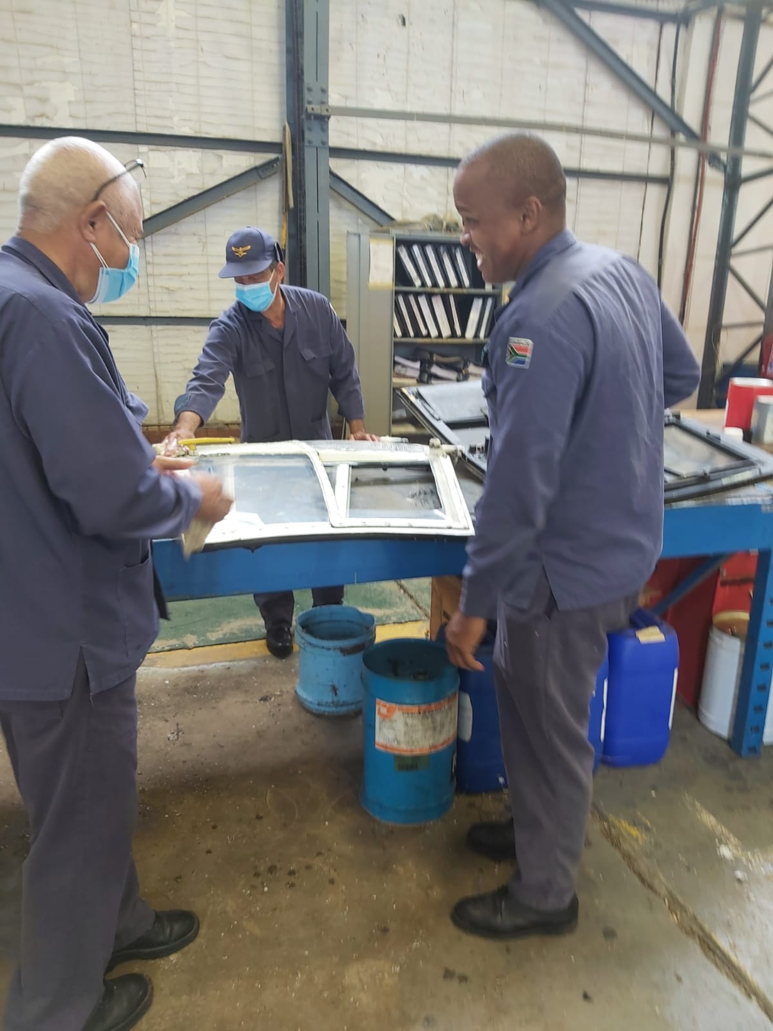
ACHIEVEMENTS (1/15) SKILLS TRANSFER

Slide 56
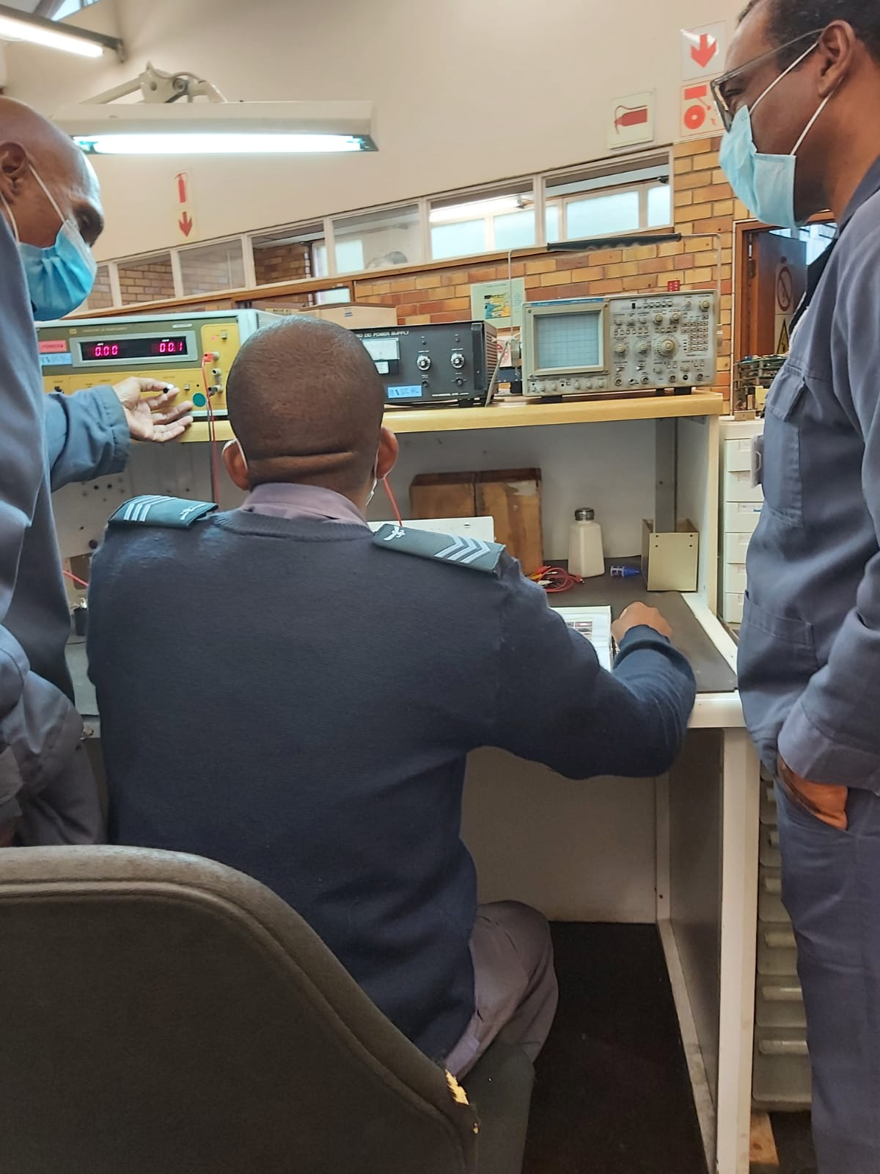
ACHIEVEMENTS (2/15)

Slide 57
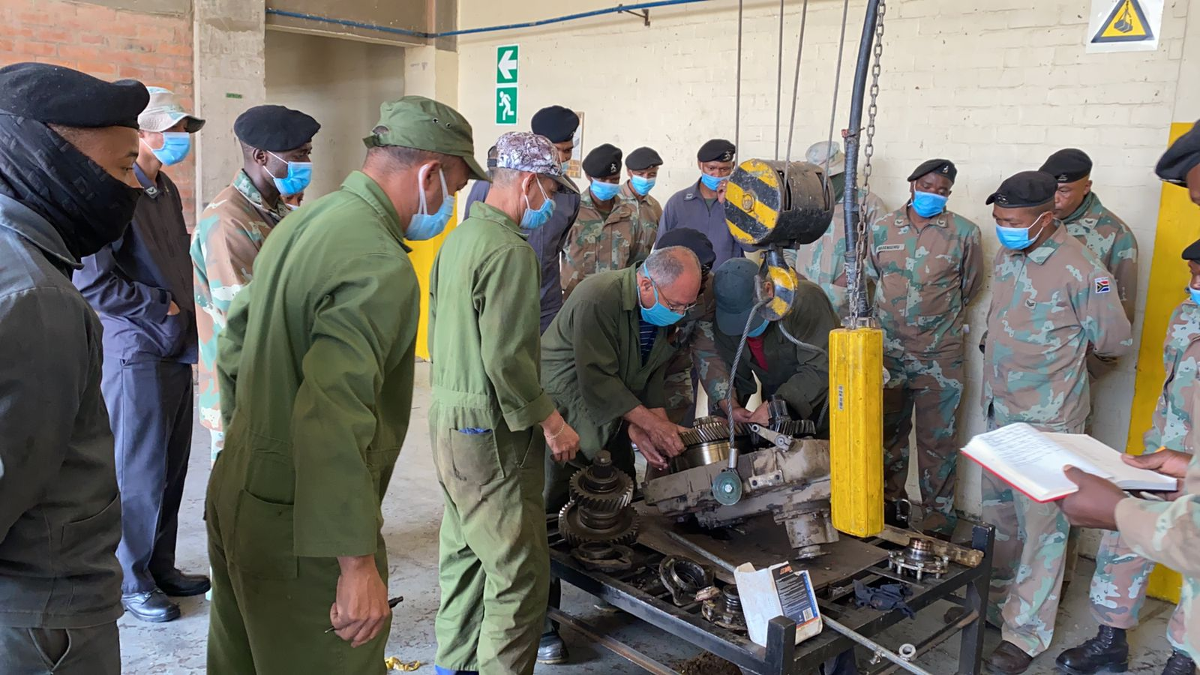
SKILLS TRANSFER (3/15) SKILLS TRANSFER

Slide 58
ACHIEVEMENTS (4/15) SKILLS TRANSFER Skills transfer Video

Slide 59
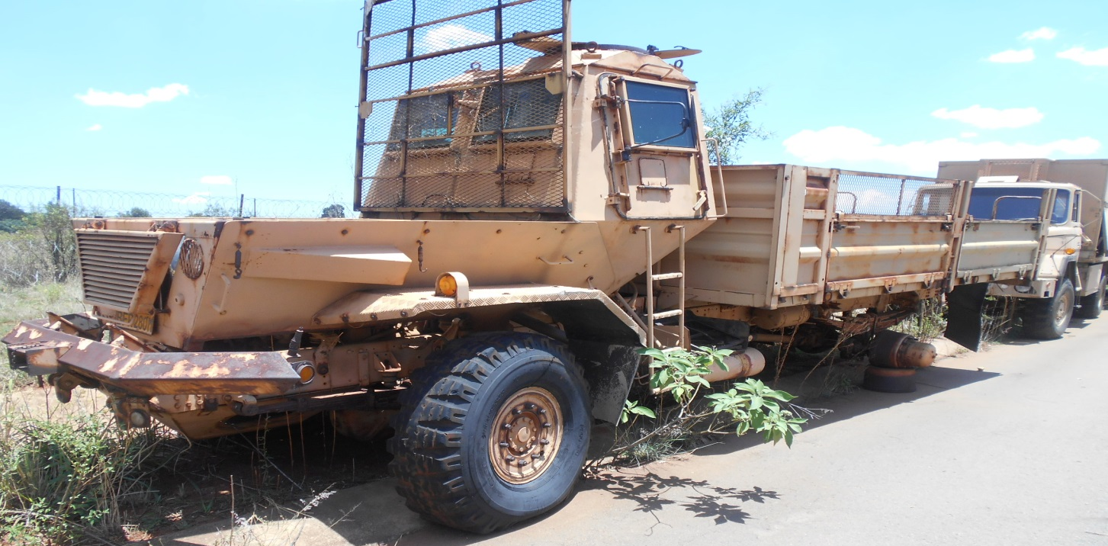
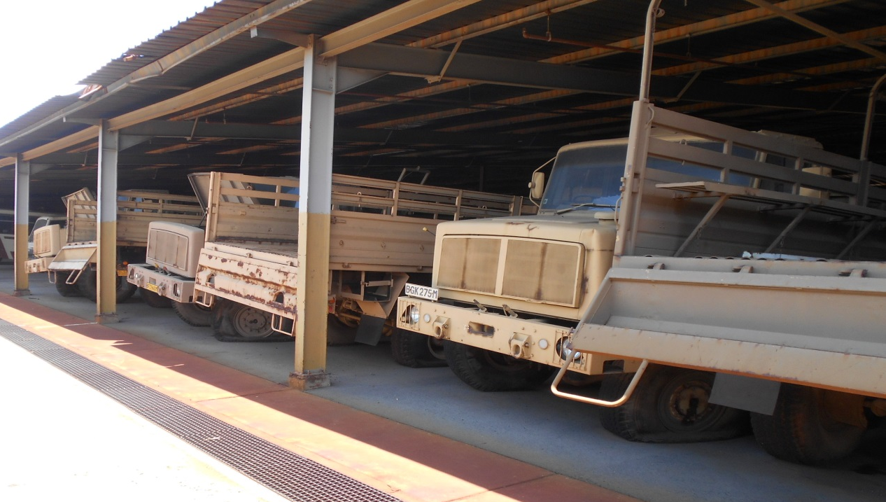
ACHIEMENTS (5/15)
VEHICLES BEFORE REPAIRS
59
BEFORE

Slide 60
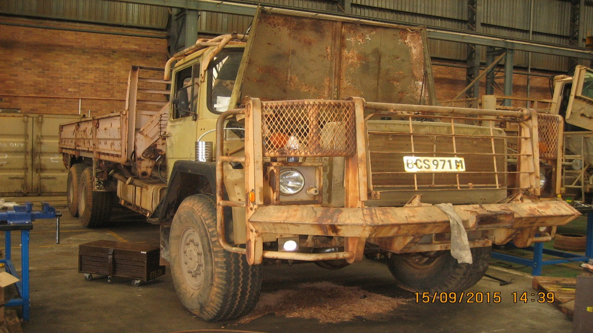
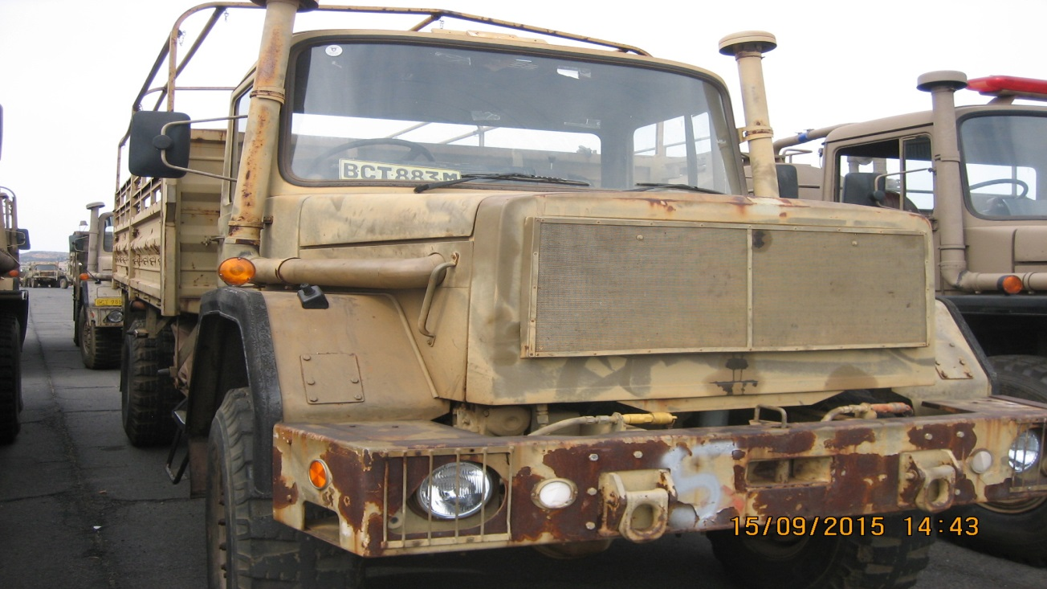
60
ACHIEVEMENTS (6/15)
VEHICLES BEFORE REPAIRS
BEFORE

Slide 61
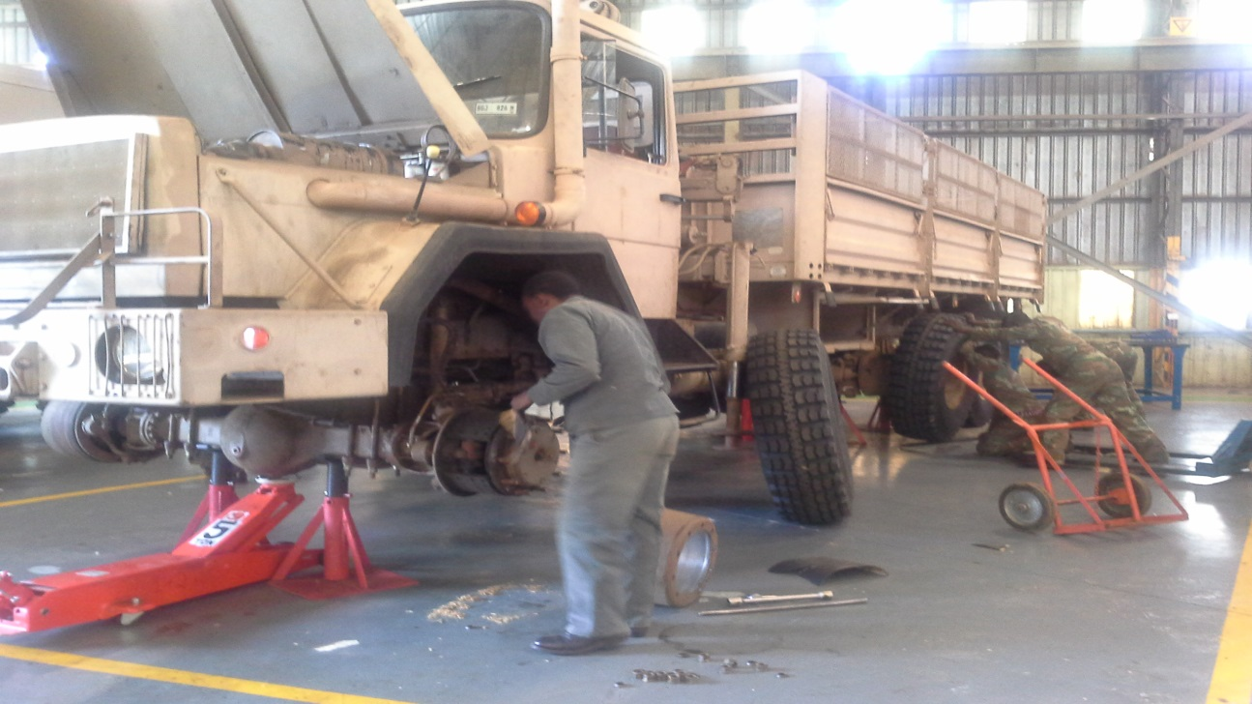
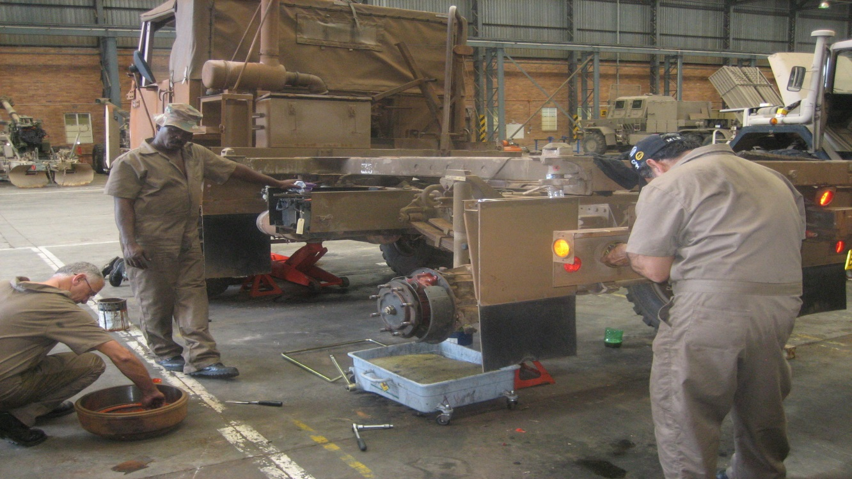
61
ACHIVEMENTS (7/15)
VEHICLES DURING REPAIRS
IN PROCESS

Slide 62
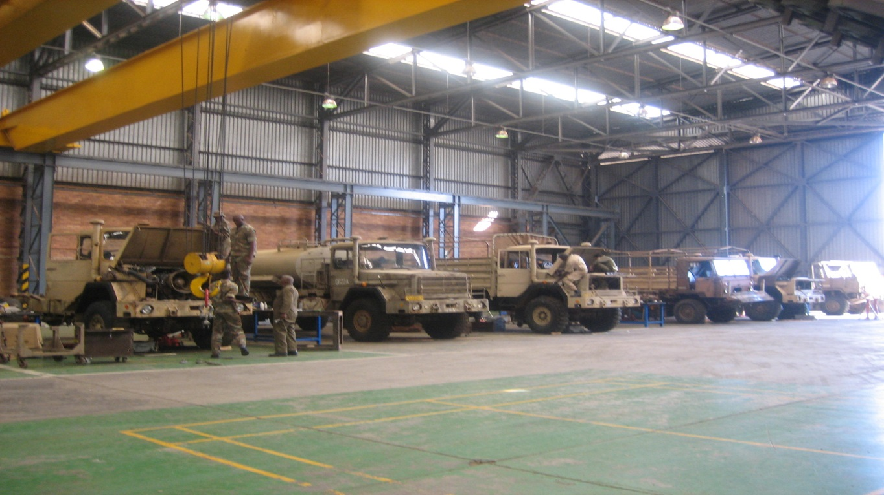
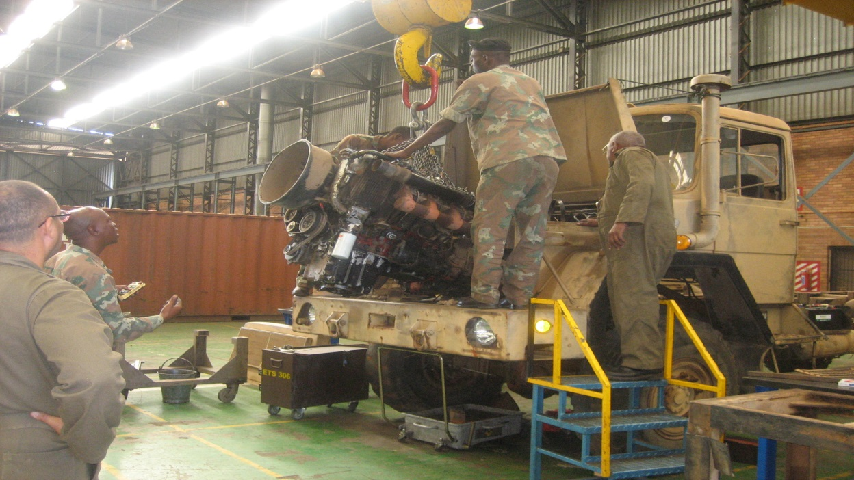
62
ACHIEVEMENTS (8/15)
VEHICLES DURING REPAIRS
IN PROCESS

Slide 63
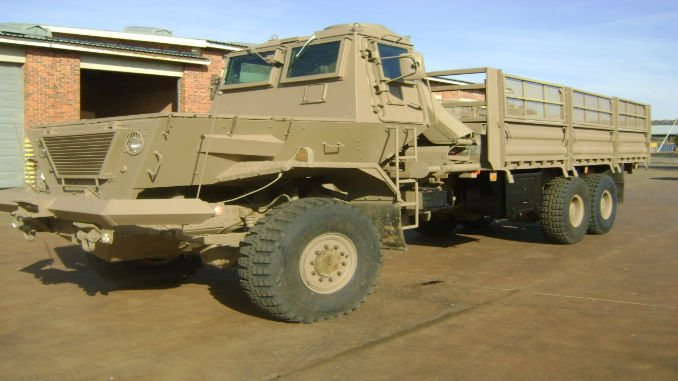
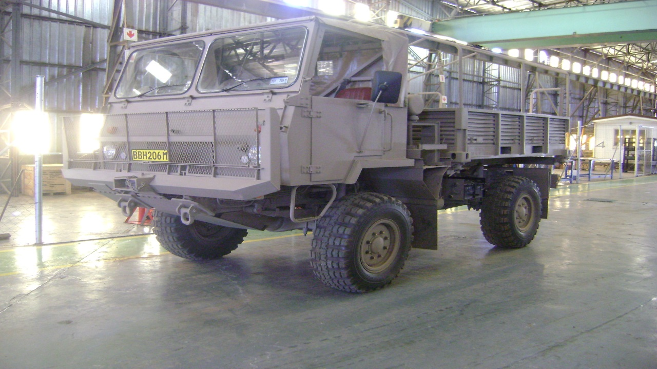
63
ACHIEVEMENTS (9/15)
VEHICLES AFTER REPAIRS
AFTER

Slide 64
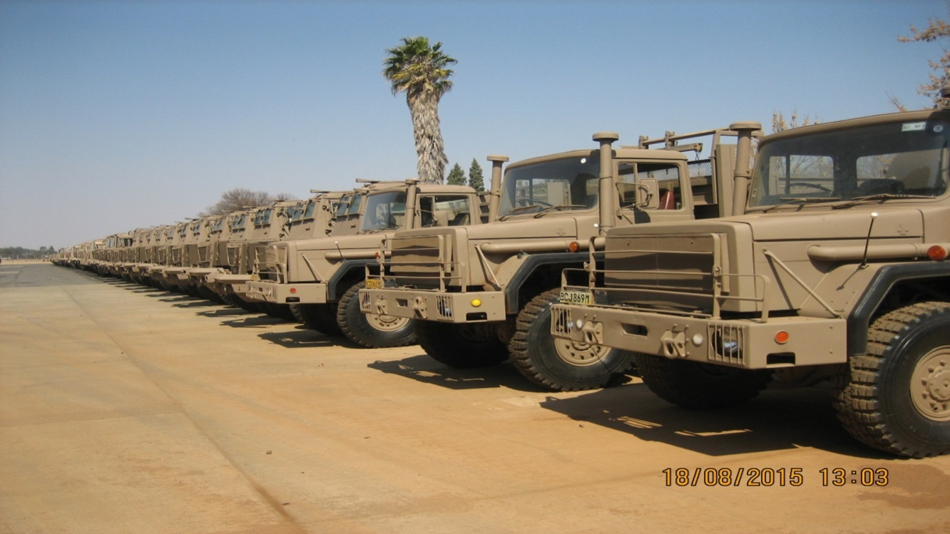
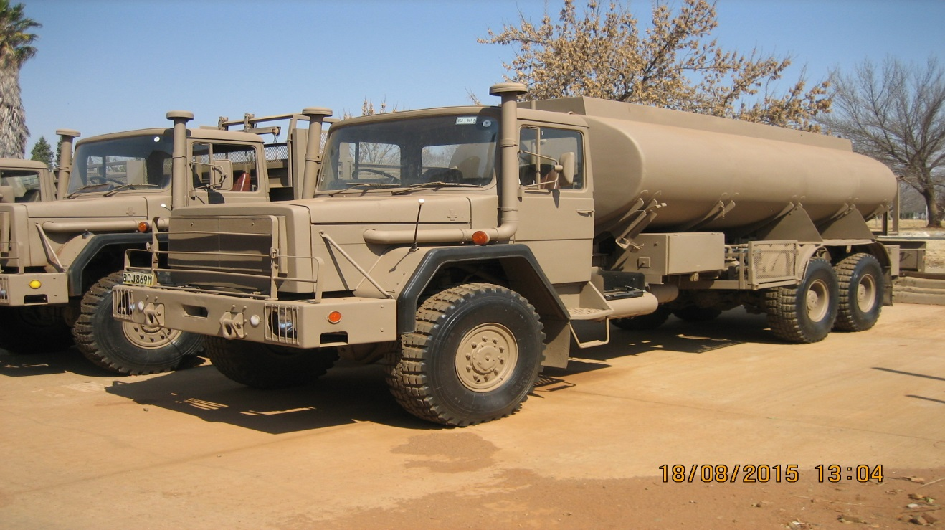
64
ACHIEVEMENTS (10/15)
VEHICLES AFTER REPAIRS
AFTER

Slide 65
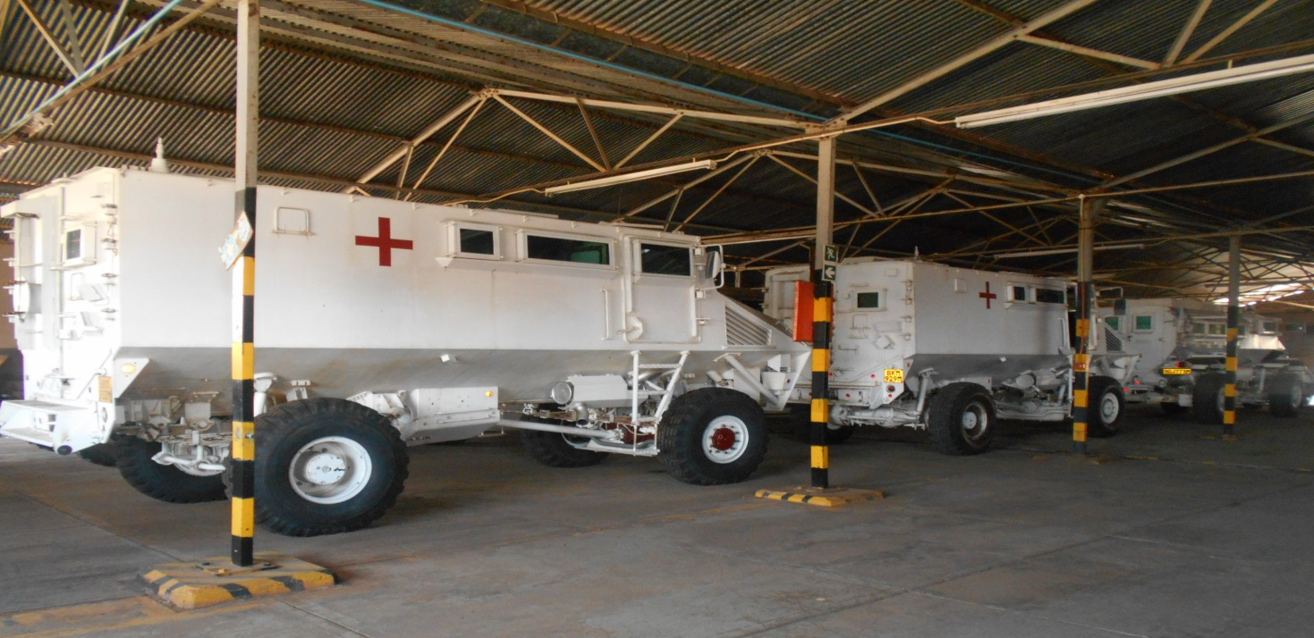
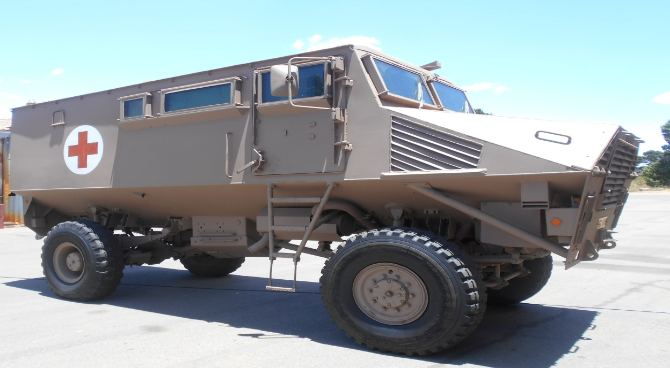
ACHIEVEMENTS (11/15)
VEHICLES AFTER REPAIRS
65
AFTER

Slide 66
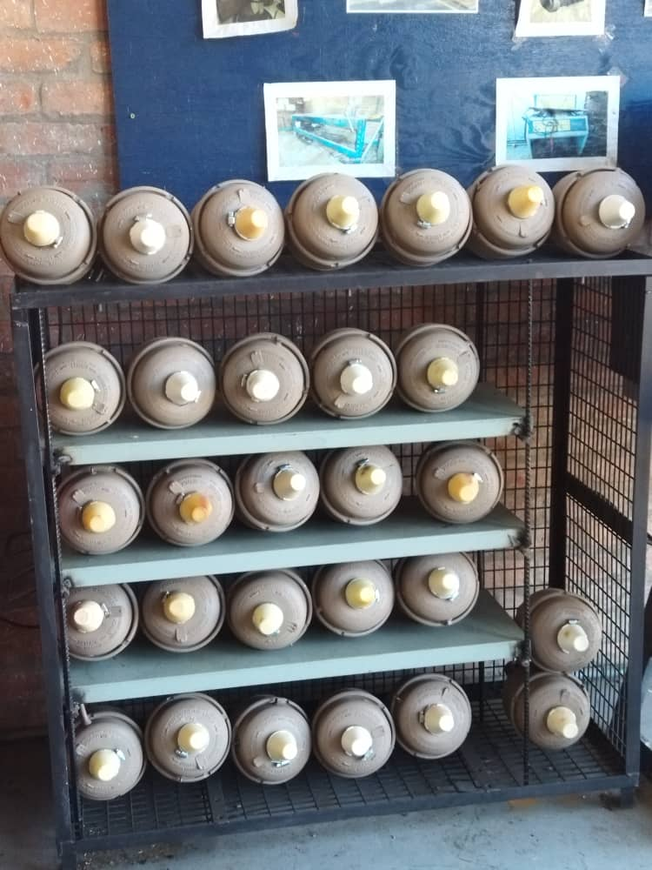
ACHIEVEMENTS (12/15) COMPONENTS REPAIRS

Slide 67
ACHIEVEMENTS (13/15) Component Repairs Video

Slide 68
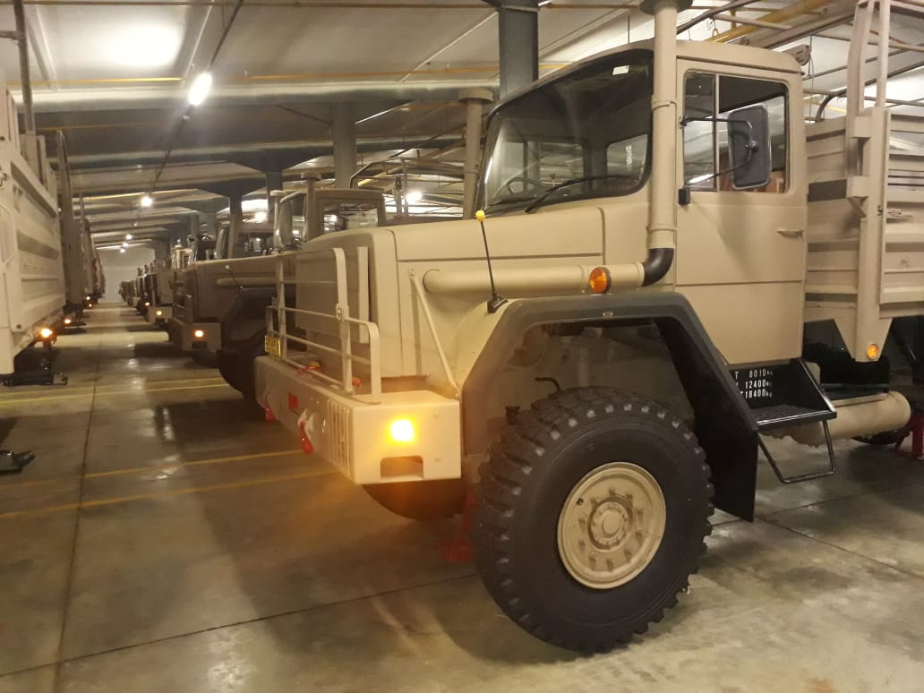
ACHIEVEMENTS (14/15) VEHICLES IN PRESERVATION
68

Slide 69
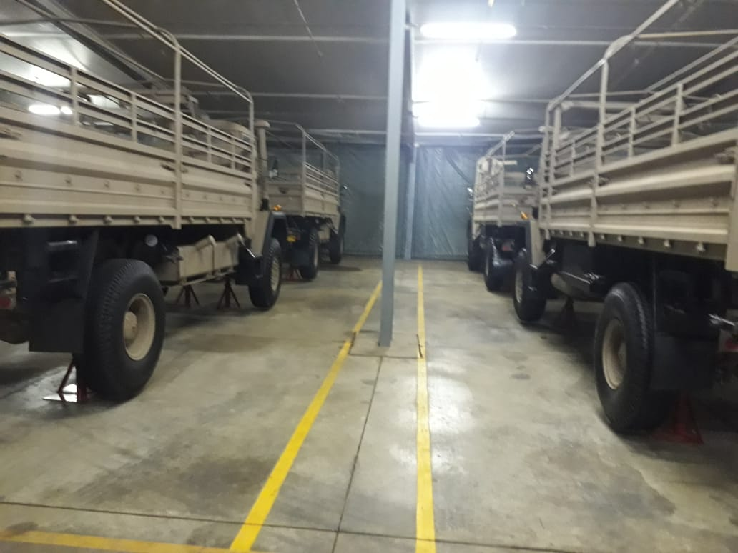
ACHIEVEMENTS (15/15) VEHICLES IN PRESERVATION
69

Slide 70
RFI FROM AGSA
70
Logistics Division (C Log) has responded to all Request for Information (RFI) from Auditor General SA. This is confirmed in the correspondence from Mr Demar Le Roux to Mr Edem Abotsi dated 01 June 2022.
Outstanding information from Arms of Services is being attended to and will be forwarded to AGSA as soon as possible.

Slide 71
CONCLUSION
71
Project THUSANO continues its development, following the elements agreed in the contract signed between both parties. Its objectives are being fulfilled, and we continue moving forward despite the challenges imposed by the current fiscal situation
To undertake training and to meet assigned missions safely and successfully, military equipment must be kept in good working condition and be ready for action on short notice, this will ensure that the Department of Defence and Military Veterans' Mandate is successfully carried out
Invitation is forwarded to the Parliamentary Portfolio Committee on Defence to visit the DOD Mob Centre and Walmansthal to physically view the inroads of Project THUSANO

Slide 72
DISCUSSION

