Slide 1
AUDIT COMMITTEE BRIEFING Explaining our role and function, as well as the monitoring of Audit Action Plan.
08 June 2022

Slide 2
CONTENTS
Introduction
Audit Committee Role and Function
Monitoring of Audit Action Plan
Concerns Raised with Management & the Executive Authority
Conclusion

Slide 3
Introduction
The Audit Committee is constituted as a statutory committee of the Department of Defence appointed in terms of section 77 of the Public Finance Management Act (Act 1 of 1999 as amended by Act 29 of 1999), read with Chapter 3 of the Treasury Regulations issued in terms of the Act. (Treasury Regulations 27.1.1)
The Audit Committee is established as an oversight assurance body, providing independent oversight over governance, risk management and control processes of the Department.

Slide 4
Introduction…cont
The Audit Committee is appointed by the Accounting Officer in concurrence with the Minister, as an independent oversight and advisory committee for a period of three years, with the option to have the term renewed for a second term (by the AO).
The Accounting Officer, may at her discretion and with the concurrence of the Executive Authority, when it has been determined that the members of the Audit Committee have acted in a grossly negligent manner; terminate the services of any or all of the committee members.
The Audit Committee is afforded direct and unobstructed line of communication to the relevant Minister, Accounting Officer, Senior Management Team, as well as the Auditor General and the Internal Audit Function.

Slide 5
Introduction…cont
Currently, the DOD Audit Committee has three members, following the expiry of terms of two of its members and one other member becoming deceased.
The current members are:
Mr. LM Mangquku, Chairperson
Ms. S Hari
Mr. M Ndlangisa
The Department is in the process of filling the Audit Committee vacancies, as we need at-least 2 additional members, with experience in Human Resources and National Defence/ Military.

Slide 6
Audit Committee Role and Function
According to our Terms of Reference, our role amongst others, is to oversee the review of the following:
The effectiveness of internal control system;
The effectiveness of the Internal Audit function;
Effectiveness of Risk Management;
Accurate identification of risk areas to be covered in the scope of internal and external audits;

Slide 7
Audit Committee Role and Function…cont
According to our Terms of Reference, our role amongst others, is to oversee the review of the following:
The adequacy, reliability and accuracy of reporting, financial and non-financial performance;
Accounting and auditing concerns identified as a result of internal and external audits;
Compliance with legal and regulatory provisions;

Slide 8
Audit Committee Role and Function…cont
With respect to Internal and External Auditors, one of our key roles is to:
Oversee the activities of the Internal Audit function, including its annual work programme, coordination with the external auditors, the reports of significant investigations and the responses of management to specific recommendations.
Consider whether management has developed an effective audit action plan, to implement all recommendations of findings on time;
Monitor whether management is implementing the action plan, i.e. recommendations from Internal and External audit findings, by addressing the root causes and improving the control environment.

Slide 9
Monitoring of Audit Action Plans
On a quarterly basis, the Audit Committee requires management to present progress on the Audit Action Plan. This is a standing agenda item in all our quarterly meetings.
AGSA issued the Department a Qualified Audit Opinion in October 2021, and the main qualification matters were:
Special Defence Account
Contingency Liabilities
Irregular and Fruitless Expenditure
Our monitoring revealed that the Department had made negligible progress by the third quarter and that no further progress was made through to the fourth quarter.

Slide 10
Monitoring of 2020/21 Audit Action Plan
Service/ Division | Number of Findings Raised | Number of Action Plans | Number of Action Plans IMPLEMENTED | Number of Action Plans NOT IMPLEMENTED | Number of Action Plans WITH NO ACTION
GOVERNANCE
Internal Audit | 7 | 7 | 2 | 5 | 0
TANGIBLE ASSETS
Logistics | 16 | 16 | 5 | 11 | 0
Defence Material Division | 1 | 1 | 0 | 1 | 0
INTANGIBLE ASSETS
Information Systems Division | 3 | 3 | 0 | 3 | 0

Slide 11
Monitoring of 2020/21 Audit Action Plan
Service/ Division | Number of Findings Raised | Number of Action Plans | Number of Action Plans IMPLEMENTED | Number of Action Plans NOT IMPLEMENTED | Number of Action Plans WITH NO ACTION
PREDETERMINED OBJECTIVES
Chief of Staff | 10 | 10 | 0 | 10 | 0
COMPENSATION OF EMPLOYEES
Human Resources | 25 | 25 | 1 | 24 | 0
GOODS AND SERVICES
Finance | 8 | 8 | 2 | 6 | 0
Logistics | 2 | 2 | 0 | 2

Slide 12
Monitoring of 2020/21 Audit Action Plan
Service/ Division | Number of Findings Raised | Number of Action Plans | Number of Action Plans IMPLEMENTED | Number of Action Plans NOT IMPLEMENTED | Number of Action Plans WITH NO ACTION
SERVICE DELIVERY
Military Health Services | 11 | 11 | 2 | 9 | 0
Logistics | 17 | 17 | 3 | 14 | 0
REVENUE, RECEIVABLES, CONTINGENT LIAB.
Finance | 25 | 25 | 1 | 24 | 0
Army | 7 | 7 | 0 | 7 | 0
Special Forces | 2 | 0 | 0 | 0 | 2
Military Health Services | 1 | 1 | 0 | 1 | 0
Air Force | 1 | 0 | 0 | 0 | 1
Logistics | 1 | 1 | 0 | 1 | 0

Slide 13
Monitoring of 2020/21 Audit Action Plan
Service/ Division | Number of Findings Raised | Number of Action Plans | Number of Action Plans IMPLEMENTED | Number of Action Plans NOT IMPLEMENTED | Number of Action Plans WITH NO ACTION
INFORMATION SYSTEMS
Information Systems Division | 15 | 15 | 3 | 12 | 0
Logistics | 9 | 9 | 1 | 8 | 0
GITO | 3 | 3 | 2 | 1 | 0
Military Health Services | 3 | 3 | 0 | 3 | 0
PROCUREMENT, FRUITLESS EXP.
Logistics | 66 | 64 | 0 | 64 | 2
Human Resources | 2 | 0 | 0 | 0 | 2
Defence Material Division | 1 | 0 | 0 | 0 | 1

Slide 14
Monitoring of 2020/21 Audit Action Plan
Service/ Division | Number of Findings Raised | Number of Action Plans | Number of Action Plans IMPLEMENTED | Number of Action Plans NOT IMPLEMENTED | Number of Action Plans WITH NO ACTION
SPECIAL DEFENCE ACCOUNT
Special Forces | 5 | 3 | 0 | 3 | 0
Finance | 1 | 1 | 0 | 1 | 0
Armscor | 2 | 2 | 1 | 1 | 0
Defence Intelligence | 8 | 8 | 1 | 7 | 0
TOTAL ACTION PLAN OUTCOMES | 229 | 219 | 24 (11%) | 195 (89%) | 08

Slide 15
Concerns raised with Management & the Executive Authority
The Department does not seem to have an effective system of accountability, where Services and Divisions are held accountable for resolving audit findings;
There seems to be poor appreciation of the responsibility placed by the PFMA on the Accounting Officer (and by default on MANAGEMENT) to design and implement effective systems of internal control and risk management, whilst ensuring full compliance with all applicable legislations;
Performance in the department is below expectations when compared to targets, and this area requires attention;
The continuing annual escalation of Irregular Expenditure, mainly from the unresolved COE shortfall and also from SCM breaches is a serious concern that requires urgent

Slide 16
Concerns raised with Management & the Executive Authority…cont
Numerous concerns within SCM, which is currently located within C-LOG:
SCM has the highest number of findings, both from AGSA and IAD, and stands with the highest number of unresolved findings;
IAD and the SCM Compliance Unit has reported a number of Procurement Units with a standing mandate to procure yet lacking basic SCM training, operating without Bid Committees, inadequate tools of trade, operating without proper delegation and poor segregation of duties;
High number of deviations in conducting procurement, and clearly not using deviation process as an exception for procurement;
The delegation to conduct Irregular Expenditure investigations to the same Services and Divisions that incurred and/or failed to prevent Irregular Expenditure, creating a possible conflict.

Slide 17
Concerns raised with Management & the Executive Authority…cont
The pace of concluding investigations, clearing Irregular, Fruitless & Wasteful Expenditure and implementing Consequence Management is painfully slow, and virtually ineffective;
The growing Contingent Liability exposure of the department requires attention and intervention.
The department is long overdue for a comprehensive ICT infrastructure refresh, to effectively confront the increasing threat of ICT Security and Cyber Security, including the ability to deliver on its mandate in a world empowered by 4IR;

Slide 18
Conclusion
The Audit Committee continues to promote cooperation and participation by all Services and Divisions in its engagements, and some small gains are beginning to form. However failure by Heads of Services and Divisions to attend Audit Committees Meetings remains a concern.
The demands of the PFMA against the dictates of the Defence Act over the Department render discipline and consequence management split between uniformed and un-uniformed members, virtually creating two centres of power around the Secretary of Defence and the Chief of SANDF. This is a material contributor to the lack of progress in the department, especially towards clean governance and accountability.

Slide 19
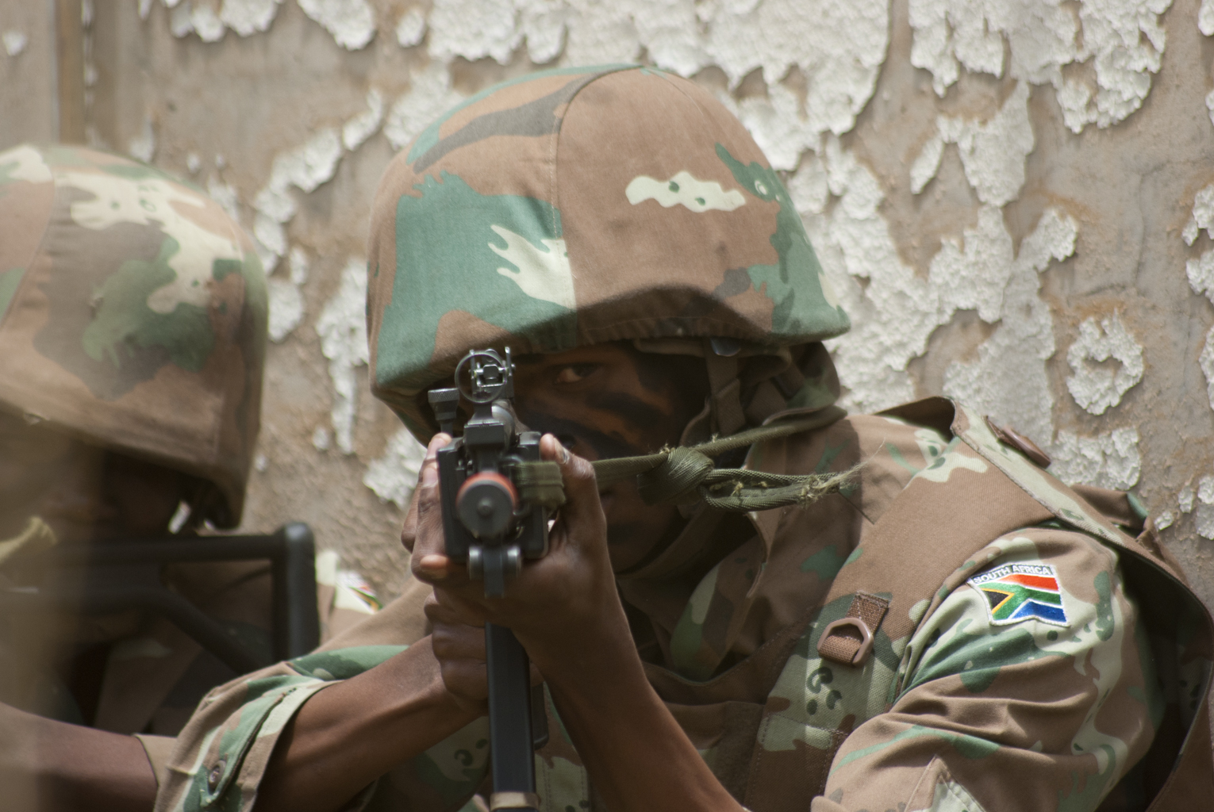
THANK YOU.

