Slide 1
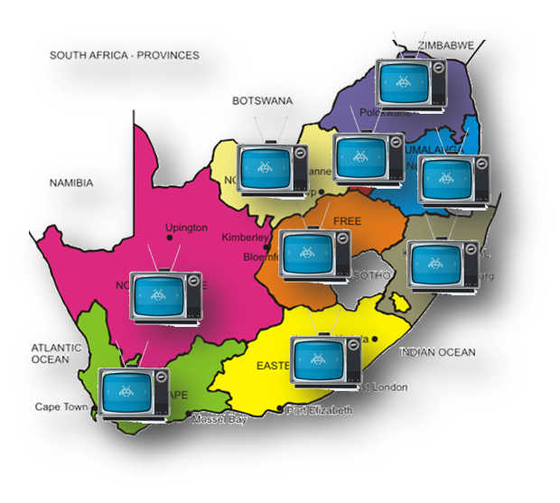
PRESENTATION TO THE PORTFOLIO COMMITTEE ON COMMUNICATIONS (PCC) BY USAASA/USAF FRAMEWORK AND TIMELINES FOR CURRENT INVESTIGATIONS AND IMPLEMENTATION DATES FOR CONSEQUENCE MANAGEMENT PROCESSES 07 JUNE 2022

Slide 2
Disciplinary Procedure Framework
On 2 October 2020, 6 employees were put on precautionary suspension with full payment on allegation of misrepresentation and alleged financial misconduct
The USAASA Disciplinary Code and Procedure requires the disciplinary process to be completed within 60 days depending on the complexity of the matter.
Due to the complexities of the matter, investigation processes were delayed.
The employees remain suspended to avoid compromising the investigation process.
The investigation processes is at its final stages and as such the Agency anticipate a draft final report at the beginning of quarter 2 of 2022/2023 financial year.

Slide 3
USAASA LITIGATION REPORT FOR THE PERIOD ENDING 31 MARCH 2022

Slide 4
Contextual Background
USAASA entered into various contracts for the following services which led to the current litigations and arbitrations:
Procurement of STB’s
Installation contracts with 27 installation companies
Currency exchange rates relate cases
Broadband related cases
All the above matters were registered at Arbitration Foundation of South Africa (AFSA) and related arbitration and litigation processes
Some cases are enrolled in various courts

Slide 5
Litigations/Arbitration Matters
Parties
VBS Bank (in liquidation) v USAASA
R 102 million
Alleged breach of the undertaking, VBS Bank (in liquidation) suffered damages in the sum of
R 102 million.
High Court
Status
The matter was heard by Johannesburg High Court on 13 May 2022 and judgement is reserved
Details of the Claim
On 7 June 2021 USAASA was served with a Notice of Motion claiming R102 million from USAASA, alleging USAASA to be in breach of a letter of undertaking signed by a former CEO of USAASA on 16 January 2016, whereby it is alleged that USAASA undertook to pay all invoices submitted by Leratadima Marketing Solutions (in liquidation) into a VBS Bank account.
There was no contract signed between USAASA and VBS. The Contract was between USAASA and Leratadima Marketing Solutions (in liquidation). Leratadima was a supplier for the BDM project. This is a delictual claim.
Claim

Slide 6
Litigations Report
Parties
Leratadima Marketing Solutions (in liquidation) v USAASA
Supplier of DTT STBs in the BDM Programme.
Claim
R4.7 million plus interest
On 7 June 2021, USAASA was served with a Notice of Motion claiming R4.7 million for invoices not paid together with costs and interest on the late payments of invoices
Status
Matter was heard on the 9th May 2022 in the Johannesburg High Court and the court ruled against USAASA. USAASA is currently studying the Judgement
Details of the Claim
USAASA and Leratadima signed the Supply and Delivery Agreement on 24 August 2015, which expired on 23 August 2018 for the supply of DTT STBs in the BDM Programme. The parties further signed an addendum to the main agreement on 10 April 2019 which expired on 30 June 2019

Slide 7
Litigations Report
Parties
KST Trading v USAASA
Installation Company of the DTT Set Top Boxes at the households of BDM beneficiaries.
Claim
R1. 8 million
KST trading is demanding payment of the escalation rate for installation fees paid by USAASA for the 2016/2017, 2017/2018 and 2018/2019 financial years.
High Court
Status
Pleadings are closed. Waiting for matter to be enrolled in the High Court.
Details of the Claim
USAASA and KST Trading signed a service level agreement on 18 January 2016, which expired on 17 January 2019 for the installation of the DTT Set Top Boxes at the households of BDM beneficiaries.

Slide 8
Litigations Report
Parties
Trading Leratadima Marketing Solutions (in liquidation) v USAASA - Arbitration
Supplier of DTT STBs in the BDM Programme.
Claim
R198 million
This claim for alleged consequential damages result from the suspension of the manufacturing of DTT Set Top Boxes, alleged non-payment of invoices as well as the variance in the exchange rate for foreign components required for the manufacturing of the Set Top Boxes .
AFSA
Status
Matter to be enrolled for hearing under auspices of AFSA. Hearing scheduled for 22 August 2022
Details of the Claim
USAASA and Leratadima signed the Supply and Delivery Agreement on 24 August 2015, which expired on 23 August 2018 for the supply of DTT STBs in the BDM Programme. The parties further signed an addendum to the main agreement on 10 April 2019 which expired on 30 June 2019.

Slide 9
Litigations Report
Parties
CZ Electronics v USAASA and Others v USAASA (Arbitration under auspices of AFSA
Supplier of DTT STBs in the BDM Programme.
Claim
R46 million
This claim is for alleged variance in the exchange rate paid for foreign components required for the manufacturing of DTT Set Top Boxes.
AFSA
Status
The Arbitrator made an award in favour of USAASA.
The claimant has filed an appeal and the matter is due to be set down for appeal
Details of the Claim
On 24 August 2015, USAASA and CZ Electronics entered into a Supply and Delivery Agreement which expired on 23 August 2018, for the supply of DTT Set Top Boxes in the BDM Programme.

Slide 10
Litigations Report
Parties
Grow Makhosikhati v USAASA
Supplier of Broadband Connectivity
Claim
R7.4 million
This claim is based on non-payment of invoices for services rendered and delivered
Status
The matter under the auspices of AFSA. Different dates for discovery , filing of witnesses statement and trial date to be agreed upon
Details of the Claim
On the 25 April 2018 , USAASA and Grow Makhosikati Trading entered into Connectivity Agreement for internet services in Impendle and Nyandeni Local Municipalities.
Delays in payment due to Internal Audit Open Review on all Broadband Contracts resulted in Grow Makhosikati filing a claim against USAASA at the Arbitration Foundation of South Africa.

Slide 11
INVESTIGATION BY NATIONAL TREASURY
Brightwave Technologies (Installer of Broadband Connectivity)
The Draft Report was presented by National Treasury to the Board in the meeting held on 28 April 2021. The Board indicated certain areas that were not covered or concluded in the investigation report. National Treasury cited the following challenges as reasons for incomplete areas: the expiry of the contract between NT and KPMG, non-delivery of certain information and non-cooperation of certain service providers. The CAE will make enquiry with NT on the current status and report accordingly to the Board.
SAP/EOH Investigation (Implementation of the SAP System)
The Draft Report was presented by National Treasury to the Board in the meeting held on 28 April 2021. The Board indicated certain areas that were not covered or concluded in the investigation report. National Treasury cited the following challenges as reasons for incomplete areas: the expiry of the contract between NT and KPMG, non-delivery of certain information and non-cooperation of certain service providers. The CAE will make enquiry with NT on the current status and report accordingly to the Board.

Slide 12
End

