Slide 1
Provincial Treasury
WESTERN CAPE RESPONSE : AGSA REPORT ON THE FINANCIAL MANAGEMENT OF
GOVERNMENT’S COVID-19 INITIATIVES
07 June 2022

Slide 2

CONTEXT
The Provincial Treasury drives accountability through the review of financial reporting of departments, entities and municipalities and embedding adherence to sound governance practices.
This is further entrenched by considering compliance with financial norms and standards through the establishment of sound financial governance within the provincial and municipal spheres.
Its measurement is continually evaluated to achieve, maintain and sustain the highest level of governance.
WCG implemented precautionary measures to strengthen controls, ensure compliance and enable an agile response within the framework of the PFMA from a procurement and financial management perspective:
  Established a COVID -19 coordination function within the Provincial Treasury (PT) for the Finance and SCM Cluster to ensure financial governance, procurement and financial management requirements were met in terms of the Disaster Management Act and Its regulations;
      Daily check-in meetings and reports until the requisite governance structures were put in place to meet every second day.
      Weekly Finance and SCM Insight Reports produced to internally support PT decision making in response to COVID-19 transversal issues.
      Weekly Expenditure reports were consolidated for the Province and reported to the National Treasury.
  Established a Central Procurement Advisory Committee (CPAC), consisting of key senior management officials within PT, Head of the PDMC, Internal Audit and CFOS from the Departments of Health; Transport and Public Works; Local Government; Community Safety and Social Development.
  Deployed Provincial Treasury logistics support and advisory teams to support the Humanitarian Relief Stream, and procurement of medical supplies and PPE.
  Established a database for medical and non-medical PPE suppliers (including cloth mask manufacturers) that provided for central management of governance requirements, supply and demand availability, lead times and benchmark pricing for departments and municipalities;
  Managed queries, and provided procurement support, assistance and guidance through the SCM helpdesk to departments, municipalities, entities and suppliers
  Engaged with National Treasury to
  Develop exemption notice (GG 43188 notice 437 of 31 March 2020) extending compliance dates (eg AFS submission from 31 May to 31 July)
  Address audit scoping matters considering the impact of the revised dates on audits.
  Engaged with provincial AGSA on suspension of non-essential audit related work until the lockdown was lifted, in accordance with national AGSA instructions

Slide 3
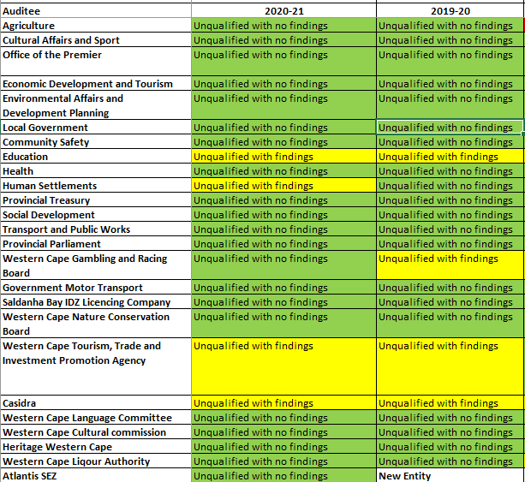
PFMA AUDIT OUTCOMES
  AGSA did not find any significant issues with the financial statements of any of the Western Cape institutions, providing “reasonable assurance” that all transactions are free from material misstatements, and have complied with the relevant laws and regulations.
  Auditees with findings relate to non-COVID-19 matters
  All instances of irregular expenditures (eg non-compliance with a regulatory requirement) are processed through a Condonation Working Committee once identified by a department
  PT addresses all AGSA recommendations through a continuous programme of assessing findings and developing approaches as part of the CGRO strategy

Slide 4
FUNDING RECEIVED FOR PROVINCIAL RESPONSE-COVID-19

Slide 5
FUNDING RECEIVED FOR THE PROVINCIAL RESPONSE TO COVID-19
Western Cape Department of Health and Wellness - Expenditure as at 21 March 2022
Fund/ Economic Classification R'000 | Funding Source | Appropriated: specifically and exclusively as: | Main Budget | Adjusted Budget
 |  |  |  |  | Expenditure | Over/ Under | % Spent of Adj Budget
COVID-19 Response | National | Earmarked | 832 000 | 1 051 427 | 989 660 | 61 767 | 94,1%
COVID-19 Grant Component | National | National Conditional Grant | 156 690 | 156 690 | 156 690 | - | 100,0%
Vaccine Programme | Provincial | Earmarked | 150 000 | 155 216 | 145 015 | 10 201 | 93,4%
Total |  |  | 1 138 690 | 1 363 333 | 1 291 365 | 71 968 | 94,7%
Economic Classification
Compensation of Employees |  |  | 417 216 | 514 420 | 481 862 | 32 558 | 93,7%
Goods and Services |  |  | 720 697 | 798 238 | 763 504 | 34 734 | 95,6%
Households |  |  |  | 970 | 2 784 | (1 814) | 287,0%
Non-Profit Institutions |  |  |  | 26 917 | 20 858 | 6 059 | 77,5%
Machinery and Equipment |  |  | 777 | 22 788 | 22 356 | 432 | 98%
Total |  |  | 1 138 690 | 1 363 333 | 1 291 365 | 71 968 | 94,7%
Source: Vuindlela, 01 June 2022

Slide 6
FUNDING RECEIVED FOR THE DEPARTMENT OF HEALTH : RESPONSE TO COVID-19
2021/22 funding for Western Cape Department of Health response to COVID-19 came from national and provincial allocations:
National funding:
    R832 million allocated in 2021/22 main budget for Department’s response to COVID-19, including staff, intermediate care facilities, testing (NHLS), consumables (incl. PPE), communication, critical equipment, transport of staff and patients, etc.
    R156 million allocated in the COVID-19 component of the HIV, Aids and TB National Conditional Grant for the rollout of the Province’s vaccine programme.
Provincial allocations:
    R150 million to further assist the Department with the implementation of the vaccine programme.
    Additional R244 million was allocated in 2021 Adjusted Estimate mainly for staff and facilities in anticipation of 4th wave.
      Mainly sourced from rollover of 2020/21 Departmental under spending.
Unspent funding as at the end of the financial year has been requested to be rolled over to 2022/23 for the Department’s continued COVID-19 response.
Note: all departments have continued to reprioritise resources within their own budgets to respond to the state of disaster

Slide 7
MATTERS RAISED IN SPECIAL AUDIT
Department | Matter | Follow up
Health | 2 transactions at prices exceeding NT benchmark prices, with potential loss of R40,000 | Initial order for 1,5 million units was cancelled as the supplier could only deliver 63 000 units.
Education | Specification of masks, PPE stock management in schools (PPE register indicating the type of PPE received, issued and used), PPE storage at schools | Establishing proper systems to ensure correct needs analysis is done before PPE is procured. Guidelines on inspecting / quality checks on PPE delivered to schools Checklist for reporting on poor-quality PPE Guidelines on process and controls to monitor PPE distribution SOP and guidelines on secure storage space
 | Deviations from competitive bidding: Dept selected preferred supplier to procure 2,646 million cloth face masks to the value of R54 747 353 without inviting as many suppliers as possible to bid before awarding the contract | Department indicated that, given the urgency, nature and quantities required, it embarked on emergency procurement in terms of its own SCM limited bidding and emergency procurement policy. Matter being treated as Irregular Expenditure

Slide 8
PRECAUTIONARY MEASURES IMPLEMENTED IN RESPONSE TO COVID-19 (PFMA)

Slide 9
PT PRECAUTIONARY MEASURES IMPLEMENTED (PFMA)
From a Financial Systems enablement perspective, the following provisions were made:
  BAS: SCOA item created as a project for COVID-19 which must be used when procuring essential goods and/ services to respond to the disaster;
  LOGIS stores linked to the created project segment;
  MEDSAS and / LOGIS: the required mechanism for requisitioning, ordering, and invoicing. Systems capture screens will be used as evidence;
  eProcurement System(ePS): provision made on the ePs to indicate whether the RFQ is linked to COVID-19. Systems generated dash-boarding and / reporting on all RFQs/ awards will be used as evidence; and
  provision made for departments to lift the threshold for the ePS during the lockdown and limited or single source bidding may be invited on the system.
From an audit committee and internal audit perspective:
  The Audit Committees approval of recommended changes in IA plans, including
    A COVID-19 project created for each department
    A standard 350 or 500 hours budgeted for covid 19 related audit engagement
    IA plan amendments up to 30 Sept 2020 or possibly until 31 March 2021

Slide 10
PT PRECAUTIONARY MEASURES IMPLEMENTED (PFMA) cont …
Issued Provincial Treasury Circulars :
  System Circular No 01: Business continuity measures in preparation for COVID-19 for corporate financial systems (BAS, LOGIS & PERSAL) and its related business intelligence tools;
  Treasury Circular No. 11 of 2020: WCG’s Procurement Requirements in response to the Declaration of a National Disaster due to the CORONAVIRUS (COVID-19) Pandemic on 23 March 2020
  Treasury Circular No. 12 of 2020: Financial Measure in Response to COVID-19: This circular aims to inform all Western Cape Government departments, public entities, and the Provincial Parliament (where applicable) of financial measures to be put in place to respond to the COVID-19 pandemic.
  Treasury Circular No. 13 of 2020 dated 25 March 2020: To provide Accounting Officers with the principles and programme regarding the rollover of unspent funds and retention of over-collected own revenue from 2019/20 to 2020/21.
  Treasury Circular No. 14 of 2020: Facilitating the receipt, reporting and accounting of cash donations to the Western Cape Government Departments and Entities, to inform Western Cape Government Departments and Provincial Public Entities of the arrangements related to cash donations, budgeting, accounting and reporting in response to the Covid- 19 pandemic. This circular complements the Western Cape Disaster Budgeting Procurement and Accounting Framework.
  Treasury Circular No. 17 of 2020: Guidelines: 2019/20 Book Closure and Annual Financial Statements: To provide direction and guidance to Accounting Authorities (AAs) and Chief Financial Officers (CFOs) of public and trading entities with the book-closure and compilation of the annual financial statements process for the year ending 31 March 2020.
  Treasury Circular 18 of 2020: Guidelines: 2019/20 Book Closure and Annual Financial Statements for Departments, to provide further direction and guidance to departments on the annual financial statements process for the year ending 31 March 2020 based on the implications of the exemptions provided for by the Minister of Finance in Government Gazette 43188 dated 31 March 2020
  Treasury Circular 19 of 2020: Programme and Guidelines for the 2019/20 Annual Report Process: To provide Accounting Officers, Accounting Authorities and Chief Financial Officers with a Programme and Guide in respect of the 2019/20 Annual Report process, inclusive of the Annual Financial Statements.
  Various Emails to provide guidance to departments on the submission of the In-Year Monitoring and Reporting (IYM) Model.

Slide 11

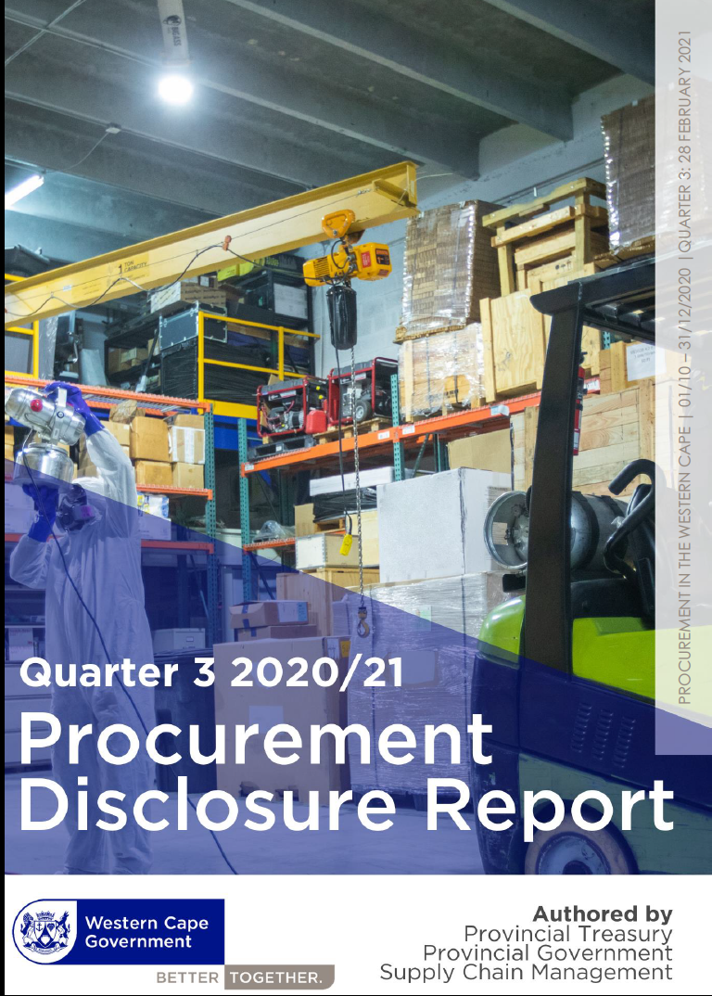
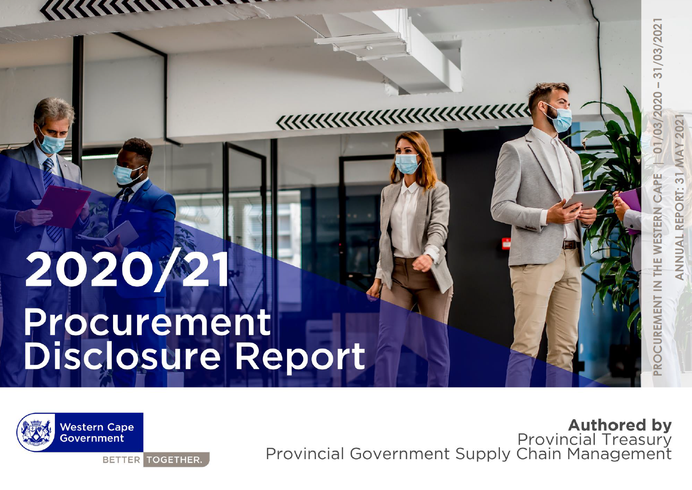
PT PRECAUTIONARY MEASURES IMPLEMENTED (PFMA) cont …
Developed and published monthly, quarterly and annual procurement disclosure reports

Slide 12
DEPARTMENTAL CHECKS AND BALANCES
Treasury Circular No. 12 of 2020: Financial Measures in Response to COVID-19: This circular aims to inform all Western Cape Government departments, public entities, and the Provincial Parliament (where applicable) of financial measures to be put in place to respond to the COVID-19 pandemic.
1, Budgetary Control
  Reprioritization of both 2019/20 and 2020/21 budgets.
  Departments and Provincial Parliament were given an opportunity to adjust their 2020/21 cashflow requirement in terms of section 40(4)(a) of the PFMA.
2, Recording of COVID-19 Expenditure
To enable recording of expenditure on BAS, departments created a project titled COVID-19 on BAS in terms of the SCoA as follows:
  PROJECTS
  DEPARTMENTAL SPECIFIC PROJ LIST
  CREATE A PROJECT ON NON-POSTING AND POSTING LEVEL WITH THE DESCRIPTION: COVID-19
All expenses in terms of COVID-19 expensed against this project on BAS.
3, Reporting Responsibilities
  In line with section 40(1)(a) of the PFMA, accounting officers for a department, CEO’s of Public Entities and the Secretary of the Provincial Parliament kept full and proper records of their financial affairs in line with the directive on recording expenditure indicated.
  Public entities and the Provincial Parliament indicated the spending on COVID-19 as part of the In-year monitoring reporting to the Provincial Treasury.
  Departments monitored the cash position of public entities and service providers that may face liquidity challenges due to business disruptions caused by the COVID-19 disaster. Any risks with regard to these entities were reported to the Provincial Treasury on an ongoing basis.
4, Disclosure of expenditure related to COVID-19 for the year ended 31 March 2020
  To be transparent and accountable, departments and entities prepared the necessary disclosure on expenditure related to COVID-19 as supplementary information.
  The supplementary information were included in the annual report of the departments and public entities under the accounting officer’s section of the annual report.

Slide 13
FUNDING & PRECAUTIONARY MEASURES IMPLEMENTED IN RESPONSE TO COVID-19 (MFMA)

Slide 14
FUNDING RECEIVED FOR THE MUNICIPAL RESPONSE TO COVID-19
Funding for the municipal response to COVID-19 comes from three broad sources:
  First, all municipalities reprioritsed resources within their own budgets to respond to the unprecedented nature of the pandemic and lockdown.
  Second, several existing conditional grant transfers to municipalities were reprioritised or had their rules changed to allow funds to be spent on COVID-19 response activities. For example, funds from the Municipal Infrastructure Grant could be used for the sanitization of public transport and for the provision of emergency water supply.
  Finally, municipalities also received additional transfers from the National and Western Cape Governments in the 2020/21 Financial Year to support initiatives to combat the COVID-19 pandemic and social related relief packages as follows:
      R7.93 million allocated to Western Cape municipalities through Municipal Disaster Relief Grant for immediate disaster relief.
      R16.2 million allocated through the Local Government Support Grant (WC Department of Local Government) to strengthen humanitarian and feeding relief initiatives by Government, Private Entities and Municipalities in vulnerable communities (Provincial Gazette Extraordinary 8232 dated 24 April 2020).
      An additional R721, 698 million was allocated to municipalities in the Western Cape Local Government Equitable Share Allocation in the June 2020 Division of Revenue Amendment Act (GG 43660 dated 28 August 2020).

Slide 15
PT PRECAUTIONARY MEASURES IMPLEMENTED (MFMA)
The Provincial Treasury implemented precautionary measures to ensure compliance to the Municipal Finance Management Act 56 of 2003 (MFMA) from a procurement and financial management perspective:
  The Minister of Finance in terms of the Municipal Finance Management Act 56 of 2003 (MFMA) issued a conditional Exemption Notice dated 30 March 2020, in order to ensure effective and efficient service delivery and to minimise any potential delay in decision making. The notice addresses amongst others provided an exemption from a provision of the MFMA which requires any action to be taken between the date of publication of the notice and the date that the national state of disaster lapses or is terminated in terms of section 27(5) of the Disaster Management Act, 2002;
  Despite this exemption, most municipalities continued to comply with the legislative prescripts in terms of in-year reporting on budget implementation. This allowed PT to continue to closely monitor the financial health of municipalities until the Exemption was withdrawn in 2021.
  The strain on municipal finances (particularly in the form of lower collection rates) led to an increase in the number of unfunded budgets. Six municipalities were assisted to develop Budget Funding Plans to address this. One municipality (Beaufort West) was placed under intervention in August 2021.
  Continuous support to municipalities and municipal entities were provided via the existing IGR structures and MFMA helpdesk. During the Strategic Integrated Municipal Engagements which focus on the draft budgets prepared by Municipalities, guidance was also provided on the impact of the COVID-19 pandemic on budget preparations.

Slide 16
PT PRECAUTIONARY MEASURES IMPLEMENTED (MFMA) cont …
  Treasury Circular Mun No. 06 of 2020: Western Cape Government's Response Plan for Disaster Procurement Requirements in Respect to the Lockdown for the Coronavirus (COVID- 19) on 23 April 2020.
  A provincial circular was also issued to provide guidance and clarity to Accounting Officers of municipalities and municipal entities in respect of:
  Managing their procurement requirements in response to the Coronavirus (COVID-19) pandemic and the subsequent business continuity during the lockdown period and thereafter.
  The impact of NT MFMA Circular 101 relating to COVID 19 - Bulk Central Procurement Strategy for Government Institutions.
  Reports of potential wrongdoing made in terms of s106 of the MSA are investigated by DLG and referred to the SIU for investigation where appropriate. Whistle-blowers can also approach the SIU directly.
  Instances of irregular expenditure had to be addressed by municipalities, in terms of their own policies and through MPAC structures. The province provides advice to municipalities on Disciplinary Board s and has assisted in training new MPACs after the elections.
  The PT also monitored municipal reports on COVID-19 spending on a weekly basis (see next slides).

Slide 17
MONITORING EXPENDITURE REPORTED BY MUNICIPALITIES IN THE WESTERN CAPE
  NT introduced a weekly expenditure reporting template to track and record expenditures specifically associated with the COVID-19 crisis, and to better understand and monitor the municipality’s financial condition.
  WC municipalities reported COVID-19 expenditures of R1.623 billion for the period, 15 March 2020 till 01 April 2022

Slide 18
EXPENDITURE PER MUNICIPALITY 15 MARCH 2020 – 01 APRIL 2022 (by function)

Slide 19
EXPENDITURE PER MUNICIPALITY 15 MARCH 2020 – 01 APRIL 2022
(by funding source)

Slide 20
SPECIAL AUDIT MATTERS – CITY OF CAPE TOWN
Matter | Remaining matters | Follow up
PPE procurement controls | Detection of non-compliance in selecting and approaching existing suppliers Premiums beyond benchmark prices | No IR detected. Disciplinary action against one official linked to contract Forensic investigation of prices conducted. Reported to NT and Competition Commission. Disciplinary action against two officials
Hiring of tents | Project planning and preparing needs analysis | IR for Wingfield site – beyond scope of City functions and USDG
Water supply for informal settlements | Contract oversight and consultation with custodians of existing contracts | Referred for a forensic investigation. MPAC considering recovery of over-charging
Emergency procurement controls | Use justified by reasonable lead times | No IR detected
Controls over deviations | Use of competitive processes | No IR detected
Control over expansions of existing contracts | Lack of consultation with contract managers | No IR detected

Slide 22
MFMA AUDIT OUTCOMES
Summary Status 2020/21
  22 Unqualified with no findings
  5 Unqualified with finding
  3 Qualified
  5 Improvements
  24 Unchanged
  1 Regression
Municipality | 2015 | 2016 | 2017 | 2018 | 2019 | 2020 | 2021 | Y-o-Y Movement
Beaufort West Municipality |  |  |  |  |  |  |  | Ý
Bergriver Municipality |  |  |  |  |  |  |  | Ü
Bitou Municipality |  |  |  |  |  |  |  | Ü
Breede Valley Municipality |  |  |  |  |  |  |  | Ü
Cape Agulhas Municipality |  |  |  |  |  |  |  | Ü
Cape Winelands Municipality |  |  |  |  |  |  |  | Ü
Cederberg Municipality |  |  |  |  |  |  |  | Ý
Central Karoo District Municipality |  |  |  |  |  |  |  | Ü
City of Cape Town |  |  |  |  |  |  |  | Ü
Drakenstein Municipality |  |  |  |  |  |  |  | Ü
Garden Route District Municipality |  |  |  |  |  |  |  | Ý
George Municipality |  |  |  |  |  |  |  | Ý
Hessequa Municipality |  |  |  |  |  |  |  | Ü
Kannaland Municipality |  |  |  |  |  |  |  | Ü
Knysna Municipality |  |  |  |  |  |  |  | Ü
Laingsburg Municipality |  |  |  |  |  |  |  | Ü
Langeberg Municipality |  |  |  |  |  |  |  | Ü
Matzikama Municipality |  |  |  |  |  |  |  | Ý
Mosselbay Municipality |  |  |  |  |  |  |  | Ü
Oudtshoorn Municipality |  |  |  |  |  |  |  | Ü
Overberg District Municipality |  |  |  |  |  |  |  | Ü
Overstrand Municipality |  |  |  |  |  |  |  | Ü
Prince Albert Municipality |  |  |  |  |  |  |  | Þ
Saldanabay Municipality |  |  |  |  |  |  |  | Ü
Stellenbosch Municipality |  |  |  |  |  |  |  | Ü
Swartland Municipality |  |  |  |  |  |  |  | Ü
Swellendam Municipality |  |  |  |  |  |  |  | Ü
Threewaterskloof Municipality |  |  |  |  |  |  |  | Ü
West Coast District Municipality |  |  |  |  |  |  |  | Ü
Witzenberg Municipality |  |  |  |  |  |  |  | Ü

